Slide 1
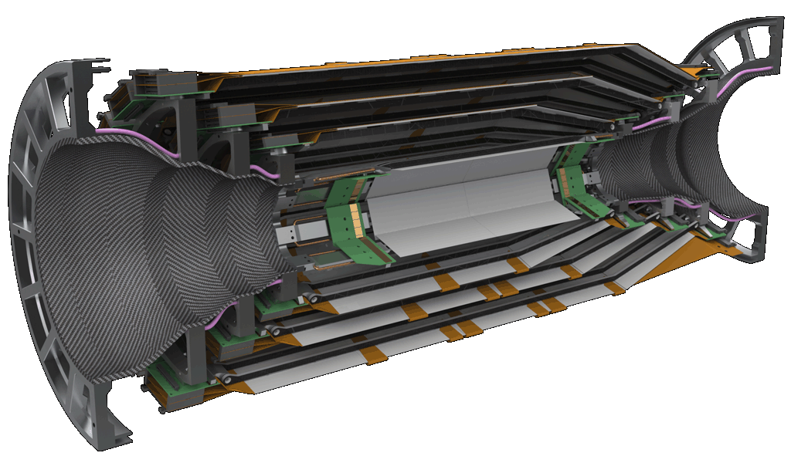
VXDDAQ Workshop, 9 April 2013
SVD Status for the DESY Beam Test
Markus Friedl (HEPHY Vienna)

Slide 2
Introduction
Status of Parts

Slide 3
General SVD Readout Scheme
Already shown many times
DATCON
ONSEN
Finesse Transmitter
Board (FTB)
FADC
1748
APV25
chips
~2m
copper
cable
Junction
box
~10m
copper
cable
Unified optical
data link (>20m)
COPPER
Front-end
hybrids
Rad-hard
DC/DC
converters
Analog level translation,
data sparsification and
hit time reconstruction
Unified Belle II
DAQ system

Slide 4
A (Slightly) More Realistic View
ONSEN
DAQ: PC Farm
COPPER: common readout platform
FADC system with optical link to COPPER
DOCK box with DC/DC
Front-End
DATCON

Slide 5
Introduction
Status of Parts

Slide 6
Present Status
Now preparing prototype system for DESY beam test
Some parts exist already, some are being designed
Locations: FTB – Cracow, rest – Vienna
First version exists, second iteration underway
Design done, now layout; small parts exist
Exists
Exists
A few Origami modules exist

Slide 7
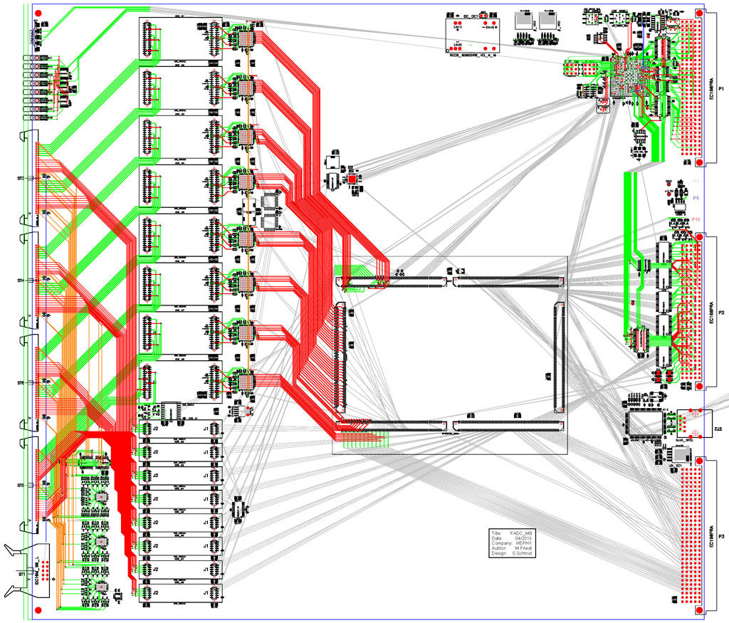
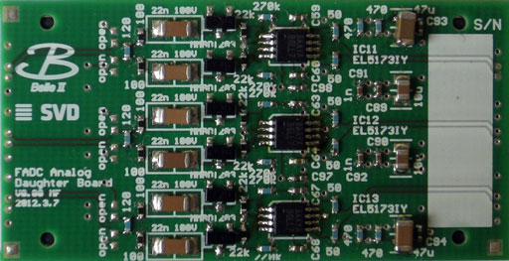
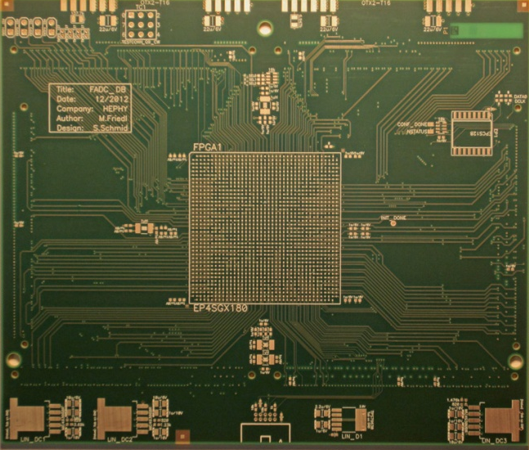
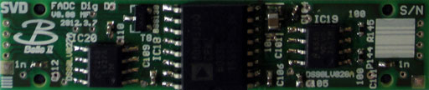
FADC
9U VME module (needs much space for level translation circuits)
Circuit is designed, PCB layout almost finished

Slide 8
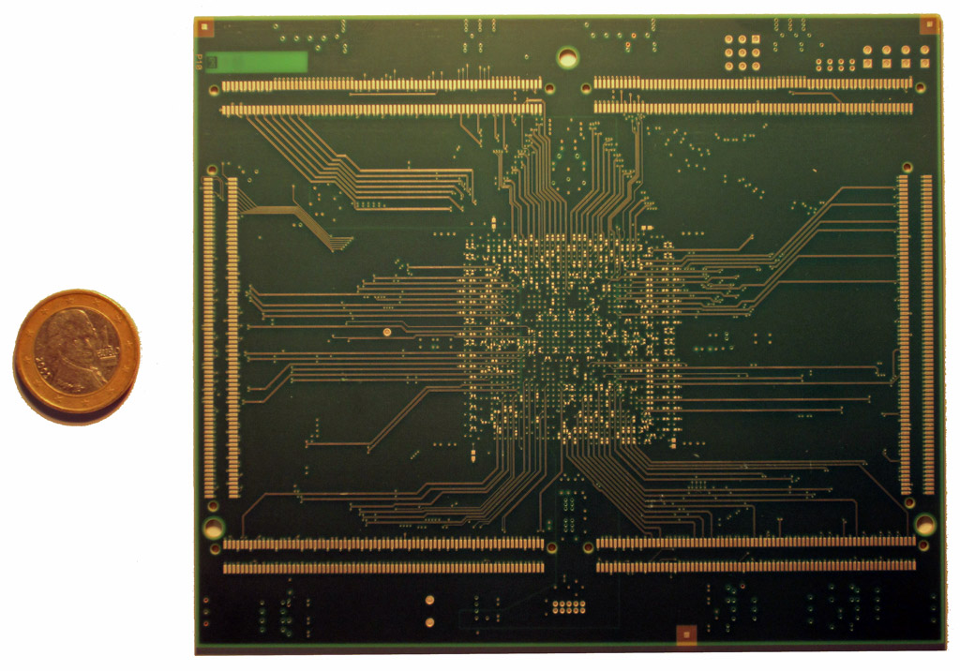
FPGA Daughter Board: the “Human” Touch…

Slide 9
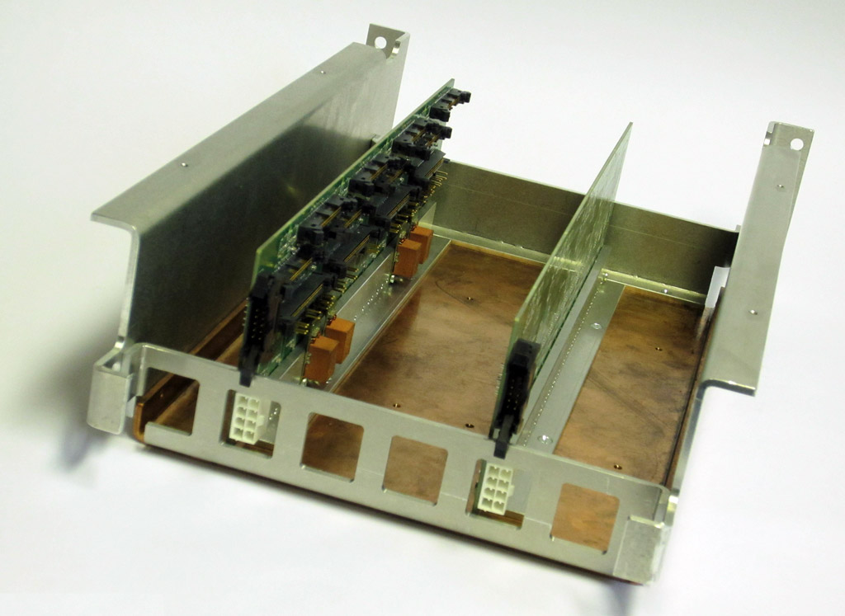
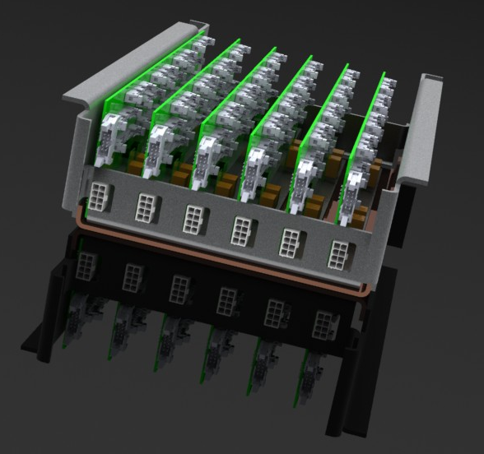
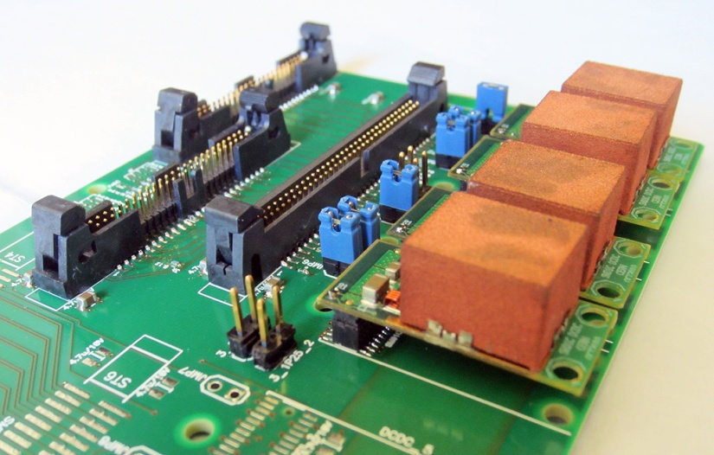
Junction Box
CERN-made DC/DC converters for front-end powering
One board ready, second board to be populated soon

Slide 10
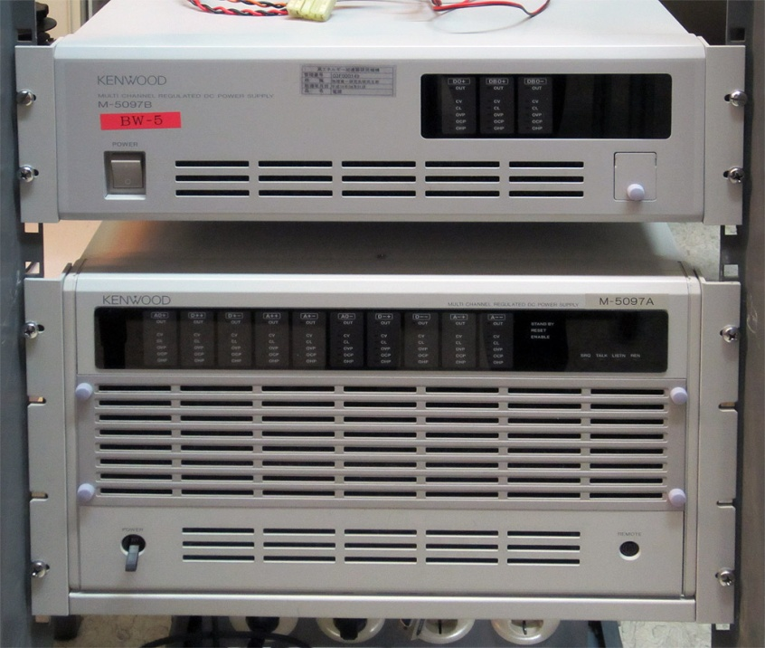
Power Supply
One Kenwood power supply now in Vienna
  Will be used for the DESY beam test
  GPIB communication (finally) works from PC running SL6
  Now fixing hardware interlock
  Software (EPICS) needs to be
  developed
    Student working on this

Slide 11
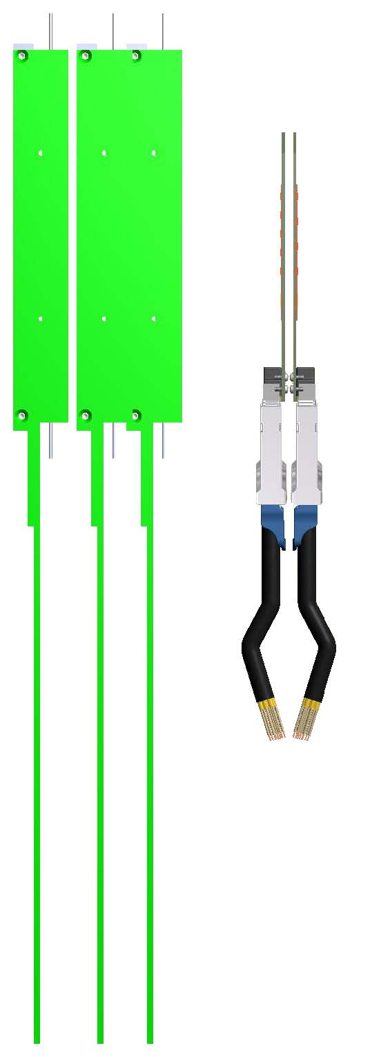
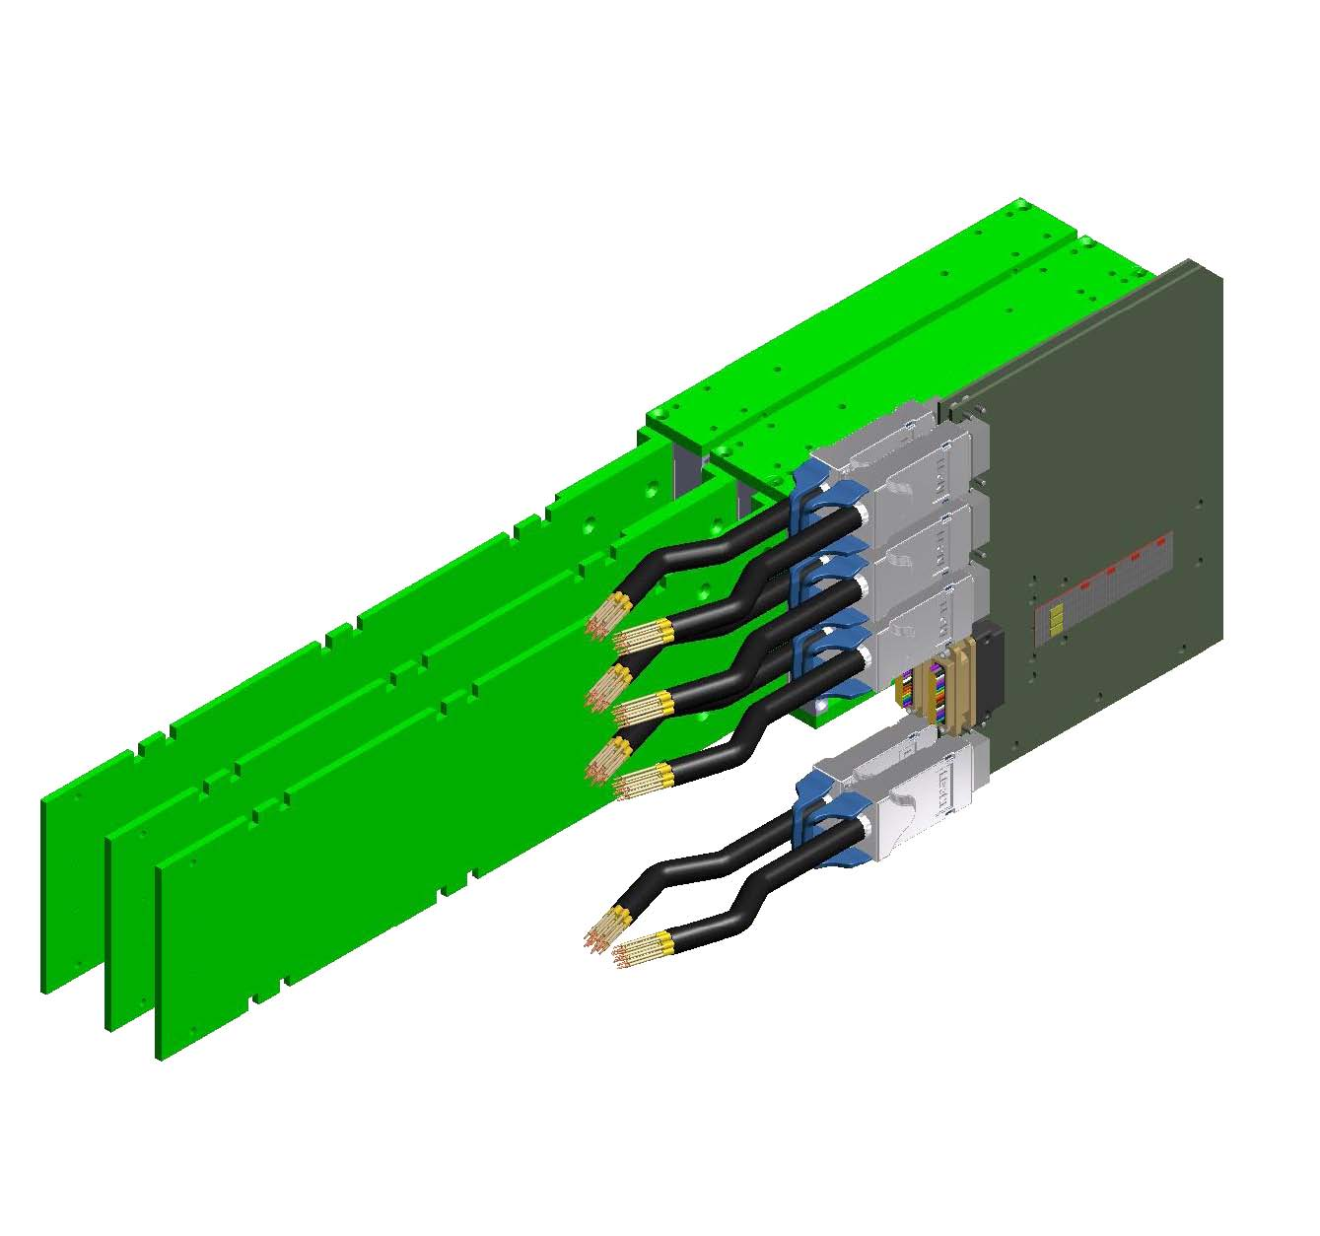
Front-End
Tscharlie’s drawing

Slide 12
Front-End: Update
To be added: L3 module box
  similar to others, but without long tail
L5 box will be made thinner by 3mm to avoid interference with L4

Slide 13
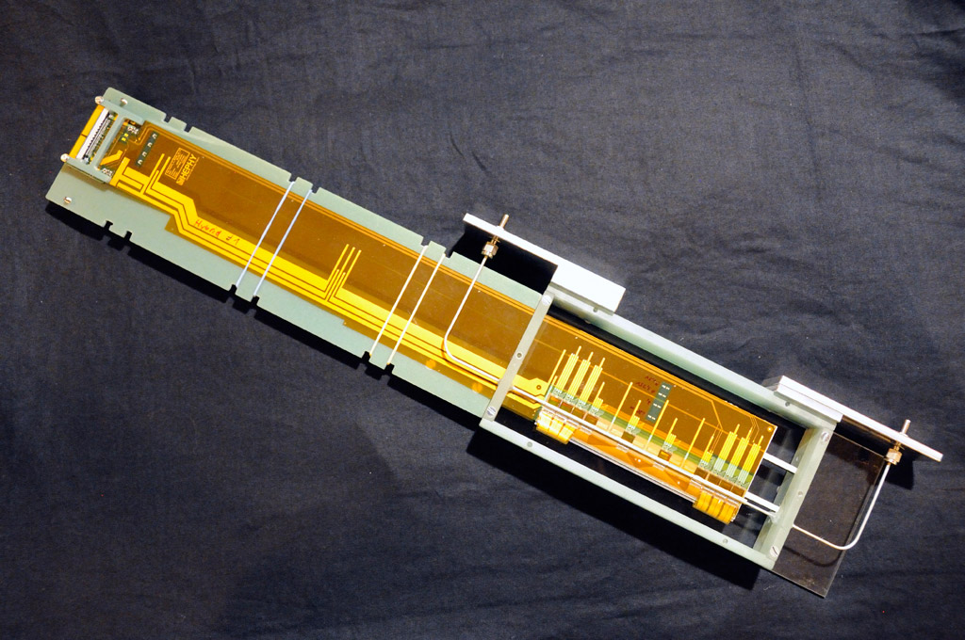
Front-End: Cooling Pipes
L4,5,6 Origami modules exist including cooling pipes
and connectors
Idea: screw down modules on base plate (from bottom)
Serial CO₂ connections on top side

Slide 14
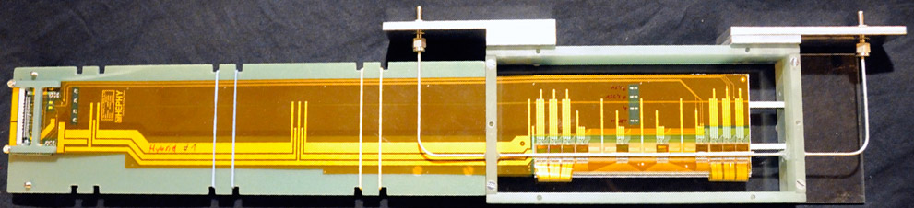
Front-End: Mounting SVD Modules
CO₂ connections to neighbors
Base plate
2 x M3 screws from bottom
Where to put Junction box?
  2m from front-end; could even be inside magnet

Slide 15
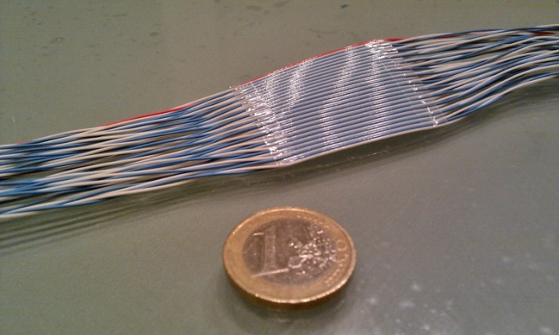
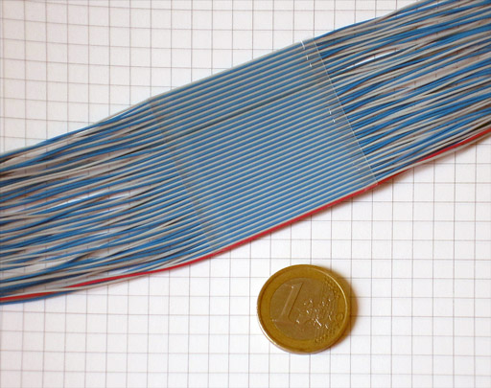
SVD Front-End Cables/Connections
Out of cold volume:
  8 flat cables (50 cond.; 32 x 1 mm²)
  Length ~2m (to Junction Box),
  very flexible
  A few fibers? (~1mm diameter)
  A few cables for temp & rH monitoring (~1mm diameter)
  1 CO₂ cooling circuit (in+out)
  cold dry gas inlet (no outlet needed)
Junction Box → FADC:
  > 10m needed – to be measured
  (and minimized) tomorrow
Hybrid → Junction Box
Junction Box → FADC

Slide 16
Backup Slides

Slide 17
FADC Block Diagram
Analog & digital level translation between ± bias and GND
Digitization, signal conditioning (FIR filter), data processing
Central FPGA is an Altera Stratix IV GX

Slide 18
FADC System Modularity
4 crates with FADC modules (one crate shown above)
One single FADC Controller
  Receives TTD signals
  Distributes clock, trigger and other controls to all Buffer
Buffer module
  One in each crate
  Distributes signals to FADCs through backplane bus

Slide 19
FADC I/O
From/to FADC Controller via Buffer and backplane bus
  Clock, trigger, other controls
From/to PC via VME bus
  Configuration, slow controls, monitoring (e.g. bias currents)
From/to PC via GbE
  Spy data, local data (pedestal/noise evaluation, internal calibration)
To COPPER and DATCON via FTB
  “Normal” data path

Slide 20
FADC Data Output Format
Modes of operation:
  Raw mode
    raw ADC data for a defined length
  Transparent mode
    APV25 frame detection with header data and raw data of all strips
  Zero-suppressed mode
    Pedestal subtraction, CMC, only hits above threshold (3 or 6 samples)
  Zero-suppressed + hit time finding mode
    Peak sample and peak time, all 3 or 6 samples only for unclear cases (such as double peak = pileup)
Raw + transparent are typically used SVD-internally (timing adjustments, pedestal/noise evaluation, calibration, …)
Zero-suppressed (+hit time finding) are the normal data formats sent to FTB + COPPER/DATCON

Slide 21
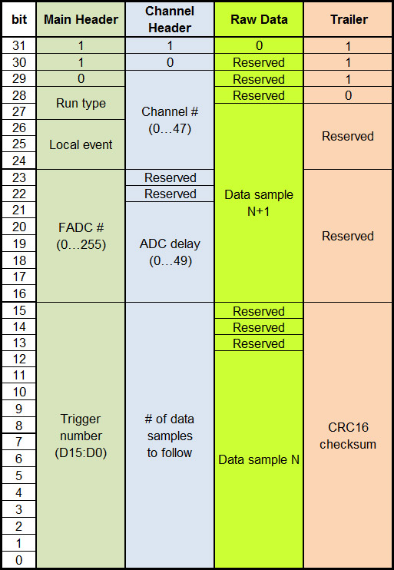
Data Format: Raw Mode
Run type
  00…raw
  01…transparent
  10…zero-suppressed
  11…zero-suppressed + hit time finding
Event type
  000…TTD event
  100…local software trigger
  101…local intcal

Slide 22
Raw Mode Example
One data frame consists of
  1 Main Header
  1 Channel Header per active APV25 input (up to 48)
  X/2 words for raw data for each active APV25
    X…number of ADC samples (written in channel header)
  1 Trailer
Main Header
Channel Header 0
Raw data of channel 0
Channel Header 1
Raw data of
channel 1
Channel Header 2
Raw data…
Trailer

Slide 23
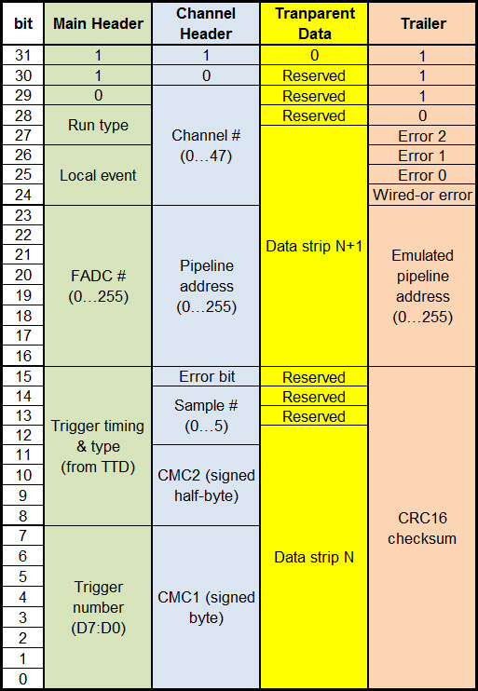
Data Format: Transparent Mode
Error bit
  Extracted from APV25 header
Wired-or error
  OR of all APV25 error bits
Error 0, 1, 2
  indicators for abnormal conditions

Slide 24
Transparent Mode Example
One data frame consists of
  1 Main Header
  1 Channel Header per active APV25 input (up to 48)
  64 words for raw strip data for each active APV25 and sample
  1 Trailer
Main Header
Channel Header 0,
sample 0
Transparent strip data
of channel 0, sample 0
Channel Header 0,
sample 1
Transp. data
channel 0,
sample 1
Channel Header 0,
sample 2
Transp.
strip
data…
Trailer

Slide 25
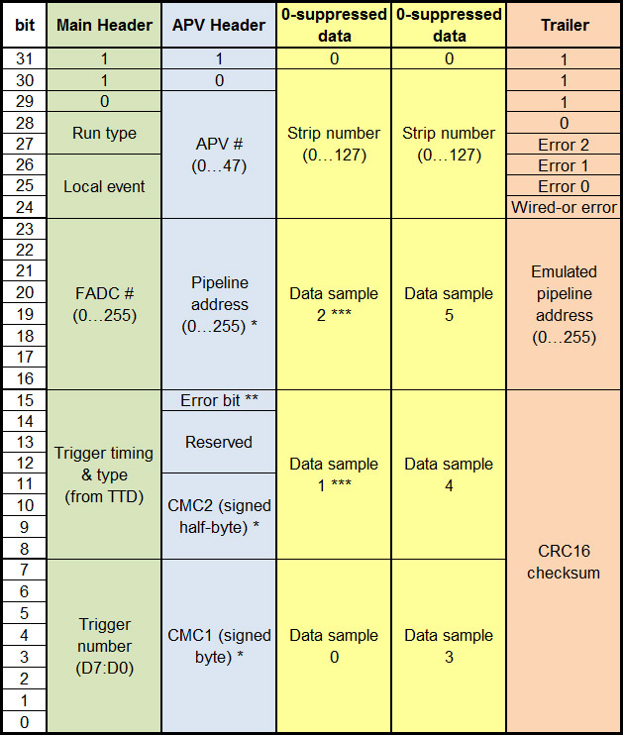
Data Format: Zero-suppressed Mode
Remarks
  * of first sample
  ** wired-or of all samples
  *** only if >1 samples
Second yellow block only appears if 6 samples are read out

Slide 26
Zero-suppressed Mode Example
One data frame consists of
  1 Main Header
  1 Channel Header per active APV25 input (=up to 48)
  2N data words with N hit strips (in case of 6 samples)
    No data words if no hits found
  1 Trailer
Main Header
Channel Header 0
One hit
(6 data
samples)
Channel Header 1
Channel Header 2
Channel Header 3
Two hits
(6 data samples each)
Channel Header 4
Hits…
Trailer

Slide 27
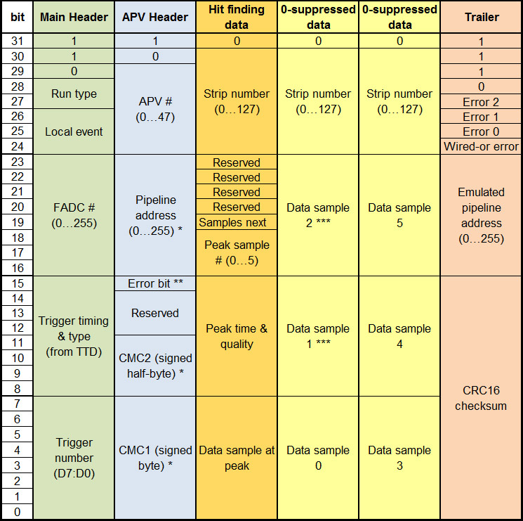
Data Format: Zero-suppressed + Hit Time
Normally, only peak sample and peak time is sent (orange)
Yellow sample data word(s) only appears if hit time cannot be found reliably
  E.g. double-peak due to pile-up
  “Samples Next” = 1 in such a case
(Only if 6 samples)

Slide 28
Zero-suppressed + Hit Time Example
One data frame consists of
  1 Main Header
  1 Channel Header per active APV25 input (=up to 48)
  N data words with N hit strips
  + 2 data words per bad hit (no timing found)
  1 Trailer
Main Header
Channel Header 0
One
good
hit
Channel Header 1
Channel Header 2
Two
good
hits
Channel Header 3
One bad hit followed by 6 data samples
Channel Header 4
Hits…
Trailer

Slide 29
Data Size
Minimum size (for all modes):
  Assuming that all APV channels are deactivated:
  Main header + trailer = 2 words
Maximum size:
  Raw mode: 950 ADC samples per channel → 22850 words
  Transparent mode: 64 words per channel & sample → 18722 w.
  Zero-suppressed mode: all channels have hits → 12338 words
  Zero-suppressed + hit time mode: all channels have hits & need sample data → 18482 words
For the latter two cases, the actual size depends on the occupancy and is typically much smaller
  1% occupancy makes ~173 words (zero-suppresed mode, 6 samples) or 124 words (zs+hit time mode, 10% bad timing)

