Slide 1
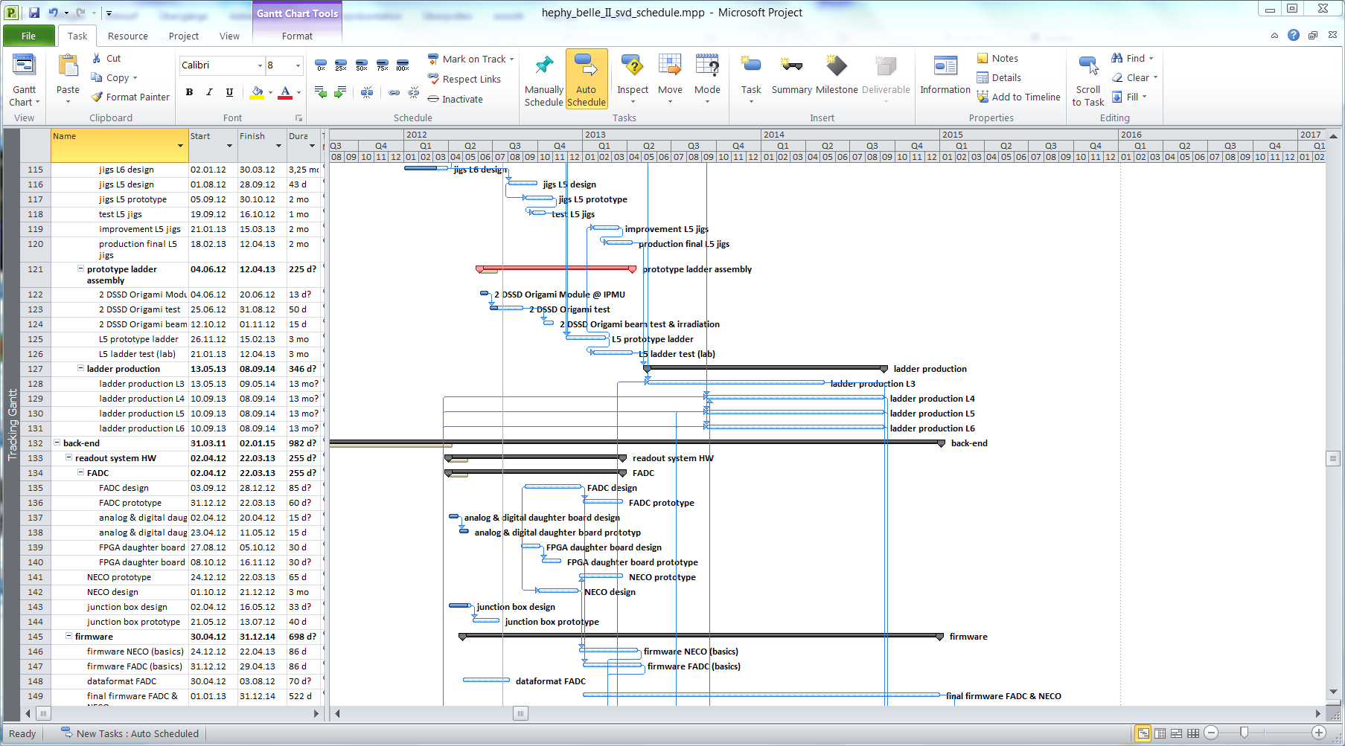
Schedule
Belle 2 Telescope “Gemba” Meeting @ DESY

Slide 2
SVD Schedule Overview
 |  | Date |  |  | 2013 |  |  |  |  |  |  |  |  |  |  |  | 2014
 |  | from | to |  | 01 | 02 | 03 | 04 | 05 | 06 | 07 | 08 | 09 | 10 | 11 | 12 | 01 | 02 | 03 | 04
L3 module | production | 2013/09 | 2013/10
FADC | design and layout | 2013/02 | 2013/04
 | production, test | 2013/05 | 2013/06
Altera Daughterboard | Electrical test | 2013/04 | 2013/04
 | Basic FW for Data I/O | 2013/04 | 2013/05
Connectivity test | Test with dummy data | 2013/06 | 2013/06
FADC Firmware |  | 2013/06 | 2013/11
NECO (controller) | design and layout | 2013/05 | 2013/06
 | production, test | 2013/07 | 2013/08
Firmware NECO |  | 2013/08 | 2013/11
Buffer | design, prod., test | 2013/08 | 2013/09
Backplane P2 | design, prod., test | 2013/07 | 2013/09
Slowcontrol EPICS | design | 2013/04 | 2013/07
Software TuxDAQ |  | 2013/07 | 2013/10 | ? |  |  |  |  |  |  | ? | ? | ? | ?
Full SVD readout available |  | 2013/11 | 2013/12
Testbeam preparation |  | 2013/10 | 2013/12 | ? |  |  |  |  |  |  |  |  |  | ? | ? | ?
BEAMTEST @ DESY |  | 2014/01 | 2014/01

Slide 3
Important Milestones 2013
FADC board
Layout until mid of April
Production in May → available by June!
FADC Firmware
New PhD student: Richard Thalmeier
Very basic FW for Data I/O by end of May
Firmware development until mid of Nov. 2013
June: FADC & FTB & DATCON connectivity test
NECO board
Design and layout finalized by end of June
Prototype available in July / August
Firmware development from August to November
End of October: HW & FW test in Vienna, full system

Slide 4
Important Milestones 2013
Sept.: delivery of L3 sensors → build module
Oct. – Dec.: Beam test preparation @ DESY
Setup and common test of all subsystems
November++: DAQ connectivity @ DESY beam test
November: shipping SVD system to DESY
Second half of November
January 2014: Beam test

Slide 5
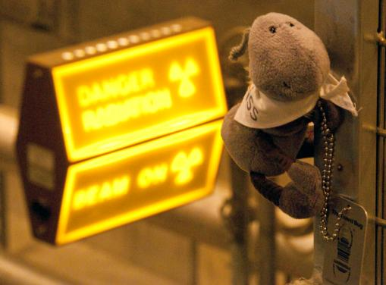
Thank you

