Slide 1
Lattice QCD:
Successes and Challenges
Hartmut Wittig
PRISMA Cluster of Excellence, Institute for Nuclear Physics and Helmholtz Institute Mainz
DESY Theory Workshop
Nonperturbative QFT: Methods and Applications
25 September 2013
TexPoint fonts used in EMF.
Read the TexPoint manual before you delete this box.: AAAAAAAAAAAAAAAA

Slide 2
2 |
Introduction

Slide 3
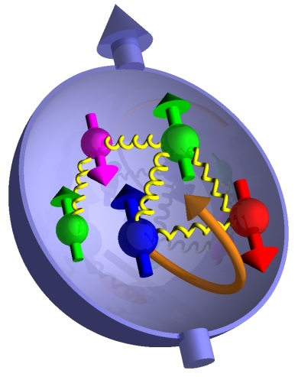
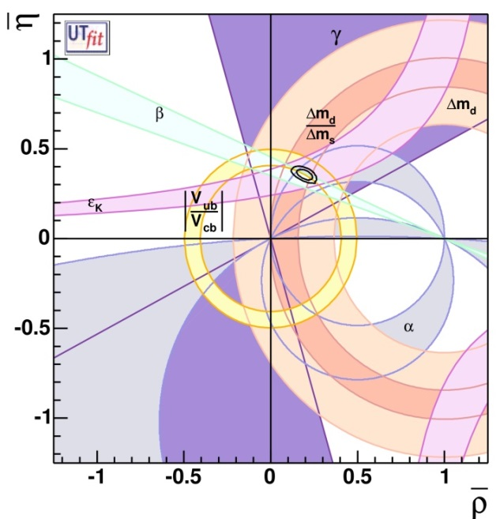
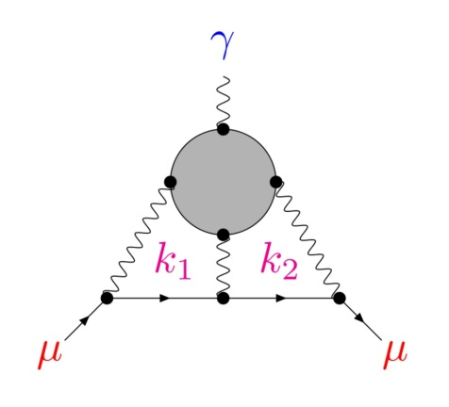
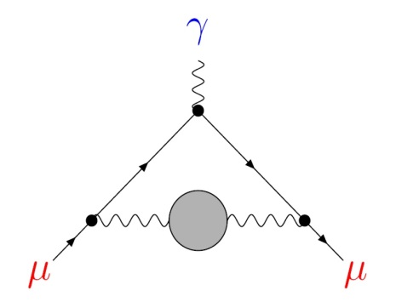
3 | Introduction
Low-Energy QCD in the LHC Era
Quantitative understanding of hadronic properties:
Hadron masses and decays
Structural properties
Determination of Standard Model parameters
Quark masses, strong coupling constant
Precision tests of the Standard Model at low energies:
QCD corrections to weak decay amplitudes
Hadronic contributions to the muon $(g−2)$

Slide 4
4 | Introduction
Lattice QCD: non-perturbative; regularised Euclidean functional integrals
Minkowski space-time, continuum$⟶$ Euclidean space-time, discrete
lattice spacing: $a, x_{μ}=n_{μ}a, a^{−1}∼Λ_{UV}$
finite volume: $L^{3}⋅T$
Stochastic evaluation of $〈Ω〉$ via Markov process
Simulation algorithm: Hybrid Monte Carlo
[Duane et al., 1987]
Strong growth of numerical cost near physical $m_{u}, m_{d}$
Pion mass, i.e. lightest mass in the pseudoscalar channel:
$$≈500 MeV$$
(2001)
$$≈130−200 MeV$$
(2013)
$$⟶$$

Slide 5
5 | Introduction
Systematic Effects
Lattice artefacts:
$⟶$ extrapolate to continuum limit from $a≈0.05−0.12 fm$
Finite volume effects:
Observables distorted by finite box size
Empirically: $m_{π}L ≳4$ sufficient for many purposes
Unphysical quark masses:
Chiral extrapolation to physical values of $m_{u}, m_{d}$ required
Use ChPT as a guide
Inefficient sampling of SU(3) group manifold:
Simulations trapped in topological sectors as $a→0$
Use open boundary conditions in time direction
[Lüscher & Schaefer, 2012]

Slide 6
6 | Outline
Outline
Successes
Light hadron spectrum
Lattice constraints on CKM physics
Challenges
Axial charge of the Nucleon
Scalar form factor of the pion
Hadronic contributions to ${\left(g−2\right)}_{μ}$
Conclusions

Slide 7
7 |
Successes

Slide 8
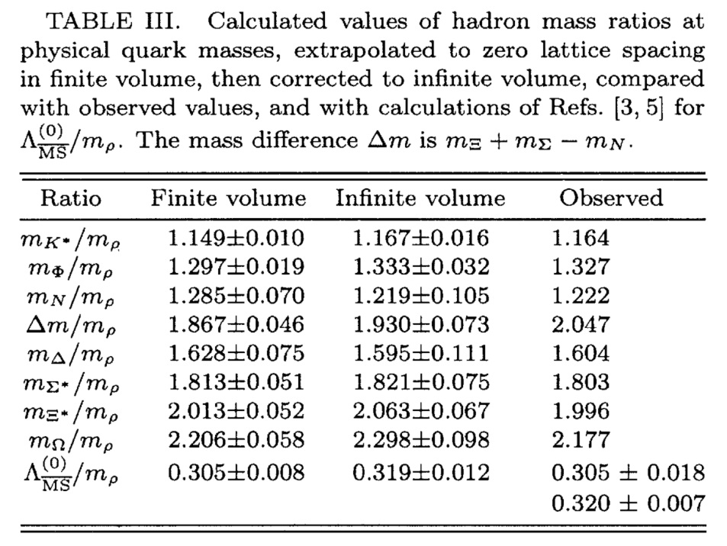
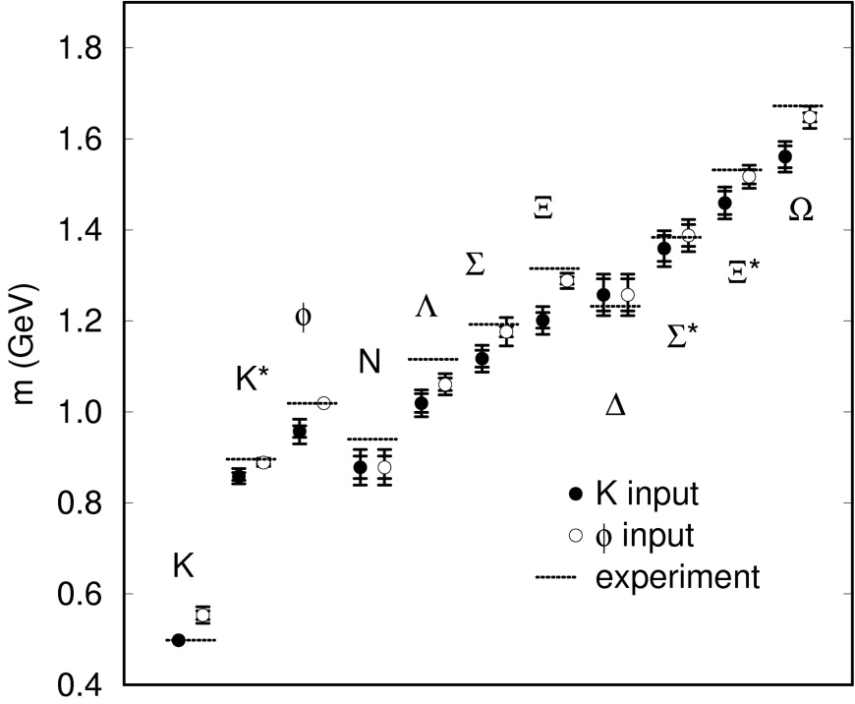
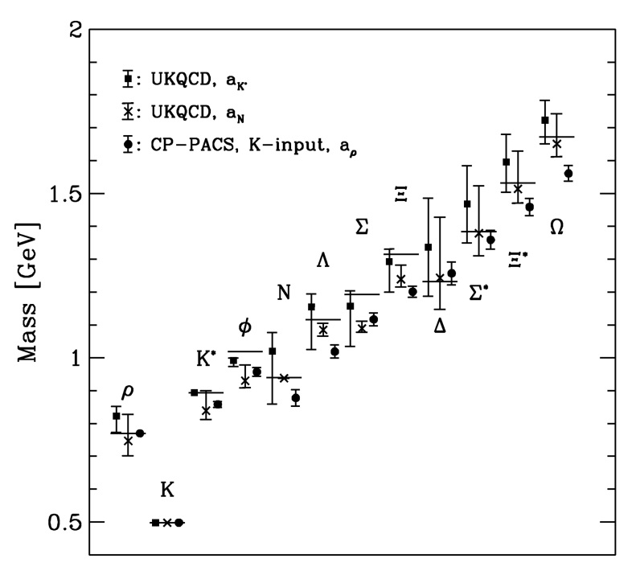
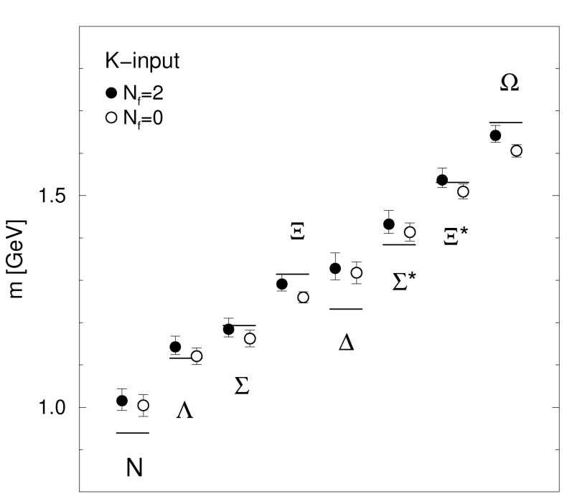
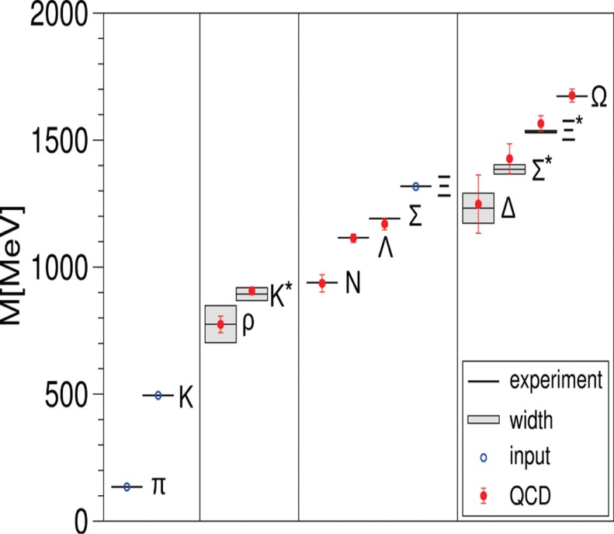
8 | Hadron Spectroscopy
Light Hadron Spectrum
Masses of the lowest-lying hadrons: Benchmark of Lattice QCD
GF11 Collaboration (1992):
CP-PACS Collaboration (1998):
UKQCD Collaboration (1999):
CP-PACS Collaboration (2002):
BMW Collaboration (2008):
Dynamical $u, d, s$ quarks
Excellent agreement with experiment in continuum limit
Quenched approximation
No significant deviation from experiment within 10 – 15%
Quenched approximation
Agreement with experiment at the level of 10 – 15%
Statistically significant deviations
Quenched approximation
Confirmation of the GF11/CP-PACS results using different discretisation
Dynamical $u, d$ quarks
Better agreement with experiment after inclusion of dynamical quarks
Masses of the lowest-lying hadrons computable from first principles

Slide 9
9 | Lattice constraints on CKM physics
CKM Physics: First Row Unitarity and |V_{us}|
Unitarity implies
$${\left|V_{ud}\right|}^{2}+{\left|V_{us}\right|}^{2}+{\left|V_{ub}\right|}^{2}=1$$
Experimental constraints:
$$|V_{ud}|=0.97425(22)$$
Super-allowed nuclear $0^{+}→0^{+}$ $β$-decays
[Hardy & Towner, 2009]
$$\left|V_{us}\right| f_{+}\left(0\right)=0.2163\left(5\right), \frac{\left|V_{us}\right|}{\left|V_{ud}\right|}\frac{f_{K}}{f_{π}}=0.2758(5)$$
Branching fractions for $K_{ℓ2}$ and $K_{ℓ3}$ decays
[Antonelli et al., 2010]
Use experimental and lattice data to
Obtain precise determinations of $\left|V_{ud}\right|$ and $|V_{us}|$
Perform precision tests of CKM unitarity

Slide 10
10 | Lattice constraints on CKM physics
Compilation & Comparison: The FLAG Working Group
[Colangelo et al., Eur Phys J C71 (2011) 1695]
Provide PDG-style “global averages”
Rate lattice results according to “quality criteria”
“when the systematic error has been estimated in a satisfactory manner and convincingly shown to be under control”
“when a reasonable attempt at estimating the systematic error has been made, although this could be improved”
“when no or a clearly unsatisfactory attempt at estimating the systematic error has been made”
Example: Continuum extrapolation
Example: Finite-volume effects
Example: Chiral extrapolation
Quality criteria must be adjusted over time!
3 or more lattice spacings, at least 2 points below $a=0.1 fm$
$m_{π}^{min}L>4$ or at least 3 volumes
$$m_{π}^{min}<250 MeV$$
2 or more lattice spacings, at least 1 point below $a=0.1 fm$
$m_{π}^{min}L>3$ and at least 2 volumes
$${250 MeV<m}_{π}^{min}<400 MeV$$
otherwise
otherwise
$$m_{π}^{min}>400 MeV$$

Slide 11
11 | Lattice constraints on CKM physics
Compilation & Comparison: The FLAG Working Group
[Colangelo et al., Eur Phys J C71 (2011) 1695]
Provide PDG-style “global averages”
Rate lattice results according to “quality criteria”
“when the systematic error has been estimated in a satisfactory manner and convincingly shown to be under control”
“when a reasonable attempt at estimating the systematic error has been made, although this could be improved”
“when no or a clearly unsatisfactory attempt at estimating the systematic error has been made”
Example: Chiral extrapolation – FLAG-2
Quality criteria must be adjusted over time!
$$m_{π}^{min}<200 MeV$$
$${200 MeV<m}_{π}^{min}<300 MeV$$
$$m_{π}^{min}>300 MeV$$

Slide 12
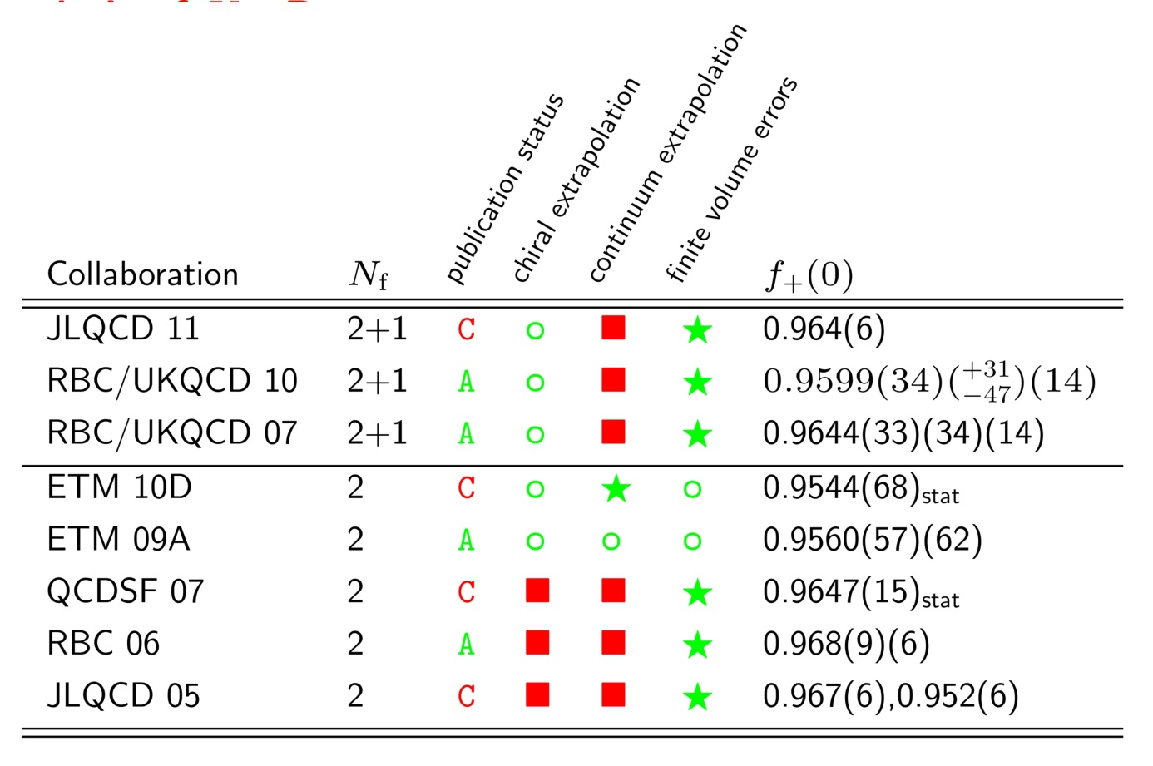
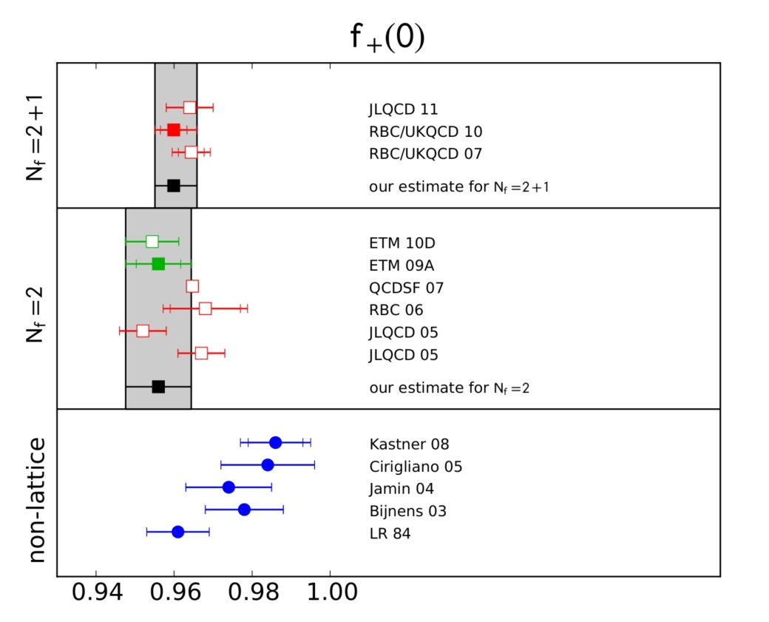
12 | Lattice constraints on CKM physics
FLAG Analysis of $K_{ℓ3}$ Decays
[Colangelo et al., Eur Phys J C71 (2011) 1695, and in prep.]
Lattice results consistent with Ademollo-Gatto theorem
[Leutwyler & Roos 1984]
FLAG global estimates:
$$f_{+}\left(0\right)= \left\{\begin{matrix}0.9599\left(34\right)(_{−47}^{+31})\left(14\right), N_{f}=2+1 \\ 0.9560\left(57\right)\left(62\right), N_{f}=2\end{matrix}\right.$$

Slide 13
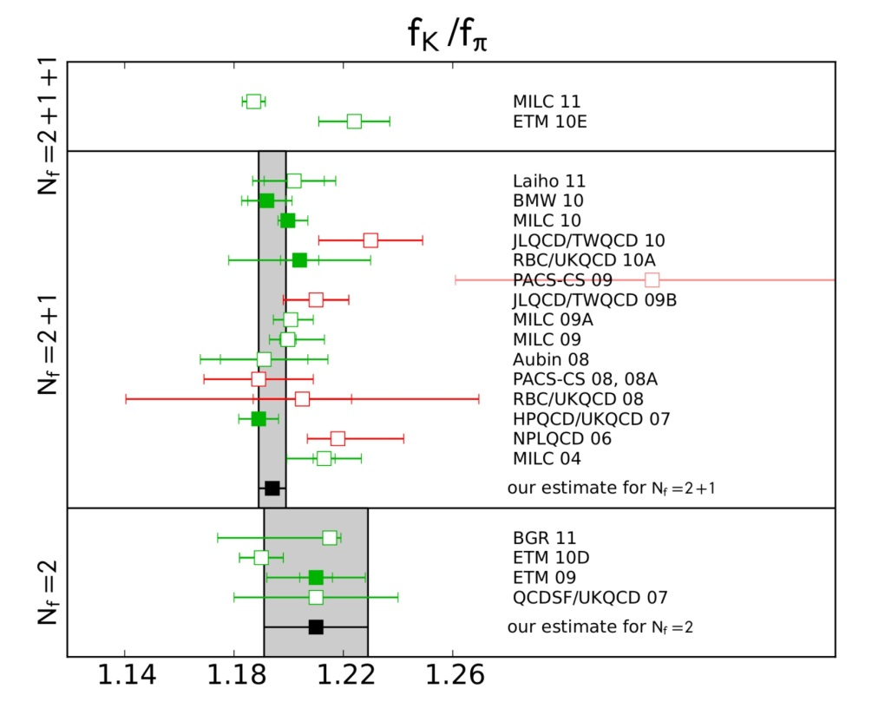
13 | Lattice constraints on CKM physics
$|V_{us}|$ from $K_{ℓ2}$ Decays
[Marciano, Phys Rev Lett 93 (2004) 231803]
Leptonic decay rate: $\frac{Γ\left(K→μ{\overline{ν}}_{μ} \left(γ\right)\right)}{Γ\left(K→e{\overline{ν}}_{e} \left(γ\right)\right)}∝{\left|\frac{V_{us}}{V_{ud}}\right|}^{2} \frac{{f_{K}^{2}m}_{K}}{f_{π}^{2}m_{π}}$
Lattice determination of ${f_{K}}/{f_{π}}$ yields CKM matrix elements
Published FLAG averages:
$${f_{K}}/{f_{π}}=1.193\left(5\right), N_{f}=2+1$$
$${f_{K}}/{f_{π}}=1.210\left(6\right)(17), N_{f}=2$$
[FLAG-2 - preliminary]

Slide 14
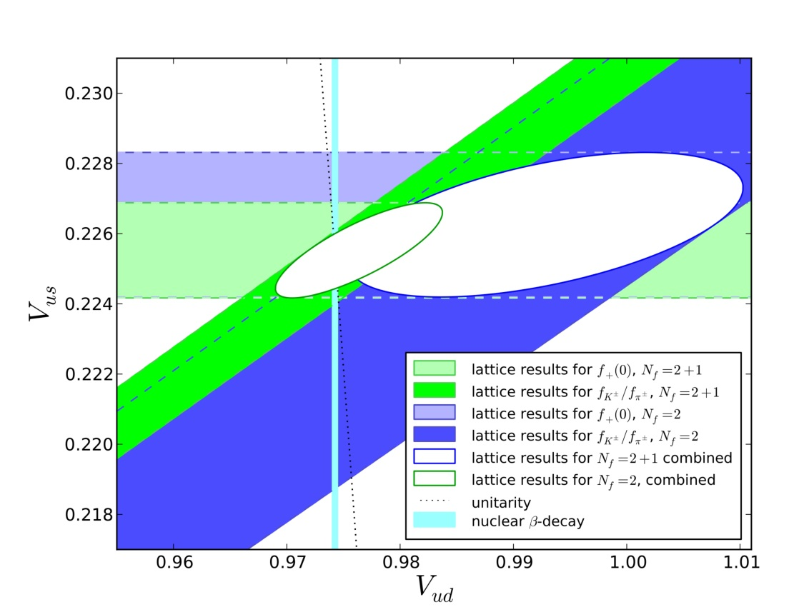
14 | Lattice constraints on CKM physics
Testing the Standard Model
[Colangelo et al., Eur Phys J C71 (2011) 1695]
First row unitarity: ${\left|V_{ud}\right|}^{2}+{\left|V_{us}\right|}^{2}+{\left|V_{ub}\right|}^{2}≡{\left|V_{u}\right|}^{2}=1$
Measured branching fractions:
$$\left|V_{us}\right|f_{+}\left(0\right)=0.2163(5)$$
$$\frac{\left|V_{us}\right|}{\left|V_{ud}\right|}\frac{f_{K}}{f_{π}}=0.2758(5)$$
Global estimates $\left(N_{f}=2+1\right):$
$${\left|V_{u}\right|}^{2}=1.002(15)$$
Combine lattice results with $\left|V_{ud}\right|$ from nuclear $β$-decay:
$f_{+}(0)$-input:
$${\left|V_{u}\right|}^{2}=1.0000(7)$$
${f_{K}}/{f_{π}}$-input:
$${\left|V_{u}\right|}^{2}=0.9999(6)$$

Slide 15
15 |
Challenges

Slide 16
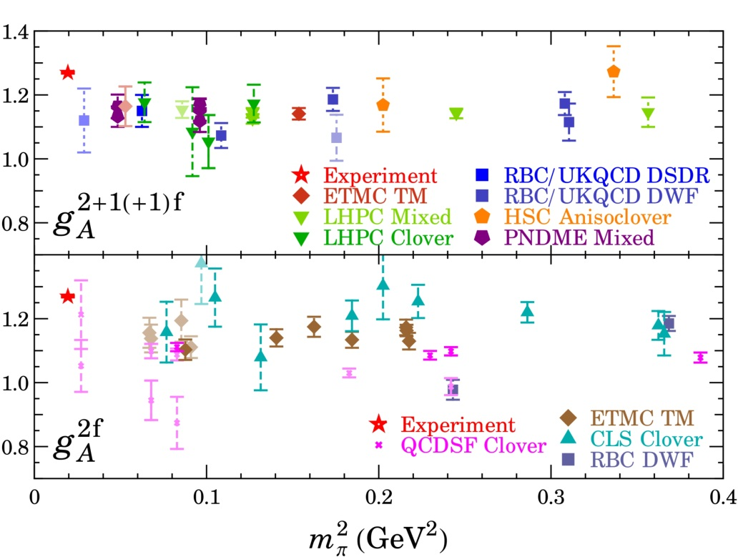
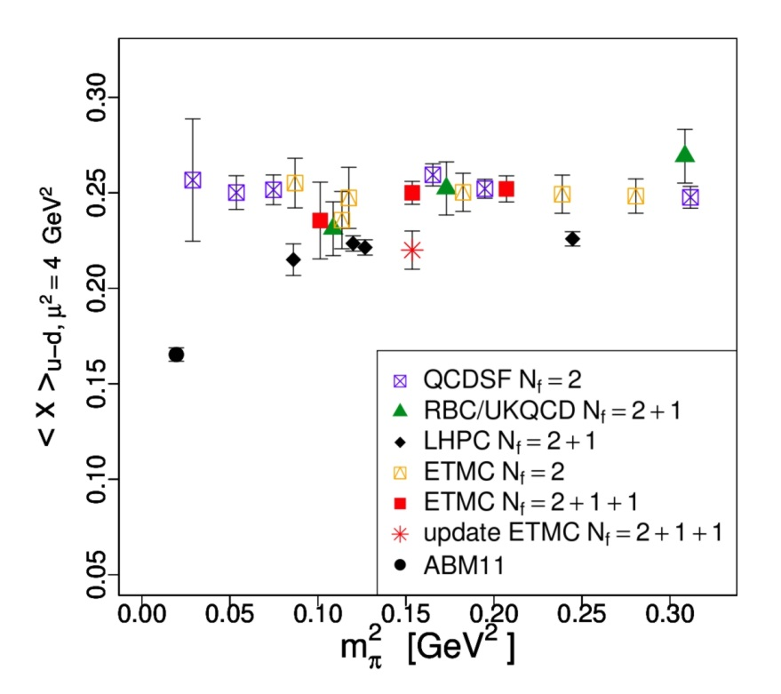
16 | Challenges
Average momentum fraction
Nucleon axial charge
Current lattice simulations do not reproduce experimental results on nucleon structure
[Alekhin, Blümlein, Moch, Phys Rev D86 (2012) 054009]
[H-W Lin, PoS LATTICE2012 (2012) 013]
Systematic effects not fully controlled
Lattice artefacts
Chiral extrapolation to physical pion mass
Finite-volume effects
“Contamination” from excited states
Quark-disconnected diagrams ignored

Slide 17
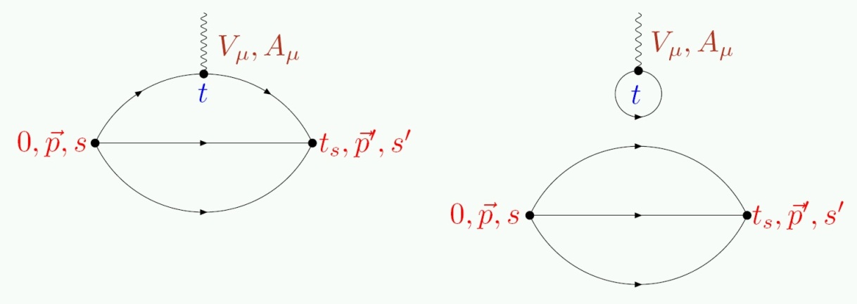
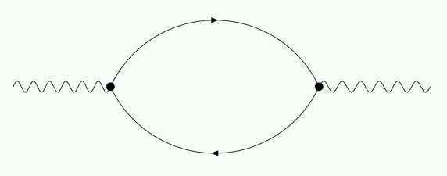
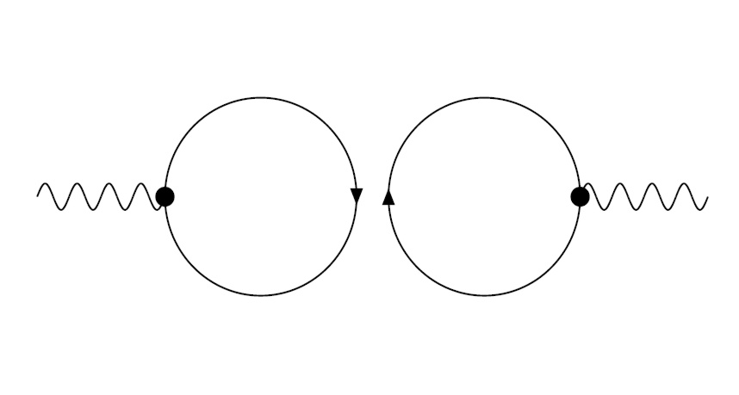
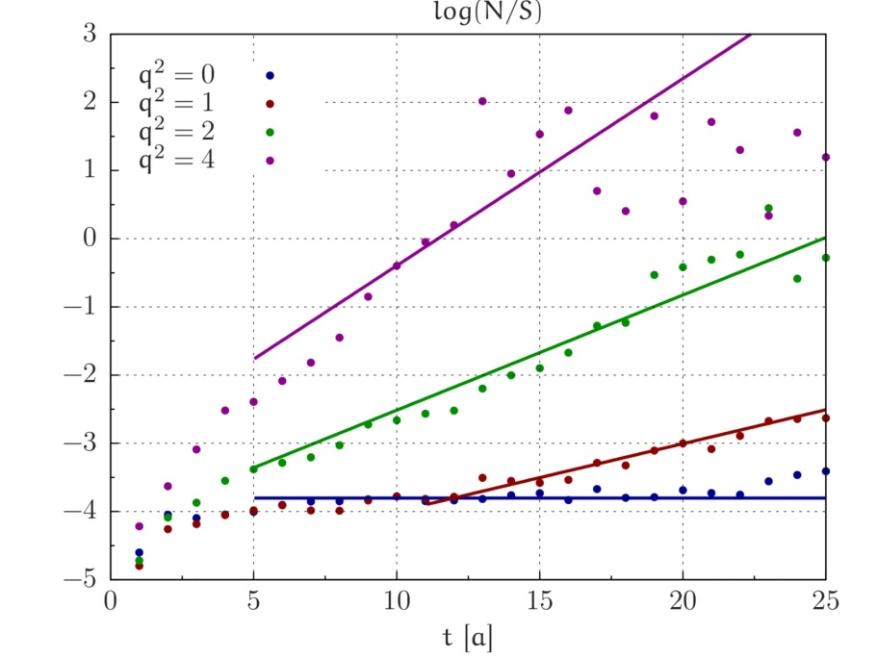
17 | Challenges
Many observables require evaluation of quark-disconnected diagrams:
Exponentially increasing noise-to-signal ratio:
Nucleon at rest: $R_{NS}\left(x_{0}\right)∼e^{\left(m_{N}− \frac{3}{2}m_{π}\right)x_{0}}$
Pion at $\vec{p}≠0$:
$$R_{NS}\left(x_{0}\right)∼e^{\left(\sqrt{m_{π}^{2}+{\vec{p}}^{2}}−m_{π}\right)x_{0}}$$
Serious obstacle for accurate determinations of hadron form factors

Slide 18
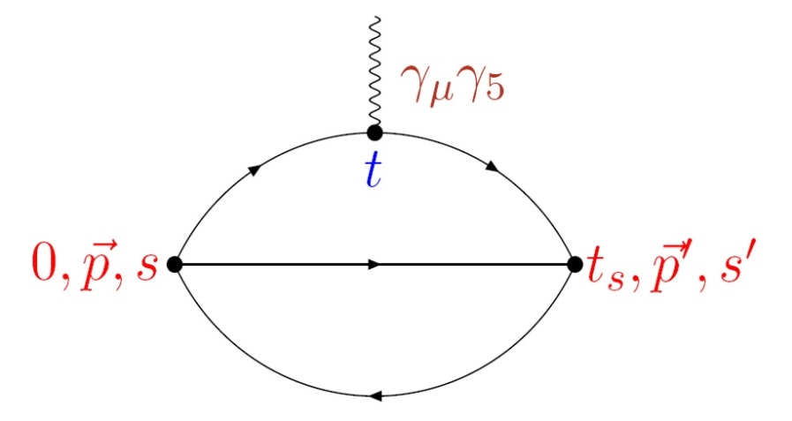
18 | Axial Charge of the Nucleon
Axial Charge of the Nucleon
$g_{A}:$ nucleon matrix element of the axial current:
$$〈N\left(p,s\right)|A_{μ}^{u−d} |N\left(p,s\right)〉=2g_{A} s_{μ}$$
Ideal benchmark quantity for lattice QCD:
Simple quark bilinear: $A_{μ}=\overline{q} γ_{μ}γ_{5} q$
No momentum transfer between initial and final state
No quark-disconnected diagram
Lattice calculations underestimate $g_{A}$ by $∼10\%$

Slide 19
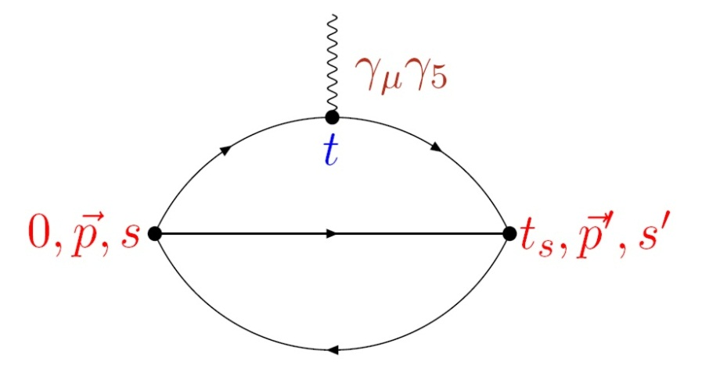
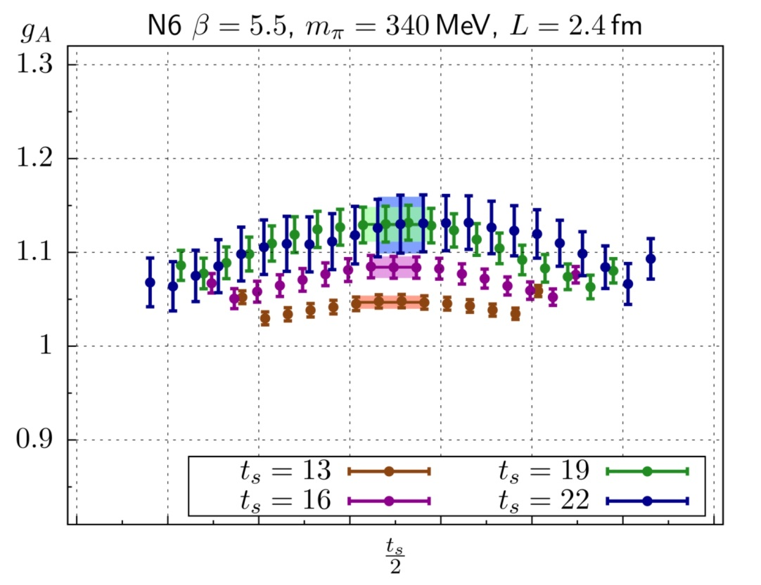
19 | Axial Charge of the Nucleon
Standard Method
Extract nucleon hadronic matrix elements from ratios of three- and two-point correlation functions, e.g.
Statistical fluctuations impose $t_{s}≲1.3 fm$

Slide 20
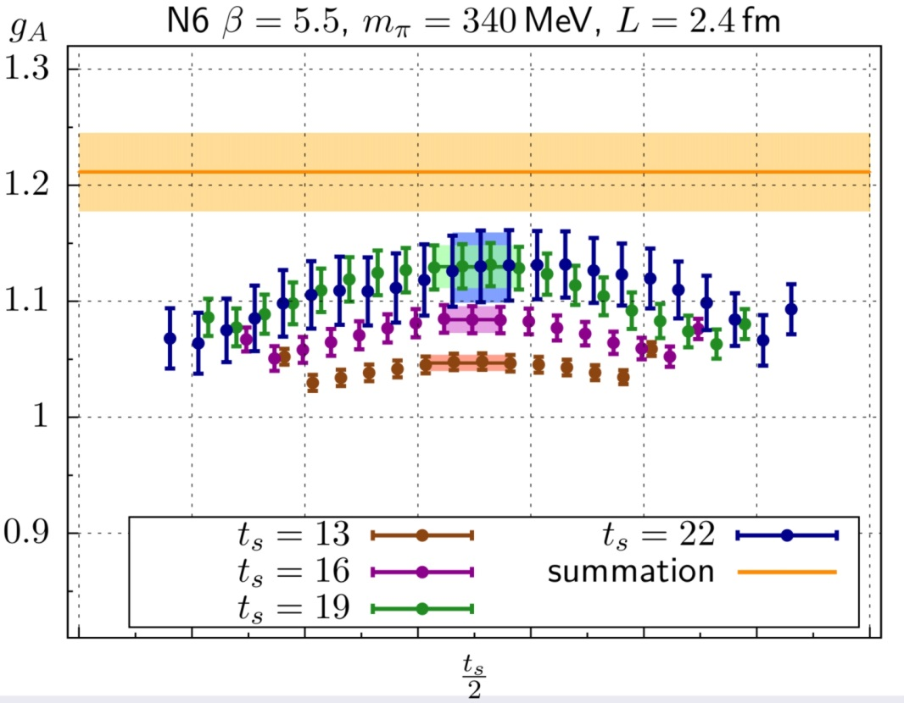
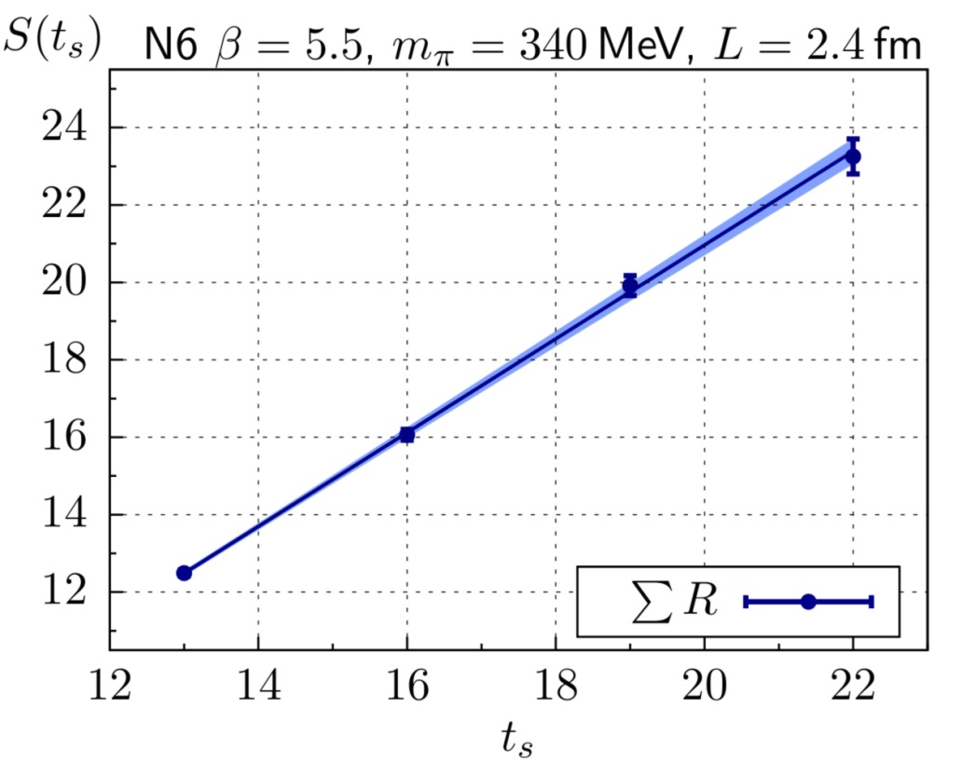
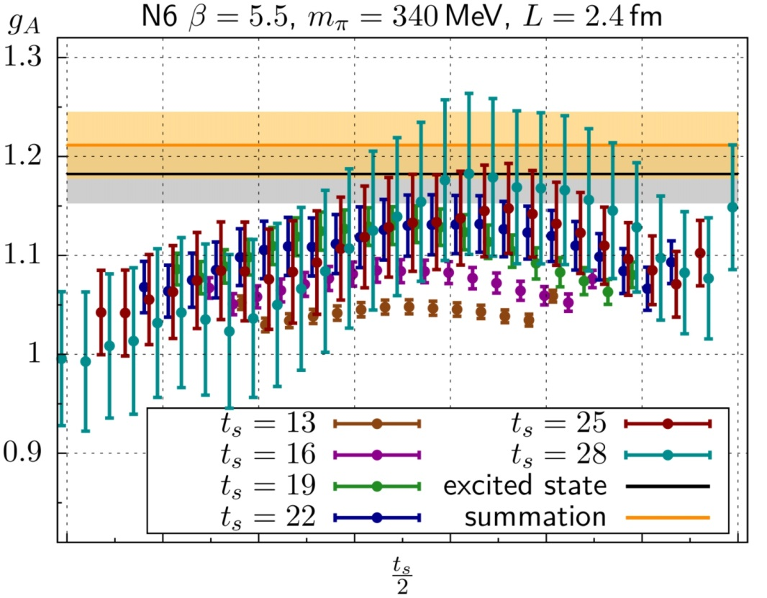
20 | Axial Charge of the Nucleon
Summed Insertions
[Maiani et al. 1987, Güsken et al. 1989, Bulava et al., Capitani et al.]
Standard method: $R_{Γ}\left(\vec{q},t,t_{s}\right)=ℳ_{Γ}(\vec{q})+O\left(e^{−Δt},e^{−Δ^{′}\left(t_{s}−t\right)}\right)$
Summed insertion:
$$S_{Γ}\left(t_{s}\right)≡\sum_{t=0}^{t_{s}}{R_{Γ}\left(\vec{q},t,t_{s}\right)}=K_{Γ}+t_{s}\left\{ℳ_{Γ}(\vec{q})+O\left(e^{−Δt_{s}}, e^{−Δ^{′}t_{s}}\right)\right\}$$
Excited state contributions more strongly suppressed
Determine $ℳ_{Γ}(\vec{q})$ from linear slope of summed ratio
(axial charge)
(axial charge)
(axial charge)

Slide 21
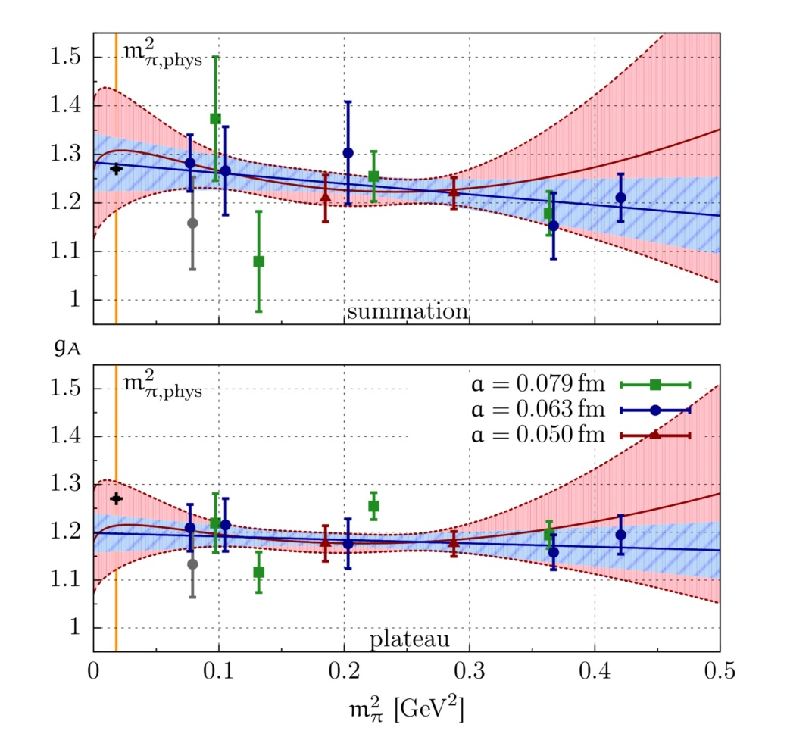
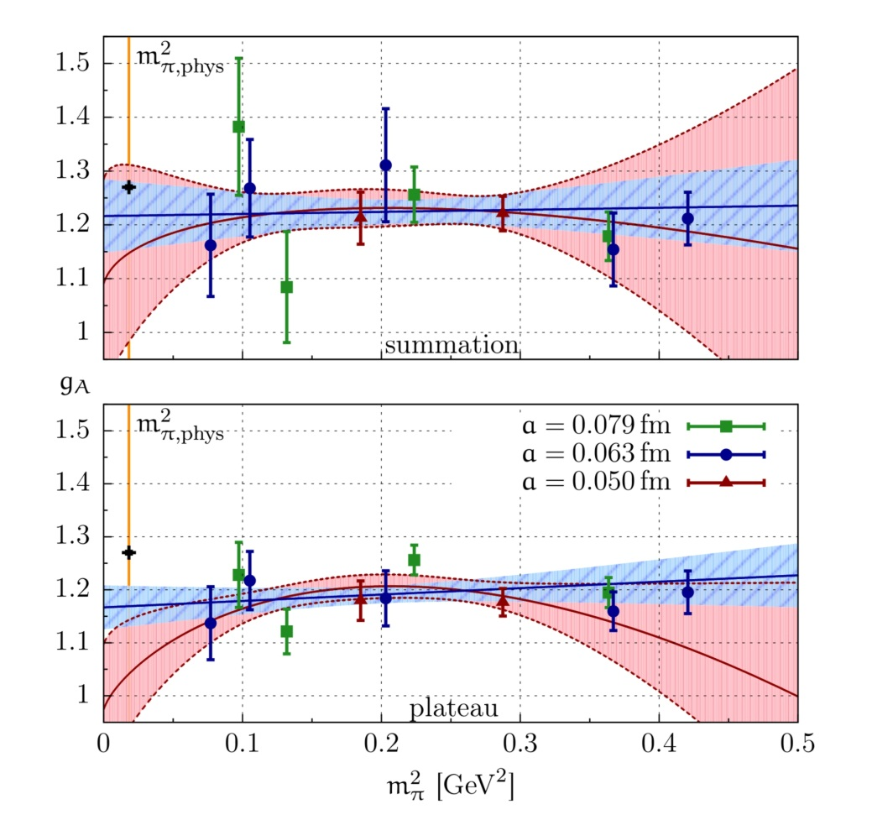
21 | Axial Charge of the Nucleon
Nucleon axial charge in two-flavour QCD
[Capitani, Della Morte, von Hippel, Jäger, Jüttner, Knippschild, Meyer, H.W., Phys Rev D86 (2012) 074502]
$O\left(a\right)$ improved Wilson fermions: $a=0.05, 0.063, 0.079$ fm
Pion masses: $m_{π}^{min}=$ 280 – 650 MeV, $m_{π}^{min}L≥4.0$
$$g_{A}=1.223±{0.063}_{stat}^{} (_{−0.060}^{+0.035})_{syst}$$

Slide 22
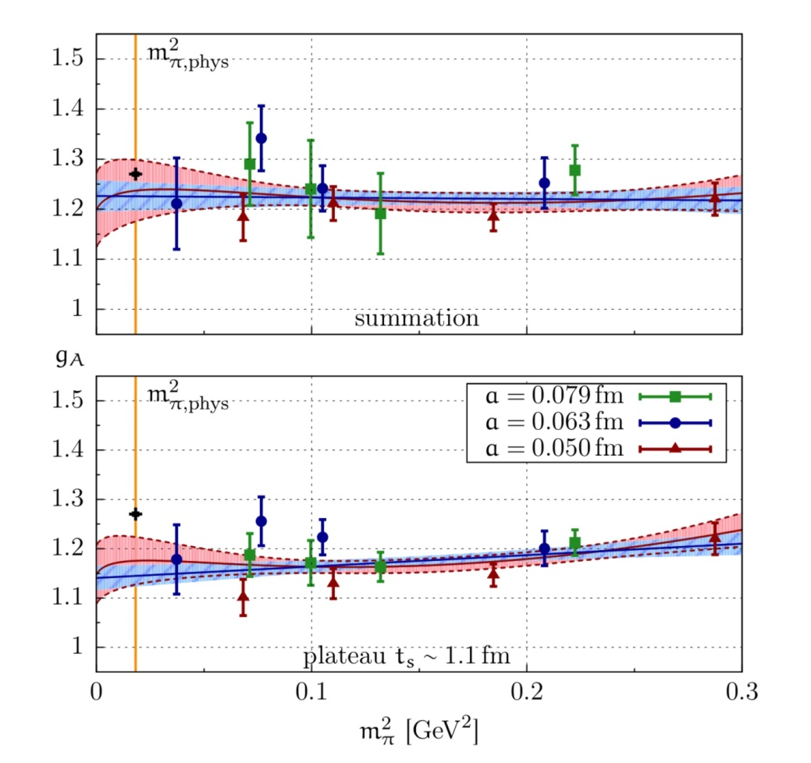
22 | Axial Charge of the Nucleon
Nucleon axial charge in two-flavour QCD
[Capitani, Della Morte, von Hippel, Jäger, Jüttner, Knippschild, Meyer, H.W., Phys Rev D86 (2012) 074502]
$O\left(a\right)$ improved Wilson fermions: $a=0.05, 0.063, 0.079$ fm
Pion masses: $m_{π}^{min}=$ 195 – 540 MeV, $m_{π}^{min}L≥4.0$

Slide 23
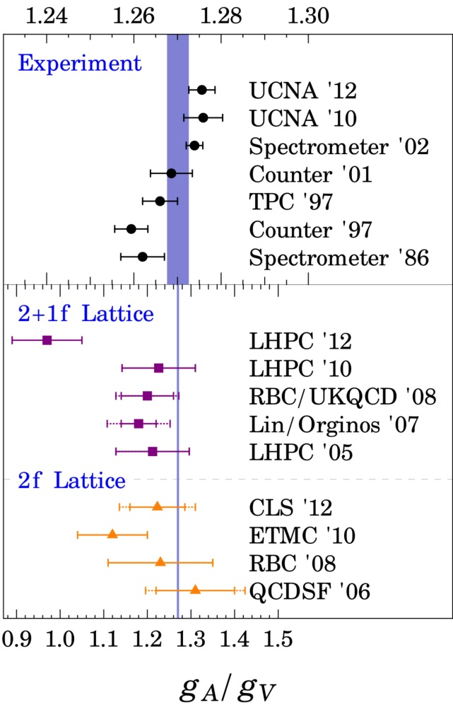
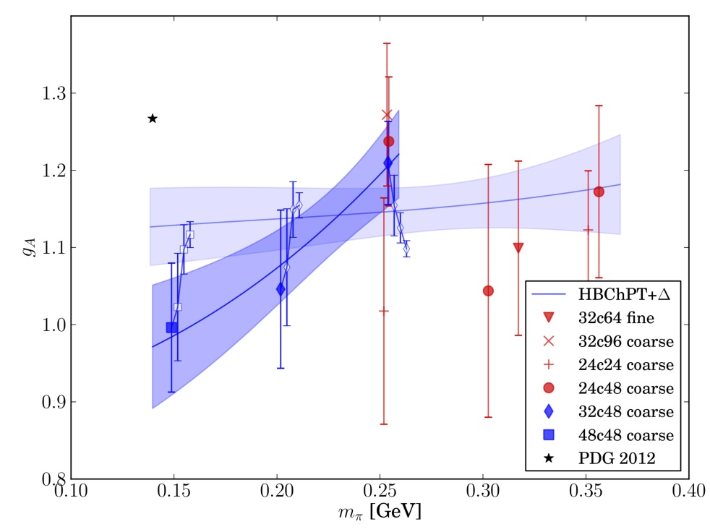
23 | Axial Charge of the Nucleon
Summary: Axial Charge of the Nucleon
Short source-sink separation $t_{s}$ dictated by noisy signal
Addressing excited-state contamination indispensable
LHP Collaboration
[H-W Lin, PoS LATTICE2012 (2012) 013]
[Green et al., arXiv:1209.1687]
Physical pion mass at $a=0.12 fm$
Excited-state contribution addressed

Slide 24
24 | Scalar Form Factor of the Pion
Scalar form factor of the pion
Definition; charge radius:
$$q^{2}={\left(p_{f}−p_{i}\right)}^{2}=−Q^{2}$$
$$+$$
$$F_{s}\left(0\right)≡σ_{π}$$
(pion $σ$-term)
Chiral expansion:
$${\overline{ℓ}}_{4}=4.783±0.097⟹ {\left\langle r^{2}\right\rangle }_{s}=0.645±0.017 fm^{2}$$
Phenomenological determination from $ππ$-scattering
[Colangelo, Gasser & Leutwyler, Nucl Phys B603 (2001) 125]
$${〈r^{2}〉}_{s}=0.61±0.04 fm^{2}$$

Slide 25
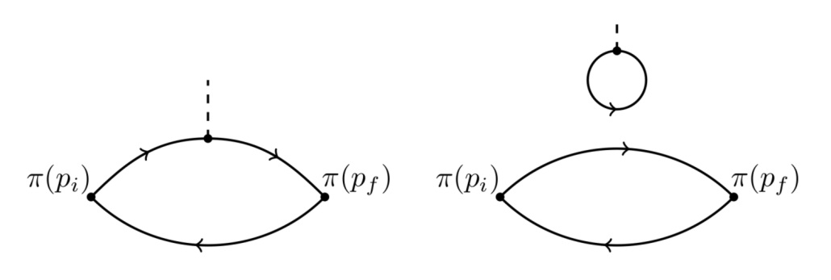
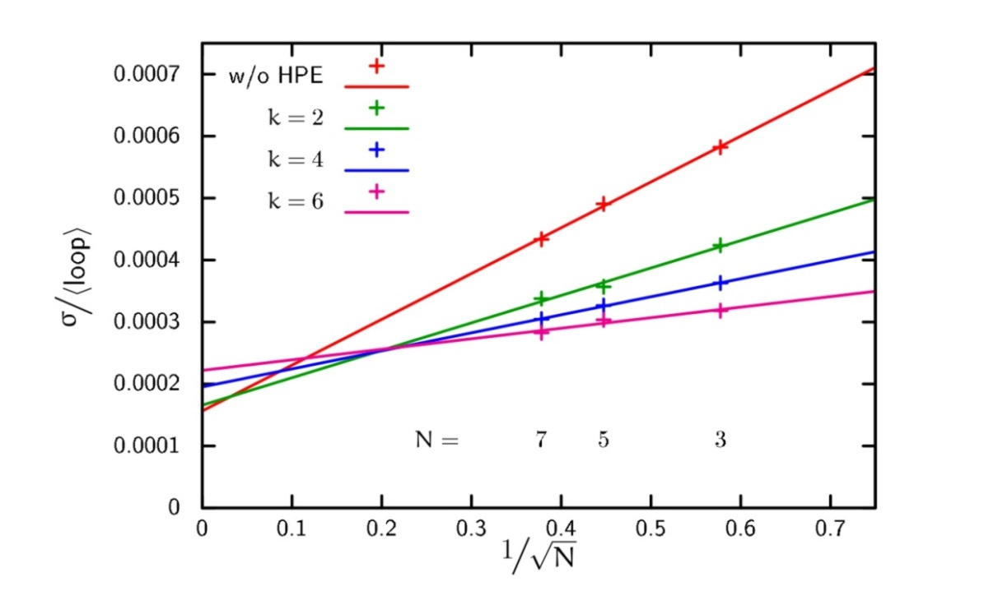
25 | Scalar Form Factor of the Pion
Lattice calculation
[Gülpers, von Hippel, H.W., arXiv:1309.2104]
Quark-disconnected diagrams:
Stochastic evaluation of disconnected contribution: $N$ stochastic sources
“Hopping parameter expansion” of Dirac operator to order $k$
Choose $k$ and $N$ to minimise computational effort at fixed variance
$${〈loop〉= \left\langle \sum_{\vec{x}}{Tr \left\{D^{−1}\left(x,x\right)\right\}} \right\rangle }_{G}$$

Slide 26
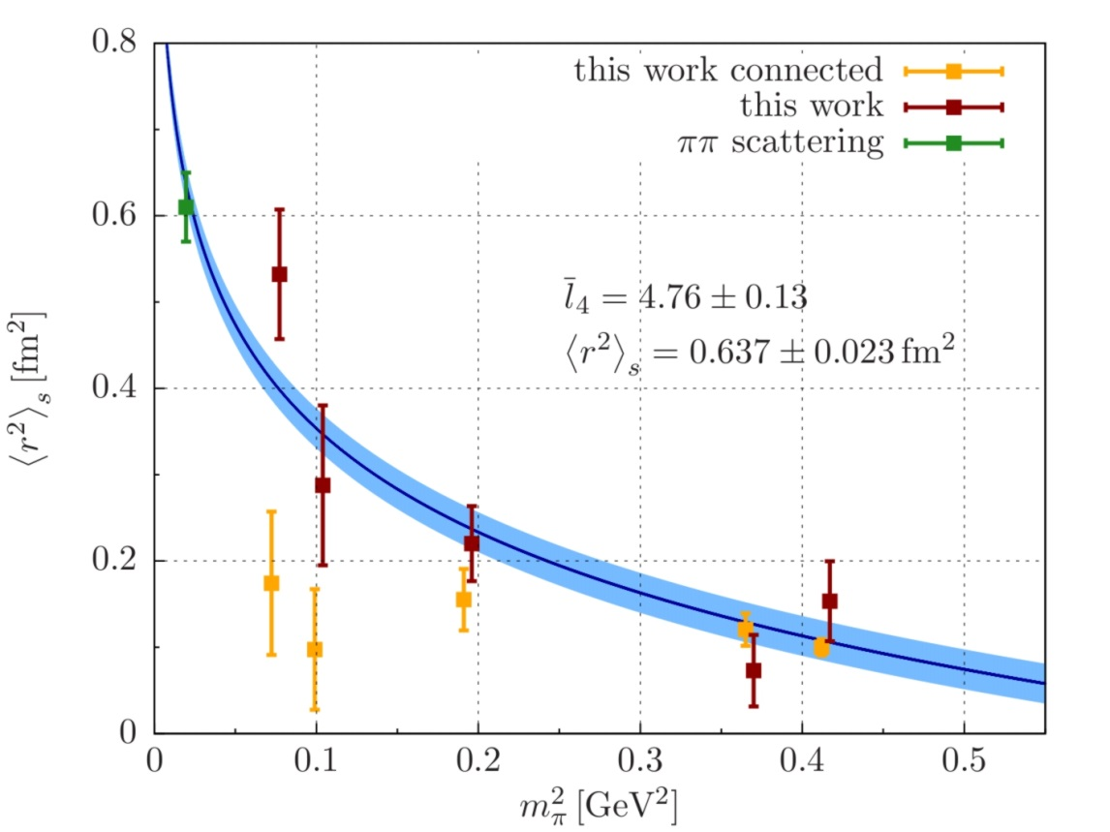
26 | Scalar Form Factor of the Pion
Lattice calculation
[Gülpers, von Hippel, H.W., arXiv:1309.2104]
$O\left(a\right)$ – improved Wilson fermions $a=0.063 fm, m_{π}=280−650 MeV$
Fit to ChPT @ NLO: ${〈r^{2}〉}_{s}=0.637±{0.023}_{stat} fm^{2}$
Inclusion of quark-disconnected contribution crucial

Slide 27
27 | Hadronic contributions to the muon $(g−2)$
Hadronic vacuum polarisation contribution to ${\left(g−2\right)}_{μ}$
$$a_{μ}^{VP;had}=(6923±42±3)∙{10}^{−11}$$
(combined $e^{+}e^{−}$ data)
Theory prediction uses experimental data as input
Ab initio estimate from Lattice QCD: total accuracy of $≤0.5\%$ required!

Slide 28
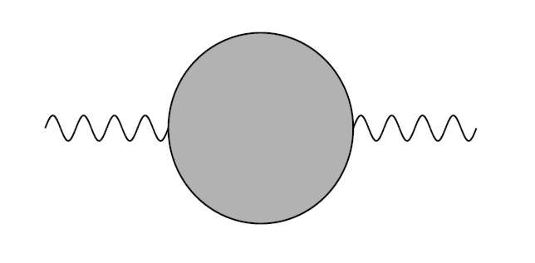
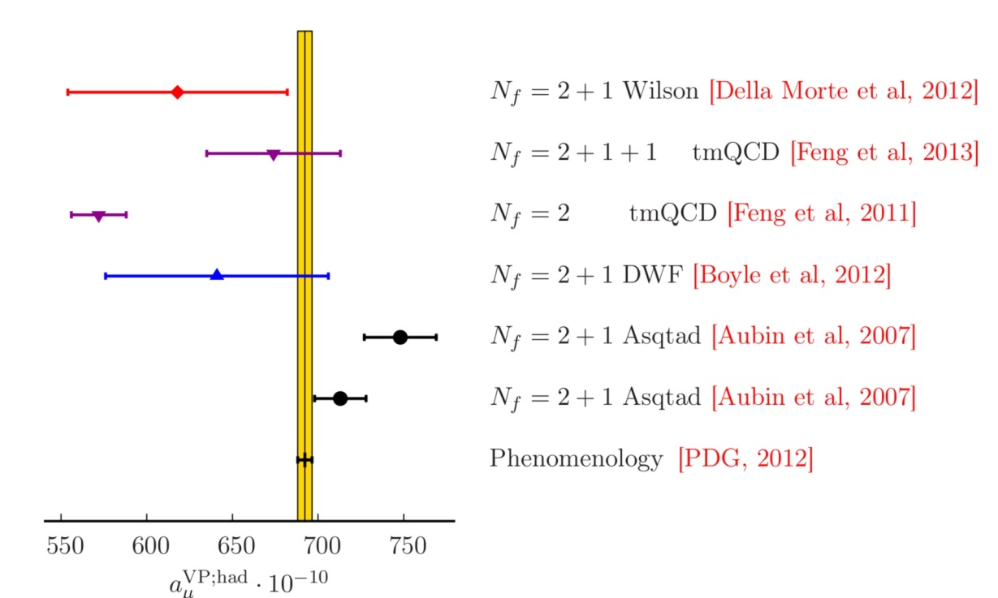
28 | Hadronic contributions to the muon $(g−2)$
Hadronic vacuum polarisation on the Lattice
Lattice approach: evaluate convolution integral over Euclidean momenta
Current lattice estimates not competitive with dispersive approach

Slide 29
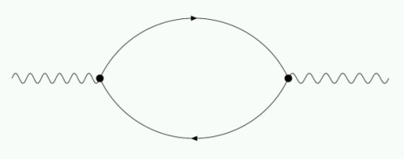
29 | Hadronic contributions to the muon $(g−2)$
Hadronic vacuum polarisation on the Lattice
Increase statistical accuracy in lattice calculation of $Π(q^{2})$
Reduce systematic uncertainty associated with $q^{2}−$ dependence:
Convolution function peaked far below lowest Fourier momentum:
Maximum of $f\left(q^{2}\right)$ near $\left(\sqrt{5}−2\right)m_{μ}^{2}≈0.003 GeV^{2}≪{\left(\frac{2π}{T}\right)}^{2}≈0.06 GeV^{2}$
Subtracted amplitude required: $\hat{Π}\left(q^{2}\right)≡Π\left(q^{2}\right)−Π(0)$
$⟶$ determine $Π(0)$ via extrapolation $q^{2}→0$
Quark-disconnected diagrams:

Slide 30
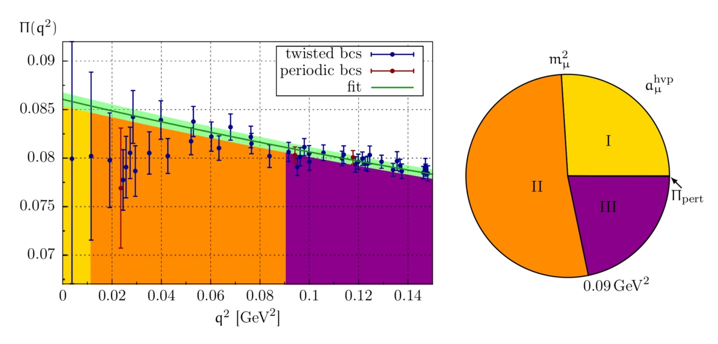
30 | Hadronic contributions to the muon $(g−2)$
Low-momentum region of $Π(q^{2})$
$$ψ\left(x+L{\hat{e}}_{k}\right)=e^{iθ_{k}} ψ\left(x\right) ⟹ p_{μ}=\frac{2π}{L}+\frac{θ_{μ}}{L}$$
Twisted boundary conditions:
$$m_{π}≃195 MeV$$
$$L≃4 fm$$
[Della Morte, Jäger, Jüttner, H.W., JHEP 1203 (2012) 055, and to appear]
$q^{2}$-dependence described by [2,3] Padé ansatz [Blum, Golterman & Peris, 2012]

Slide 31
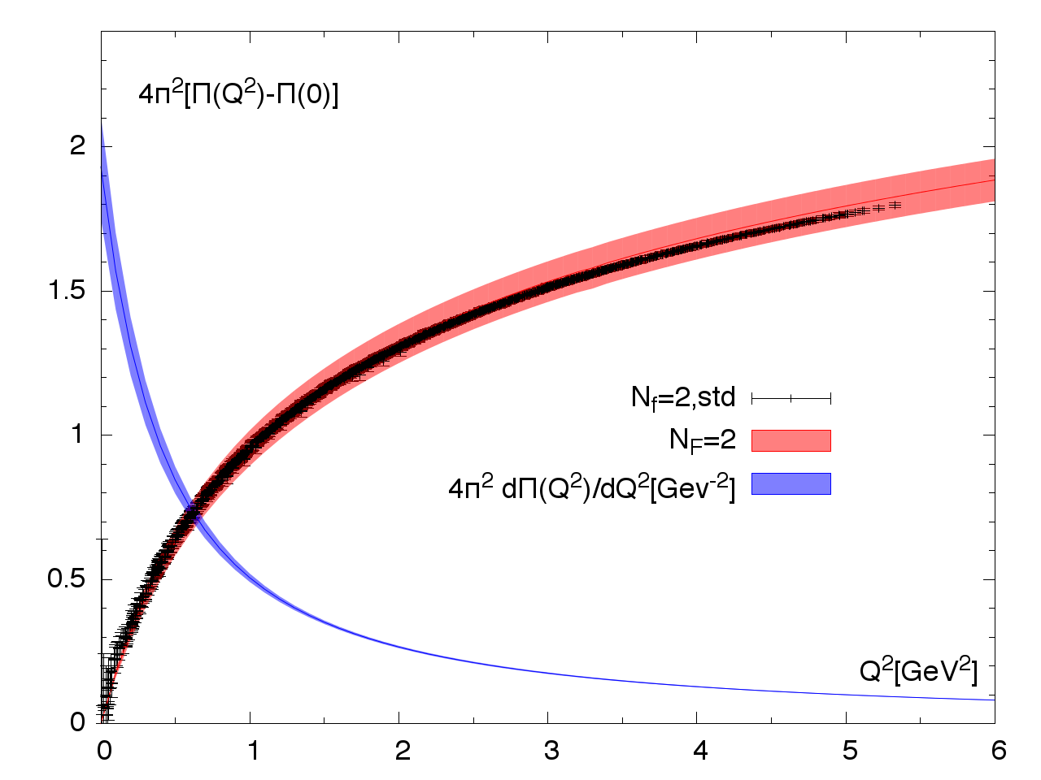
31 | Hadronic contributions to the muon $(g−2)$
Low-momentum region of $Π(q^{2})$
Mixed-representation correlator:
[Bernecker & Meyer, 2010; Feng et al., 2013]
Momentum $Q^{2}$ is tunable parameter
Constrain momentum dependence near $Q^{2}=0$
Allows for determination of the Adler function
[Francis, Jäger, Meyer, H.W., Phys Rev D88 (2013) 054502]
$$m_{π}≃325 MeV$$

Slide 32
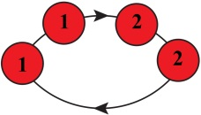
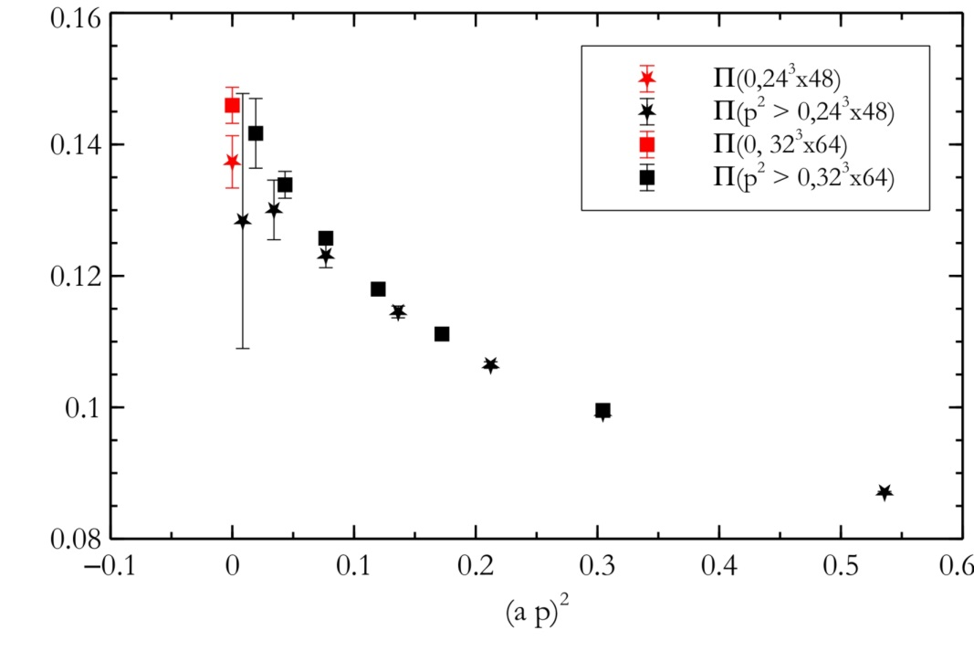
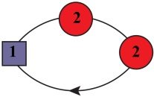
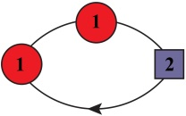
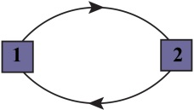
32 | Hadronic contributions to the muon $(g−2)$
Low-momentum region of $Π(q^{2})$
Direct calculation of $Π(0)$:
[de Divitiis et al., 2012]
$$=−$$
$$−$$
$$−\frac{1}{2}$$
$$−\frac{1}{2}$$
$$−\frac{1}{4}$$
Compute three- and four-point functions of vector and tensor currents

Slide 33
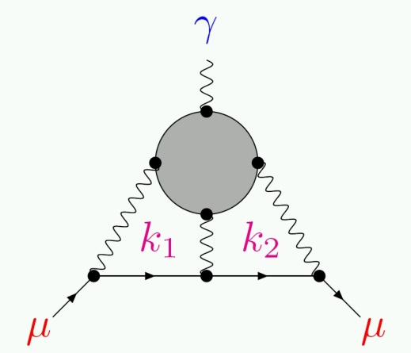
33 | Hadronic contributions to the muon $(g−2)$
Lattice approach to hadronic light-by-light scattering
Brute force:
Compute 4-point function
Integrate over internal momenta
Extrapolate: $q^{2}→0$
Simultaneous QCD+QED simulations:
[Blum, Chowdury et al.]
Difference yields desired contribution up to $O(α^{3})$

Slide 34
34 | Conclusions
Conclusions:
Lattice QCD an established and mature method to study QCD at low energies
Successful “post-diction” of the light hadron spectrum
Predictions for decay constants, form factors, low-energy constants,…
Is there interaction between Lattice QCD and experiment?
CKM physics; first-row unitarity,…
QCD Thermodynamics: freeze-out conditions in heavy-ion collisions
…
Tackle more ambitious quantities
Nucleon form factors and axial charge: 2nd generation benchmark
Excitation spectrum
Hadronic contributions to muon $\left(g−2\right)$
Notes:
a frontier program in electroweak physics with sensitivities to New Physics up to the multiple TeV scale
The Dark Photon project is a high-risk high-gain experiment with a fundamental discovery potential
not accessible at the high energy frontier
We moreover see exciting project in the fields of Nuclear and Hadron physics, for instance a measurement of the proton radius, the strangeness content of the nucleon Or measurements of the neutron skin of light nuclei as needed for astrophysics issues.
We believe that this is a a highly visible and complementary program in the LHC era

