Slide 1
Realtime follow-up analyses with IceCube
Marek Kowalski
Universität Bonn
High Energy Universe
Splinter meeting
Tübingen
26.9.2013

Slide 2
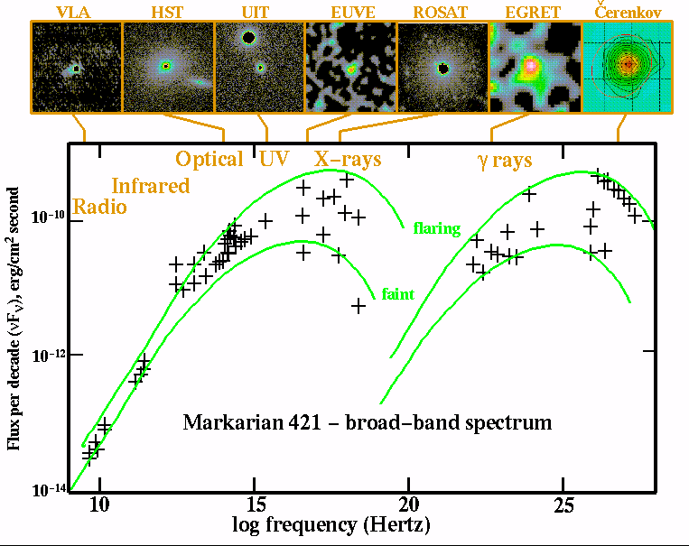
The multi-messenger approach to neutrinos:
Correlating neutrinos with electromag. signal to improve sensitivity for astrophysical neutrinos

Slide 3
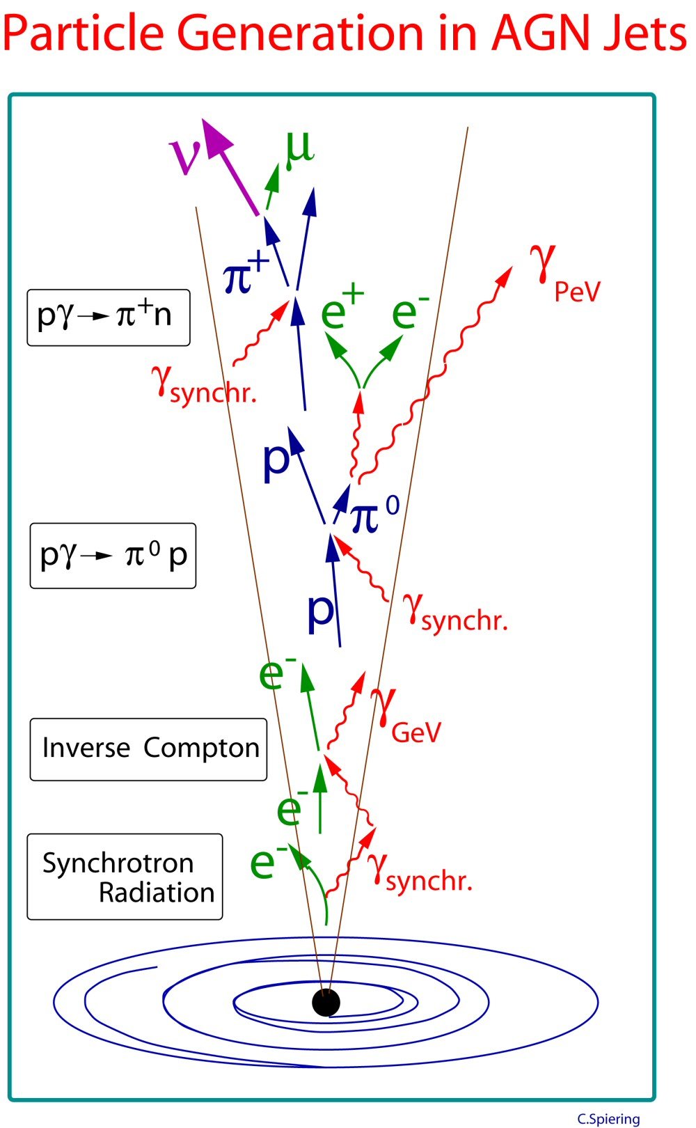
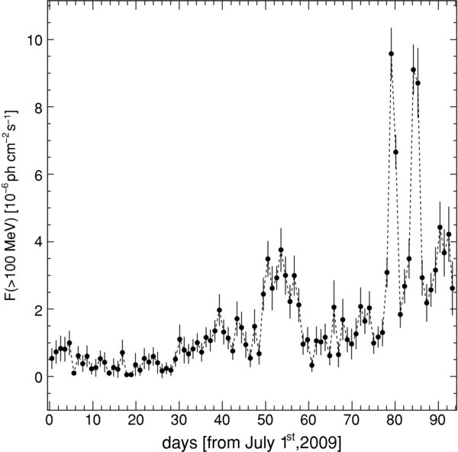
Example I: AGNs and the search for flares
  Search for flares with a high-energy neutrino telescope is
  motivated by high variability of the electromagnetic emission
Gamma-ray light curve of 3C273
hadronic
leptonic
Fermi-Large Area Telescope Observations of the Exceptional Gamma-ray Outbursts of 3C 273 in 2009 September, Abdo et al. 2010 ApJ 714 L7
adapted from
Relevant time scale for neutrino emission is unknown!
adapted from C. Spiering

Slide 4
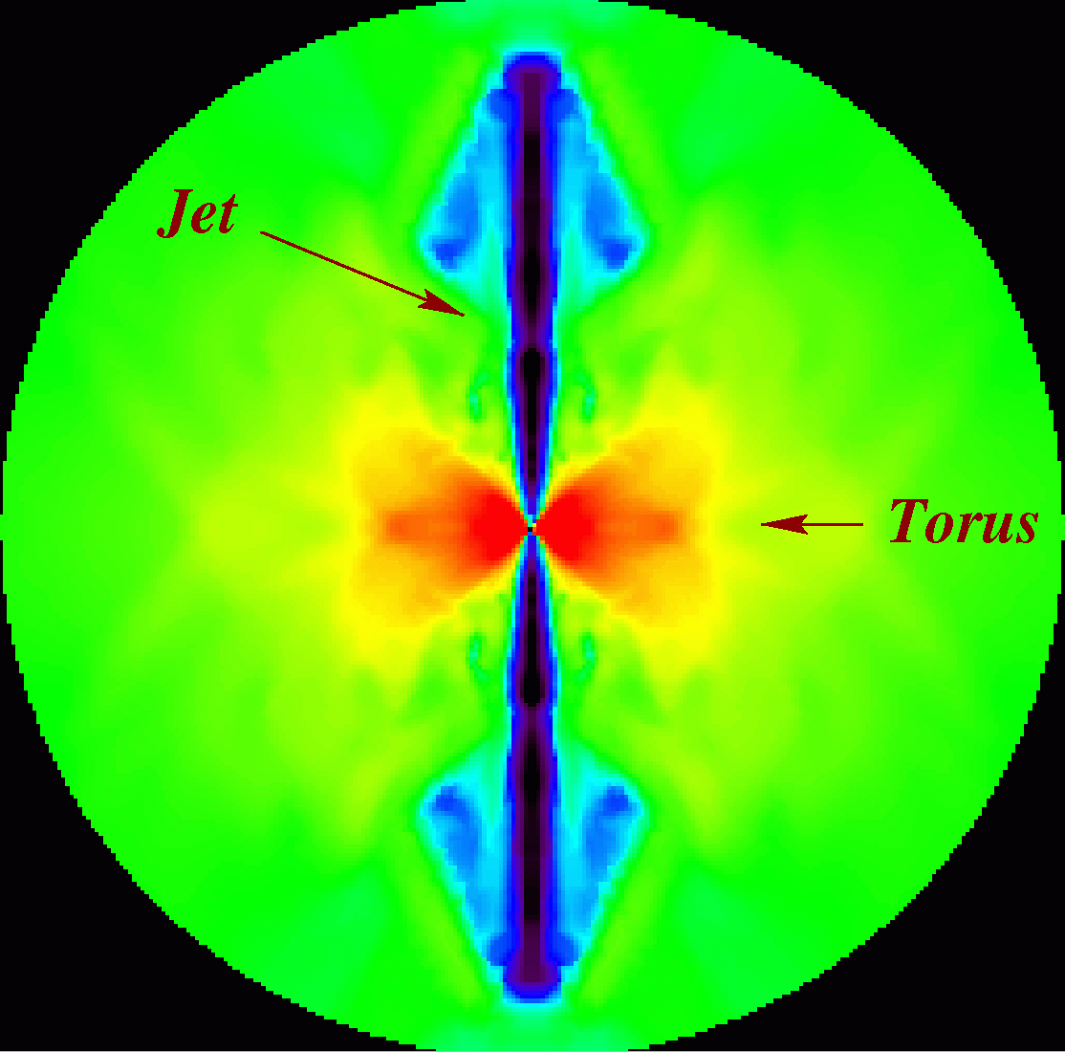
Example 2: high energy neutrinos from Supernovae
  Core-collapse Supernovae with mildly-relativistic jets inside that don’t reach the surface ➔ neutrino factory! Time scale~10 s
  Emission of core-collapse SNe of type IIN from shock interaction with progenitor wind ➔ Neutrino emission with time scale ~ weeks
Gravitative collaps of
a very massive, rotating
star (>25 M):
Conventional search methods:
Individual interesting SNe,
e.g. SN2008D Abbasi et al. A&A, 2011
Stacking of nearby SNe
B~10⁸ GeV
T_{dyn}~1 s
Simulation: MacFadyen (2000)
Relevant time scales for neutrino emission known

Slide 5
Realtime neutrino follow-up
The problem: monitoring of electromagnetic sky is very
incomplete, particular in the optical, X-ray and hard gamma rays.
The solution: Trigger other telescopes on interesting neutrino
signatures to obtain data from AGNs, SNe, GRBs that would
otherwise never been taken
Enhencement of sensitivity depends on signal, e.g. for SNe
improvement of up to a factor 3 possible.

Slide 6

IceCube follow-up programs:
Optical (Bonn)
X-ray (Bonn)
Gamma-Ray (DESY)
AGN/SN/GRB
IceCube

Slide 7
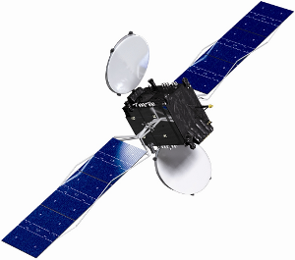
IceCube follow-up programs:
Optical (Bonn)
X-ray (Bonn)
Gamma-Ray (DESY)
AGN/SN/GRB
Bonn/DESY/Madison
Iridium
IceCube

Slide 8
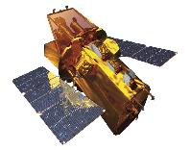

IceCube follow-up programs:
Optical (Bonn)
X-ray (Bonn)
Gamma-Ray (DESY)
Swift (X-ray)
Magic & Veritas
AGN/SN/GRB
Bonn/DESY/Madison
Optical Telescopes
ROTSE & PTF
Iridium
IceCube

Slide 9
IceCube follow-up programs:
Optical (Bonn)
X-ray (Bonn)
Gamma-Ray (DESY)
Swift (X-ray)
Magic & Veritas
AGN/SN/GRB
Bonn/DESY/Madison
Optical Telescopes
ROTSE & PTF
Iridium
IceCube

Slide 10
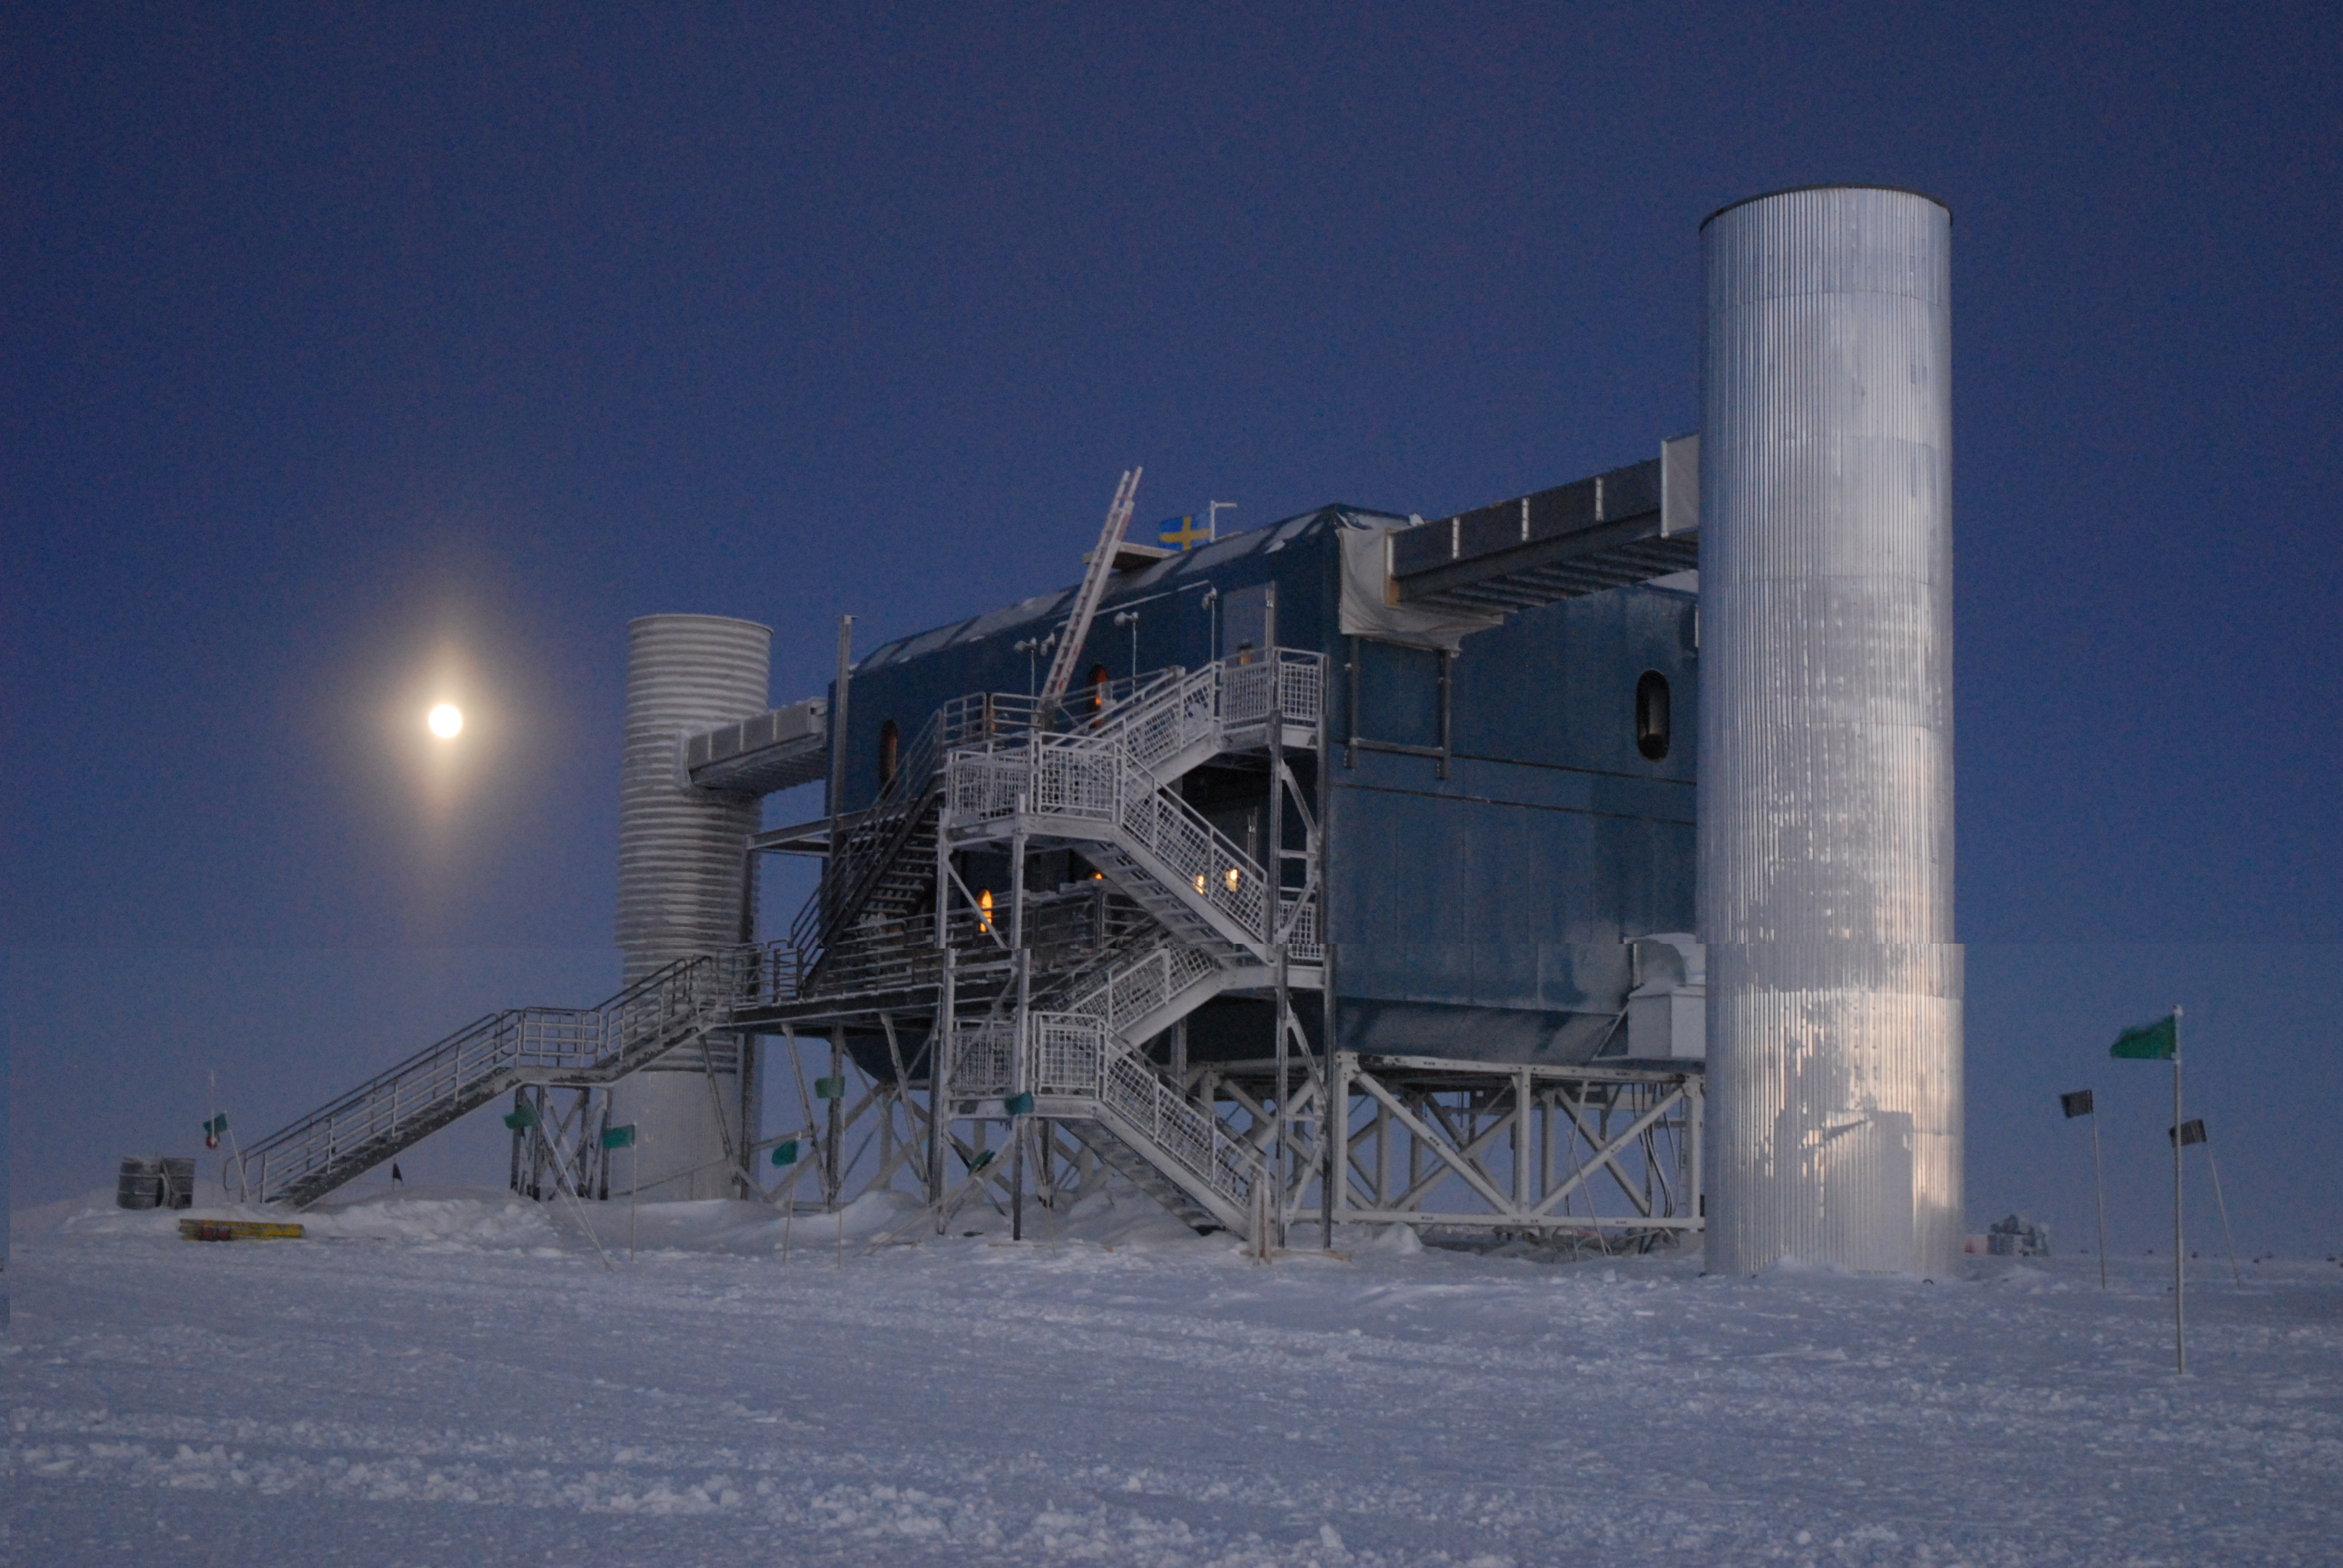
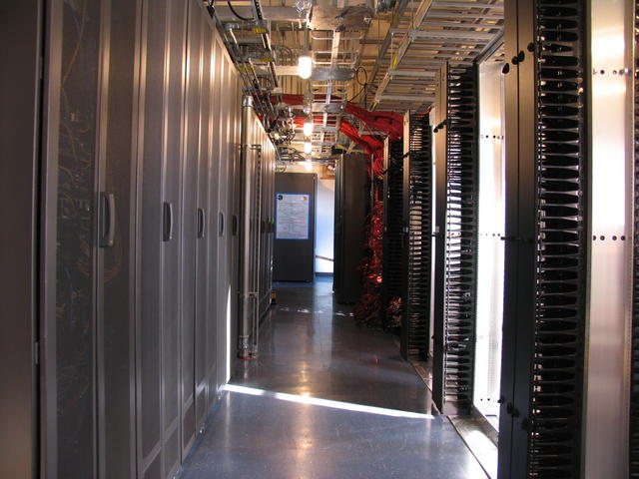
IceCube online data processing pipeline
Trigger
2000 Hz
Level 1
30 Hz
Neutrino-
Level
0.002 Hz
Farm for online reconstruction
Neutrino-
Multiplets
Latency 2009: 4-8 hours
since 2010: ~5 minutes

Slide 11
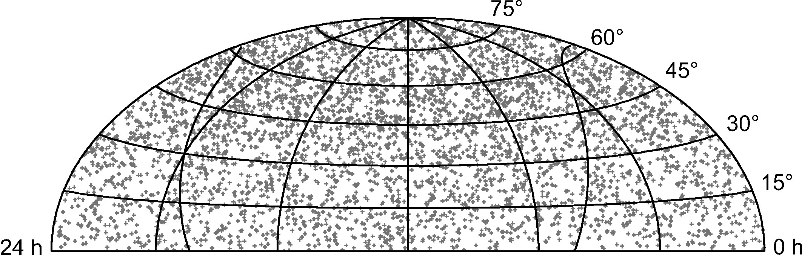
Triggering the follow-up
Neutrino-
Level
0.002 Hz
Time-scale for
cluster search:
seconds to ~3 weeks
-3
-2
-1
Now
Likelihood based doublet trigger
Cluster trigger
Optical follow-up:
ROTSE/PTF
~ 25 few per year
X-ray follow-up
~ 7 per year
Gamma-ray follow-up
~ 3 per year

Slide 12

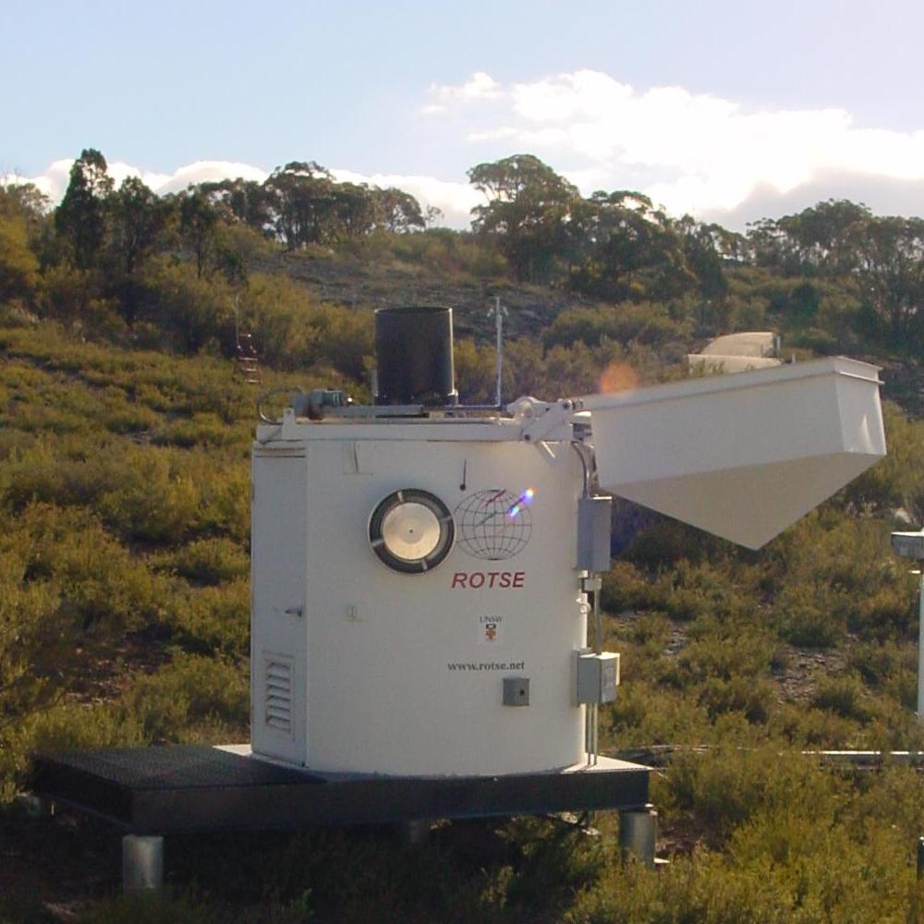
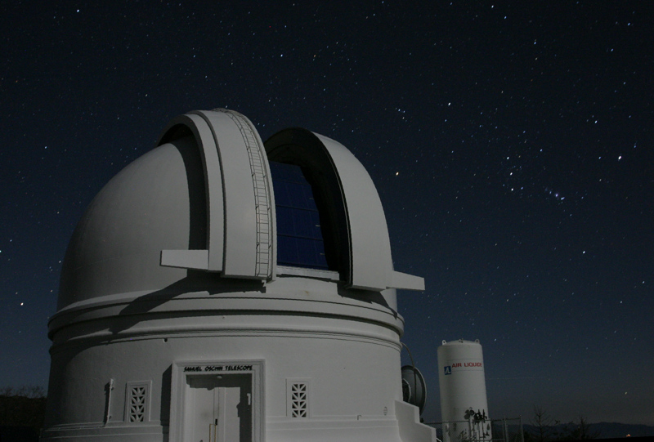
Optical Neutrino Follow-up
The Telescope Network
ROTSE (since 2008)
- 0.45 m diameter
- 3.5 deg² FoV
PTF (since 2011)
- 1.2 m diameter
- 8 deg² FoV
27

Slide 13
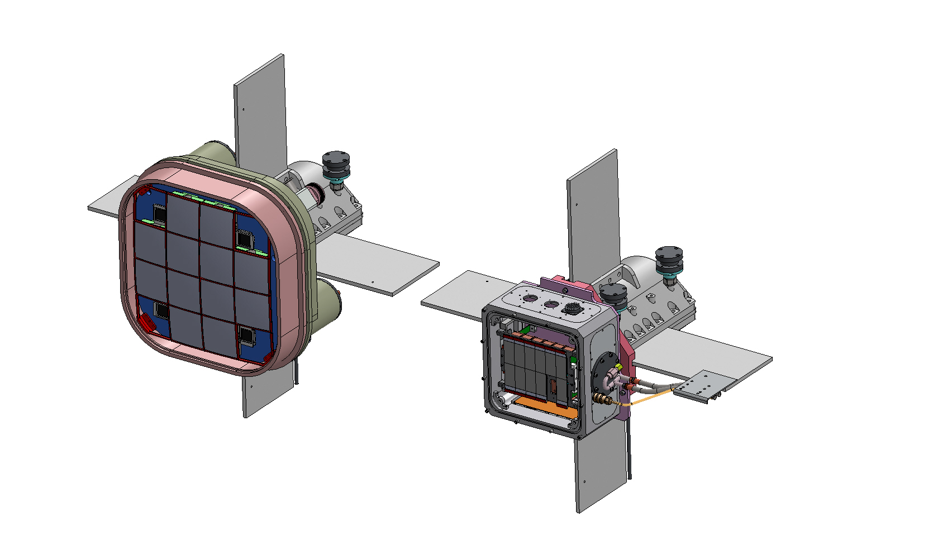
Optical Neutrino Follow-up
Palomar Transient Factory
Existing PTF camera: MOSAIC 12k – 7.2deg²
1.2 m Schmidt telescope
Starting 2015:
Zwicky Transient Factory:
16 6k x 6k e2v CCDs – 42 deg²

Slide 14
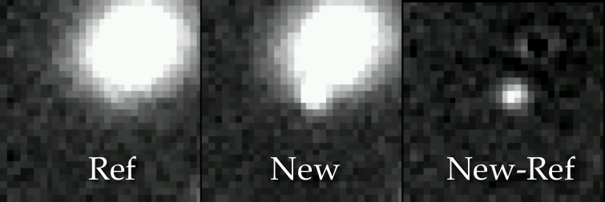
Optical Neutrino follow-up
Hunting Supernovae
No such Supernova observed in 2008/2009
Abbasi et al., A&A 2012

Slide 15
Optical Neutrino follow-up
Hunting Supernovae
 | multiplicity | observed | expected
SNe |  | 0 | 0.074
IC 40 | Doubletts | 15 | 8.55
IC 40 | Tripletts | 0 | 0.003
IC 59 | Doubletts | 19 | 15.66
IC 59 | Tripletts | 0 | 0.004
First year alert statistics (Δt<100s)
Abbasi et al., A&A 2012

Slide 16
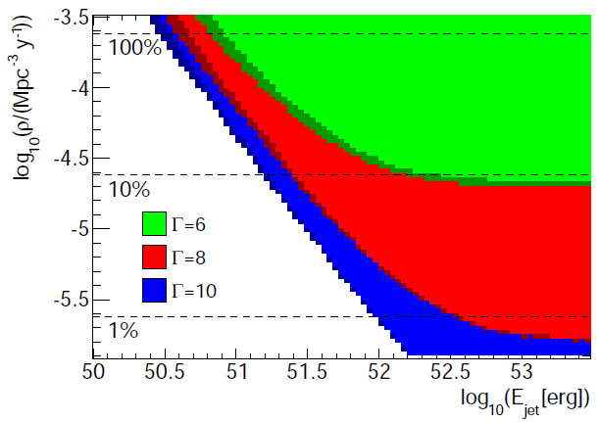
Optical neutrino follow-up
Supernova constraints
Abbasi et al., A&A 2012
Are there GRB-like jets inside of core-collapse supernovae?
GRBs
Less than 4.2% of all core-collapse SNe contain a jet with Γ = 10 und E_{jet} = 3×10⁵¹erg
SNe ?

Slide 17
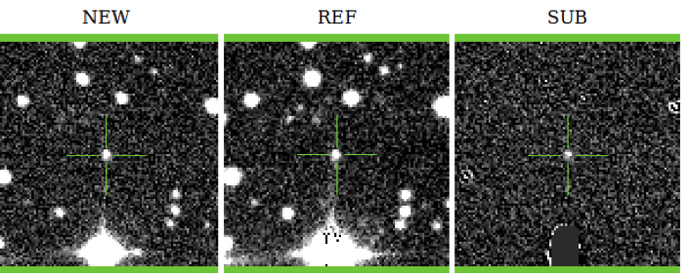
Optical neutrino follow-up
The first Supernova!
Spring 2012 alert
  Two neutrinos Δt=1.3 s apart
  Discovery of SN with PTF at the location of the alert
  Spectroscopic confirmation as SN Type IIn @ z=0.06
  Significance for correct
  association ~2σ
  Caveat: Archival search with PanStarrs showed Supernova was already several month old
Voge et al., ICRC 2013

Slide 18
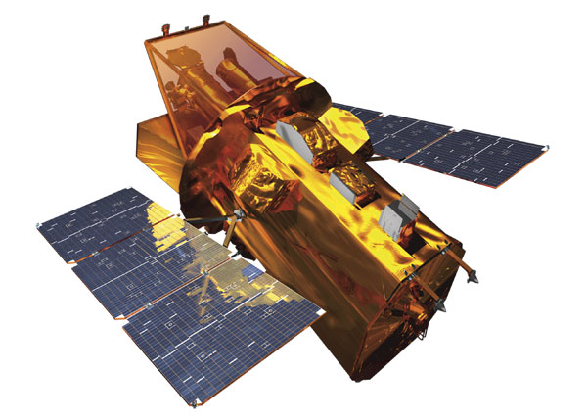
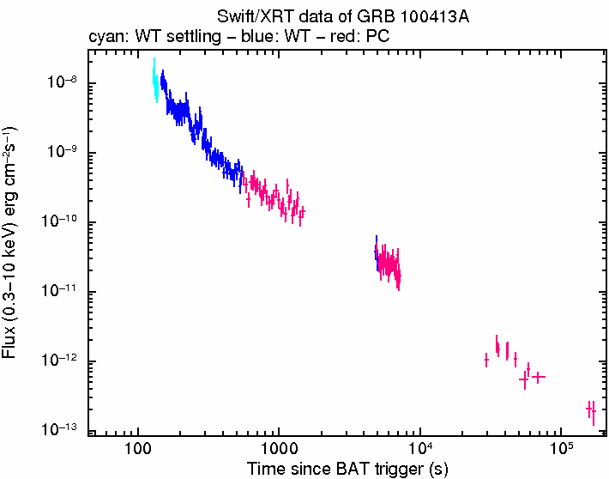
X-ray follow-up with SWIFT/XRT
Hunting GRB afterglows
0.4°
1 hour
1 day
1 week
First observations with < 4 hours delay
Tiling needed due to small FoV of Swift
Currently: One field per orbit
Swift team implementing 7 fields per orbit

Slide 19
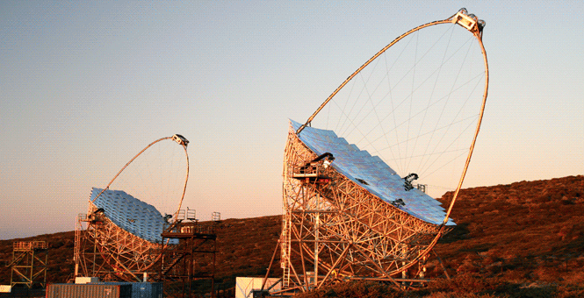
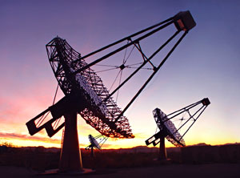
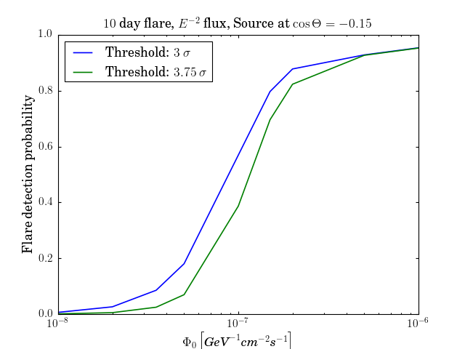
Gamma-ray follow-up with MAGIC & Veritas
Trigger on neutrino cluster in direction of predefined candidate list
Trigger threshold set according ACT time allocation (1-3 per year) MAGIC: 3.2 σ; Veritas: 3.5 σ
Follow-up active since April 2012 (Franke et al., ICRC 2013)
Sensitivity to strongest Mkr 421 flare, assuming ν:γ=1

Slide 20
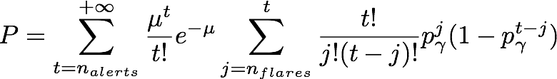

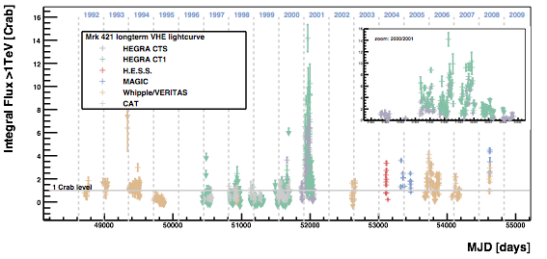
Correlating the neutrino alerts with flaring probability
Long-term monitoring and use of historical data!!
M. Tluczykont, E.B. et al., Astronomy and Astrophysics 524 A48 (2010)

Slide 21
IceCube is fully subscribed to Multi-Messenger
- online or offline!

Slide 22
IceCube is fully subscribed to Multi-Messenger
- online or offline!
Some future directions & wishes:
IceCube – high energy single event trigger
Gamma-ray follow-up – more AGN phenomenology:
light curve feature ➔ neutrino signal
Optical follow-up – wide field optical imagers to monitor the full sky

Slide 23
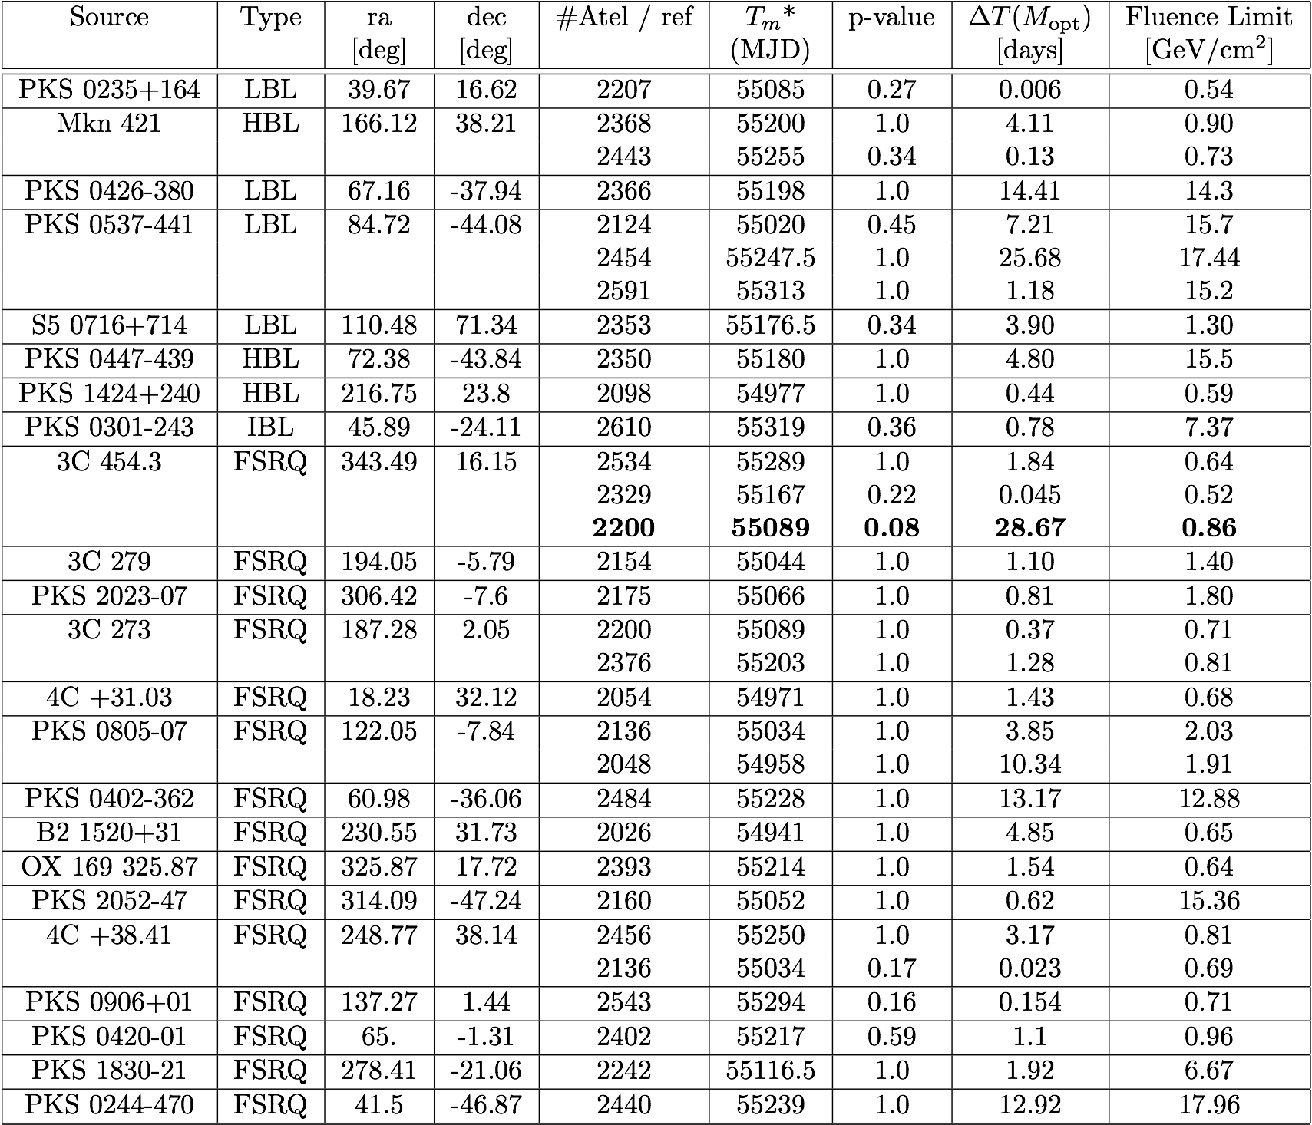
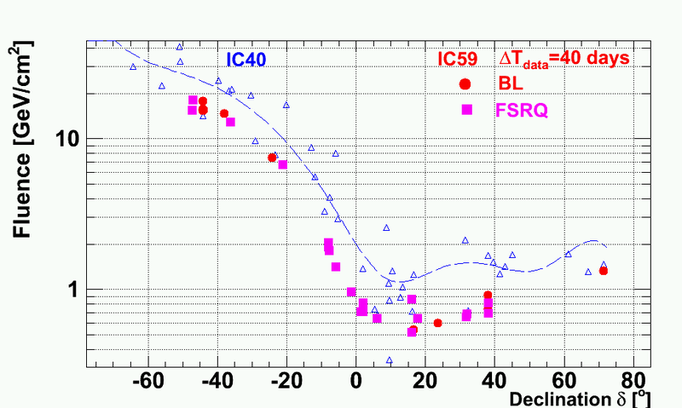
Multiflare analysis of IceCube-59 (2009-2010) data
Time-clustering algorithm combined with unbinned maximum likelihood method. D. Gora et. al., Astropart. Phys. (2011)
Application to selected sources and periods of interest ICRC 2011; astroph 1111.2741
No significant deviation from background

Slide 24
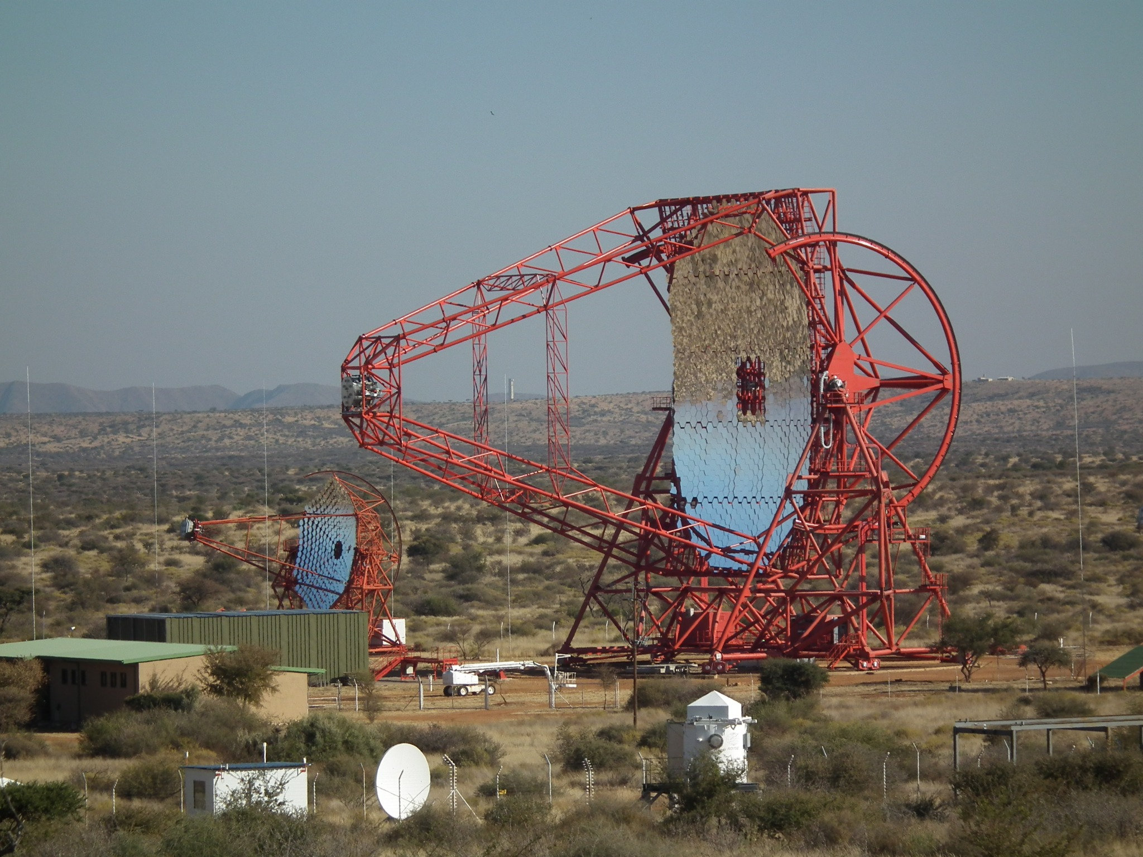
Optical Neutrino Follow-up
ROTSE telescopes
ROTSE 3c
Astronomy Picture of the Day, July 27, 2012

Slide 25
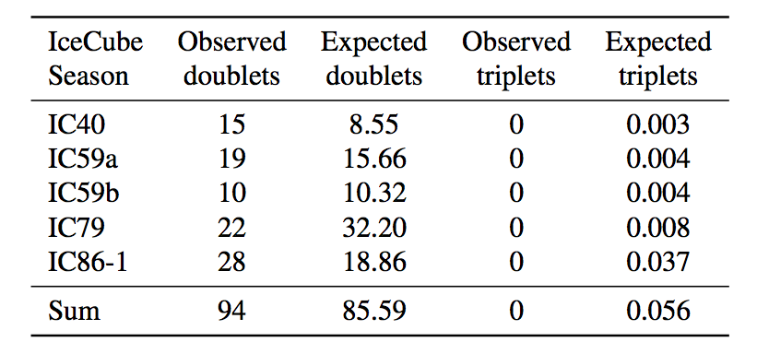
Optical Neutrino follow-up
Hunting Supernovae
No such Supernova observed in 2008/2009
Abbasi et al., A&A 2012
Voge et al., ICRC 2013

