Slide 1
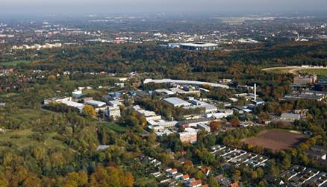
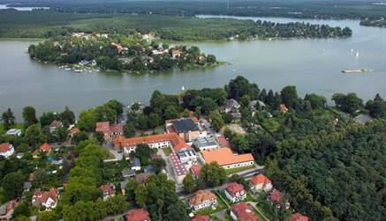
Introduction to DESY and the European XFEL
Welcome at DESY!
Hans Weise, Project Leader DESY XFEL
2nd MTCA Workshop, Hamburg, 11-12 Dec. 2013
Hamburg.
Zeuthen.

Slide 2
DESY as Member of the Helmholtz Association
Research centers: 17
Employees: ~ 33,000
Budget (B€) ~ 3,3
Research Areas:
  Health
  Energy
  Earth and Environment
  Key Technologies
  Structure of Matter
  Aeronautics, Space and Transport

Slide 3
DESY Figures and facts
Budget ~ 182 Mio/year
♦ Research with Photons 156 Mio
♦ Particle and Astroparticle Physics 24 Mio
♦ Accelerator Research ~2 Mio
Research cooperations with worldwide leading laboratories
Interdisciplinary international research platform
(particle physics, biology, chemistry, geology, material science, physics,….)
Employees ~ 2,000
Large infrastructures: DORIS-III, FLASH, PETRA-III, XFEL, TIER-2
Ext. users: ~ 2000/y (research with Photons)
~ 900/y (particle physics)
from 45 countries

Slide 4
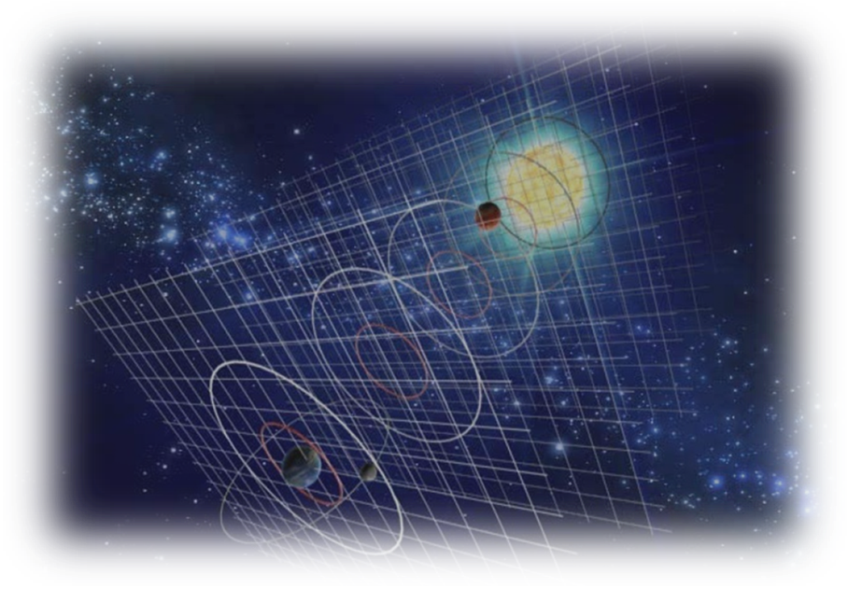
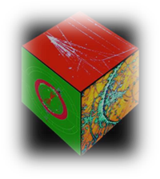
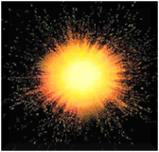
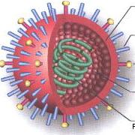
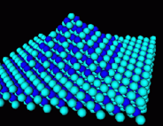
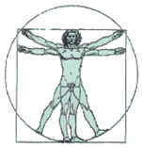
DESY Research
∞ small
∞ large
nano
cosmos
universum
Elementary particles
Unification of forces
Cosmology
Astrophysics
Condensed
Matter
∞ complex
Nanoscience, Biology, …
Synchrotron radiation
X-ray lasers

Slide 5
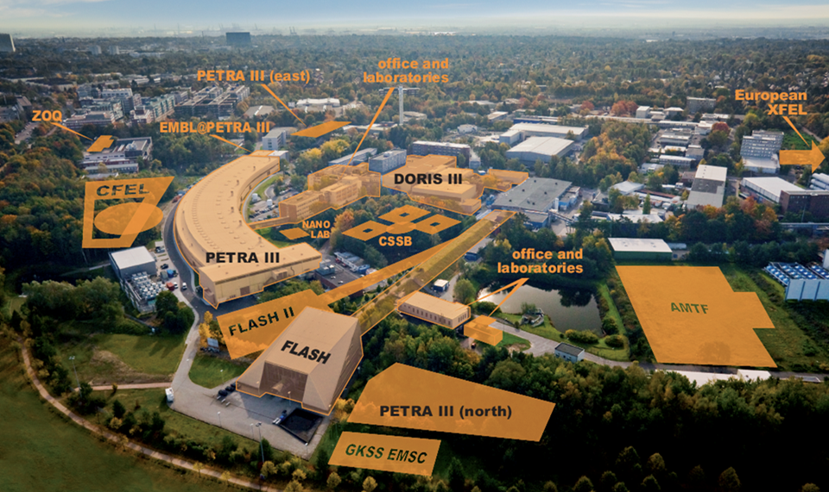
Accelerators and Research with Photons

Slide 6
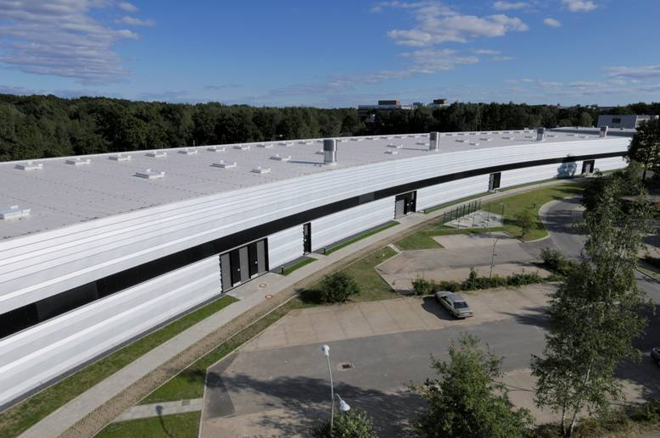
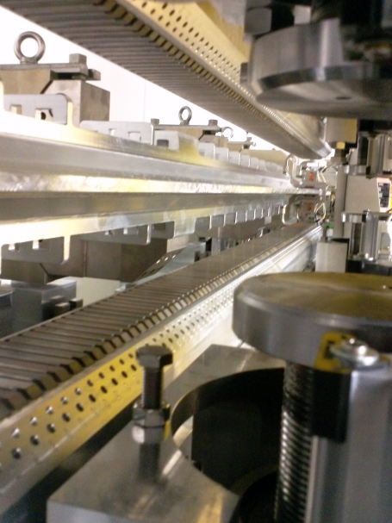
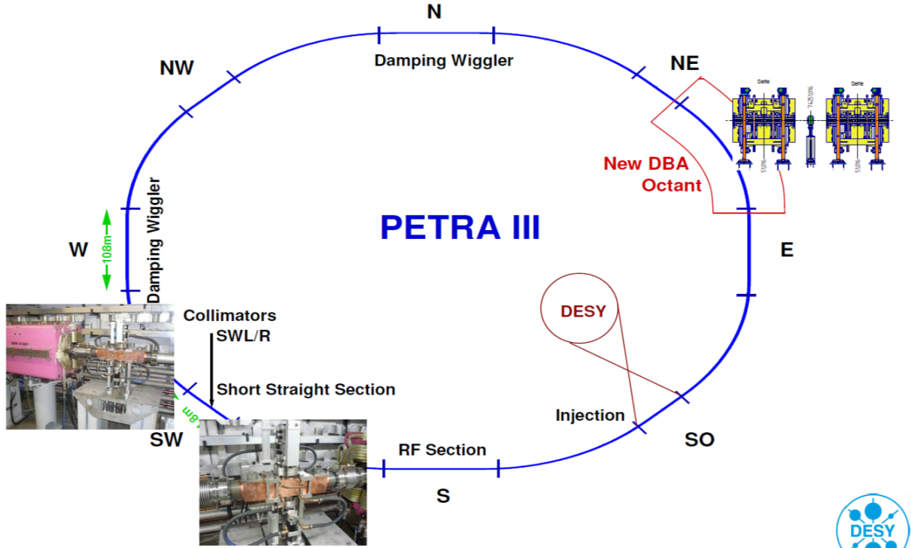
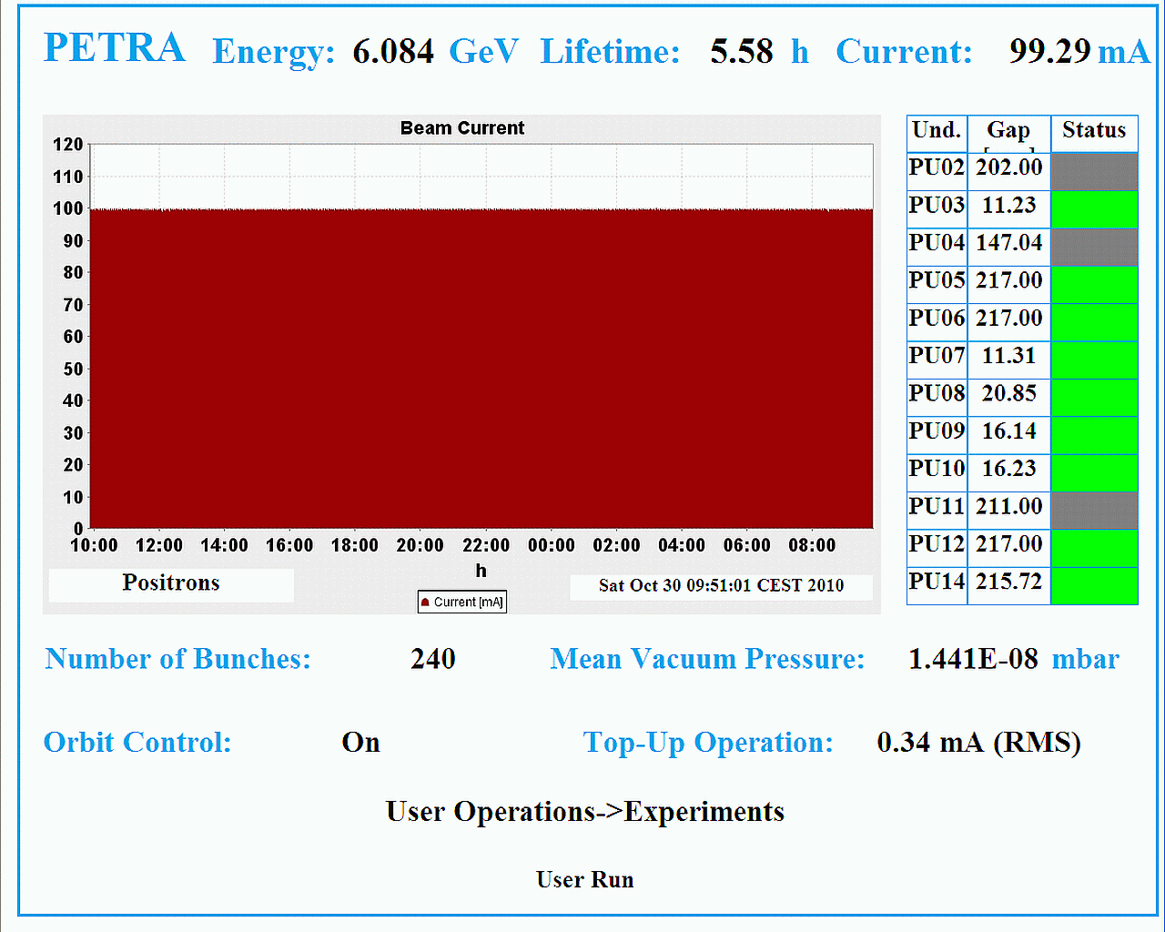
PETRA-III: User Operation since 2010

Slide 7
Parameters: Lowest emittance source to date
 | ESRF | SPring 8 | APS | PETRA III
E/GeV | 6 | 8 | 7 | 6
C/m | 844 | 1434 | 1104 | 2304
ε_{x}/nm | 4 | 3 | 3 | 1
ε_{y}/ε_{x} | 0.1 – 0.2% | 0.2% | 0.3 - 1% | ~1%
I_{beam}/mA | 200 | 100 | 100 – 300 | 100
All design objectives achieved
Top-up mode with beam intensity variation <1%
14 undulator beam lines operational

Slide 8
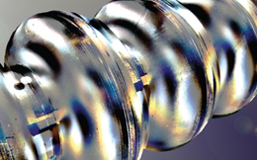
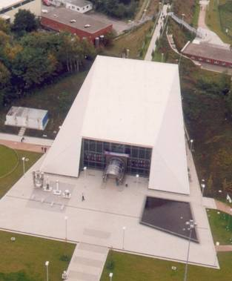
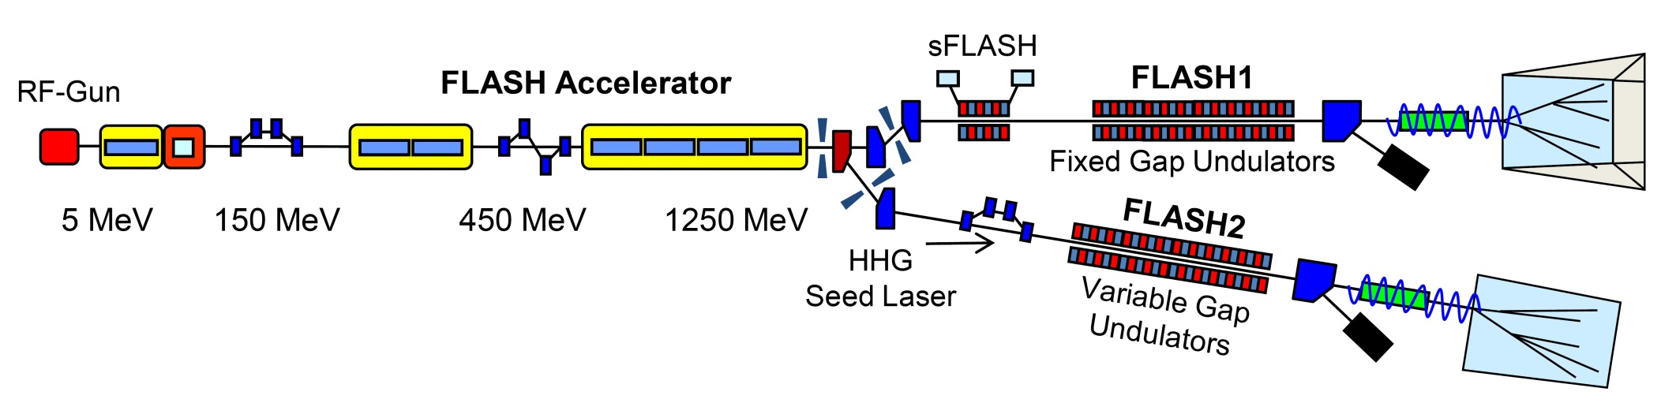
FLASH: Free Electron Laser in VUV – soft X-ray regime
Worldwide first facility of this kind
Regular user operation since 2005
Superconducting accelerator technology for high photon beam intensity & excellent beam stability

Slide 9
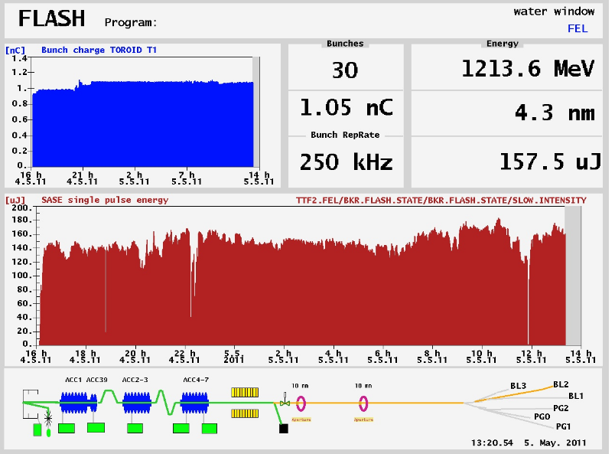
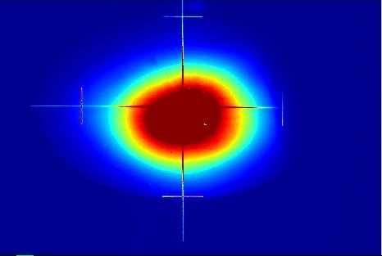
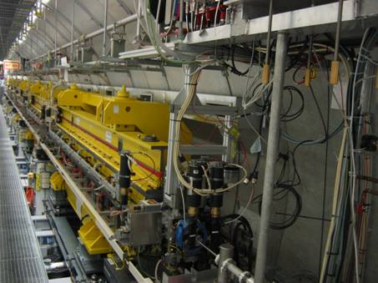
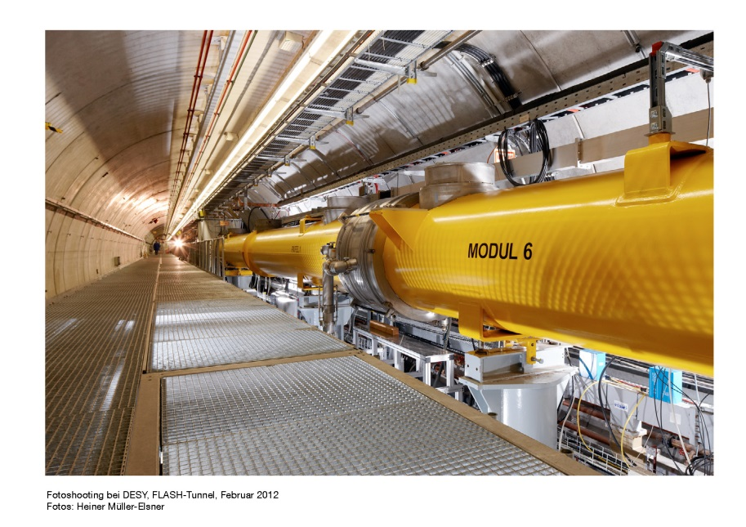
FLASH Operation

Slide 10
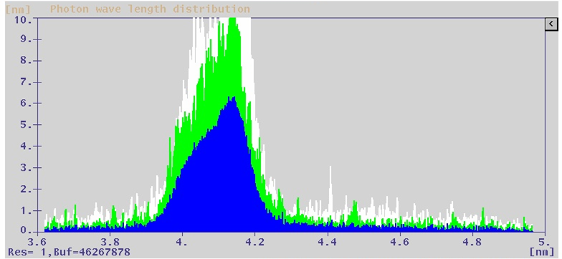
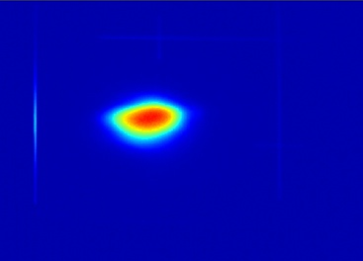
Brilliant results with an upgraded FLASH!
Water window reached
Beam energy 1.25 GeV
(250 MeV above original FLASH design goal)

Slide 11
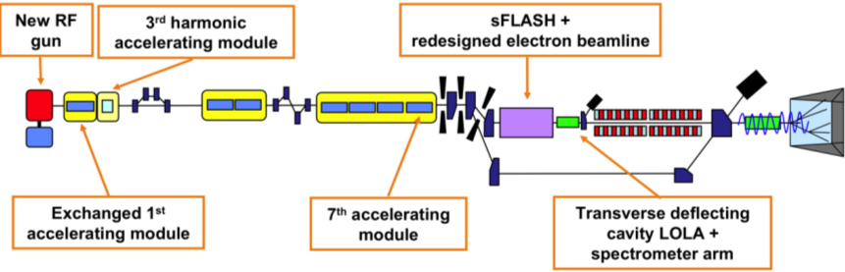
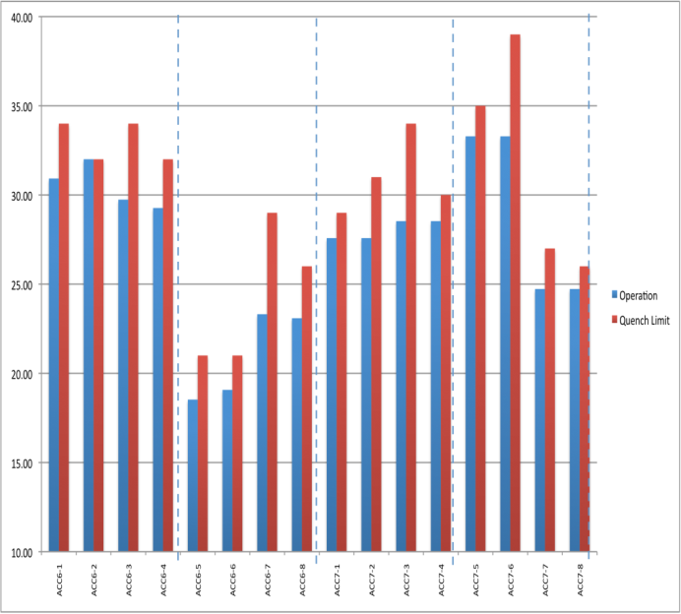
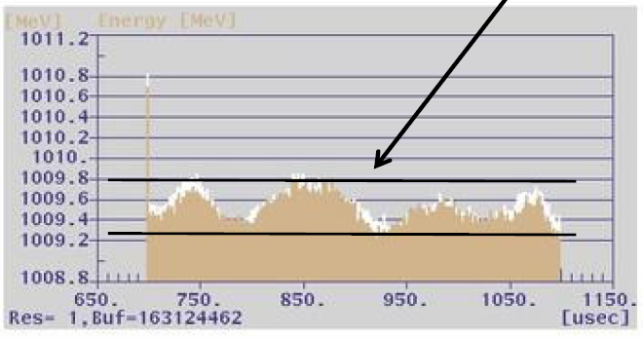
FLASH – ILC – XFEL Synergy
Long bunch trains with high current
Accurate LLRF stabilisation for excellent energy stability
40.0
ACC6
ACC7
35.0
31.5 MV/m
30.0
25.0
20.0
15.0

Slide 12
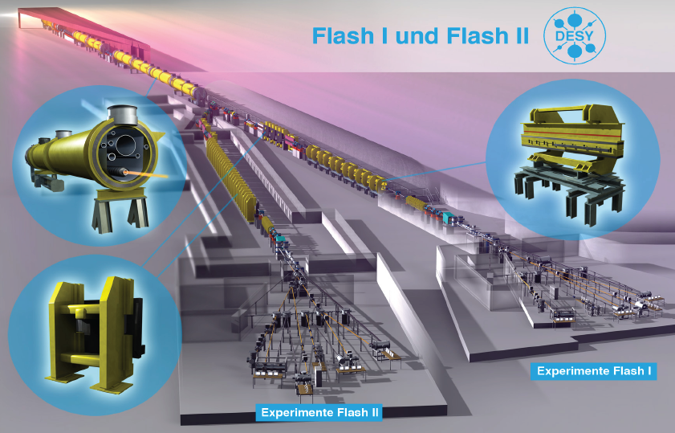
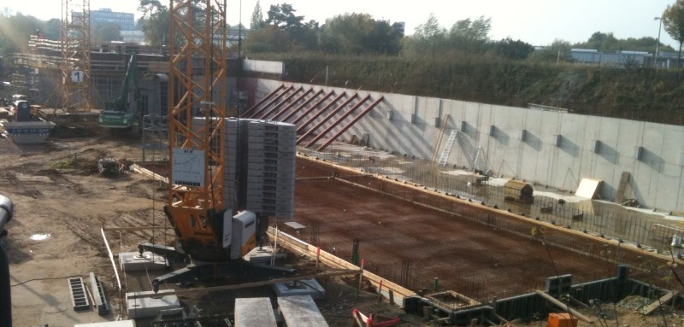
FLASH II
Gun
ACC1+ACC39
ACC2&3
ACC4,5,6,7
Up to ~1.25 GeV
SASE
~4.1 – 44 nm
EXP. Hall
sFLASH
1st BC
2nd BC
Seed laser
SASE/Seeding
Variable gap undulator
FLASH II
Notes:
12

Slide 13
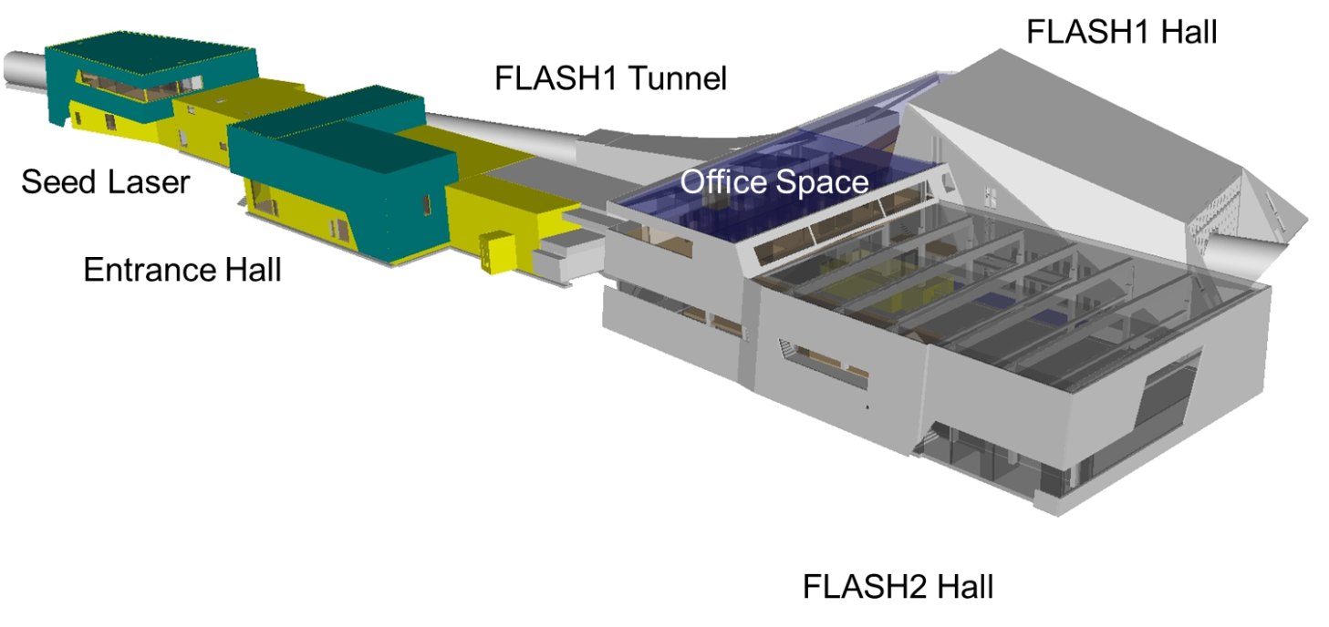
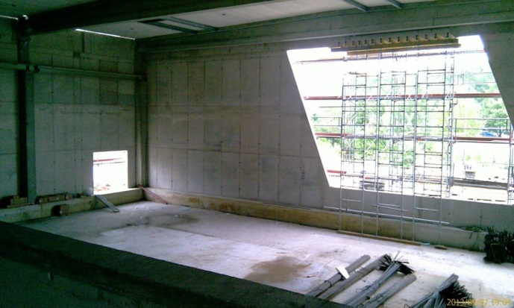
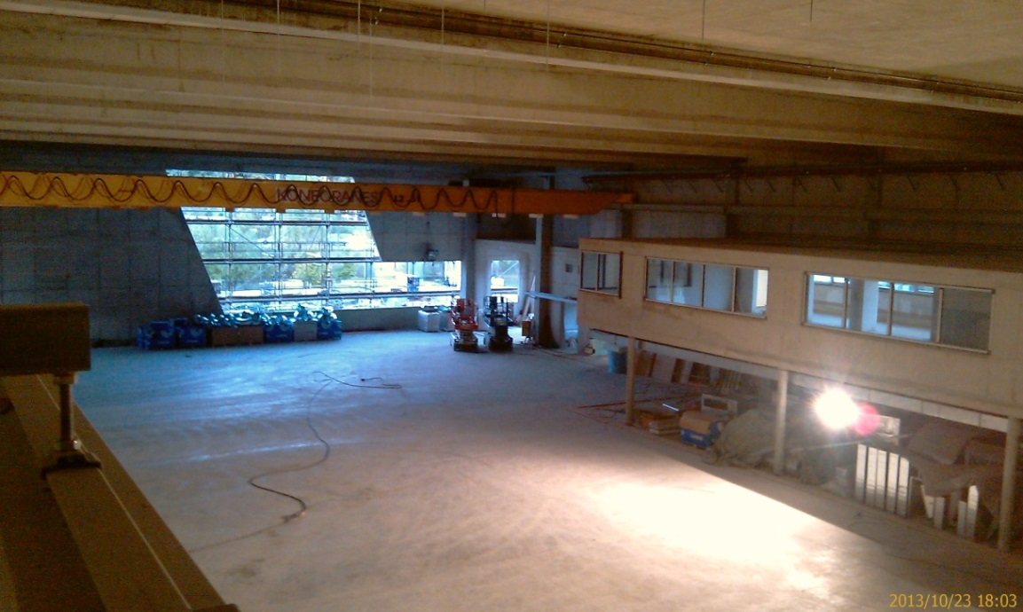
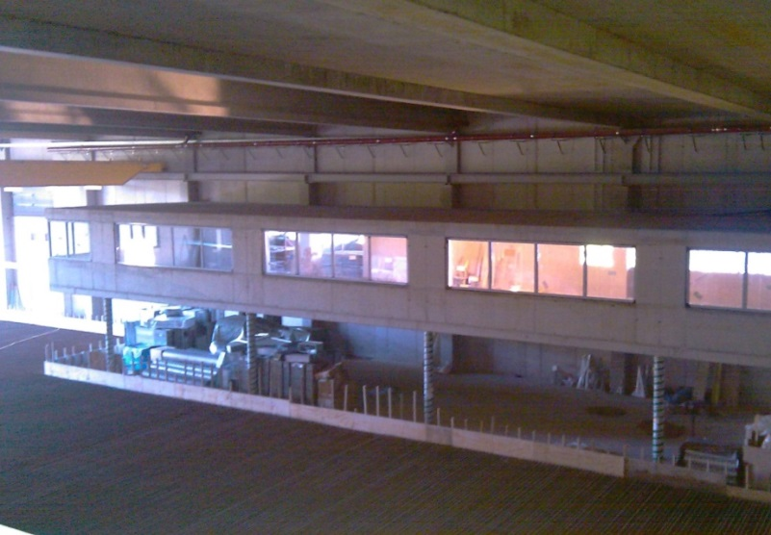
FLASH II Hall

Slide 14
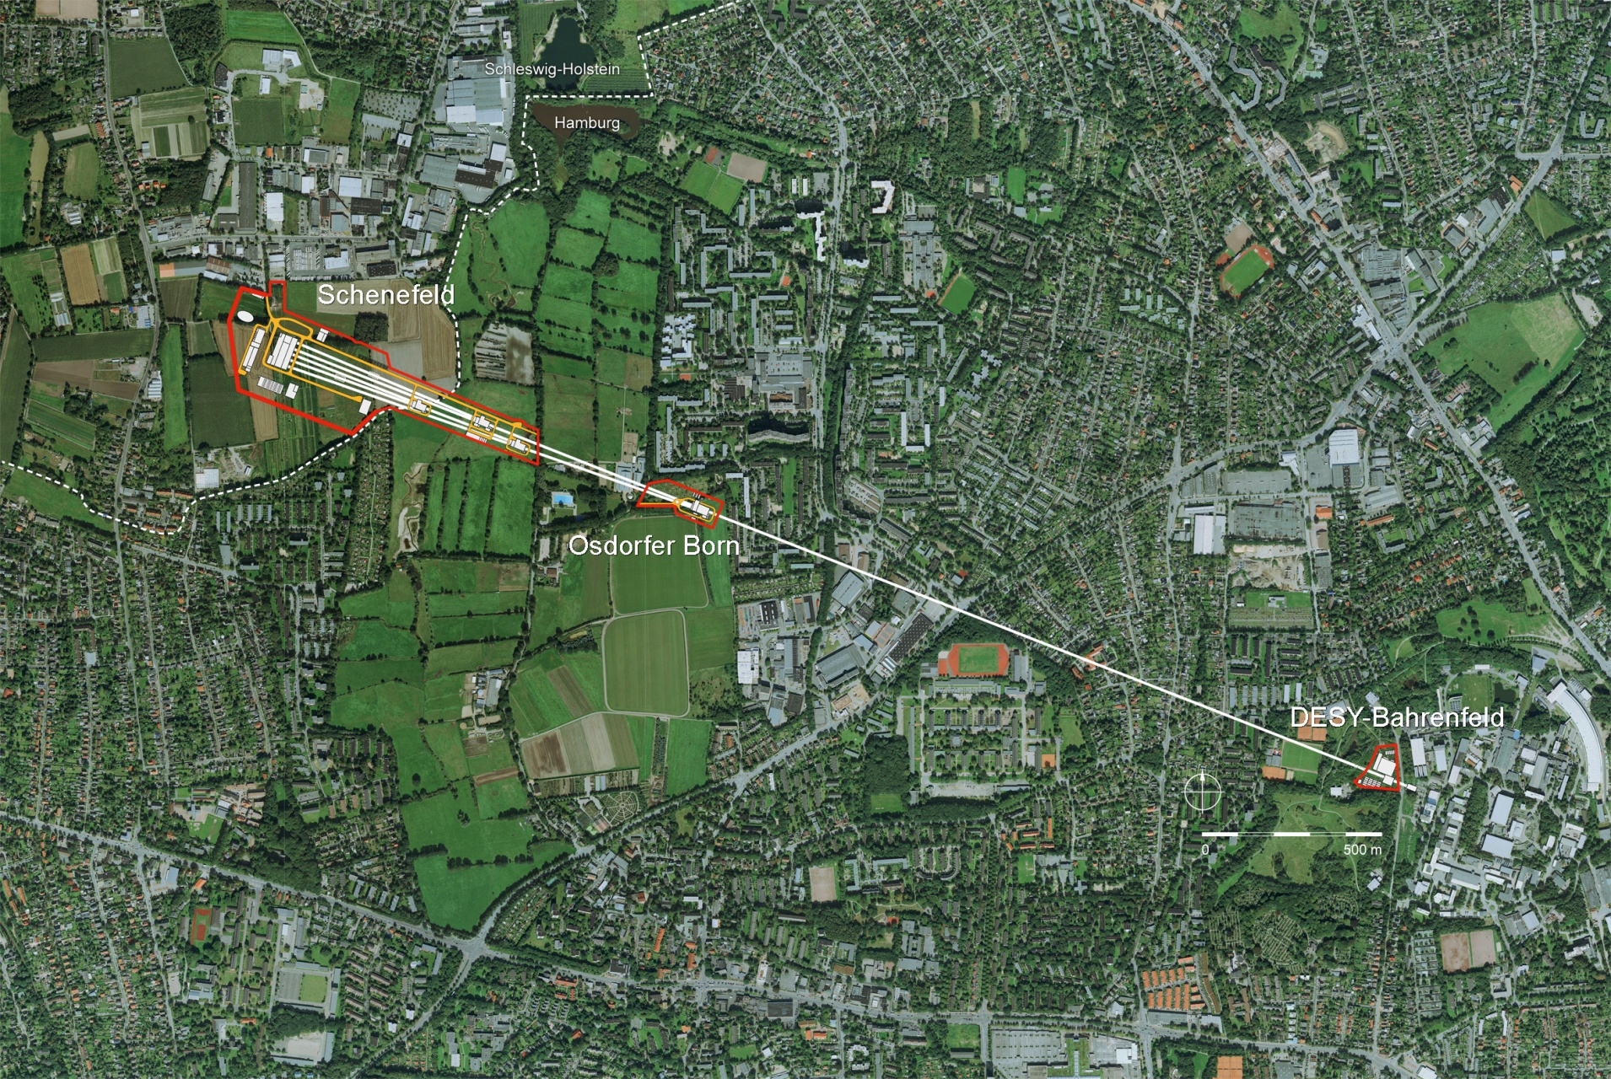
European XFEL Project
Photon beamlines tunnel
Accelerator tunnel
Schenefeld:
Research with photons
Center of the international
research facility
Undulator tunnels
2nd MTCA Workshop, 11-12 December 2013
Hans Weise, DESY

Slide 15
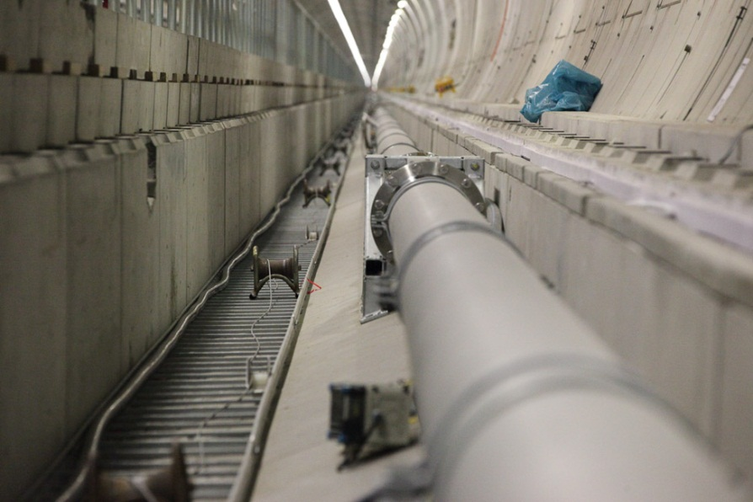
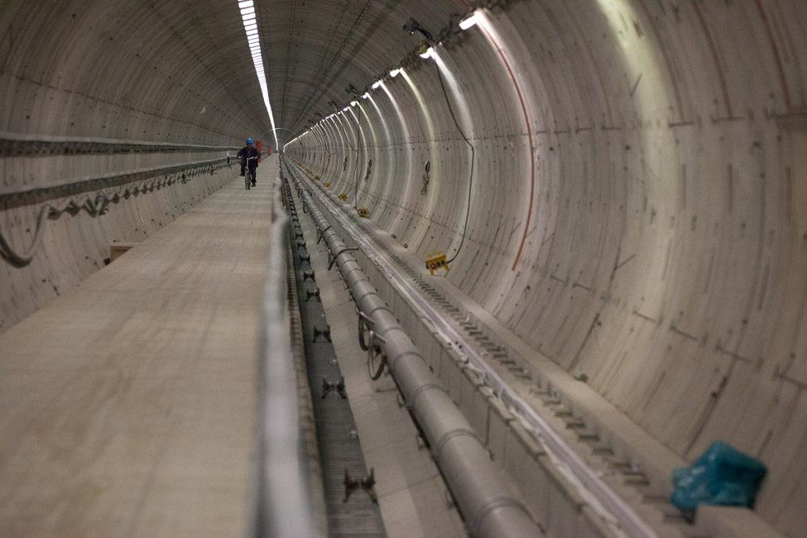
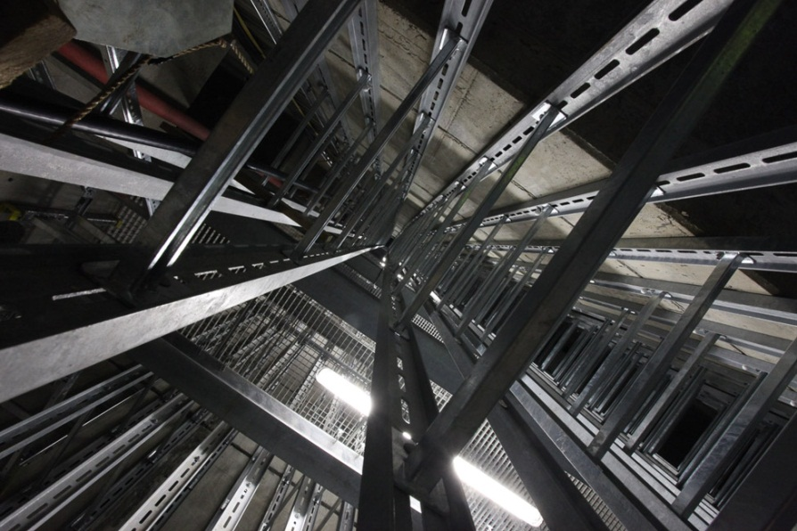
Construction of tunnels completed, installation started
2nd MTCA Workshop, 11-12 December 2013
Hans Weise, DESY

Slide 16
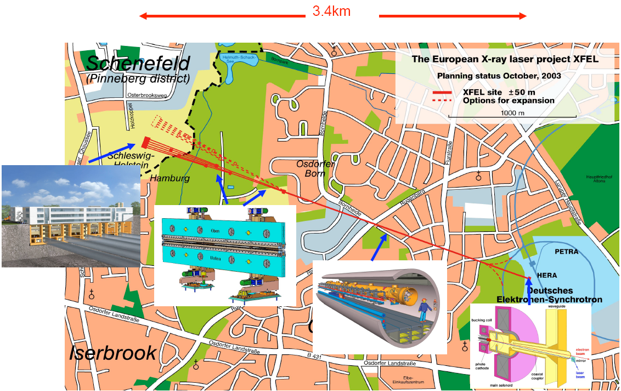
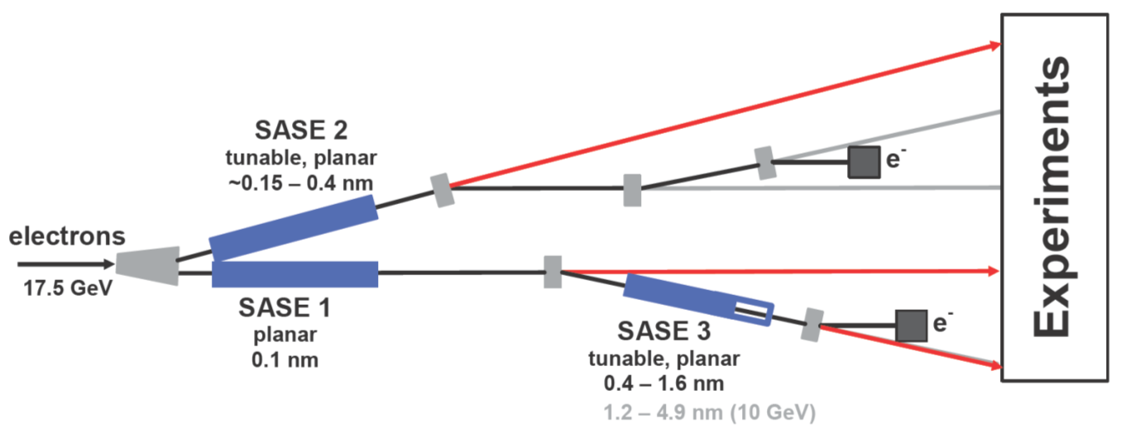
The European XFEL
Built by Research Institutes from 12 European Nations
Some specifications
Superconducting linac. 17.5 GeV
10 Hz (27 000 b/s)
Photon energy 0.3-24 keV
Pulse duration ~ 10-100 fs
Pulse energy few mJ
5 beamlines / 10 instruments
  Start version with 3 beamlines and 6 instruments
Several extensions possible:
  More undulators
  More instruments
  …….
  Variable polarization
  Self-Seeding
  CW operation
SASE2
(= SASE1)
17.5 GeV
SASE1, λ_{u}= 40 mm
0.2 – 0.05 nm
SASE3, λ_{u}= 68 mm
1.7 – 0.4 nm
2nd MTCA Workshop, 11-12 December 2013
Hans Weise, DESY

Slide 17






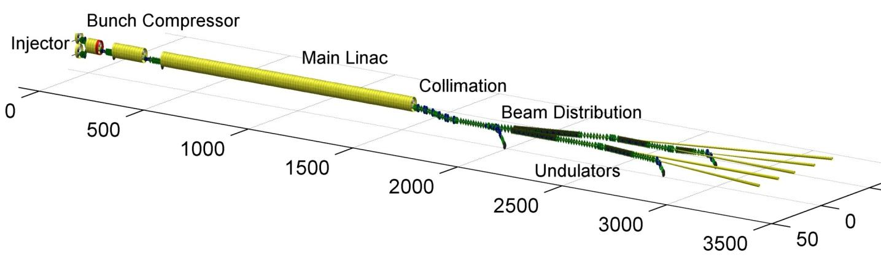





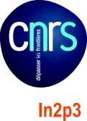





DESY coordinates the accelerator consortium
2nd MTCA Workshop, 11-12 December 2013
Hans Weise, DESY

Slide 18
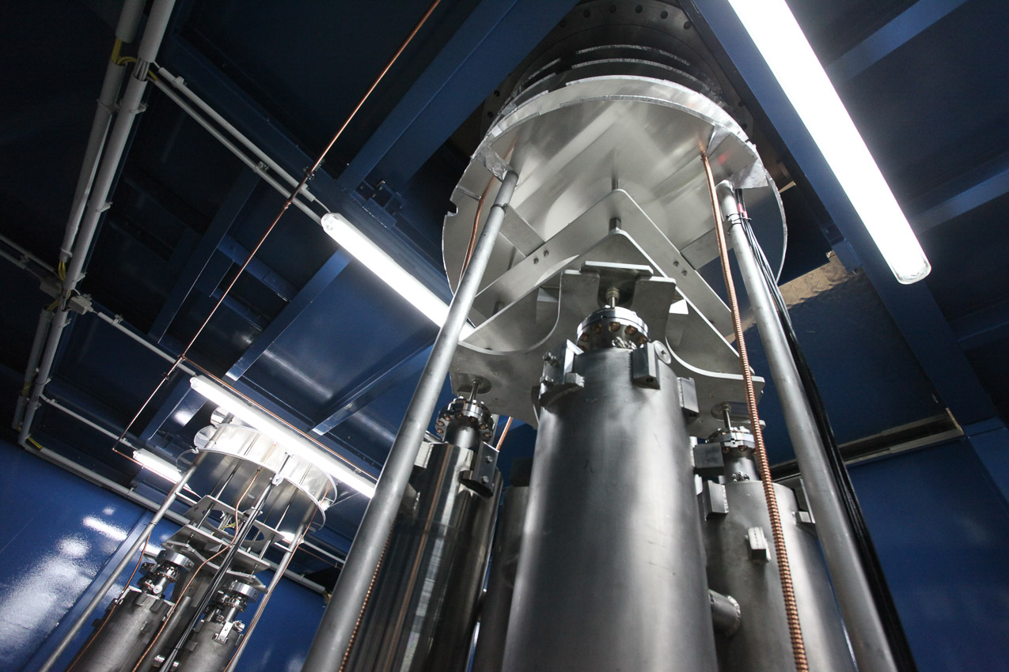


XFEL Cavities Testing in the AMTF
2nd MTCA Workshop, 11-12 December 2013
Hans Weise, DESY

Slide 19
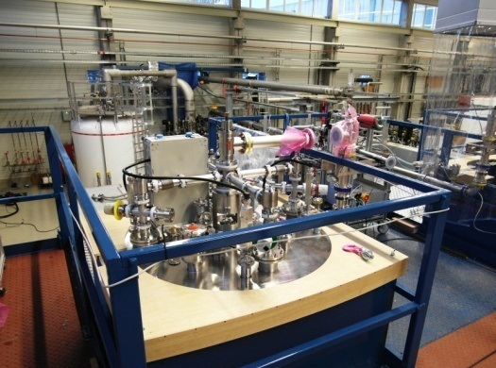
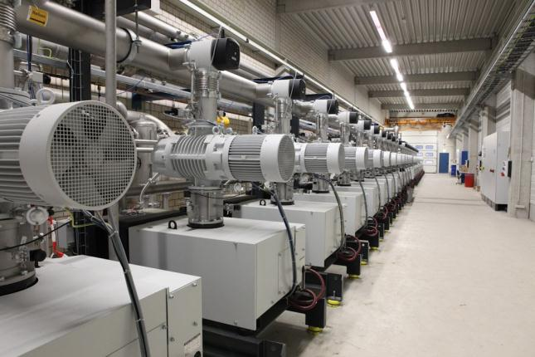
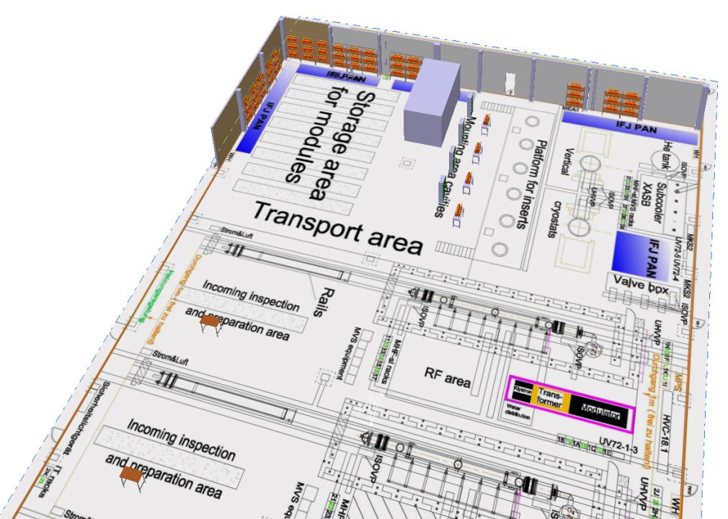
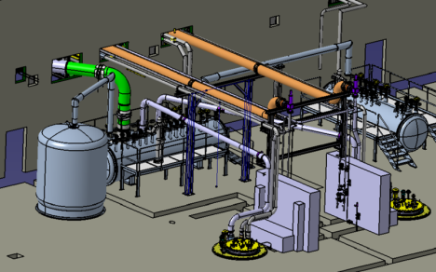
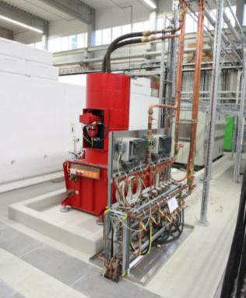
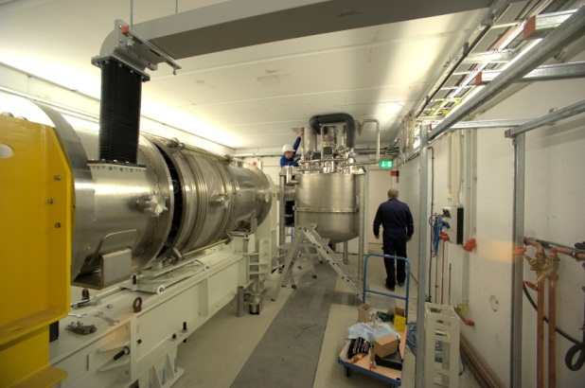

AMTF Test Stand Infrastructure
2nd MTCA Workshop, 11-12 December 2013
Hans Weise, DESY

Slide 20
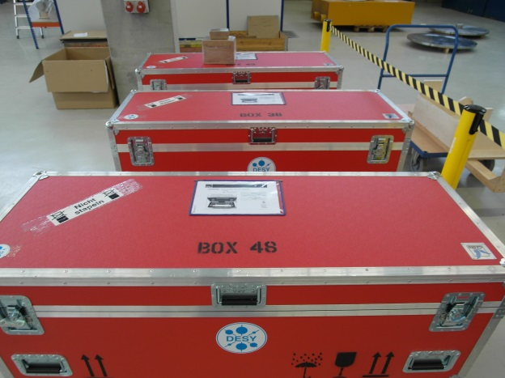
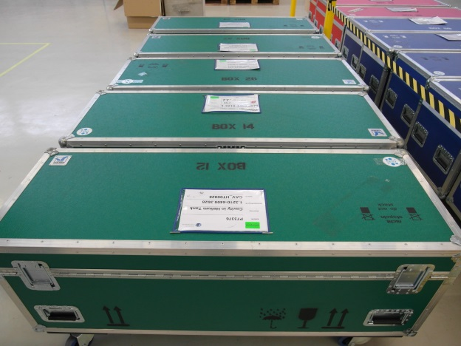

Next Eight Cavities Arrived…
2nd MTCA Workshop, 11-12 December 2013
Hans Weise, DESY

Slide 21
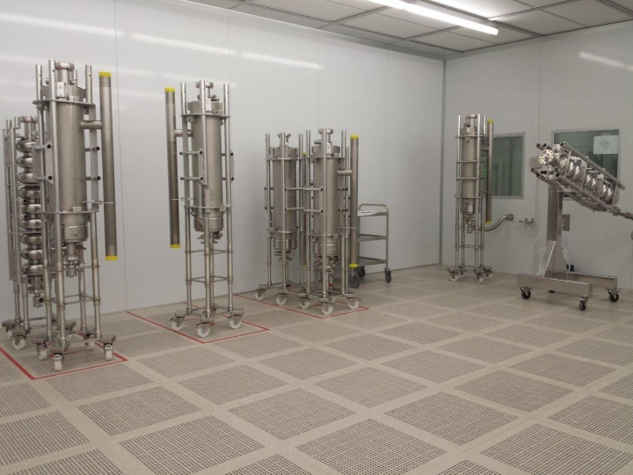
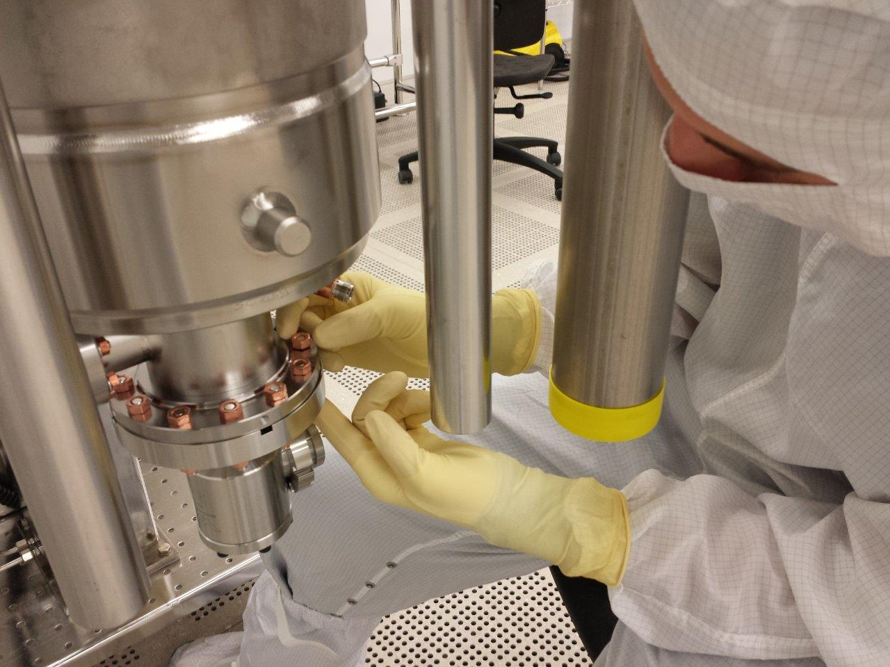
Cavities at ZANON Clean Room
2nd MTCA Workshop, 11-12 December 2013
Hans Weise, DESY

Slide 22

AMTF Vertical Insert for Cavity Testing
2nd MTCA Workshop, 11-12 December 2013
Hans Weise, DESY

Slide 23

Accelerator Module XM-2 Ready for Testing
2nd MTCA Workshop, 11-12 December 2013
Hans Weise, DESY

Slide 24



Many Cryostats and Cold Masses Available
a total of 25 cryostats & cold masses delivered by E. Zanon
20 units delivered by IHEP but 7 need re-work due to non-conformities
some minor re-work takes place at CEA Saclay
overall delivery schedule ok
45 including 7 to be re-worked / repaired
2nd MTCA Workshop, 11-12 December 2013
Hans Weise, DESY

Slide 25

The XFEL Village at IRFU / CEA Saclay
2nd MTCA Workshop, 11-12 December 2013
Hans Weise, DESY

Slide 26

XFEL RF Gun Installed in the Tunnel
2nd MTCA Workshop, 11-12 December 2013
Hans Weise, DESY

Slide 27

Multi Beam Klystron in the Injector Building
2nd MTCA Workshop, 11-12 December 2013
Hans Weise, DESY

Slide 28

RF Power Modulator Commissioning
2nd MTCA Workshop, 11-12 December 2013
Hans Weise, DESY

Slide 29

LLRF for the European XFEL
808 superconducting 1.3 GHz TESLA RF cavities
101 cryomodules (8 cavities)
25 RF stations (4 cryomodules)
1 LLRF system / RF station (i.e. per klystron)
CM1
CM2
CM3
CM4
LLRF master
KLYSTRON
LLRF slave
BEAM
2nd MTCA Workshop, 11-12 December 2013
Hans Weise, DESY

Slide 30



LLRF for the European XFEL
RF station: semi-distributed LLRF system
Section | Rack space | Redundancy
Gun, I1, 3H1 | 16U | Full
Linac 1 | 28U | Full
Linac 2 | 28U | No
Linac 3 | 28U | No
2nd MTCA Workshop, 11-12 December 2013
Hans Weise, DESY

Slide 31






The MTCA.4 LLRF system
AMC: Advanced Mezzanine Card
RTM: Rear Transition Module
12 slots, hot swap
Redundant power supply
PREF
PFWD
PROBE
BACK
uVM
Vector Modulator (uVM)
LLRF Controller (uTC)
FRONT
uDAQ
Down Converter (uDWC)
Digitizer (uADC)
2nd MTCA Workshop, 11-12 December 2013
Hans Weise, DESY

Slide 32



New accelerator R&D program in Helmholtz
Approved 2011 with 16.3M€ funding for implementation phase 2011 - 2014

Slide 33

HEP and photon science lab: DESY Accelerator R&D

Slide 34
Accelerator technology transfer & spinoff
Cooperation with industry for the development of new accelerator technology has a long tradition
  For a large scale project like XFEL, cooperation starts at a very early stage (here: 15 – 20 years ago)
  Technology transfer is a remarkable sucess story!
These technical developments, originally for a specific project ,often have large potential for other projects and applications
Application of new technology for other research areas, in industry and for society at large is a perfect match with the mission of the Helmholtz Association

Slide 35
Thank you for your attention!
Enjoy the workshop and your stay in Hamburg!

