Slide 1
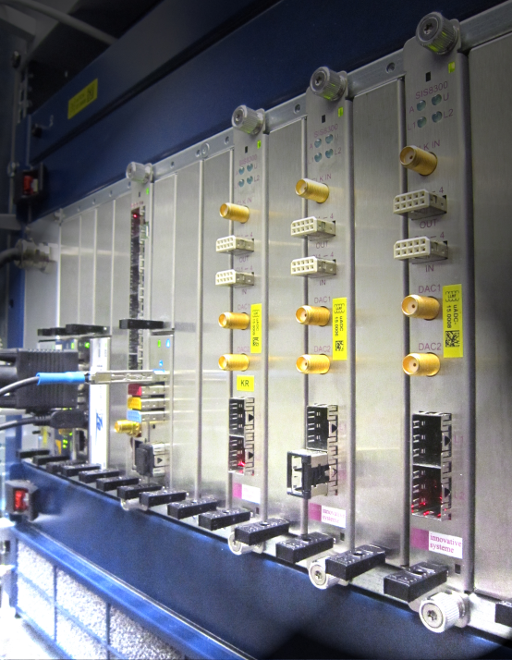
Status of the ''MTCA.4 for Industry"
Helmholtz Validation Fund
and workshop organization
Dr. Holger Schlarb
MSK, DESY
DESY, 11.12.2013

Slide 2
History of MicroTCA@DESY
2
Nov. 2005: Reliability Workshop in Grömitz, Germany
  Joint meeting with ILC (intern. linear collider, 33km, 500GeV)
Dec. 2007: XFEL Crate-Standard Workshop
  MicroTCA and ATCA was defined to be used
Mar. 2009: First PICMG Meeting “xTCA for Physics”
  Hardware group: rear I/O and timing
  Software group: standardization of interfaces for FPGAs…OPsys
Oct. 2011: Official announcement of PICMG Specification
  “MTCA.4 Enhancements for Rear I/O and Precision Timing“
Jul. 2012: Start of Helmholtz Validation Fund
  „MicroTCA.4 for Industry“
Notes:
Before you start editing the slides of your talk change to the Master Slide view:
Menu button “View”, Master, Slide Master:
Edit the following 2 items in the 1st slide:
1) 1st row in the violet header:
Delete the existent text and write the title of your talk into this text field
2) The 2 rows in the footer area: Delete the text and write the information
regarding your talk (same as on the Title Slide) into this text field.
If you want to use more partner logos position them left
beside the DESY logo in the footer area
Close Master View

Slide 3
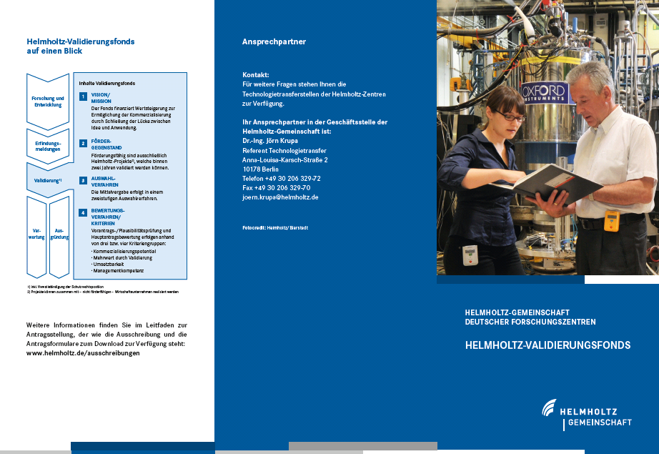
Helmholtz association (HGF) validation-fond (HVF)
3
What is the HGF validation fond?
Finance instrument to support the spin-off and technology transfer from scientific, technical inventions or developments from HGF centers to the industry and society
Validation: increase of value (material/immaterial) with direct application to society / industry
Ideally: generate commercial product
Boundaries:
Duration max. 2 years
Funding max. 2 M€/a (50% by HGF)
Screening of DESY (2011):
“MTCA.4 ….” good candidate
Notes:
Before you start editing the slides of your talk change to the Master Slide view:
Menu button “View”, Master, Slide Master:
Edit the following 2 items in the 1st slide:
1) 1st row in the violet header:
Delete the existent text and write the title of your talk into this text field
2) The 2 rows in the footer area: Delete the text and write the information
regarding your talk (same as on the Title Slide) into this text field.
If you want to use more partner logos position them left
beside the DESY logo in the footer area
Close Master View

Slide 4













Helmholtz validation-fund (HVF)
4
Board developed for X-FEL/FLASH
… 2012 substantial investment to develop platform and various modules:
AMCs
RTMs
Industry
DAMC02
X1TIMER
X2TIMER
uTC-V5
uTC-K7
DS800
…
RTM test boards
MPS signal adapter
AD-DA-converter
Coupler interlock
Beam loss monitor
Toroid readout
Wire scanner
…
uDWC
APD stretcher
BPM
uDWC-VM
uVM
uLOG (eRTM)
Adapters uRFB
…
Crates
PS-1138/…
PM Wiener
SIS8300/8900
AM900
uLOG (RTM)
ADQxxx
MCH
TAMC900
ADIO24
…
RTM backplane (precision analog, here RF/Clk distribution)
Many of the module being design within collaboration
…
Jan 2012: Pre-proposal
Apr 2012: Proposal (~ 20 sub-packages)
Jun 2012: Approved full funding received 4 M€
Jul. 2012: Project start
Notes:
Before you start editing the slides of your talk change to the Master Slide view:
Menu button “View”, Master, Slide Master:
Edit the following 2 items in the 1st slide:
1) 1st row in the violet header:
Delete the existent text and write the title of your talk into this text field
2) The 2 rows in the footer area: Delete the text and write the information
regarding your talk (same as on the Title Slide) into this text field.
If you want to use more partner logos position them left
beside the DESY logo in the footer area
Close Master View

Slide 5
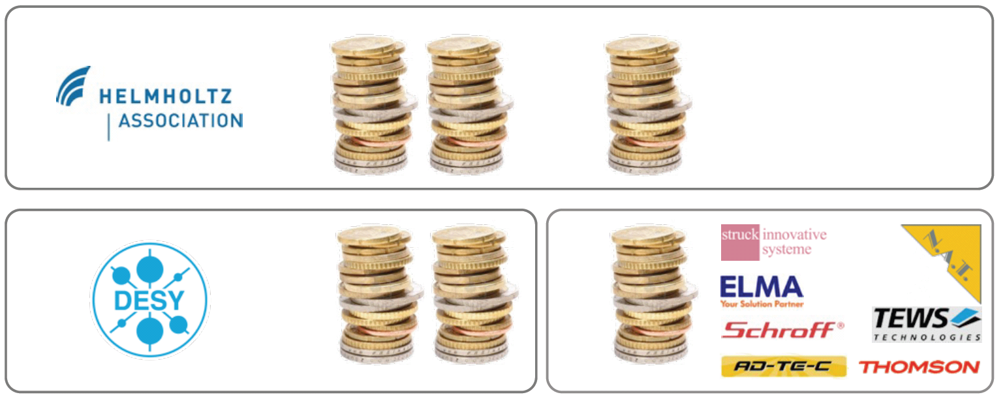

Helmholtz validation-fund (HVF) “MTCA for Industry”
5
Main objectives of project:
Establish MTCA.4 electron crate system
  In accelerator community
  Industrial branches
  Scientific community
by reducing the market entry barriers and foster MTCA.4 to industry
Business model:
  Marketing for the RF controls modules via Company using DESY License
Funding distribution:
4 Mio€
50%
30%
20%
Notes:
Before you start editing the slides of your talk change to the Master Slide view:
Menu button “View”, Master, Slide Master:
Edit the following 2 items in the 1st slide:
1) 1st row in the violet header:
Delete the existent text and write the title of your talk into this text field
2) The 2 rows in the footer area: Delete the text and write the information
regarding your talk (same as on the Title Slide) into this text field.
If you want to use more partner logos position them left
beside the DESY logo in the footer area
Close Master View

Slide 6
















Consortion is steadly growing …
6
Status 29. October 2013
  Cooperation partners
Original HVF Consortium (7):
New Partners (5):
Negotiation phase(5):

Slide 7
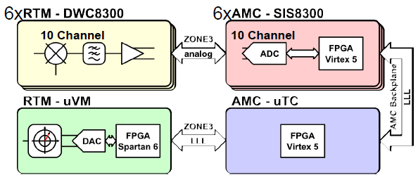
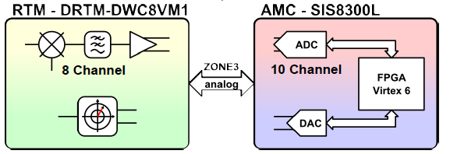
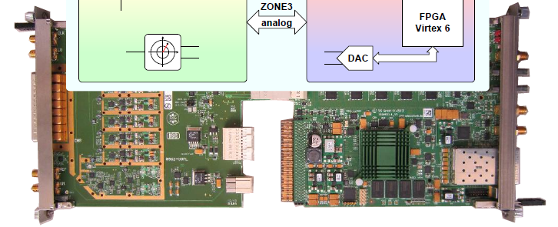
Helmholtz validation-fund (HVF)
AP1: RF control system in MTCA.4
AP1.1 Revision of existing modules
    AP 1.1.1 Field Detection (uDWC)
    AP 1.1.2 Controller (uTC)
    AP 1.1.3 RF driver unit (uVM)
    AP 1.1.4 Local RF-Generation (uLOG)
AP1.2 Cost opt. for Single Cavities Applications
    AP 1.2.1 Field detector with RF driver (uDWC-VM)
    AP 1.2.2 High-end Digitizer (DAQ-LNC)
AP1.3 Extending Portfolio in Frequency
    AP 1.3.1 Field detector with RF driver (uVM, 0.35-6GHz)
    AP 1.3.2 Local RF-Generation (uLOG, 0.35-6GHz)
    AP 1.3.3 RTM with local clock circuit (uCLK-RTM, 10–350MHz)
    AP 1.3.4 Global clock generation (uCLK-eRTM, 10-350MHz)
    AP 2.2.8 Backplane Development for 10 Gbit/sec Transfer Speed
AP1.4 Supplementary systems for RF control
    AP 1.4.1 Multi-channel Direct RF-sampling (uDS800)
    AP 1.4.2 AMC carrier with motor/RTM with Piezo driver (uFMC20)
AP1.5 Introduction of RTM-RF Backplane
AP 1.5.1 Development of RTM-RF Backplane concept
AP 1.5.2 Crate integrated RF source (uOSC_eRTM)
32 cavities
~mdeg precision
Due to modularity only moderate effort required to develop
RF controls for
- 1/2/4/.. Cavities
- NRF/SRF
- 10-6000 MHz
- valuable add on’s
Notes:
Ribosom

Slide 8
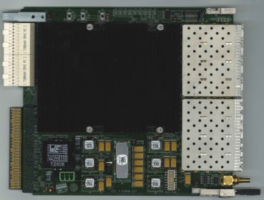
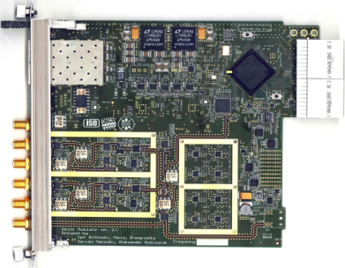
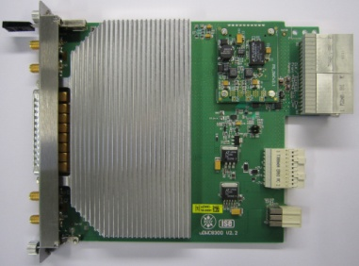
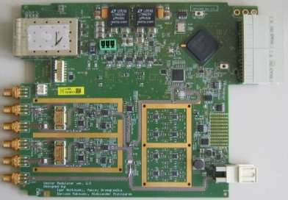
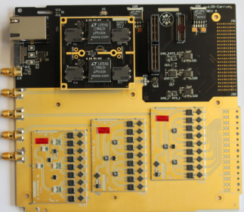
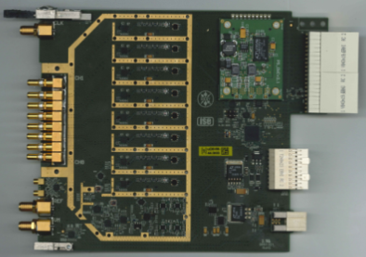

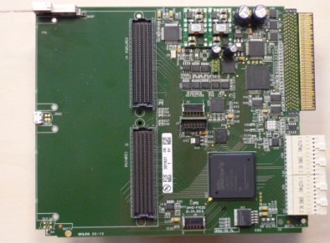
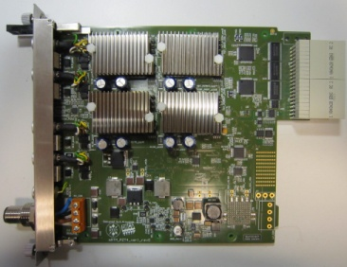
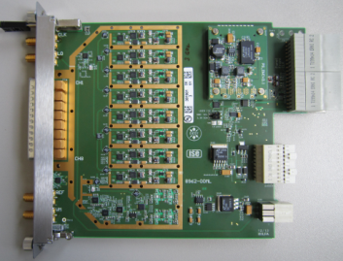
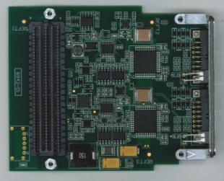
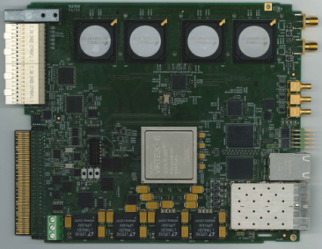
Helmholtz validation-fund (HVF)
8
Board developed for licensing …
DRTM-DWC10
DAMC-TCK7
DRTM-VM2HF
eRTM-LOG1300
DRTM-VM2LF
DRTM-VM2LF
DRTM-DS8VM1
DAMC-FMC20
DRTM-PZ4
DRTM-DWC8VM1
Together 27 hardware projects,
~ 16 developed by DESY
~ 6 developed by Industry,
~ 5 joint effort DESY & Industry
…
DFMC-MD22
DAMC-DS800

Slide 9
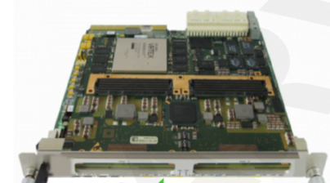


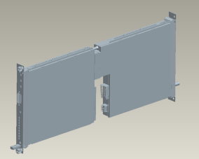



Helmholtz validation-fund (HVF)
9
AP2: Completion of MTCA.4 for industry and institutions
  Extension of product portfolio for MTCA.4
    Industrial production of timing module
    2 GSPS, 4 channel , 12bit ADCs on RTM & AMC
    32 ch., 40MSPS, AMC-RTM with analog shaping capability
    Management low noise power supplies
  EMI optimization and classification of MTCA.4 components
    EMI test board development
    EMI current distribution in MTCA.4 crate
    Optimization of crate-contact transitions
    Shields for AMC/RTM boards
    EMI Bypass-concept
    Vibration studies and vibration reduction
    EMI classification of AMC and RTM boards commercially available
    AMC Backplane/connector/board development towards 10Gbit/sec
  Application of MTCA.4 in industry
    Integrated klystron life-time and LLRF system
  Evaluation of MTCA.4 market
    Market evaluation for industry
    Market evaluation for institutes
    Optional industry order after evaluation
  Integral test of MTCA.4 in large facility, availability, failure analysis
    Inter-compatibility of boards/sub-systems, radiation, remote controllability
T. Owczarek
→ 4x25 Gbps
Notes:
Before you start editing the slides of your talk change to the Master Slide view:
Menu button “View”, Master, Slide Master:
Edit the following 2 items in the 1st slide:
1) 1st row in the violet header:
Delete the existent text and write the title of your talk into this text field
2) The 2 rows in the footer area: Delete the text and write the information
regarding your talk (same as on the Title Slide) into this text field.
If you want to use more partner logos position them left
beside the DESY logo in the footer area
Close Master View

Slide 10
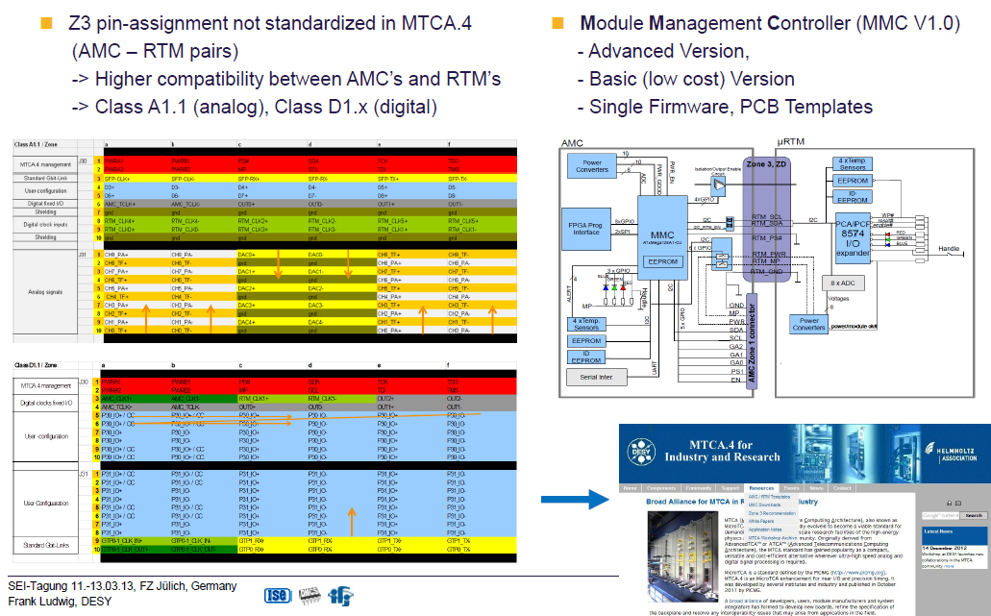
ZONE 3 class recommendation / MMC
10
F. Ludwig
M. Fenner
Notes:
Before you start editing the slides of your talk change to the Master Slide view:
Menu button “View”, Master, Slide Master:
Edit the following 2 items in the 1st slide:
1) 1st row in the violet header:
Delete the existent text and write the title of your talk into this text field
2) The 2 rows in the footer area: Delete the text and write the information
regarding your talk (same as on the Title Slide) into this text field.
If you want to use more partner logos position them left
beside the DESY logo in the footer area
Close Master View

Slide 11
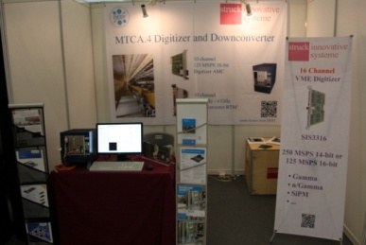
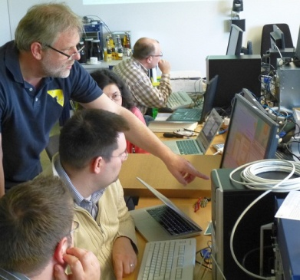
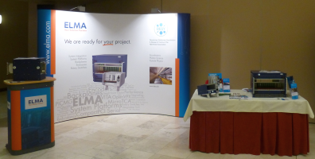
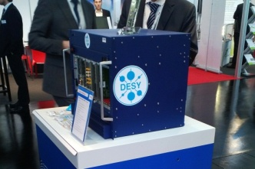
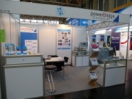
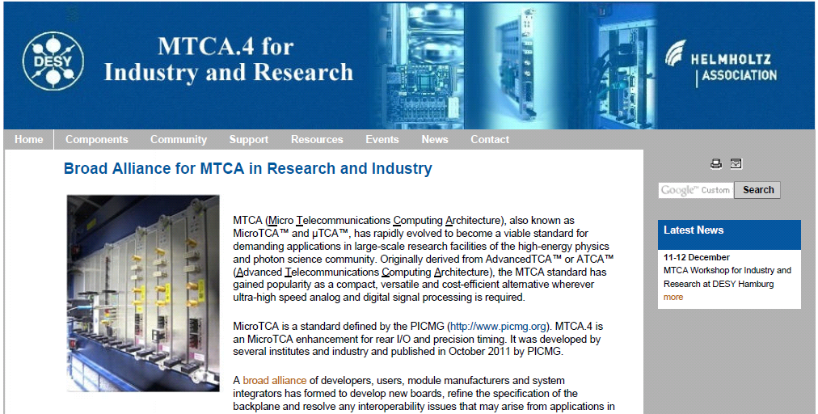
Helmholtz validation-fund (HVF)
11
AP3: Support and consulting for industry and institutions
  MTCA.4 support and consulting
    FAQ
    Hotline
    1 FTE for direct support → webpage!
    Tutorial, every 1 month “hands on”
    6 in 2013
    18 in 2014 (6 advanced)
  MTCA.4 users guide
    Book published by DESY/NAT
  Products marketing & information
  2 → 3 MTCA.4 workshops (9-11.12.2014)
  Special task forces
  Marketing on industrial exhibitions
  28 (+11) in 2013
  30 (+10) in 2014 planned
  Webpage
MTCA Tutorials at DESY (05/2013)
IPAC 2013 Shanghai
Embeddedworld 2013
Nürnberg
TWEPP 2013 Perugia
European Microwave
Week2013
Webpage URL http://mtca.desy.de/
Notes:
Before you start editing the slides of your talk change to the Master Slide view:
Menu button “View”, Master, Slide Master:
Edit the following 2 items in the 1st slide:
1) 1st row in the violet header:
Delete the existent text and write the title of your talk into this text field
2) The 2 rows in the footer area: Delete the text and write the information
regarding your talk (same as on the Title Slide) into this text field.
If you want to use more partner logos position them left
beside the DESY logo in the footer area
Close Master View

Slide 12
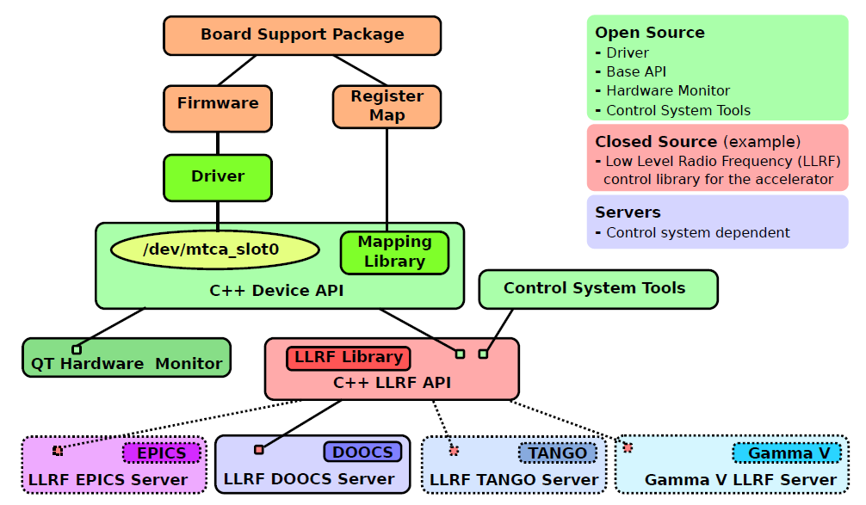


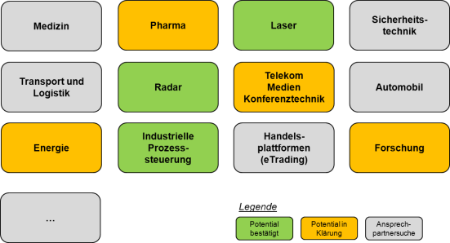
Helmholtz validation-fund (HVF)
12
What comes next…
Focus for 2014:
Interoperability issues to be solved!
  AIW25 will be at DESY @ Apr 2014
  AIW26 like at Vadatech @ Oct 2014
Focus on firmware/ software “easy to integrate”
Marketing:
  Science: change focus towards new fields
    Instrumentation/Laser/Radar/Astrophysics/Plasma/….
  Industry: to be continued…
    Industrial processing
  Start program to approach Technical Universities
HGF Accelerator & Research Program (ARD) 2015-2019
  Tech. Transfer of MTCA.4 to HGF centers (HZB/HZDR/KIT/GSI/HZJ/DESY)
MTCA4U, M. Killenberg
Market study by DESY, T. Walter

Slide 13
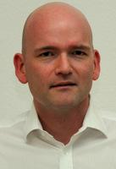
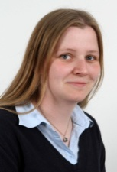
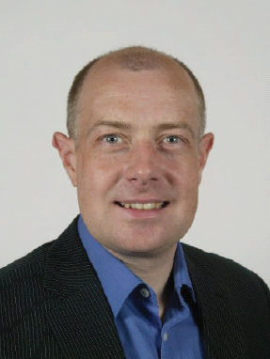
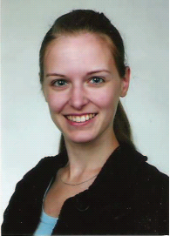
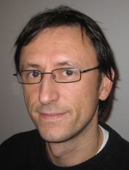
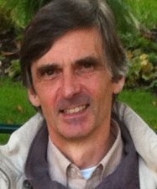
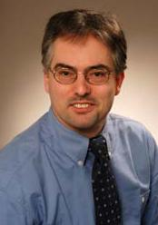

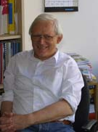
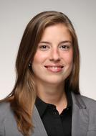
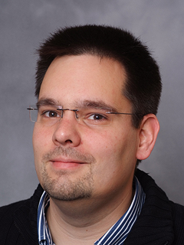

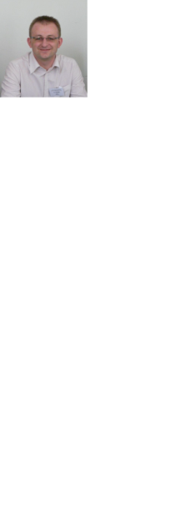







Personal…/ faces … / HVF team…
13
Since spring/summer 2013
Management
Contracts
Software
Tech. Marketing
Thomas Walter
Ilka Mahns
Martin Killenberg
Annika Rosner
Old faces…
Event/Markt.
Development
.
Developers
Katharina Fein
Michael Fenner

Slide 14
14
Workshop organization
Notes:
Before you start editing the slides of your talk change to the Master Slide view:
Menu button “View”, Master, Slide Master:
Edit the following 2 items in the 1st slide:
1) 1st row in the violet header:
Delete the existent text and write the title of your talk into this text field
2) The 2 rows in the footer area: Delete the text and write the information
regarding your talk (same as on the Title Slide) into this text field.
If you want to use more partner logos position them left
beside the DESY logo in the footer area
Close Master View

Slide 15
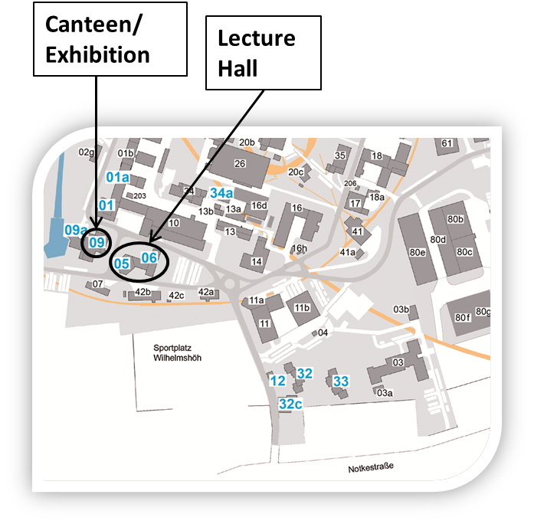
General information
15
Lunch
Lunch tickets valid until 10 €
DESY canteen building 9, opposite of lecture hall
Dinner
Wednesday, November 11th at 20:00
During exhibition in building 9
end 22:00

Slide 16
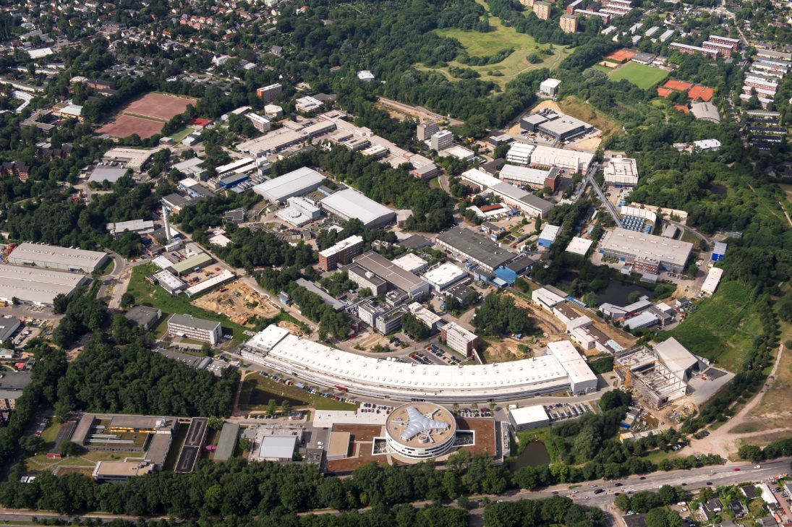
General information
16
DESY tour
Meeting point ➔ in front of the registration desk
Please be on time!
Canteen closes at 14:00 ➔ lunch in cafeteria possible (also building 9)

Slide 17
General information
17
Group photo
Wednesday, November 11th at 13:10
Meeting point (depending on weather) in the lecture hall or in front of building 5
WLAN
name ”MTCA-Workshop”
Password bFtL9hXb
Please note: the workshop will be audio and video recorded for live streaming. The talks will be stored and published after the workshop.

Slide 18
18
Wish you an informative
and pleasant
2nd MTCA Workshop
Thanks for attention
Notes:
Before you start editing the slides of your talk change to the Master Slide view:
Menu button “View”, Master, Slide Master:
Edit the following 2 items in the 1st slide:
1) 1st row in the violet header:
Delete the existent text and write the title of your talk into this text field
2) The 2 rows in the footer area: Delete the text and write the information
regarding your talk (same as on the Title Slide) into this text field.
If you want to use more partner logos position them left
beside the DESY logo in the footer area
Close Master View

