Slide 1



Low-Latency 1D Image Detector
Realized as an AMC Module
A teamwork of:
Aleksander Mielczarek
Grzegorz Jabłoński
Dariusz Makowski
Piotr Perek
Bernd Steffen
Christopher Gerth
Lodz University of Technology
Department of Microelectronics
and Computer Science

Slide 2
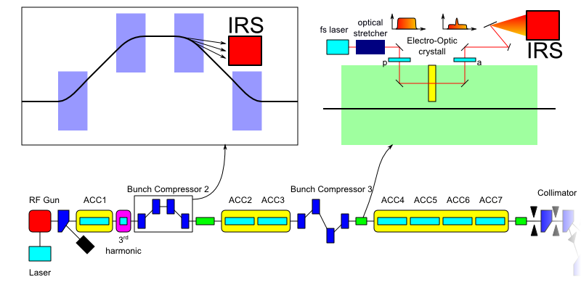
1D Image Detector
Usage Scenarios
2

Slide 3
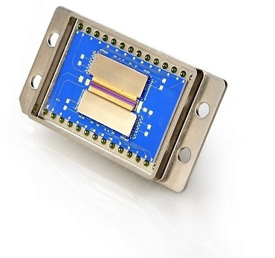
1D Image Detector
Requirements
Operation in MicroTCA crate
1 MHz full-line readout
About 256 pixels
Si and InGaAs photodiode arrays
Example commercial solution:
256 pixels
Serial analogue readout over 2 lines
1 MHz readout clock
128 times slower than required!
3

Slide 4
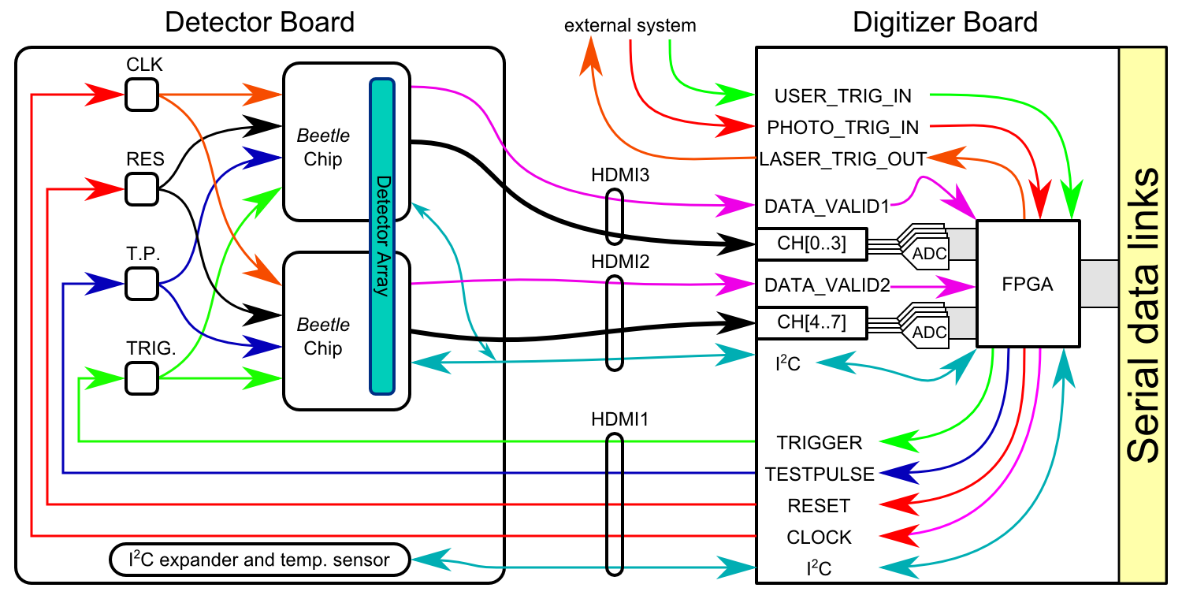
1D Image Detector
System Structure
4

Slide 5
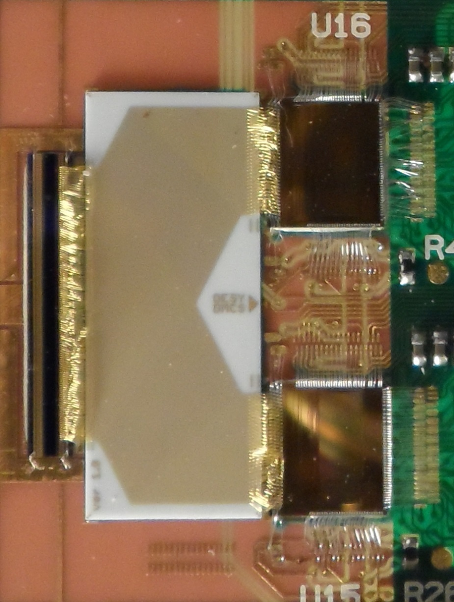
1D Image Detector
Dedicated Sensor Solution
Photodiode Array:
Photodiode size: 50 x 500 μm
Organization: 1 x 256 pixels
Material: InGaAs, ~1300 nm
Readout circuit:
Beetle chip (designed for LHCb)
128 charge sensitive channels
Up to 1.1 MHz full readout rate
Four-port analogue readout
Analogue pipeline
5

Slide 6
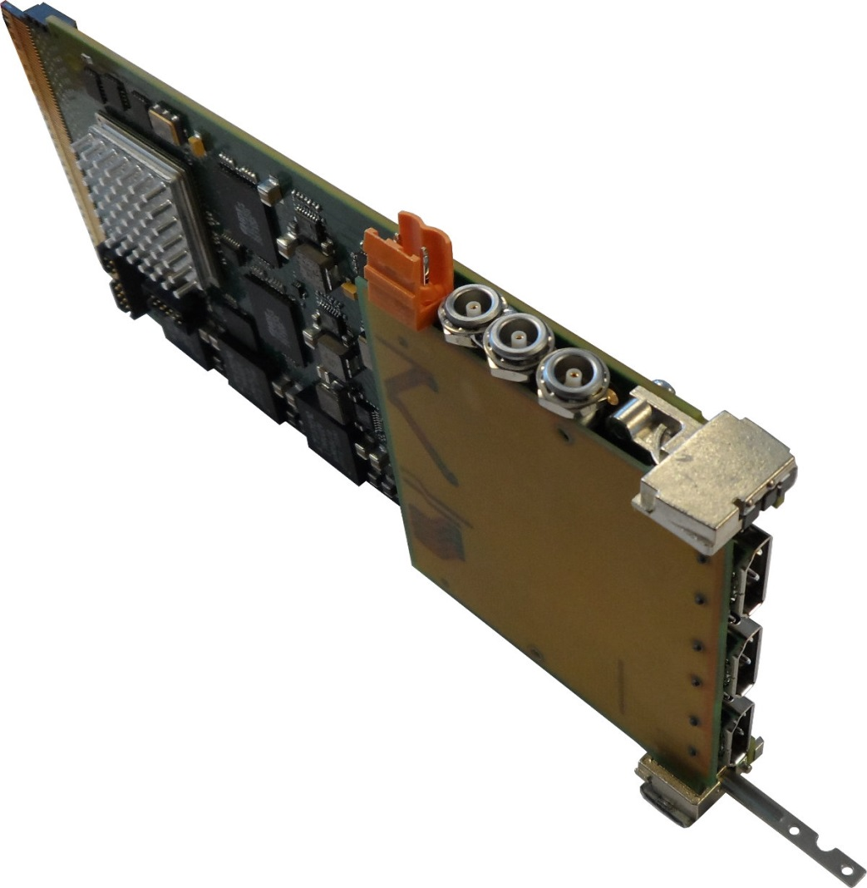
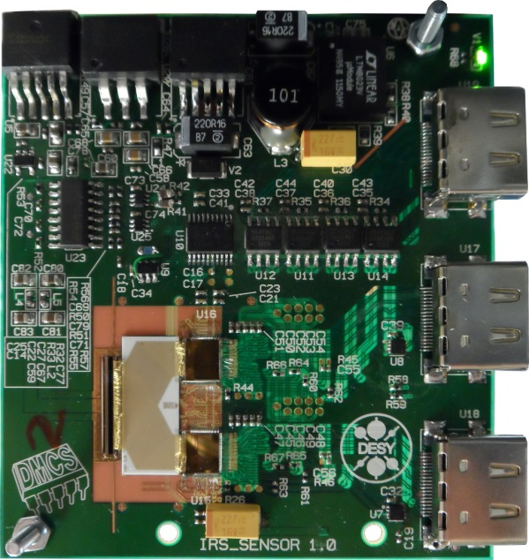
1D Image Detector
Hardware Design
Ooops!
6

Slide 7
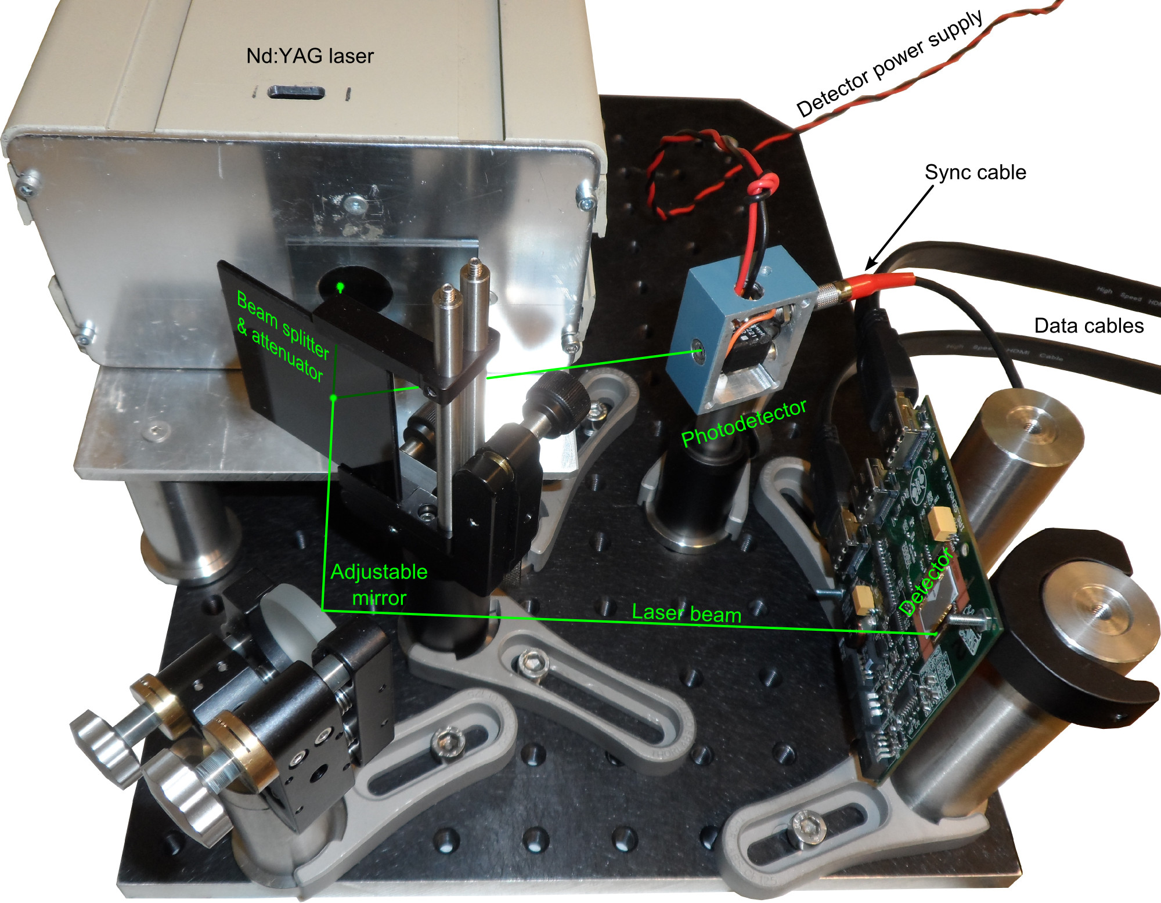
1D Image Detector
DAQ Module + Signal Conditioning
7

Slide 8
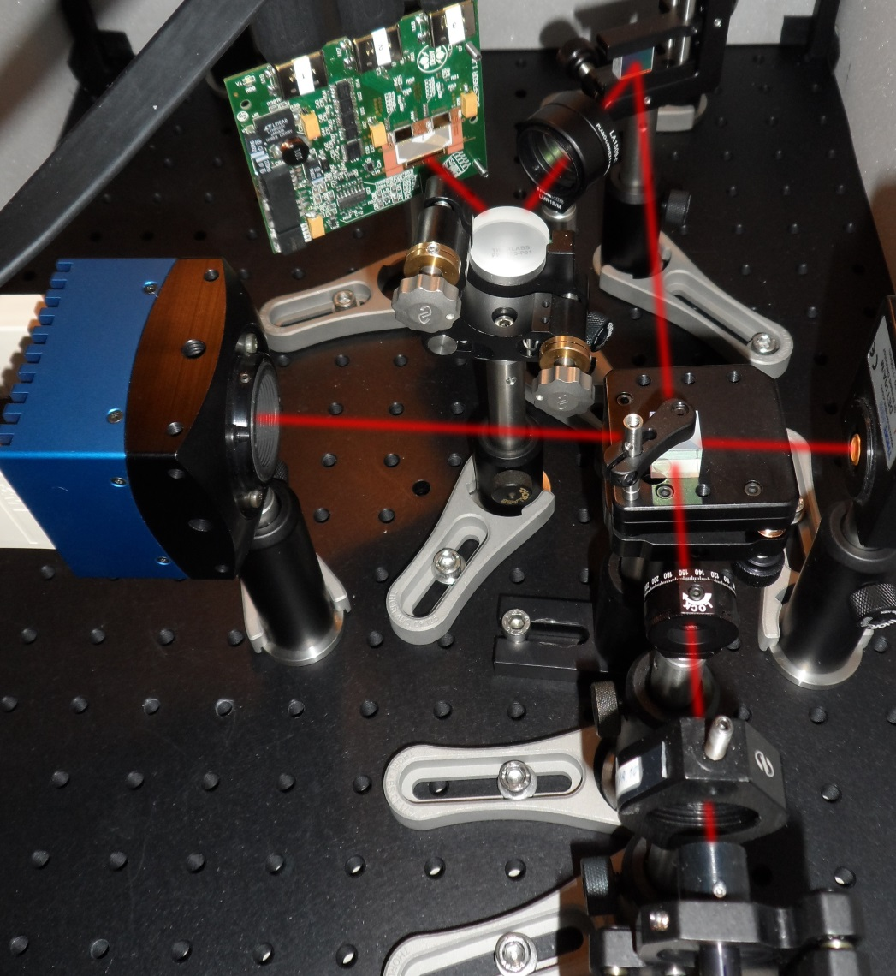
1D Image Detector
Spectrometer Setup
Synchronous operation
Diffraction grating
Spectrum analysis
Verified with commercial wavelength analyzer
8

Slide 9
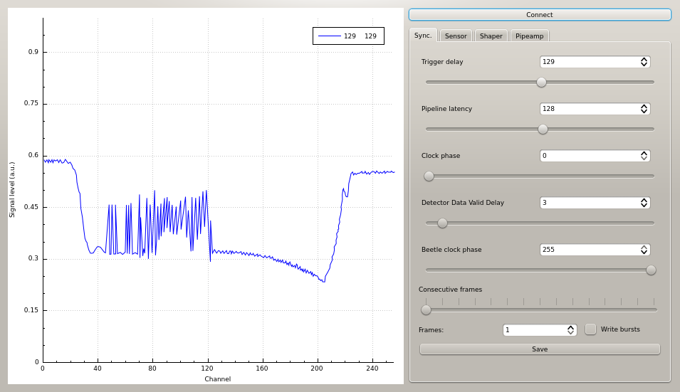
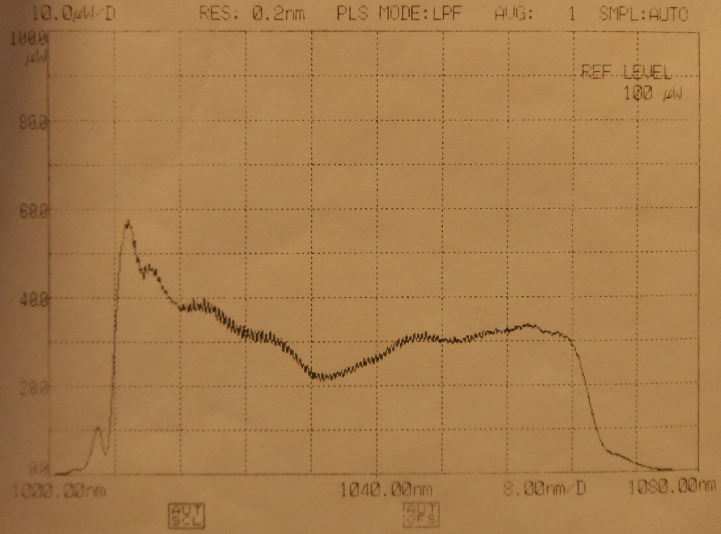
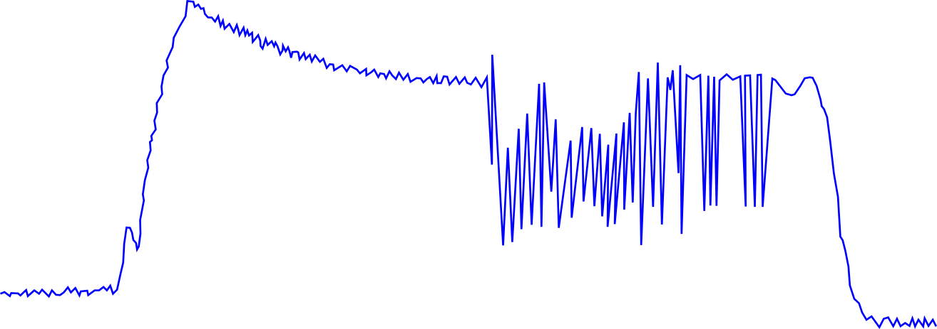
1D Image Detector
Preliminary results
Smashed bonding
9
Notes:
Basically, it works
Many benefits of AMC/FMC compliance: scalability, performance, RAMI
Some drawbacks, but the module is still very useful

Slide 10
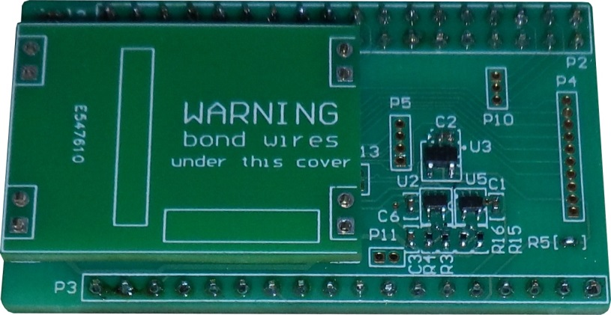
1D Image Detector
Summary
Fast 1D detector (1 MHz full-line readout )
Capable of working with femtosecond light pulses
Can be used as part of the spectrometer
Remember to protect your bond wires
10
Notes:
Basically, it works
Many benefits of AMC/FMC compliance: scalability, performance, RAMI
Some drawbacks, but the module is still very useful

Slide 11
1D Image Detector
Thank You for Your Attention
Your questions are welcome
11

