Slide 1
Kontron High Performance Products for Research & Science
Business Development
Andreas Geisler
December 2013

Slide 2
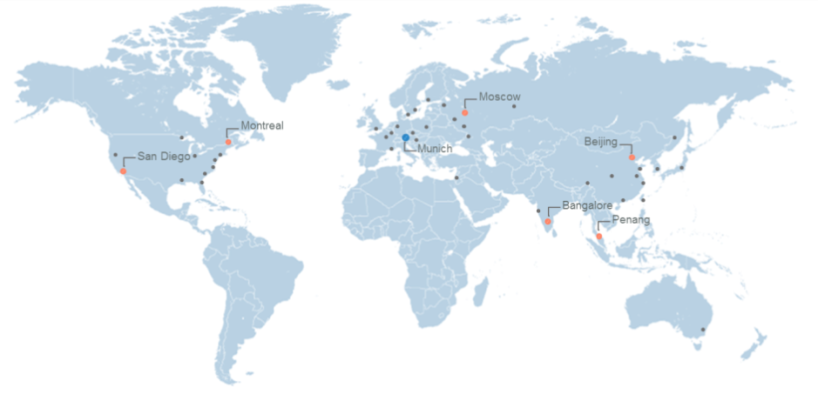
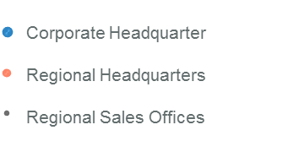
Kontron – We Are Where You Are Design, configuration and system integration in all major regions
Revenue 547 mio. € (2012)
Employee size 2,208 (Dec. 31, 2012)
Represented in 56 different countries worldwide with
- More than 50 sales offices
- More than 140 sales partners

Slide 3
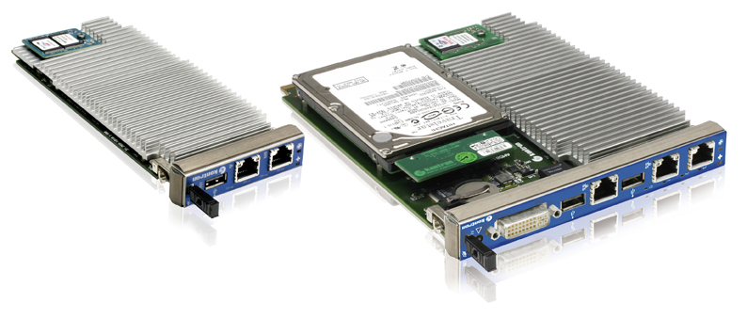
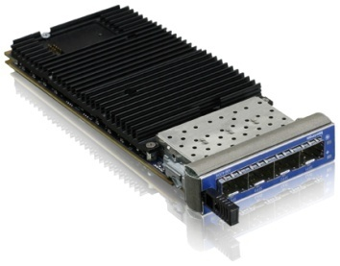
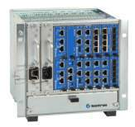
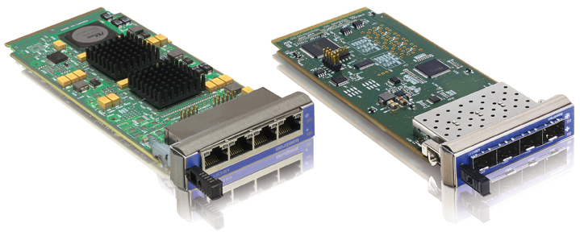
AMC/MicroTCA Portfolio
Processor AMC
MCH
Packet Processor AMC
System
I/O AMC

Slide 4
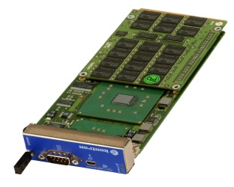
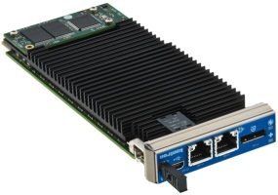
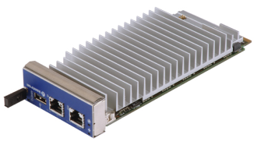
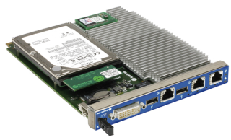
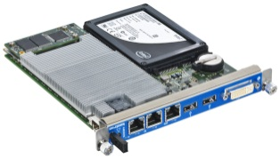
Kontron‘s expertice and continuity
AM4001/2
Pentium M
AM4010
Core2 Duo
AM4020
Core i7
AM4022
Core i7 3rd Gen
AM4024
NextGen x86
AM5010
Core2Duo
AM5020
Core i7
AM5022
Core i7 3rd Gen
2006
2008
2010
2012
2014
Kontron as reliable partner – ensuring customer’s application lifecycle
Notes:
Take this template as a base for your individual roadmap and adopt for each family the categories at the left side of the diagram

Slide 5
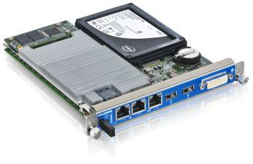
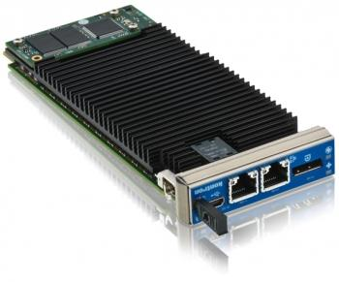
Kontron preferred AMC form factors
From Single Mid-Size to Double Mid-Size
Basic form factor for new CPU Designs Single Mid-Size
Mid-
Size
Single
Mid-Size
Double
Single
Double
Mid-Size

Slide 6
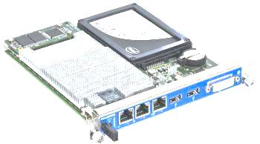
Kontron preferred AMC form factors
Proven design based on building blocks
Accelerated development phase
Perfect platform for custom designs
SSD Raid, 10GbE, PCIe Endpoint,…

Slide 7
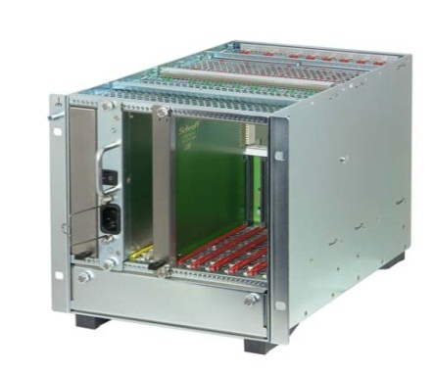
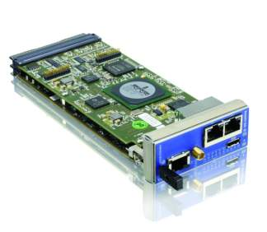
MicroTCA.4 – Kontron‘s offering
CPU
MCH
Chassis
System
Integration
DESY MicroTCA Workshop

Slide 8
Customer Services
Technical Support
Free of charge during Design-In Phase
Defined Response Times & Escalation
Direct Access to Engineering if needed
Training & Consulting
Provided by tech support specialists
Web based or on site
Tailored to your needs
System Integration
Development & Manufacturing
Include 3rd Party Products
Full Custom Designs
Board & System Level
Tailor Made to your Specification
Repair
RMA process w/ defined turn around times
Advanced Shipment Buffers
Priority Repair
Longevity of Supply & Repair
EOL components Inventory
Monitor remaining BOM
Maintain Production & Test Tools
Revision Control
Product Freeze
Change Notification & Authorization
Extended Supply Chain
Vendor Managed Inventory
DESY MicroTCA Workshop

Slide 9
Thank you for your attention
Contact:
Business Development Industrial Automation
Andreas Geisler
andreas.geisler@kontron.com
+49 (0)8341 803 425

