Slide 1
Real-time performance issues in linux / microTCA
Rev.2 2013_1209
Kukhee Kim for microTCA support team in SLAC SLAC National Accelerator Laboratory Dec 12, 2013

Slide 2
Abstract
The microTCA platform has been selected for usage as the base platform for SLAC control systems for future designs and upgrades - along with embedded linux as the software platform. We have evaluated the microTCA and linux platform for usage in our timing, low-level RF, and BPM systems. We have found that the new platform brings challenges in interrupt handling, and scatter DMA.
Despite migration of much of the hard real-time functionality to the FPGA firmware level, the interrupt handling and its real-time performance are important factors for our control system as the software layer needs to deterministically process time critical functions driven by each interrupt. Linux has a long processing chain for the interrupt from the kernel to user space driver, and it also provides various methods of providing the interrupt notice to the user driver: signal and ioctl() with device file. Each method provides different performance. We are going to describe our experience for interrupt handling with regard to real-time performance.
In some cases DMA is also needed for applications which use fast digitizers. We have used traditional DMA for the real-time world previously, because most real-time OS(s) are based on a flat memory model. However, for linux based systems, it is not a flat memory model and we are not so lucky. We intend to use a scatter DMA engine for achieving real-time performance under linux. We have chosen the SIS8300 module from Struck for our low-level RF system and BPMs. The firmware from Struck did not support the scatter DMA, thus we had to allocate linear memory space in the kernel space for the DMA, and needed to implement a bounce buffer to copy the DMA data to the user space. This led to a lag in real-time performance. Thus, we had to implement a scatter DMA technique to avoid the bounce buffer and to allocate the DMA buffer directly into the user space. During the firmware upgrade, we learned that the following steps: configuring the DMA engine, re-arming the DMA and waiting for interrupt should be an atomic operation.
In this presentation we are going to discuss the details of our software experience with interrupt handling, and scatter DMA using the microTCA and linux platform.

Slide 3
Contents
Software Environment Change: RTOS vs. Linux
Priority Scheduling vs. Round Robin
Signal & interrupt Handling
Event System
Asynchronous vs. Synchronous
DMA Issues
LLRF System
Conventional DMA vs. Scatter DMA
Interrupt loss
Conclusion

Slide 4
Software Environment Change
 | RTOS (RTEMS, VxWorks) | Linux | Supplementary Work
Scheduling | Priority Base | Round Robin | Turn on RT priority for Kernel thread and User thread which are related with real-time performance
Memory Model | Flat Memory | Virtual Address | Bounce buffer in Kernel Space or Scatter DMA
Privilege | Same Privilege for Kernel and User application | Privilege for Kernel | System call, device file
I/O access | Memory mapped I/O can be accessed by user application | Kernel module can provide, Memory mapped I/O^{(*1)} PCI special file in sysfs ^{(*2)} File read/write Ioctl() | Need kernel module, Need to use system call and device file ^{(*1)} does *not* need system call ^{(*2)} created by PCI core
Interrupt Handling | ISR can be a part of user application | ISR should be implemented in Kernel and Kernel module | Require a signal mechanism to notice to user space

Slide 5
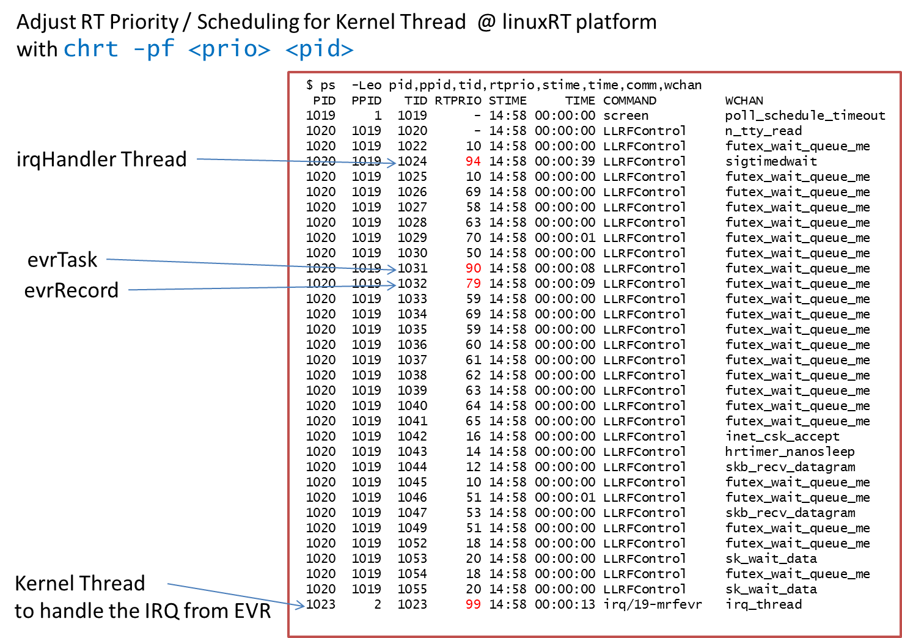
Consideration for RT performance / RT priority
Use Linux RT preemptible patch – reduce interrupt latencies while kernel functions are executing
EPICS base patch to use RT priority for application threads in the EPICS ioc (by Till Straumann)
Implement “system()” command to execute shell script to set up RT priority for kernel threads

Slide 6
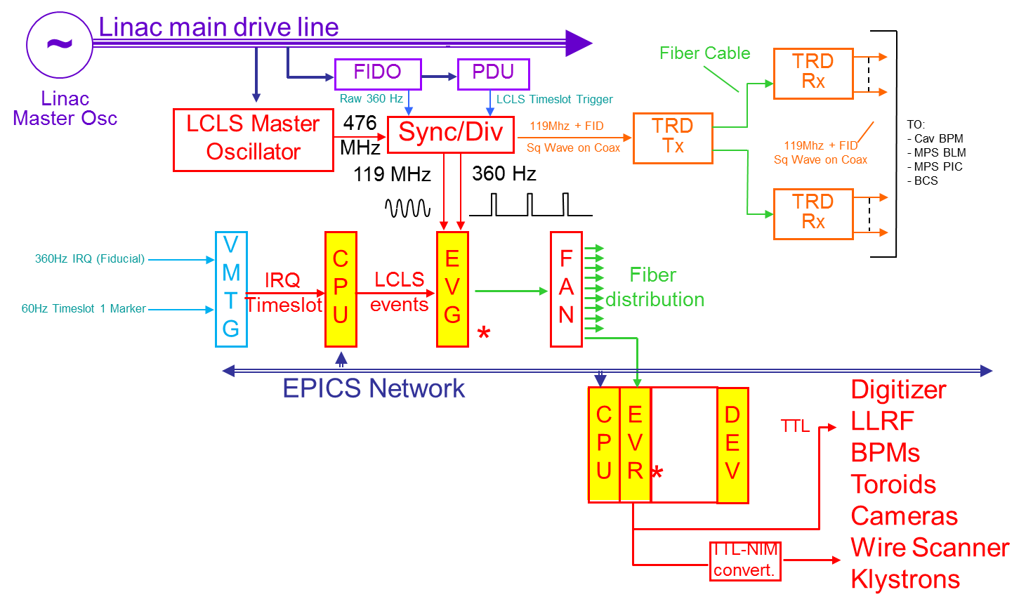
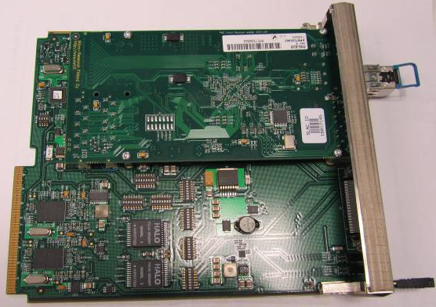
Event System for MicroTCA Platform
MRF EVR (PMC) + AMC Carrier

Slide 7
Event Receiver (EVR) and Event Module
MRF EVR hardware and Event module (software) are a common part of applications such as LLRF, BPM, and etc
EVR provides hardware triggers and also provides interrupts for software event (fiducial/events) and timing pattern (data interrupt)
Fiducial/Event interrupt
Drive software processing for the event module
Generates software event
Data interrupt
Provide 192 bits timing pattern, pulseID embedded timestamp
Essential for Beam Synchronous Acquisition (BSA) which is an entire facility wide data acquisition system
Make recognize which data is for which beam pulse

Slide 8
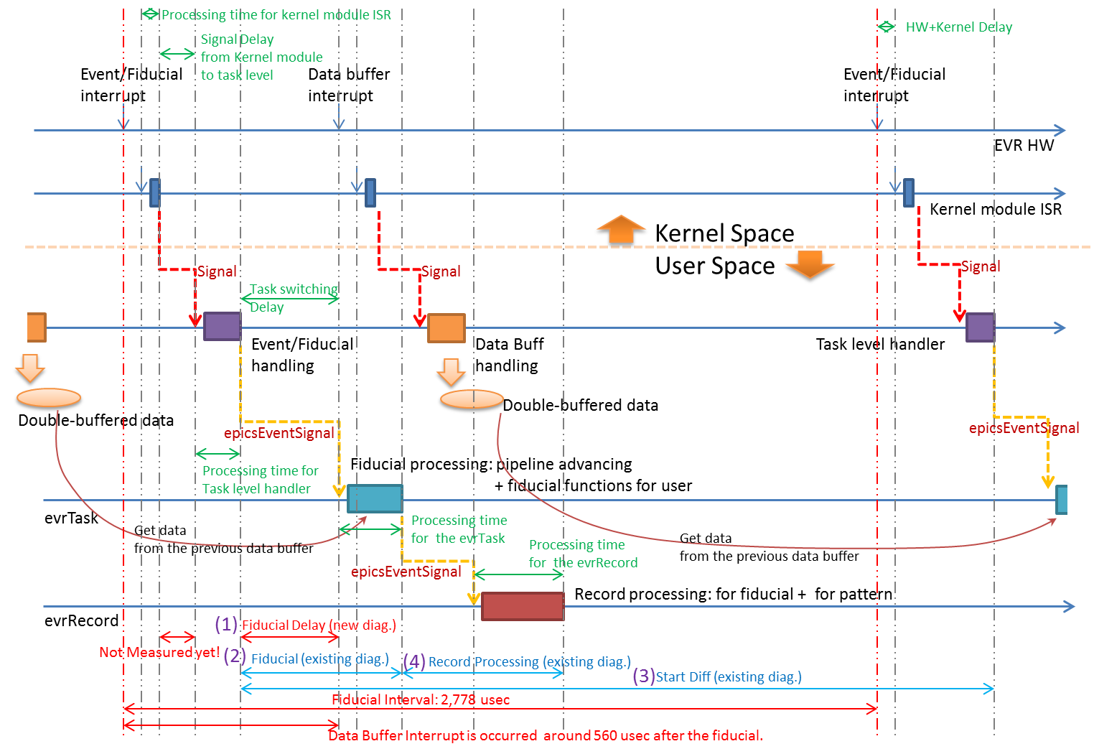
Timeline for the EVR interrupt handling

Slide 9
Interrupt Handling for EVR Signal Handling: Asynchronous vs. Synchronous
Vendor’s kernel module generates POSIX signal to notify interrupt to user space driver
User space driver in event module handles the signal with a signal handler
During 10 hours monitoring under normal CPU load (<50%)
Average interrupt delay: ~ 30 usec
Maximum jitter for interrupt: > 6 msec
RT Violation counter: > 160 times
Asynchronous signal handling
Scenario
The signal handler could be run on an arbitrary thread context
And, the context which runs the signal handler, could be preempted by higher priority thread
Improvement for the User space driver
Synchronous signal handling
Make new thread which has higher priority than other thread in the application, and waits the signal directly
Average interrupt delay: ~ 13 usec
Maximum jitter for interrupt: ~ 30 usec
RT Violation counter: 0

Slide 10
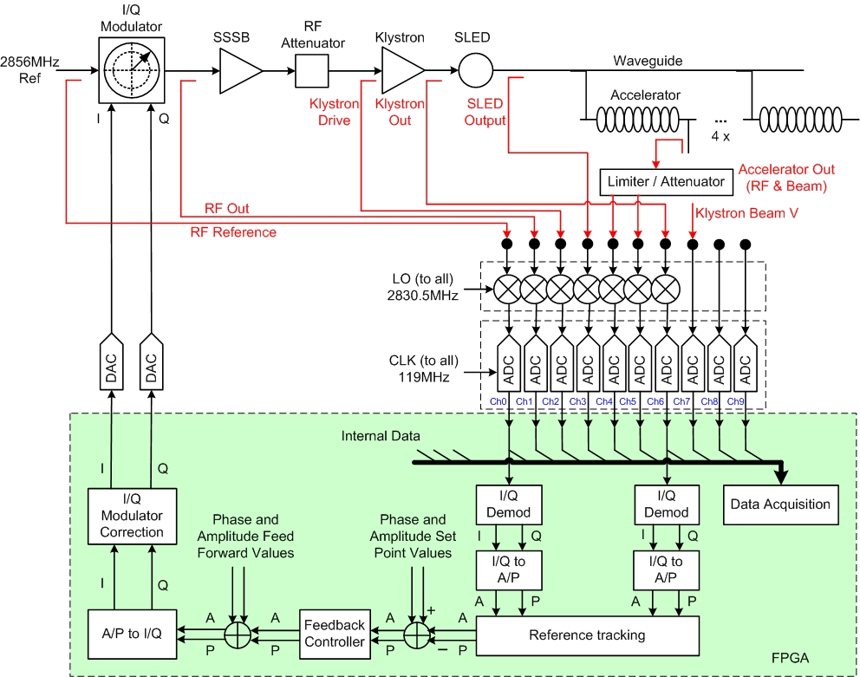
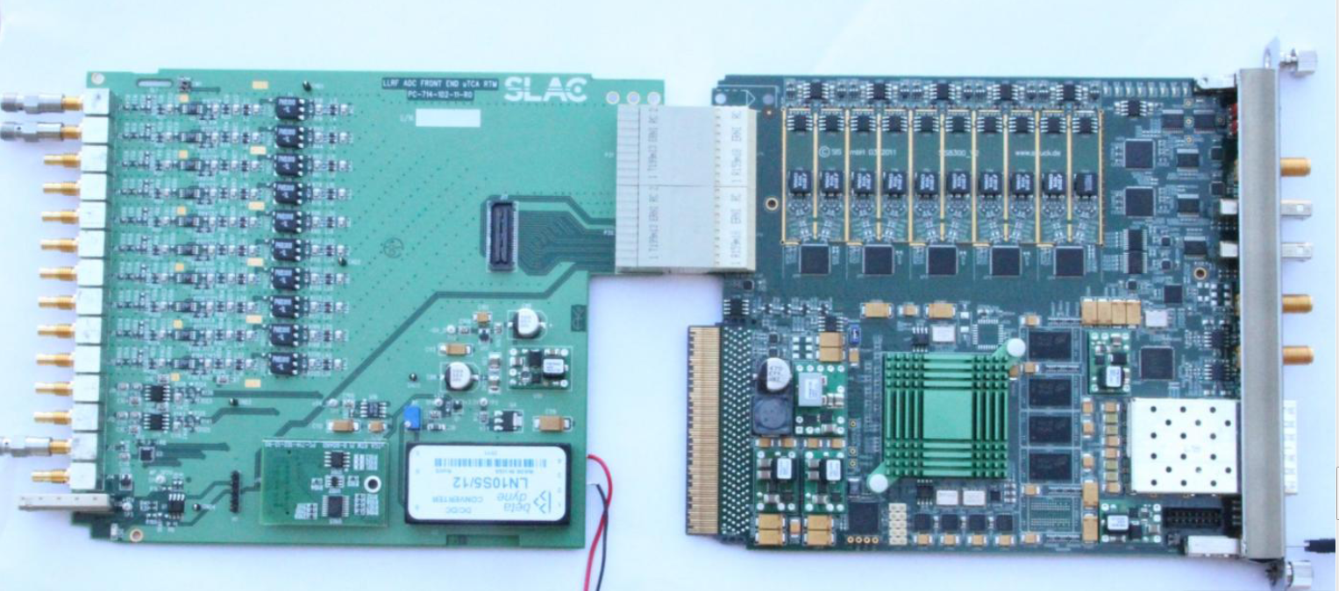
MicroTCA LLRF
SIS8300 + RF RTM

Slide 11
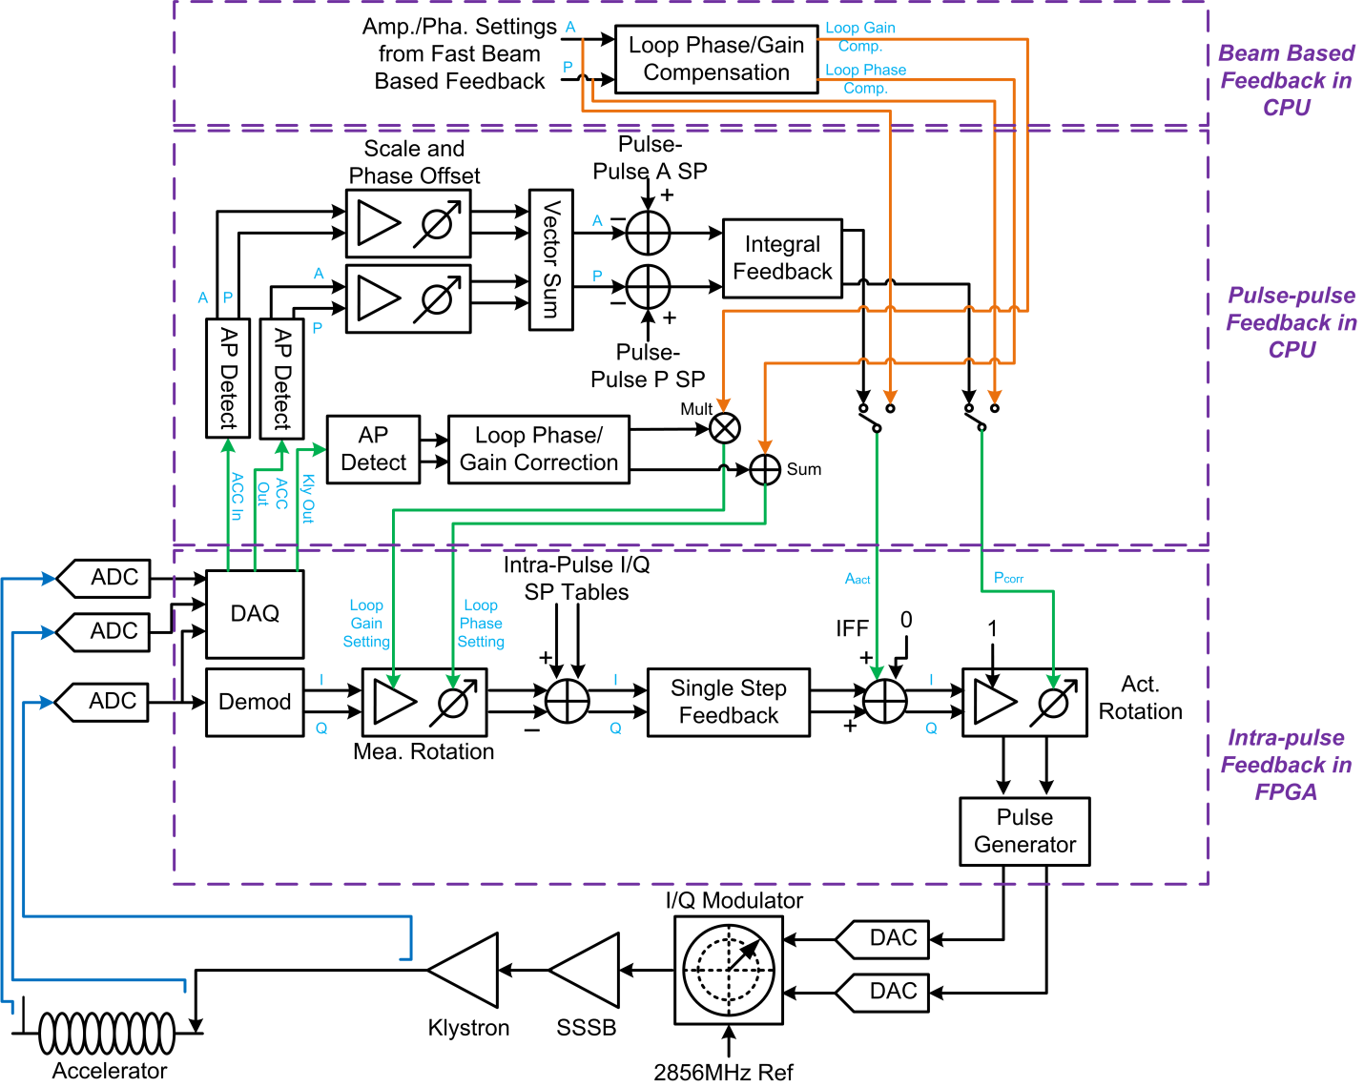
Performance Issues on LLRF application
Despite migration of much of hard real-time functionality to the FPGA firmware level, the interrupt handling and its real-time performance are still important
Intra-pulse feedback is implemented in the FPGA level (few usec response)
Pulse-Pulse feedback and Beam based feedback are implemented in software (msec response)
Performance measurement for proto-type software
According to 120Hz beam rate, maximum 8.3 msec time budget, but recommended 2.7 msec (360Hz timeslot resolution) budget to consider other software activities: communication with higher level feedback, pattern awareness operation, and etc
Already reached budget with a single module, but we are going to put multiple modules up to 8 modules in a chassis
Definitely, need to improve the performance

Slide 12
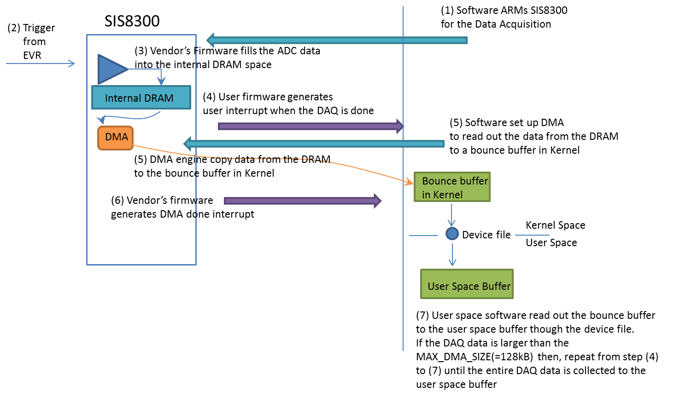
Analysis for the original implementation (SIS firmware)
Too much handshakes to complete the data transfer
Arming DAQ, DAQ done interrupt
Initiate DMA transfer for a channel, DMA done, copy bounce buffer to user space
Initiate DMA again for next channel, and so on…
Doesn’t support scatter DMA
Requires physically continuous memory
Bounce buffer in Kernel space, need to copy to user space
Too much interrupts (~1.44kHz per module)

Slide 13
Conventional DMA vs. Scatter DMA
Conventional DMA
requires physically contiguous memory
requires kernel memory such as kernel bounce buffer
memory copy to user space makes performance dragging
use mmap() to user space to reduce the performance dragging
but the kernel memory is expensive resource
DMA
Memory
Scatter DMA
Does not require contiguous memory
Does not require kernel space buffer
can make direct copy to user space memory (virtual memory)
need software effort to build scatter list
If we use pre-allocated memory buffer then, the effort for scatter list is just initial overhead
DMA
Memory

Slide 14
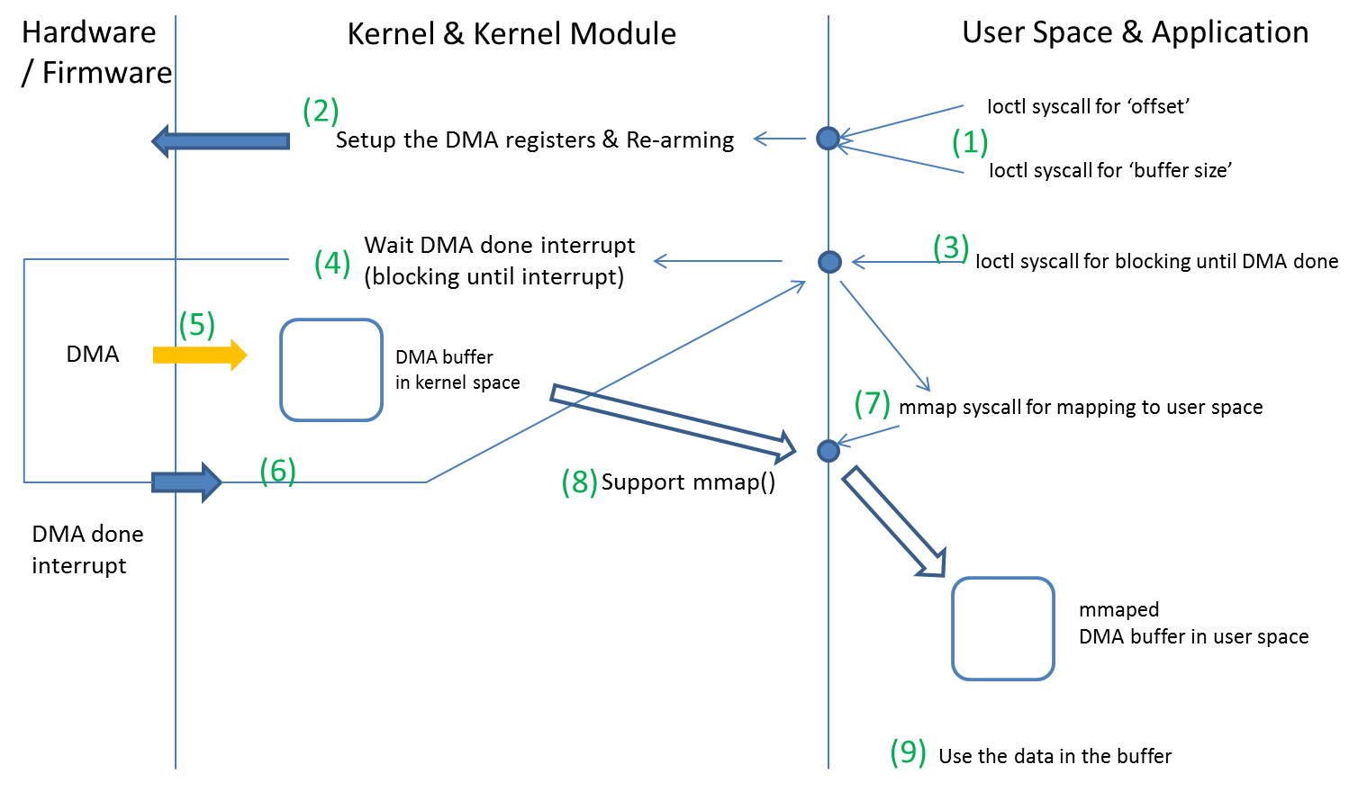
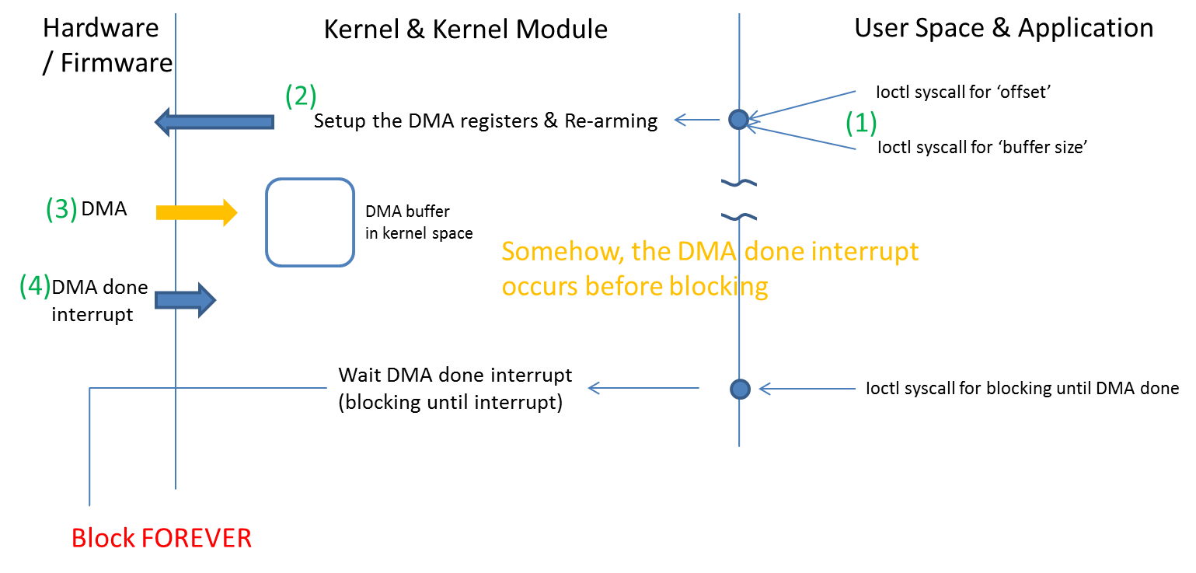
Improvements (eicSys firmware, current implementation)
Improvements
DMA initiated by DAQ done event from the base firmware instead of software
DMA transfers entire data instead of single channel
Remained issue
Still using kernel bounce buffer need to upgrade to the scatter DMA
Multiple system calls
Dragging performance
Missing interrupt (caused by non-atomic operation)
need to make single system call

Slide 15
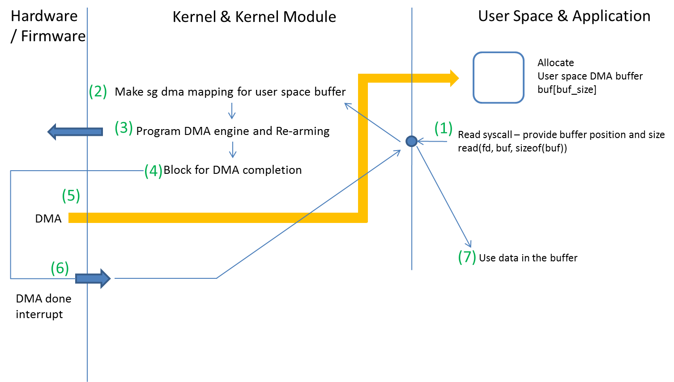
Improvement Plan (eicSys firmware)
Atomic operation required
Single system call arms DAQ and waits DMA done interrupt
To avoid interrupt loss
Reduce software work load

Slide 16
Conclusion
Compare RTOS vs. Linux
Use RT priority for kernel thread and user thread which are related with the real-time processing
Implement system escape into EPICS to adjust RT priority for kernel threads
Use Synchronous signal handling instead of Asynchronous
Implement performance measurement tool as an EPICS driver, it provides sub-micro second resolution delay measurements and statistics. It is almost non-invasive tool for real-time application.
Make handshake between kernel module and user space driver as simple as possible, also simple handshake between firmware and software
Make atomic system call for arming and waiting interrupt to avoid interrupt loss
Use scatter DMA to avoid kernel bounce buffer overhead

Slide 17
Thank You

