Slide 1

MTCA Tutorial:
Configuring and Maintaining
Follow on of “How to setting up Tutorial” of 1st Workshop
ONE TECHNOLOGY MULTIPLE SOLUTIONS
Dipl. Phys. Heiko Körte Dipl. Ing. Vollrath Dirksen
heiko@nateurope.com vollrath@nateurope.com

Slide 2
2nd MTCA Workshop for Industry and Research MTCA Tutorial: Configuring and Maintaining
Why you should be here and why we are here
Who we are
What you saw in last year tutorial
What you should see today
  Configuring Management: power up process and inventory management
  Configuring Data Plane: GbE, PCIexpress, status of PCIexpress training
  Maintaining MTCA:
    Sensor, Alerts, Emergency Shutdown
    Read the backplane and AMC FRU and update it
    Update the firmware of the MCH, AMCs, CU, PM?
What you can do as well
What you (should) have learned today

Slide 3
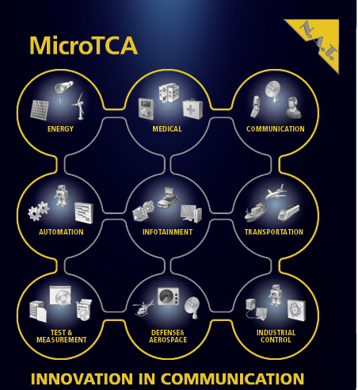
MTCA Tuturial: Configuring and Maintaining
Why you should be here and why we are here
1 or 2 “big“ standards in our work life
  VME, PCI, cPCI ....
MicroTCA and AMCs will be the next dominating standards for industrial systems
  nothing real new but better and different
  one standard meeting requirements of many different vertical markets
➔ MicroTCA is important already !
➔ MicroTCA will become even more important in the future !

Slide 4
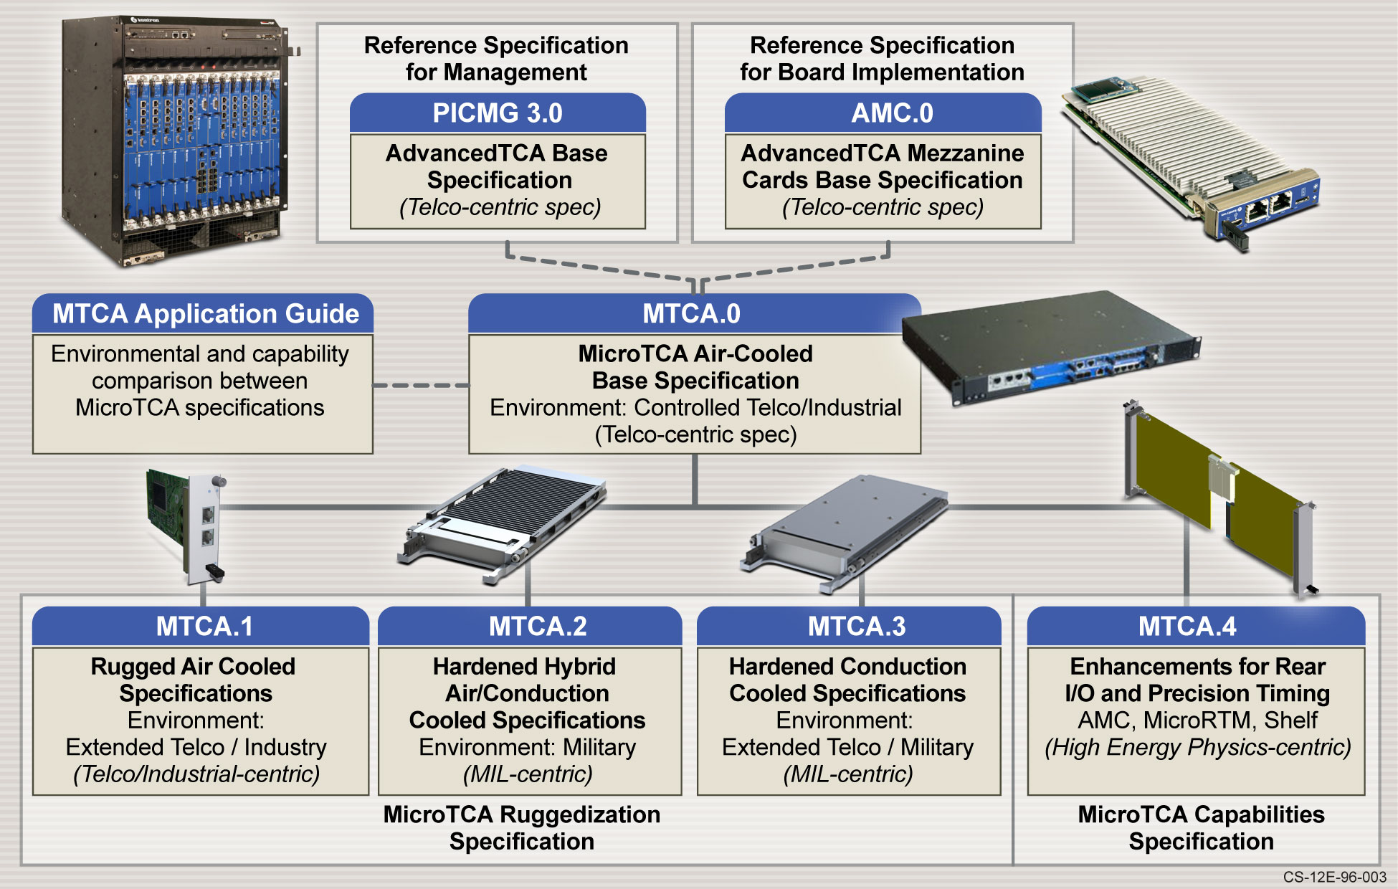
MTCA Tutorial: Configuring and Maintaining
Why you should be here and why we are here

Slide 5
2nd MTCA Workshop for Industry and Research MTCA Tutorial: Configuring and Maintaining
Why you should be here and why we are here
Who we are
What you saw in last year tutorial
What you should see today
  Configuring Management: power up process and inventory management
  Configuring Data Plane: GbE, PCIexpress, status of PCIexpress training
  Maintaining MTCA:
    Sensor, Alerts, Emergency Shutdown
    Read the backplane and AMC FRU and update it
    Update the firmware of the MCH, AMCs, CU, PM?
What you can do as well
What you (should) have learned today

Slide 6


About N.A.T.
Network and Automation Technology
Dipl. Ing. Vollrath Dirksen and Dipl. Phys Heiko Körte
Founded in 1990, privately owned
Hard- and Software design and manufacturing
Focus on innovation in communication
international and worldwide operations
Headquarters
      Konrad-Zuse-Platz 9
      53227 Bonn
      Germany
Notes:
Within an age of more than 22 years N.A.T. is one of the most experienced companies in the market
From the early days, N.A.T. has own departements for hardware and software design and manufacturing
Since the beginning our focus has been to create innovative products for embedded communications
NAT is located in the mid-west of Germany, directly at the River Rhine

Slide 7
2nd MTCA Workshop for Industry and Research MTCA Tutorial: Configuring and Maintaining
Why you should be here and why we are here
Who we are
What you saw in last year tutorial
What you should see today
  Configuring Management: power up process and inventory management
  Configuring Data Plane: GbE, PCIexpress, status of PCIexpress training
  Maintaining MTCA:
    Sensor, Alerts, Emergency Shutdown
    Read the backplane and AMC FRU and update it
    Update the firmware of the MCH, AMCs, CU, PM?
What you can do as well
What you (should) have learned today

Slide 8
MTCA Tutorial: Configuring and Maintaining
What you saw in last year tutorial
First of all .... pulling things together
Enabling the Management Plane
Installing the Data Plane
Enabling the Data Plane
Configuring the Data Plane
Operating the MTCA.4 system

Slide 9
2nd MTCA Workshop for Industry and Research MTCA Tutorial: Configuring and Maintaining
Why you should be here and why we are here
Who we are
What you saw in last year tutorial
What you should see today
  Configuring Management: power up process and inventory management
  Configuring Data Plane: GbE, PCIexpress, status of PCIexpress training
  Maintaining MTCA:
    Sensor, Alerts, Emergency Shutdown
    Read the backplane and AMC FRU and update it
    Update the firmware of the MCH, AMCs, CU, PM?
What you can do as well
What you (should) have learned today

Slide 10
MTCA Tutorial: Configuring and Maintaining
Enabling the Management Plane
What does “Enabling the Managment Plane“ mean?
Getting the infrastructure from the power-off state into the managed state
  understand the expectation
  put power to the system
  check the basics and find out if the expected has happend
in theory
in practise

Slide 11
MTCA Tutorial: Configuring and Maintaining
Enabling the Management Plane
Autonomous mode
Booting
Operational
CU
♥
♥
MP
PP
IPMB-0
Pres.
Enable
IPMB-0
Booting
Operational
Autonomous mode
Booting
Operational
LEDs:
NAT-MCH
source: Schroff
PM
AC

Slide 12
MTCA Tutorial: Configuring and Maintaining
Enabling the Management Plane
Operational
CU
♥
♥
FRU-ID
I2C
MP
PP
IPMB-0
IPMB-L
Pres.
Enable
IPMB-0
Operational
FRU-ID
FRU-ID
Operational
MMC
operational
Operational
LEDs:
LEDs:
AC
NAT-MCH
source: Schroff
AMC
PM

Slide 13
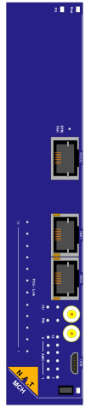
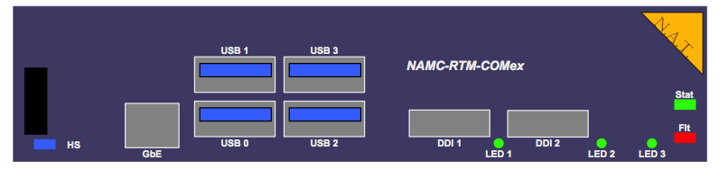
MCH demanded by SLAC and Desy
NAT-MCH-PHYS
STAT
Primary/Secondary LED
RS232
GbE1
GbE2
CLK1&2
USB
Blue LED
Hot-Swap Hdl
FLT
Red LED =Fault
PCIexpress Status and Speed LEDs:
off no PCIe link active
on PCIe-Gen3 link active
fast flashing PCIe-Gen2 link active
slow flashing PCIe-Gen1 link active
FRU Status LEDs:
AMC 1-12
CU 1, 2
PM 1, 2
Notes:
RS232 The RJ45 Connector CON3 connects via a RS-232 level converter to the Coldfire UART to provide a serial console debug interface
GbE 1 The RJ45 connector S1 connects a
1000BaseT Ethernet network (via PHY chip) to the Gigabit Ethernet switch. The switch connects the network to fabric A and to the ColdFire CPU. Therefore this port can be used to update the ColdFire Software, and to permit communication with external shelf or system mangers.
GBE 2 The optional RJ45 connector S2 has the same function as GBE1. Together with GBE1 this port can be used to increase the bandwidth of the uplink.
Clk This figure shows two SMA connectors. Other external clock transceiver modules can have other connectors.
USB The micro USB connector S1 connects to a MC that emulates a USB CDC (serial console) interface, connected to the ColdFire UART. It can be used as an alternative for the direct RS232 connector.

Slide 14






MTCA Tutorial: Configuring and Maintaining
Enabling the Management Plane
Live
Demo

Slide 15
MTCA Tutorial: Configuring and Maintaining
What you saw in last year tutorial
First of all .... pulling things together
Enabling the Management Plane
Installing the Data Plane
Enabling the Data Plane
Configuring the Data Plane
Operating the MTCA.4 system

Slide 16
2nd MTCA Workshop for Industry and Research MTCA Tutorial: Configuring and Maintaining
Why you should be here and why we are here
Who we are
What you saw in last year tutorial
What you should see today
  Configuring Management: power up process and inventory management
  Configuring Data Plane: GbE, PCIexpress, status of PCIexpress training
  Maintaining MTCA:
    Sensor, Alerts, Emergency Shutdown
    Read the backplane and AMC FRU and update it
    Update the firmware of the MCH, AMCs, CU, PM?
What you can do as well
What you (should) have learned today

Slide 17
MTCA Tutorial: Configuring and Maintaining
Installing the Data Plane
Infrastructure of a MicroTCA system
Chassis
Cooling Unit
#2
μTCA Carrier
μTCA Carrier Hub #2
Power Mod #N
Cooling Unit
#1
μTCA Carrier Hub #1
Power Mod #2
Common
Options
Fabric
Fat
Pipe
Fabric
C
L
K
J
T
A
G
Power Mod #1
MCMC
Power Conv.
and Controller
MCMC
MCMC
Backplane (Interconnect)
A
M
C
#1
A
M
C
#2
A
M
C
#3
A
M
C
#4
A
M
C
#5
A
M
C
#6
A
M
C
#7
A
M
C
#8
A
M
C
#9
A
M
C
#10
A
M
C
#11
A
M
C
#12

Slide 18
MTCA Tutorial: Configuring and Maintaining
Installing the Data Plane
What does “Installing the Data Plane“ mean?
Establishing the physical link between the AMCs and the MCH switches for the Base Fabric and the Fat Pipes
  Base Fabric: MCH fabric A ⬄ AMC ports #0 and #1
  Fat Pipe: MCH fabric D-G ⬄ AMC ports #4-7 and #8-11
  understand the expectation
  insert AMCs
  check the basics and find out if the expected has happend
in theory
in practise using PCIe

Slide 19
MTCA Tutorial: Configuring and Maintaining
Star Topology: IPMI, PCIe (SRIO, XAUI), GbE
AMC 1
12
AMC 2
IPMI
GbE
PCIe
10 Gb/s
3
11
10 Gb/s
32 Gb/s
10 Gb/s
10
4
2.5 Gb/s
20 Gb/s
9
2.5 Gb/s
5
8
6
7

Slide 20
MTCA Tutorial: Configuring and Maintaining
Installing the Data Plane
Bits are transmitted one after the other over single data line
Every data byte (8bit) is transformed to 10bit symbol that contains enough transitions
→ 8B/10B Coding
Clock is recovered from serial stream
Bidirectional transmission via
dedicated Tx and Rx lines
  One Tx/Rx pair is called “Lane”
Interconnect between multiple devices realized by switches

Slide 21
MTCA Tutorial: Configuring and Maintaining
Installing the Data Plane
Very high frequencies: > 1Ghz
  No per-cycle-relation to other signal needed
  point-to-point connections only
Differential Signaling
  Better immunity to disturbances and interferences
Bandwidth is determined/limited by:
  Maximum frequency depends on chip technology and interconnect quality
  Example: Harting MCH/AMC plugs and backplane connectors are specified with 6,25GHz
  Multiple Lanes are used in parallel to increase bandwidth
The whole signal
path is important!

Slide 22
MTCA Tutorial: Configuring and Maintaining
Installing the Data Plane
Defined in PICMG AMC.x series (the “Fabrics”):
  AMC.0 – Base Specification
  AMC.1 – PCI Express (PCIe)
  AMC.2 – Ethernet (1GbE and 10GbE/XAUI)
  AMC.3 – Storage (SAS/SATA)
  AMC.4 – Serial Rapid I/O (SRIO)

Slide 23
MTCA Tutorial: Configuring and Maintaining
Installing the Data Plane
Protocol
PCIe
1GbE and 10 GbE
SRIO
Advantage
Memory mapped access
Software compatible to PCI
Not only for system internal connectivity
Data is ready for connect direct to LAN
Hardware data integrity
Memory mapped access
Disadvantage
Host centric architecture
High Software Overhead
???
Typical
Application
Processing Blade
Next generation Industrial PC
Media Gateway Network Convergence
Distributed Data processing or Data Acquisition
Bandwidth
per lane
2.5Gbps (Gen1)
5.0Gbps (Gen2)
1.25Gbps (1GbE)
3.125Gbps (XAUI)
3.125Gbps (Gen1)
6.25Gbps (Gen2)
slide 23

Slide 24
MTCA Tutorial: Configuring and Maintaining
Installing the Data Plane
Expectations when inserting AMCs
  AMCs are recognized by MCH
  AMCs and MCH exchange their capabilities (“e-keying process”)
  AMCs and MCH establish fabric links if e-keying successful

Slide 25
MTCA Tutorial: Configuring and Maintaining
Installing the Data Plane
Live
Demo

Slide 26
2nd MTCA Workshop for Industry and Research MTCA Tutorial: Configuring and Maintaining
Why you should be here and why we are here
Who we are
What you saw in last year tutorial
What you should see today
  Configuring Management: power up process and inventory management
  Configuring Data Plane: GbE, PCIexpress, status of PCIexpress training
  Maintaining MTCA:
    Sensor, Alerts, Emergency Shutdown
    Read the backplane and AMC FRU and update it
    Update the firmware of the MCH, AMCs, CU, PM?
What you can do as well
What you (should) have learned today

Slide 27
MTCA Tutorial: Configuring and Maintaining
Configuring the Data Plane
What does “Configuring the Data Plane“ mean?
Using special capabilities of the fat pipe switch in order to achieve certain system functionalities
  XAUI: i.e. port based or tagged VLAN, IGMP
  SRIO: i.e. configuring peer matrix
  PCIe: i.e. clustering
    A “PCIe Cluster“ is defined as a set of at least two PCIe end points with one of them acting as a Root Complex
      i.e. a PrAMC and one or multiple I/O or DAC AMCs
    Question: how to hide the different Clusters from each other?
    Answer: use “virtual switches“ and their “non-transparent upstream ports“

Slide 28
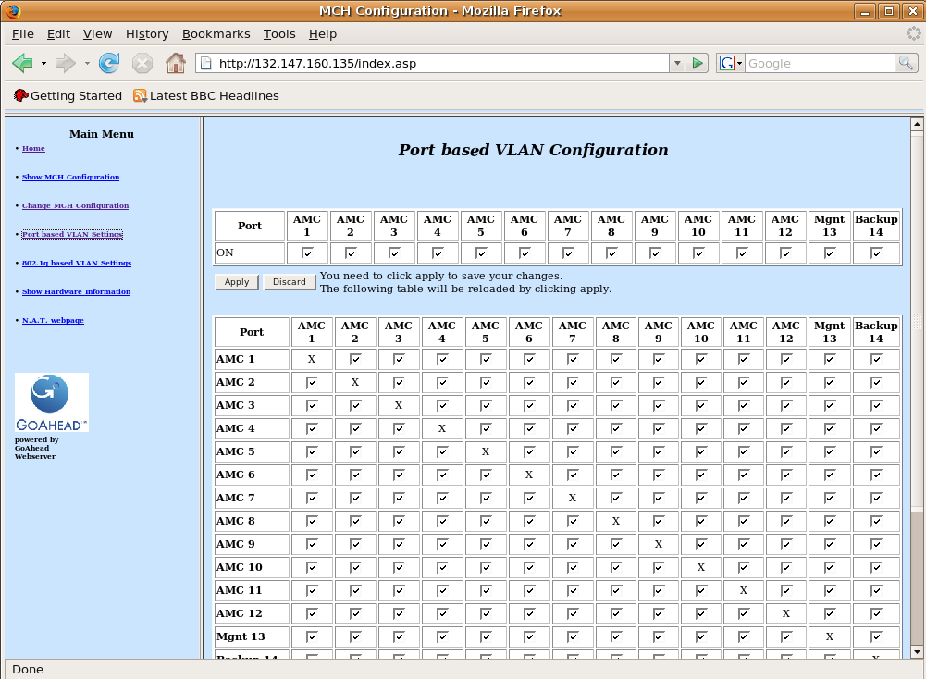
MTCA Tutorial: Configuring and Maintaining
Webinterface -> Configuration

Slide 29
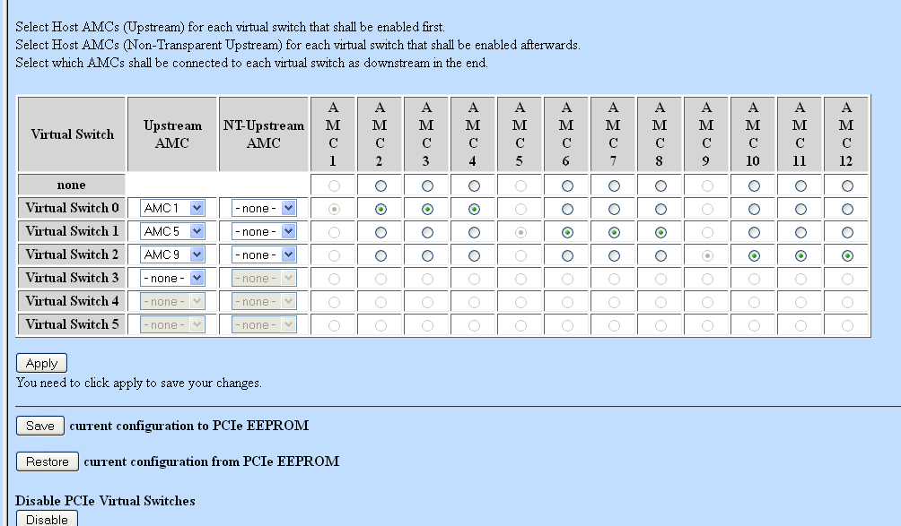
MTCA Tutorial: Configuring and Maintaining
Configuring the Data Plane

Slide 30
MTCA Tutorial: Configuring and Maintaining
Result of correct configured PCIe (1/3) nat> show_ekey
EKeying information - activated Links:
--------------------------------------
AMC FRU State Channel Type Port
=================================================
AMC1 5 M4
AMC2 6 M4 0 Eth 0 <-> MCH1 Fabric A 1000Base-BX
1 Eth 1 <-> MCH1 Fabric A 1000Base-BX
4 PCIe 4 <-> MCH1 Fabric D **root** Gen 2, no SSC
5 <-> MCH1 Fabric E **root** Gen 2, no SSC
6 <-> MCH1 Fabric F **root** Gen 2, no SSC
7 <-> MCH1 Fabric G **root** Gen 2, no SSC
AMC3 7 M4 0 PCIe 4 <-> MCH1 Fabric D downstream Gen 1, no SSC
5 <-> MCH1 Fabric E downstream Gen 1, no SSC
6 <-> MCH1 Fabric F downstream Gen 1, no SSC
7 <-> MCH1 Fabric G downstream Gen 1, no SSC
AMC4 8 M4 0 PCIe 4 <-> MCH1 Fabric D downstream Gen 1, no SSC
AMC5 9 M4 0 PCIe 4 <-> MCH1 Fabric D downstream Gen 1, no SSC
AMC6 10 M1
=================================================

Slide 31
MTCA Tutorial: Configuring and Maintaining
Result of correct configured PCIe (2/3) nat> show_link_state
AMC 1 Port 0 is Ethernet - 1000Base-BX
AMC 2 Port 0 is Ethernet - 1000Base-BX
AMC 2 Port 1 is Ethernet - 1000Base-BX
AMC 3 Port 4 is PCIe - x4 - 2,5 GT/s
AMC 3 Port 5 is PCIe - x4 - 2,5 GT/s
AMC 3 Port 6 is PCIe - x4 - 2,5 GT/s
AMC 3 Port 7 is PCIe - x4 - 2,5 GT/s
AMC 4 Port 4 is PCIe - x1 - 2,5 GT/s
AMC 5 Port 4 is PCIe - x1 - 2,5 GT/s
local RTM link status:
Ethernet - 1000Base-BX
PCIe - x4 - 8,0 GT/s

Slide 32
MTCA Tutorial: Configuring and Maintaining
Result of correct configured PCIe (3/3) nat@NAT-MCH-RTM-I7:~$ lspci
00:00.0 Host bridge: Intel Corporation Ivy Bridge DRAM Controller (rev 09)
00:01.0 PCI bridge: Intel Corporation Ivy Bridge PCI Express Root Port (rev 09)
00:02.0 VGA compatible controller: Intel Corporation Ivy Bridge Graphics Controller (rev 09)
00:14.0 USB controller: Intel Corporation Panther Point USB xHCI Host Controller (rev 04)
00:16.0 Communication controller: Intel Corporation Panther Point MEI Controller #1 (rev 04)
00:19.0 Ethernet controller: Intel Corporation 82579LM Gigabit Network Connection (rev 04)
00:1a.0 USB controller: Intel Corporation Panther Point USB Enhanced Host Controller #2 (rev 04)
00:1c.0 PCI bridge: Intel Corporation Panther Point PCI Express Root Port 1 (rev c4)
00:1d.0 USB controller: Intel Corporation Panther Point USB Enhanced Host Controller #1 (rev 04)
00:1f.0 ISA bridge: Intel Corporation Panther Point LPC Controller (rev 04)
00:1f.2 SATA controller: Intel Corporation Panther Point 6 port SATA Controller [AHCI mode] (rev 04)
00:1f.3 SMBus: Intel Corporation Panther Point SMBus Controller (rev 04)
01:00.0 PCI bridge: PLX Technology, Inc. Device 8748 (rev ba)
02:00.0 PCI bridge: PLX Technology, Inc. Device 8748 (rev ba)
02:01.0 PCI bridge: PLX Technology, Inc. Device 8748 (rev ba)
02:02.0 PCI bridge: PLX Technology, Inc. Device 8748 (rev ba)
02:08.0 PCI bridge: PLX Technology, Inc. Device 8748 (rev ba)
02:09.0 PCI bridge: PLX Technology, Inc. Device 8748 (rev ba)
03:00.0 PCI bridge: PLX Technology, Inc. PEX8112 x1 Lane PCI Express-to-PCI Bridge (rev aa)
04:00.0 Bridge: PLX Technology, Inc. PCI9030 32-bit 33MHz PCI <-> IOBus Bridge
05:00.0 Bridge: TEWS Technologies GmbH Device 828b
06:00.0 Communication controller: Research Centre Juelich Device 0018
09:00.0 Ethernet controller: Intel Corporation I350 Gigabit Backplane Connection (rev 01)

Slide 33
MTCA Tutorial: Configuring and Maintaining
Configuring the Data Plane
Live
Demo

Slide 34
2nd MTCA Workshop for Industry and Research MTCA Tutorial: Configuring and Maintaining
Why you should be here and why we are here
Who we are
What you saw in last year tutorial
What you should see today
  Configuring Management: power up process and inventory management
  Configuring Data Plane: GbE, PCIexpress, status of PCIexpress training
  Maintaining MTCA:
    Sensor, Alerts, Emergency Shutdown
    Read the backplane and AMC FRU and update it
    Update the firmware of the MCH, AMCs, CU, PM?
What you can do as well
What you (should) have learned today

Slide 35
MTCA Tutorial: Configuring and Maintaining
Maintaining MTCA.4 system
What will happen during “operation“ of a MTCA.x system ?
Sensors in the system will generate events
  How to log these events ?
  How are these events flagged/signalled ?
  Can certain sensors be monitored ?
    Live Demo using temperature events and hot-swap events as examples

Slide 36
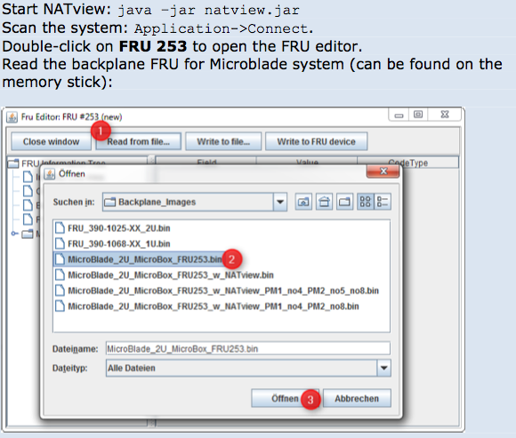
MTCA Tutorial: Configuring and Maintaining
NATview: Load new Backplane FRU

Slide 37
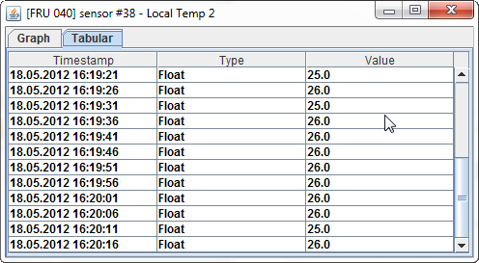
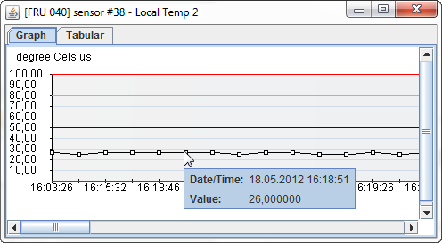
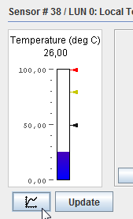
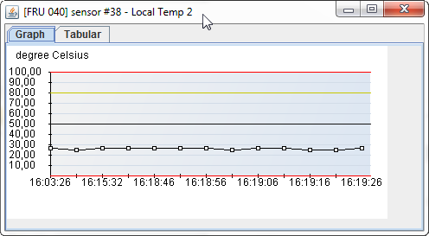
MTCA Tutorial: Configuring and Maintaining
NATview : Sensors (1/2)
Sensorhistory

Slide 38
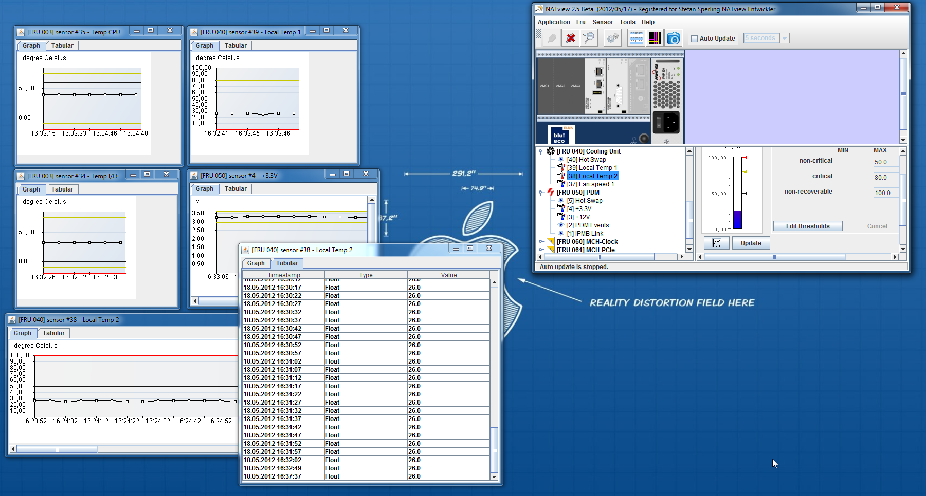
MTCA Tutorial: Configuring and Maintaining
NATview : Sensors (2/2)
Sensor panels
Each sensorpanel is an
independent window

Slide 39
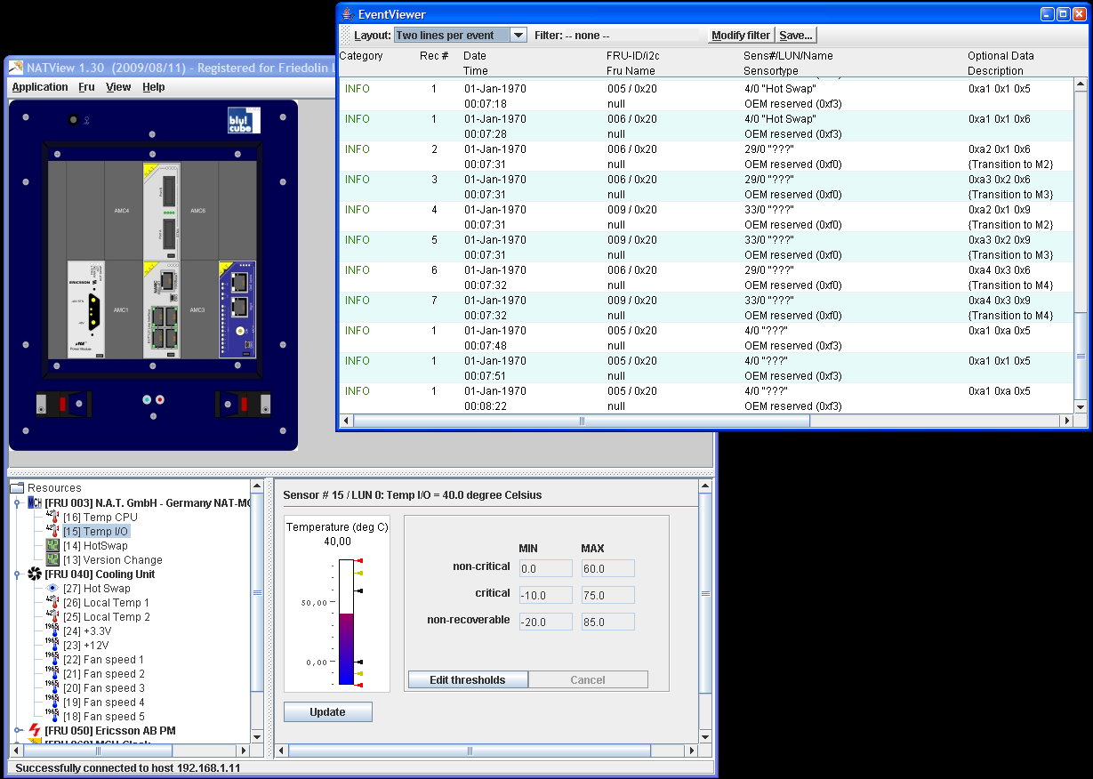
MTCA Tutorial: Configuring and Maintaining
NATview : Event Viewer

Slide 40
MTCA Tutorial: Configuring and Maintaining
Current Measurement in a Life System nat> show_sensorinfo 50
# SDRType Sensor Entity Inst Value State Name
------------------------------------------------------------------
27 MDevLoc 0x0a 0x61 NAT-PM-AC600
1 Full Temp 0x0a 0x61 33 C ok T_CPU
2 Full Temp 0x0a 0x61 57 C ok T_XFrm
3 Full Temp 0x0a 0x61 37 C ok T-PSB
4 Full Temp 0x0a 0x61 44 C ok T-PFC1
5 Full Temp 0x0a 0x61 51 C ok T-PFC2
6 Full Voltage 0x0a 0x61 45 V ok VIN
7 Full Voltage 0x0a 0x61 12.1 V ok 12V
8 Full Voltage 0x0a 0x61 3.5 V ok 3.3V
9 Full Current 0x0a 0x61 12.25 A ok I_Sum
10 Compact Current 0x0a 0x61 2.75 A ok I_CH01
11 Compact Current 0x0a 0x61 0.00 A ok I_CH02
12 Compact Current 0x0a 0x61 0.80 A ok I_CH03
13 Compact Current 0x0a 0x61 0.00 A ok I_CH04
14 Compact Current 0x0a 0x61 2.75 A ok I_CH05
15 Compact Current 0x0a 0x61 2.60 A ok I_CH06
16 Compact Current 0x0a 0x61 2.35 A ok I_CH07
17 Compact Current 0x0a 0x61 0.65 A ok I_CH08
18 Compact Current 0x0a 0x61 0.45 A ok I_CH09
19 Compact Current 0x0a 0x61 0.00 A ok I_CH10
20 Compact Current 0x0a 0x61 0.00 A ok I_CH11
21 Compact Current 0x0a 0x61 0.00 A ok I_CH12
22 Compact Current 0x0a 0x61 0.00 A ok I_CH13
23 Compact Current 0x0a 0x61 0.00 A ok I_CH14
24 Compact Current 0x0a 0x61 0.00 A ok I_CH15
25 Compact Current 0x0a 0x61 0.00 A ok I_CH16
26 Compact 0xf2 0x0a 0x61 0x01 HotSwap

Slide 41
MTCA Tutorial: Configuring and Maintaining
Maintaining MTCA.4 system
Live
Demo

Slide 42
2nd MTCA Workshop for Industry and Research MTCA Tutorial: Configuring and Maintaining
Why you should be here and why we are here
Who we are
What you saw in last year tutorial
What you should see today
  Configuring Management: power up process and inventory management
  Configuring Data Plane: GbE, PCIexpress, status of PCIexpress training
  Maintaining MTCA:
    Sensor, Alerts, Emergency Shutdown
    Read the backplane and AMC FRU and update it
    Update the firmware of the MCH, AMCs, CU, PM?
What you can do as well
What you (should) have learned today

Slide 43
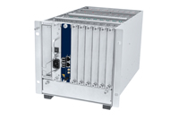
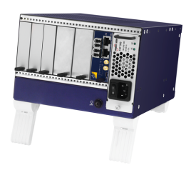
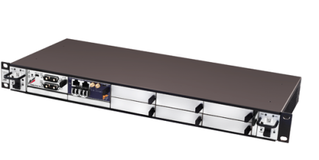
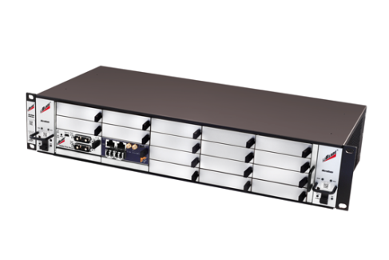
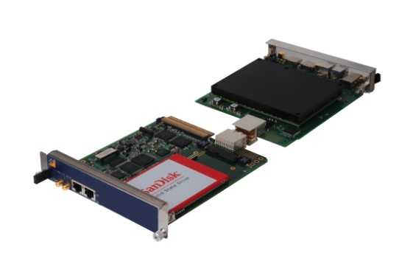
MTCA Tutorial: Configuring and Maintaining
What you can do as well
Most important:
  use vendors that guarantee interoperability of their
  Products with other MTCX.x and AMC.x compliant
  products from other vendors
      ➔ PICMG interoperability workshops (“IW“)
No need for redundancy or so many slots or RTMs?
            ➔ Use a smaller or different system !
Need more AMC or RTMs slots?
            ➔ Use different system components,
            i.e. NAT-MCH-PHYS +RTM (Session 5 tomorrow at 3pm)

Slide 44
2nd MTCA Workshop for Industry and Research MTCA Tutorial: Configuring and Maintaining
Why you should be here and why we are here
Who we are
What you saw in last year tutorial
What you should see today
  Configuring Management: power up process and inventory management
  Configuring Data Plane: GbE, PCIexpress, status of PCIexpress training
  Maintaining MTCA:
    Sensor, Alerts, Emergency Shutdown
    Read the backplane and AMC FRU and update it
    Update the firmware of the MCH, AMCs, CU, PM?
What you can do as well
What you (should) have learned today

Slide 45
2nd MTCA Workshop for Industry and Research MTCA Tutorial: Configuring and Maintaining
Summary:
  MTCA is the coming standard for industrial embedded systems
  When thinking about MTCA, think of N.A.T.
      Our credo: Talk to us, we care ...
  We showed and demonstrated:
    First of all .... pulling things together
    Enabling the Management Plane
    Installing the Data Plane
    Enabling the Data Plane
    Configuring the Data Plane
    Operating the MTCA.4 system
    Alternatives for some requirements

Slide 46

Thank you very much!
Questions?
Heiko Körte
Director Sales & Marketing
heiko@nateurope.com
Vollrath Dirksen
Strategic Business Development
vollrath@nateurope.com
N.A.T. GmbH
Konrad-Zuse-Platz 9
53227 Bonn, Germany
www.nateurope.com
Further presentation:
  Session 2 Wednesday at 11:40 am
or see us at the booth

