Slide 1

XFEL-MPS
XFEL Machine Protection System (MPS) based on MicroTCA
Sven Karstensen, DESY
MTCA workshop 10.-12. Dec 2013, DESY Hamburg

Slide 2
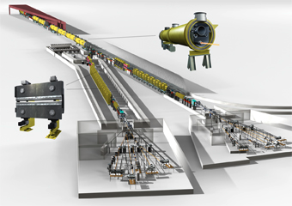
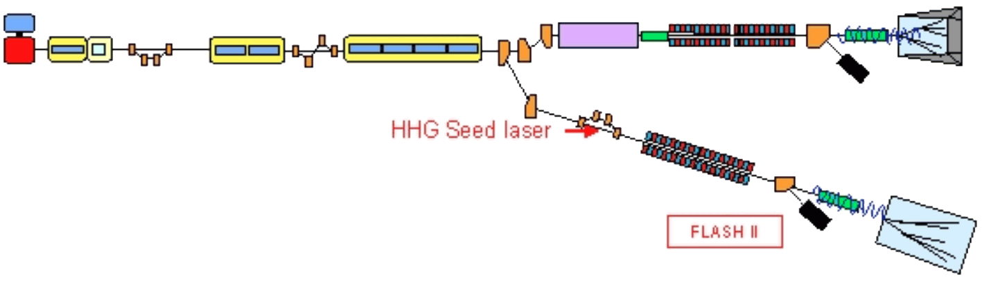
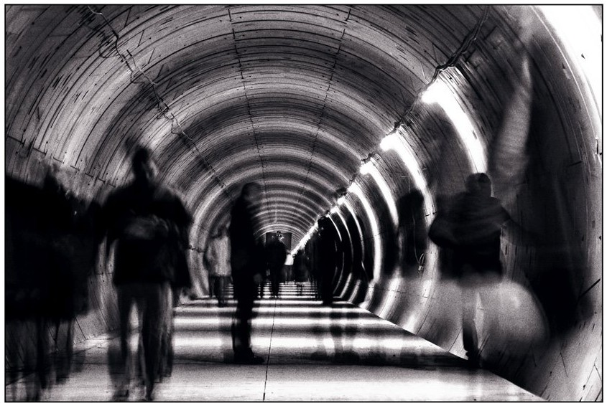
FLASH 2 and XFEL
Overall length
FLASH: 500m
XFEL: 5.4 km

Slide 3
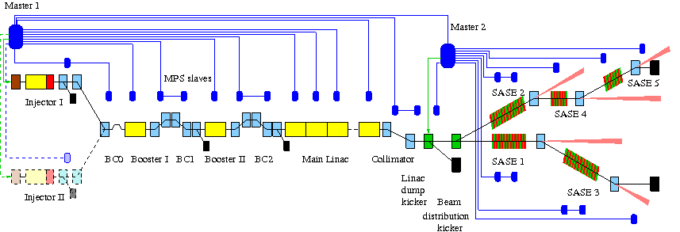
MPS architecture in XFEL
2 Masters, >120 Slaves

Slide 4
The Problems
Latency of signals
Reliability of components
Maintenance without shutdown the accelerators XFEL or FLASH

Slide 5
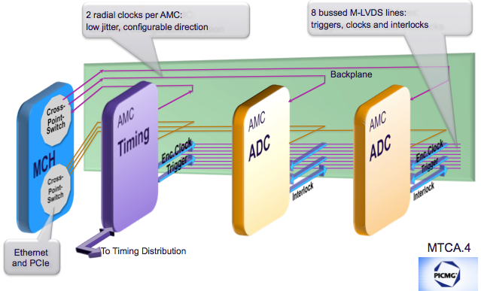
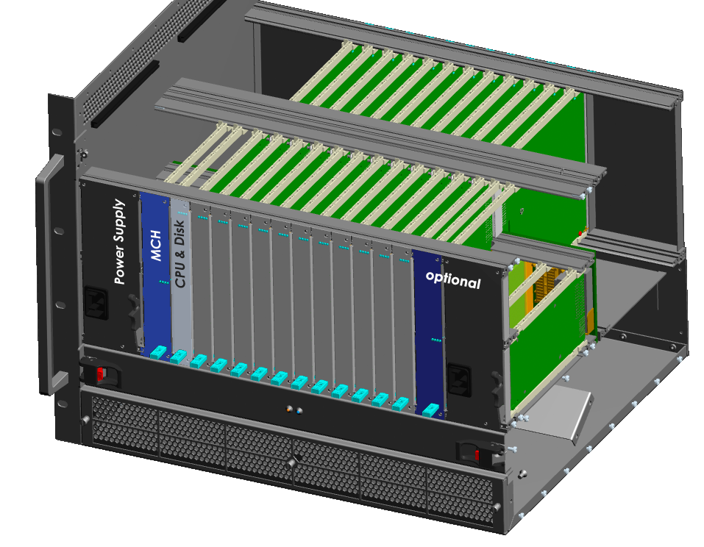
MTCA.4 in general
IPMI Management for 12 AMC modules
Management for up to 4 Power Modules
Fabric Switching for up to 60 Ports
  12 GbE minimum
  12 x 4 lanes XAUI, PCI-E or SRIO
Management for up to 2 Cooling Units
Optionally provides Shelf Management
Front Panel Alarms
Clock Distribution system
Fabric Channel Uplink
HOT SWAPable
Source: http://www.picmg.org/pdf/introduction_to_microtca.pdf
and Kay Rehlich, DESY

Slide 6
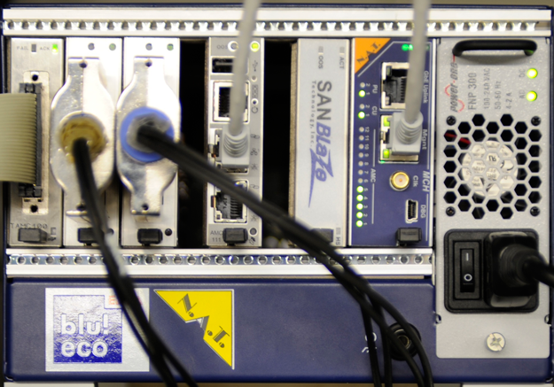

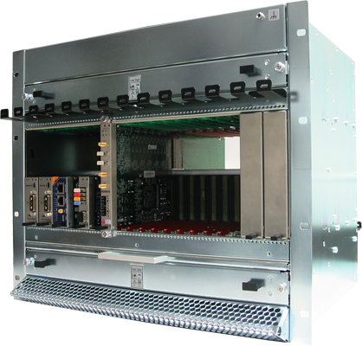
MTCA.4 @ XFEL
Modular + modern architecture
  Reusability + PCIe + Ethernet
High availability (.999 to .99999)
  Redundant power and fan optional
  IPMI management
High performance:
  Very low analog distortions
  4 lanes PCIe: 400 MB/s ... 3.2 GB/s
XFEL fast electronics will be based
on MTCA.4: > 200 Crates
Courtesy to Kay Rehlich, DESY

Slide 7
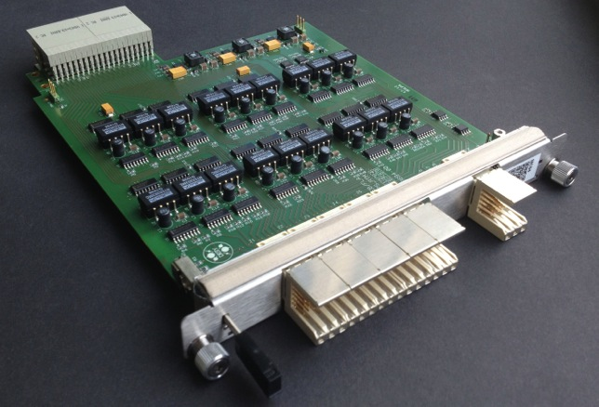
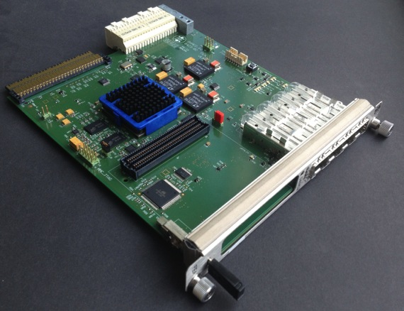
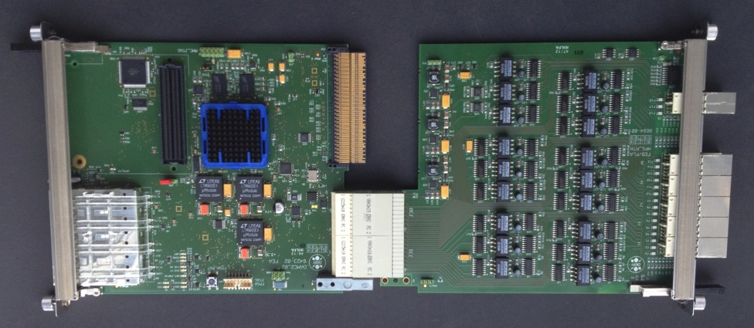
MPS MTCA components, DESY design
Virtex 5
FPGA
DC/DC
DAMC2
4 x SFPs
MPS RS422 RTM
45 in / 7 out
FMC

Slide 8
Overall MPS features
Scalability
same firmware in every DAMC2
Every DAMC2 slave holds all information of all prior connected slaves (debugging)
Every slave can be connected to the timing system
Every slave can be hold one I2C driven FMC Dosimetry board
Configurable – NOT programmable

Slide 9
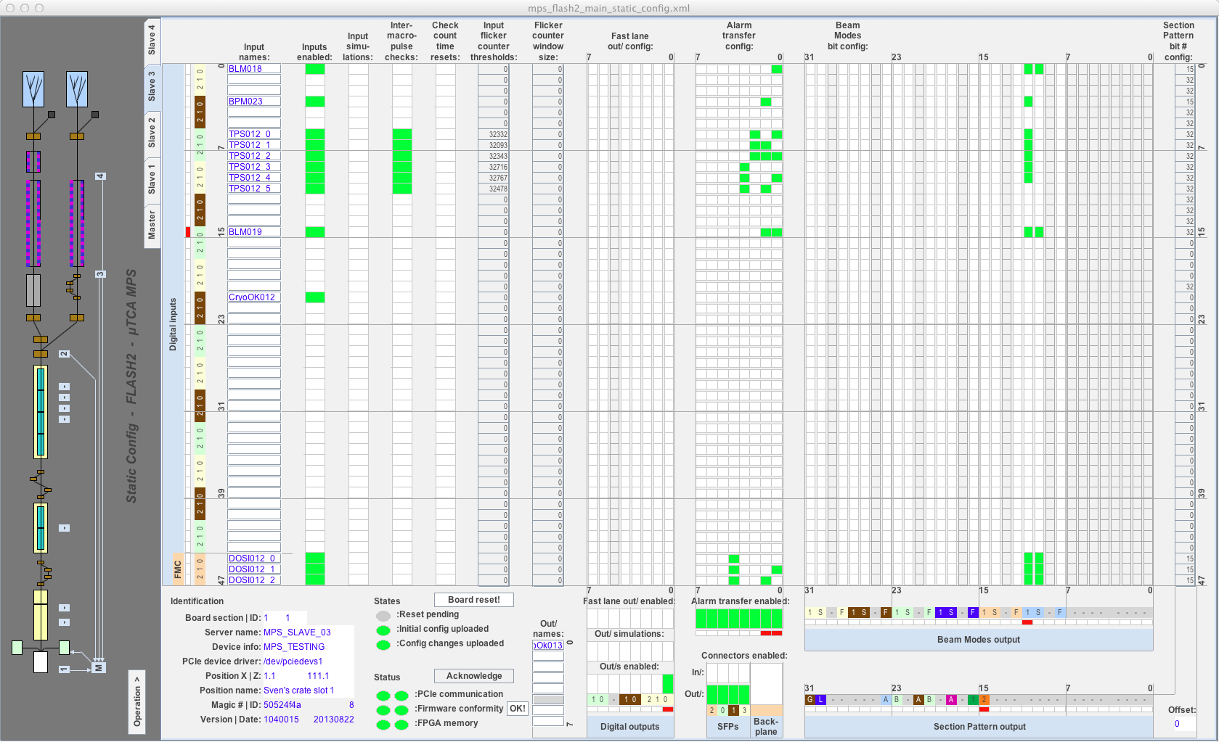
Configuration Panel

Slide 10
General MPS features for every DAMC2
45 RS422 external input channels
3 internal input channels for FMC
7 RS422 output channels, 1 Backplane Output
I²C support to FMC
4 SFP I/O fiber optic lines (0-4 Inputs, 0-4 outputs)
Addressable up to 64 Sections, each equipped with 64 DAMC2 MPS modules
Indirect redundancy
Fast internal RS422 link from in- to outputs
Debug Register
LED status indicator (heart beat, server connection, initialization)

Slide 11
IN- and OUTPUT channel features
Options for each INput channel (48):
  Enable / disable Inputs ; Test input; Check functionality of connected systems between Macro Pulses; Pulse counter within a given time, both configurable; Beam Mode generation; Section Pattern generation; Alarm Type generation; Save each Alarm into DOOCS history
Options for each OUTput channel (8):
  Enable / disable Outputs ;Test output; Fast output line; Save each action into DOOCS history; Fast Output configuration on same DAMC2 board

Slide 12
The Protocol

Slide 13
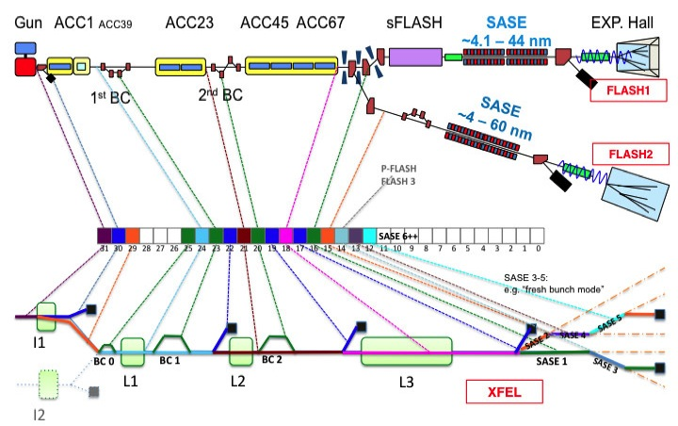
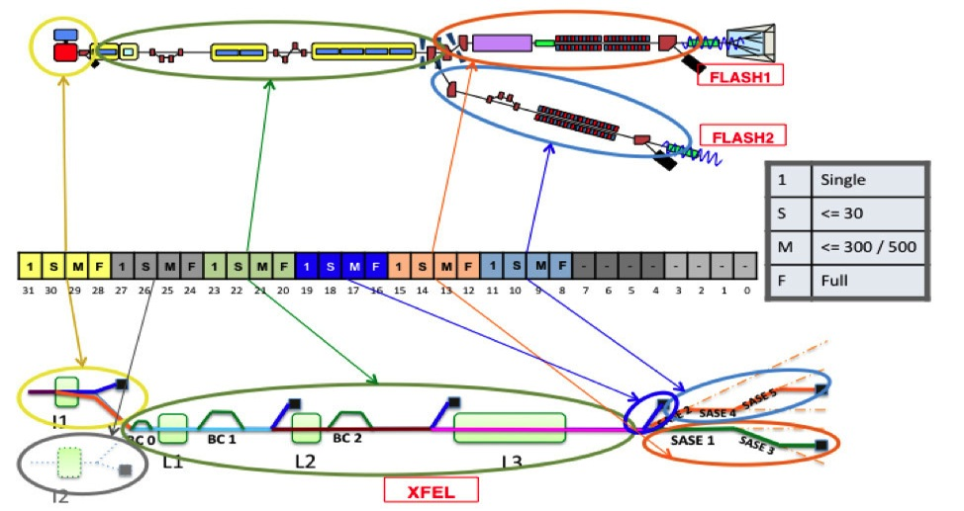
Information structures, protocol priority, pre-processing
Beam Modes
Section Pattern
Slave Info

Slide 14

How it works, priority protocols
1.) Beam Modes very high
Alarm
2.) Section Pattern high
3.) Slave info low
Slave 2
Slave 1
OR
timing
OR
Master
Alarm
OR
OR
OR
OR
Slave 3
E
ALARM out
ALARM out

Slide 15
Reaction Times in XFEL
Beam loss location | Distance from injector | Distance from dump | # of lost bunches
Injector | 0 m | -1970 m | 0
BC1 | 160 m | -1810 m | 7
BC2 | 360 m | -1640 m | 15
Linac center | 1040 m | -930 m | 44
Linac end | 1650 m | -320 m | 69
Beam distribution | 2010 m | 40 m | 2
Last undulator | 3010 m | 1040 m | 44
~ 50 bunches are inside accelerator
Signal transport from dump to injector 20 µs (2000 m)
~ 50 bunches generated before laser is blocked
Using beam dump kicker reduces the number of lost bunches inside SASE Undulator sections.

Slide 16
What does all information of the slides before now mean for our largest problem:
the Latency?

Slide 17
Latency MPS-DAMC2 boards (August 2013)
Fiber optics: unattended (5ns / m)
Speed: 1.25 GBps
Latency between DAMCs will be improved.
Factor 3 is aspired.
Alarm out
DAMC2
Alarm IN
82 ns
Alarm out
DAMC2
DAMC2
Alarm IN
780 ns
Alarm out
DAMC2
DAMC2
DAMC2
Alarm IN
1400 ns
XFEL needs 20 µsec, we peak: 1400 ns + 2000 m * 5 ns/m = 11,4 µsec

Slide 18
Thank You

Slide 19
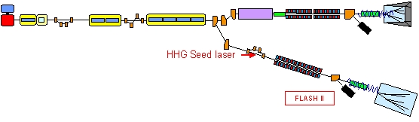
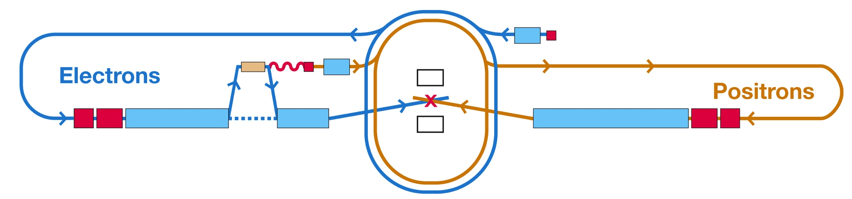
FLASH II, XFEL, ILC
scalability

Slide 20
Configuration Instruction

Slide 21
MPS architecture in XFEL
Numbers in drawing corresponding to numbers in FPGA code
Excel Sheet includes all addresses

