Slide 1
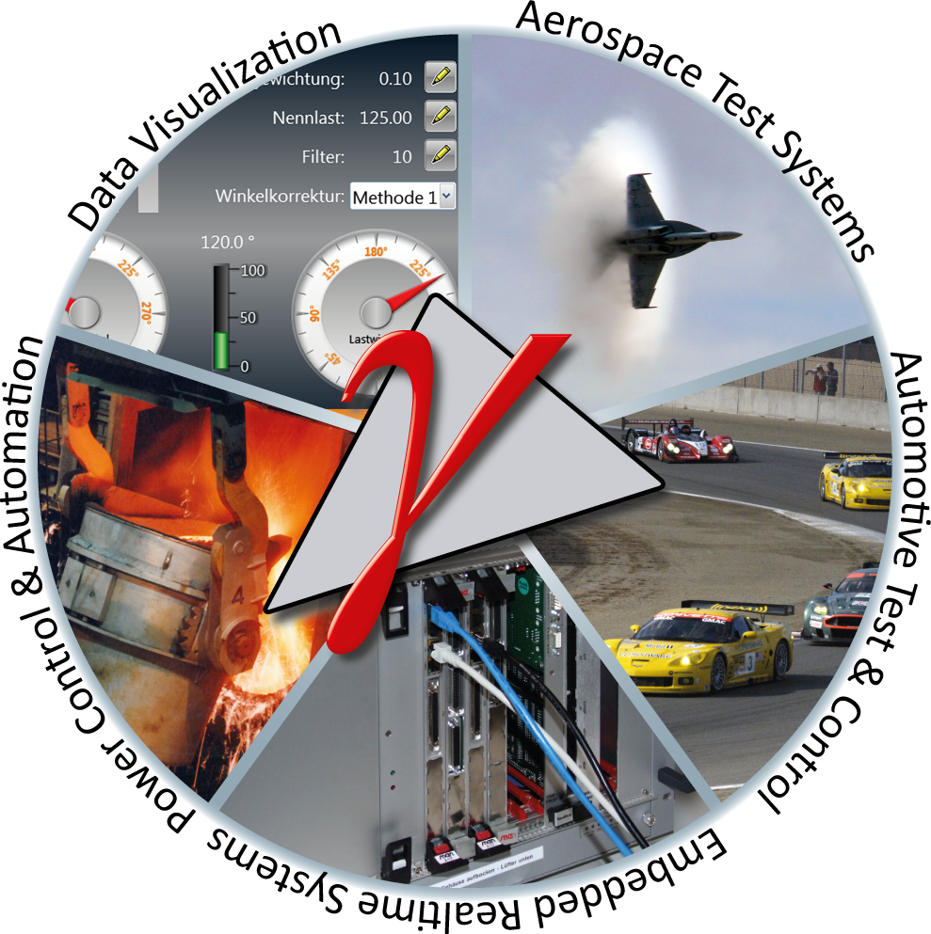
Gamma Middleware meets MTCA.4

Slide 2
Situation
MTCA.X is mainly used in research and telecommunication area
The requirements are there very high sophisticated
Interfaces required in the industrial area is not available
MTCA.X hardware has to be combined with different other form factors
Development tools are missing
Actually there is no community to provide MTCA.X technology in the industrial market
… We need a bridge between MTCA.X and the industrial area

Slide 3

Middleware combines technologies
Eclipse (C/C++/Python)
radCASE (PLC)
eTrice
Matlab Simulink
CETES++
QT
Development Areas
Development languages
Modelling Tools
Matlab Simulink
XiBase9
Testtools
Visualization
Gamma Application Interface (API)
Middleware
Abstraction layer and intelligent data model
Gamma Service & Plug-Ins
Operating System (Windows / Linux)
Hardware
I/O
Network / Fieldbus
Middleware platforms abstract the hardware platforms and provide standardized software interfaces.
Interchangeability of hardware and development tools
ARM
OPC-UA
x86
ProfiBus
PPC
analog
CAN
spezifisch
digital
TCP/IP
EtherCAT

Slide 4
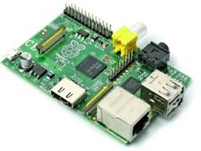
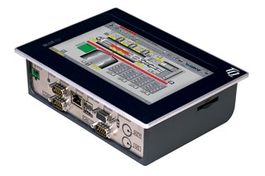
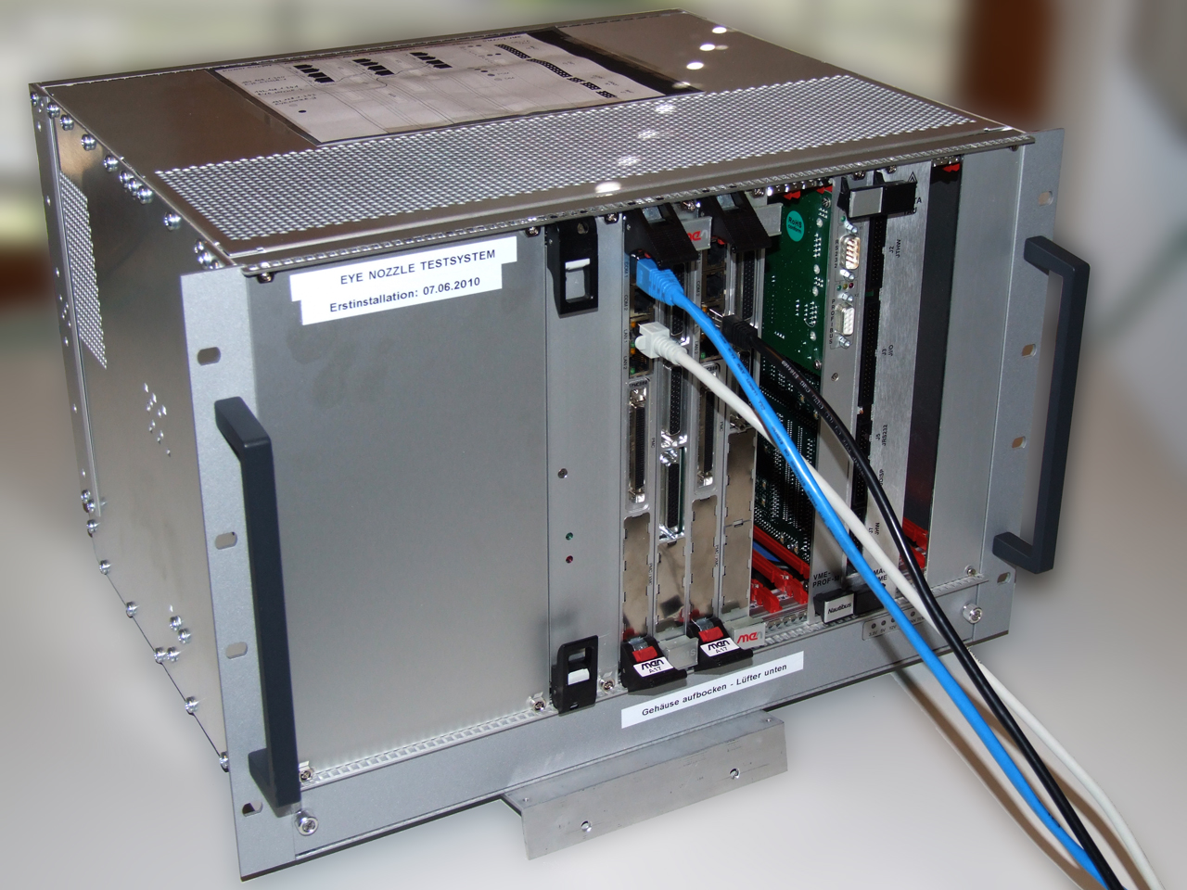
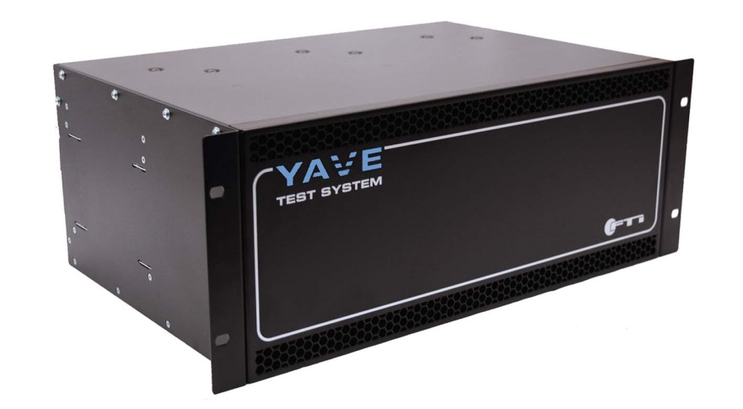
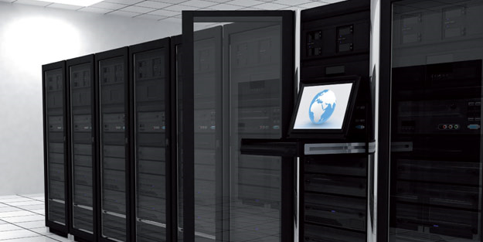
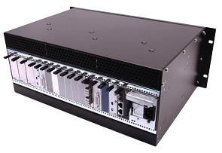
Scalability
The flexibility and scalability of the Gamma platform enable tailor-made solutions for every application:
Small Embedded-Systems
compact Terminals
VME-Bus Systems
Large scale systems
MicroTCA

Slide 5
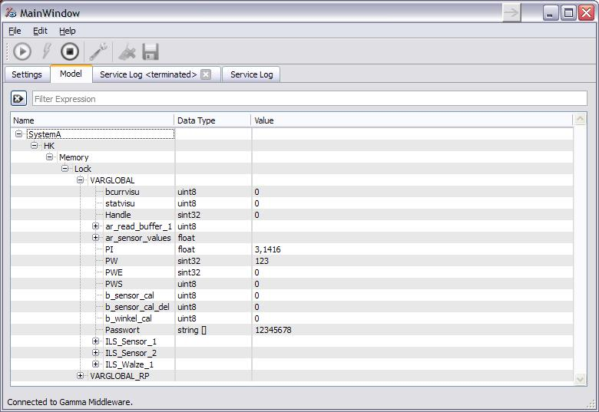
The data model structure
Hierarchical structure
Image of reality
Bridges system and network boundaries
Dynamically extensible
Unlimited size and number of variables
The structure of the data model is
comparable with the file structure
a file system.
Middleware Data viewing
Tool: Gamma Explorer

Slide 6
I/O-Integration in using
Plug-Ins
Datenmodell
Gamma-Service
lädt
I/O-Plugin
XML
Configuration File
bestimmt
Kommunikationsstack
Hardware
Hardware can be adapted by Plug-Ins which converts I/O Data into the data model
In addition signals can be filtered by filter Plug-Ins
Industrial hardware can be adapted by PMC adapters until native hardware is available
lokale I/O
Netzwerk
Feldbus

Slide 7
Overview I/O functions
Network
TCP/IP
UDP
    MIDDLEWARE
    Gamma V (by RST)
    Data and Time model
Platforms
x86
PowerPC
ARM
MicroTCA
VME
PC
Embedded-Moduls
I/O
Digital
Analog
Counter
Stepper
Timer
LVDT,
Synchro resolver
Switch matrix
Fieldbus
EtherCat
Embrick
OPC UA
CAN
Serial
AFDX, ARINC429
Flexray
GPIB, LXI
Devices
Measure systems
Power Supplies
Multiplexer
climate chamber
. . .
(for additional functions ask us)

Slide 8
Integrated Features
Full real-time capability
Dynamic network interconnection and data browsing
Deterministic Remote Access
Single process values and serialized can be combined
Intelligent variables signal on Change, limit checking, simulation, logging…
Simulation Interface
Data Logging
Time model for synchronization with schedulers (for multicore application)
Open I/O plug-in interface (with many existing interfaces)

Slide 9
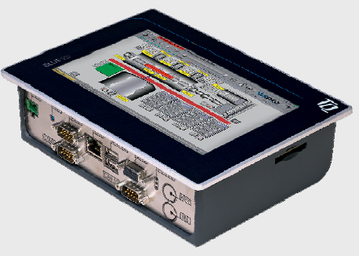


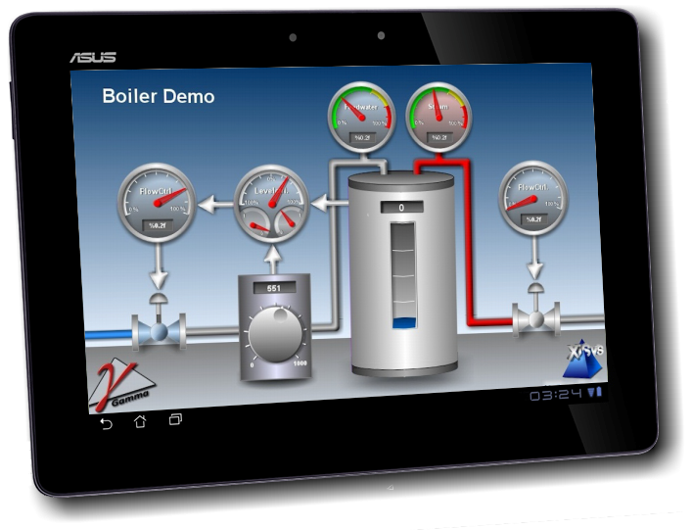
Networking
User terminal
SYSTEM 1
SYSTEM 2
SYSTEM n
(...)
Ethernet
SYSTEM A
Logging
Data analysis
Visualization
WLAN
Mobile user interface

Slide 10
Development tools
Different development tools for different purposes:
PLC languages ​​(eg IEC 61131 and 61499): Easy to use, high penetration, fast implementation of standard tasks.
High-level languages ​​C / C + + for complex tasks (eg, image processing)
Script configuration with Python
Model-based development techniques (eg UML): High flexibility not only for standard tasks
Domain-specific or application-specific languages ​​(ROOM) with an optimal degree of abstraction and high productivity with code generation
Use of appropriate methods in combination

Slide 11
Python Demo
# import libraries
import gaapi
import gacommon
# attach to gamma middleware
gacommon.attachToService()
# attach process variable
ExamplePV = gaapi.PV( ":Node.Array.Value" )
# read process variable
print "Opened variable with value %s" % ExamplePV.value
# write process variable
ExamplePV.value = 123
print "Changed variable value to %s" % ExamplePV.value

Slide 12
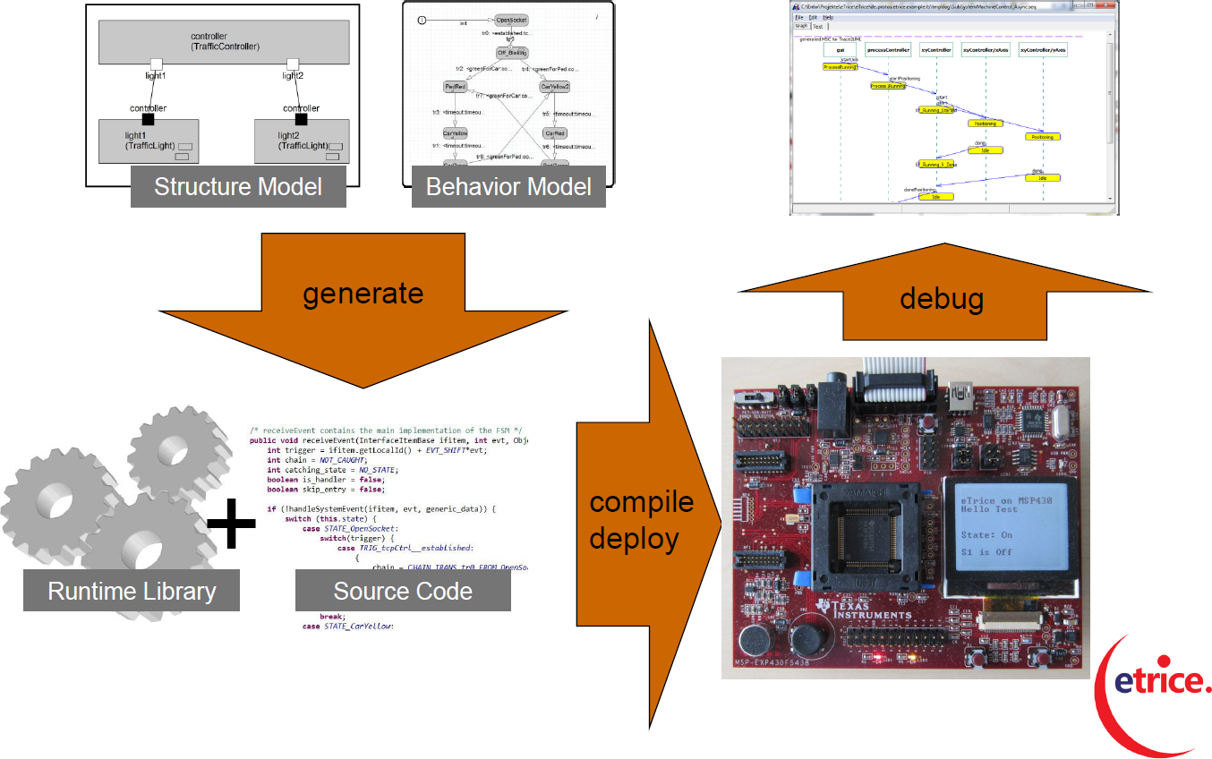
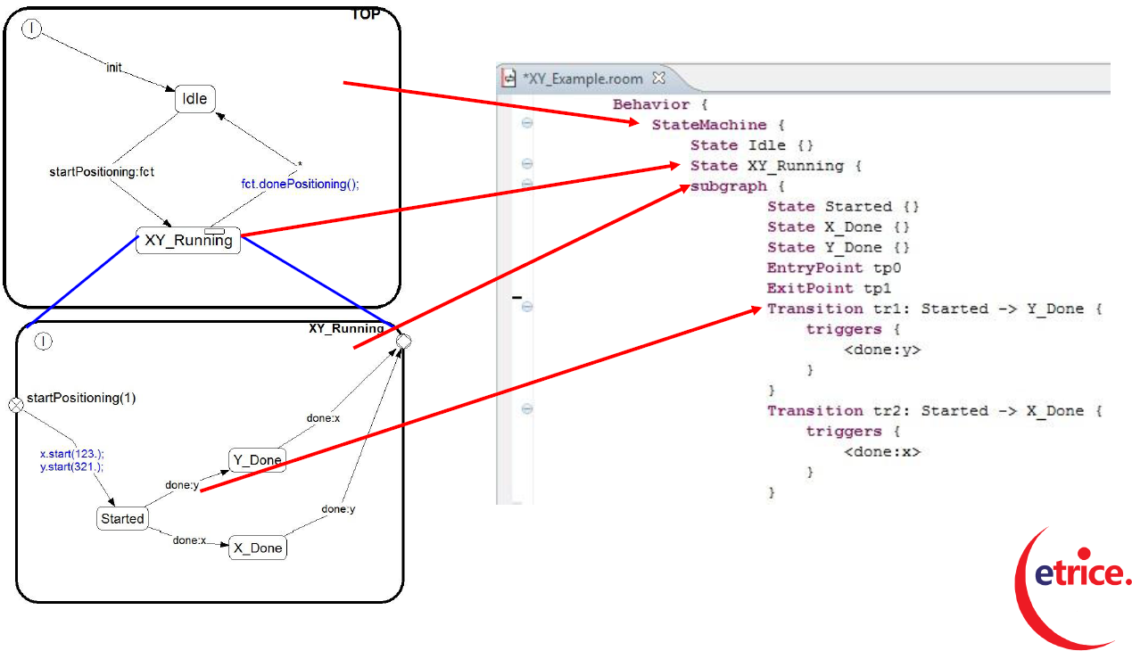
Development with eTrice
eTrice - Toolchain

Slide 13
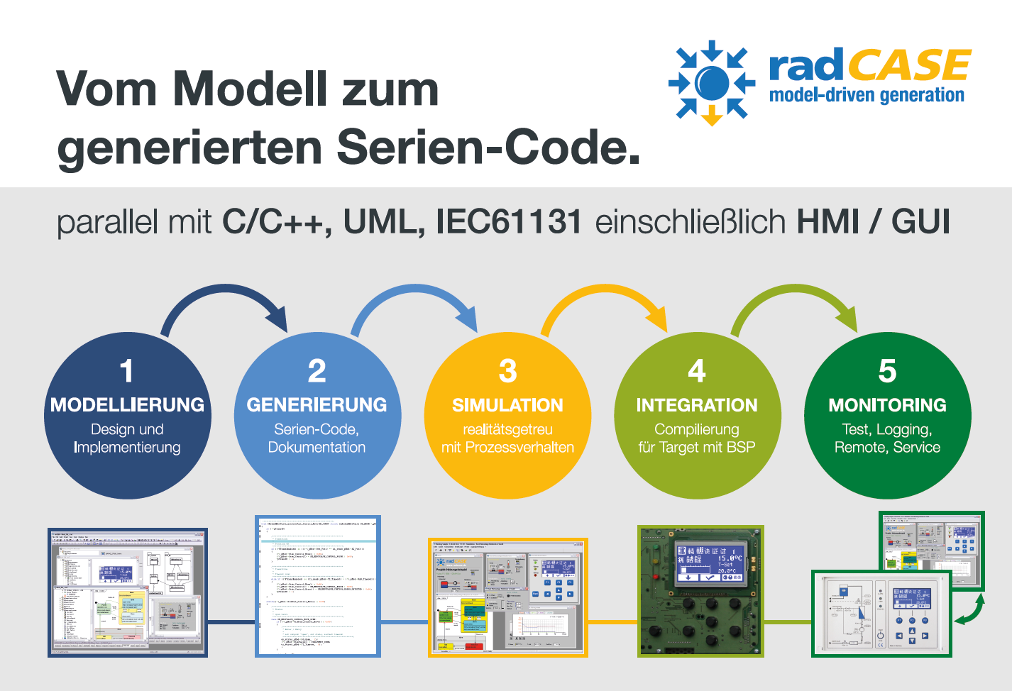
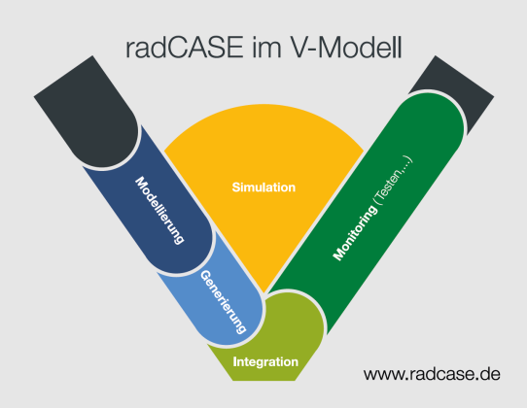
PLC Development with RadCase
Key features:
model-based, hierarchical, consistent
parallel C / C + +, UML / SysML and IEC61131
integrated MMI modeling (WYSIWYG)
O ³ model (Overall Object Oriented)
energy Analysis
PC remote visualization and WEB
Design-level debugging
automatic documentation
coupling to external tools
series generation without rework
100% target platform independent
C / C + + code generation production
targets from 1kB-ROM, 100 bytes of RAM
realistic PC simulation (SiL)

Slide 14
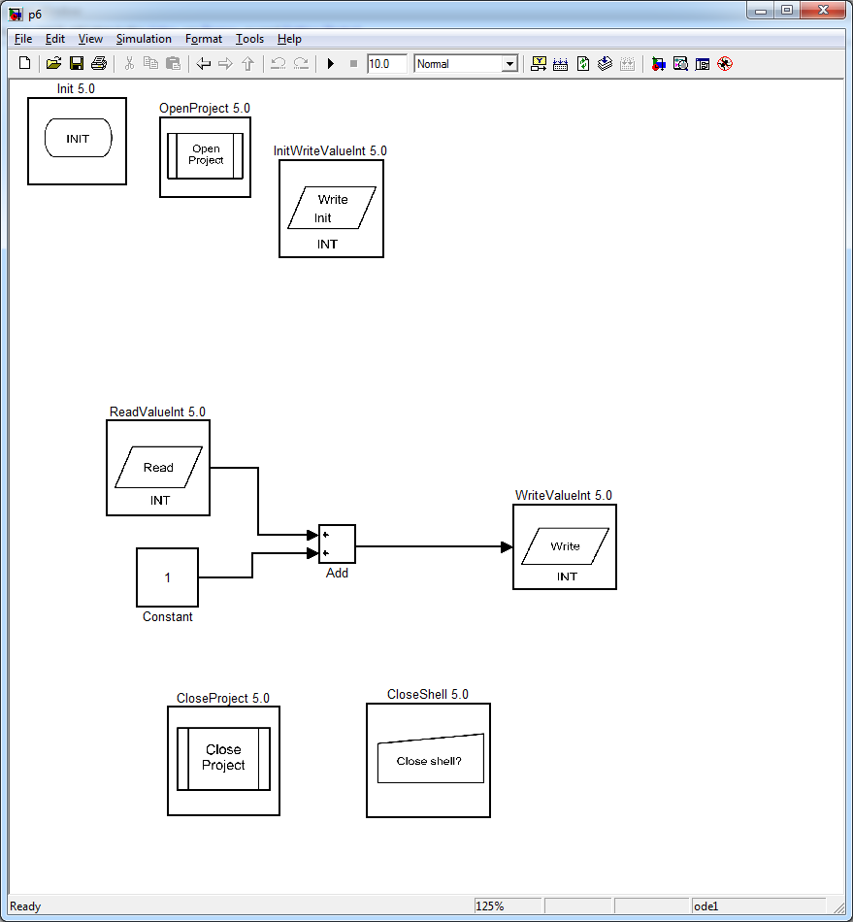
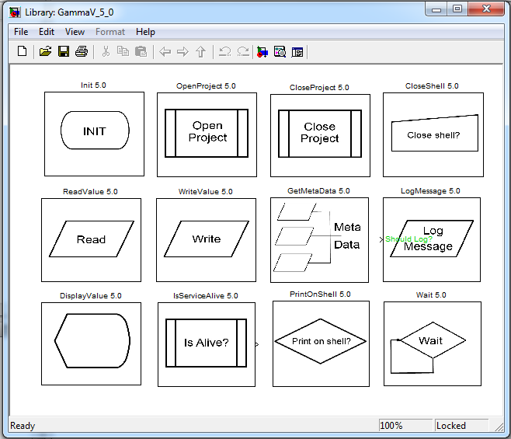
Matlab Simulink Blockset
Integration of middleware based S-functions
S-Function builder block
Runs directly in Matlab Simulink, Windows and Linux
Multicore-capable via middleware scheduler
Easy integration with templates
Easy transfer of models (eg. from Dspace)

Slide 15
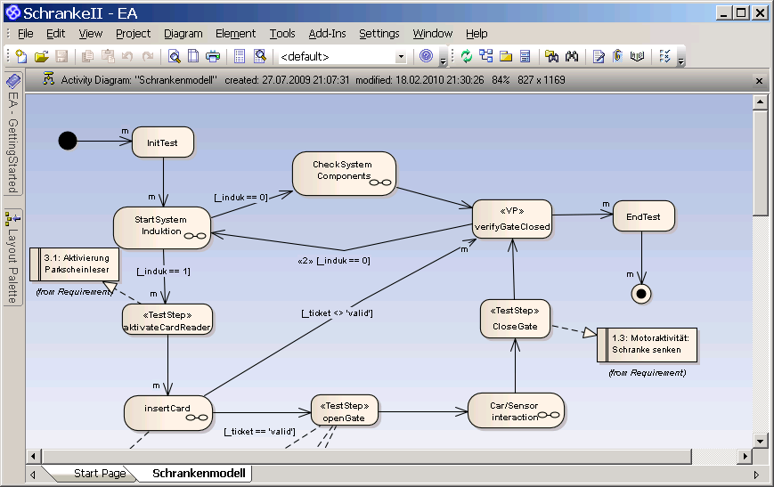
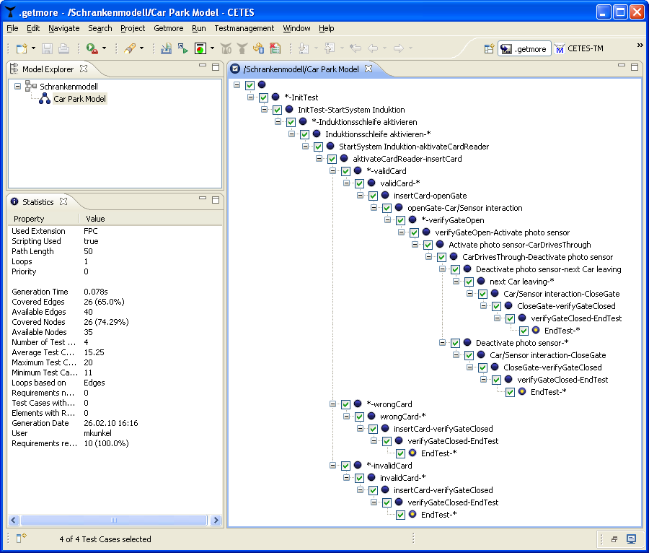
Test Development
YAVE Testing Environment
Model-based Test Case Generator .getmore
Model-based Test Case Generator .getmore / CETES Test Environment

Slide 16
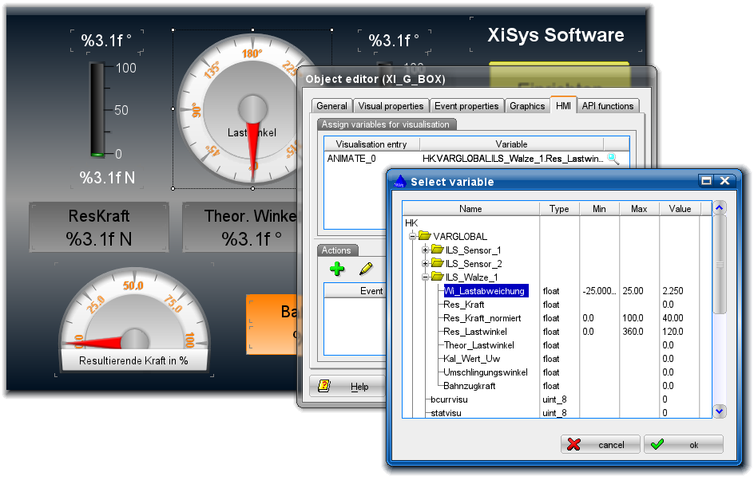
XiBase9: GUI-Builder

Slide 17


















Embedded4You e.V.
ModellbasedTest,
Embedded Linux, Automation
Avionik, Real-time Java
Real-time systems, Linux, Portation, GUI
Application development,
User Interfaces
Backplanes, Racks
Safety, Validation & Verification,
Application development
Research, Innovation, Technology scouting
Verifikation, Testmanagement,
Real-Time Systems, Avionic
Research
Hard- und Software development customer specific measure and control systems
Test systems, Rapid Prototyping, HIL-Test
Testmanagement, Software & Management Consulting
Embedded Systems, OS-9
Embedded Systems, Networking, Communication
Development tools, Application development
Middlewareplattform, System integration, customer applications
Software development, modell centralized Test / Testfallgenerierung, Consulting
Universität Regensburg
Research, Software development, IT- und functional safety
HW- & SW-Development, Smart Products Engineering
Universität Augsburg
Modelling, Analysis methodology
IC-/System-Test, on-Chip / off-Chip Infrastruktur, digital/analog/mixed-signal
Data visualization, User Interfaces

Slide 18
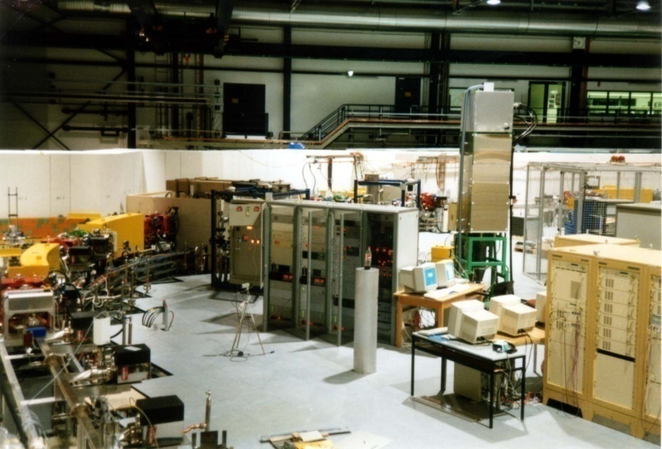
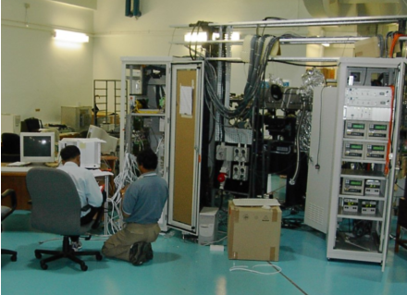
Beamline control systems
National University of
Singapore (SSLS)
Forschungszentrum
Karlsruhe (Anka)

Slide 19
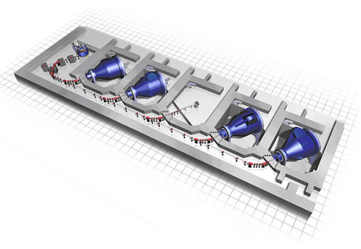
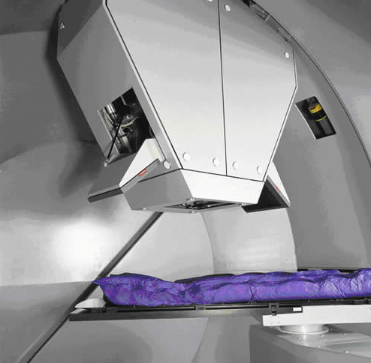
Proton Therapy RPTC München
Scanning Control System for Tumor Irradiation with protons
4 gantries
for tumor scanning
one fixed beam system

Slide 20
Take advantage of universal platforms and become part of the development network around Embedded4You!
After all, who does not cooperate - loses.

