Slide 1

µTCA.4 based developments for the ESS
MTCA Workshop
12.12.2013
DESY Hamburg
Marko Mehle
ESS - Cosylab

Slide 2
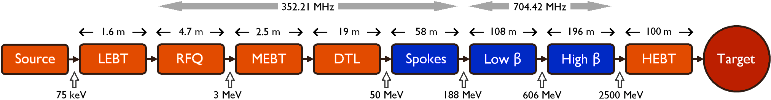
The European Spallation Source
Neutron source located in Lund, Sweden.
2,5 GeV protons (H+), 5MW beam power, 50mA pulse current, 14Hz repetition rate, RF freq: 352MHz / 704MHz.
More than 200 SCRF cavities.
HW plattforms supported by ICS: cPCI, PLC and uTCA.4
Estimated number of EPICS control boxes: 400 cPCI and 200 uTCA.
First neutrons in 2019.

Slide 3
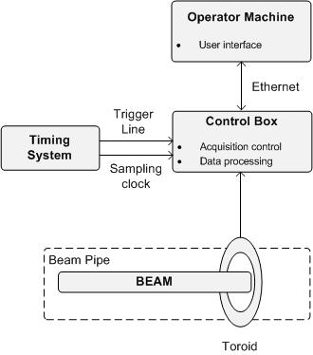
Beam Current Monitor
Beam current measurement with a ACCT transformer.
Triggers and clock from timing system.
Process data between pulses.
ESS BCM:
Implemented on Struck SIS8300 fast digitizer with SIS8900 RTM.
Integrated into EPICS using NDS.
Firmware modifications to allow differencial current measurements.

Slide 4
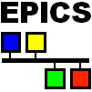
Software Architecture
EPICS, Implemented as an extension of AsynDriver.
NDS (Nominal Device Support) provides general device abstraction. It stadarddizes the interface for common DAQ functionality.
Additions:
  Device state management
  Standard API on EPICS level
  Standard initialization
  Implement only DAQ functionality
  Driver implementation template
  EPICS record templates

Slide 5
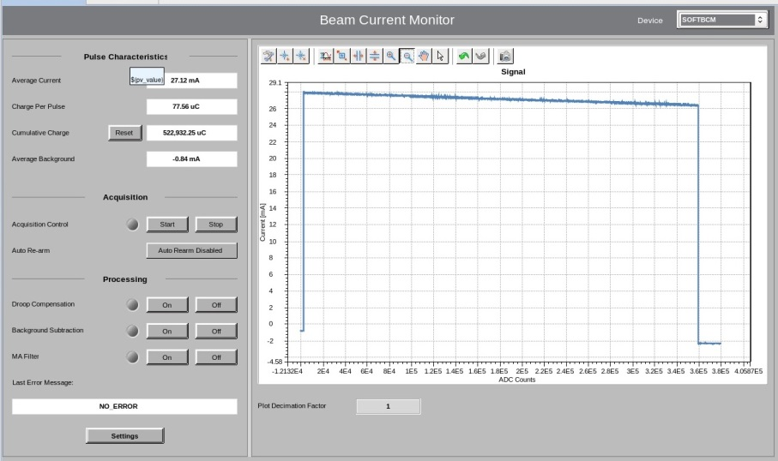
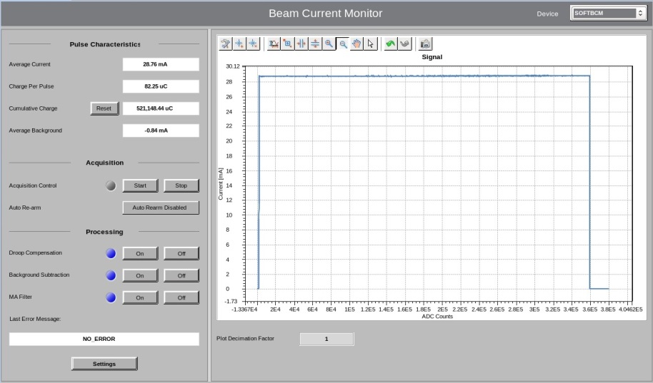
Results
The uTCA BCM system was succesfully tested using a signal generator to emulate the beam (14 Hz square wave).
EPICS gui showing the pulse with and without drop compensation

Slide 6
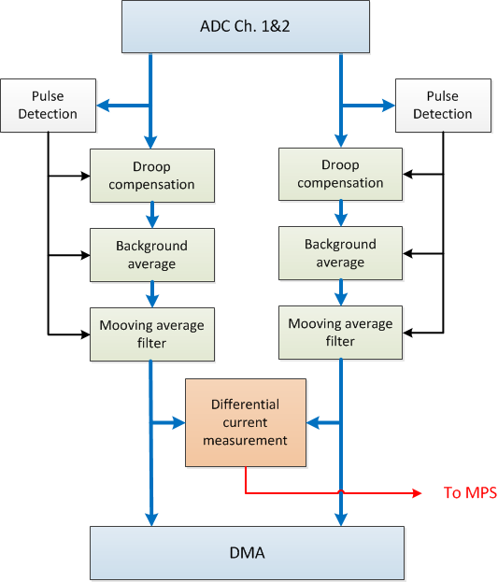
Firmware customization
BCM functions also implemented in the Struck FPGA to allow low latency differential current measurement to trigger the MIS.
10 channels available, grouped in pairs sharing the same clock.
FPGA resources in the Virtex5 very limited (>95% original Struck FW, >98% after upgrade).

Slide 7
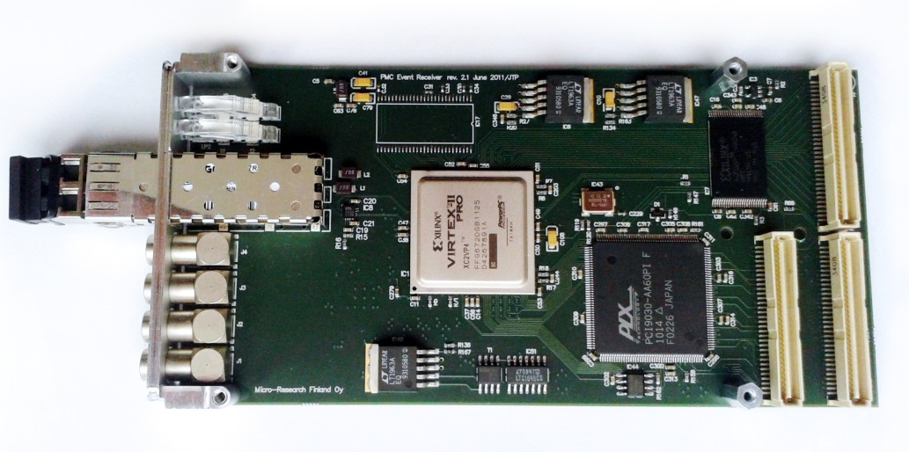
Timing Sistem
Implemented using Micro Research Finland hardware in two form factors: cPCI and uTCA.4.
Custom firmware for ESS timing.
First prototypes for uTCA.4 implemented using EVR PMC module mounted on TEWS TAMC260 (uTCA PMC Carrier). Backplane triggers are not yet available on HW, but are planed for the next versions and already implemented in firmware.
A EVR uTCA.4 card is being developed by MRF.
Notes:
General layout
* signal plot
* beam parameters
* basic acquisition control
* signal processing control
Expert screem

Slide 8
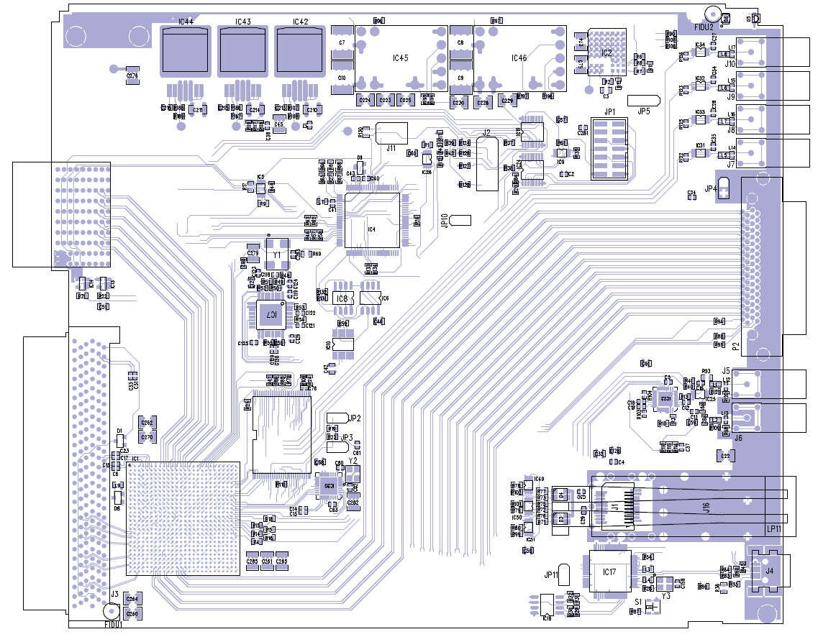
MRF EVR on µTCA.4
Based on Xilinx Kintex FPGA.
The board will have:
2 TTL inputs (LEMO)
4 TTL outputs (LEMO)
micro-SCSI connector for I/O box
support for LVDS signals to RTM
Expected on spring 2014.

Slide 9
HW Trigger lines
Implements 4 types of triggers:
3 Front paner LVTTL ports (LEMO)
8 uTCA M-LVDS lines on the backplane
2 delay compesated star clock lines
Software triggers (non deterministic)
Configurable Delay, Width and Mode (action on event or constant clock signal).

Slide 10
Software
EPICS driver implemented using Nominal Device Support.
NDS meant basically for DAQ devices, but some features also usefull for other type of devices.
NDS provides a state machine with predefined states and gives you the possibility to define the conditions for state transitions and the actions on those transitions.

Slide 11
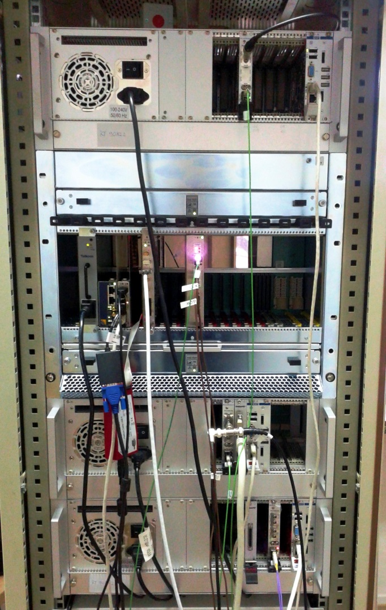
Conclusions
Complete uTCA.4 system with timing receiver (prototype) and BCM tested with good results.
We had to deal with some minor HW issues.
Expecting to get the new uTCA.4 EVR card from MRF to test the backplane triggers.
Some functions will be added to the firmware and software in the future.

