Slide 1
DESY MMC V1.0
DESY Starter Kit for MTCA.4 Module Management
Michael Fenner
MMC V1.0 - DESY Starter Kit for MTCA.4 Module Management
Hamburg, 12.12.2013

Slide 2
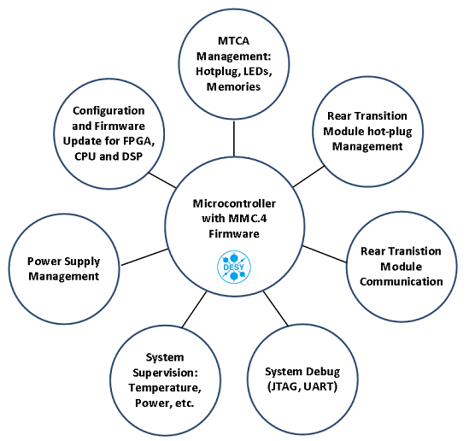
What is MMC V1.0 ?
DESY MMC V1.0 is a set of hardware and software building blocks
Allows AMC/RTM designers to develop management for MTCA.4 cards
Developed together with DESY collaboration partners
Schematics and source code available → Starter Kit
Can be fully customized or used as a drop-in module based on fixed schematics and binary FW image

Slide 3
Reasons for developing MMC V1.0
All MTCA cards need management
Typical functions: power enable and supervision, temperature management, MTCA LEDs, hot-plug and FRU handling
Additional features needed
Dual boot image support
Remote FPGA firmware update (PCIe, IPMI)
RTM activation, monitoring, compatibility handling (E-keying)
JTAG distribution
…
Observation (without common MMC)
  Different vendors have different approaches to these functions
  Software-based incompatibility of AMCs and RTMs
  Important functions missing (redundant memories, IPMI-based firmware update, etc…)

Slide 4
DESY Approach – Available Building Blocks
Idea: Provide HW and FW building blocks“, let user decide what to copy
Philosophy: „If you if know better, modify it. If you don‘t know, copy it“

Slide 5
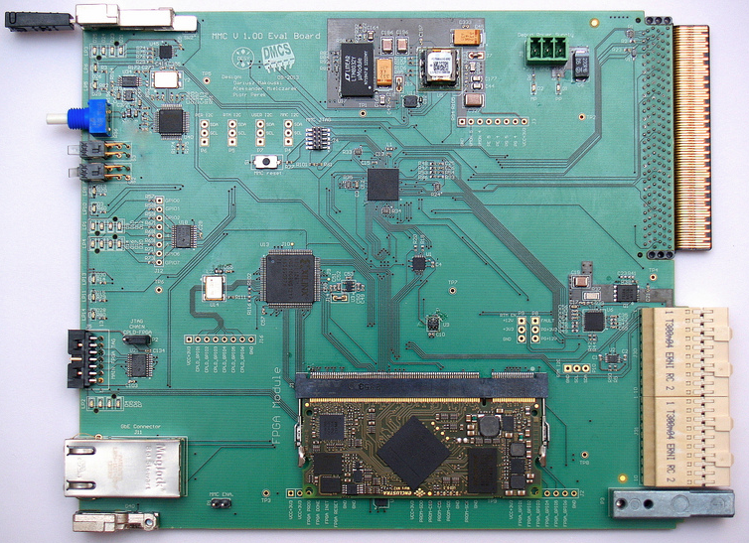
Starter Kit Components – Top
PMBUS module
USB serial
MMC
RTM Power
User I2C
CPLD:
SPI+JTAG
MP→PP
shift
ENCLUSTRA MARS Spartan-6 module
Design: Dariusz Makowski, DMCS

Slide 6
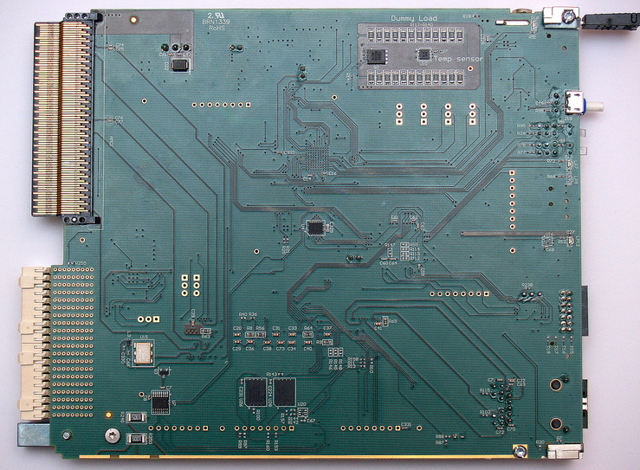
Starter Kit Components – Bottom
Sensor + Load
2x SPI FLASH for FPGA
Design: Dariusz Makowski, DMCS

Slide 7
Status and Conclusion
Hardware
  Hardware is defined and ready: used in industry
  AMC evaluation board ready and available
  RTM evaluation board under construction
Software
  Code Base (ATMEGA) runs in different projects (research/ industry)
  MMC V1.00 Software is under constant development
MMC V1.0 is currently shared with partners under NDA at no charge
Partners benefit from existing and working solutions (less design effort, less interoperability problems)
We benefit from advanced MMC features on boards (mandatory on many research projects) and less software bugs
We want to gain partners and feedback - You are welcome to join

Slide 8
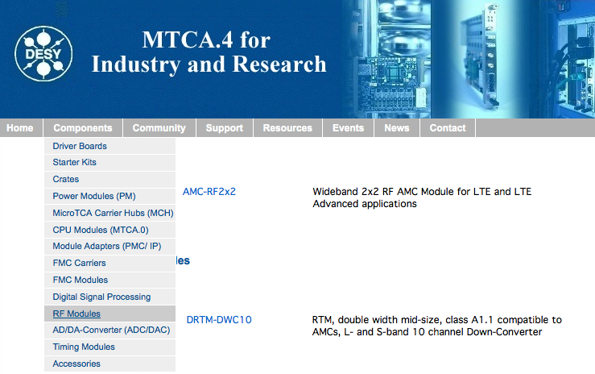
Thank you
Website remark: Is your MTCA.4 product listed on mtca.desy.de?

Slide 9
Spare – MMC V1.0 Features and timescale

