Slide 1
A General MTCA.4-based Laser-to-RF Synchronization System.
Uroš Mavrič on behalf of the MTCA.4 Laser-to-RF Synch Task Force
2nd MTCA Workshop for Industry and Research, DESY, 12.12.2013

Slide 2
Problem Description.
Synchronize Laser-to-RF in order to get synchronism of laser pulses with the rest of the timing on the accelerator.
Combine the good characteristics of both:
Good phase noise performance of laser at higher frequencies
Good phase noise performance of the RF sources at lower frequencies
Usually laser locking systems are composed of several units:
Digitizer, digital processing (e.g. VME-based), PI unit, vector modulator unit, etc.
Piezo driver (19” unit with ext. power supply)
RF box (19 “ unit with ext. power supply)
We are in the process of integrating these modules in a MTCA.4 environment.

Slide 3
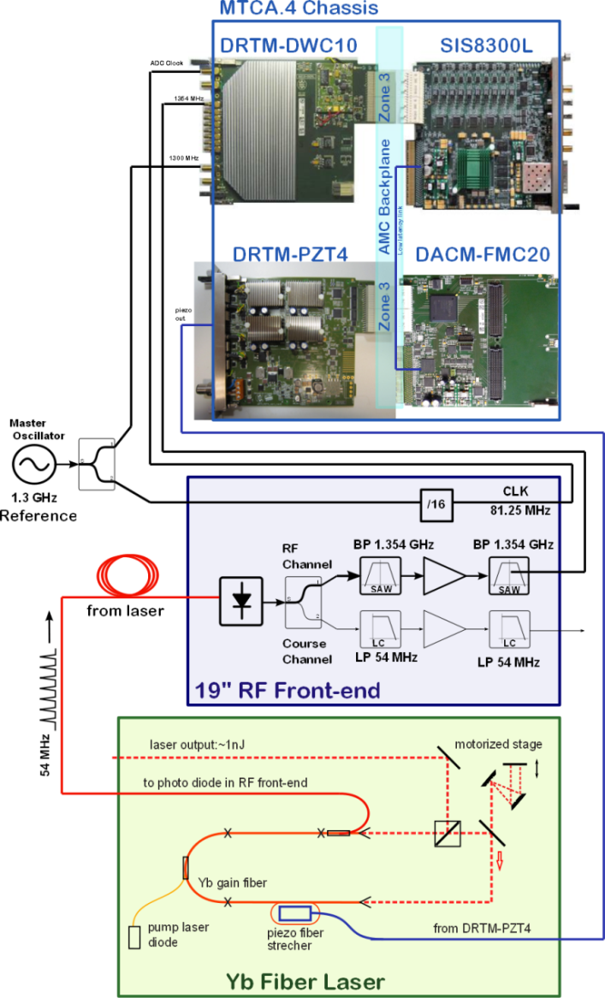
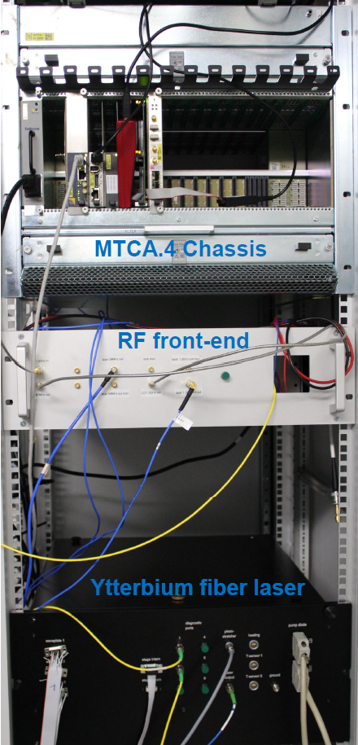
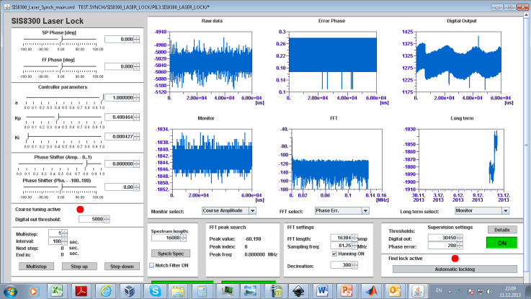
Description of the Loop.
Similar scheme implemented also at:
REGAE
Laser 3 Injector Laser at FLASH
JDDD GUI
Automated course tuning and locking procedure
System locked for several days
See talk from M. Felber at 10:15

Slide 4
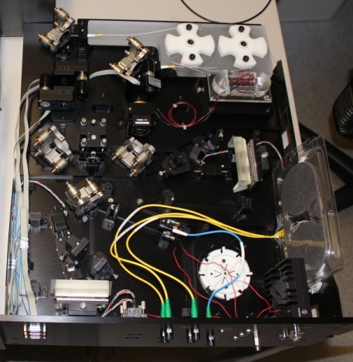
EO Laser
Optimized laser for electro-optical bunch length measurement at XFEL
Mode locked Yb fiber laser developed at PSI and assembled at DESY
Specifications:
Wavelength: 1030nm
Bandwidth: 25-50nm (amplified: 100nm)
Pulse length: 5ps (compressible to <100fs)
Pulse energy: 1-2nJ (amplified: 100nJ)
Repetition rate: 54MHz (amplified: 4.5MHz)
Temperature stabilized to 0.1°C

Slide 5
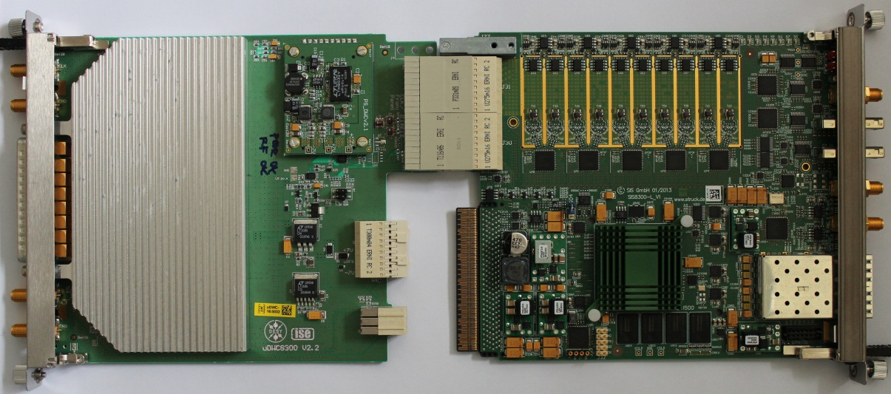
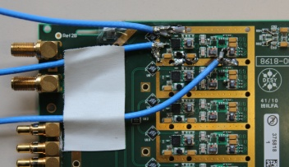
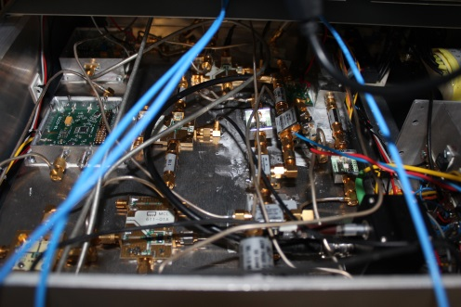
RF Detection.
RF
PD in
LPF f_{ref}
RF Ampl.
AC Ports 0-4
IF0
...
IF9
IF
CPL. 10dB
BPF f_{lock}
RF Ampl.
Down-converter
8
AC Ports 5-7
DET1
DAC 0..3
Input stage
DC/AC configurable
+ Amplifier
RTM_CLK 0/1
RTM Management
RTM.1/.2/.4
DET2
LPF f_{ref}
RF Ampl.
User I2C
LO
PD in
CPL. 10dB
BPF f_{lock}
RF Ampl.
Down-converter
LO / CLK
Generation
Mezzanine
DET1
Input stage
DC/AC configurable
+ Amplifier
DET2
DAC1-4
Conditioning
Circuit
DAC 0..3
RF in
RF-Distribution / PWS Detector
Merge 19” RF detection and RTM detection to a single RTM unit.
Design is in progress.
19” RF Box

Slide 6
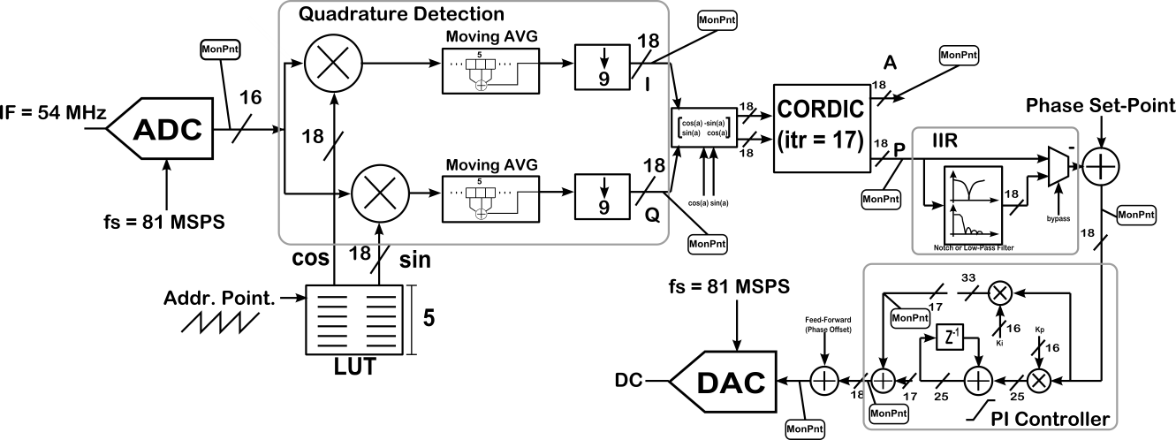
Digitalization and Signal Processing.
SIS8300-L
10 channel, 16 bit digitizer (AC or DC coupled) – low noise design.
Up to 130 MSPS
Virtex 6
2 DACs
DDR3 2 Gbyte
IF in
ADC
DAC
PCIe & PtP
FPGA
I/Q detection
NCO can be swept externally
CORDIC
Locking on the phase component
Internal IIR for Notch (piezo resonance suppression)
PI controller
Feed-forward table
Phase shifter for locked phase settings

Slide 7
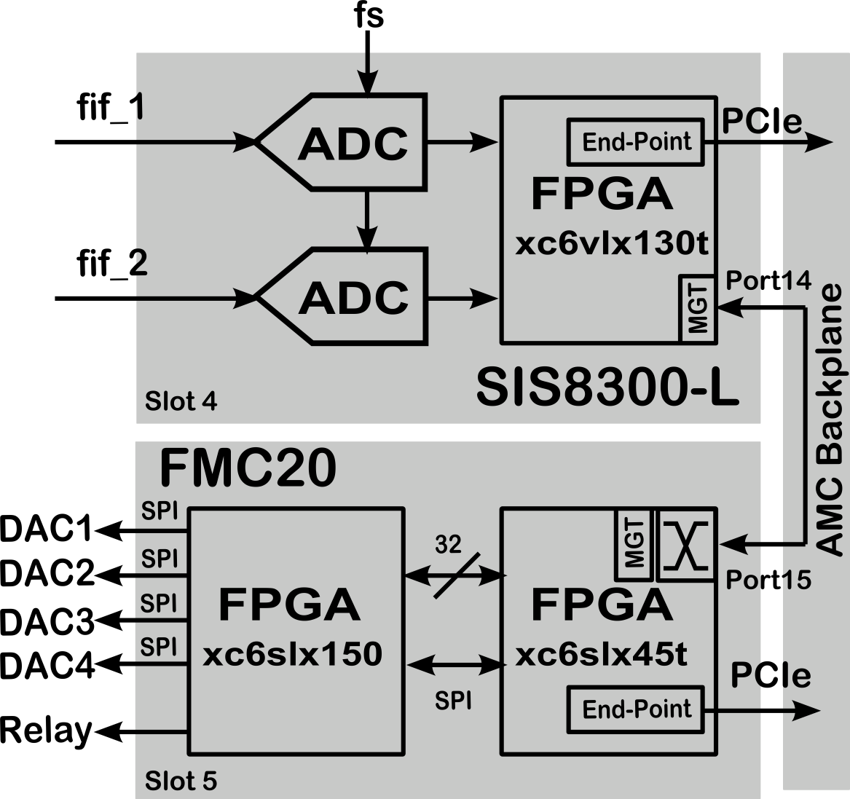
Data Transmission.
Loop delay < 2us
enough for ~60 kHz closed-loop bandwidth.
PCIe links and Point-to-point links run at 2.5 Gbps.
SPIs between FPGAs run at 62.5 MHz.
SPI for DACs runs at 500kSPS.

Slide 8
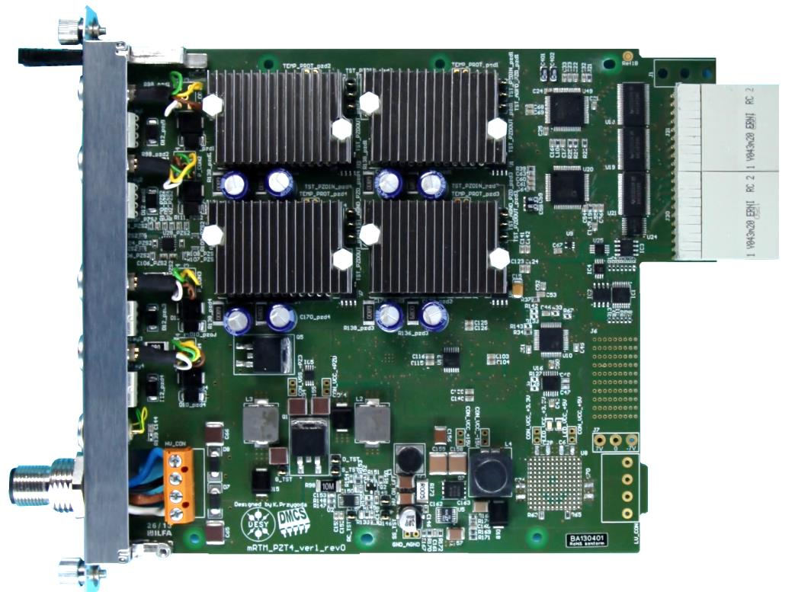
DRTM-PZT4.
DAC
Main applications:
Cavity fine tuning using piezo elements (e.g. for Lorentz force detuning compensation or microphonics noise rejection)
Synchronizaton of pulsed lasers to RF source
Stabilization of the fiber links that provide synchronization signal over the accelerator machine
Main features:
Simultanouse driving and sensing of 4 piezo actuators and sensors.
It provides the possibility of usage of internal or external power supply for the power amplifiers.
It provides external interlock input signal to disable the power amplifiers.
The modue is enclosed inside a metal housing to prevent against touching of high voltage.
PA 2
PA 1
PA 3
PA 4
DAC
EXT. PS Input
4 power amplifier with 0-100V, -100V/+100V
DAC outputs +/-5V, +/-10V, 0/5V, 0/10V
Each power amplifier can drive up to 10uF capacitance.
See talk from K. Przygoda at 13:15 - Session 6

Slide 9
Recent Results.
Out-of-loop measurement, comparing the RF at 1.3 GHz and the locked 1.3 GHz component from the laser.
50, 100 , 150 Hz, Real?
Defined by quality of FB
First piezo resonance
Defined by quality of the Rec.
35 fs [10 Hz-1MHz]

Slide 10
The MTCA.4 Laser-to-RF Synch Task Force.
Lukasz Butkowski
Hans-Thomas Duhme
Matthias Felber
Michael Fenner
Christopher Gerth
Tomasz Kozak
Peter Peier
Paweł Prędki
Konrad Przygoda
Holger Schlarb
Bernd Steffen

Slide 11
Thank you for your attention.

