Slide 1


FCAL Status Report
Wolfgang Lohmann, BTU and DESY
On behalf of the FCAL Collaboration
AGH University of Science and Technology Cracow, ANL Argonne, CERN Geneva, DESY Zeuthen, IFIN-HH Bukharest, INPPAN Cracow, ISS Bukharest, LAL Orsay, JINR Dubna, NCPHEP Minsk, Pontifica Universidad Catholica Santiago de Chile, SLAC Stanford, Tel Aviv University, Tohoku University Sendai, University of Colorado Boulder, UC California Santa Cruz, Vinca Belgrade

Slide 2
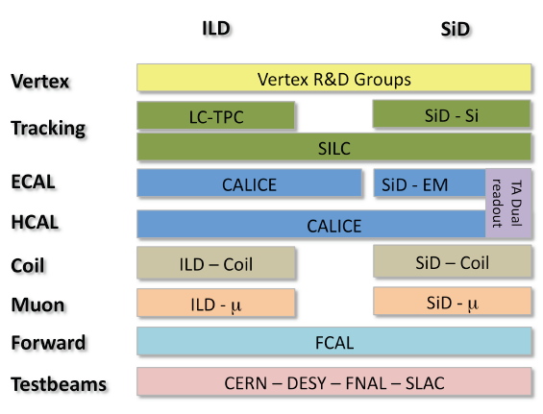
Mission and Landscape
FCAL Mission
Design of the very forward region of detectors at future linear collider
Concept for precise and fast measurement of the luminosity
Development, prototyping and test of major components of the detectors
Verification of Monte Carlo estimates of the detector performance
Ensure that critical R&D is addressed in a timely manner
FCAL in the R&D landscape
Challenges:
High precision luminometer
High occupancy
High radiation tolerance
Fast readout electronics

Slide 3
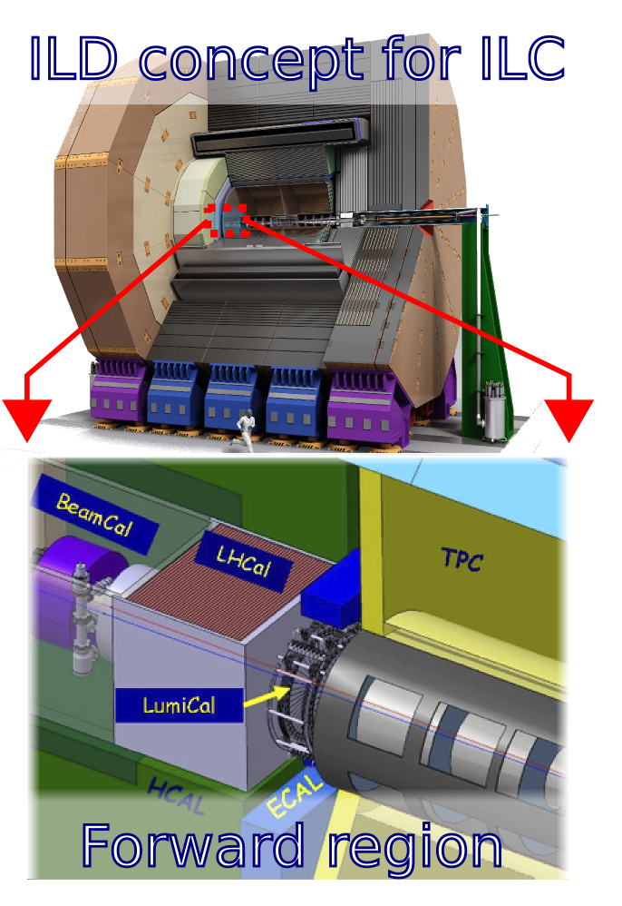
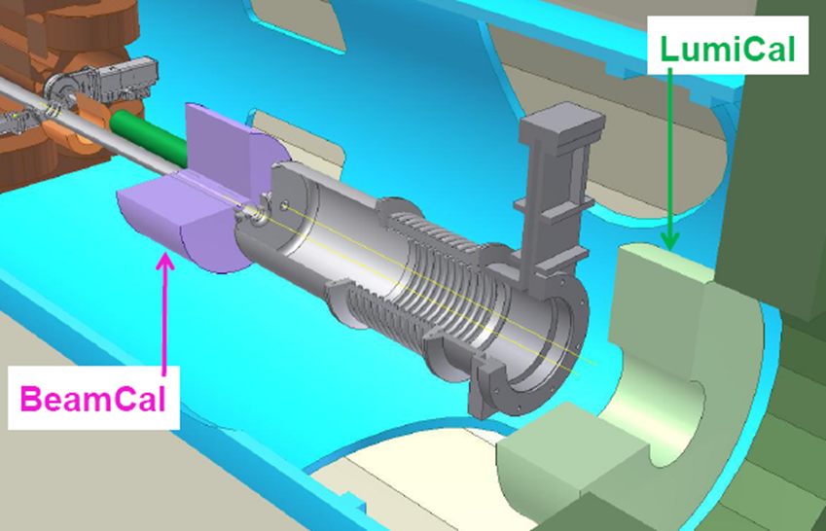
Example Very Forward Region of the ILD and a CLIC Detector
FCAL unique contributions to the
ILC RDR
ILD and SiD Concepts
CLIC CDR
ILD TDR (DBD for ILD and SiD)

Slide 4
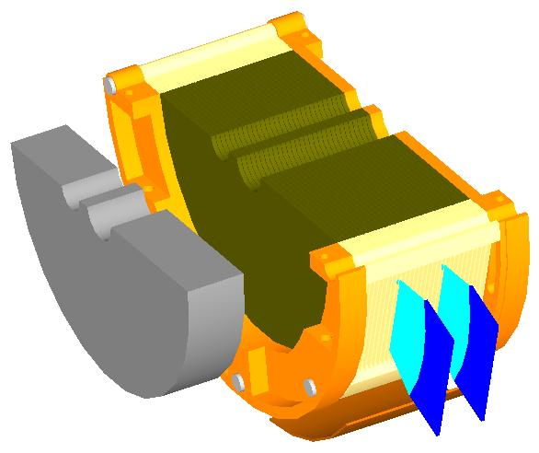
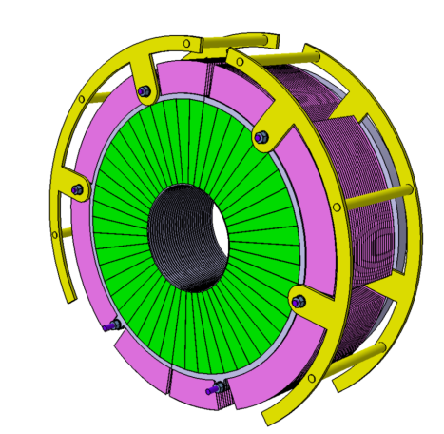
Subdetectors
BeamCal (+Pair Monitor)
Fast luminosity estimate (bunch-by-bunch at ILC)
Beam parameter estimation
Fast feedback to the machine
Hermeticity & Low angle electron tagging
LumiCal
Precise measurement of the luminosity
(10⁻³ at ILC, 10⁻² at CLIC)
Hermeticity
Low angle physics

Slide 5
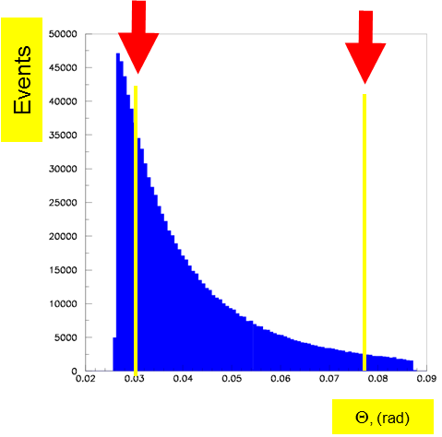
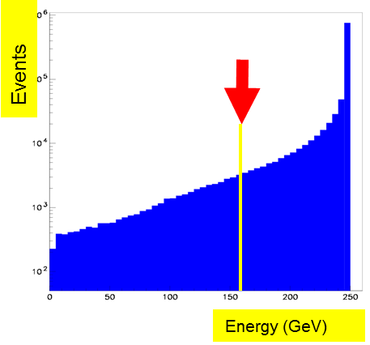
LumiCal
Precise measurement of the luminosity
(10⁻³ at ILC, 10⁻² at CLIC)
Hermeticity
Low angle physics
Gauge process for the luminosity measurement: Bhabha scattering
e⁺e⁻ e⁺e⁻ (γ)
L = N / σ
Count Bhabha events
From theory

Slide 6
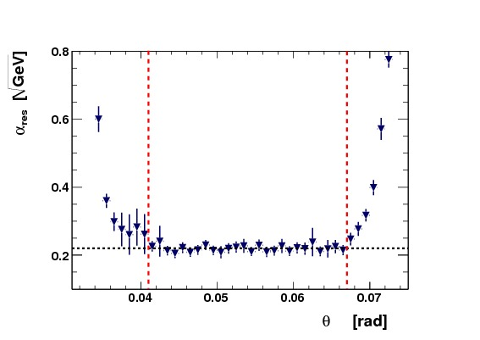
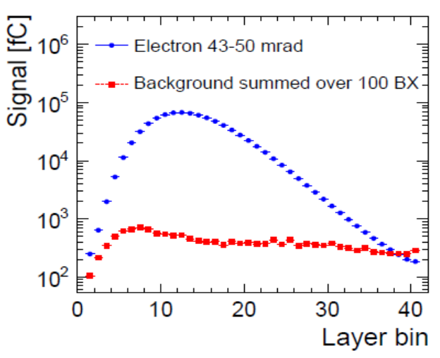
LumiCal
LumiCal Design Studies
Energy resolution vs. polar angle
Energy resolution with and without
gaps between sensor tiles
CLIC, impact of background

Slide 7

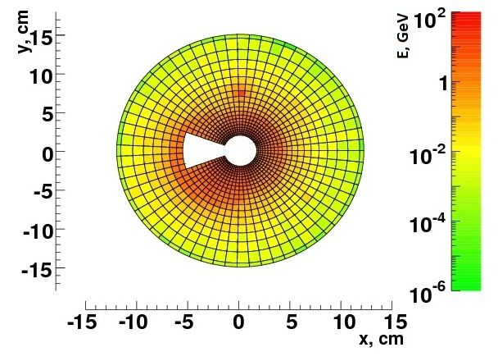
BeamCal
Fast luminosity estimate (bunch-by-bunch at ILC)
Beam parameter estimation
Fast feedback to the machine
Hermeticity & Low angle electron tagging
Beam parameter determination and fast feed-back to the collider
(may include the pair monitor and a possible GamCal)
Electron tagging at low polar angle

Slide 8

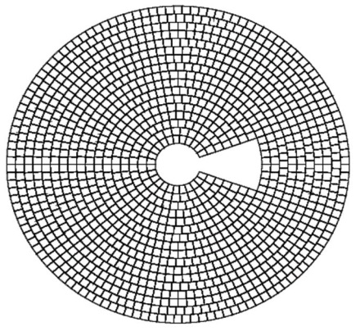
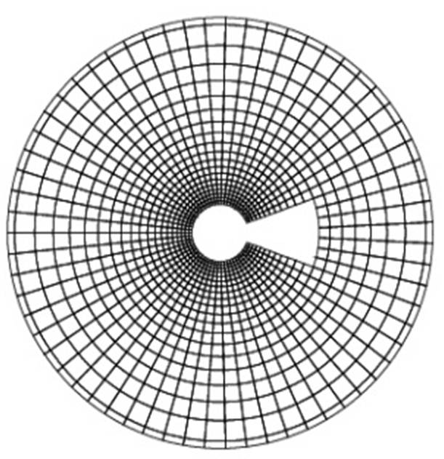
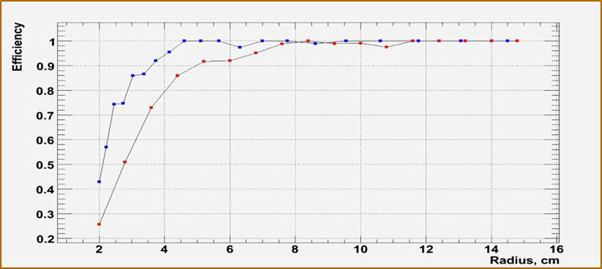
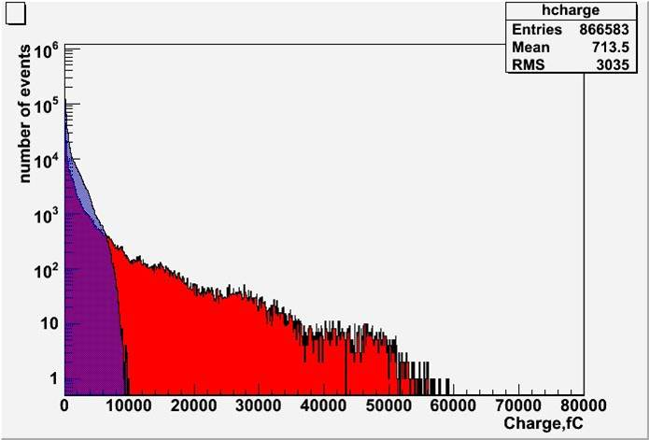
BeamCal
Performance at CLIC, 3 TeV
Study of different segmentations 1 TeV
Estimate of the signal range, 1 TeV
Red: Equal size pads
Blue: pad size growing with the radius
Red: Equal size pads
Blue: pad size growing with the radius

Slide 9

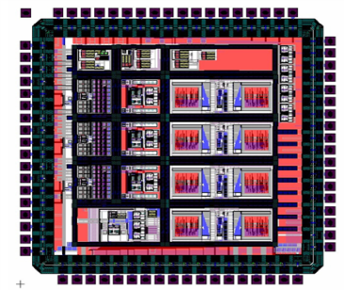
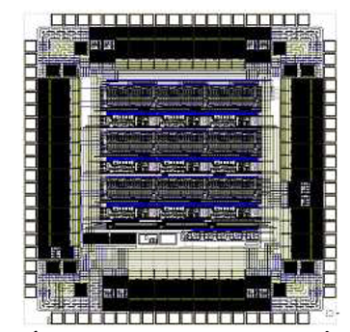
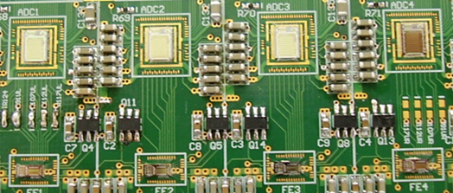
Sensors and ASICs
FE ASICs developments dedicated to LumiCal, BeamCal and pair monitor
FE ASIC, 8 channels, 4 RC and 4 FET feedback, 350 nm AMS
FE and ADC ASIC, 180 nm
4 channels, fast adder for fast feedback to the machine
3 x 3 pixel readout
200 nm CMOS
PCB instrumented with FE ASICs and 10 bit pipeline ADC ASICs for test-beam studies
Dedicated talk by Krzystof

Slide 10
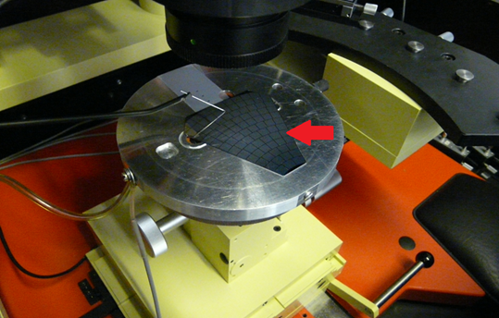
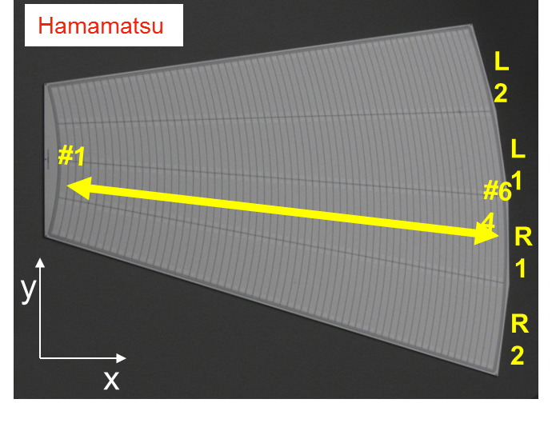
Sensors and ASICs
Characterisation of a GaAs sensor on the probe-station
Silicon sensor prototype for LumiCal
Compensated GaAs
Institute in Tomsk, DESY-JINR collaboration (BMBF supported)
Characterised at JINR and DESY
Dedicated talk by Georgy
p in n, strip pitch 2.2 mm
40 pieces, joint effort
IFJ PAN Cracow, DESY, TAU
Electrical characterisation done, matches quality criteria

Slide 11
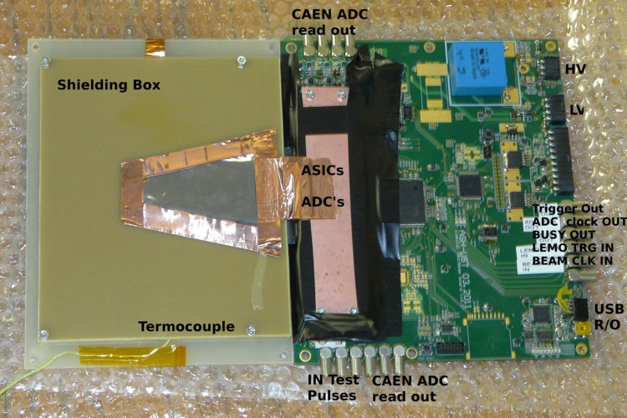
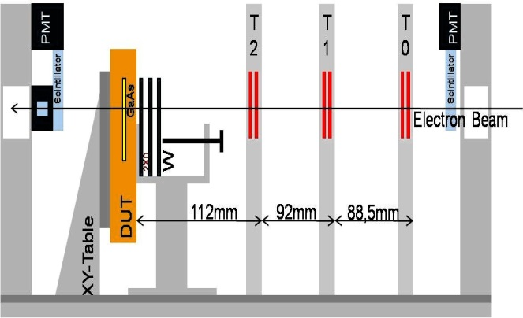
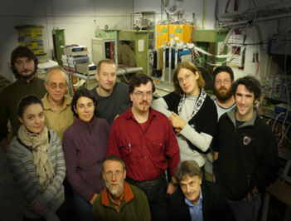
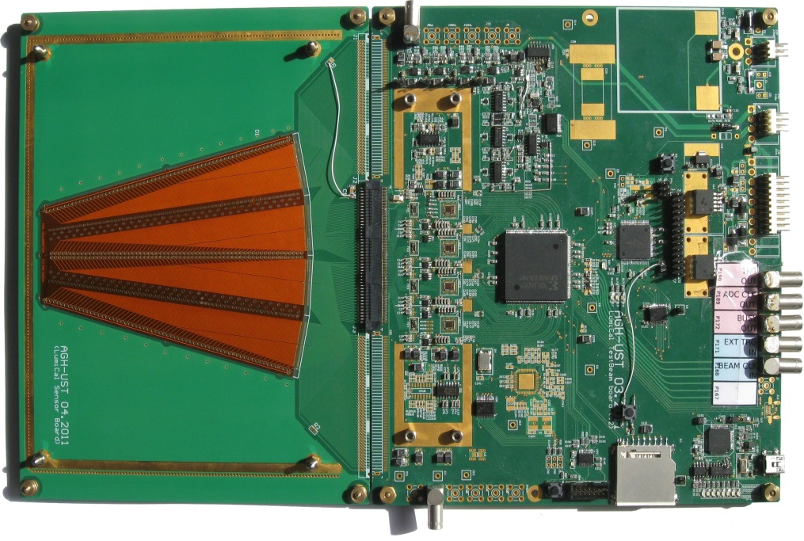
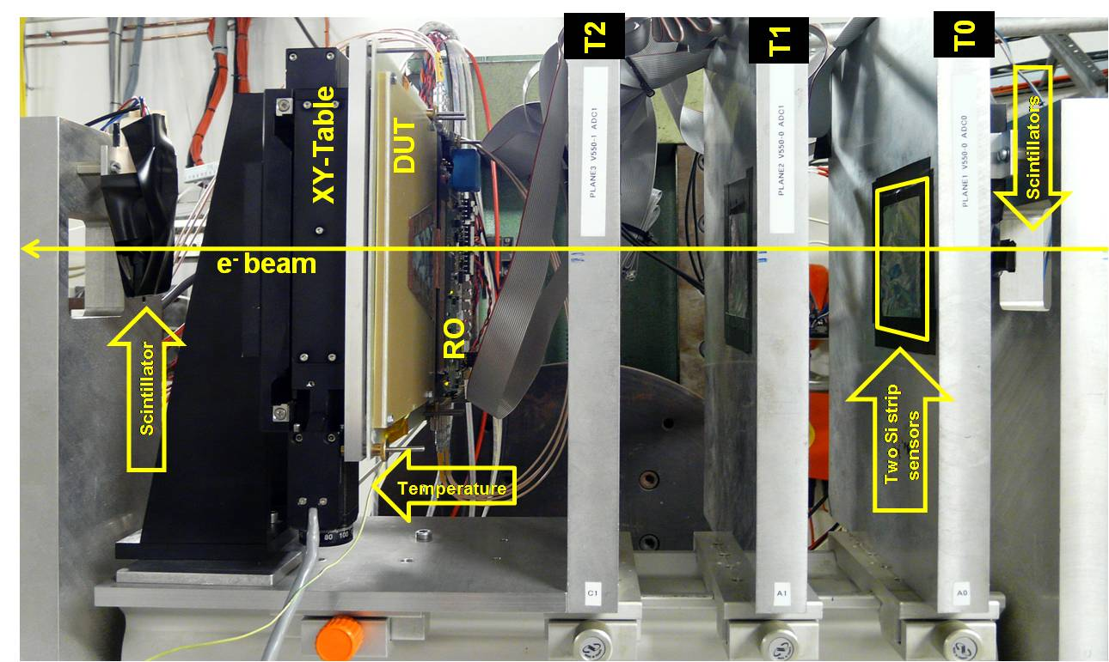
Fully Assembled Sensor Planes
Performance studies in an electron beam 2-4.5 GeV at DESY
> 50 x 10⁶ trigger

Slide 12
Beam Test Readout and DAQ
32 channels fully equipped
(Sensor + Front-end + ADC)
Signal handshaking with Trigger Logic Unit (TLU)
EUDAQ software
ADC Clock source
  Internal (asynchronous with beam operation) – CLIC mode
  External (beam clock used to synchronize with beam) – ILC mode
  ADC sampling rate is up to 20 Ms/s (6.4 Gbps)

Slide 13
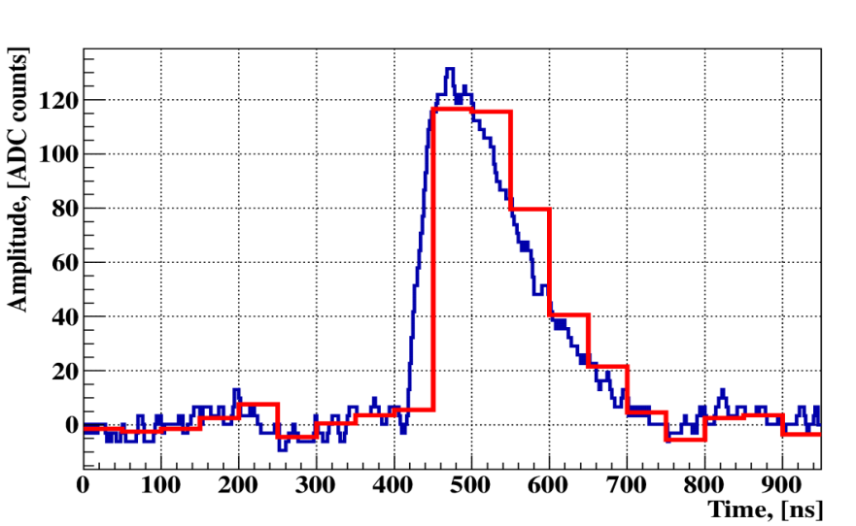
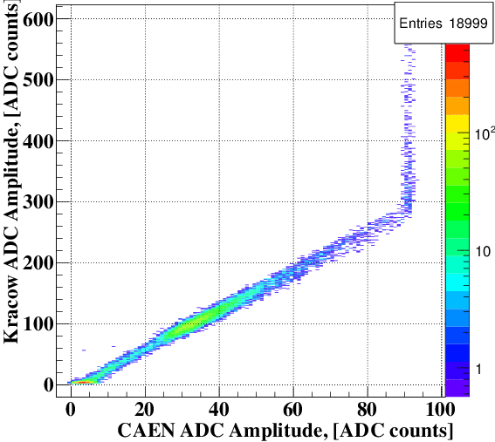
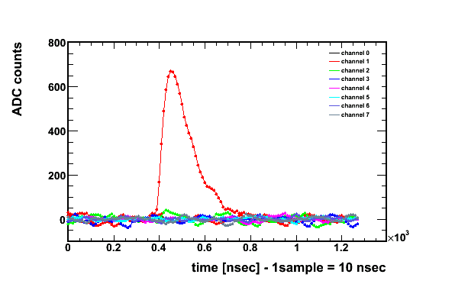
Beam-test Results
Example signal:
Signal digitized with ADC ASIC (red) and external ADC (blue )
Comparison of the amplitude measured with
the ADC ASIC and a CAEN 500 Ms/s flash ADC
Aplitude vs. time for several channels

Slide 14
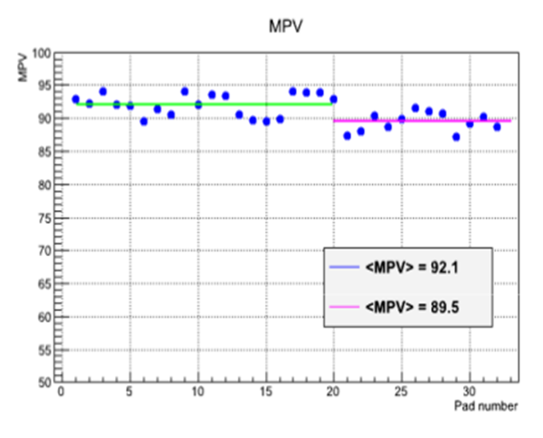
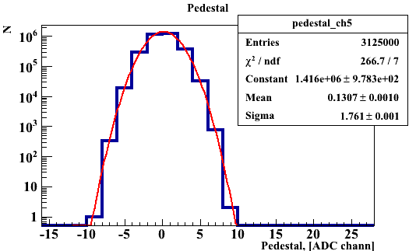
Beam-test Results
Gain vs. channel
Triggered signal spectrum
Pedestal
(taken without signal)

Slide 15
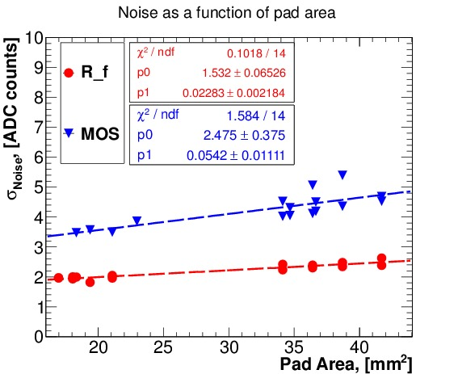
Beam-test Results
S/N from mips vs. channel
both for RC and FET feedback
Sigma(ped) as a function of the pad size

Slide 16
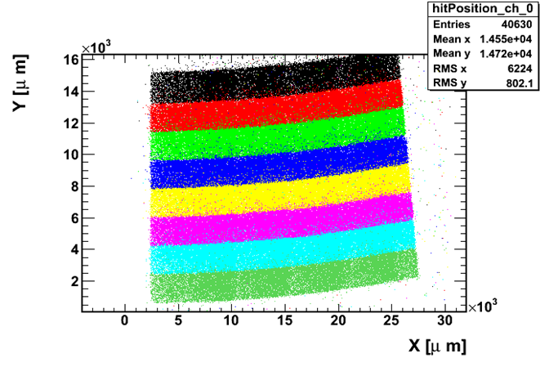
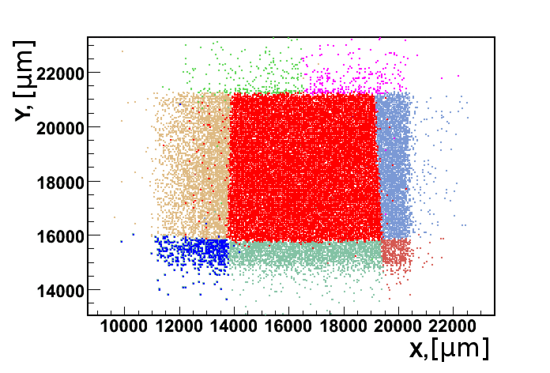
Beam-test Results
Impact point reconstruction using
the beam telescope
LumiCal sensor
Impact point reconstruction using
the beam telescope
BeamCal sensor

Slide 17
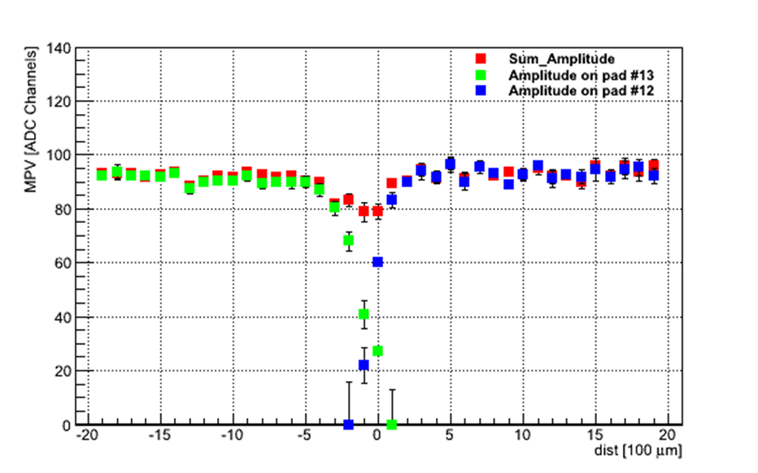
Beam-test Results
Scan across a pad boundary
BeamCal sensor
LumiCal sensor

Slide 18
Beam-test Results

Slide 19
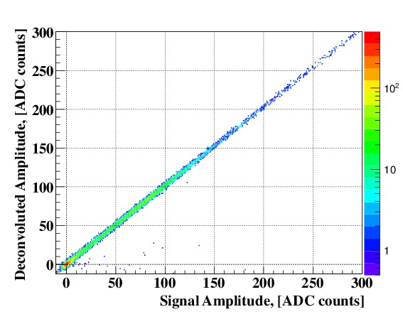
Beam-test Results
Data reduction and pile-up treatment by signal deconvolution
Reconstruction of the deconvoluted amplitude and comparison with full ADC information

Slide 20
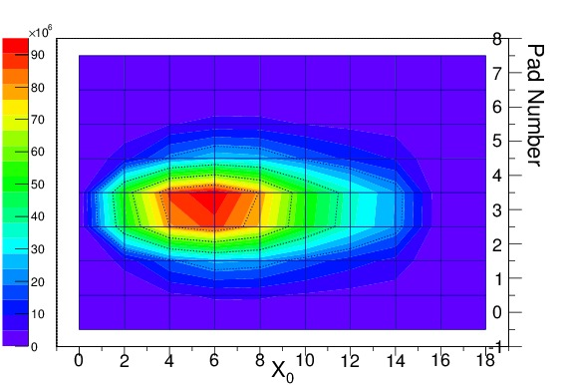
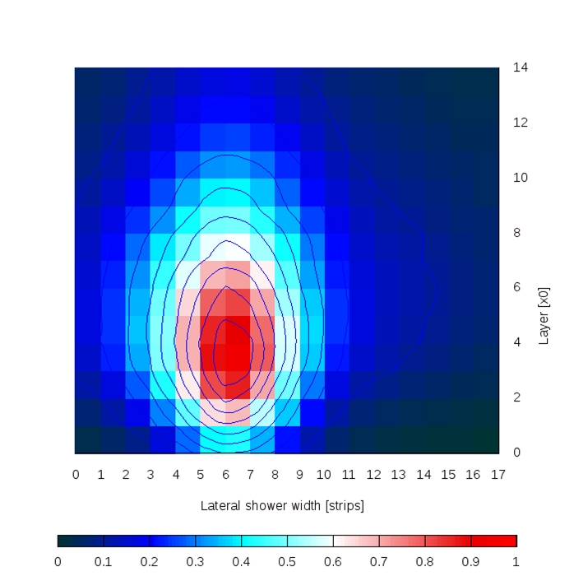
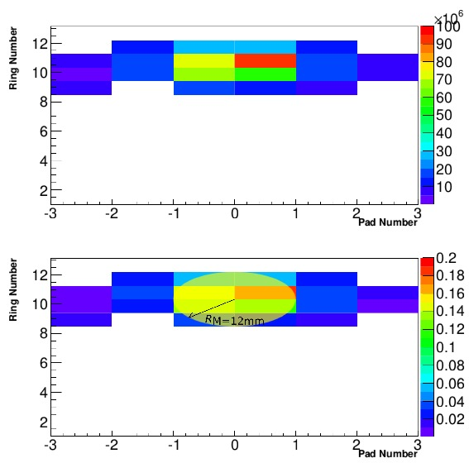
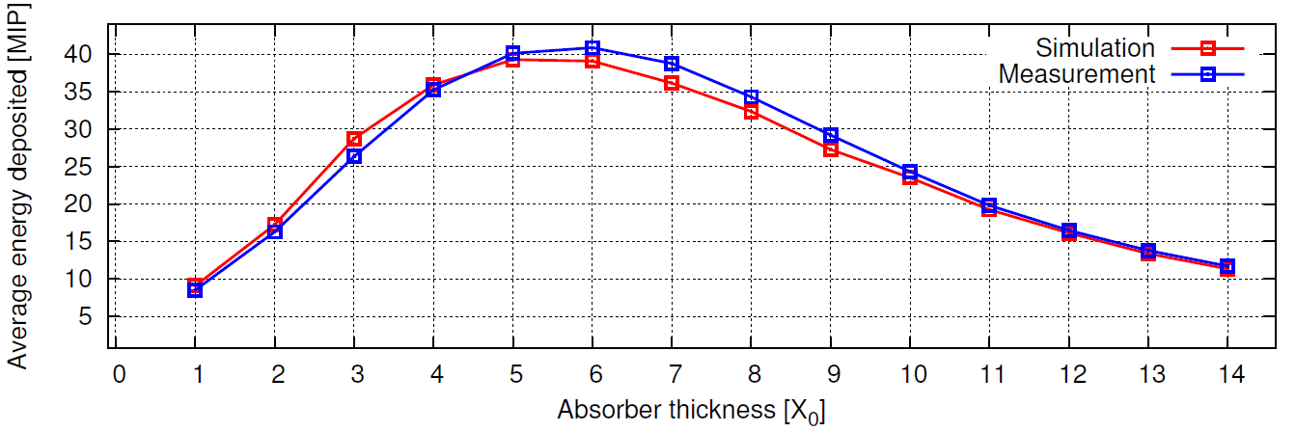
Beam-test Results
Shower profile measurements with n X₀ tungsten blocks in front of the sensors

Slide 21

Luminosity Spectrum and Beam-Beam Effects
Both for Luminosity measurement and for Physics analyses this spectrum must be known
The strong magnetic field during bunch crossing also changes the direction of Bhabha electrons
Dedicated talks by Andre and Strahinja

Slide 22
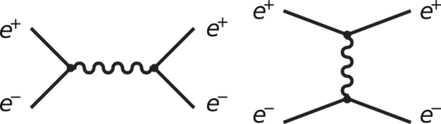
Physics Background
Signal
Background

Slide 23
Summary
FCAL Deliveries
Designs of the very forward region for ILC and CLIC detectors
Monte Carlo estimates of the expected performance of a luminometer for precise luminosity measurement
Feasibility of fast luminosity measurement, beam parameter
determination and electron tagging with BeamCal and Pair
Monitor
Successful development of sensors and dedicated ASICs
Successful prototyping and test of major components in the beam
Unique contributions to the ILC RDR, the CLIC CDR, the ILC TDR and to the detector concepts ILD and SiD

