Slide 1
Introduction Thomas Berghöfer • APPEC General Secretary

Slide 2
Introduction
What is APPEC?
Why we are here?
What do we do here together?
How do we continue after the workshop?

Slide 3
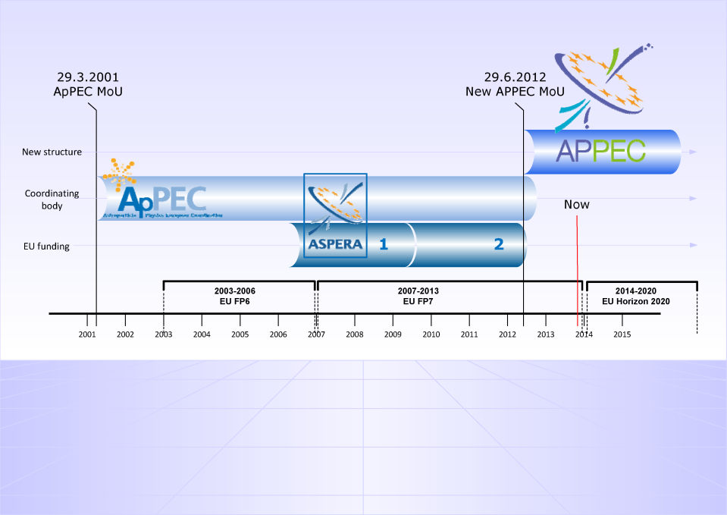

Slide 4
… is the European consortium of ministries, funding agencies, or their designated national institutions active in astroparticle physics
Based on an MoU signed by 17 partners (November 6, 2013): FRS-FNRS, FWO (Belgium); CSF (Croatia); CEA, CNRS (France); DESY [BMBF], KIT [Helmholz Association] (Germany); RIA (Ireland); INFN (Italy); FOM (Netherlands); NCN (Poland); IFIN-HH (Romania); LSC [MINECO] (Spain); SNSF (Switzerland); STFC (UK); VR (Sweden); JINR (Dubna);
Observer: ESO

Slide 5
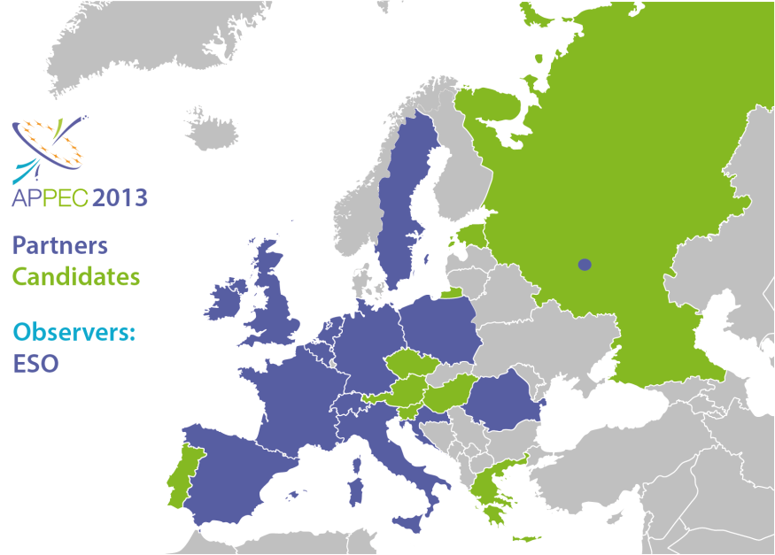

Slide 6
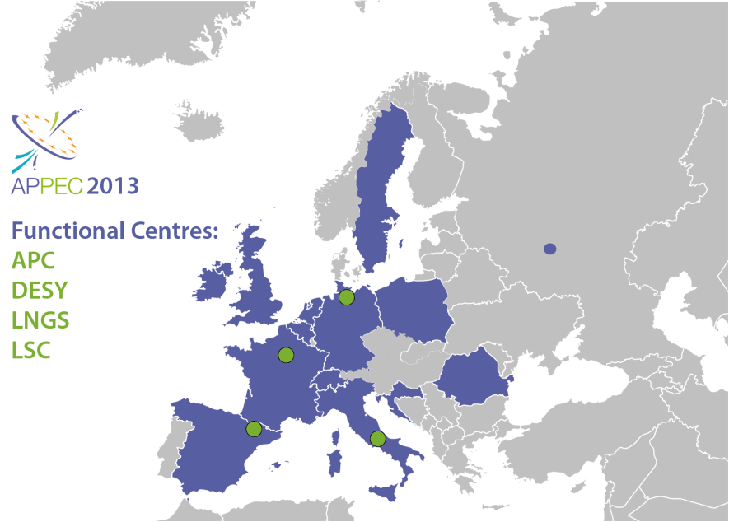
International Contact Computing
Industrial Relations
Strategic Actions, Interdisciplinarity Outreach
Networking
Theory
Education centre
Electronic Tools Web

Slide 7
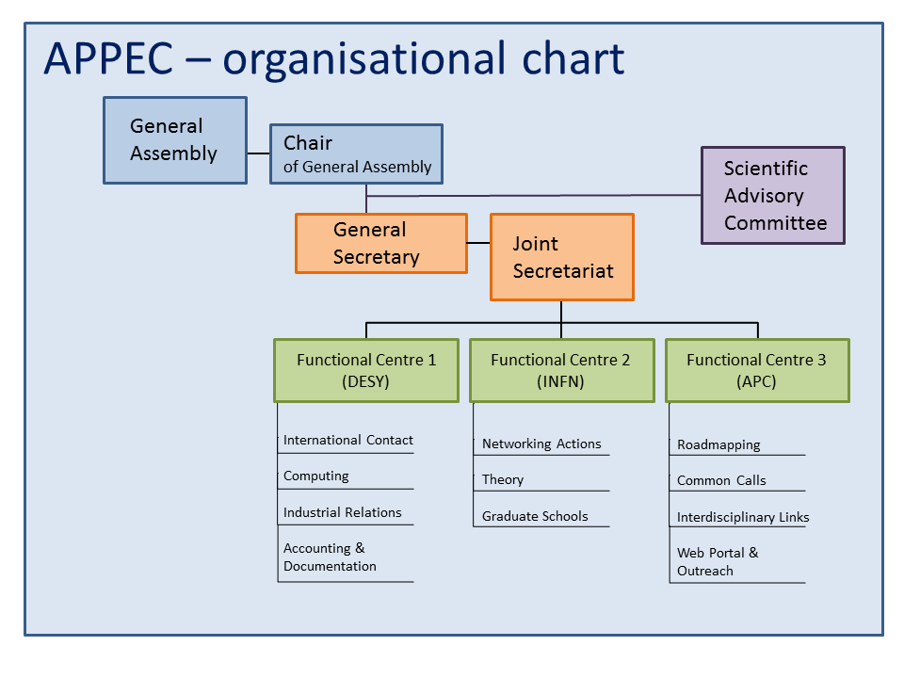
Stavros Katsanevas
Antonio Masiero
Thomas Berghöfer

Slide 8
Why we are here?

Slide 9
Horizon 2020 The EU Framework Programme for Research and Innovation
Start: January 1, 2014
Adoption of work programme and first calls: December 11, 2013
First deadlines: mid of April, 2014

Slide 10
Horizon 2020:
Research and Innovation in three pillars
1
2
3
EXCELLENT
SCIENCE
22,27 B€
INDUSTRIAL LEADERSHIP
15,51 B€
SOCIETAL CHALLENGES
27,05 B€

Slide 11
What do we do here together?
… a short tour through the workshop programme

Slide 12
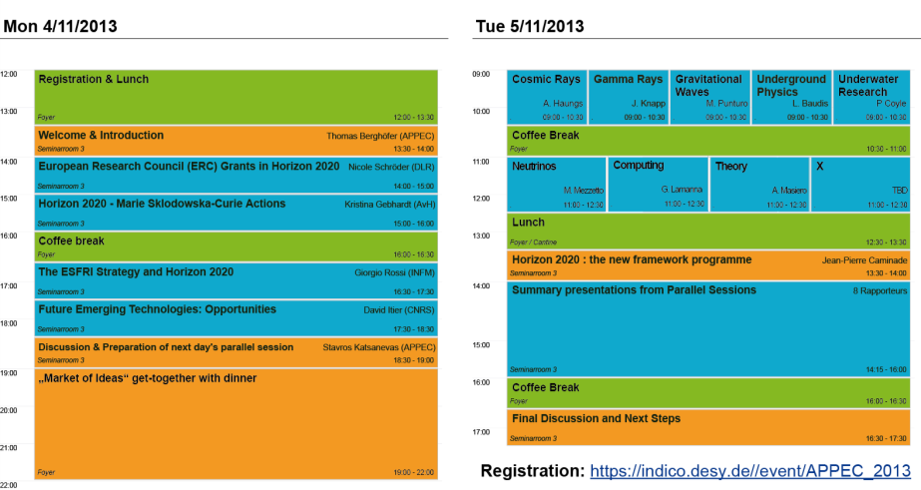
paRALLEL SESSIONS
iNFORMATION
Compilation
DISCUSsION & PREPARATION
Next steps

Slide 13
INFORMATION
14:00 - 15:00
European Research Council (ERC) Grants in Horizon 2020 Nicole Schröder (DLR)
15:00 - 16:00
Horizon 2020 - Marie Sklodowska-Curie Actions Kristina Gebhardt (AvH)
16:30 - 17:30
The ESFRI Strategy and Horizon 2020 Giorgio Rossi (INFM)
17:30 - 18:30
Future and Emerging Technologies David Itier (CNRS)

Slide 14
DISCUSSION & PREPARATION
18:30 - 19:00
Discussion & Preparation of next day's parallel session all
convener: Stavros Katsanevas (APPEC)
19:00 - 22:00
„Market of Ideas“ get-together with dinner all
Zeuthen to Berlin at: …, 20:28, 20:48, 21:08, 21:28, 21:48, 22:08, 22:28, …

Slide 15
PARALLEL SESSIONS
9:00 - 10:30 convener
Cosmic Rays Andreas Haungs
Gamma Rays Johannes Knapp
Gravitational Waves Michele Punturo
Underground Physics Laura Baudis
Underwater Research Paschal Coyle
11:00 - 12:30
Neutrinos Mauro Mezzetto
Computing Giovanni Lamanna
Theory Antonio Masiero
+ Any additional topic (on request)

Slide 16
COMPILATION (APPEC funding agency representatives invited)
13:30 - 14:00
Horizon 2020 : the new framework programme Jean-Pierre Caminade
14:00 - 16:00
Summary presentations from Parallel Sessions 8 (9) Rapporteurs
Cosmic Rays
Gamma Rays
Gravitational Waves
Underground Physics
Underwater Research
Neutrinos
Computing
Theory
+ Any additional topic (on request)

Slide 17
FINAL DISCUSSION and NEXT STEPS
16:30 - 17:30
Final Discussion all
How do we continue after the workshop?
APPEC continues to prepare all available information (WPs, calls, …)
Disseminate information to interested groups
Let‘s discuss what else APPEC can do for you
APPEC General Assembly meets tomorrow in Berlin to further discuss: link to ESFRI, lobbying in Brussels, support and quality check of collaborative proposals, …

Slide 18
Thank you for your attention!
Let‘s start with a successful meeting!
Many many thanks to all who helped organising this meeting (Martina, Sandra, Christine, Ino, …)

