Slide 1
APPEC and Horizon 2020 Opportunities for discussion
S. Katsanevas APPEC
Notes:
Cette présentation illustre les nouvelles fonctionnalités de PowerPoint, qui sont optimisées pour un affichage sous forme de diaporama. Ces diapositives visent à vous donner des idées pour créer des présentations captivantes dans PowerPoint 2011.
Pour obtenir d’autres exemples de modèles, cliquez sur le menu Fichier, puis sur Nouveau à partir d'un modèle. Sous Modèles, cliquez sur Présentations.

Slide 2
APPEC programs in FP6-FP7
MSCA
THEORY
GW-ITN
(+industry)
Unsuccessful I3: ILIAS-next, HEAPNET 1-2-3
KM3-DS
LAGUNA-DS
LBNO-DS
ET-DS
KM3NET-PP
CTA-PP
I3 ILIAS
ASPERA

Slide 3
Excellent Science 31,73% i.e. 22,27 B euros
1
A: Marie Skłodowska Curie Actions (MSCA)
B: Frontier research (ERC)
C: Research infrastructures (RΙ)
D: Future and Emerging Technologies (FET)

Slide 4
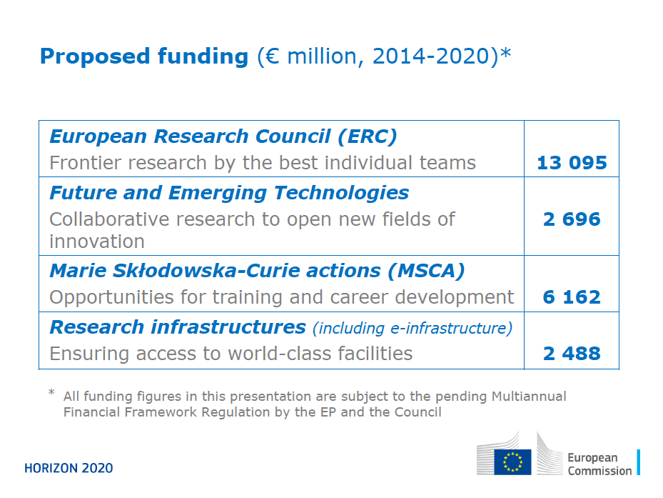
1st pillar excellent science

Slide 5
Marie Curie Actions, ERC
Network opportunities (community/international networks)
MSCA Innovation Training Networks (ITN)
3 year PHD, 500 person-months
Deadline April 2014, Budget 350 ME, success 10%
MSCA-COFUND, cofunding of training programs, 3-5 years
National funds 50% / EC 50%
Deadline November 2014, Budget 80 ME
MSCA-RISE, Global research and innovation staff exchange
Staff exchange with European and non-European countries
Deadline Jan 2015, Budget 80 ME, success 60%
Individual opportunities
MSCA Individual Fellowships (IF)
Deadline April 2014, Budget 350 ME
ERC, TOTAL BUDGET €13 billion (currently 15% success)

Slide 6
A network example: COFUND
An example of a big (90 fellowships) project that has multiple host institutions is CASCADEfellows. The programme is coordinated by the University of Nottingham in the UK and currently involves over 25 international host organisations. Projects last between 12-24 months and fellows are recruited through three open Calls for proposals. http://cascadefellows.eu/ I think this is what we should be aiming for for PACT. Finally, there are a couple of links for the CERN fellowships: https://ert.cern.ch/web/COFUND.pdf

Slide 7
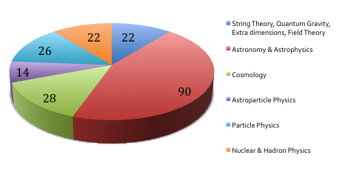
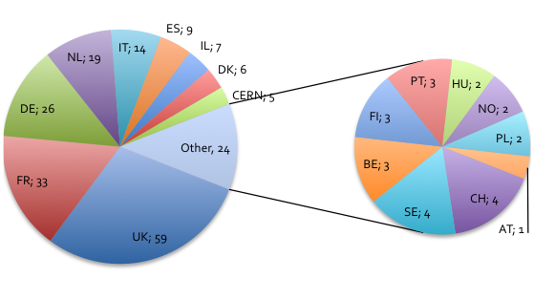
An individual example: ERC (202 P2I projects in first 10 calls)
Study by N. Augé and B. Saghai in next APPEC newsletter

Slide 8
Research Infrastructures
B1 Call 1 - Developing new world-class research infrastructures
INFRADEV 1-2014: Design Studies (15 ME)
1-3 ME, September 2014
INFRADEV 2-2015: Preparatory Phase of ESFRI projects (14 ME)
New RI (after update of ESFRI Roadmap, 2016) 5 ME
Extra funds to existing PP (up to 2 ME)
January 2015
INFRADEV 3-2015: Individual implementation and operation of ESFRI projects (90 ME)
Based on ESFRI prioritisation, up to 15 ME, January 2015
INFRADEV 4-2014/2015: Solutions for clusters of ESFRI and other relevant research infrastructure initiatives (55 ME 2014, 25 ME 2015)
6-15 ME, September 2014

Slide 10
B2 Call 2 - INFRAIA 1-2014/2015: I3 for research infrastructures of pan-European interest
Physical Sciences - Starting Communities
European laboratory astrophysics.
Research infrastructures for high-energy astrophysics.
Science at deep-underground laboratories.
Integrating gravitational wave research.
Physical Sciences - Advanced Communities
Detectors for future accelerators.
Research infrastructures for nuclear physics.
European planetary science.
Starting communities , up to 5 ME, September 2014
Advanced Communities, up to 10 ME, September 2014
Rate of success is 50%
90 ME 2014, 50 ME 2015

Slide 11
EXCELLENT SCIENCE: Research Infrastructures
B3 Call 3 - e-Infrastructures
EINFRA 1-2014 – Managing, preserving and computing with big research data
September 2014, 55 ME
EINFRA 9-2015 – e-Infrastructures for virtual research environments (VRE)
January 2015, 42ME

Slide 12
EINFRA 1-2014 Managing, preserving and computing with big research data (50 M)
Service-driven data e-infrastructures responding to general and specific requirements of researchers and research organisations for open access to and deposit of scientific information.
Services to ensure the quality and reliability of the e-infrastructure, including certification mechanisms for repositories and certification services to test and benchmark capabilities in terms of resilience and service continuity of e-infrastructures;
Federating institutional and, if possible, private data management and curation tools and services used across or at some point of the full data lifecycle, including approaches for identification of open data sources and data collected with sensitive or restricted access features.
Large scale virtualisation of data/compute centre resources to achieve on-demand compute capacities, improve flexibility for data analysis and avoid unnecessary costly large data transfers.
Development and adoption of a standards-based computing platform (with open software stack) that can be deployed on different hardware and e-infrastructures (such as clouds providing infrastructure-as-a-service (IaaS), HPC, grid infrastructures…) to abstract application development and execution from available (possibly remote) computing systems.
Support to the evolution of EGI (European Grid Infrastructure)
Proof of concept and prototypes of data infrastructure-enabling software (e.g. for databases and data mining) for extremely large or highly heterogeneous data sets scaling to zetabytes and trillion of objects. Clean slate approaches to data management targeting 2020+ 'data factory' requirements of research communities and large scale facilities (e.g. ESFRI projects) are encouraged

Slide 13
EINFRA 9-2015 – e-Infrastructures for virtual research environments (VRE) (42 M)
Specific challenge: There is yet considerable potential and room for development in the use of virtual research environments. The objective is to address this challenge by supporting capacity building in interdisciplinary research communities to empower researchers through development and deployment of service-driven digital research environments, services and tools tailored to their specific needs. These virtual research environments (VRE) should integrate resources across all layers of the e-infrastructure (networking, computing, data, software, user interfaces), should foster cross-disciplinary data interoperability and should provide functions allowing data citation and promoting data sharing and trust.
.

Slide 14
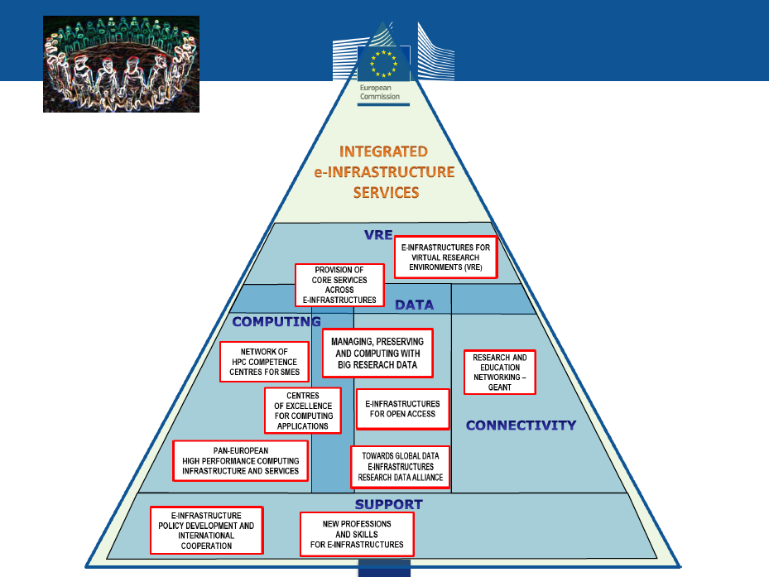

Slide 15
In blue:
Appec interest

Slide 16
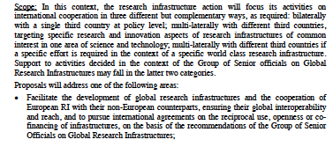
EXCELLENT SCIENCE: Research Infrastructures
B4 Call 4- INFRASUPP 6-2014 – International cooperation for research infrastructures, September 2014, 7 ME

Slide 17
A Research Infrastructures ERANET for APPEC?
ERA-NET in Horizon2020: Top-up (33%) funding of individual joint calls for transnational research and innovation in selected areas.
Multiple joints calls in an variable geometry with individual grant agreements for each call Large initiatives with major strategic research agendas might propose a series of call topics for which top-up funding could be provided.
Unresolved question for APPEC, will there be ERANET+ in RI ? Up to now we know only ERANETs associated with the societal challenges (Pillar 3)
From report written by the members of the Joint Programming Unit
Contact: Jörg Niehoff joerg.niehoff@ec.europa.eu DG Research & Innovation Unit B4 - Joint Programming

Slide 18
EXCELLENT SCIENCE: C. Future Emerging technologies (FET)
Open:
Short programs funded on aggressive R&D with industrial application 80 ME/year
Proactive 9 themes 60-82 ME/year
Understanding time for new technologies 20 ME
Symbiosis between artificial and natural systems 25 ME
Adaptive bottom-up construction 35 ME
New possibilities at the nano-bio-chem interface 25 ME
Knowing, doing and being: Cognition beyond problem solving 35 ME
Ecological ubiquitous technology 25 ME
Exploiting light-matter interaction 20 ME
Quantum simulation and networking 30 ME
Global Systems Science 20 ME
CSA 2,3 ME
Flagships
Graphène
Humain Brain Project
Computer Science, towards hexascale
HPC workloads 20 ME
APPEC interests, can we map them to FET ?
Sensor networks in hostile environments
Low radioactivity tracing
Photonics
Photodetectors (large area, small pixels)
Extreme photonics (lasers/mirrors)
Cryogenic detectors (MKIDs, TES)
Materials of extreme radiopurity
Space

Slide 19
Industrial Leadership 22,09% i.e. 15,51 B euros
2
Leadership in enabling and industrial technologies:
ICT; Nanotechnologies; Advanced Materials; Biotechnology; Advanced Manufacturing and Processing; and Space
B. Access to risk finance
C. Innovation in Small and Medium-Sized Enterprises (SMEs)

Slide 20
INDUSTRIAL LEADERSHIP: LEIT ICT
1.A.1 ICT Challenge 1 – A new generation of components and systems
1.A.1.3 Advanced Thin, Organic and Large Area Electronics (TOLAE) technologies
1.A.2 ICT Challenge 2 - Advanced Computing
1.A.2.1 Customised and low power computing
1.A.3 ICT Challenge 3 – Future Internet
1.A.3.1 Smart Networks and novel Internet Architectures
1.A.3.2 Smart optical and wireless network technologies
1.A.3.3 Advanced Cloud Infrastructures and Services
1.A.3.5 Tools and Methods for Software Development
1.A.3.7 FIRE+ (Future Internet Research & Experimentation)
1.A.4 ICT Challenge 4 – Content technologies and information management
1.A.4.1 Big Data Innovation and take-up
1.A.4.2 Big Data - research
1.A.5 ICT Challenge 5 – Robotics
1.A.5.1 Roadmap-based R&D&I in Robotics
1.A.6 ICT Challenge 6 – Micro- and nano-electronic technologies, Photonics
1.A.6.2 Photonics KET 2014
1.A.6.3 Photonics KET 2015
1.A.8 ICT Cross-Cutting and Horizontal Activities
1.A.8.1 Internet of Things and Platforms for Connected Smart Objects

Slide 21
INDUSTRIAL LEADERSHIP: A. LEIT Space
2.1.7.A.2 Call “Earth Observation”
Objective 1 – Space enabled Applications
Topic A – New ideas for Earth-relevant space applications
2.1.7.A.3 Call “Competitiveness of the European Space Sector”
Objective 1 - Protection of European Assets in and from Space
Topic A – Space Weather
Objective 5 – Outreach and Communication
Topic A – Global outreach through education
Topic B – European outreach through education
2.1.7.A.5 Call “Competitiveness of the European Space Sector”
Objective 3 - Space Science
Topic A – Scientific exploitation of astrophysics data

Slide 22
Societal Challenges 38,53% i.e. 27,05B euros
3
HEALTH
FOOD SECURITY, SUSTAINABLE AGRICULTURE, MARINE AND MARITIME RESEARCH AND THE BIO-ECONOMY
ENERGY
TRANSPORT
CLIMATE ACTION, RESOURCE EFFICIENCY AND RAW MATERIALS
INCLUSIVE, INNOVATIVE AND REFLECTIVE SOCIETIES
SECURE SOCIETIES CHALLENGE

Slide 23
Working group checklist
Will we do a MSCA and of which type ? (ITN, COFUND,RISE) and which perimeter ?
Can we propose a Design Study ?
Is there a present/future ESFRI link ? PP?, Implementation ?
Can we propose an I3 beyond GW, UL
Can we participate in an RI cluster ?
Can we bid to an e-infrastructure ? (calls 1 and 9)
Can we participate in a FET open ?
What are the global aspects of our research ?
What are the R&D themes that an ERANET+ could support ?
Can we apply for FET’s, LEITs, societal challenge R&D ?

