Slide 1
Geometrical data of the XTIN/XFEL
WP32
Survey & Alignment
Johannes Prenting
Notes:
How to edit the title slide
Upper area: Title of your talk, max. 2 rows of the defined size (55 pt)
Lower area (subtitle): Conference/meeting/workshop, location, date, your name and affiliation, max. 4 rows of the defined size (32 pt)
Change the partner logos or add others in the last row.

Slide 2
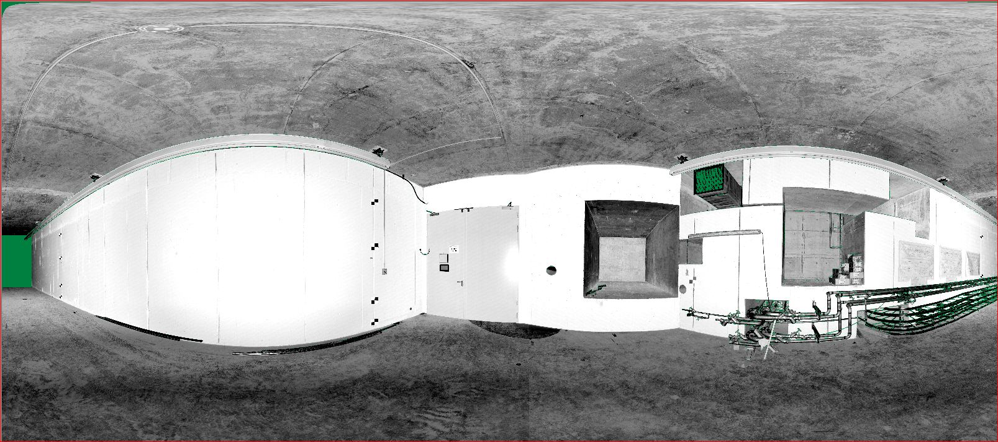
Survey work carried out so far:
Reference grid: installation and survey done,
Stake out of reference points for installations : Injector dump set out
Scan of geometry with 3D laserscan: ready
Photograph:
View from XS1 to XTD2
3D Laserscan:
View from XS1 to XTD2

Slide 3
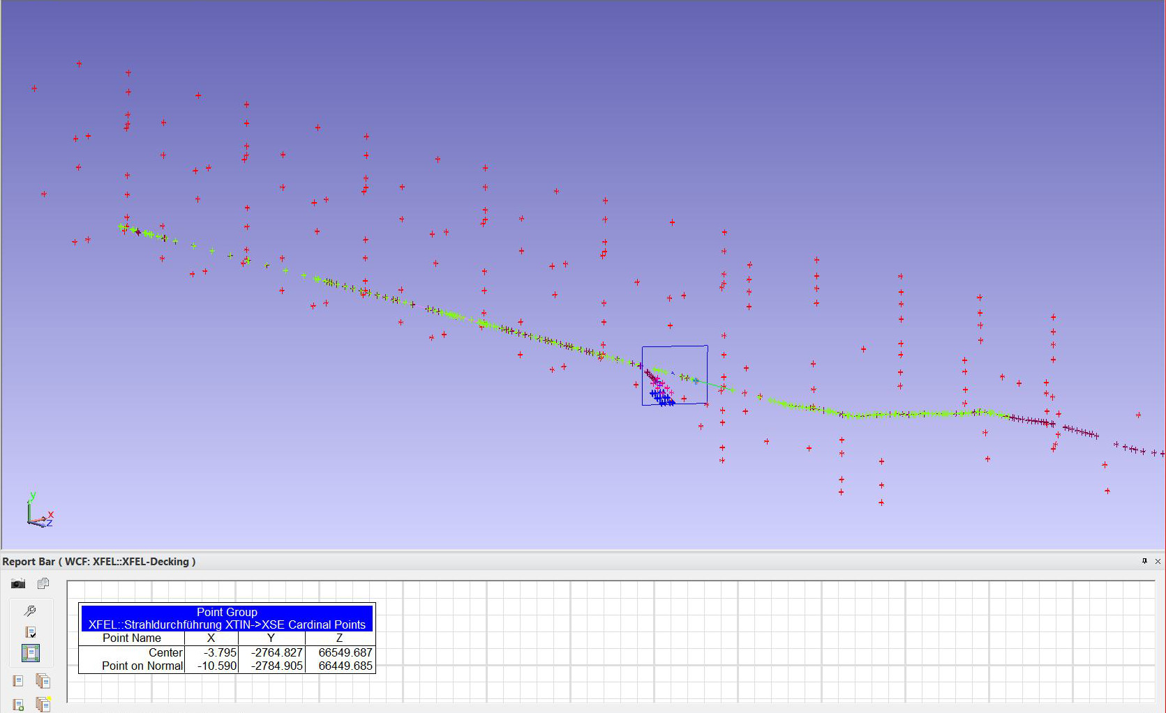
Position of beam pipe, wall to XSE:
Displacement is
4mm lateral (borehole is on right side of the beam)
15mm in height (borehole is lower than the beam)

Slide 4
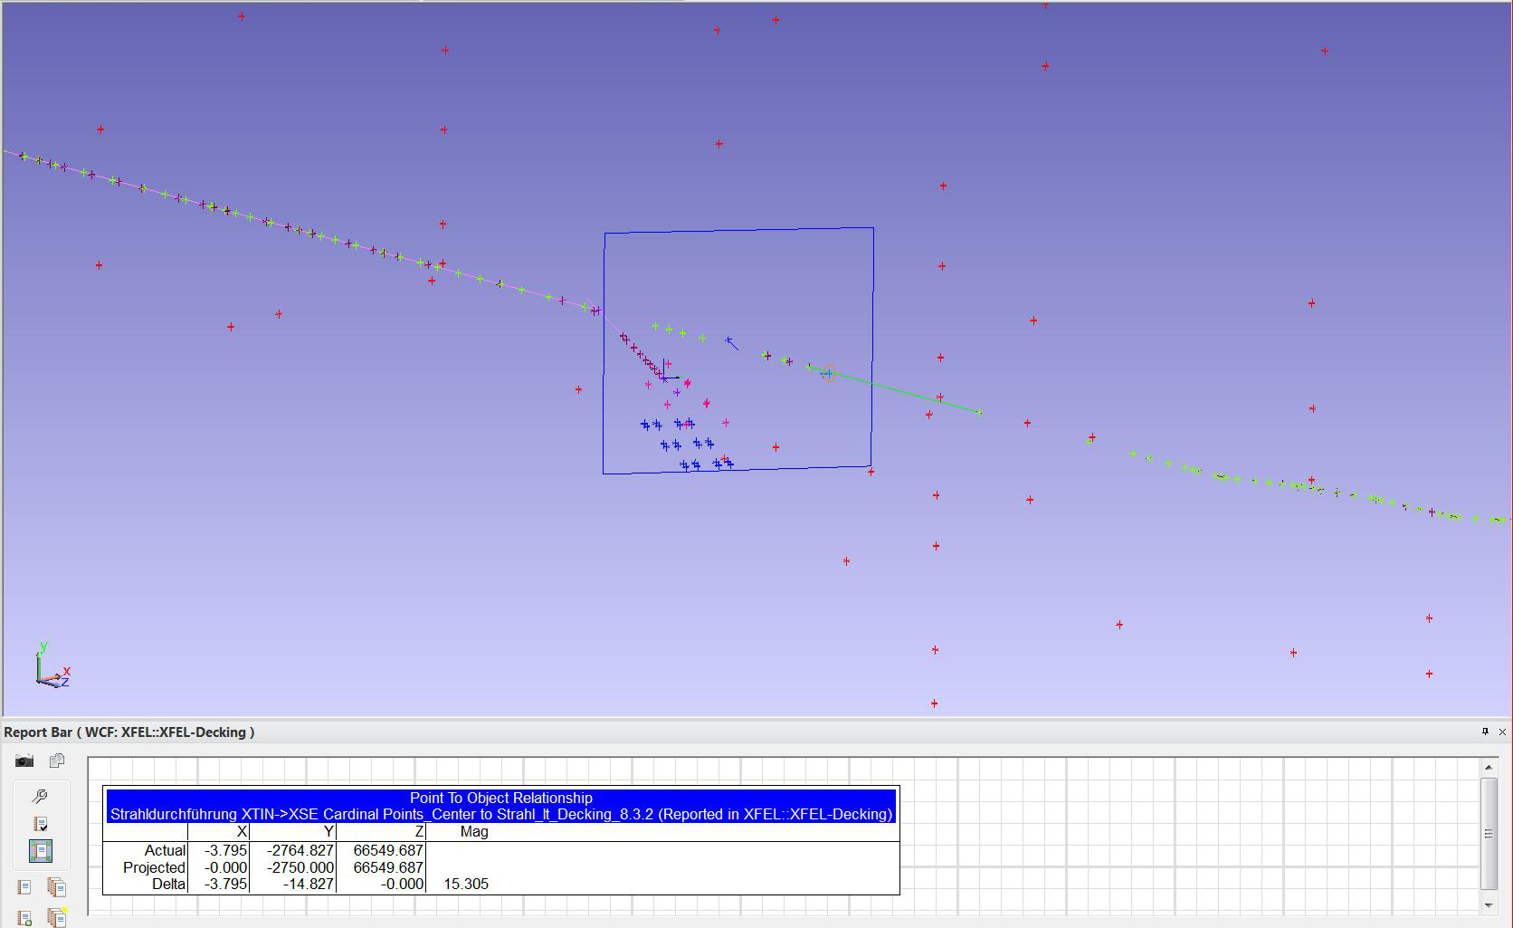
Position of beam pipe, wall to XSE:
Displacement is
4mm lateral (borehole is on right side of the beam)
15mm in height (borehole is lower than the beam)

Slide 5
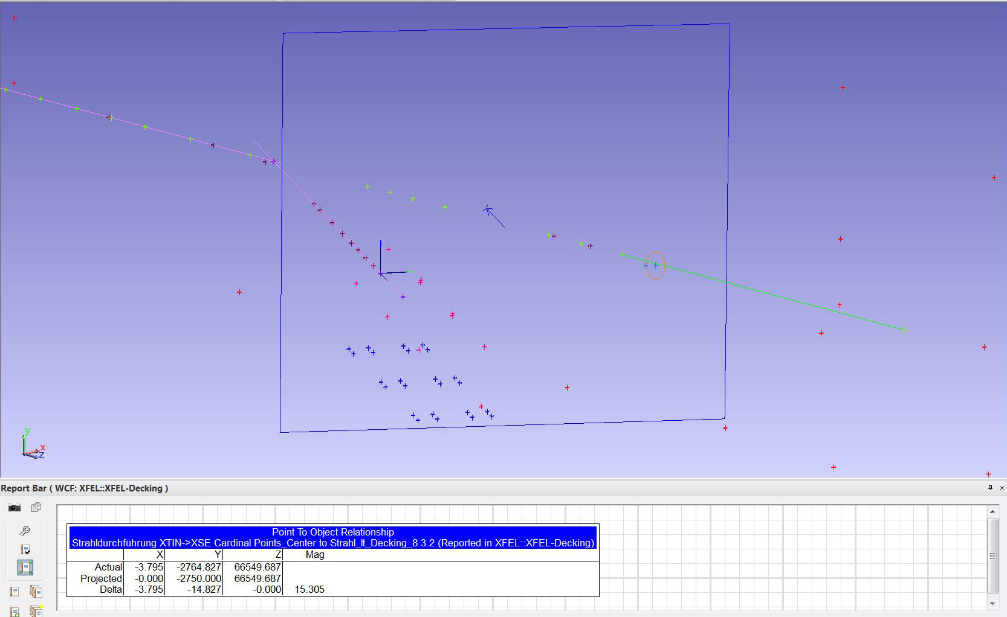
Position of beam pipe, wall to XSE:
Displacement is
4mm lateral (borehole is on right side of the beam)
15mm in height (borehole is lower than the beam)

Slide 6
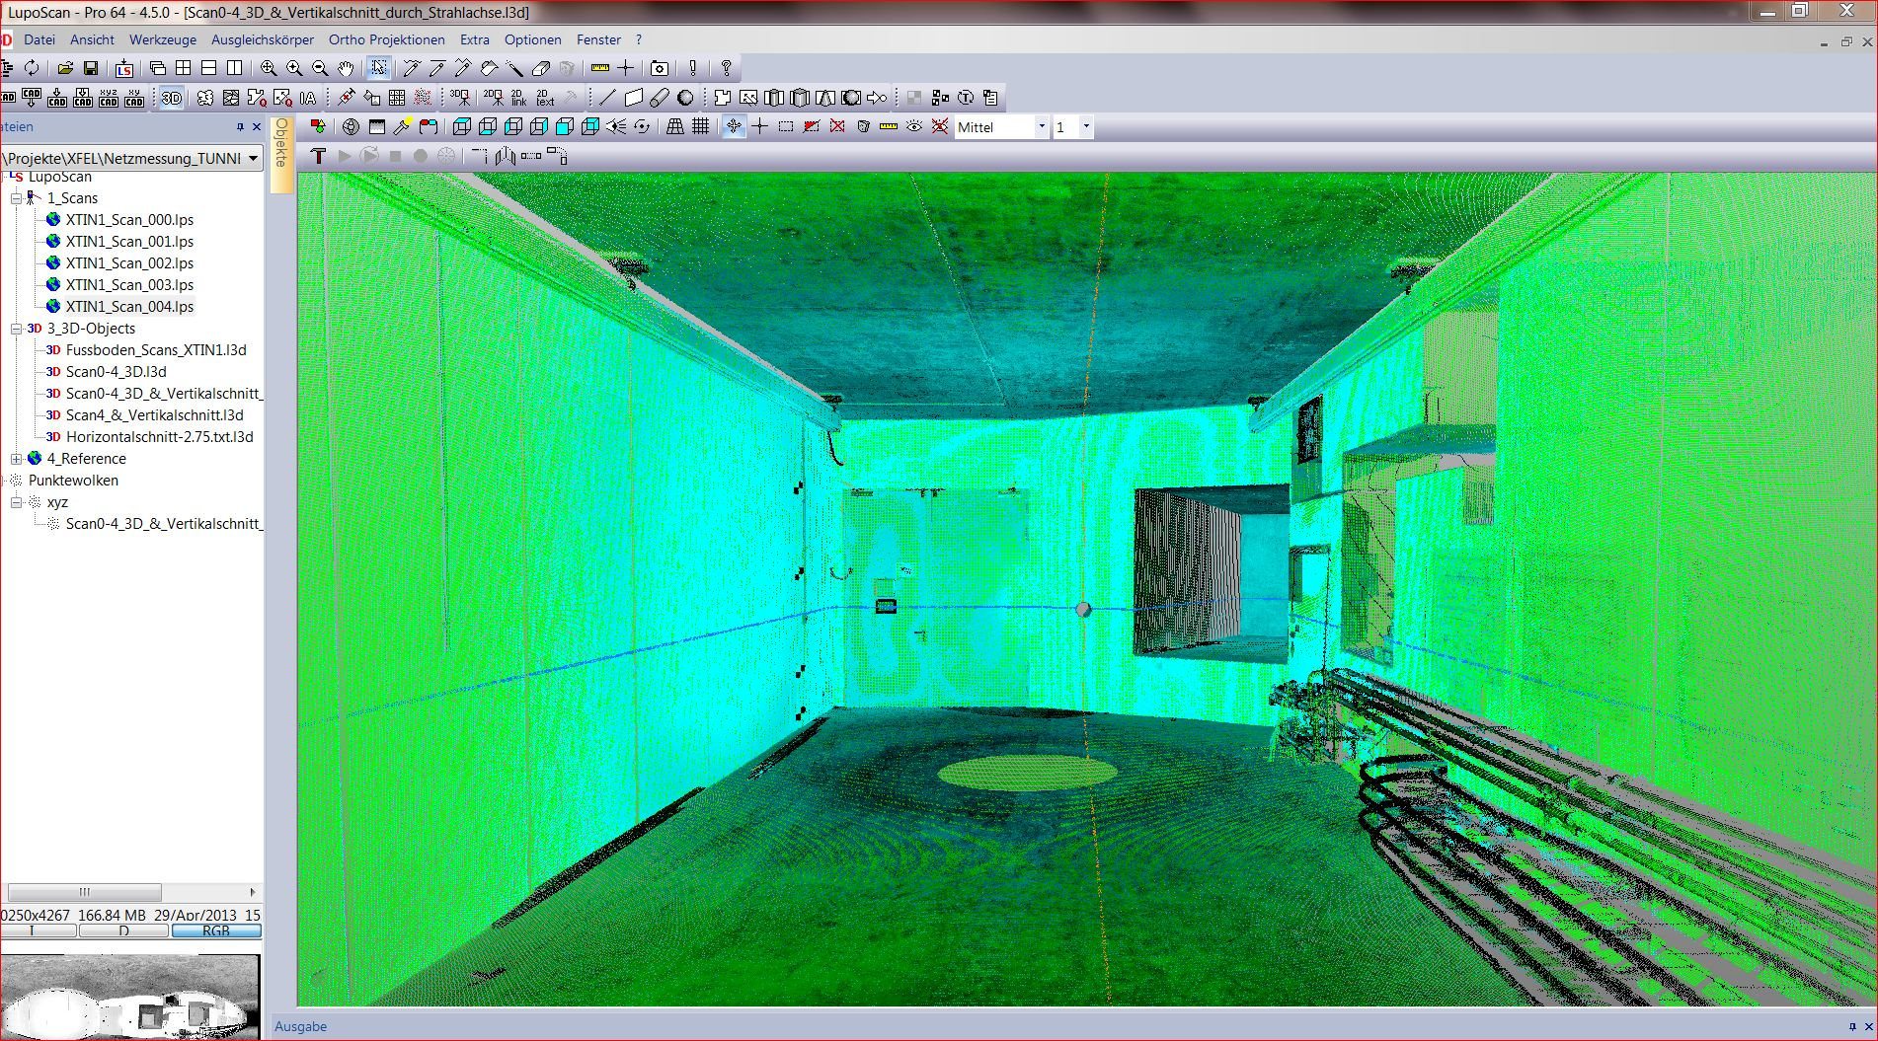
3D point cloud of XTIN1 with horizontal and vertical intersecting planes through beam axis

Slide 7
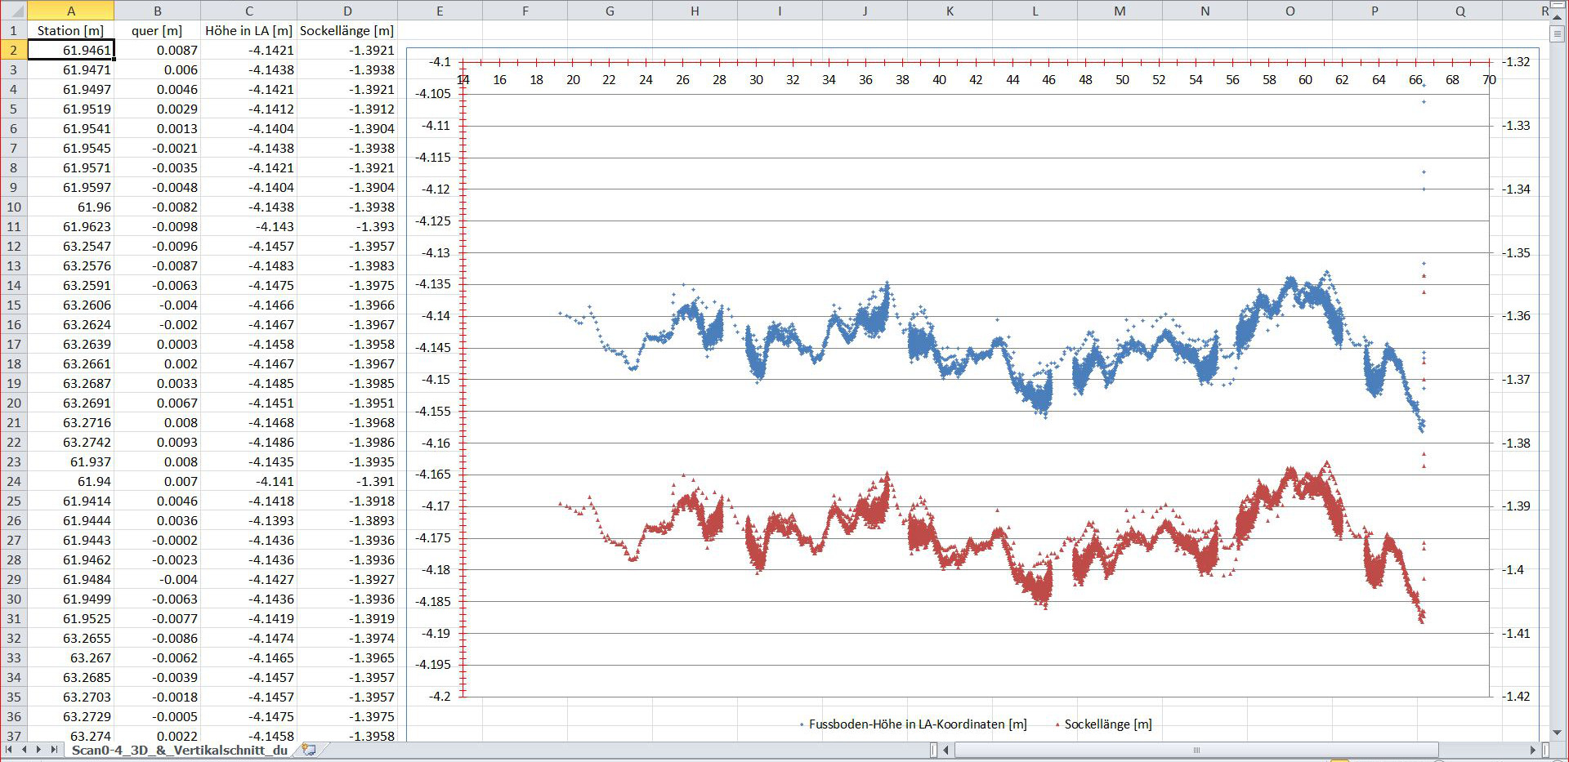
Height of the floor [m] resp. to CS LA (blue line, left axis), distance from beam to floor [m] (red line, right axis):

Slide 8
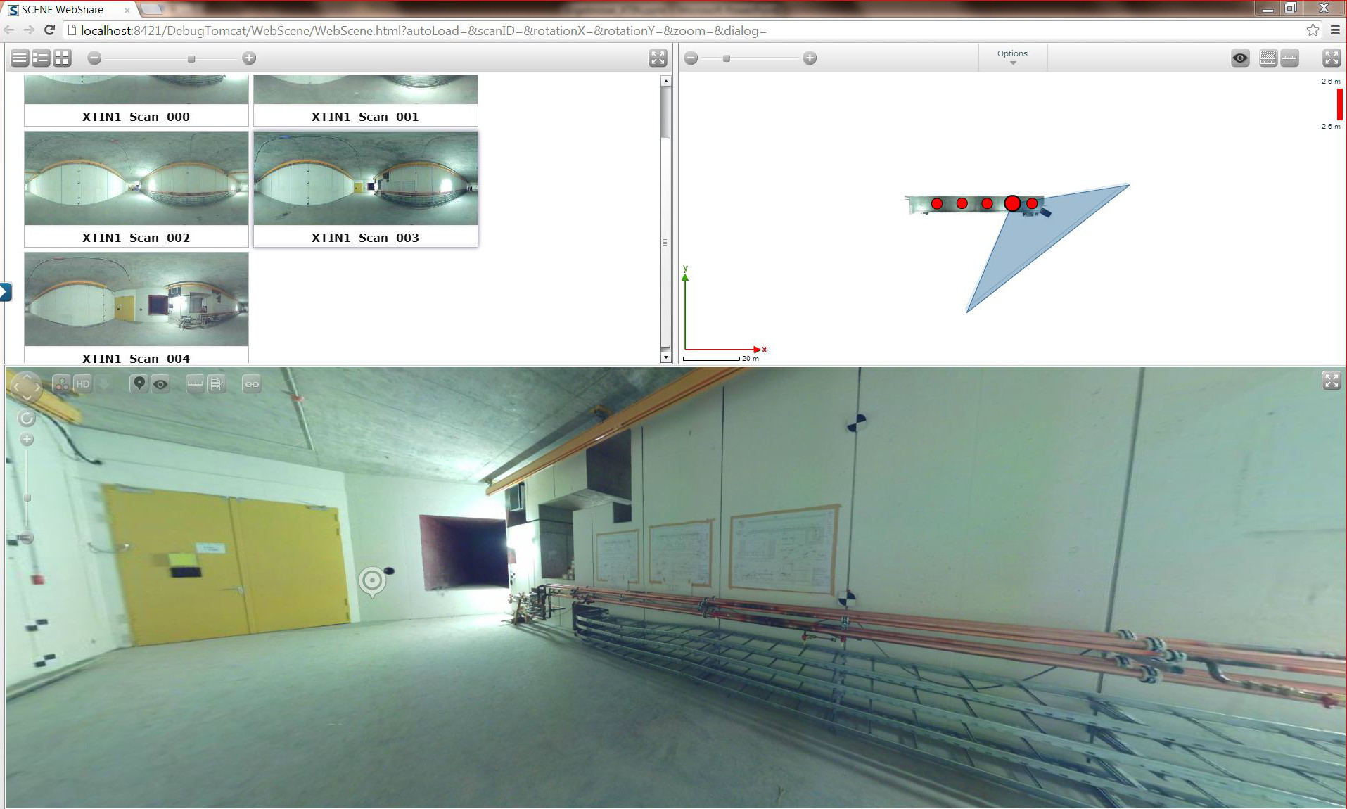
Webserver with panoramic views soon to come…
XTIN 1

Slide 9
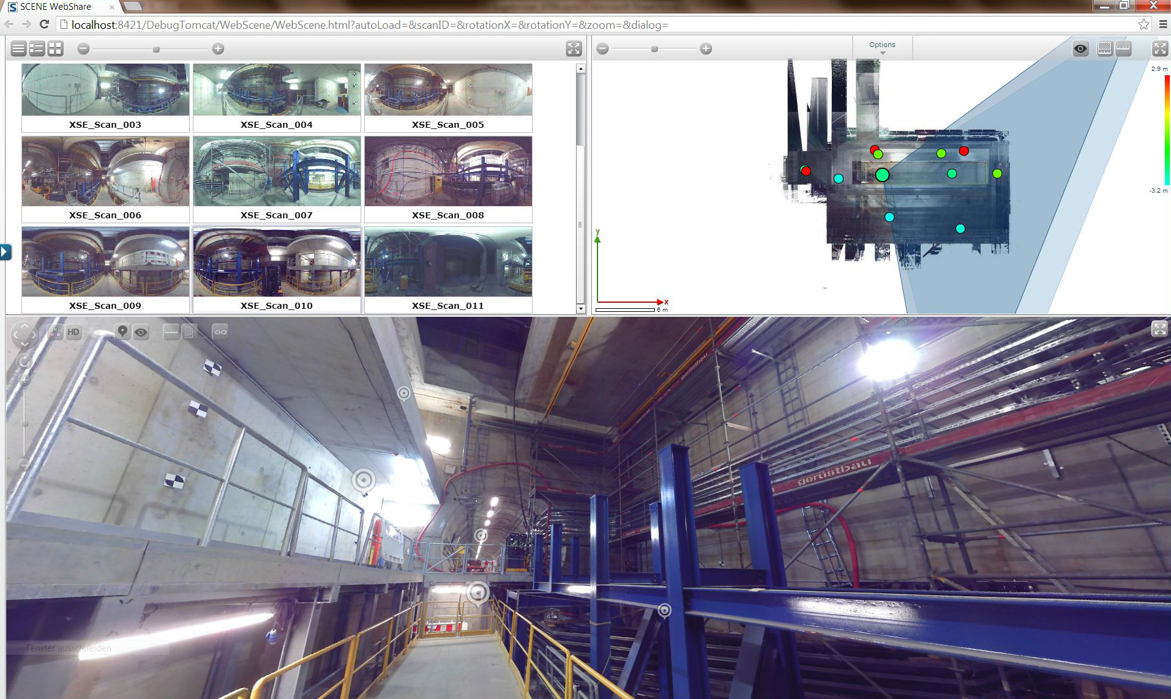
Webserver with panoramic views soon to come…
XSE

