Slide 1
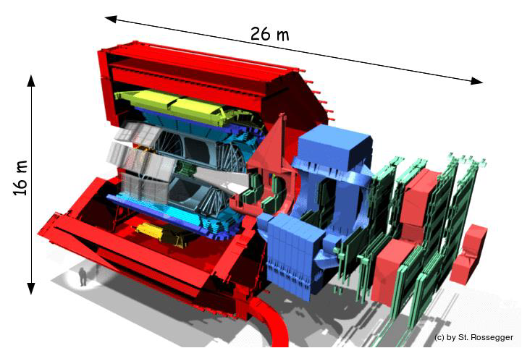
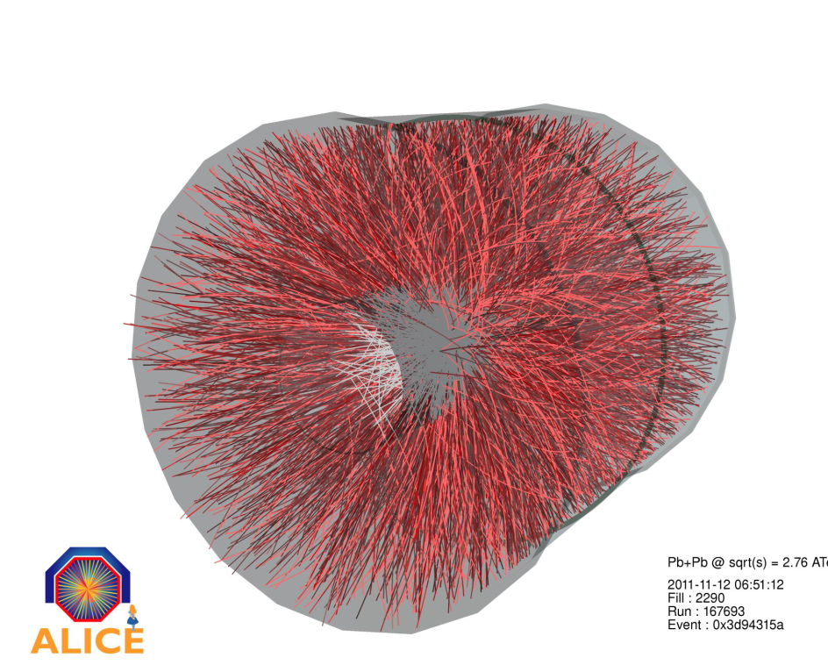

Evolution of ALICE Computing
3.12.2013
P.Malzacher@gsi.de
7th Annual Workshop of the Helmholtz Alliance "Physics at the Terascale”

Slide 2
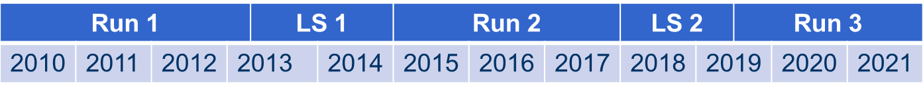
Evolution of ALICE Computing
Components of the ALICE Computing Model
Evolution of ALICE
Run 2
Run 3 / O2
FAIR Computing
Summary

Slide 3
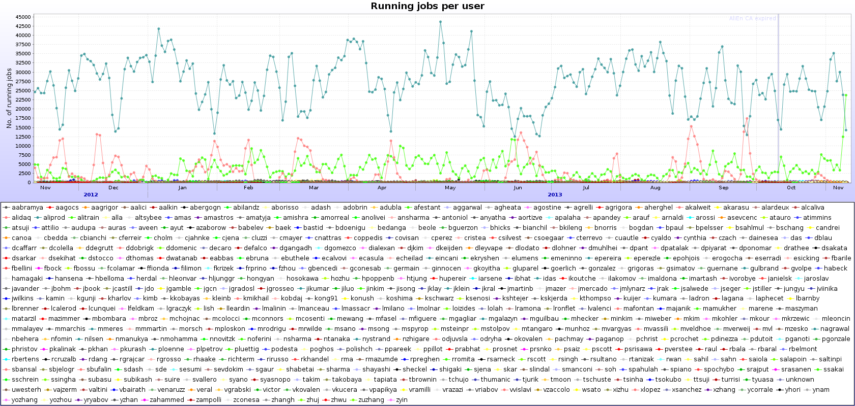
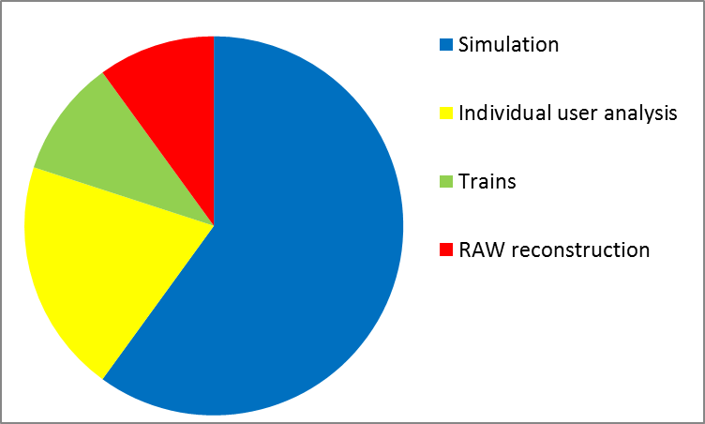
Components of ALICE Computing:
ROOT, XRootD, AliRoot, AliEn & MonALISA
MC
~ 36.8K jobs
~ 450 individual users
Trains
RAW
Stable Operation
~ 80 % efficiency
Problems:
user analysis
widly distributed datasets
lack of manpower

Slide 4
7.3 PB of raw data collected during RUN1
16 PB of derived data on disk (MC,ESD, AOD)

Slide 5
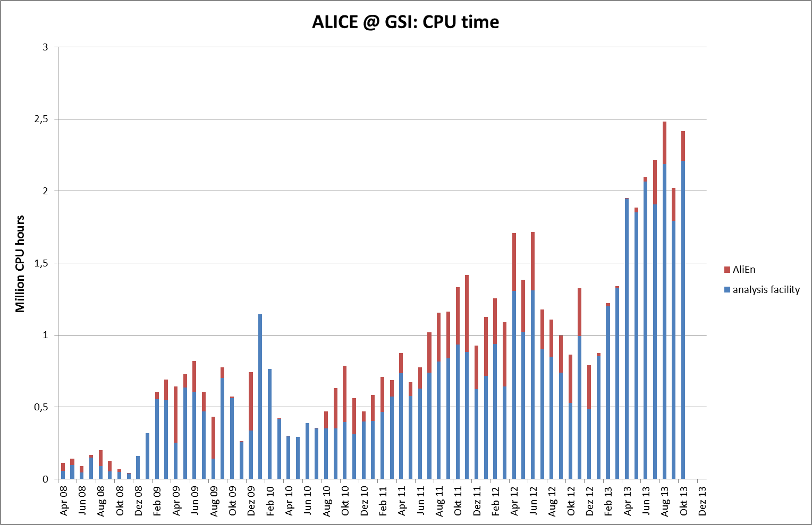
The ALICE T2 / AF ~ 20% of ALICE T2 requests

Slide 6
Analysis
Trains = organized analysis
  10-20 analysis tasks (wagons) running together on the same data sample
  57 active trains (from all Physics Working Groups)
  Running twice weekly
  Average train duration – 21 hours
  10% of all resources in the past year

Slide 7
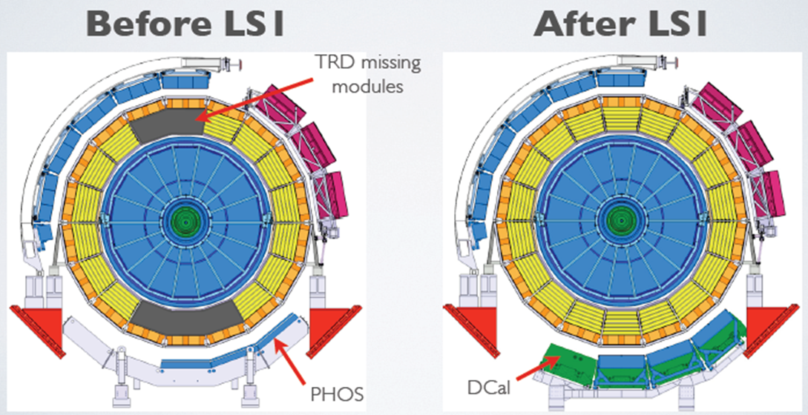

The Evolution of ALICE: From Run 1 to Run 2
instant luminosity Pb-Pb * 4
additional detector coverage
upgrade DAQ & HLT
upgrade of readout electronics
readout rate * 2
Year | System | Instant Lumi. (cm⁻² s⁻¹) | Interaction Rate (kHz) | Running Time (s) | # Events (*10⁹)
2015 | p-p unbiased | 2*10²⁹ | 20 | 3.1*10⁶ | 1.5
 | Pb-Pb | 10²⁷ | 8 | 0.7*10⁶ | 0.35
2016 | p-p rare triggers | 5*10³⁰ | 500 | 5.2*10⁶ | 2.6
 | Pb-Pb | 10²⁷ | 8 | 0.7*10⁶ | 0.35
2017 | p-p rare triggers | 5*10³⁰ | 500 | 7.1*10⁶ | 3.4
 | p-Pb | 10²⁸ ⁻ 10²⁹ | 20 - 200 | 0.7*10⁶ | 0.35

Slide 8

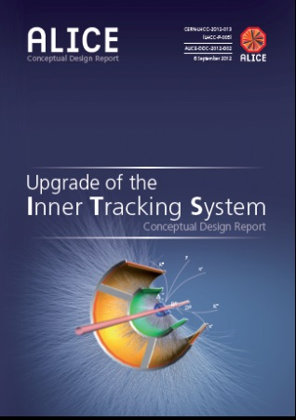

Evolution of ALICE: Upgrade during LS 2
Inner Tracking System (ITS)
  New, high-resolution, low-material ITS
Time Project Chamber (TPC)
  Upgrade of TPC with replacement of MWPCs with GEMs
  New pipelined continuous readout electronics
New 5-plane silicon telescope in front of
the Muon Spectrometer
New and common computing system for online
and offline computing

Slide 9
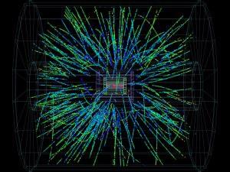


Requirements: Event Rate
Rate increase: from 500 Hz to 50 kHz
  Physics topics require measurements characterized
  by very small signal-over-background ratio → large statistics
  Large background → traditional triggering or filtering techniques very inefficient for most physics channels.
  Strategy: read out all particle interactions 50 kHz
  (anticipated Pb-Pb interaction rate)
TPC intrinsic rate << 50 kHz
  In average 5 events overlapping in the detector
  Continuous read-out

Slide 10
(R)evolution of ALICE Computing
Similar vision for distributed computing
Evolution: AliRoot 5.x
Based on Root 5.x ?
Improved algorithms
Implements needs of the PWGs
Revolution: AliRoot 6.x
Based on Root 6.x, C++11
Optimized for I/O
FPGA, GPU, MIC, ...
Steered by O2 CWGs
Run 1 |  |  |  | LS 1 |  | Run 2 |  |  | LS 2 |  | Run 3
2010 | 2011 | 2012 | 2013 |  | 2014 | 2015 | 2016 | 2017 | 2018 | 2019 |  | 2020 | 2021

Slide 11
The foreseen improvements of the software for Run 2 will focus on:
Moving one calibration iteration into the Online environment
Using HLT track seeds to speed up the Offline reconstruction
Replacing Geant 3 with Geant 4
Improving the performance of Geant 4 in ALICE
Fast and parameterized simulation to reduce the CPU needs
Collaboration with other experiments to make use of opportunistic resources for simulation
Adapting to cloud environments, use HLT for Offline processing
Reducing turn-around time of analysis trains
Consolidating popular datasets on fewer sites

Slide 12
Resource Requirements for Run 2
 | CPU (kHEPSPEC06)
 | Tier0 | CAF | Tier1s | Tier2s
2015 | 130 | 45.0 | 120 | 200
2016 | 170 | 45.0 | 160 | 240
2017 | 200 | 45.0 | 210 | 270
 | Disk (PB)
 | Tier0 | CAF | Tier1s¹⁾ | Tier2s
2015 | 11.2 | 0.34 | 15.4 | 22.1
2016 | 13.4 | 0.44 | 18.6 | 26.8
2017 | 14.7 | 0.54 | 21.8 | 31.4
 | Tape (PB)
 | Tier0 | Tier1
2015 | 16.2 | 10.2
2016 | 21.6 | 15.6
2017 | 25.7 | 19.7

Slide 13
Preparation for Run 3: O² Project
Project
Leaders
DAQ
CWG1 Architecture
CWG2 Procedure & Tools
HLT
CWG5 Platforms
O² Steering Board
Projects
Computing
Working Groups
Offline
CWG3 DataFlow
CWG4
Data Model
CWG6 Calibration
CWG7 Reconstruc.
CWG8
Simulation
CWG9
QA, DQM, Vi
CWG10
Control
CWG11
Sw Lifecycle
CWG12
Hardware
- 50 people active
in 1-3 CWGs
- Service tasks
CWG13
Sw Framework
CWGnn
-----
CWGnn
-----
CWGnn
-----
CWGnn
-----
CWGnn
-----
Institution
Boards
Online
Institution Board
Computing
Board

Slide 14
Sep 2012 ALICE Upgrade LoI
Jan 2013 Report of the DAQ-HLT-Offline software panel on “ALICE Computer software framework for LS2 upgrade”
Mar 2013 O² Computing Working Groups
Sep 2014 O² Technical Design Report
Intensive period of R&D :
  Collect the requirements: ITS and TPC TDRs
  System modeling
  Prototyping and benchmarking
Technology and time are working with us
  New options
  Massive usage of commercial equipment very appealing
O2 Computing
Working Groups
O²
Technical
Design
Report

Slide 15
Requirements for Run 3: Data Volume
Detector | Event Size | Bandwidth @50 kHz Pb-Pb (GByte/s)
 | After Zero Suppression (MByte)
TPC | 20.0 | 1000
TRD | 1.6 | 81.5
ITS | 0.8 | 40
Others | 0.5 | 25
Total | 22.9 | 1146.5
Massive data volume reduction needed
Only option is by online processing

Slide 16
O² Hardware System
~ 2500 links
in total
ITS
FLP
Farm
Network
Storage
Network
10 Gb/s
2 x 10 or
40 Gb/s
10 Gb/s
TPC
FLP
EPN
TRD
FLP
FLP
EPN
Data
Storage
EMC
PHO
FLP
Data
Storage
EPN
TOF
FLP
Muon
FLP
L0
L1
EPN
FTP
FLP
Trigger Detectors
~ 250 FLPs
First Level Processors
~ 1250 EPNs
Event Processing nodes

Slide 17
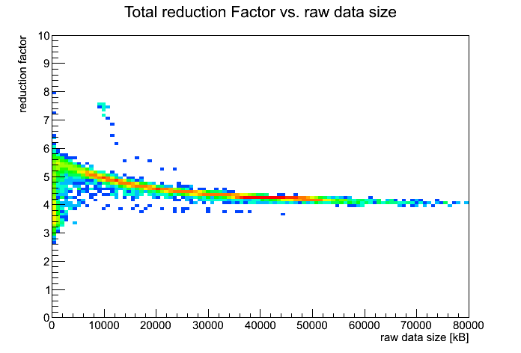
TPC Data Volume Reduction
 | Data Format | Data Reduction Factor | Event Size (MByte)
 | Raw Data | 1 | 700
FEE | Zero Suppression | 35 | 20
HLT | Clustering & Compression | 5-7 | ~3
 | Remove clusters not associated to relevant tracks | 2 | 1.5
 | Data format optimization | 2-3 | <1
TPC data volume reduction by online event reconstruction
Discarding original raw data
In production from the 2011 Pb-Pb run

Slide 18
Total Data Volume
Detector | Input to Online System (GByte/s) | Peak Output to Local Data Storage (GByte/s) | Avg. Output to Computing Center (GByte/s)
TPC | 1000 | 50.0 | 8.0
TRD | 81.5 | 10.0 | 1.6
ITS | 40 | 10.0 | 1.6
Others | 25 | 12.5 | 2.0
Total | 1146.5 | 82.5 | 13.2
LHC luminosity variation during fill and efficiency taken into account for average output to computing center

Slide 19

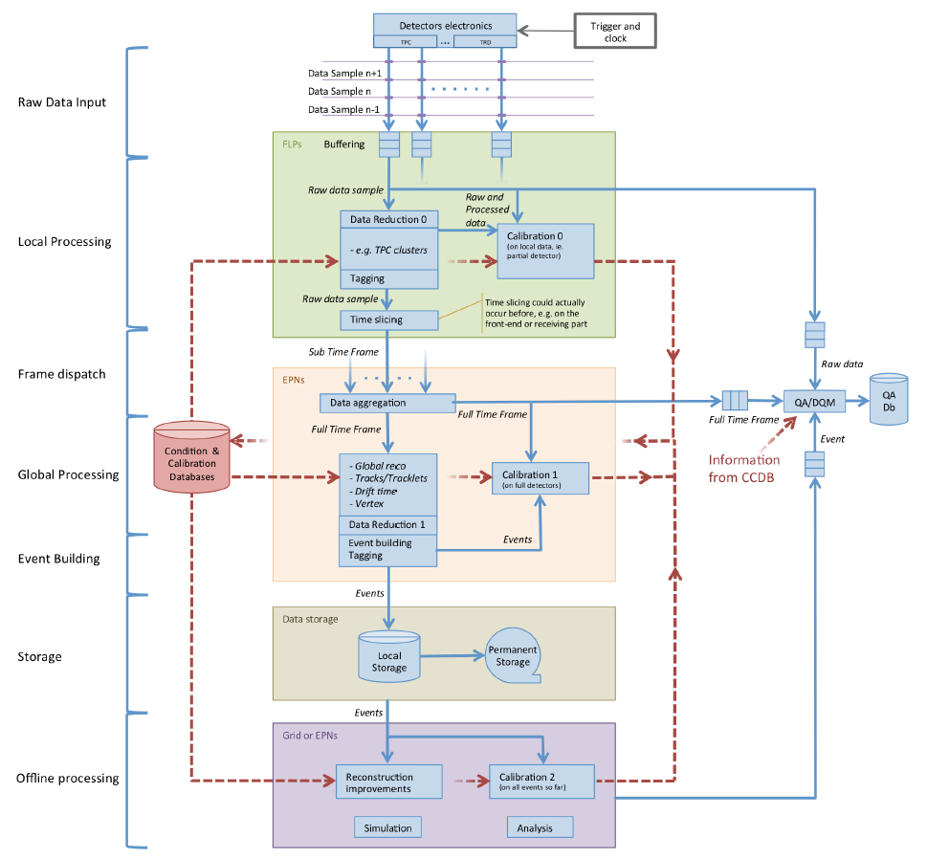
O2 Computing Working Groups
CWG12
Computing Hardware
CWG1
Architecture
CWG1
Architecture
CWG1
Architecture
CWG1
Architecture
CWG1
Architecture
CWG1
Architecture
CWG1
Architecture
CWG1
Architecture
CWG1
Architecture
CWG1
Architecture
CWG1
Architecture
CWG11
Software
Lifecycle
CWG1
Architecture
CWG11
Software
Lifecycle
CWG10
Control,
Configuration
CWG2
Tools
CWG2
Tools
CWG2
Tools
CWG2
Tools
CWG2
Tools
CWG2
Tools
CWG2
Tools
CWG2
Tools
CWG2
Tools
CWG2
Tools
CWG10
Control,
Configuration
CWG2
Tools
CWG10
Control,
Configuration
CWG9
QA, DQM
CWG3
Dataflow
CWG9
QA, DQM
CWG9
QA, DQM
CWG9
QA, DQM
CWG3
Dataflow
CWG3
Dataflow
CWG3
Dataflow
CWG3
Dataflow
CWG3
Dataflow
CWG3
Dataflow
CWG3
Dataflow
CWG3
Dataflow
CWG3
Dataflow
CWG8
Physics
Simulation
CWG4
Data Model
CWG8
Physics
Simulation
CWG8
Physics
Simulation
CWG8
Physics
Simulation
CWG8
Physics
Simulation
CWG4
Data Model
CWG4
Data Model
CWG4
Data Model
CWG4
Data Model
CWG4
Data Model
CWG4
Data Model
CWG4
Data Model
CWG4
Data Model
CWG7
Reconstruction
CWG5
Computing
Platforms
CWG7
Reconstruction
CWG7
Reconstruction
CWG7
Reconstruction
CWG7
Reconstruction
CWG7
Reconstruction
CWG5
Computing
Platforms
CWG5
Computing
Platforms
CWG5
Computing
Platforms
CWG5
Computing
Platforms
CWG5
Computing
Platforms
CWG5
Computing
Platforms
CWG5
Computing
Platforms
CWG6
Calibration
CWG6
Calibration
CWG6
Calibration
CWG6
Calibration
CWG6
Calibration
CWG6
Calibration
CWG6
Calibration

Slide 20






ALICE@Run3
Private CERN
Cloud
Analysis
Reconstruction
Custodial Data Store
AliEn
CAF
On
Demand
AliEn
HLT
DAQ
O₂
Online-Offline
Facility
T1/T2/T3
AliEn
CAF
On
Demand
Simulation
AliEn
Analysis
Simulation
Data Cache
Vision
Public Cloud(s)

Slide 21
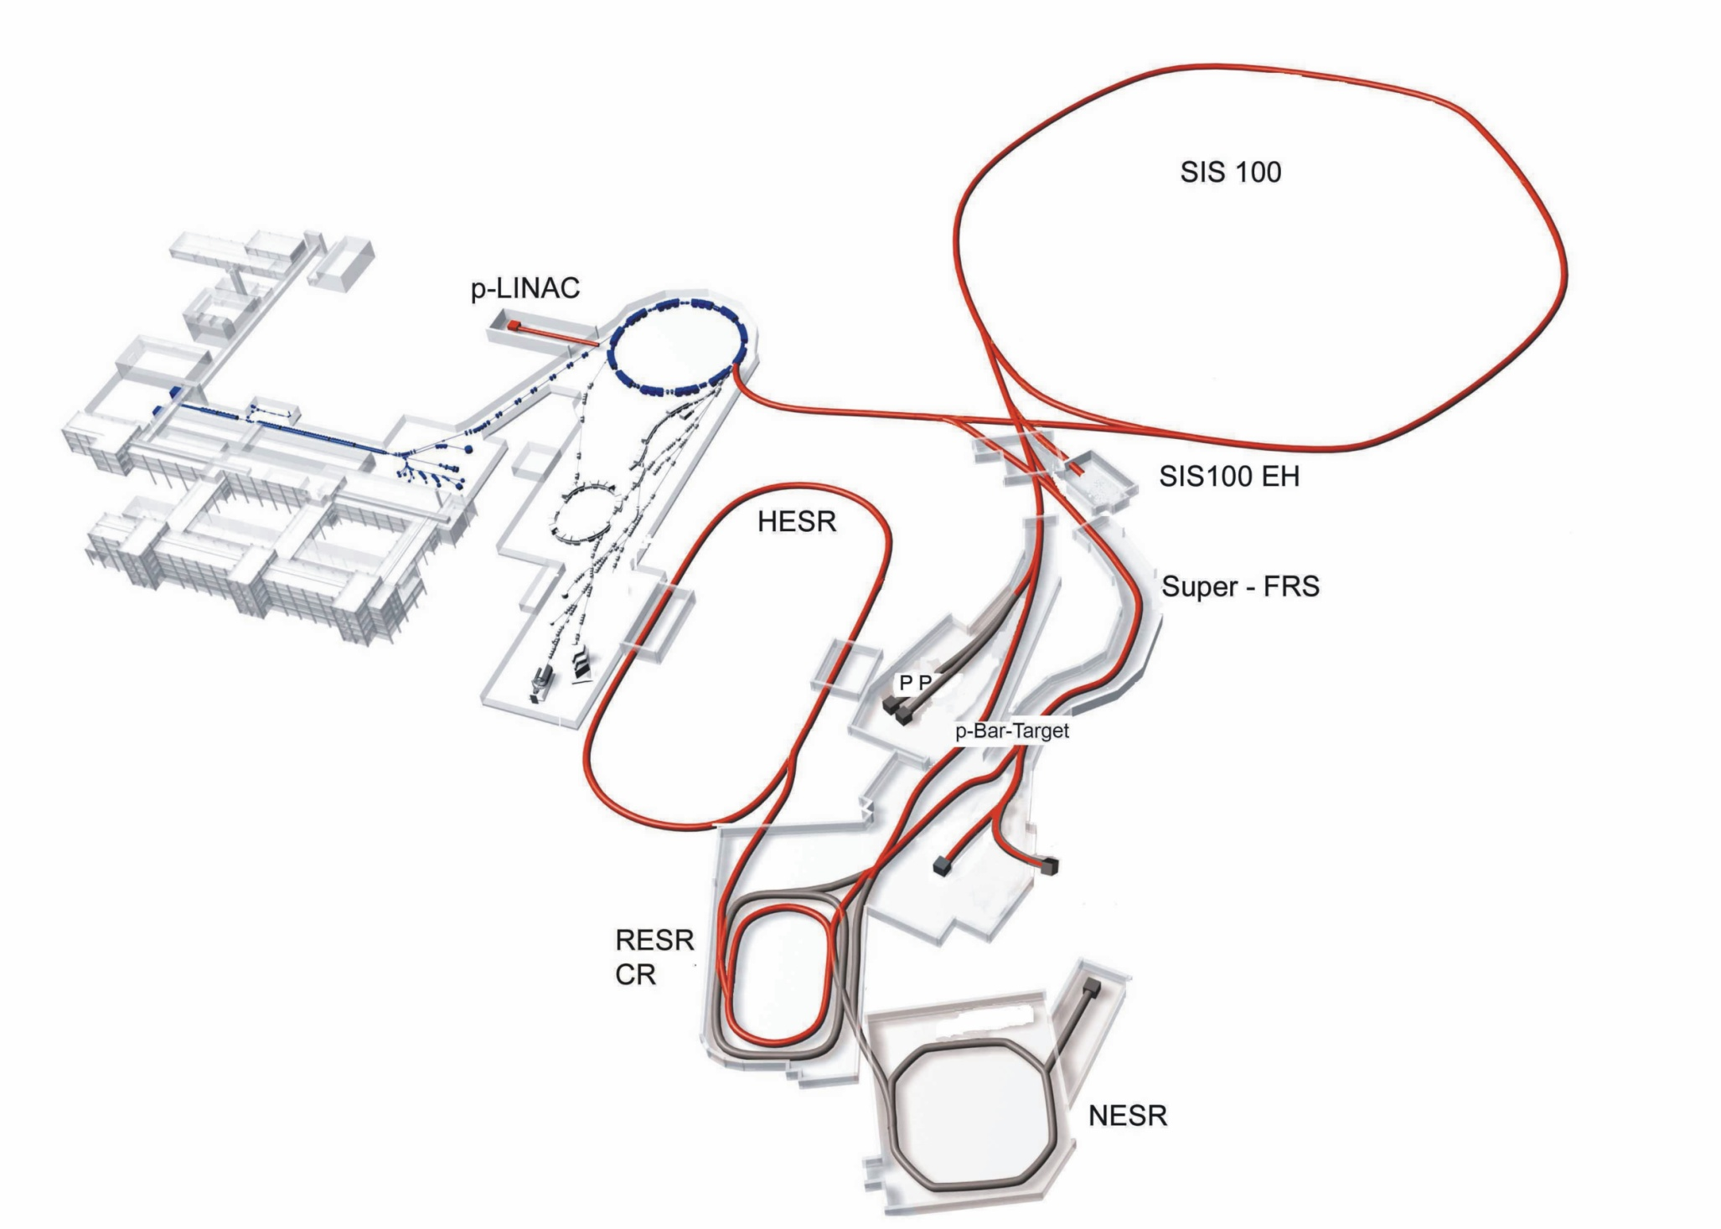
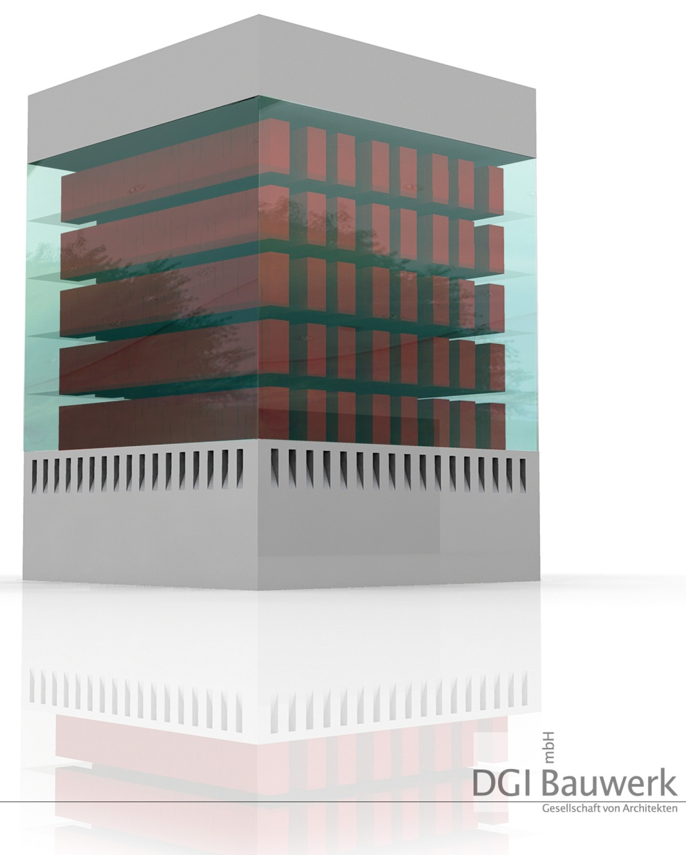
FAIR: Facility for Ion and Antiproton Research:
First Beam ~2018, explore commonalities, CTDR due 2015
GSI computing 2013
  ALICE T2/AF
  HADES, Theory, FAIR
  ~ 14000 cores,
  ~ 5 PB lustre
FAIR computing 2020
  CBM
  PANDA
  NuSTAR
  APPA
  LQCD
  300000 cores
  40 PB disk
  40 PB archive
CBM/HADES
APPA
PANDA
NuSTAR
open source and community software
budget commodity hardware
support different communities
scarce manpower
& FAIR MAN
& FAIR Grid/Cloud

Slide 22







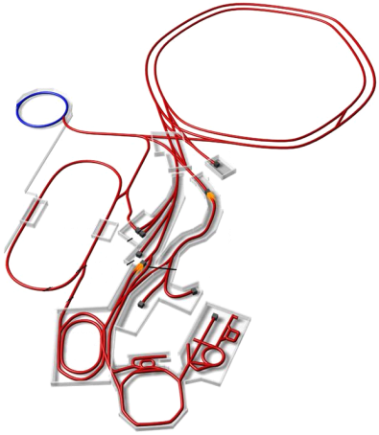












FAIR T0/T1 Metropolitan Area Network integrated in an international Grid/Cloud
1Tb/s
1Tb/s
TB/s
1Tb/s
1Tb/s

Slide 23
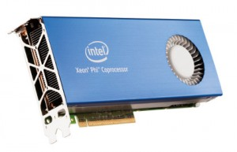
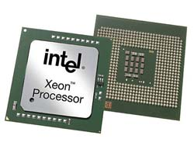

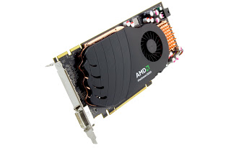

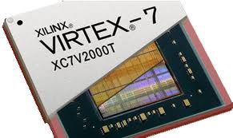
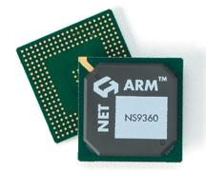
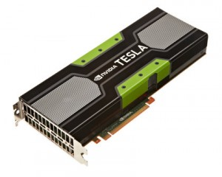
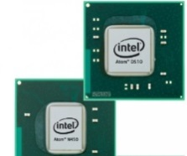
In discussion: Joining effort from O2 and FairRoot
Analysis
Simulation
Data
Acquisition
high-performance asynchronous
messaging library; patterns:
request-reply, publish-subscribe, push-pull, exclusive pair
Analysis
Cluster
Finding
Tracking
ESD, AOD

Slide 24
Summary: (R)evolution of ALICE Computing
Three phases, each jumping one order of magnitude in statistics and progressively improving the detectors, e.g.:
Run1 Pb-Pb: 0.1 nb⁻¹ Run2: 1 nb⁻¹ Run3&4: 10 nb⁻¹
ROOT, XRootD, AliRoot, AliEn & MonALISA the key components for the successful analysis of Run 1.
Computing for Run 2 is an evolution of the systems from Run 1 by the three projects DAQ, HLT and Offline.
For Run 3 the O2 project develops a complete redesign of:
  one common new online and offline computing system
  a common computing farm and software framework.
The main risk is scarce manpower team up with other experiments and projects from industry and open source.

