Slide 1
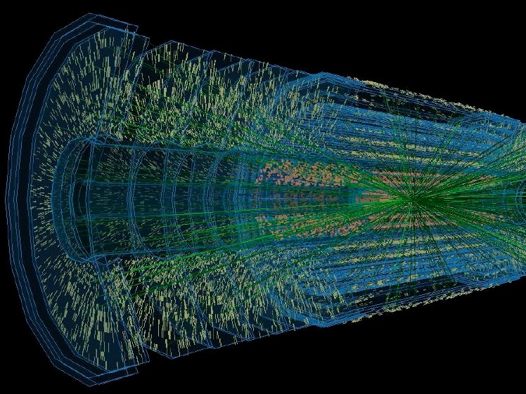
ATLAS Si Strip Tracker Upgrade
ATLAS Silicon Strip Tracker Upgrade Activities with Focus on German Groups
Ulrich Parzefall
University of Freiburg

Slide 2
Outline
Overview
Layout
German Participation
Summary & Outlook

Slide 3
Silicon Tracker Layout
Barrel strips
Forward strips
r
η
z
Beam pipe
φ
Stub layer
Pixel Disks
Barrel Pixels
LoI ITK Layout
All silicon detector (TRT replaced by strips)
Robustness under challenging conditions
Reduced material budget
Balance high performance with ease of build
Layers | Pixels | Strips
Barrel | 4 2 small, 2 large | 5 2 short, 3 long
End-cap | 2x6 | 2x7
Phase-2, 3000 fb⁻¹

Slide 4
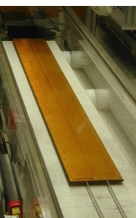
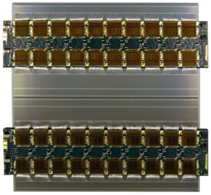
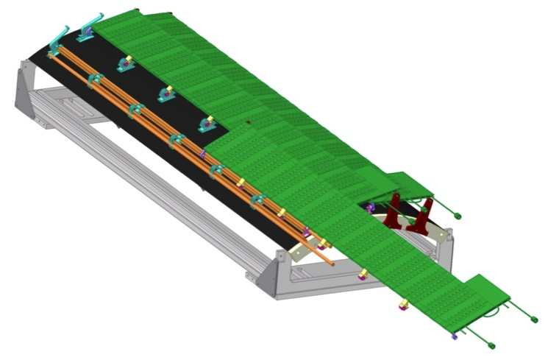
Barrel Stave Concept
~1.2 m
Module
Stave Support
Structure
10cm
Stave Core
1280 strips
Coolant tube structure
Bus cable
Carbon fiber
facing
Hybrids
Carbon honeycomb
or foam
Readout IC’s
Double-sided Stave
48 modules glued to core structure
Carbon fibre laminated to foam filler
Embedded cooling pipes (CO₂)
Co-cured bus tape for data and power
Attached to global support structure
Carbon fibre support structure with brackets for attachment
End insertion for easy assembly and access
Stave Modules
Hybrid: ASICS glued to kapton-flex, then wirebonded
Populated hybrid directly glued to silicon sensor, strips connected via wire bonds
Prototyping with Hamamatsu 6” sensor and ABCn ASIC (now 250nm, moving to 130nm)
Phase-2, 3000 fb⁻¹

Slide 5
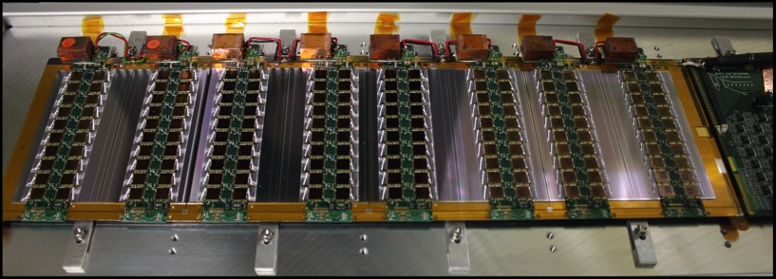
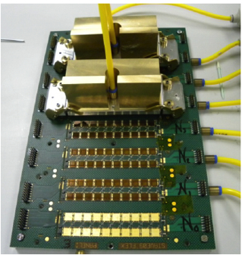
Stave Module Production
Focus on mass-production
Testing & population on panel
Simple vacuum pickup tooling
8 production sites
≈70 Modules produced
≈10 Modules “made in Germany”
Stavelet Program
Three single-sided 4-module “Stavelets”
Allow testing of construction and powering options
Two full-length staves nearing completion, doubled-side stavelets planned
Next steps
256 channel ASIC in 130nm submitted
Halve number of chips → lower power
Phase-2, 3000 fb⁻¹

Slide 6
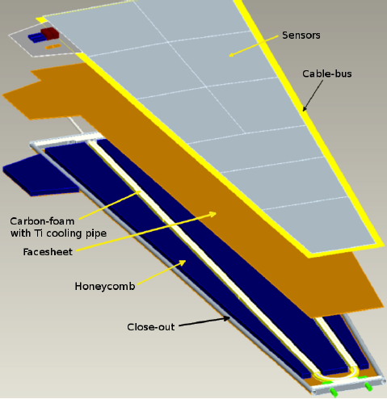
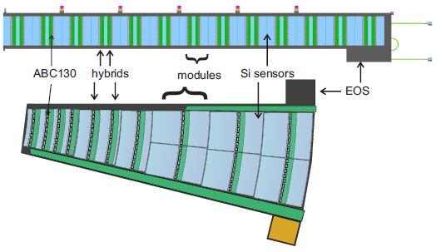
Stave End-cap = Petal
German groups involved in end-caps
ECs follow stave concept closely (module & hybrid design, assembly)
EC has 6 rings of sensors with radial strips, glued onto bus tape, glued onto carbon core
Phase-2, 3000 fb⁻¹

Slide 7
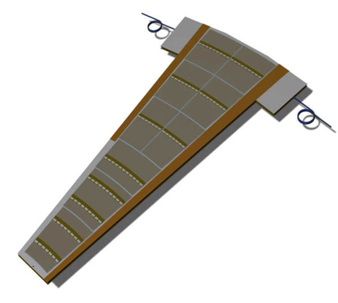
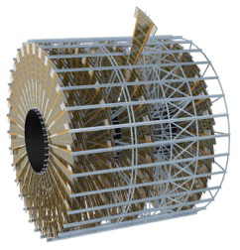
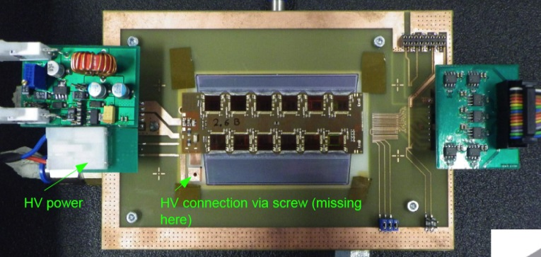
Stave End-cap = Petal
~30cm
7 disks per end-cap
Many different sensor sizes
Strip length 8 mm to 58 mm
32 petals per disk
6 rings of sensors with radial strips
Petalet programme underway
Double-sided, six-sensor prototype
Explore many options
Prototypes sensors & hybrids available
All module types produced successfully
~60cm
Phase-2, 3000 fb⁻¹

Slide 8
German Participation in Si Strips
Germany responsible for one End-Cap
224 Petals with 4072 modules
Berlin (Humboldt)
Module prototyping & production
DESY
Module prototyping & production (Z)
R&D, Prototyping & production of Cores (HH)
Module-to-core mounting
Macro-Assembly
Freiburg
Hybrid procurement
Module prototyping & production
Module-to-core mounting
And the other Endcap…

Slide 9
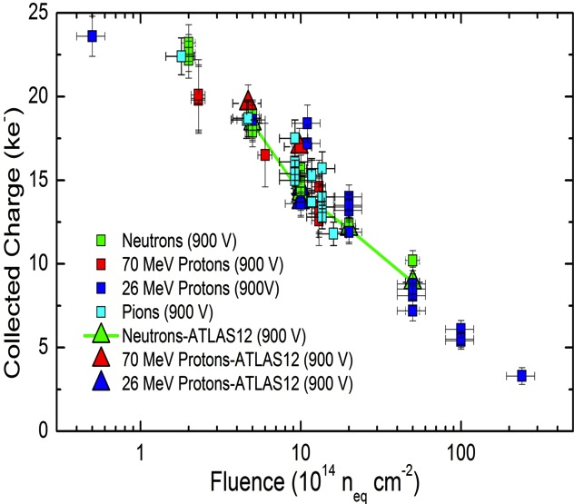
Sensors
Tests on ATLAS12 minis (HPK) confirm radiation hardness to 10¹⁵ N_{eq}
Full 6” ATLAS12EC design progressing (mostly by Valencia, production with HPK very likely)
Negotiating 8” p-type run with “a large European vendor”
EC: Current module building with 4” CNM sensors

Slide 10
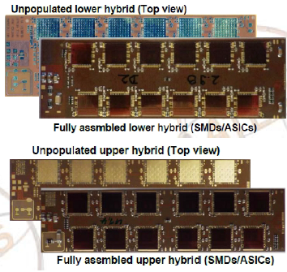
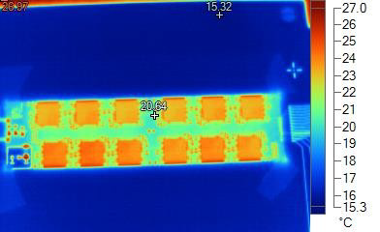
Hybrids
4-Layer Kapton-flex PCB
Design principles from barrel
Made at Würth Electronics (D)
Populated either in-house or in industry
ASICs placed in-house
Reasonably smooth production so far
Bias connections (4x per sensor)
Power
LV
HV
Data Readout

Slide 11
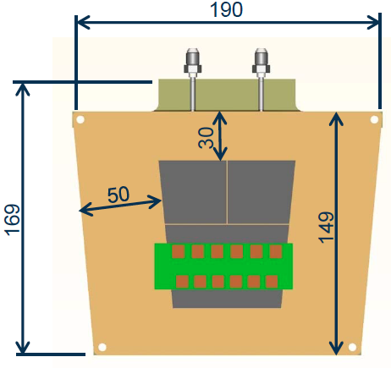
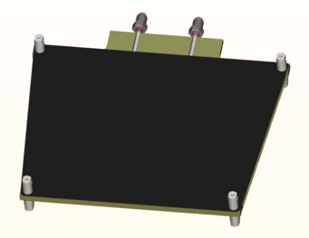
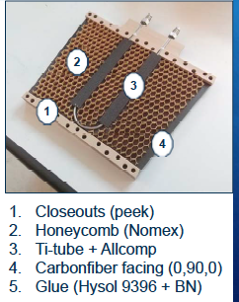
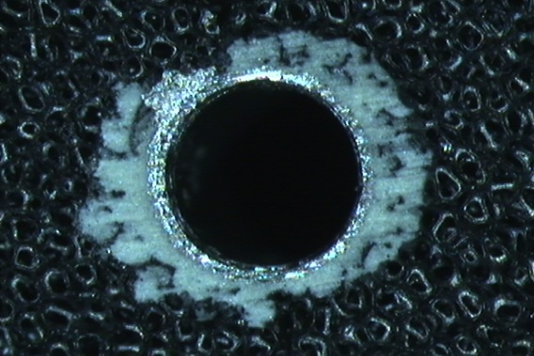
Cores
First petalet cores made and tested successfully
Tested for planarity, thermal performance etc
Stress and pressure tests of Ti-tubes and joints
Titanium Tube bonded into Petalet

Slide 12
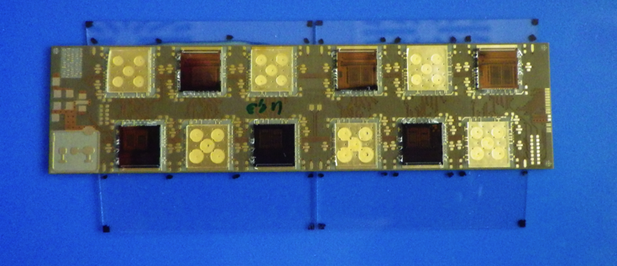
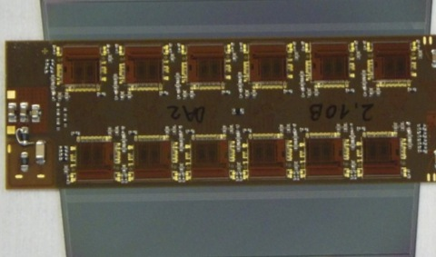
Assembly
Manual assembly with precision tooling
Tools made in our workshops
Adjustable to achieve desired dimensions (glue thickness)
More complex and delicate than it might look, yet easier than double-sided ATLAS SCT modules
All petalet module types produced successfully
Next step: module-to-core assembly
Trial upper module for Petalet
Lower module for Petalet

Slide 13
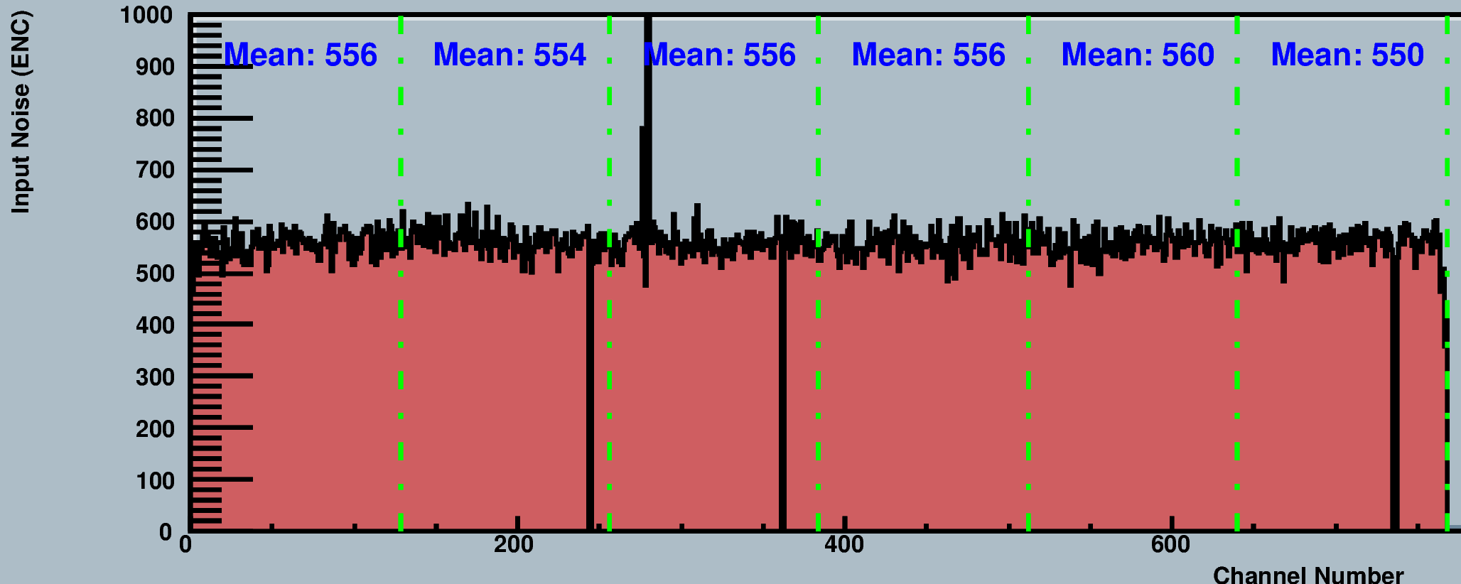
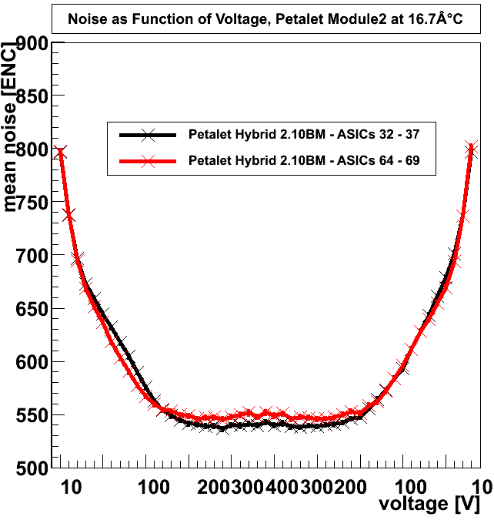
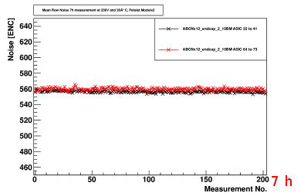
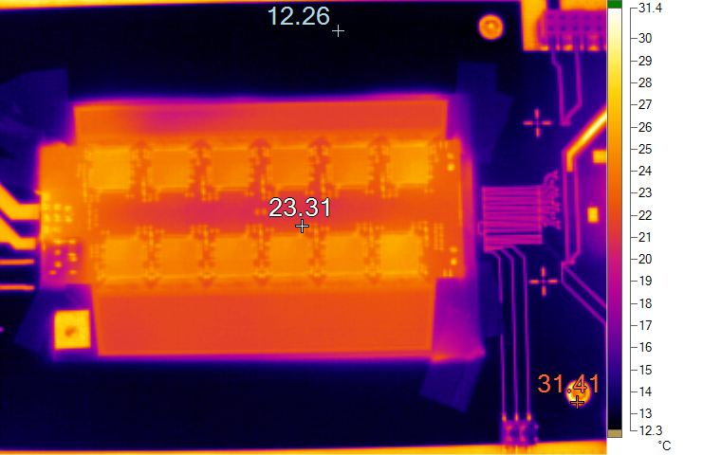
Module Performance
Assembled modules show good performance
Noise, thermal behaviour
module noise ~560e
Noise (e⁻)
bias-dependence of noise
strip number
long-term stability of noise

Slide 14
Summary & Outlook
Phase-2 ATLAS Silicon Strip Tracker design defined in LoI
3 German groups closely cooperating in End Caps
HU Berlin, DESY, Uni Freiburg
Each group takes over particular responsibilities
Plan to build one End Cap in Germany
ATLAS Si Strip (Endcaps) in general appear short of manpower/groups

Slide 15
Credits
Based on material from and/or discussions with a large number of colleagues
Tony Affolder, Phil Allport, Dario Ariza, Ingo Bloch, Ingrid Gregor, Marc Hauser, Susanne Kühn, Carlos Lacasta, Riccardo Mori, Richard Nickerson, Volker Prahl, et al

Slide 16
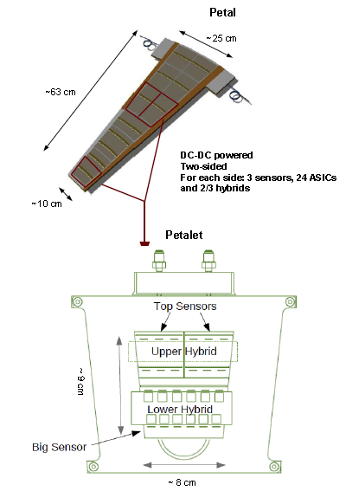
BACKUP only after this slide

Slide 17
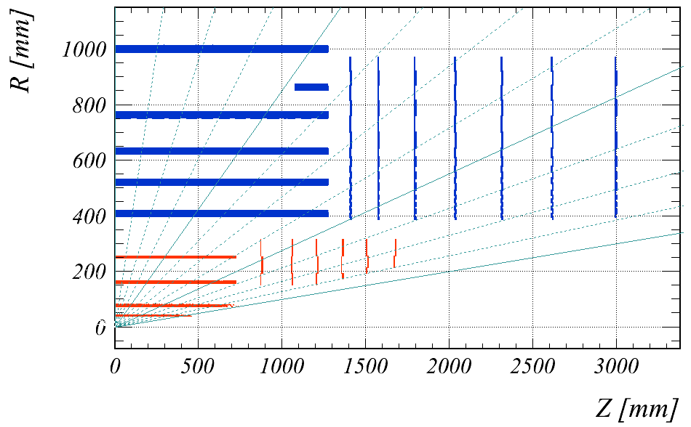
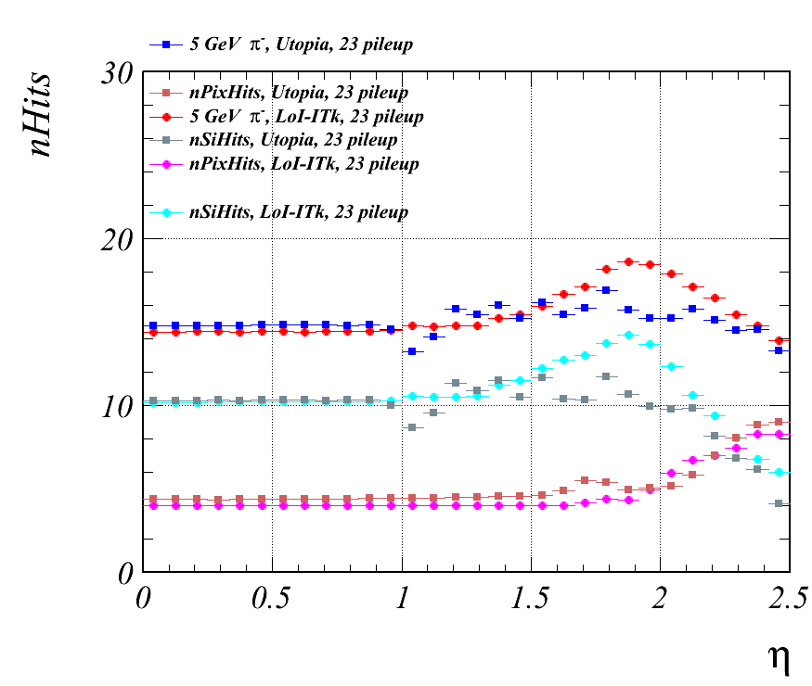
Design Parameters and Layout
η=1.0
Effect of
stub layer
η=2.0
η=3.0
Total of 14 hits with full coverage to η<2.5
Pixels to η<2.7 (forward muon ID)
Minimize gaps in coverage
Last strip disk at z=3m
Small “stub” layer in barrel
Last pixel layer at 25-30cm
Improve double track resolution
Good momentum resolution across whole pseudorapidity range
Phase-2, 3000 fb⁻¹

