Slide 1
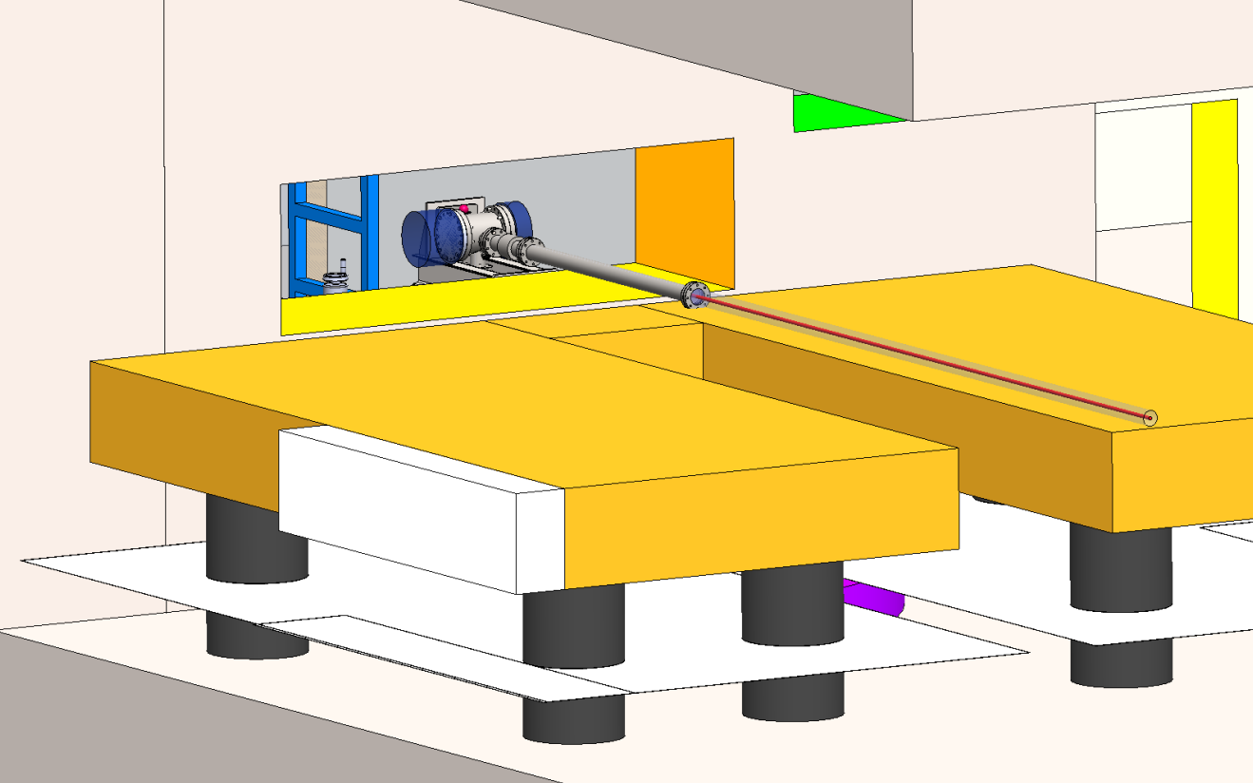
Laser Room Level 5 looking towards vertical shaft

Slide 2
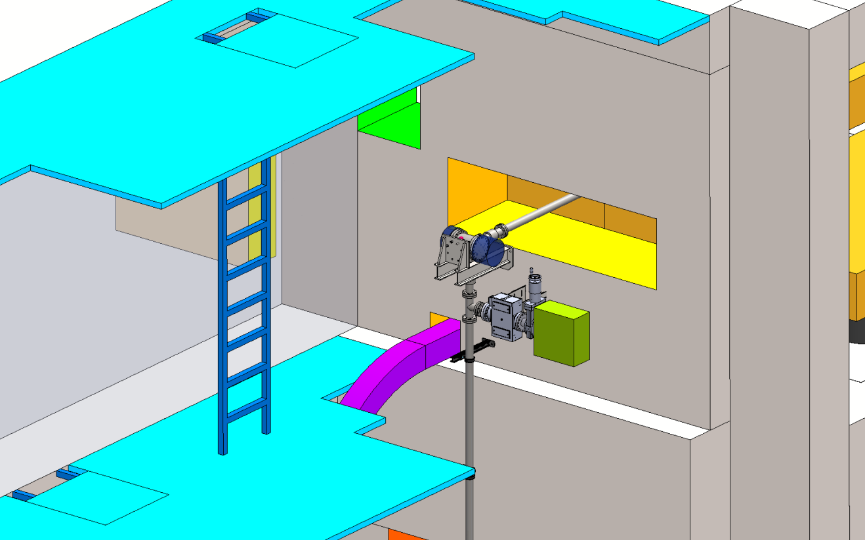
Inside vertical shaft looking down towards laser room

Slide 3
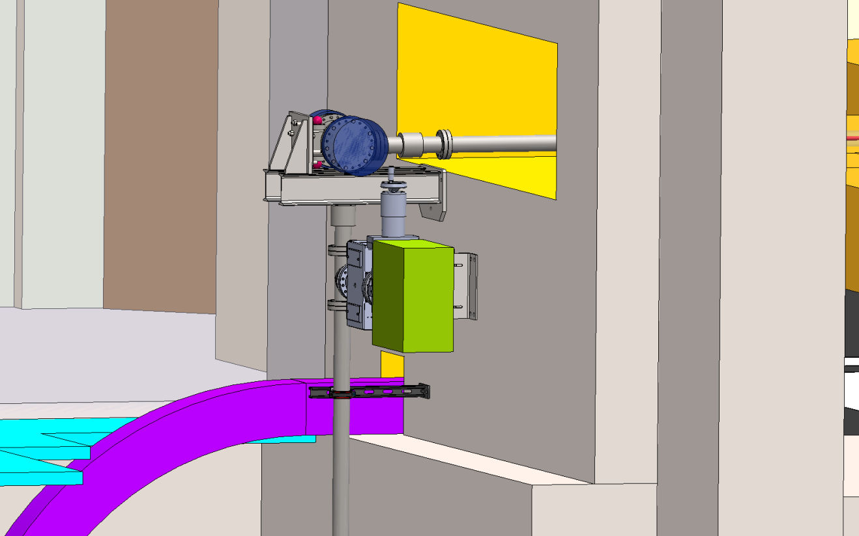
Inside vertical shaft looking towards laser room

Slide 4
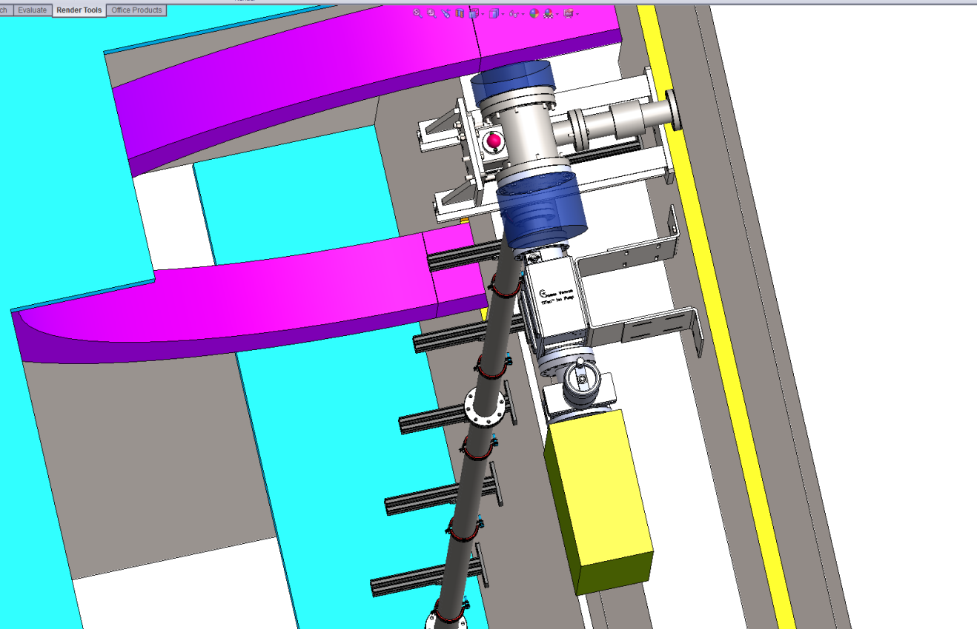
Inside vertical shaft above laser room looking down

Slide 5
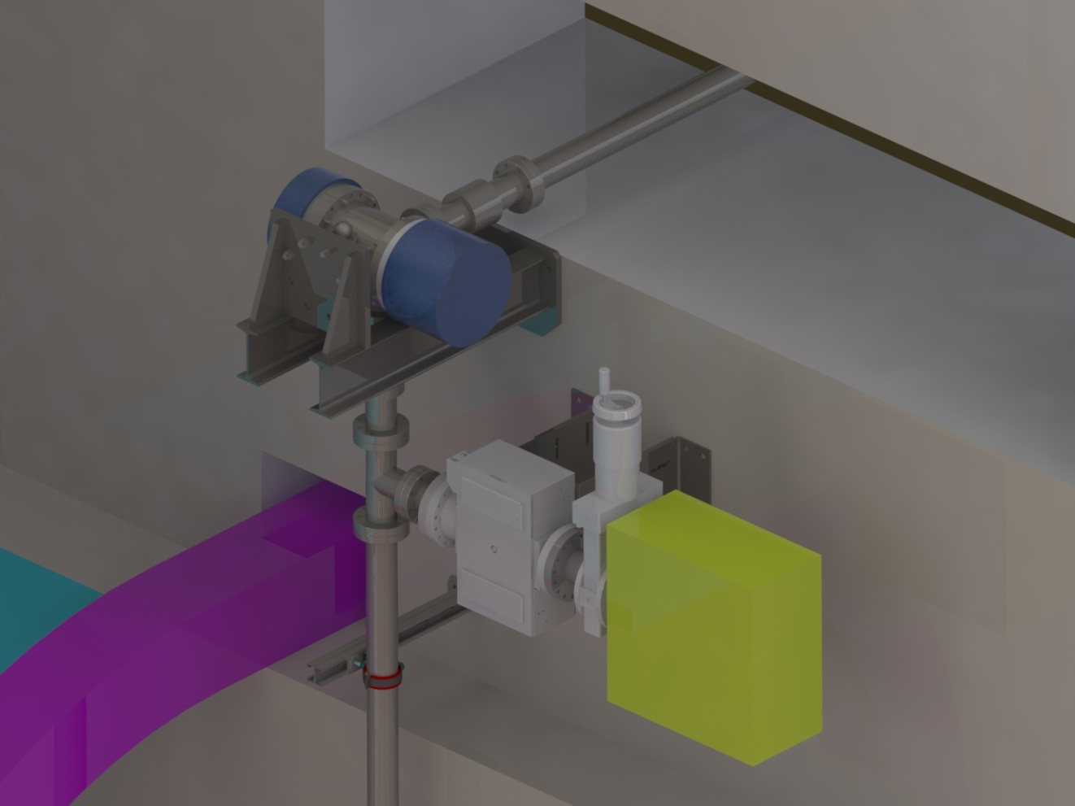
Inside vertical shaft looking towards laser room

Slide 6
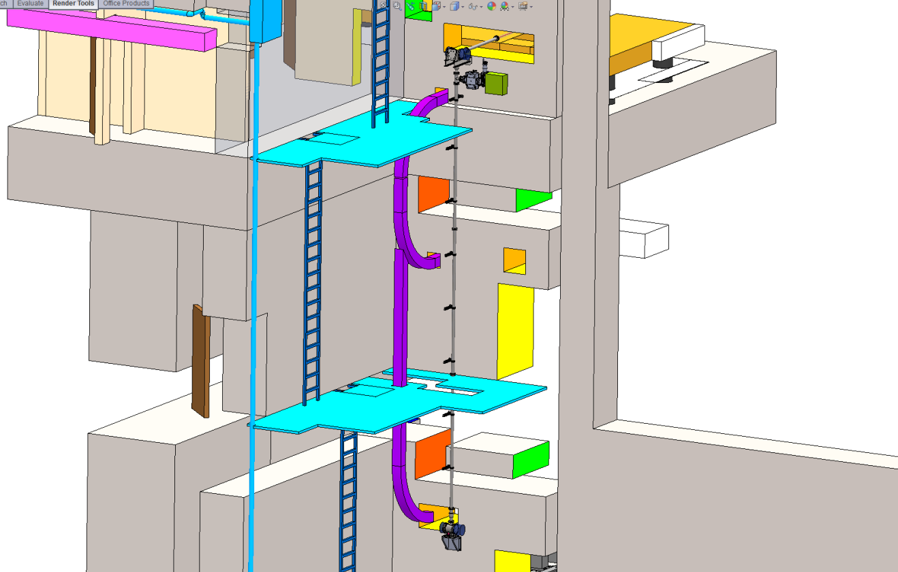
Looking towards vertical shaft from distance
Opening on LVL 5 as seen from shaft
500 mm
LVL 5 Laser room
92 mm
Vacuum pipe
100 mm
LVL 7
115 mm
Opening on LVL 7 as seen from shaft
Pipe center distance from wall:
LVL5 ~ 365 mm
LV6-LVL7 ~ 115 mm

Slide 7
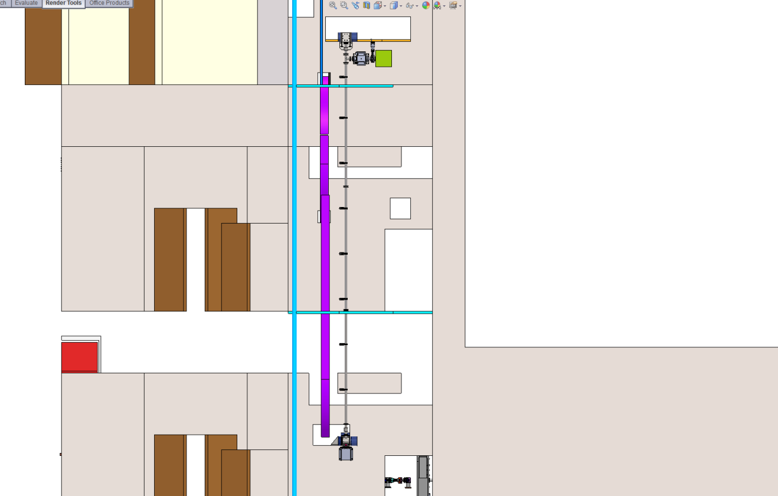
Looking towards vertical shaft from distance

Slide 8
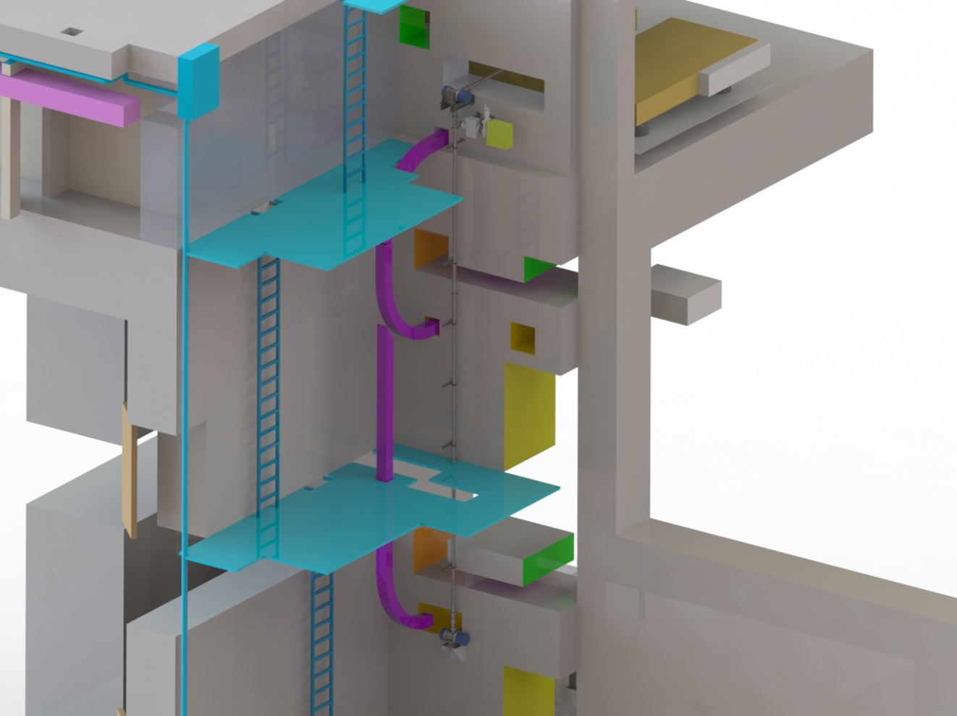
Looking towards vertical shaft from distance

Slide 9
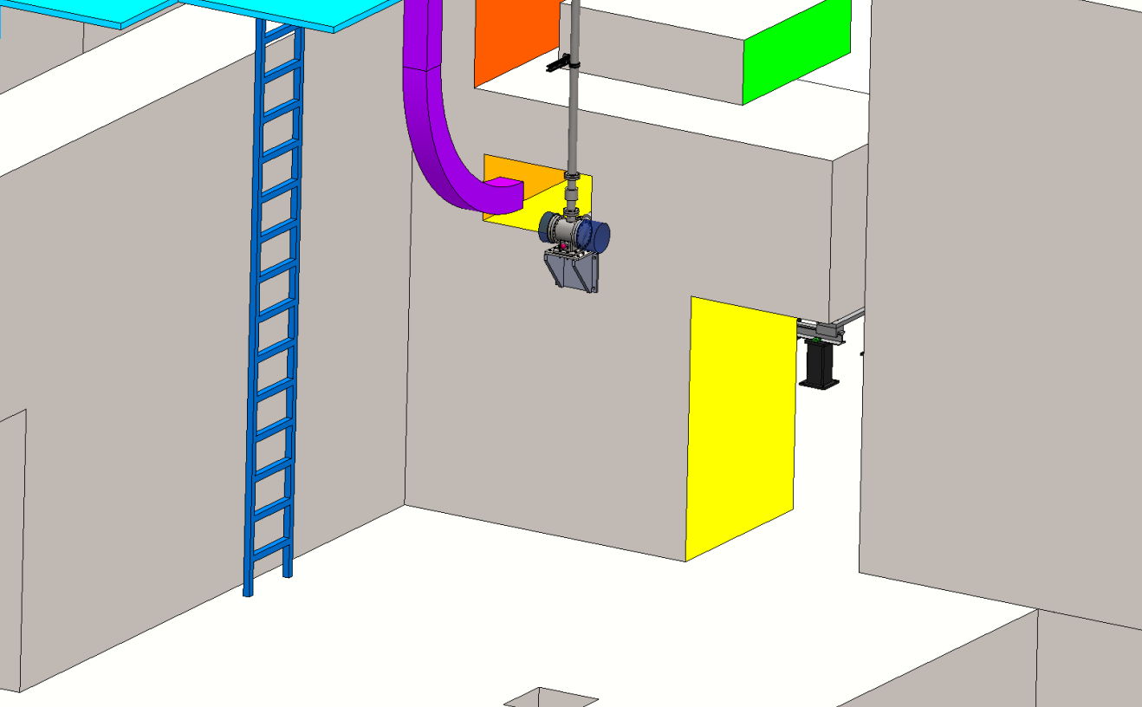
Looking towards vertical shaft Level 7

Slide 10
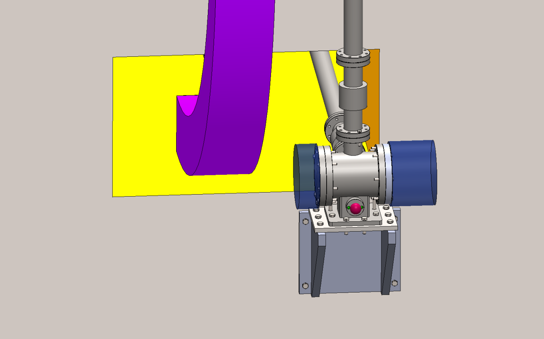
Inside vertical shaft looking towards inlet to tunnel
Place holder for mount / dismount flange with mirror mount
Note the blue cylinders are place holder for being able to mount/dismount the flanges.
The red ball is a fiducial (they are mounted the same way on each mirror corner including the ones sitting inside of the tunnel)

Slide 11
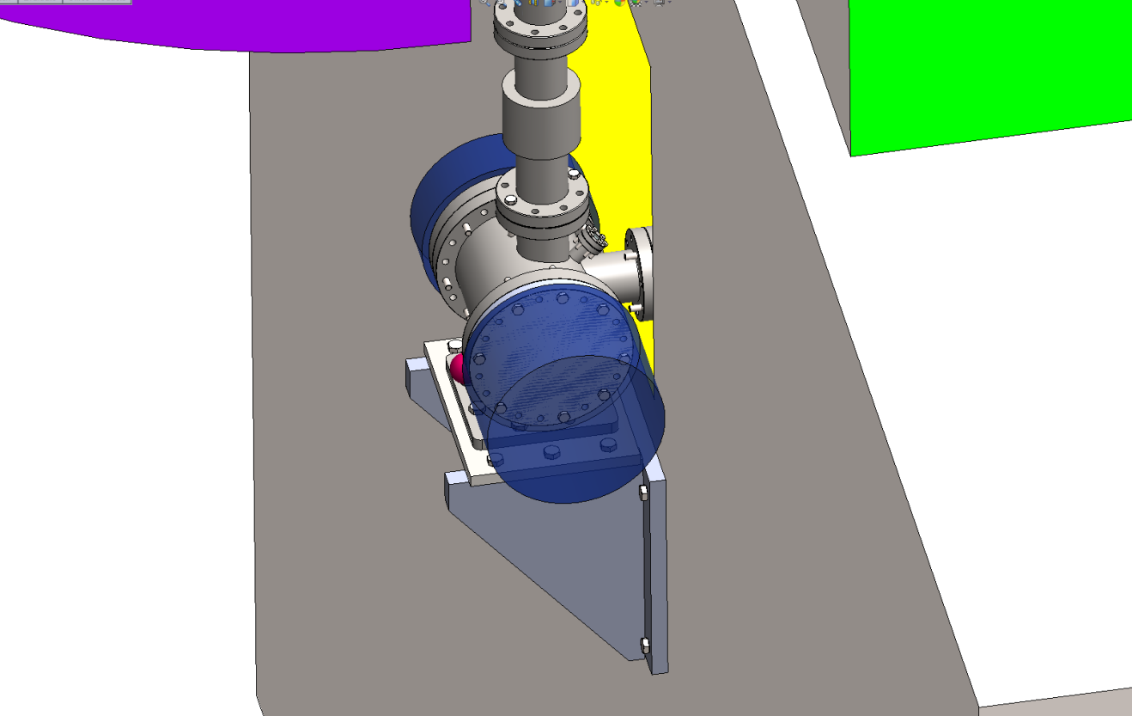
Inside vertical shaft looking towards inlet to tunnel

Slide 12
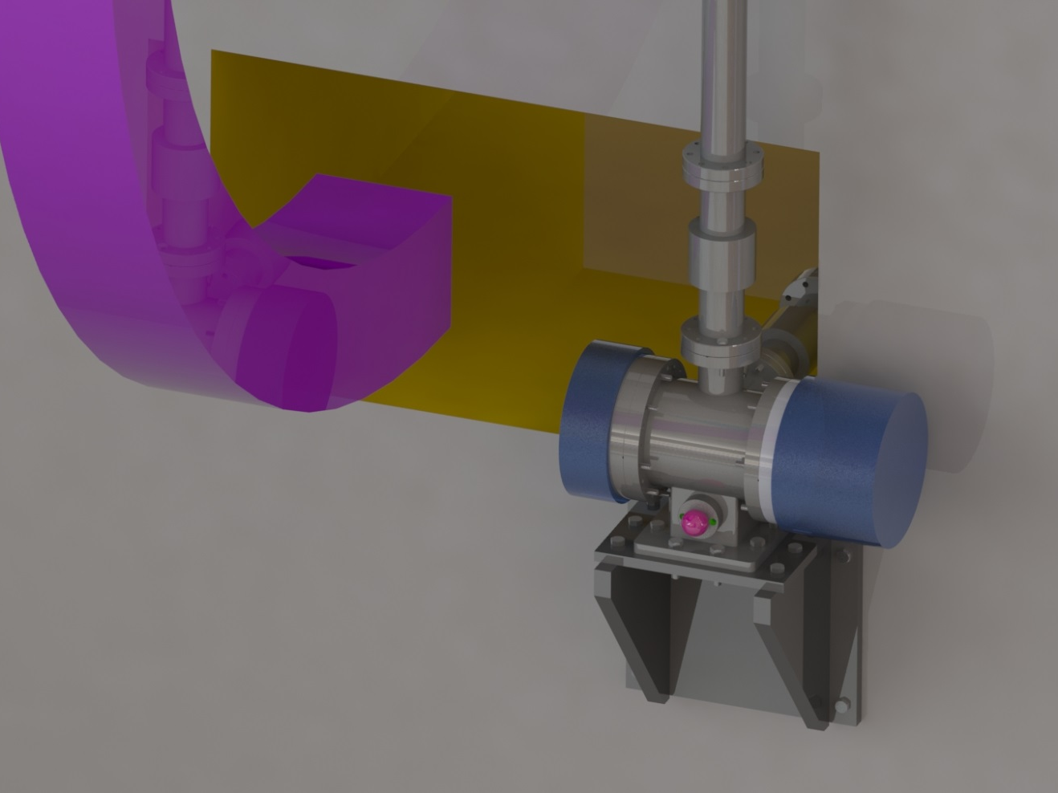

Slide 13
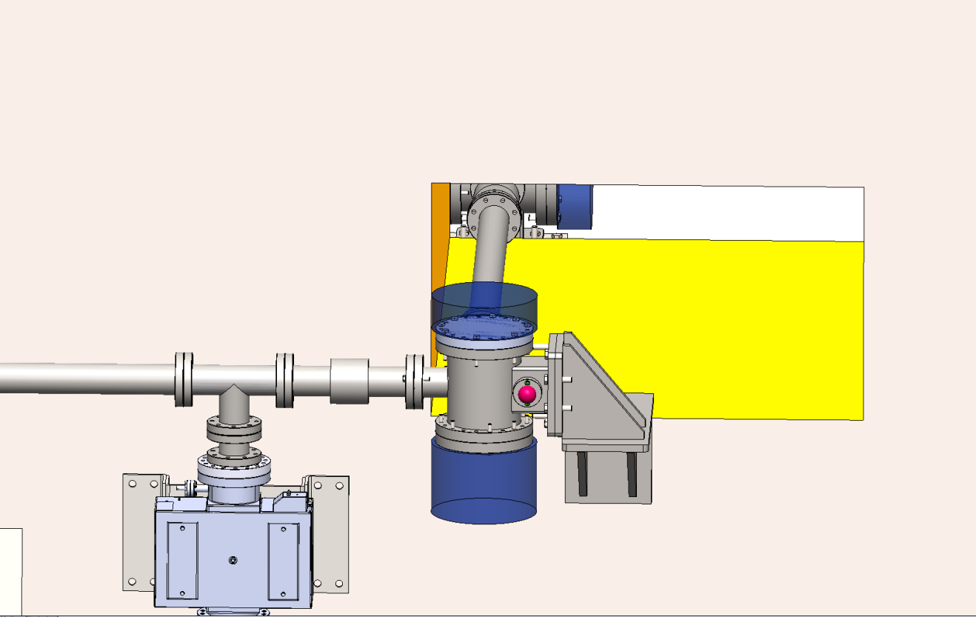
Inside tunnel LVL7 looking towards beam pipe coming from vertical shaft

Slide 14
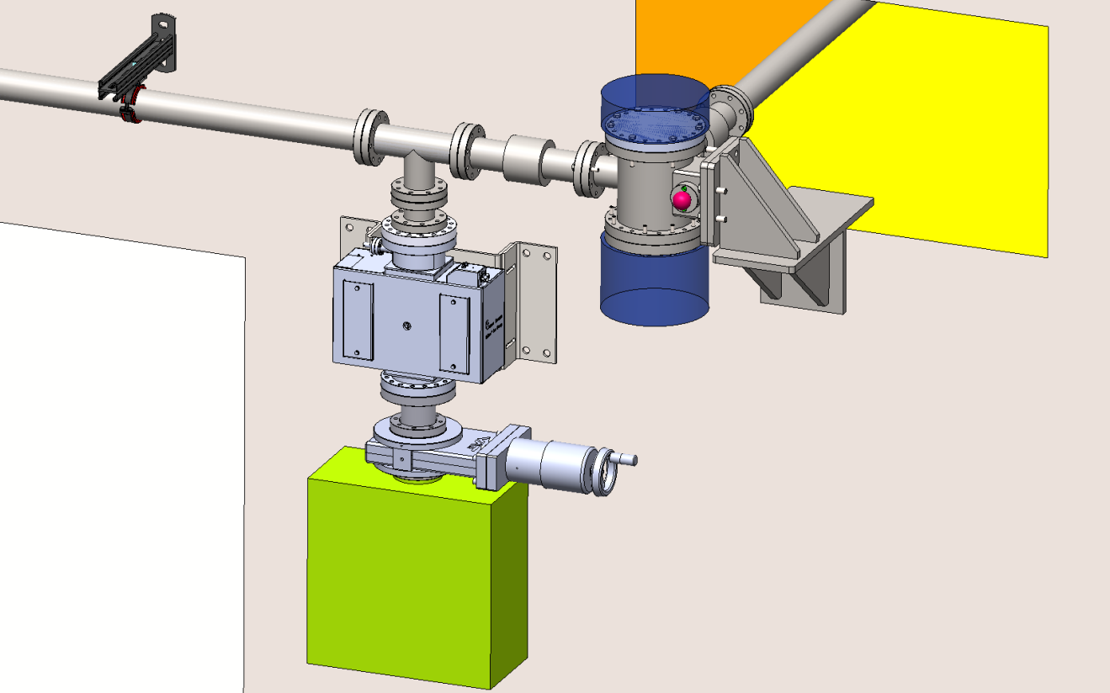
Inside tunnel LVL7 looking towards beam pipe coming from vertical shaft

Slide 15
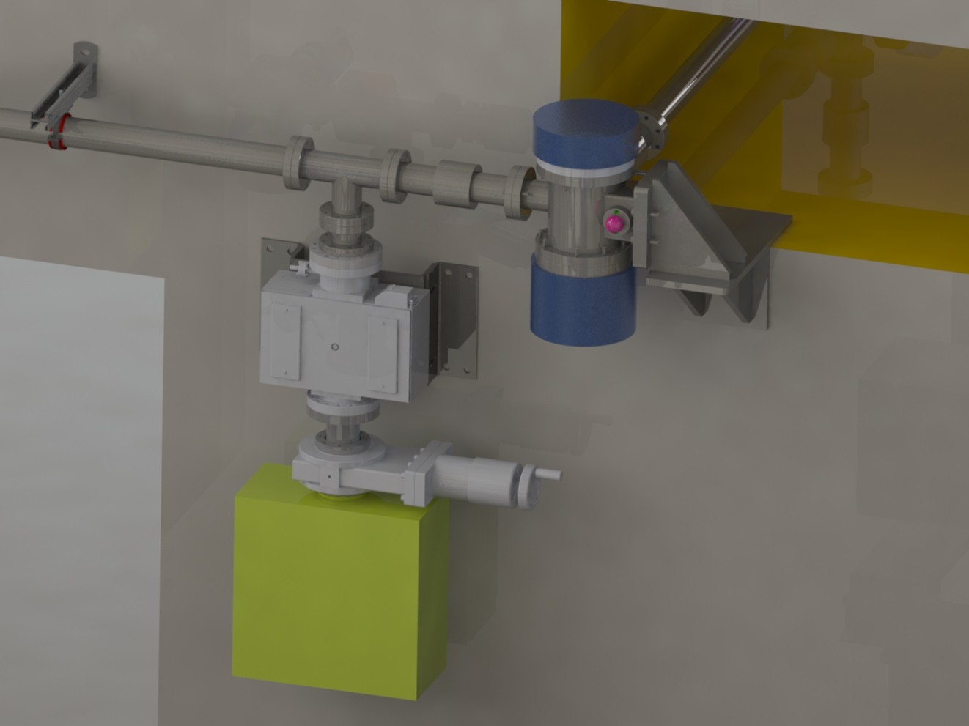
Inside tunnel LVL7 looking towards beam pipe coming from vertical shaft

Slide 16
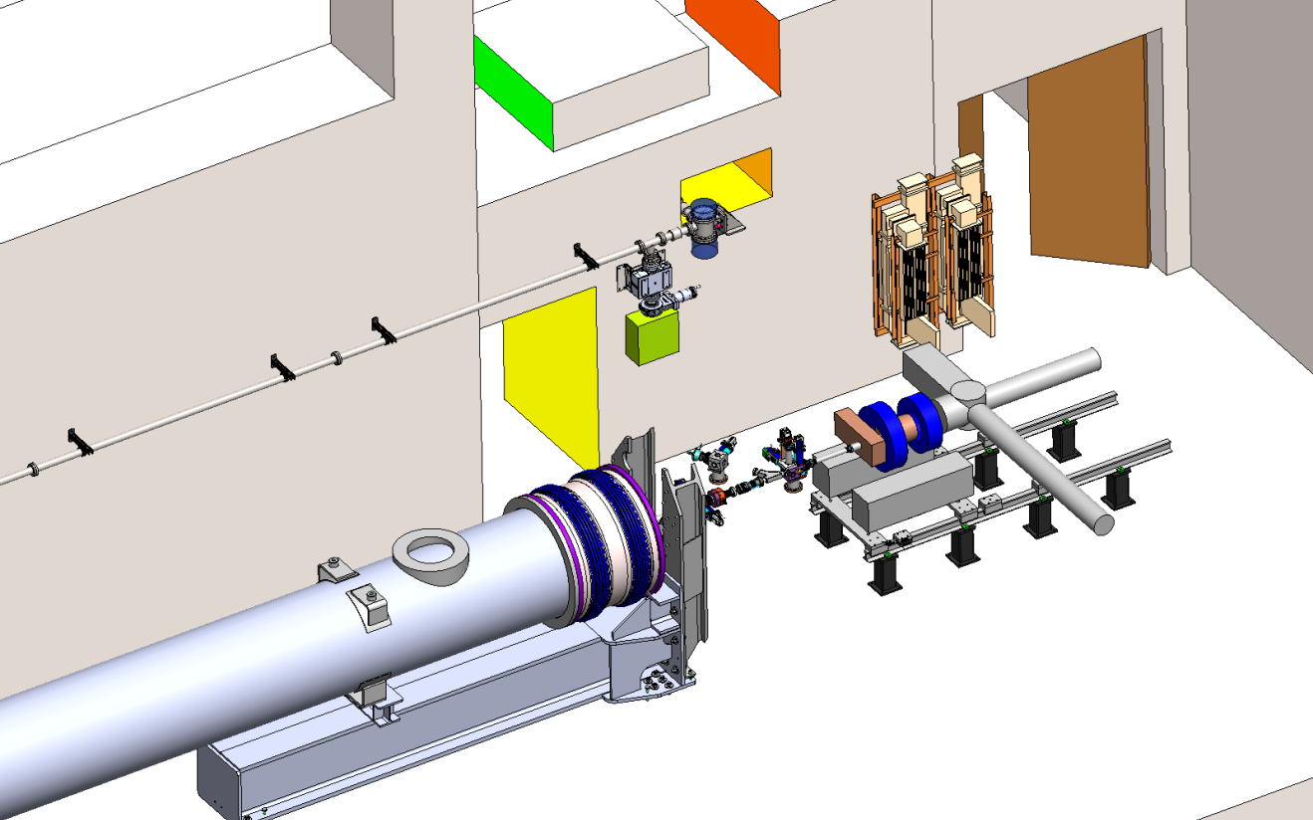
Inside tunnel LVL7 looking towards beam pipe coming from vertical shaft

Slide 17
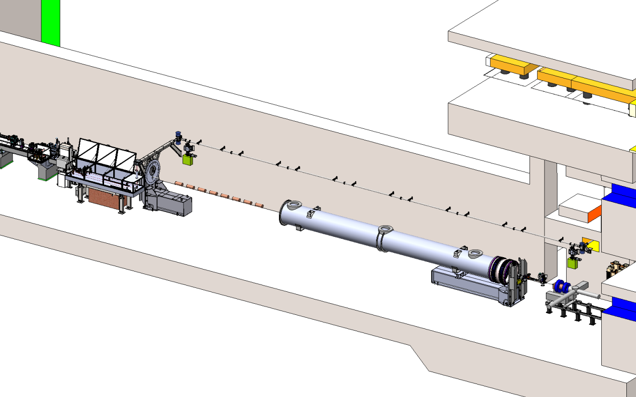
Inside tunnel LVL7 looking from distance along the tunnel towards laser heater

Slide 18
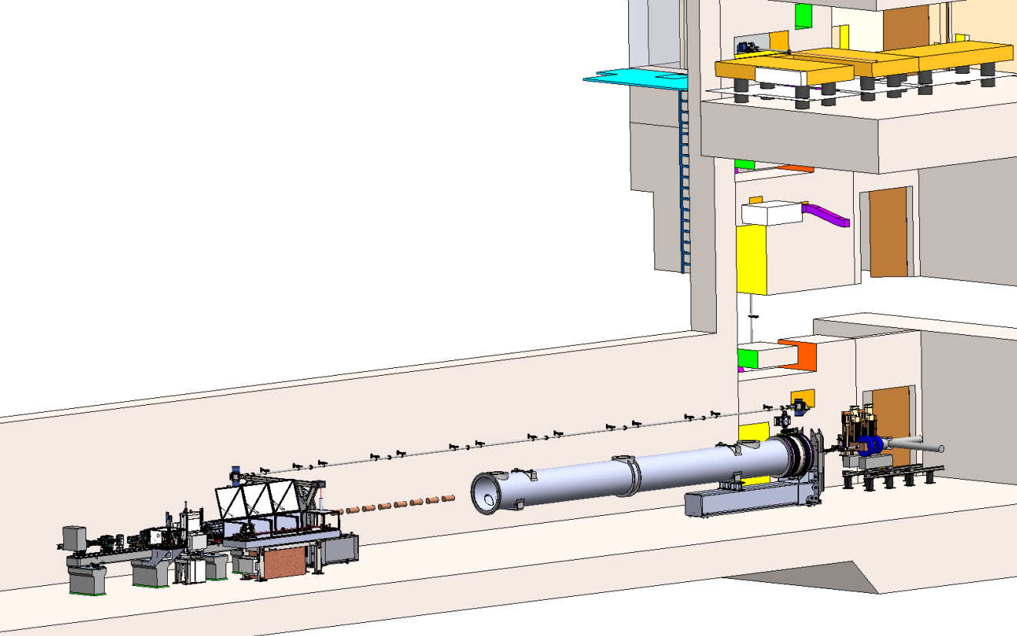
Inside tunnel LVL7

Slide 19
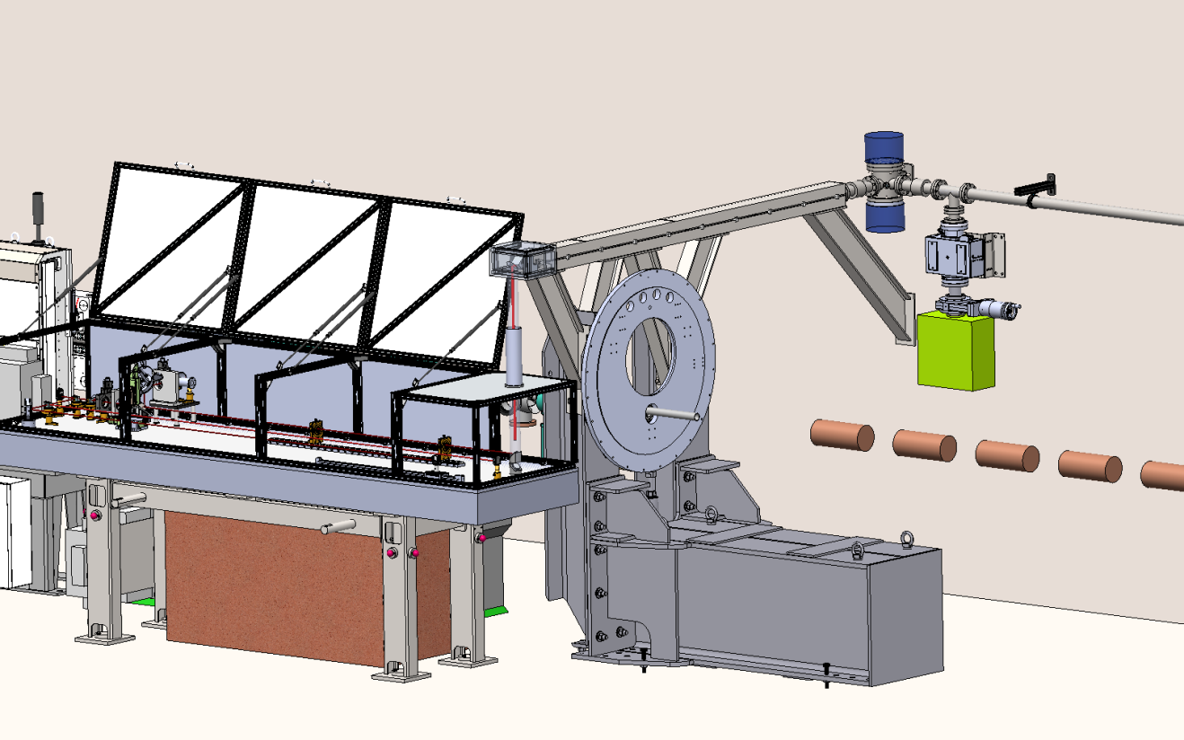
Laser Heater setup with wider table stand to allow for radiation protection

Slide 20
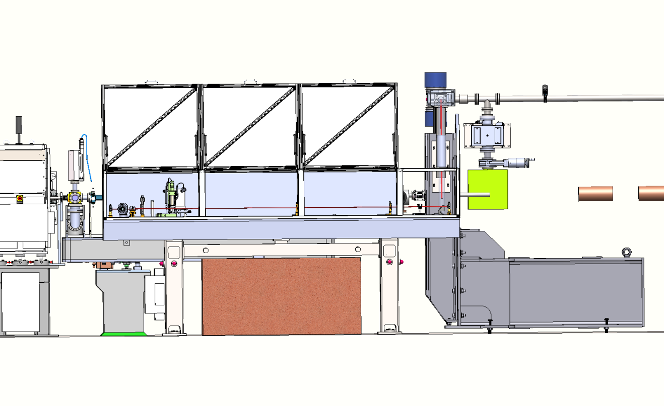
Laser Heater setup with wider table stand to allow for radiation protection

