Slide 1
SASE1
Installation of Undulator Systems
J. Pflüger WP71

Slide 2
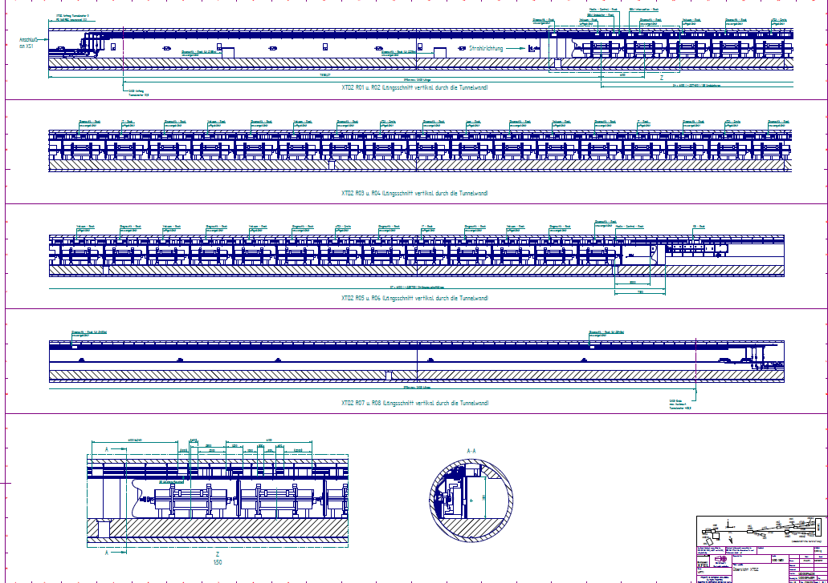

Slide 3
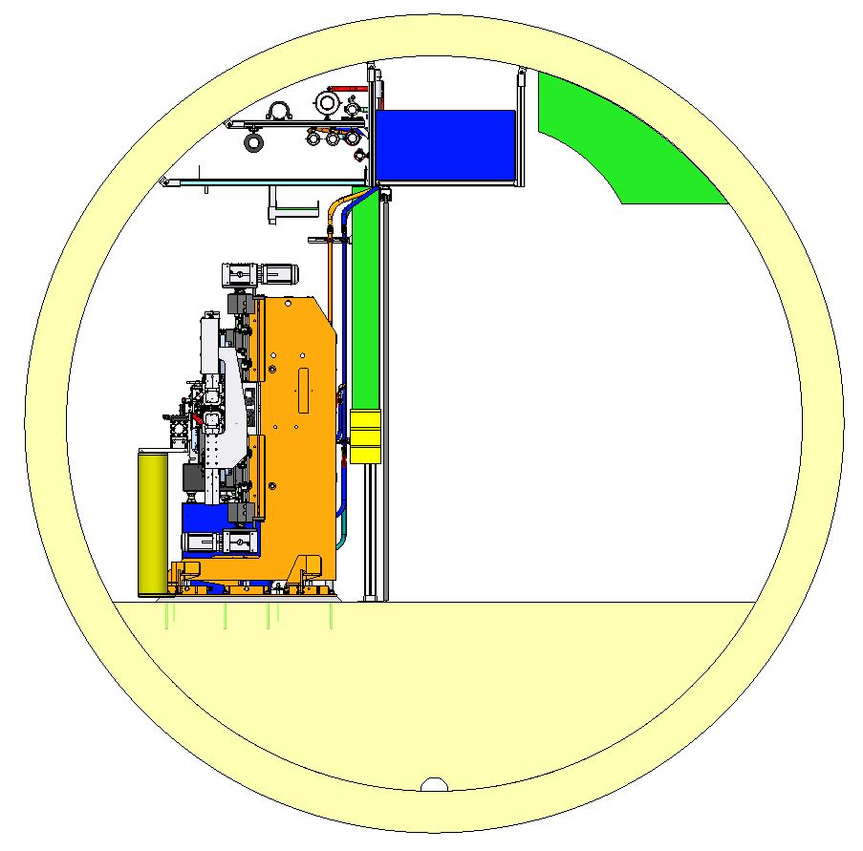

Slide 4
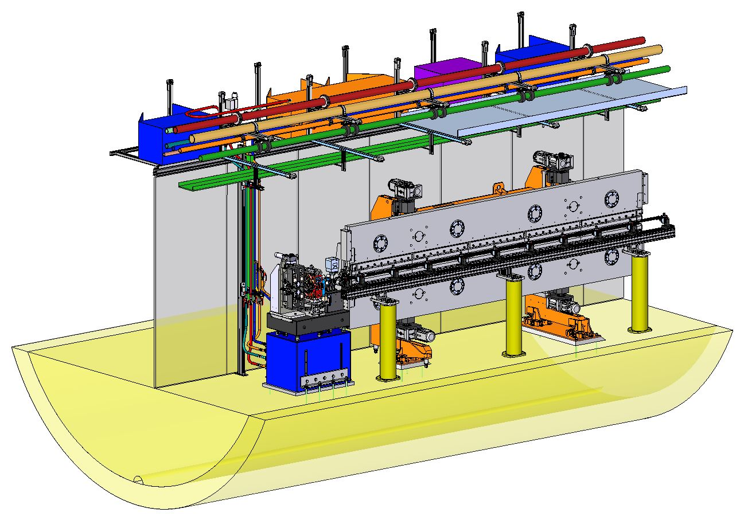

Slide 5
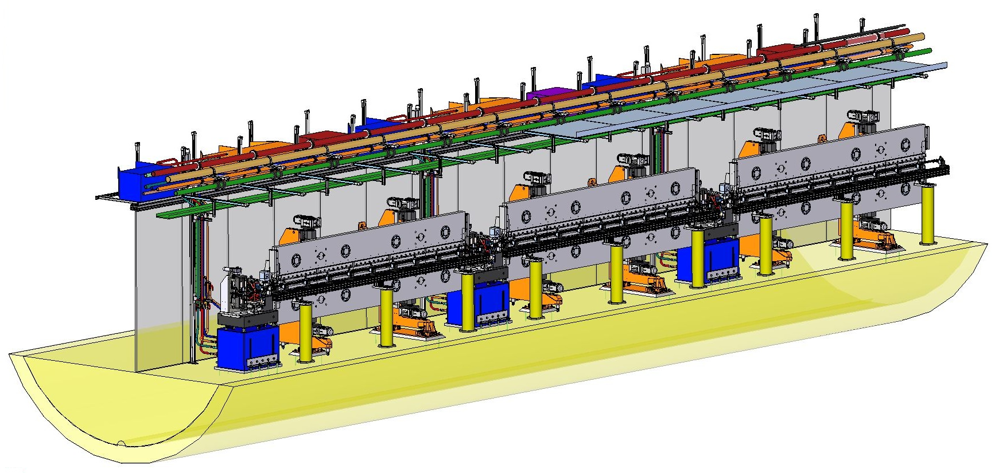
ui

Slide 6
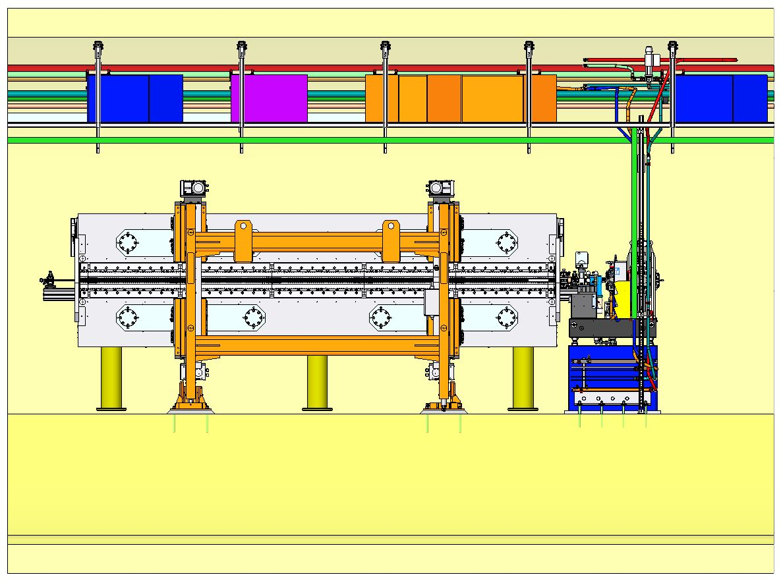
SASE1 Cell

Slide 7
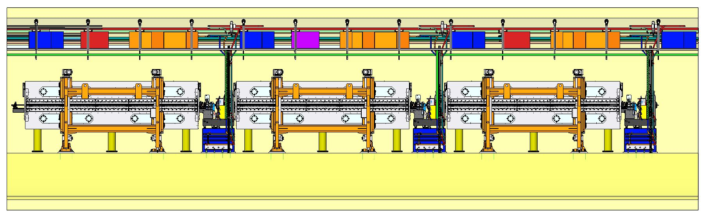

Slide 8
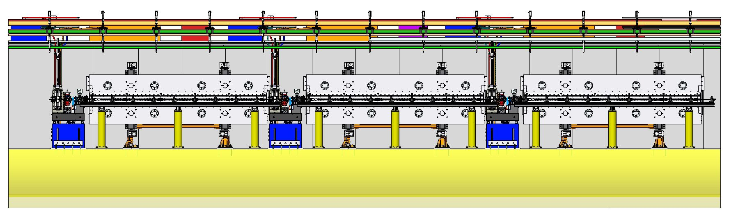

Slide 9
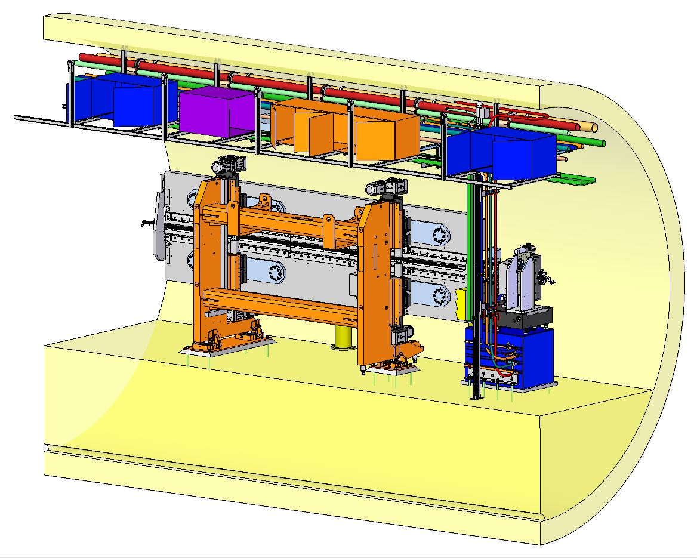

Slide 10
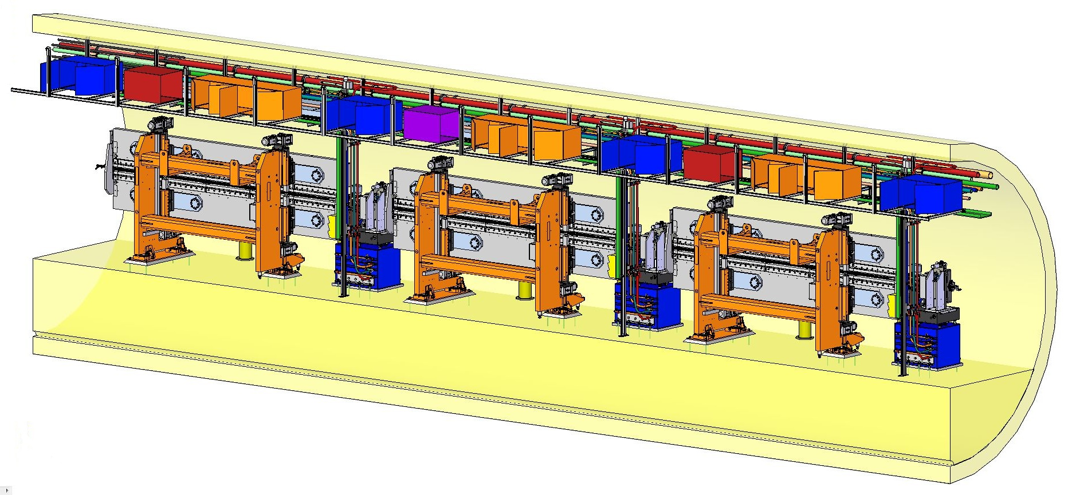

Slide 11
Open 17.6.2013:
Laser Alignment Beam Pipe
  Resposibility
  Not in our model
  Construction schedule – not clear
Fire Extinguishing System
  Construction details / schedule not clear

Slide 12
The End

