Slide 1
Precision assembly of back-to-back “2S” modules and Front-to-back Metrology
Lutz Feld
(RWTH Aachen)
PETTL-WP4 Meeting 12. 9. 2013

Slide 2
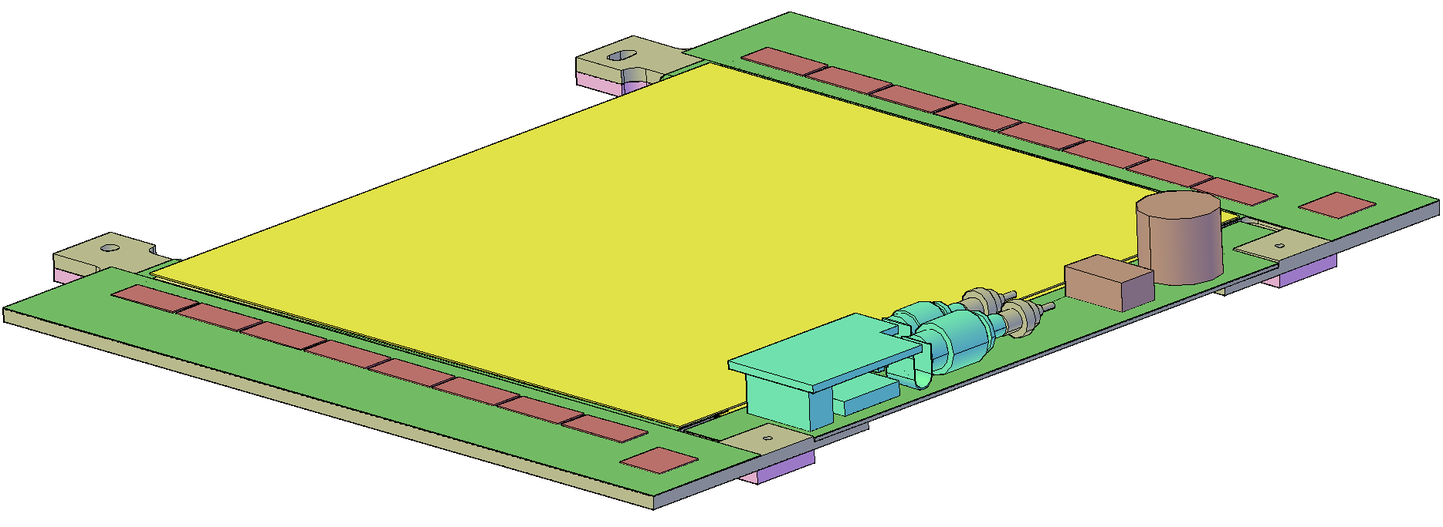
Precision Assembly of 2S Modules

Slide 3
Front-to-back Metrology

Slide 4
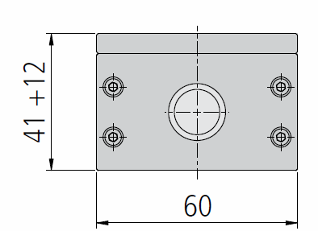
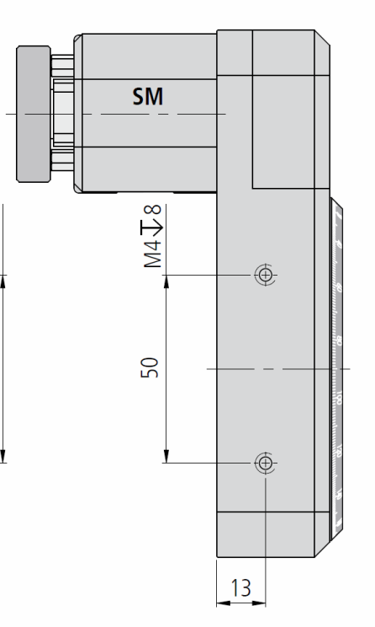
Front-to-back Metrology Machine
focusing stage
microscope
hybrid/module
rotating table
microscope
rotary stage
focusing stage
frame

Slide 5
Part List
Part | Source | Product | Quantity | Uni Cost | Cost
Rotary Stage | Owis | DRTM 90-D53-HiSM | 1 | 1.600 € | 1.600 €
Controller Rotary Stage | Owis | PS10 | 1 | 200 € | 200 €
Power Supply | Owis |  | 1 | 100 € | 100 €
Focusing Stage | Owis | HV 60-12-MS | 2 |  | 0 €
Microscope Camera | Conrad | 191377-62 | 2 | 100 € | 200 €
 |  |  |  |  | 0 €
 |  |  |  |  | 0 €
 |  |  |  |  | 0 €
Total |  |  |  |  | 2.100 €

Slide 6
Next Steps
Finish Design of FB Metrology Machine
Build it
Develop Software (LabView Vision)
Determine measurement accuracy

