Slide 1
MSSM Higgs Signal in bb
Ewen

Slide 2
Last Week…
Toolkit for Multivariable Analysis (TMVA)
  Optimization package in ROOT
Searching for optimal variable choice for MSSM Higgs Signal in higher mass regimes
  Regression Analysis
  MSSM Higgs doublet

Slide 3
MSSM
Minimal Supersymmetric Model
Predicts partner particles for every particle in the standard model
  Boson Fermion
  Squarks ←→ Quarks (super-quarks)
  Sleptons ←→ Leptons (super-leptons)
  Boson ←→ Bosino
  Sfermion ←→ Fermion

Slide 4

Higgs in SM
SM Higgs field is a complex doublet
Electroweak symmetry breaking “rotates” this field
  W⁺⁻, Z, and H
  Higgs here is Charge Parity (CP) even and has no electric charge (neutral)

Slide 5
Higgs in MSSM
MSSM extends to two complex doublet fields
  Hu = (H⁺_{u,} H⁰_{u}) = up-like (positive) quarks
  Hd = (H⁻_{d,} H⁰_{d}) = down-like (positive) quarks
Eight Degrees of Freedom (DoF)
  As before, three go to W⁺⁻, Z
  The remaining five are Higgs Bosons
    Two CP-even and neutral: h⁰ and H⁰
    One CP-odd and neutral: A⁰
    Two CP-even and charged: H⁺ and H⁻

Slide 6
    h⁰
By convention, m_{h} < m_{H}
h⁰ is superposition of H⁰_{u} and H⁰_{d}
  Interacts with both up and down like quarks
Theory limits mass to m_{h} < 135 GeV
  Looks a lot like SM iggs

Slide 7
H⁰
Similar to h⁰ but BIGGER
(*) Usually postulated around > 300 GeV
(*) This is the signal we want in the bb channel.

Slide 8
My Work
Adjusting settings on TMVA to find best channel selection.
  Separating background bb events from potential H⁰ bb events.
Uses a regression analysis

Slide 9
Regression Analysis
GenP_{t}* = Event Generator
DetectedP_{t}* = Detector Simulation
DetectedP_{t} = Experiment
P_{t} = Result!

Slide 10
Minimizing Error
Region where the ≈ symbol is most valid
No data yet, split montecarlo data into two sets
  (*) “Training” sample determines
  (*) “Testing” sample determines x
Select Parameters to determine best region, i.e. of smallest x

Slide 11
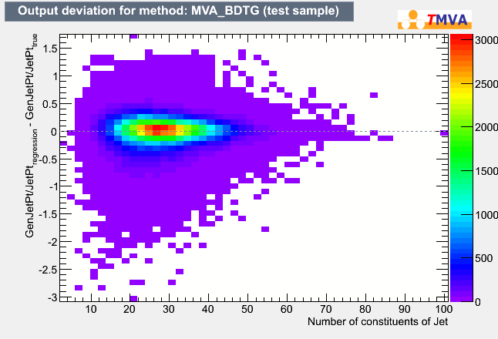
Good Plot

Slide 12
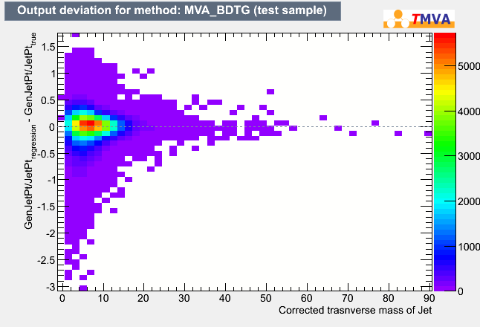
Bad Plot

Slide 13
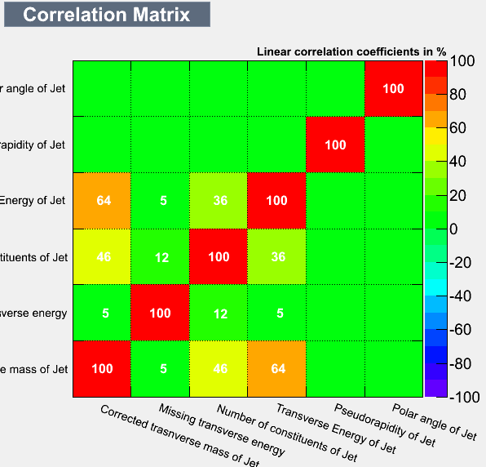
Correlation Considerations

Slide 14
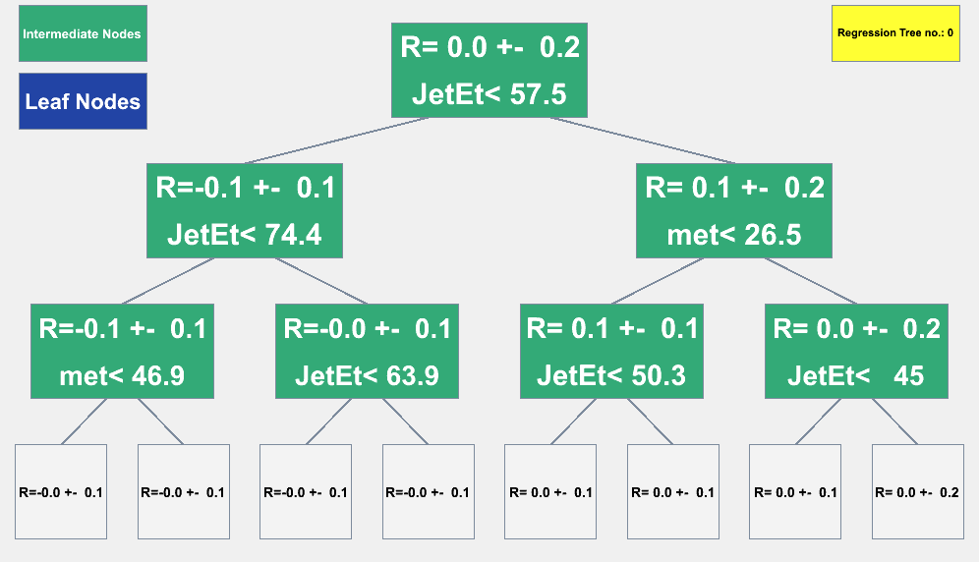
Boosted Decision Tree

