Slide 1
Weekly Summary
Ewen L. Gillies
12/8/13

Slide 2
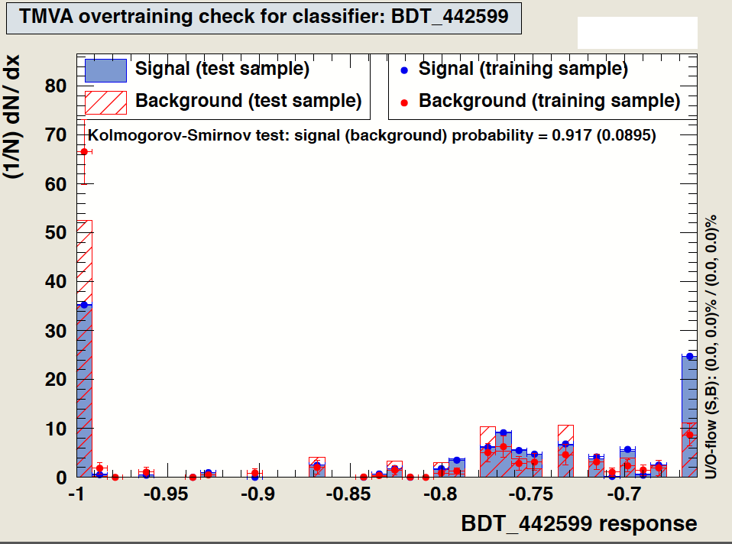
Classification - BDT
Binary Regression
Signal Data Sets for Medium Mass:
140 GeV SUSY Signal – Excluded
200 GeV SUSY Signal
250 GeV SUSY Signal
Background Sets
General QCD – Excluded
bEnriched Scenario

Slide 3
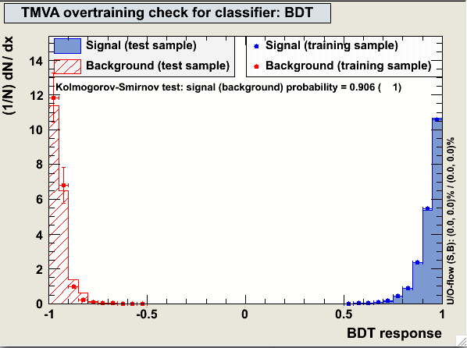
Classification - BDT
Pre-training
Input trees already “prepared”
Signal Data Sets for Medium Mass:
140 GeV SUSY Signal
200 GeV SUSY Signal
250 GeV SUSY Signal
Background Sets
General QCD
bEnriched Scenario

Slide 4
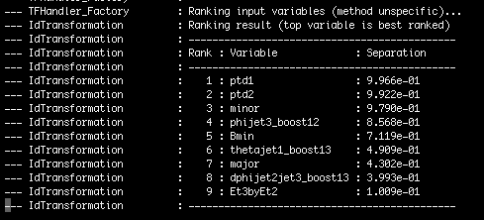
Variable Ranking
BDT
Counts how often variables are used to split decision tree nodes
Weights each split according to separation achieved and number of events
Results show unstable at best
Rankings often shift
High variance
Script for large sample?
Unreliable
Best used as rough guide

Slide 5
Looking ahead
TMVA Training
“Second Order” Training
Written to select optimal cut parameters
tmva_standalone_v10
Diagnosis of pre-training effects
Verification of signal/background separation
Use with real data
Other classification techniques
Neural networks
Likelihood etc.

