Slide 1
Summary
Schedule / Beam Test / Gated Mode Tests

Slide 2
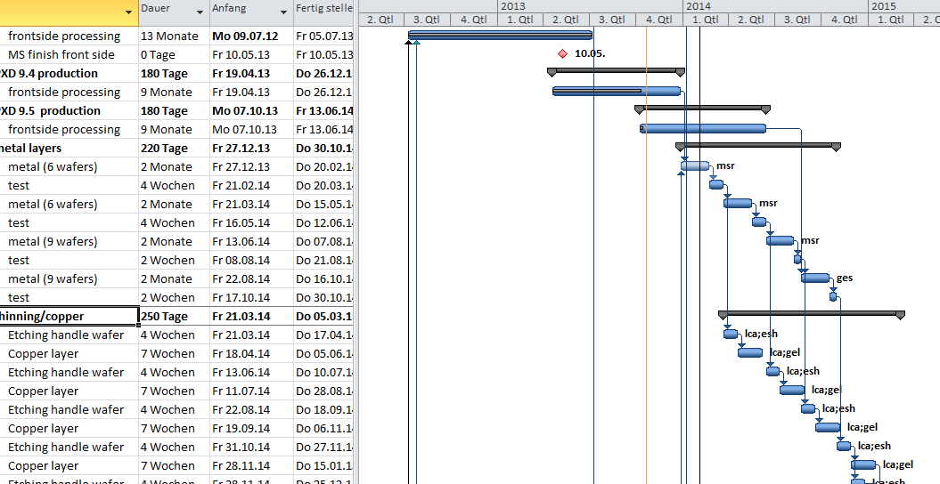
Modified Sensor Production Schedule
This might shift by 2-3 months
EMCM3 & 4
Gated mode
New batch (PXD 9.5) started last week
SOI wafers still available (17)
Will be ready in time to join BOL of other batches
No overall delay expected
First wafer level tests in March 2014
First sensors available in June 2014
Production finished in March 2015
Shift by 2-3 months

Slide 3
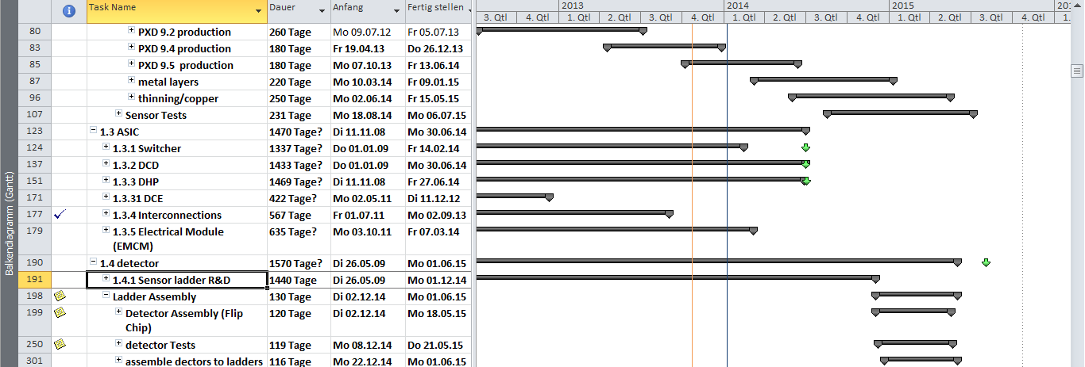
Overall Schedule
First sensors available in October 2014.
Surprisingly, this is still ok with delivery to KEK in August 2015 (which is not needed)
However, very tight schedule:
protototype module + test: 2 months ?
assembly of 20+ ladders: 6 months

Slide 4
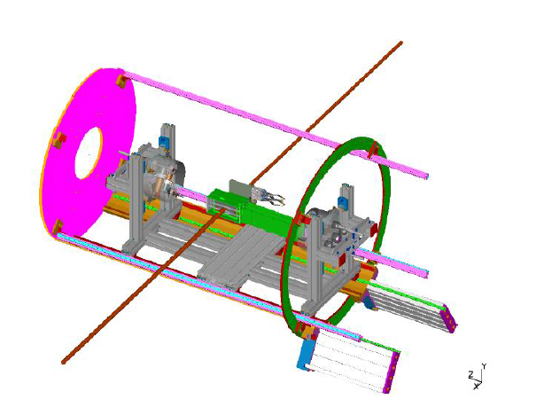
Beam Test
Next months dominated by beam test (preparation & run)
Remember: requested by BPAC1
System Test
=> prepare PXD6 matrices (& backup)
=> prepare system hardware
=> prepare software
This has to be done in parallel with (the equally important) tests of the EMCMs
Immense progress reported!

Slide 5
Gated Mode
What we have tested: basic functionality of DEPFET pixel
What we don’t know so far:
(full) functionality of new DHP and Switcher
DCD response ?
system (capacity of large matrix, instantaneous currents)
ASICs can be tested with single chip setup (hybrid 4 and/or 5)
System needs large matrix
EMCM will not do
PXD6 isn’t the real thing either
PXD9 would answer (but…..)
anyway, there are only very limited possibilities to modify metal network
what we could change, however, are the ASICs

Slide 6
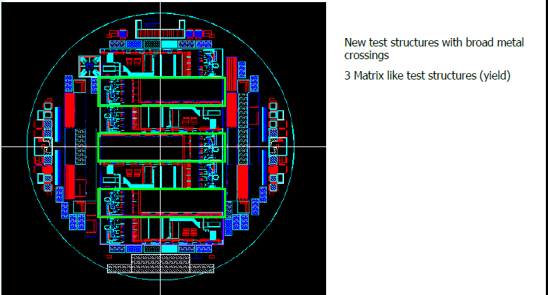
Gated Mode
They could be a test bench for
gated operation
(to be checked)
Furthermore we can see if the lost
PXD9.3 batch could be used.

Slide 7
Summary
Thanks to the DESY beam for hosting and organizing this event

