Slide 1
DCD Irradiation and temperature tests
Florian Lütticke, Carlos Marinas
University of Bonn
DESY BelleII PXD/SVD meeting, 22.10.2013 , luetticke@physik.uni-bonn.de

Slide 2
Outline
Measurement Setup
Irradiation Results
Temperature Measurements
luetticke@physik.uni-bonn.de

Slide 3
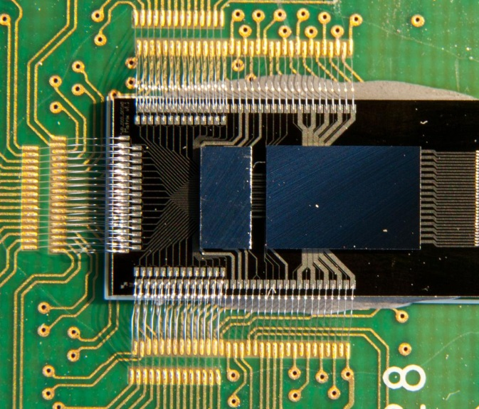
DCDB Irradiation setup
Irradiation at KIT with 60keV X-rays
Hybrid 4 .1 without Matrix
Homogeneous irradiation
After each step:
Annealing, 80°C, 100 min
Measure transfer curves for different bias voltages and for different DAC settings
External measurement of DAC current
Done with 4 ADCs
Extract INL, Gain, Offset from data
luetticke@physik.uni-bonn.de

Slide 4
Irradiation INL: Pre Irradiation
luetticke@physik.uni-bonn.de

Slide 5
Irradiation INL: 5kGy
luetticke@physik.uni-bonn.de

Slide 6
Irradiation INL: 10kGy

Slide 7
Irradiation INL: 20kGy

Slide 8
Irradiation INL: 35kGy
luetticke@physik.uni-bonn.de

Slide 9
Irradiation INL: 60kGy
luetticke@physik.uni-bonn.de

Slide 10
Irradiation INL: 100kGy
luetticke@physik.uni-bonn.de

Slide 11
Irradiation INL: 200kGy
luetticke@physik.uni-bonn.de

Slide 12
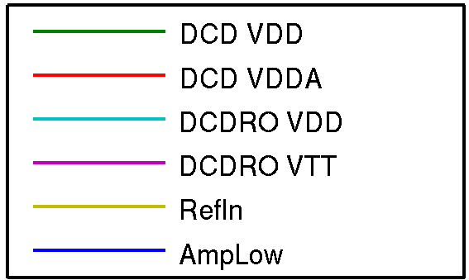
Irradiation Voltage Log
5kGy
+5kGy
+10kGy
+15kGy
+25kGy
+40kGy
+100kGy
= 200kGy TID
VTT
VDD
Irradiation
Annealing
80 °C, 100 min
Characterization
0
1
2
3
4
Time [days]
luetticke@physik.uni-bonn.de

Slide 13
Irradiation Current Log
Higher current consumption after irradiation in VDDD
Current decrease during operation - additional annealing?
DCD gets quite warm in the measurement setup
After irradiation VDDD changes if bias voltages change – not observed before irradiation
VTT
VDD
0
1
2
3
4
Time [days]
luetticke@physik.uni-bonn.de

Slide 14
Temperature INL: -30°C
luetticke@physik.uni-bonn.de

Slide 15
Temperature INL: -20°C
luetticke@physik.uni-bonn.de

Slide 16
Temperature INL: -10°C
luetticke@physik.uni-bonn.de

Slide 17
Temperature INL: 0°C
Bad timing setting in FPGA – Bit was stuck
luetticke@physik.uni-bonn.de

Slide 18
Temperature INL: 10°C
luetticke@physik.uni-bonn.de

Slide 19
Temperature INL: 20°C
luetticke@physik.uni-bonn.de

Slide 20
Temperature INL: 30°C
luetticke@physik.uni-bonn.de

Slide 21
Temperature Scan Voltage Log
VTT
VDD
8
10
12
14
16
18
Time [days]
luetticke@physik.uni-bonn.de

Slide 22
Temperature Scan Current Log
+10°C
0°C
-10°C
run crashed
-10°C
VTT
-20°C
+30°C
VDD
-30°C
+20°C
One power supply
lost connection
Power supply
software
maintenance
climate chamber needed by different project
8
10
12
14
16
18
Time [days]
luetticke@physik.uni-bonn.de

Slide 23
Current consumption changes with temperature
-10°C
-20°C
300mA
VTT
-30°C
VDD
250mA
luetticke@physik.uni-bonn.de

Slide 24
Difference of Irradiation
Pre irradiation
Post irradiation @ 10°C
luetticke@physik.uni-bonn.de

Slide 25
Irradiation Results
After 20kGy DCD starts to show strange behavior.
Unable to switch off analogue part
High VDDD current consumption
VDDD current depends on Bias voltages.
Gets worse at 35kGy then starts to improve again
At 100kGy analogue part could partly switched off (half current consumption)
Power consumption decreases over time – additional annealing?
After the weekend behavior changed
DCD was stored under room temperature during the weekend
On Monday, DCD was installed in climber chamber, switched on and run for a few hours
Measurements show performance similar to the initial performance
Irradiated DCD seems to have a wider area of acceptable bias voltages
DCD shows higher gain / less dynamic range .
DCD irradiated with 60keV X-rays up to TID of 200kGy could be operated in a temperature range between +30 to -30°C
To be confirmed with new DCDB versions

Slide 26
Thank you very much!

