Slide 1

Wafer-level Testing of long PXD6 matrices
4th Belle II PXD/SVD Workshop
and 14th International Workshop on DEPFET Detectors and Applications
21 – 23 October 2013, DESY, Hamburg, Germany
Paola Avella for the MPP/Semiconductor Lab crew

Slide 2

Production quality tests
Verify the status of the matrices on the wafers (pretested after Al2), measuring the characteristics of:
  All Gates vs All Clear (bulk)
  All Gates vs Clear Gate
  All Clears vs Source
  All Clears vs Clear Gate
Measure the transfer characteristics for all the (768) DEPFETs on one electrical row
Periphery testing

Slide 3
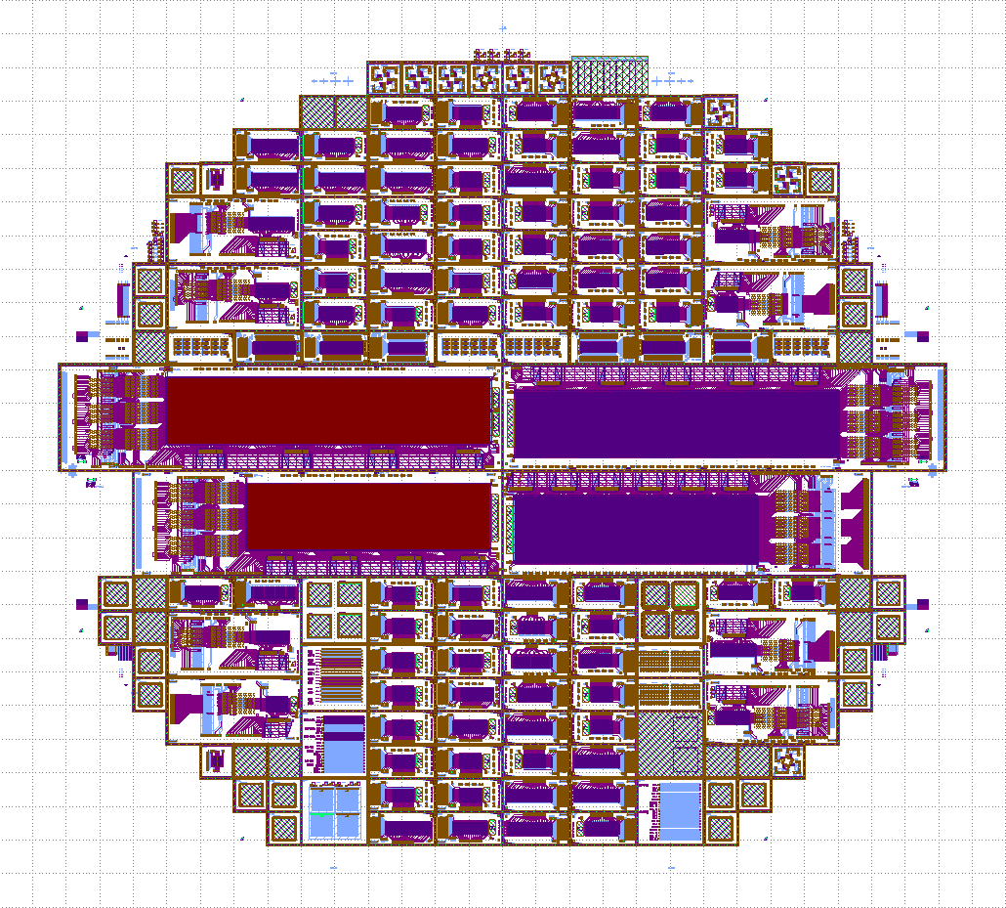
Batch III wafers 4 & 5
Devices Under Test:
W04 → I06
W05 → I00
W05 → J00
Short description:
I06 → 192 x 640 pixels, standard pixel and drift,
surrounding cleargate, 75 μm pitch, 5 switchers
I00 → 192 x 480 pixels, capacitive coupled cleargate, enhanced drift, surrounding cleargate, 100 μm pitch, 4 switchers
J00 → 192 x 480 pixels, capacitive cleargate, poly cover, 75 μm pitch, 4 switchers
Type:
ARR_768x160_ST_SD_SCG_Z075
ARR_768x120_CC_ED_SCG_Z100
ARR_768x120_CC_PC_Z075

Slide 4
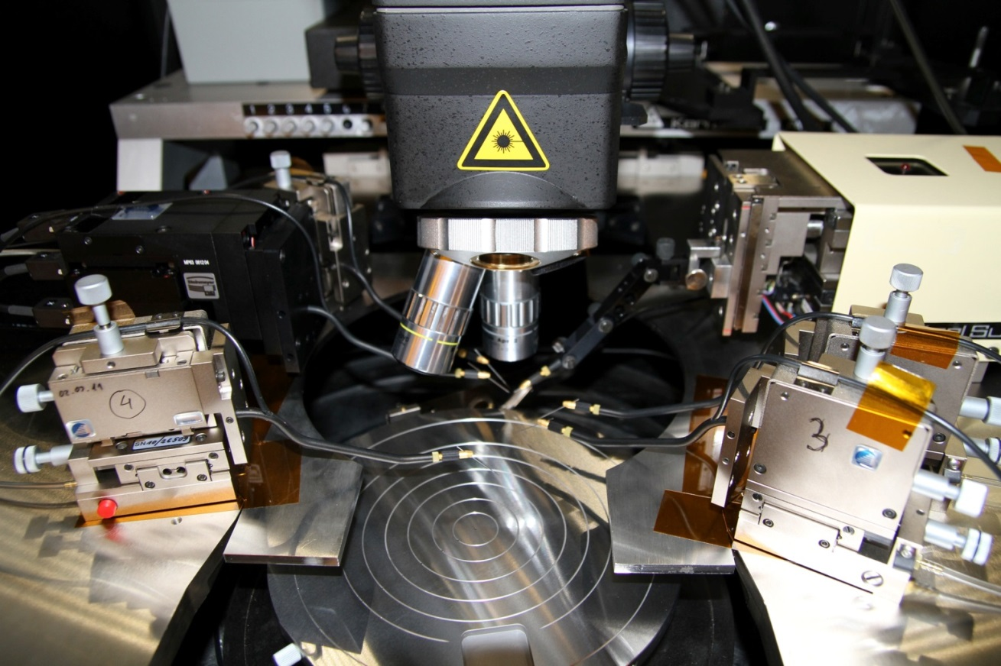
Instrumentation
Instrumentation:
Probe station SUSS PA200
4 manual probe heads SUSS PH120
1 semi-automatic probe head SUSS PH600
1 semi-automatic probe head Cascade PH510 (used as manual)
Semiconductor Characterization System Keithley SCS 4200

Slide 5
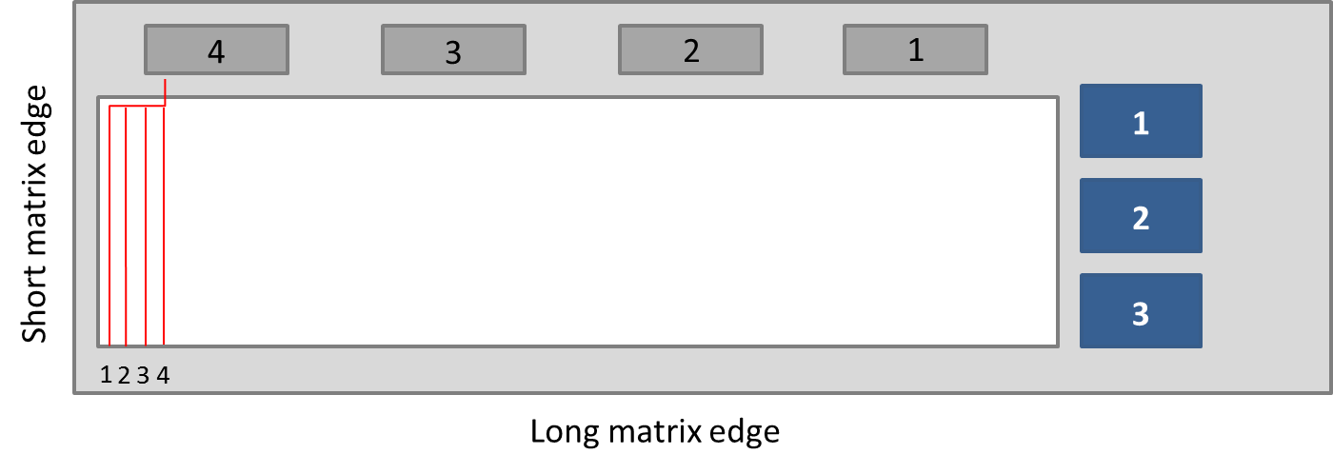
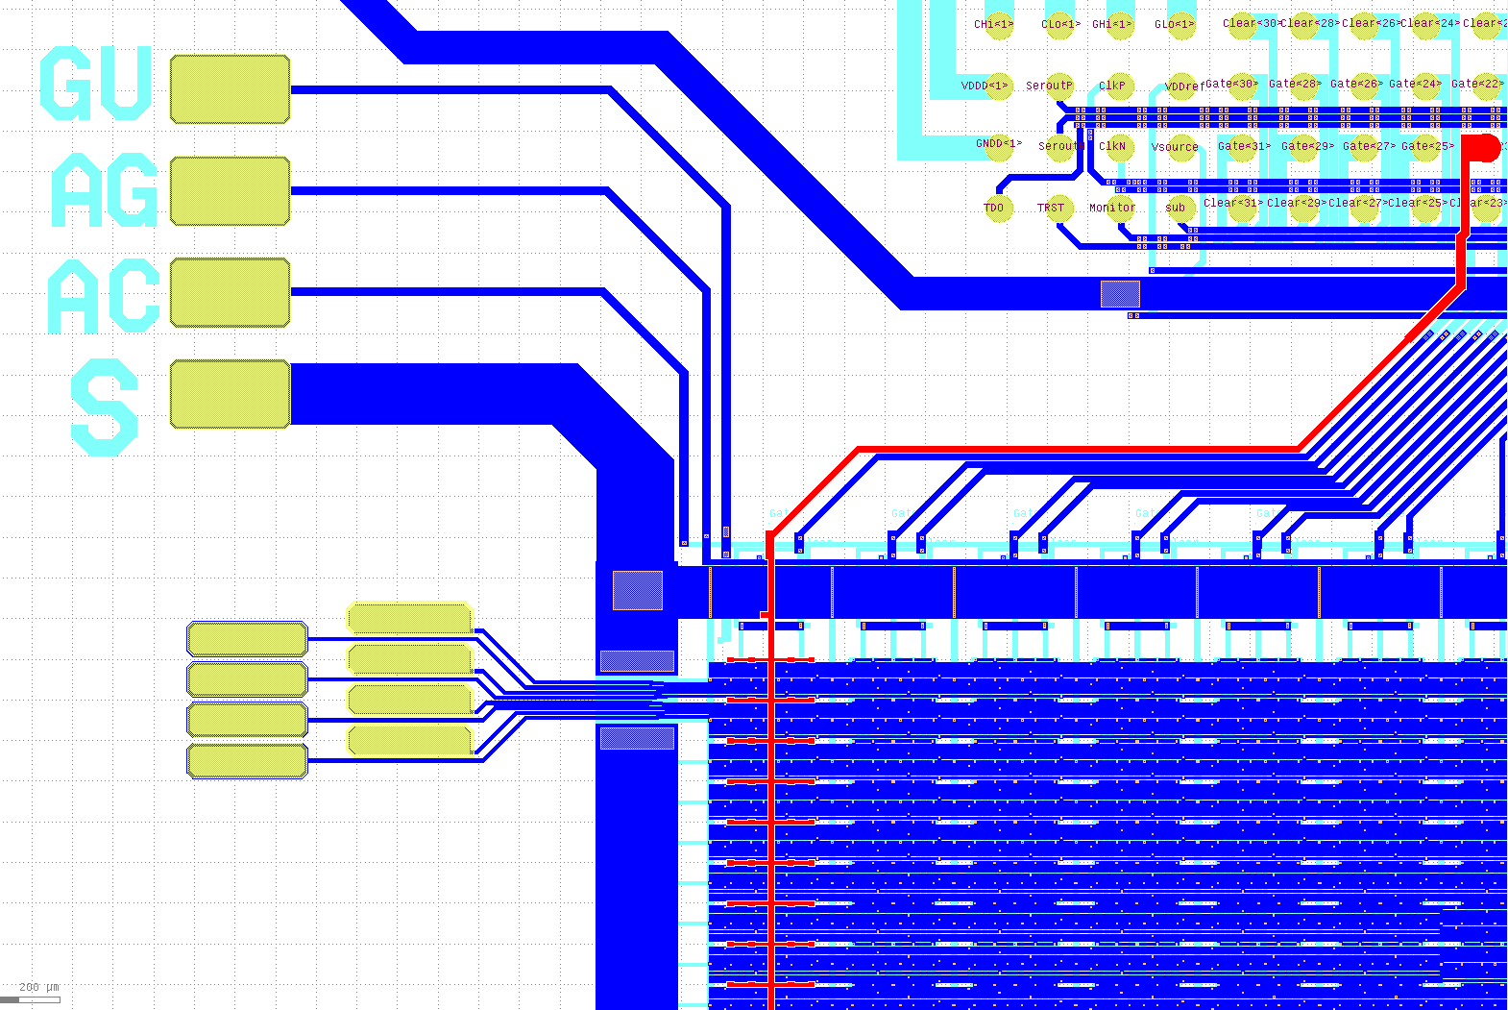
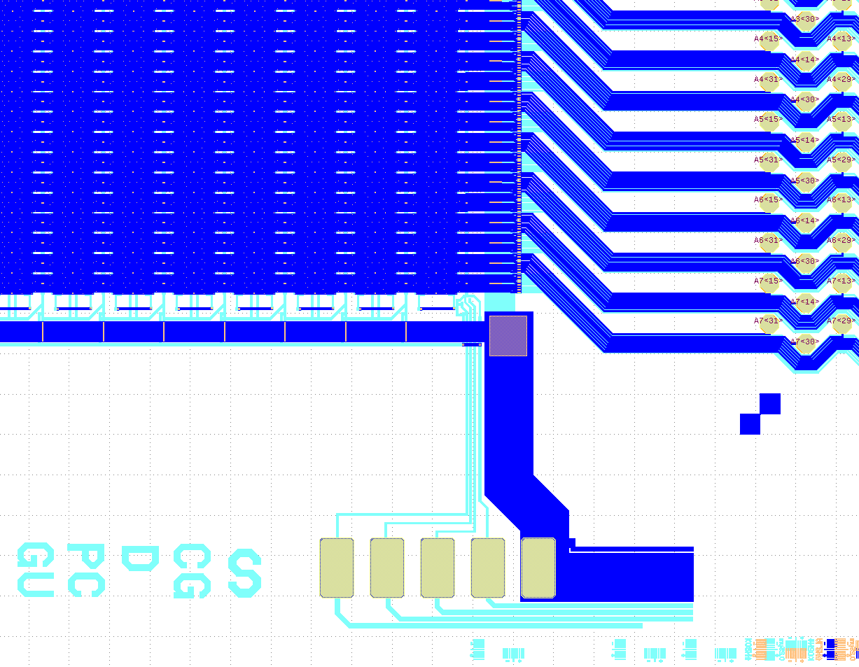
Testing strategy [I]: “static” needles
PH510
1
2
3
4

Slide 6
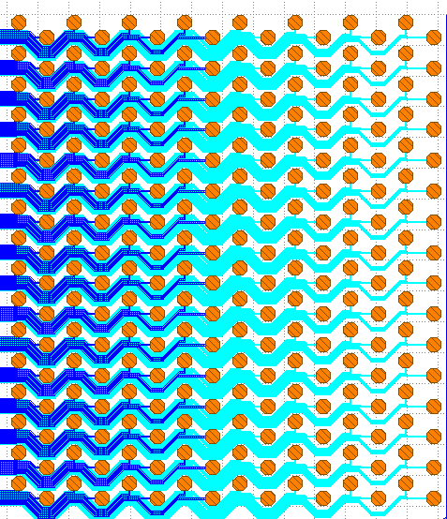
Testing strategy [II]: semi-automatic needle (PH600)
Applied voltages:
AG voltage = +2 V
AC voltage = +15 V
Source voltage = 0 V
CG voltage = +5 V
Drain voltage = -5 V
(semi-automatic needle)
-3 V < Gate voltage < +2 V
Testing time for 256 pads = 1.15 h
Mapping of the pixels in the matrix:
16 | 15 | 14 | 13
12 | 11 | 10 | 9
8 | 7 | 6 | 5
4 | 3 | 2 | 1
16 15 14 13 12 11 10 9 8 7 6 5 4 3 2 1
← Numbering of DCD columns

Slide 7
Transfer characteristics
The average on I_{ds} is made for all the current values which are in the interval -30 μA < I_{ds} < -100 nA @ V_{g} = -3 V.

Slide 8
DCD pads layout

Slide 9
Physical rows: faulty pixels

Slide 10
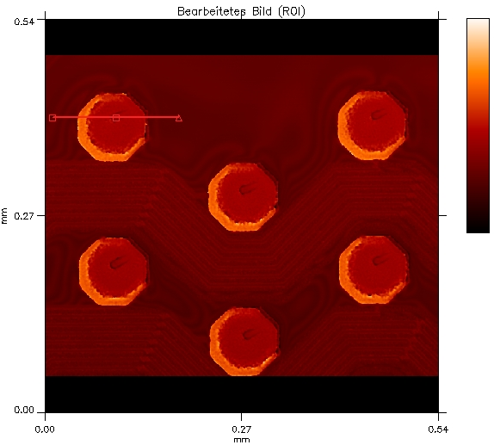

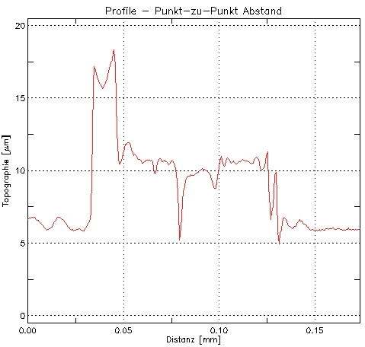
Profile scan on DCD pads
~ 5 μm
Using 0.02" tungsten needles, straight (radius: 7um, taper: 0.200 - 0.220", length: 1.25").

Slide 11
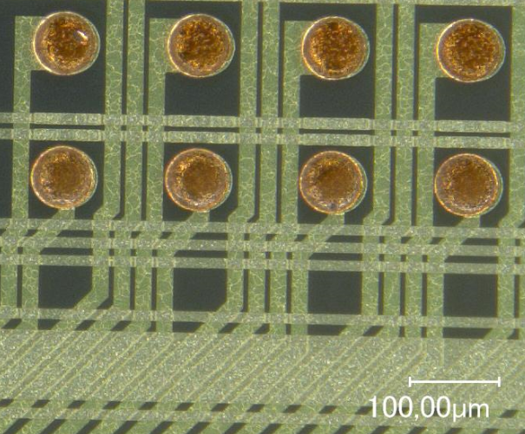
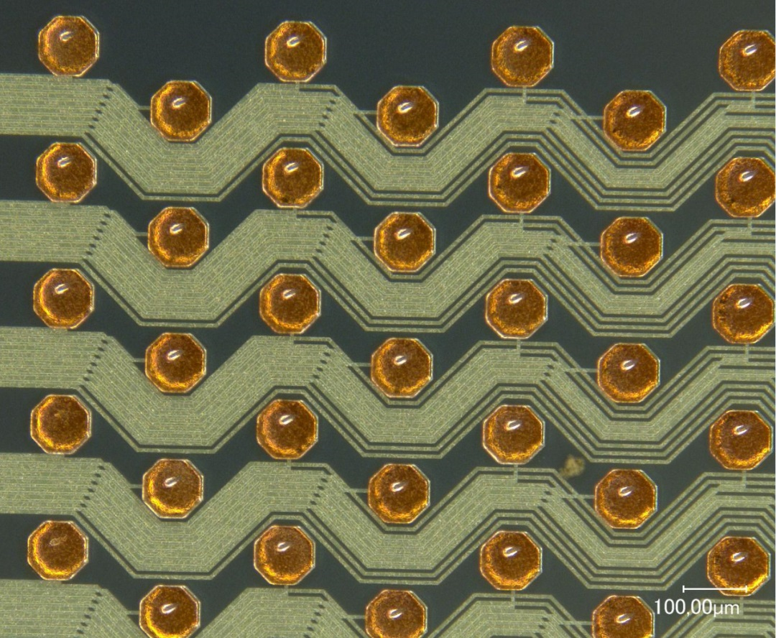
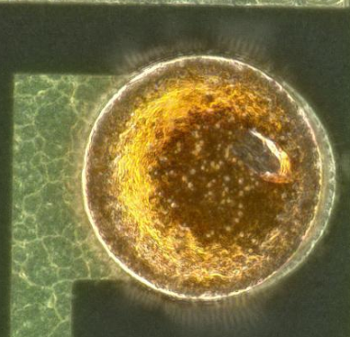
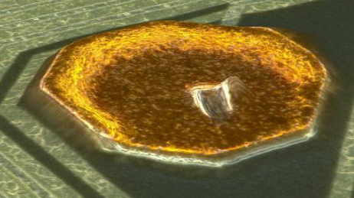
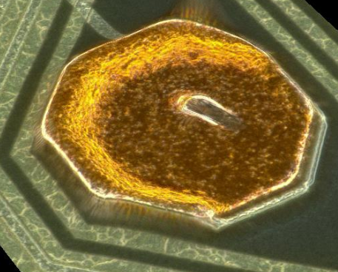
Footprints on SWITCHERB and DCDB pads
SWITCHERB
DCDB

Slide 12
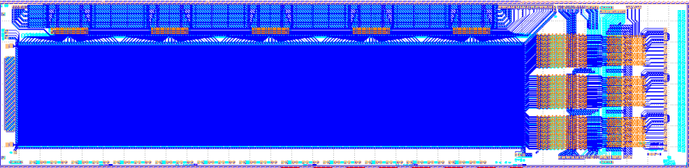
Periphery testing
Check for shorts/opens in the two metal layers in the peripheral region
performed at ATG, as in the case of the EMCM
(see talk from C. Koffmane for setup details)
all the matrices passed the test

Slide 13
Measurements summary
DUT | DCD ID | Opens (I_{ds} > -100 nA) | Inhomogeneities (-15 μA < I_{ds} < -100 nA) | Shorts (I_{ds} < -30 μA)
W04 – I06 | 1 | 0 | 1 | 0
 | 2 | 0 | 7 | 0
 | 3 | 28 | 6 | 0
W05 – I00 | 1 | 24 | 29 | 0
 | 2 | 29 | 15 | 3
 | 3 | 26 | 1 | 0
W05 – J00 | 1 | 31 | 26 → 0† | 0
 | 2 | 44 → 36† | 13 → 1† | 0
 | 3 | 42 → 43† | 190 → 3† | 0
† Inhomogeneities in the range: -8 μA < I_{ds} < -100 nA
Notes:
Third column → discontinuities (I_{ds} > -100 nA)
Fourth column → ‘bad behaviour’ (-15 μA < I_{ds} < -10)
* DCD2 of W05 – I00 affected by 3 shorts between source and drain (Ids < -30 μA, Ids ~ tens of mA) → remove bumps to circumvent the problem

Slide 14
Conclusions
3 fully working PXD6 long matrices:
1 x I06 (ST design) → full assembly of ASICs
1 x I00 (CC design) → full assembly of ASICs IF possible to remove three bumps from DCD2 due to short between source and drain → I_{ds} ~ tens of mA
1 x J00 (CC design) → full assembly of ASICs
Remarks:
Testing time in the order of 1.15 hours for each DCD pads layout
Footprint of needle acceptable in terms of bump bonding
Effects coming from dirt accumulated on the moving needle need to be taken into account for final qualification
Notes:
Third column → discontinuities (I_{ds} > -100 nA)
Fourth column → ‘bad behaviour’ (-15 μA < I_{ds} < -10)
* DCD2 of W05 – I00 affected by 3 shorts between source and drain (Ids < -30 μA, Ids ~ tens of mA) → remove bumps to circumvent the problem

Slide 15
Thank you!

Slide 16
Backup

Slide 17
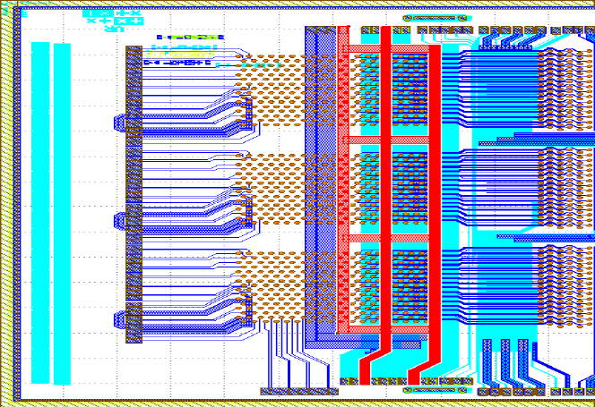
I06 – W04 → periphery testing
Al bus
(not connected)
DVDD

Slide 18
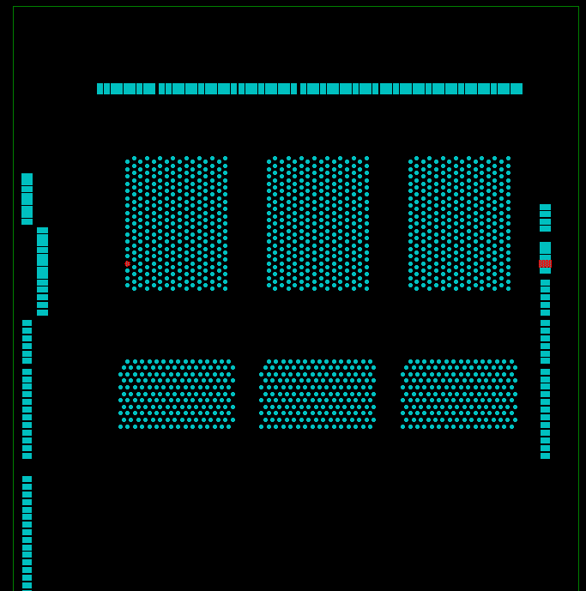
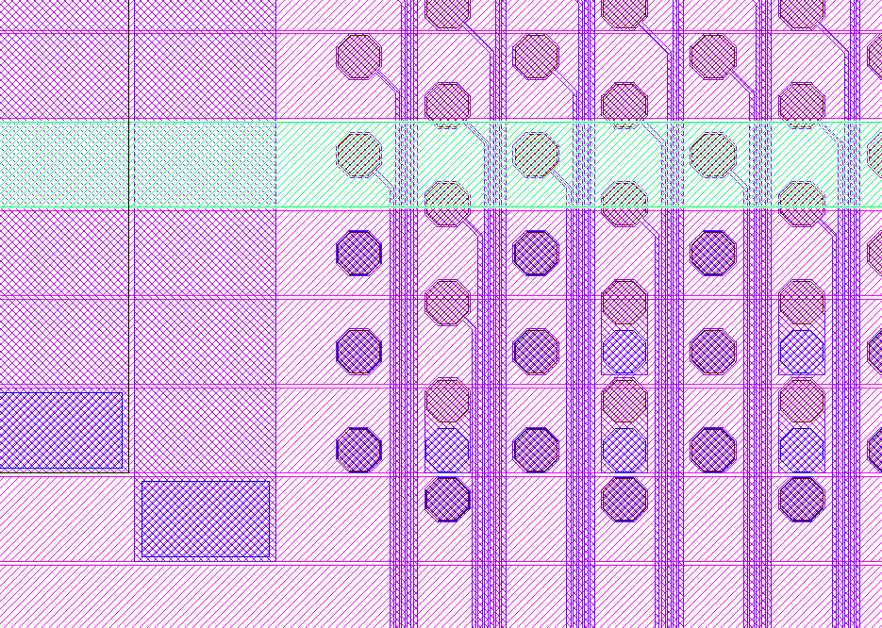
I00 – W05 → periphery testing
Al bus
(not connected)

