Slide 1
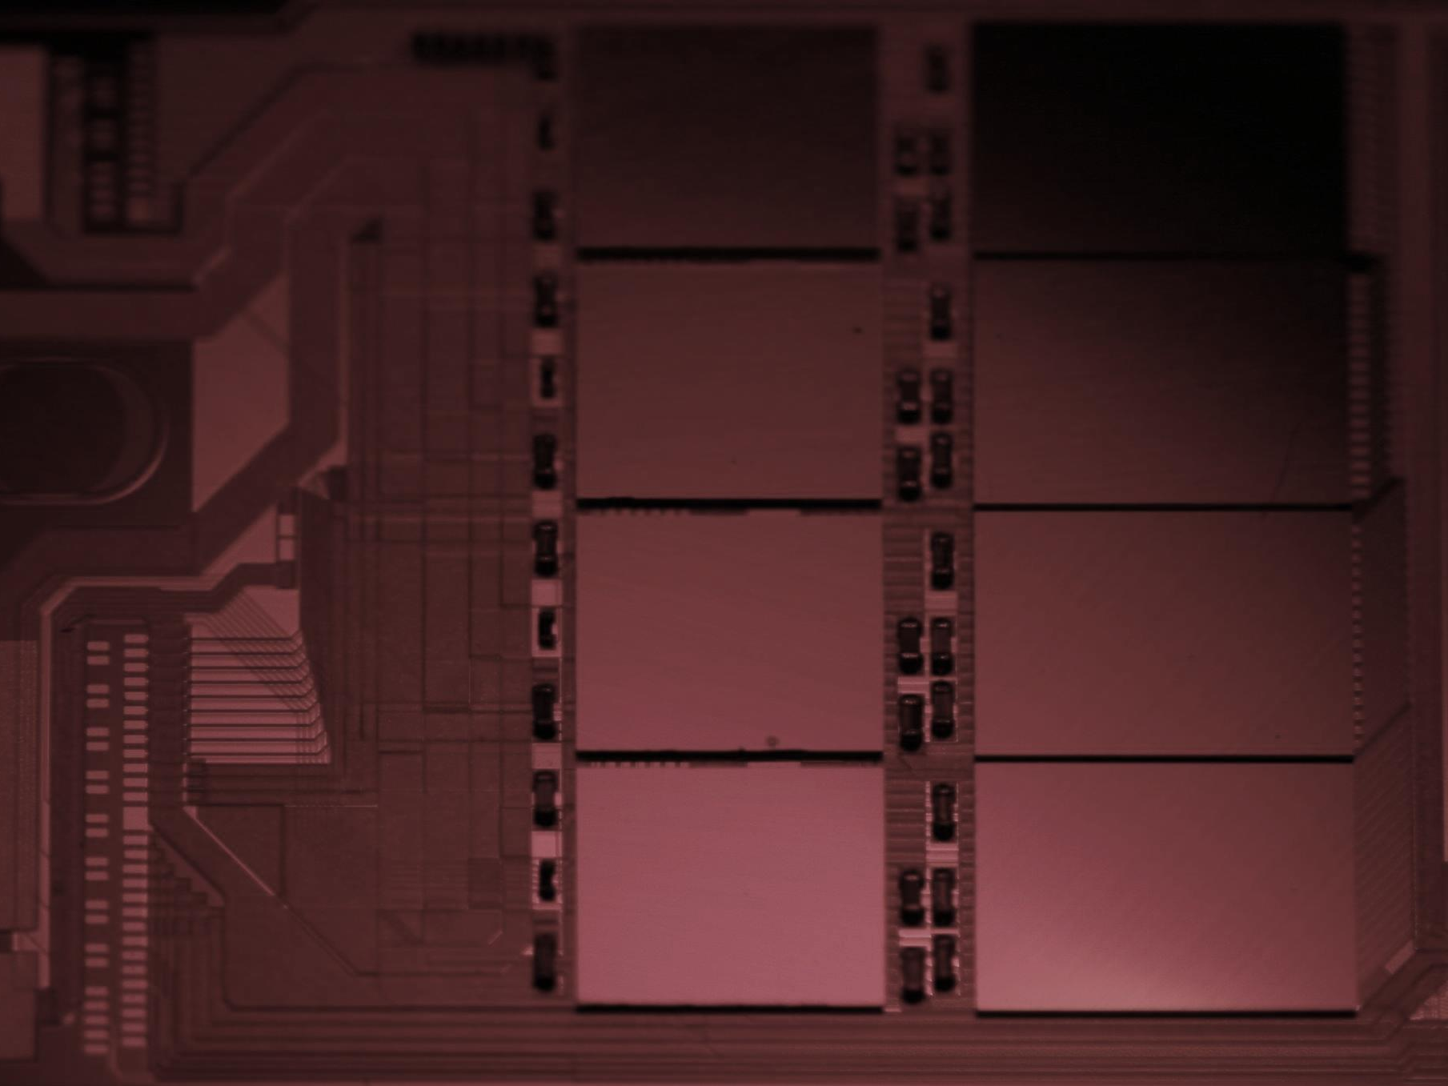
EMCM Assembly Experience
IZM - Finetech - MPP

Slide 2
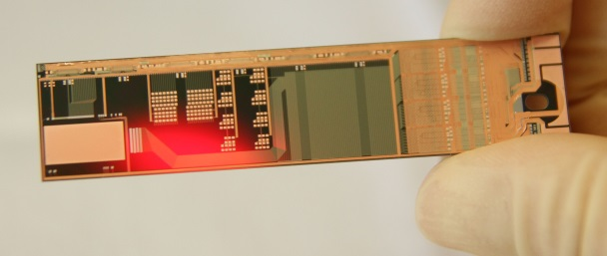
Overview
Status at the last DEPFET meeting in June:
Three EMCMs from test-zmi-5 found to be usable
Two for partial and one for full assembly (all ASICs and SMDs)
EMCM-2 production launched with some layout changes comp. to test-zmi-5 and EMCM-1
Contacts to IZM (FC) and Finetech (SMD) established
The last four months …
EMCM-2 finished and tested on wafer level (including copper and solder stop)
Jelena’s talk
Two EMCMs ready for (partial) assembly at IZM
EMCM-3 launched
Three EMCMs assembled
FC at IZM
SMD at Finetech
Kapton attach and wire bonding at MPP
EMCM evaluation still ongoing, see talks in testing session

Slide 3
Assembly steps
Flip Chip of ASICs:
Bumped ASICs have different solder balls (DHP: SnAg C4, DCD: SAC305, SWB: SAC305 on Au-stud)
~ reflow temperature ~240 °C
Due to equipment restrictions CNM was not ready to do the FC on EMCMs → try with IZM
Avoid flux, or, if flux used, make sure that there are no residues
SMD placement:
Passive components (termination resistors, decoupling caps)
Dispense solder paste, pick, place and reflow
PbSn 37/63 paste → reflow at ~200 °C
Challenge: small components and foot print! IZM did not want to do this job (no dispenser available)
Try Finetech, an equipment manufacturer (FC, die attach, rework ..)
Kapton attachment, wire bonding:
Solder paste printing on kapton,
Sn42Bi58 solder, ~160 °C
Kapton – substrate alignment by dowel pins
Wire bond, wedge-wedge, 25 µm Al bond wires between kapton and substrate

Slide 4
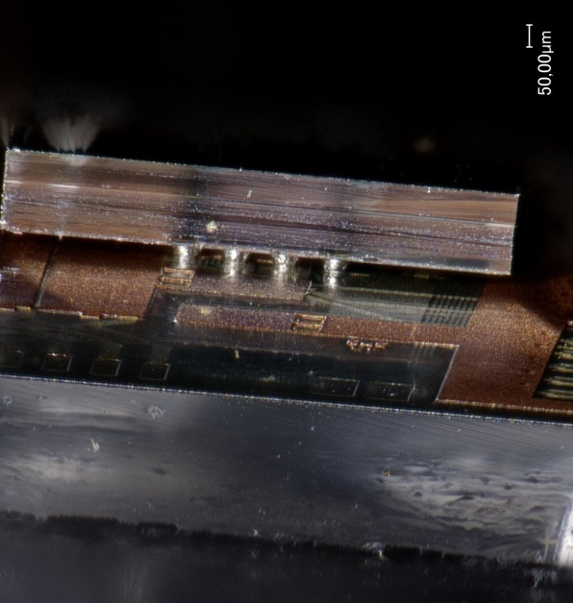
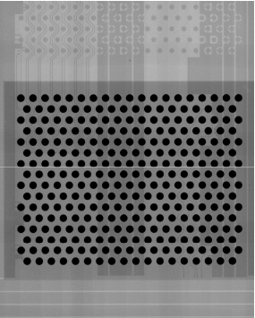
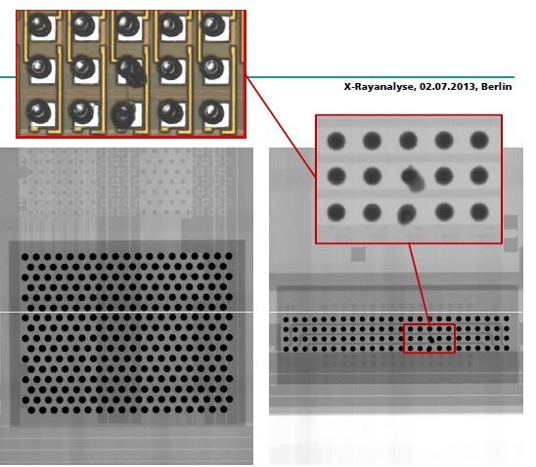
Flip Chip at IZM
After some discussions, IZM just did it … first two partially, then one fully populated …
No issues reported, no use of flux … details unknown!!
Price tag for this job: 2700 EUR
P6-1
P6-2

Slide 5
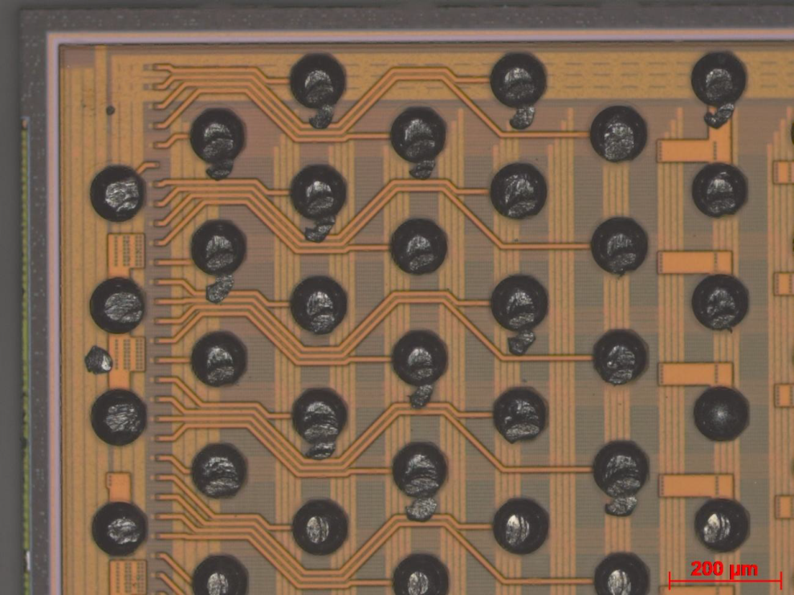
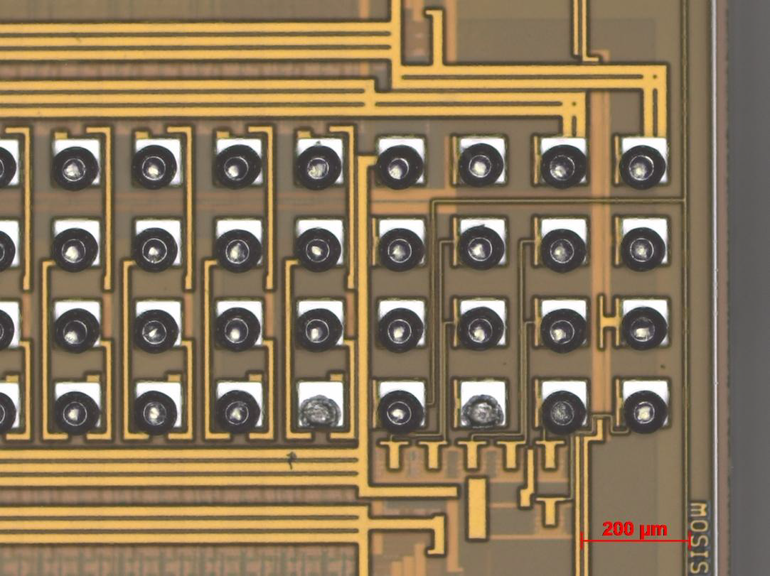
Flip Chip at IZM – first step in the right direction
Things to keep an eye on:
No QC done!! Just quick X-ray at IZM
Need shear tests, temp. cycling, aging tests ….
IZM: possible issues with SAC solder and Au stud, Au is consumed → unreliable connections!
Testing of DCDs damages bumps → better probe card??
Missing bumps on SWB
DCD
SWB

Slide 6
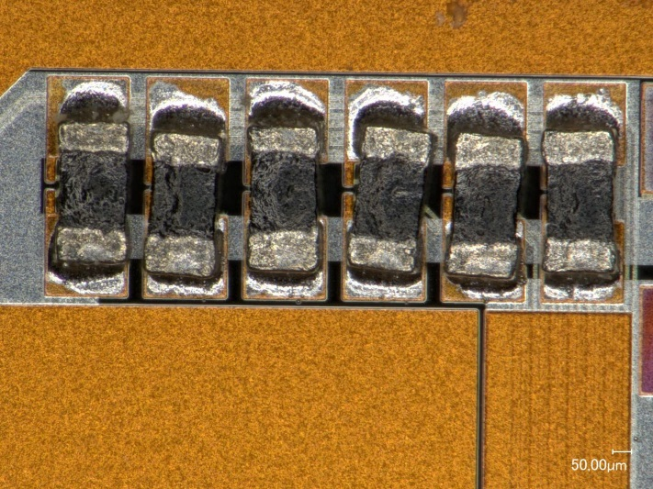
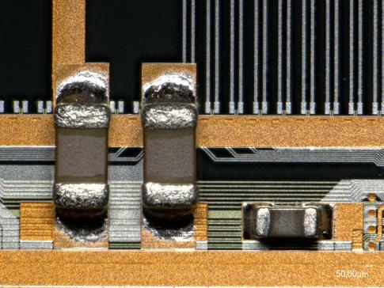
SMD placement at Finetech
we have ~50 0201 and 0402 decoupling caps, ~20 01005 termination resistors:
very small footprint of components (~220µm◻)!!
need for accurate dispensing of very fine solder paste
process details (will be) disclosed to NTC/IFIC
01005 term. res
0402 and 0201 caps

Slide 7
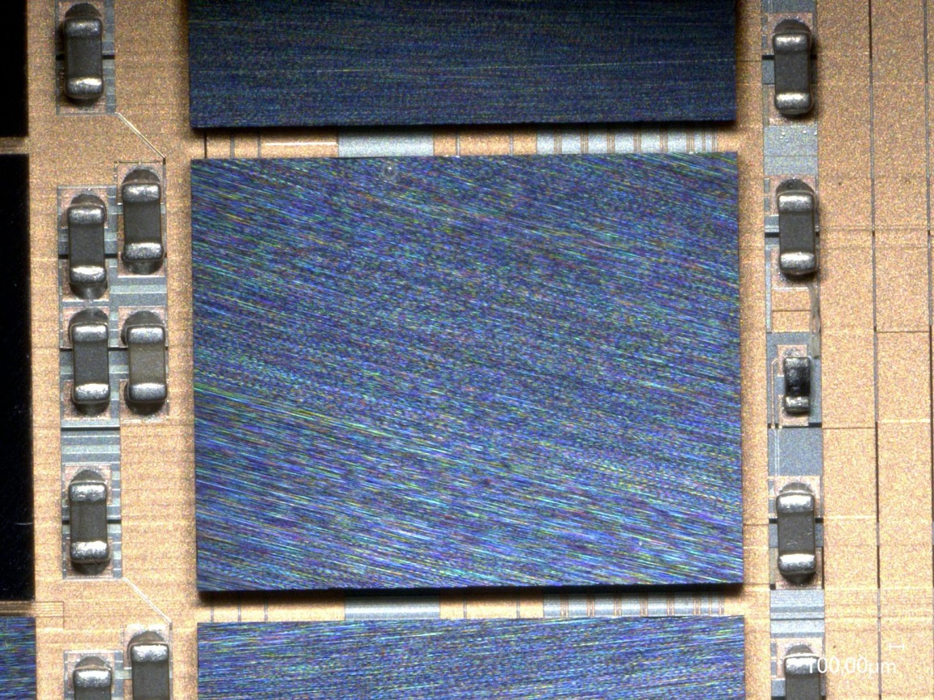
Lessons learned at Finetech
SMD (01005) is a challenging task:
Accurate and reproducible dispensing of solder paste
Pot life of paste, temperature control during dispense..
Common or individual reflow??
Little space for the dispense needle between the ASICs!!
01005 misplaced
01005 soldered??
~1mm

Slide 8
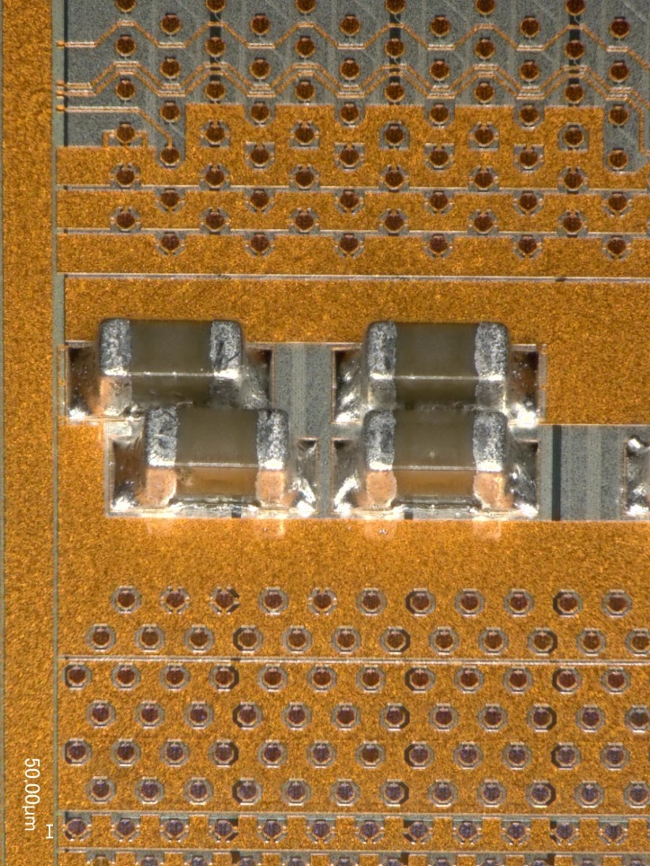
SMD – open issues
So far the SMD at Finetech was successful, but:
It is a dead end!! Finetech is not a production facility and has no capacity for “large scale” prod.
Due time restrictions QC skipped completely!!!
Possible issue:
Soldering of ceramic passives to silicon → CTE mismatch → fatigue and cracks …
To do:
Install SMD process within the collaboration (IFIC/NTC … Daniel’s talk)
Learn from Finetech experience
Make more samples!!! Get full control over the process
Need extensive QC:
Shear tests
X-ray
Cross sections
Thermal cycling and repeat the tests above
….

Slide 9
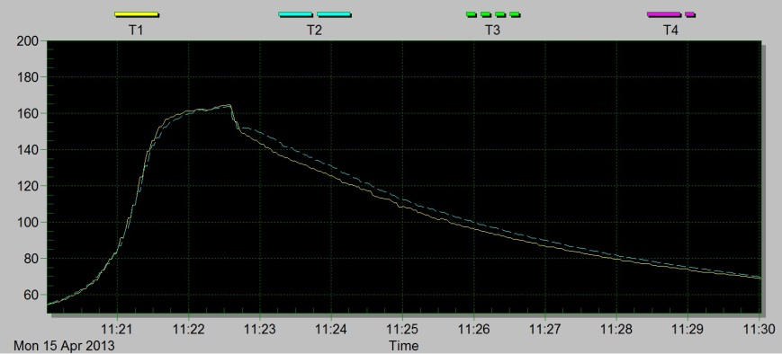
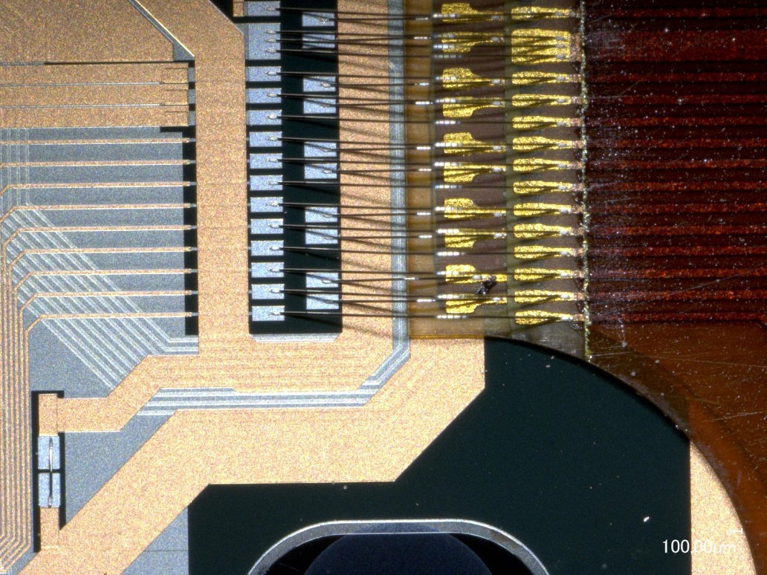
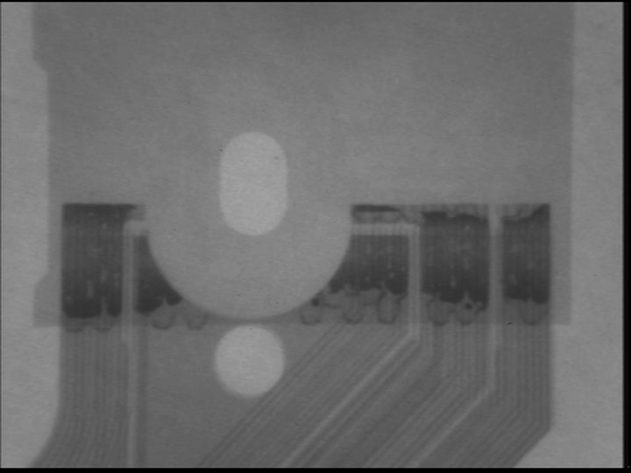
Kapton attachment and wire bonding
No real issue - all steps were perfectly prepared by Mandi, Christoph, and Tscharlie at MPP!
Some optimization/improvements:
Homogeneous solder printing
Bond loop with 25 µm wire
Still not decided: do we need a protection for the bond wires??

Slide 10
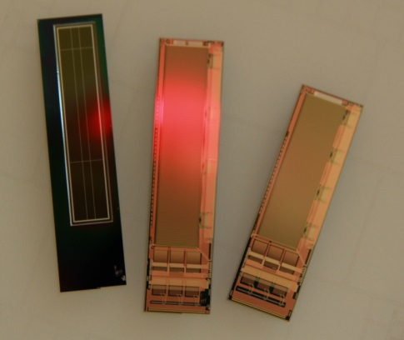
In Summary
The time pressure in spring/summer forced us to find a fast and pragmatic solution for EMCM assembly
Flip Chip at IZM and SMD at Finetech
It worked “in principle”, first EMCMs assembled
But we need to repeat that and - most importantly – qualify the processes so that they can be used for the real thing
Proposed assembly sequence for the PXD ladders:
Flip chip of all ASICs at IZM
Price tag: ~3000 EUR NRE costs, ~240 EUR/module → ~30 kEUR for 100 modules (need 40 for PXD..)
SMD at IFIC/NTC
See Daniel’s talk
Kapton attach, wire bonding, ladder assembly at MPP
Next jobs, under the same time pressure:
Flip chip to PXD6 ladders
At IZM, preparing jigs now
No SMDs … ☺
Flip chip to more EMCMs – IZM again
SMD at NTC/IFIC???

