Slide 1
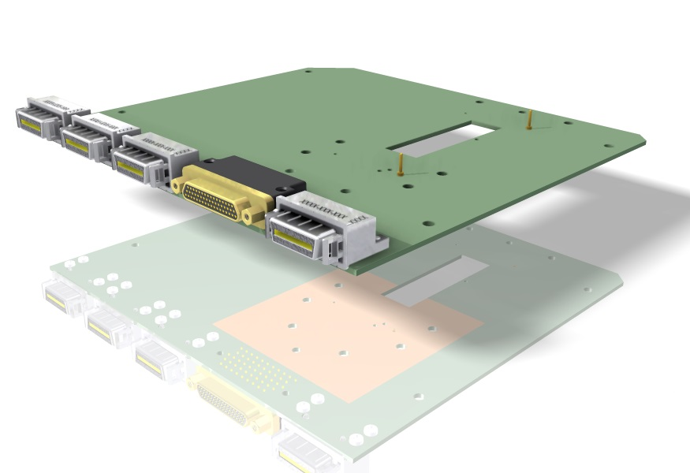

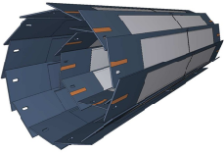

Development of Hybrid 6.0
(long PXD6 matrices for DESY TestBeam)
Felix Müller
Max Planck Institute for Physics

Slide 2
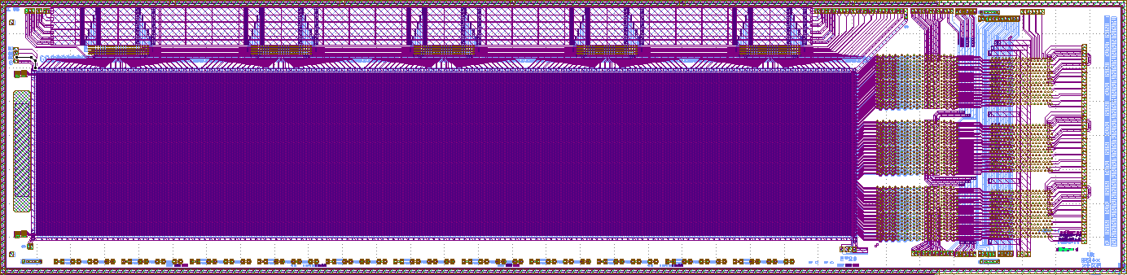
Matrices for DESY Testbeam 2014: I06 (layer 1)
Sensitive Area: 48mm
DHP
DCD
DHP
DCD
Sensitive Area: 9,6mm
DHP
DCD
Switcher
Switcher
Switcher
Switcher
Switcher
Standard Belle II design
50 x 75 μm² pixel size
192 x 640 pixels
  768 drain lines → 3 DCDs & 3 DHPs
  160 gate/clear lines → 5 SWITCHERs
see Paola‘s talk

Slide 3
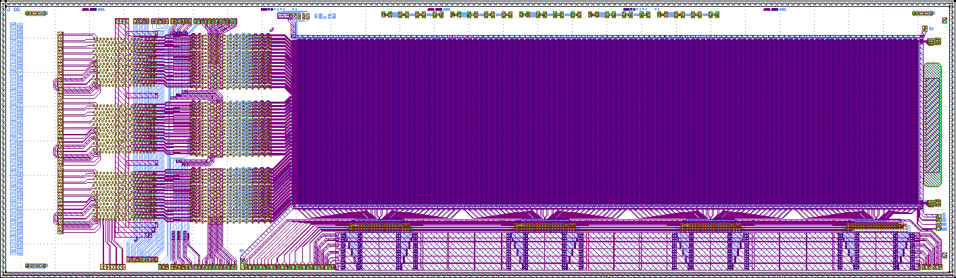
Matrices for DESY Testbeam 2014: I00 (layer 2)
Sensitive Area: 48mm
DHP
DCD
DHP
DCD
Sensitive Area: 9,6mm
DHP
DCD
Switcher
Switcher
Switcher
Switcher
Capacitive coupled clear-gate (provides Clear mechanism but harms Gated-Mode Operation)
Enhanced drift field
50 x 100 μm² pixel size
192 x 480 pixels
  768 drain lines → 3 DCDs & 3 DHPs
  120 gate/clear lines → 4 SWITCHERs
Both matrices have the same sensitive area
see Paola‘s talk
3

Slide 4
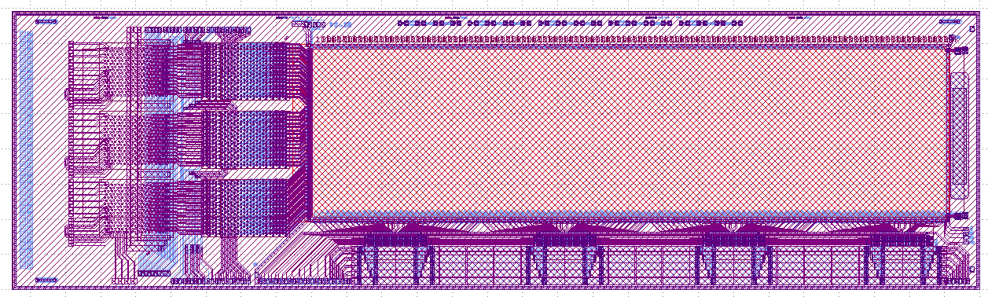
Matrix: J00 (additional, PXD6S)
Sensitive Area: 36mm
DHP
DCD
DHP
DCD
Sensitive Area: 9,6mm
DHP
DCD
Switcher
Switcher
Switcher
Switcher
Capacitive coupled clear-gate (provides Clear mechanism but harms Gated-Mode Operation)
Enhanced drift field
50 x 75 μm² pixel size
192 x 480 pixels
  768 drain lines → 3 DCDs & 3 DHPs
  120 gate/clear lines → 4 SWITCHERs
sensitive area
is smaller
(-12x9,6mm²)
see Paola‘s talk

Slide 5
Hybrid 6.0 Overview
There are three large PXD matrices working (75µm x 50µm & 100µm x 50µm (CC) & 75µm x 50µm (CC))
=> For the DESY testbeam (2014) 2 PCBs are required (mirrored)
4 Infiniband cables (High Speed DHPs, JTAG DHPs, Switcher Control, Switcher JTAG)
Power connector
Cooling (DCDs & DHPs (CO₂) and Switchers (flow of cool air) )
Plan:
Skip GatedMode Operation (Switchers are controlled by DHP)
External FPGA (DHH) provides JTAG for Switchers (TDI, TDO, TMS, TCK, TRST)
Optional:
DHH controls Switchers (STRG, STRC, CLK, SERIN, SEROUT)
Problem:
DHP0.2 does not support GatedMode Operation

Slide 6
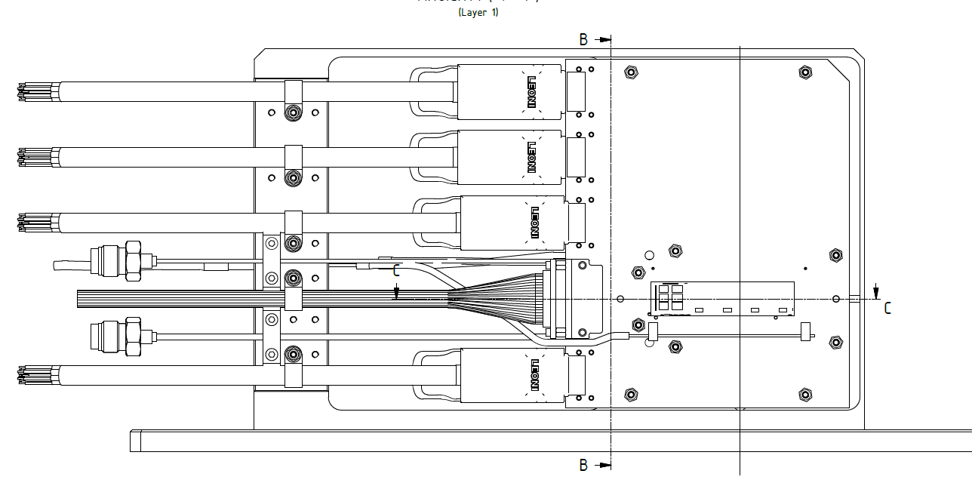
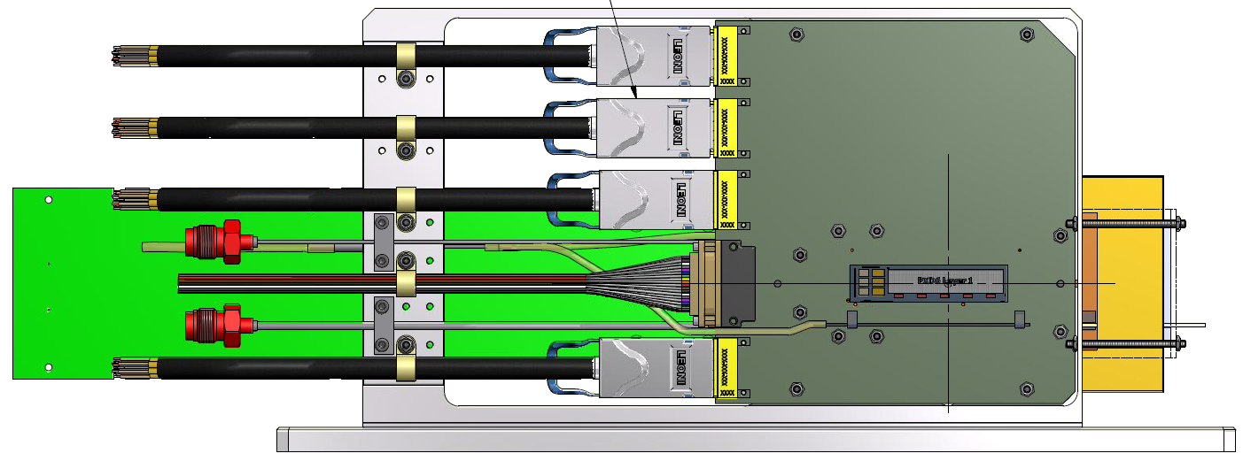
Hybrid 6.0 and Mounting
Stress relief
130mm
Infiniband
SW JTAG
Infiniband
SW signals
160mm
Infiniband
DHP JTAG
Power Supply
PXD6
Infiniband
DHP signals
Cooling pipes
(DCD, DHP)
3 Alignment pins
for PXD6
Switcher cooling pipe
Drawing by Karlheinz Ackermann

Slide 7
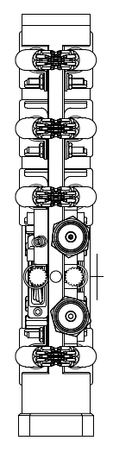
2 layers of PXD6 matrices
layer 1
layer 2
Mechanical Installation
Infiniband
PCB thickness: 1,5mm
Distance (PCB1,PCB2)=4mm
≙ thickness of cooling block
=> Matrices distance: 7mm
Infiniband
Cooling
block
Infiniband
Cooling
Power (MicroDSub, Glenair)
Cooling
Infiniband
Mechanical Installation
Drawing by Karlheinz Ackermann

Slide 8
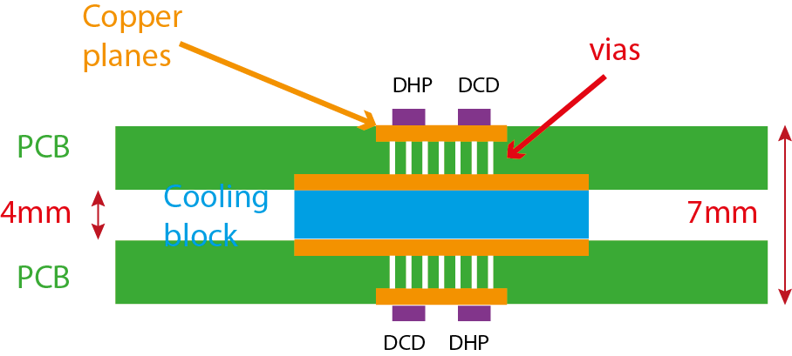
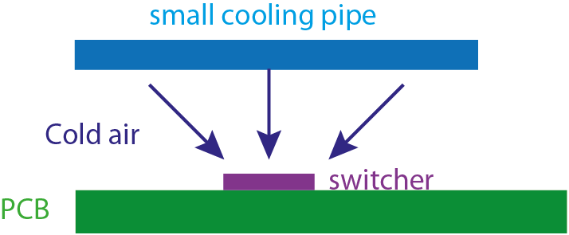
Cooling aspects
Cooling block on backside
Cooling of 3 DCDs and 3 DHPs
Large copper planes on top and bottom layer
Heat transfer between top and bottom layer by vias (same as for hybrid 5)
Diameter (pipe) 1mm
Either fluid or CO₂
Thickness 4mm (PCB: 1.5mm => distance between PXD detectors: 7mm)
Additional Switcher cooling
small pipe with ‚holes‘ installed above the switcher
air flow
easily removable

Slide 9
Switcher control
Discussed in June at 13th International Workshop on DEPFET Detectors and Applications the switcher is controlled by external FPGA (DHH with adapter board)
Status: Design of the adapter board is finished & fabricated; need to be assembled
└► See Igor‘s talk
BUT: We want an easy, fully working setup for TB2014
=> Switcher will be controlled by DHP !

Slide 10
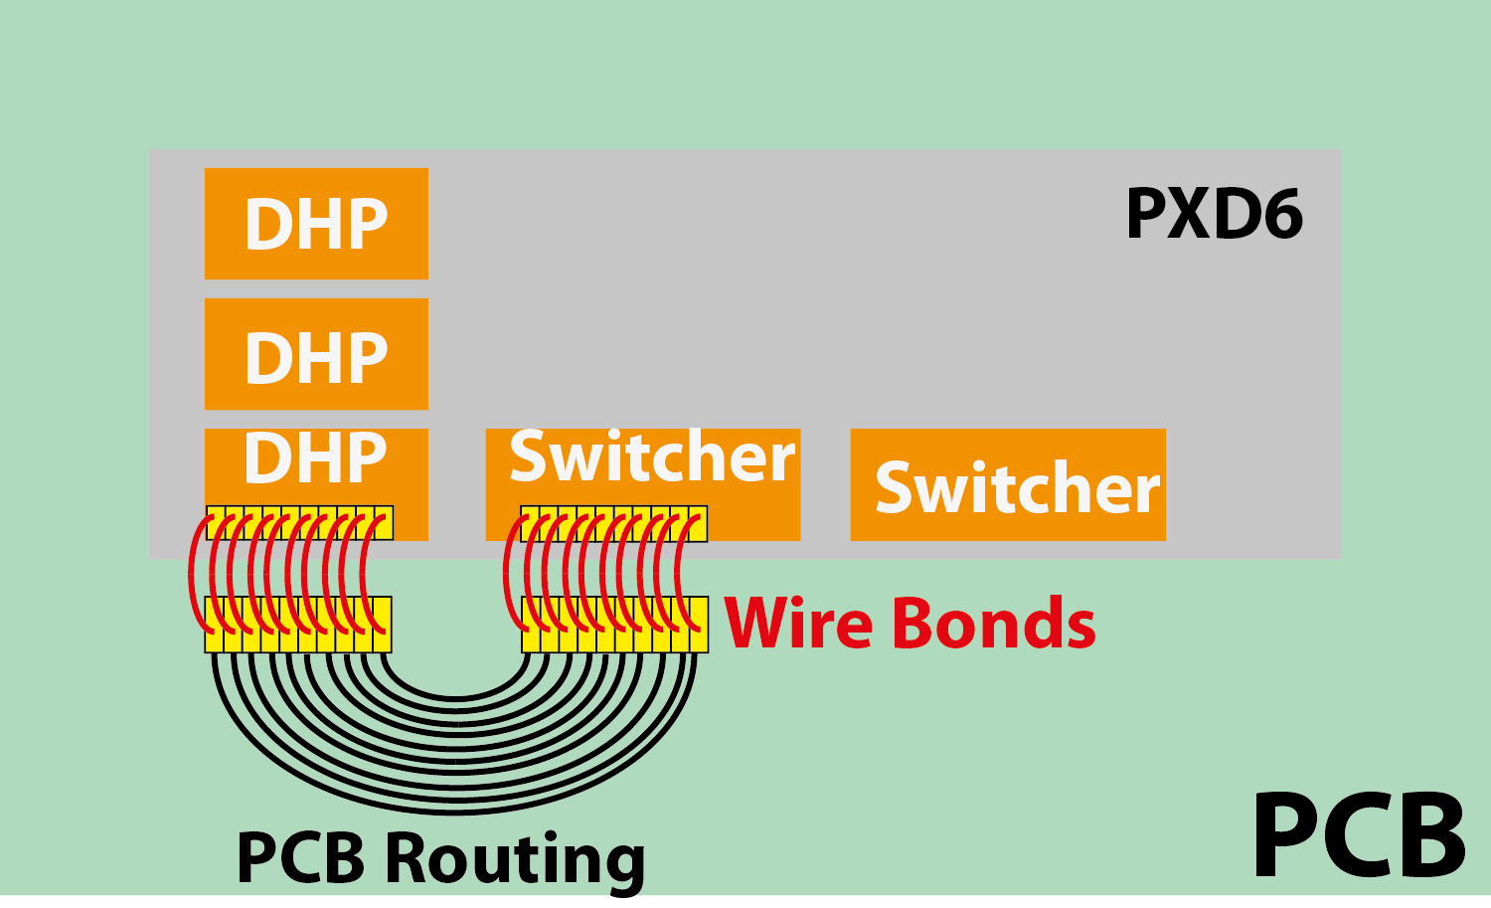
Switcher controlled by DHP
LVDS: STRG, STRC, CLK, SERIN, SEROUT
Pads

Slide 11

Additional Pad for TestBeam and Lab operation

Slide 12

Additional Pad for TestBeam and Lab operation
Operation in TestBeam 2014
DHP

Slide 13

Additional Pad for TestBeam and Lab operation
Possible Operation
(Rebonding is required)
DHH

Slide 14
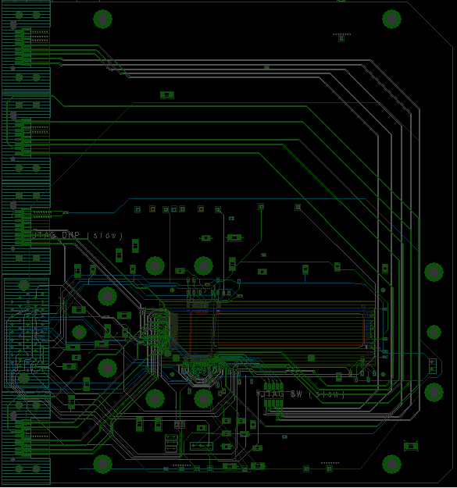
Overview
4 Capacitors for each power net (digital and analog voltages):
- 1206: 10µF
- 0805: 1µF
- 0402: 10nF, 100nF
Testpoints for voltages
Testpoints for switcher signals provided by DHP
14 layers (power planes)
Switcher JTAG: LVDS →
single ended converter
Differential signals (impedance controlled after consulting manufactorer)
Mounting holes according to drawings of Karlheinz Ackermann

Slide 15
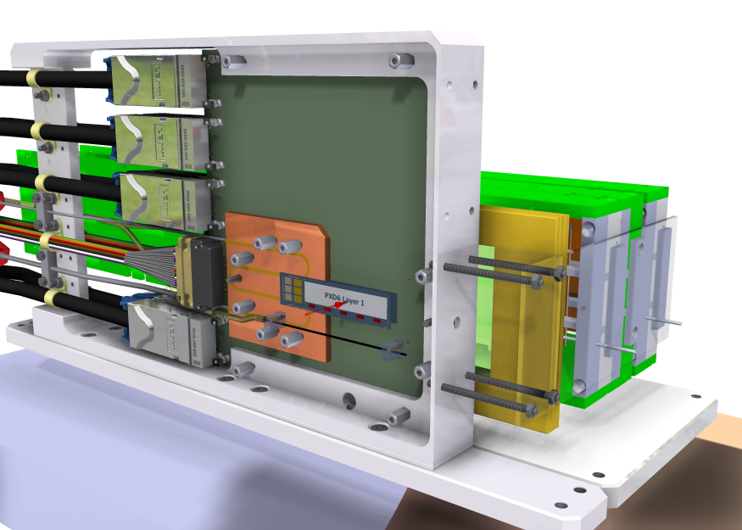
Combined PXD and SVD
Drawing by Karlheinz Ackermann
Beam

Slide 16
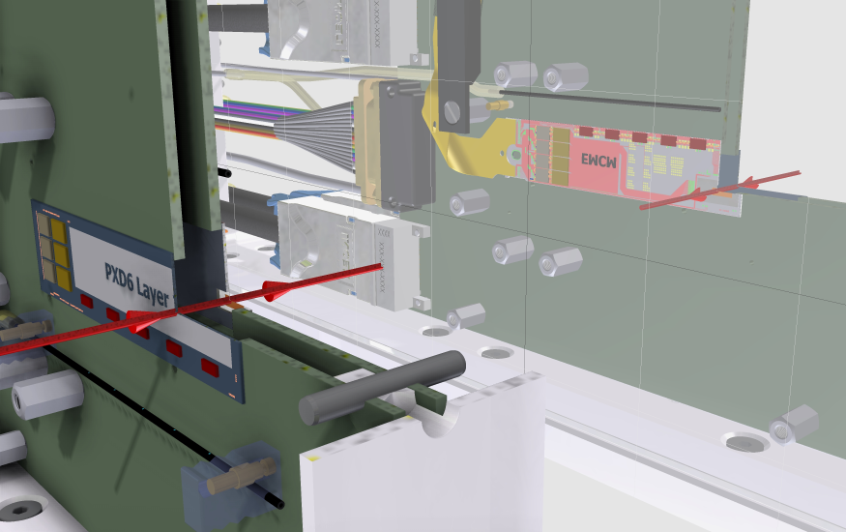
Alternative Combination(s)
Backup Solution: Hybrid 6.0 (long PXD6) and EMCM (small PXD6)
Beam
Drawing by Karlheinz Ackermann

Slide 17
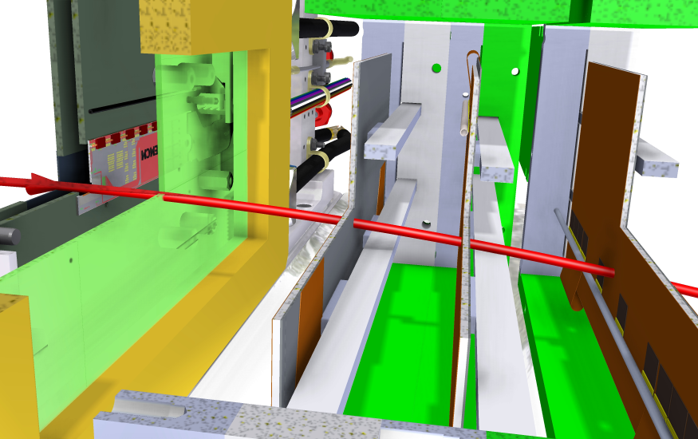
Combined PXD (hybrid6.0 & EMCM) and SVD

Slide 18
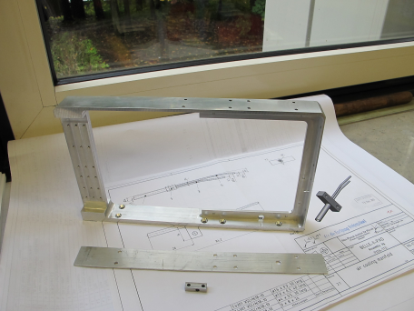
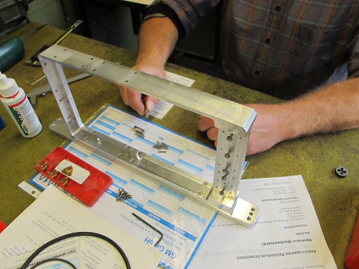
Mechanical Work – Frame for PXD6
Photos by Karlheinz Ackermann

Slide 19
Remaining Issues
ASICs:
6 DHPs
6 DCDs
6+5 Switcher
Additional TestPoints ? (Switcher signals, DHP signals)
Question: Which Switchers will be Used?
Since Gated Mode is skipped in the TestBeam 2014, it is only required for LabTests
Assembling of which ASICs on which Module/Matrix
Which is the most favorable setup (2x long PXD6, PXD6 & EMCM, 2x EMCM)
Sensitive Area of long PXD6 (48x9,6mm² = 461mm²)
Sensitive Area of small PXD6 (4,8x1,6mm² = 7,68mm²)

Slide 20
Summary
3 PXD6 matrices (1 Belle design & 2 Capacitive Coupled)
Mechanical design & fabrication is finished
Hybrid 6.0 will be ready till mid of November
to do:
Assembling (ASICs and passives)
Testing

