Slide 1
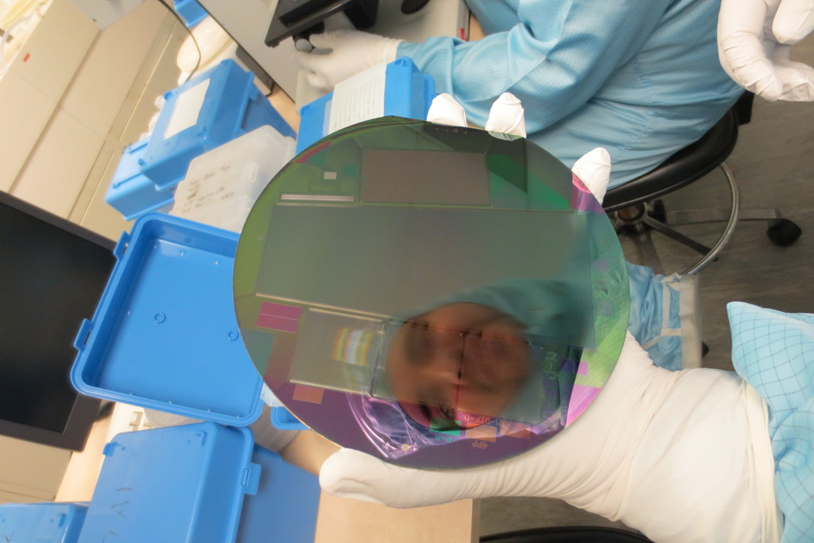
SVD Sensor Testing Strategy
4th Belle II PXD/SVD Workshop
C. Irmler (HEPHY Vienna)

Slide 2
Introduction
Discussion about sensor testing / characterization
Aim of this discussion
Define sensor testing strategy
Clarify responsibility
Priorities and milestones / deadlines
Develop a work plan, incl. manpower
Replace ?? appropriate value, NN by name and DD by a realistic date considering the available manpower
Please add a short note about the conclusion to each discussed topic

Slide 3
Sensors Types
Hamamatsu (JP)
Rectangular sensor (L4-L6 barrel part)
Delivery almost completed (~ 150 sensors in hand)
Slim rectangular sensor (L3)
Delivered end of September
IV, CV, strip-by-strip tests on p-side by HPK
no strip-by-strip measurements under bias on n-side
AC testing is done, but no DC tests
optical inspection
At least some samples should be tested (incl. n-sides)
Micron (GB)
Trapezoidal sensors
60 pieces ordered
Delivery ongoing, but slow
Sensor testing is bottle neck at Micron
New plan:
IV, CV tests by Micron
Strip-by-strip measurements by Trieste / HEPHY

Slide 4
Let’s discuss sensor testing strategy.

Slide 5
Sensor Testing Strategy
Who can / will perform sensor tests
HEPHY Vienna, INFN Trieste, KNU?
Available facilities
All delivered Micron sensors have to be tested and characterized
Selection of “good” sensors to be done by us based on contract with Micron
How many HPK sensors should we test?
L3 efficiency is important for PXD ROI finder
Who will test HPK sensors?
KNU; ~1 month for probe card production
INFN Trieste? Full scan of some sensors suggested; ~1 month for probe card; manpower issue, could start end of November with few sensors
Cross-check testing between KNU & Trieste by testing same sensors
Logistics Carnet A.T.A.?
Which tests to be performed? Everything, especially DC strip scan on n-side
Schedule
Should match with ladder assembly plans!
Start testing with ~2-3 very bad (but production) sensors (large rectangular)

Slide 6
Thank You!

