Slide 1
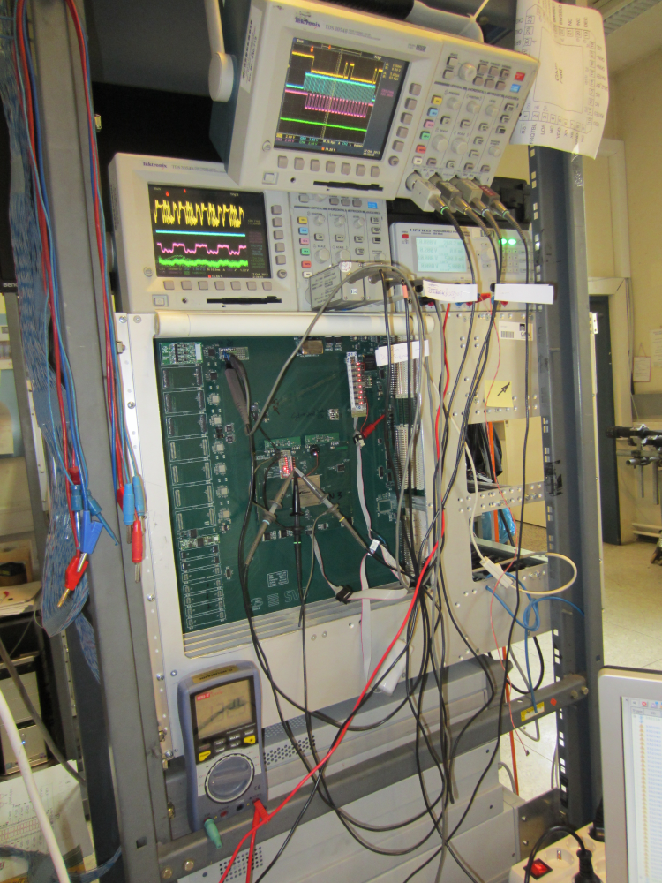
4th Belle 2 PXD/SVD workshop at DESY
The Status of the FADC Firmware
Richard Thalmeier (HEPHY Vienna)

Slide 2
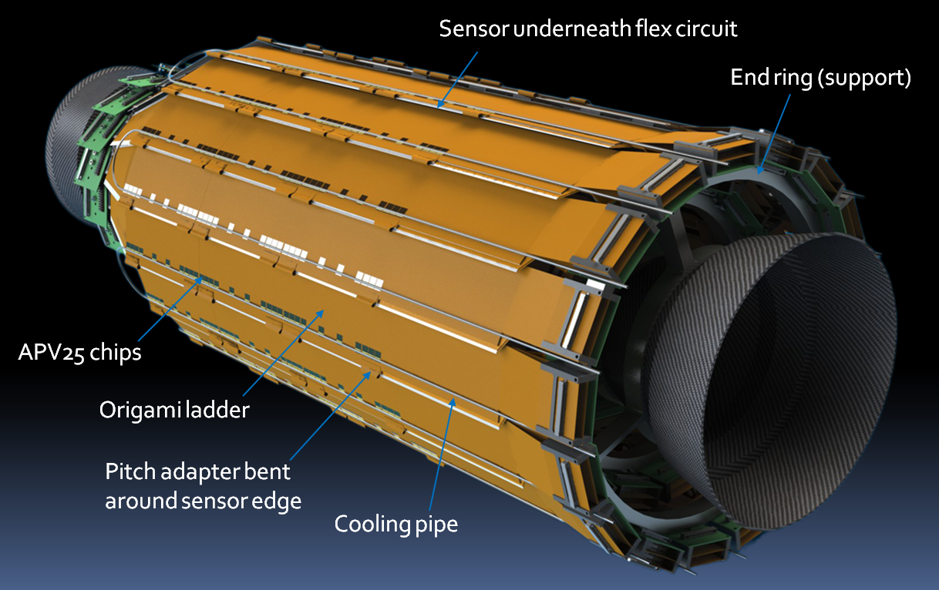
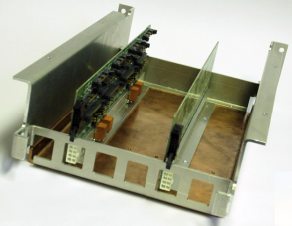
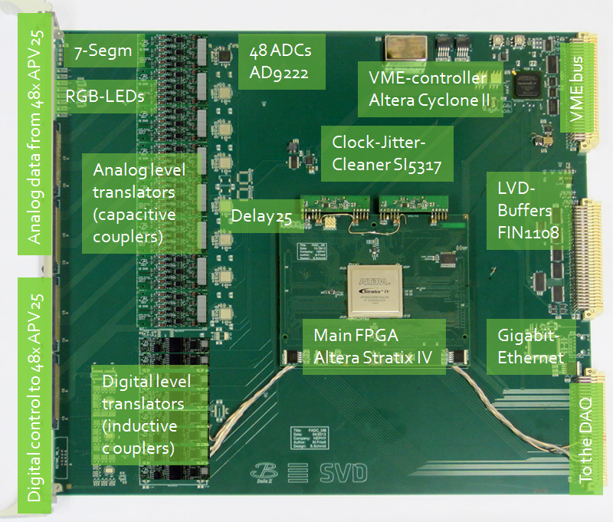
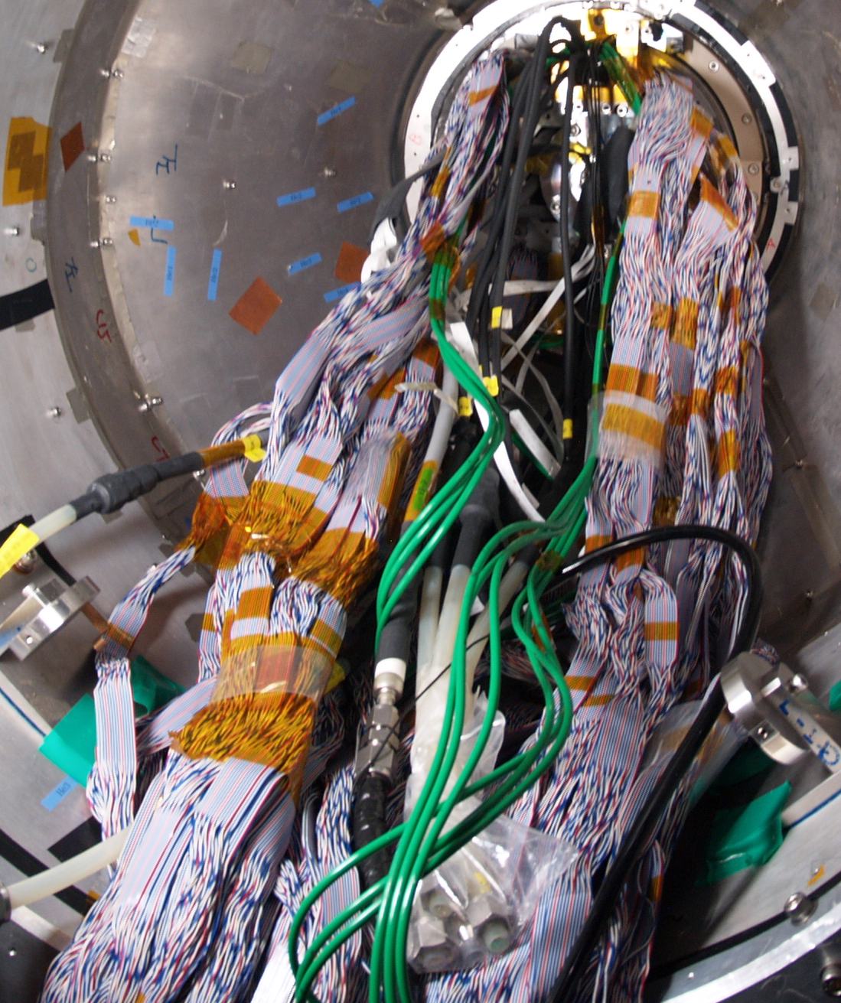

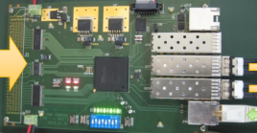
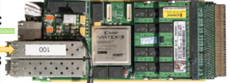
SVD Readout Scheme
48x FADC
in 4 crates.
Front-end hybrids
with 1748x
APV25-chips,
128 analog
channels each,
on 172 sensors.
48x Optical data
Links (>20m)
Data Acquisition
(DAQ)
8x Junction
boxes with
rad-hard
DC/DC-
converters
48x
FTB
344 x ~2m
copper
cable
172 x copper
cables, ~10m,
time multiplexed
analog voltages
....
COPPER
Pixel Detector

Slide 3
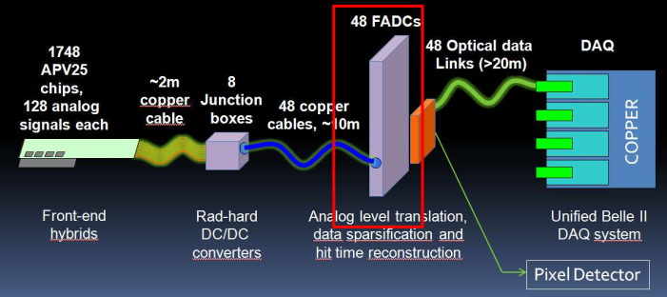
FADC Block Diagram
Analog & digital level translation between ± bias (< ± 100V) and GND
Digitization, signal conditioning (FIR filter), data processing
Central FPGA is an Altera Stratix IV GX

Slide 4
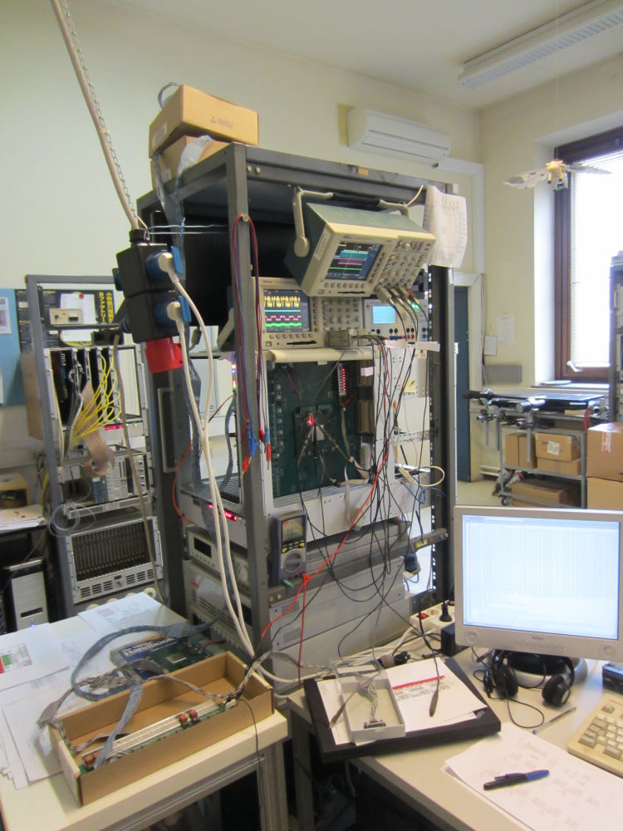
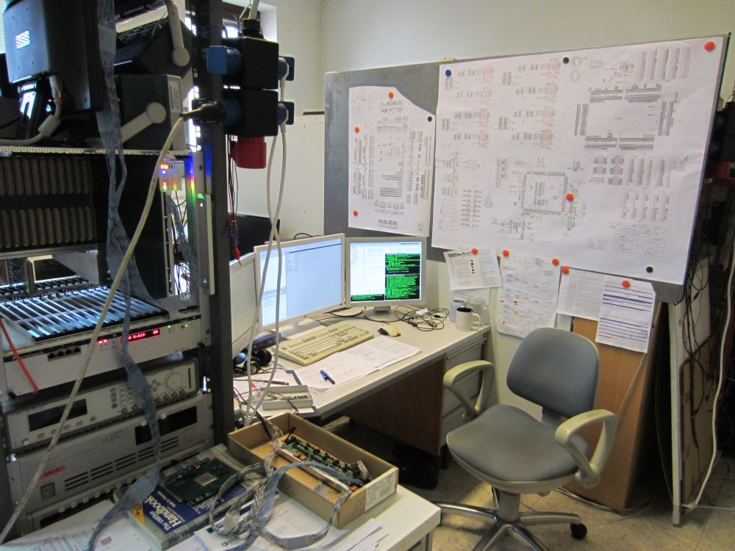
FADC Hardware

Slide 5
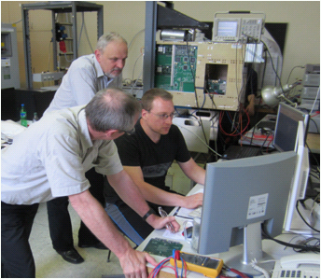
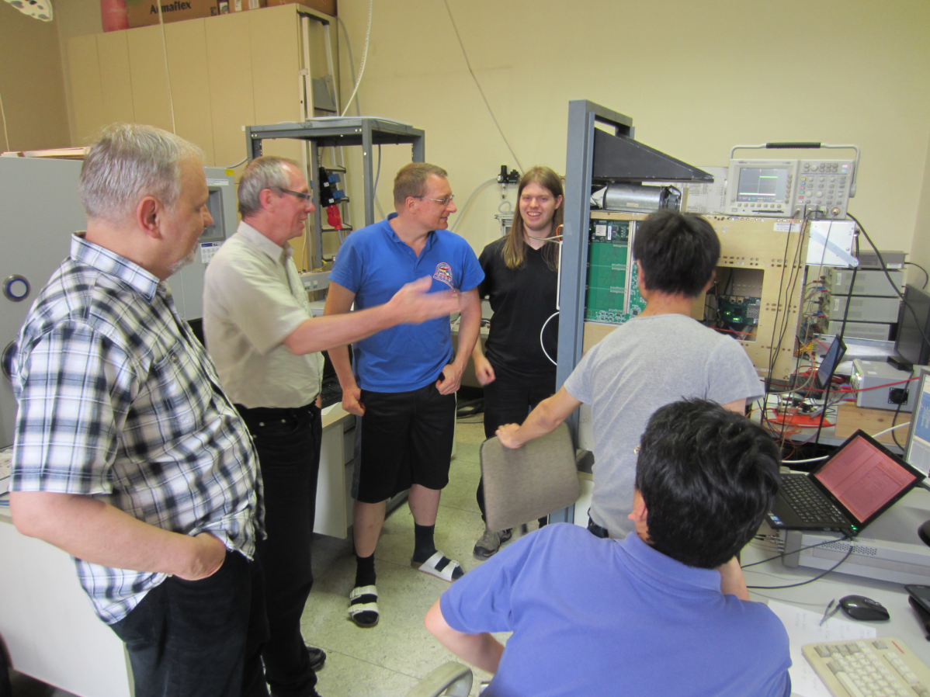
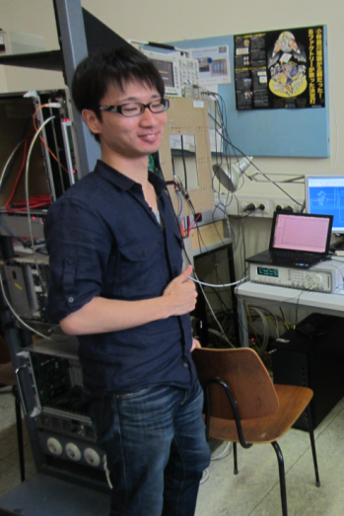
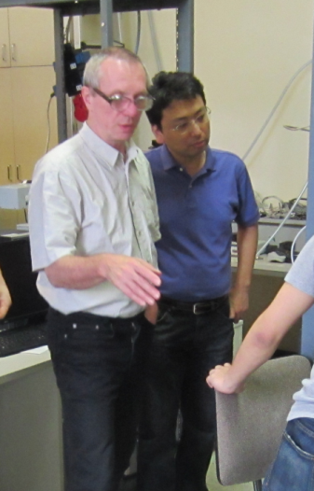
The Connectivity-Test June 2013:
FADC – FTB - Copper

Slide 6
The Connectivity-Test June 2013:
The ROM- and VHDL-generator
Perl program which generates a VHDL-file and all files needed (including all quartus project files (!), pin definitions and batch files) for Quartus to compile and flash it into the FPGA fully automatized
Command line parameters for data format (raw, transparent, zero-suppressed, zero-suppressed+hit-finding), number of events, channels per event, words per channel, pause ticks, randomization of all relevant parameters, probabilities for APV25-errorbits, etc...
Output of the data additionally as files in different file formats, including ASCII-binary („0101“...), Hex-file, Plain binary, each with and without CRC, for data comparisation.

Slide 7
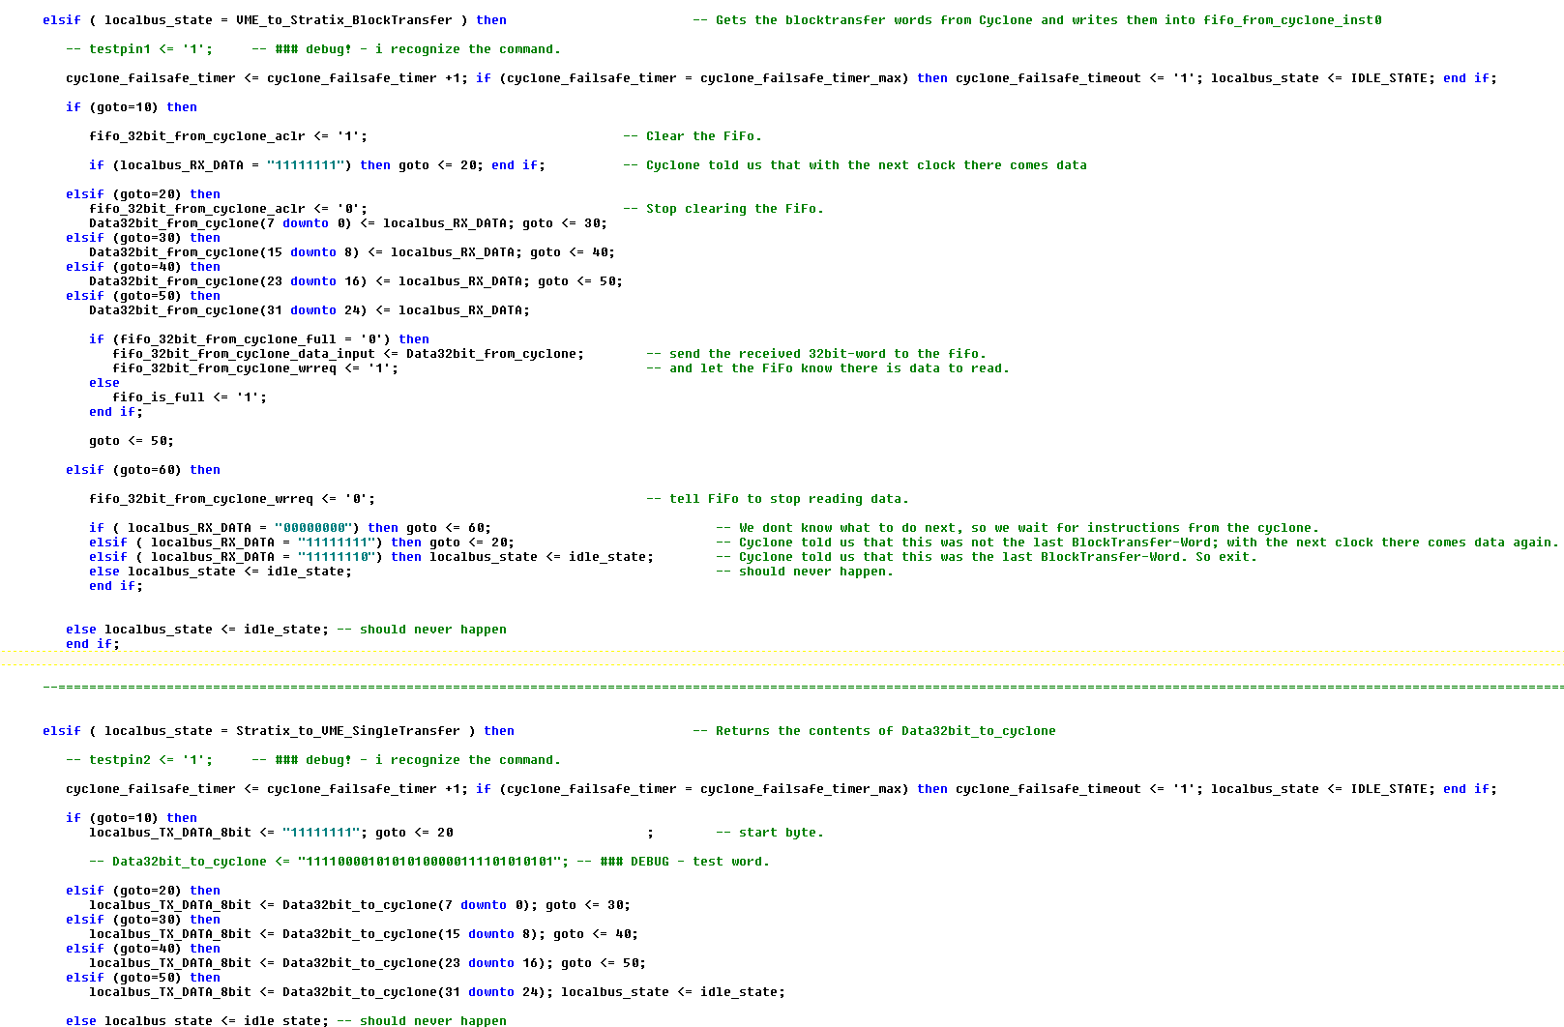
The FADC Firmware

Slide 8
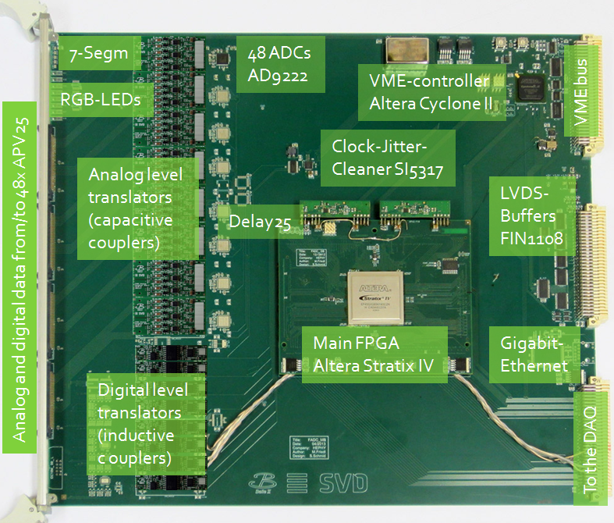
FADC – Firmware-Development: Done:
VME-bus Struck – National-
Instruments – command-wrapper
VME-bus-interface in the Cyclone
Communication Cyclone ⬄ Stratix
(Serial LVDS interface)
Protocols VME ⬄ Cyclone ⬄
Stratix
7-Segment-Display (SPI-interface)
RGB-LEDs (SPI-interface)
Jitter-Cleaner
Delay25 (I²C-interface)
APV25-programming (I²C-interface)
Readout of the 48 ADCs (Serial LVDS
interface)
FIFOs for reading out realtime
APVdata to VME
Reordering of the APV25 data
CRC16 calculation
And lots of Hardware-debugging...

Slide 9
FADC – Firmware-Development: Done:
VME-bus Struck – National-
Instruments – command-wrapper
VME-bus-interface in the Cyclone
Communication Cyclone ⬄ Stratix
(Serial LVDS interface)
Protocols VME ⬄ Cyclone ⬄
Stratix
7-Segment-Display (SPI-interface)
RGB-LEDs (SPI-interface)
Jitter-Cleaner
Delay25 (I²C-interface)
APV25-programming (I²C-interface)
Readout of the 48 ADCs (Serial LVDS
interface)
FIFOs for reading out realtime
APVdata to VME
Reordering of the APV25 data
CRC16 calculation
And lots of Hardware-debugging...

Slide 10
FADC – Firmware-Development: Done:
VME-bus Struck – National-
Instruments – command-wrapper
VME-bus-interface in the Cyclone
Communication Cyclone ⬄ Stratix
(Serial LVDS interface)
Protocols VME ⬄ Cyclone ⬄
Stratix
7-Segment-Display (SPI-interface)
RGB-LEDs (SPI-interface)
Jitter-Cleaner
Delay25 (I²C-interface)
APV25-programming (I²C-interface)
Readout of the 48 ADCs (Serial LVDS
interface)
FIFOs for reading out realtime
APVdata to VME
Reordering of the APV25 data
CRC16 calculation
And lots of Hardware-debugging...

Slide 11
FADC – Firmware-Development: Done:
VME-bus Struck – National-
Instruments – command-wrapper
VME-bus-interface in the Cyclone
Communication Cyclone ⬄ Stratix
(Serial LVDS interface)
Protocols VME ⬄ Cyclone ⬄
Stratix
7-Segment-Display (SPI-interface)
RGB-LEDs (SPI-interface)
Jitter-Cleaner
Delay25 (I²C-interface)
APV25-programming (I²C-interface)
Readout of the 48 ADCs (Serial LVDS
interface)
FIFOs for reading out realtime
APVdata to VME
Reordering of the APV25 data
CRC16 calculation
And lots of Hardware-debugging...

Slide 12
FADC – Firmware-Development: Done:
VME-bus Struck – National-
Instruments – command-wrapper
VME-bus-interface in the Cyclone
Communication Cyclone ⬄ Stratix
(Serial LVDS interface)
Protocols VME ⬄ Cyclone ⬄
Stratix
7-Segment-Display (SPI-interface)
RGB-LEDs (SPI-interface)
Jitter-Cleaner
Delay25 (I²C-interface)
APV25-programming (I²C-interface)
Readout of the 48 ADCs (Serial LVDS
interface)
FIFOs for reading out realtime
APVdata to VME
Reordering of the APV25 data
CRC16 calculation
And lots of Hardware-debugging...

Slide 13
FADC – Firmware-Development: Done:
VME-bus Struck – National-
Instruments – command-wrapper
VME-bus-interface in the Cyclone
Communication Cyclone ⬄ Stratix
(Serial LVDS interface)
Protocols VME ⬄ Cyclone ⬄
Stratix
7-Segment-Display (SPI-interface)
RGB-LEDs (SPI-interface)
Jitter-Cleaner
Delay25 (I²C-interface)
APV25-programming (I²C-interface)
Readout of the 48 ADCs (Serial LVDS
interface)
FIFOs for reading out realtime
APVdata to VME
Reordering of the APV25 data
CRC16 calculation
And lots of Hardware-debugging...

Slide 14
FADC – Firmware-Development: Done:
VME-bus Struck – National-
Instruments – command-wrapper
VME-bus-interface in the Cyclone
Communication Cyclone ⬄ Stratix
(Serial LVDS interface)
Protocols VME ⬄ Cyclone ⬄
Stratix
7-Segment-Display (SPI-interface)
RGB-LEDs (SPI-interface)
Jitter-Cleaner
Delay25 (I²C-interface)
APV25-programming (I²C-interface)
Readout of the 48 ADCs (Serial LVDS
interface)
FIFOs for reading out realtime
APVdata to VME
Reordering of the APV25 data
CRC16 calculation
And lots of Hardware-debugging...

Slide 15
FADC – Firmware-Development: Done:
VME-bus Struck – National-
Instruments – command-wrapper
VME-bus-interface in the Cyclone
Communication Cyclone ⬄ Stratix
(Serial LVDS interface)
Protocols VME ⬄ Cyclone ⬄
Stratix
7-Segment-Display (SPI-interface)
RGB-LEDs (SPI-interface)
Jitter-Cleaner
Delay25 (I²C-interface)
APV25-programming (I²C-interface)
Readout of the 48 ADCs (Serial LVDS
interface)
FIFOs for reading out realtime
APVdata to VME
Reordering of the APV25 data
CRC16 calculation
And lots of Hardware-debugging...

Slide 16
FADC – Firmware-Development: Done:
VME-bus Struck – National-
Instruments – command-wrapper
VME-bus-interface in the Cyclone
Communication Cyclone ⬄ Stratix
(Serial LVDS interface)
Protocols VME ⬄ Cyclone ⬄
Stratix
7-Segment-Display (SPI-interface)
RGB-LEDs (SPI-interface)
Jitter-Cleaner
Delay25 (I²C-interface)
APV25-programming (I²C-interface)
Readout of the 48 ADCs (Serial LVDS
interface)
FIFOs for reading out realtime
APVdata to VME
Reordering of the APV25 data
CRC16 calculation
And lots of Hardware-debugging...

Slide 17
FADC – Firmware-Development: Done:
VME-bus Struck – National-
Instruments – command-wrapper
VME-bus-interface in the Cyclone
Communication Cyclone ⬄ Stratix
(Serial LVDS interface)
Protocols VME ⬄ Cyclone ⬄
Stratix
7-Segment-Display (SPI-interface)
RGB-LEDs (SPI-interface)
Jitter-Cleaner
Delay25 (I²C-interface)
APV25-programming (I²C-interface)
Readout of the 48 ADCs (Serial LVDS
interface)
FIFOs for reading out realtime
APVdata to VME
Reordering of the APV25 data
CRC16 calculation
And lots of Hardware-debugging...

Slide 18
FADC – Firmware-Development: Done:
VME-bus Struck – National-
Instruments – command-wrapper
VME-bus-interface in the Cyclone
Communication Cyclone ⬄ Stratix
(Serial LVDS interface)
Protocols VME ⬄ Cyclone ⬄
Stratix
7-Segment-Display (SPI-interface)
RGB-LEDs (SPI-interface)
Jitter-Cleaner
Delay25 (I²C-interface)
APV25-programming (I²C-interface)
Readout of the 48 ADCs (Serial LVDS
interface)
FIFOs for reading out realtime
APVdata to VME
Reordering of the APV25 data
CRC16 calculation
And lots of Hardware-debugging...

Slide 19
FADC – Firmware-Development: Done:
VME-bus Struck – National-
Instruments – command-wrapper
VME-bus-interface in the Cyclone
Communication Cyclone ⬄ Stratix
(Serial LVDS interface)
Protocols VME ⬄ Cyclone ⬄
Stratix
7-Segment-Display (SPI-interface)
RGB-LEDs (SPI-interface)
Jitter-Cleaner
Delay25 (I²C-interface)
APV25-programming (I²C-interface)
Readout of the 48 ADCs (Serial LVDS
interface)
FIFOs for reading out realtime
APVdata to VME
Reordering of the APV25 data
CRC16 calculation
And lots of Hardware-debugging...

Slide 20
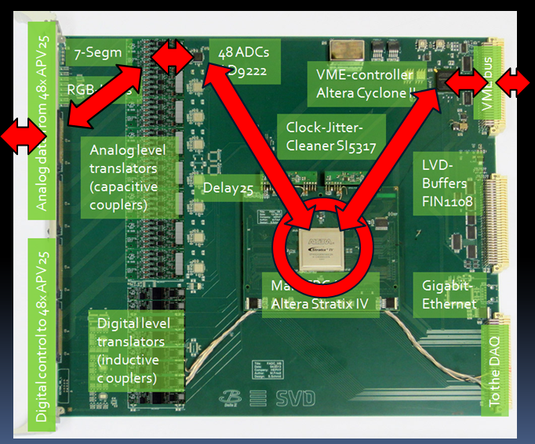
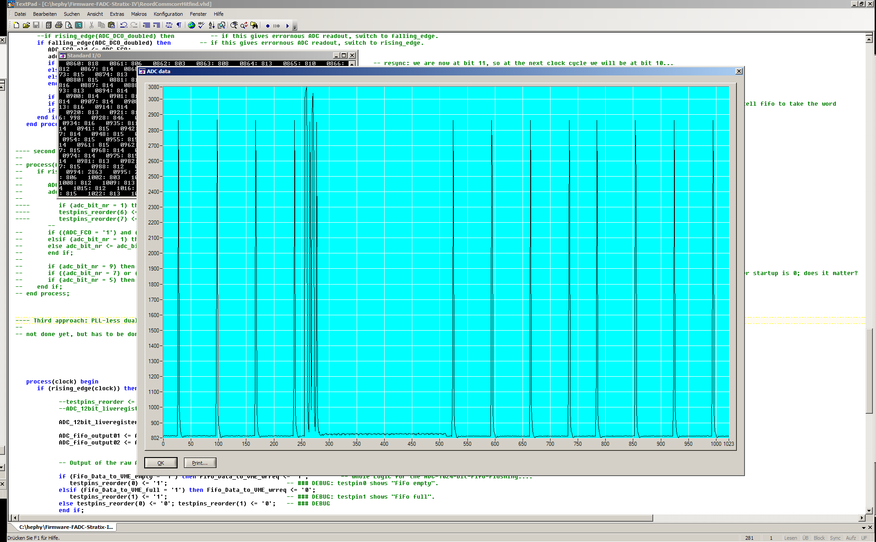
APV25 => Cabling => ADC => Stratix => Cyclone => VME => PC

Slide 21
FADC – Firmware-Development: Done:
VME-bus Struck – National-
Instruments – command-wrapper
VME-bus-interface in the Cyclone
Communication Cyclone ⬄ Stratix
(Serial LVDS interface)
Protocols VME ⬄ Cyclone ⬄
Stratix
7-Segment-Display (SPI-interface)
RGB-LEDs (SPI-interface)
Jitter-Cleaner
Delay25 (I²C-interface)
APV25-programming (I²C-interface)
Readout of the 48 ADCs (Serial LVDS
interface)
FIFOs for reading out realtime
APVdata to VME
Reordering of the APV25 data
CRC16 calculation
And lots of Hardware-debugging...

Slide 22
FADC – Firmware-Development: Done:
VME-bus Struck – National-
Instruments – command-wrapper
VME-bus-interface in the Cyclone
Communication Cyclone ⬄ Stratix
(Serial LVDS interface)
Protocols VME ⬄ Cyclone ⬄
Stratix
7-Segment-Display (SPI-interface)
RGB-LEDs (SPI-interface)
Jitter-Cleaner
Delay25 (I²C-interface)
APV25-programming (I²C-interface)
Readout of the 48 ADCs (Serial LVDS
interface)
FIFOs for reading out realtime
APVdata to VME
Reordering of the APV25 data
CRC16 calculation
And lots of Hardware-debugging...

Slide 23
FADC – Firmware-Development: Done:
VME-bus Struck – National-
Instruments – command-wrapper
VME-bus-interface in the Cyclone
Communication Cyclone ⬄ Stratix
(Serial LVDS interface)
Protocols VME ⬄ Cyclone ⬄
Stratix
7-Segment-Display (SPI-interface)
RGB-LEDs (SPI-interface)
Jitter-Cleaner
Delay25 (I²C-interface)
APV25-programming (I²C-interface)
Readout of the 48 ADCs (Serial LVDS
interface)
FIFOs for reading out realtime
APVdata to VME
Reordering of the APV25 data
CRC16 calculation
And lots of Hardware-debugging...

Slide 24
What is left to do until the beamtest
Common Mode Correction
Zero-Suppression
Generating the three runtype Data Formats (Raw mode, Transparent Mode, Zero Suppressed Mode)
FADC-Controller: End of November with Katsuro (in Vienna)
Testing, testing, testing, testing, testing, testing, testing, testing, testing...

Slide 25
Belle II FADC Firmware Development: Milestones and Conclusions
I joined the Belle II project in April 2013
End of June 2013: Connectivity Test FADC ⬄ FTB ⬄ Copper with APV25 data simulated by the Cyclone on the FADC -successful.
End of November 2013 (right after B2GM): Connectivity Test with real APV25 data.
January 2013: Beam Test at DESY
  I will be there for 1 week in December and full January

Slide 26
The End...
Thank you for your attention!

Slide 27
Backup slides...

Slide 28
The Connectivity-Test June 2013:
The ROM- and VHDL-generator (1/2)
Perl program, self-explaining help included
Inputs (per command line parameters):
  Data Format (Run type): raw, transparent, zero-suppressed, zero-suppressed+hit-finding,
  Number of events, channels per event, words per channel, pause ticks,
  Randomization for above numbers,
  Probabilities for APV25-errorbits (for all Run types except raw) and for bad hits (for zero-suppressed mode)

Slide 29
The Connectivity-Test June 2013:
The ROM- and VHDL-generator (2/2)
Output file formats:
  ASCII-binary („0101“...), with and without CRC
  Hex-file, with and without CRC
  Plain binary, with and without CRC
  VHDL-file, pin-definition-file, constraints-file, all ready for compilation and flashing
Batch files
  They create all files needed for Quartus
  They compile and flash them fully automated into the FPGA

Slide 30
The Connectivity-Test June 2013:
The VHDL file
FADCRDY
Trailer,
Header,
XD
ROM-Output-switcher
Trigger-enabled
Clk
Clk
Trailer
000...
ROM
out
down
TestpinO
Trigger
Select
Trigger
Edge
Detect
(1 clk)
Trigger
Delay
(8 clks)
Trigger
Count
ROM-
counter
ROM
Trigger
up
&
SPOU1
Addr
Clk
BsyFTB
Clk
Clk
Trigger-
Edge
Trigger
Output
(2 clks)
Testpin1
SPin1
Clk

Slide 31
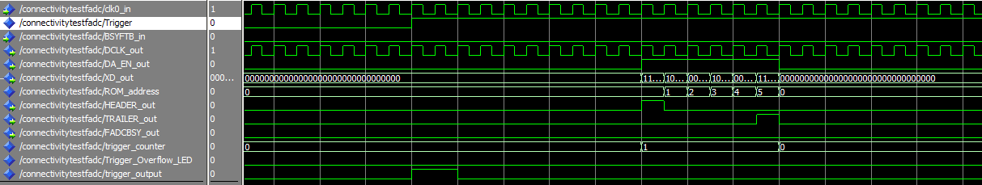
Wave samples (1/5)
One single trigger detected, no BSYFTB:

Slide 32
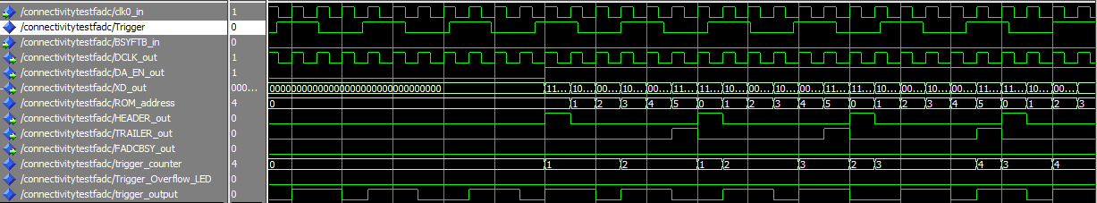
Wave samples (2/5)
7 Triggers detected, 4 queued, no BSYFTB:

Slide 33
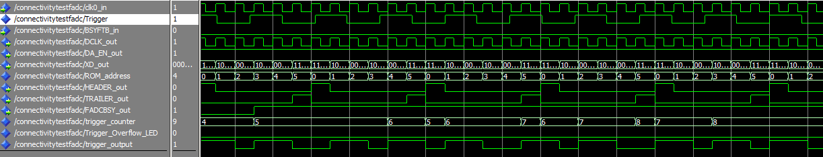
Wave samples (3/5)
More than 5 Triggers queued, no BSYFTB:

Slide 34
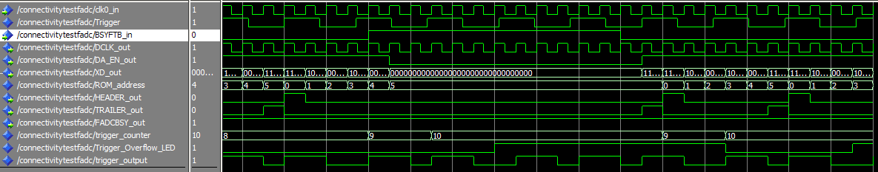
Wave samples (4/5)
At most 10 triggers are queued, and BSYFTB:

Slide 35
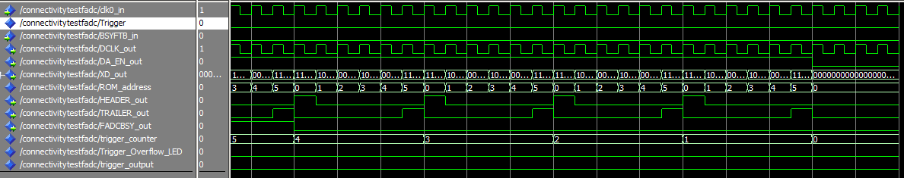
Wave samples (5/5)
Unqueuing triggers, entering idle mode:

Slide 36
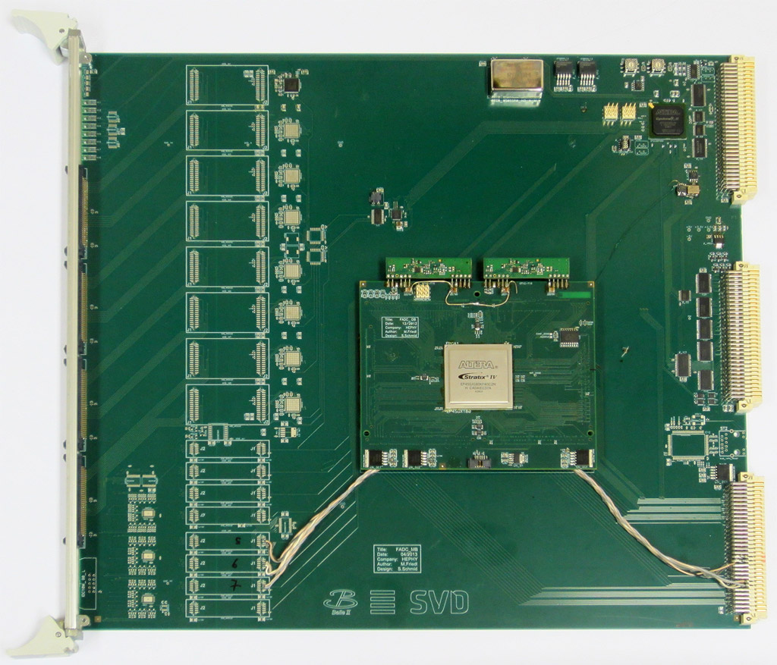
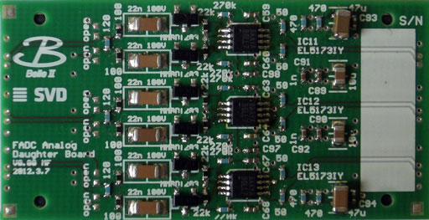
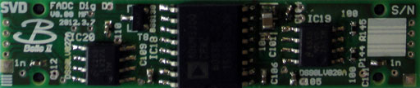
7-Segm
48 ADCs
AD9222
VME-controller
Altera Cyclone II
VME bus
RGB-LEDs
Clock-Jitter-
Cleaner SI5317
Analog level
translators
(capacitive
couplers)
LVDS-
Buffers
FIN1108
Delay25
Analog and digital data from/to 48x APV25
Main FPGA
Altera Stratix IV
Gigabit-
Ethernet
Digital level
translators
(inductive
c ouplers)
To the DAQ

Slide 38
