Slide 1



Test the GaAs sensors in the proton beam 1-3 MeV
U.Kruchonak, P. Smolyanskiy, S.Kotov, M.Gostkin

Slide 2
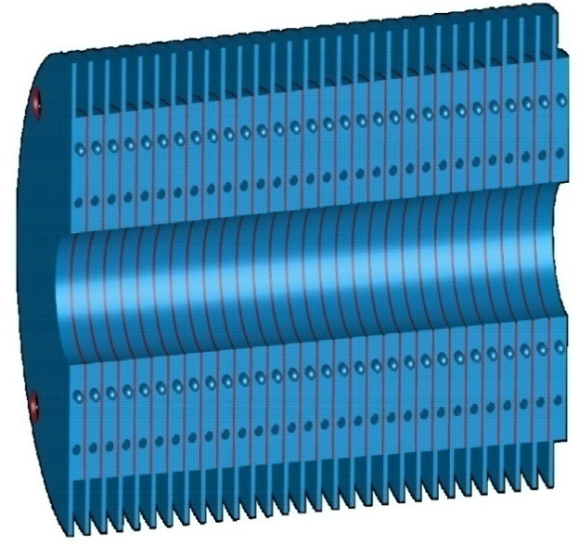
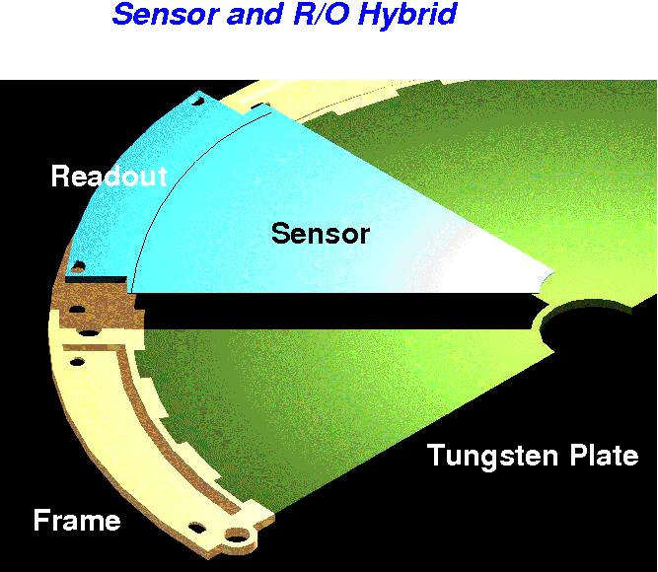
The Beam Calorimeter - BeamCal
~12cm
~10cm
BeamCal
Compact EM calorimeter with sandwich structure:
  30 layers of 1 X₀
    3.5mm W absorber and 0.3mm radiation hard sensor
  Angular coverage from 5mrad to 28 mrad
  (6.0 > |η| > 4.3)
  Moliére radius R_{M} ≈ 1cm
  Segmentation between 0.5 and 0.8 x R_{M}
  GaAs:Cr is offered as a radiation hard sensor for Beamcal.

Slide 3
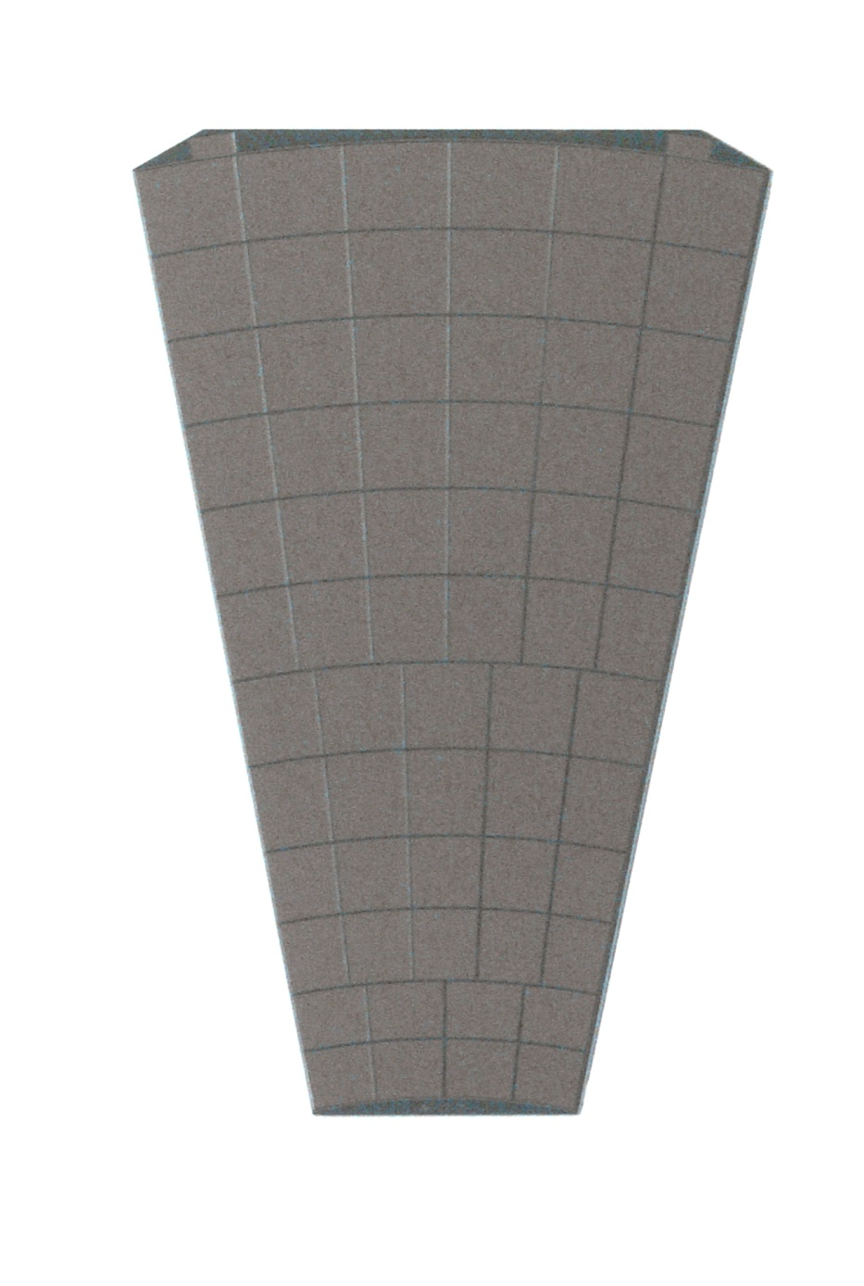
GaAs:Cr Sensor Plane
New set of 10 sector size GaAs sensors (32 at all)
Thickness ~ 500 μm
Metallization ~1 μm Ni both sides
12 rings
64 pads from 18 to 42 mm²
Surrounded by 120 μm width guard ring

Slide 4
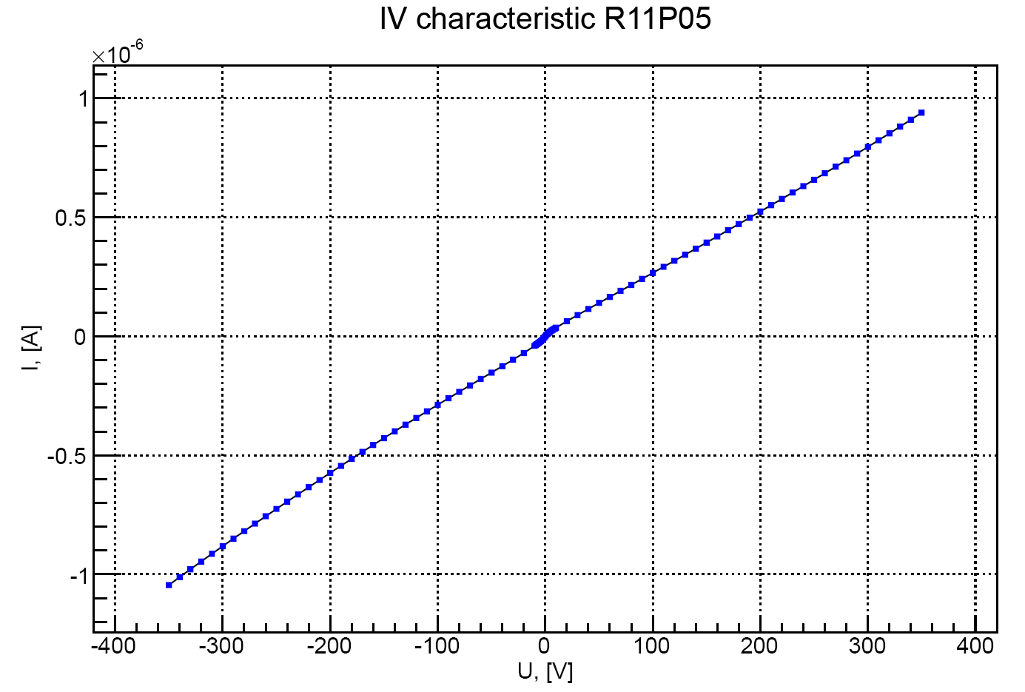
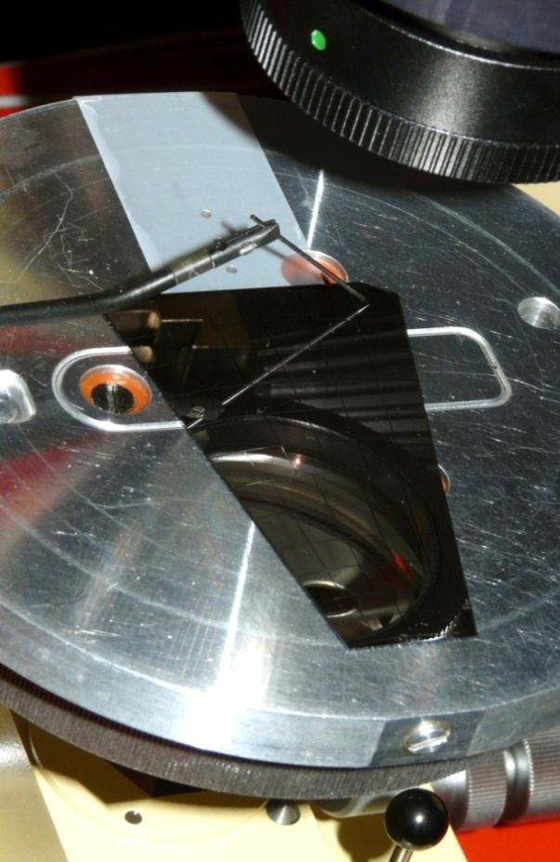
I/V pad measurements
Guard Ring
A
DC-PADs
BP
Typical IV of one pad of AG-262№3
symmetric in the range +/-350V
linear in the range +/-150V

Slide 5
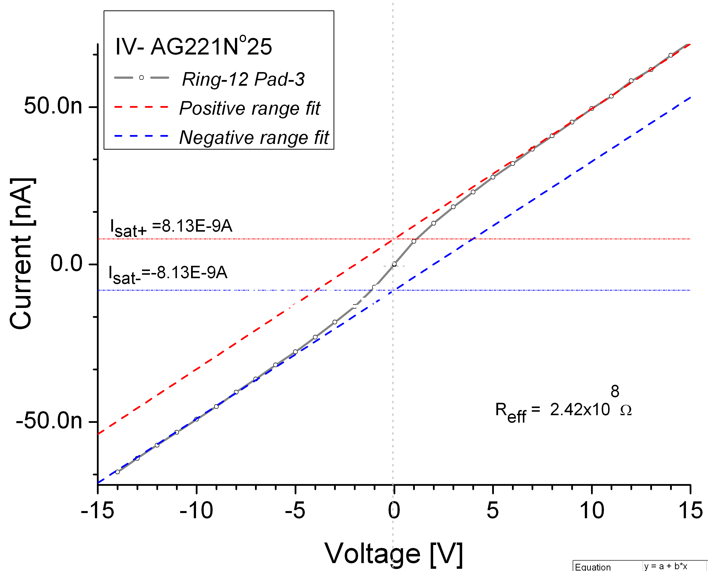

I-V in range +/-10V
Parameterization of the IV curve by 4 parameters:
  In-
  In+
  R-
  R+
  As result of IV measurement we can get 4 parameters for each pad:
  ρ-, ρ+
  φ⁻, φ⁺

Slide 6
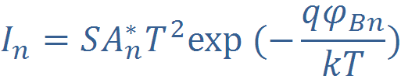

Measurement of the barrier height on border of metal−semiinsulating gallium arsenide
total current through the device
Reff - effective resistance of the entire device
In or Isat - Saturation current - Limiting current from metal to semiconductor
[1]
S- Cross-sectional area, A*_{n} = 8.16 A*cm⁻² *K⁻² - Richardson constant for GaAs
T - Temperature of device, q - electron charge, k - Boltzmann constant
- barrier height on border of metal−semiinsulating gallium arsenide
Notes:
6

Slide 7
Resistivity pads distribution of AG221№6
Resistivity, Ω
Pad №
  It was found that for some sensors the ρ-, ρ⁻ , φ⁺ , but not φ
  strongly depends on Ring №

Slide 8
Barrier height distribution of AG221№6
Barrier height
Resistivity, Ω
Pad №

Slide 9
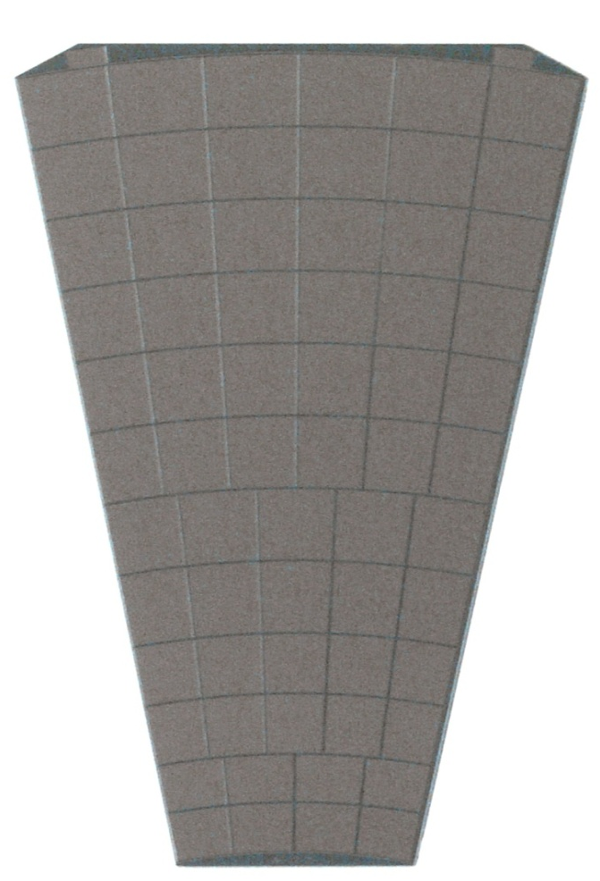
Defects found
The criteria for a pad accepted as good:
ρ> 10e9 Ω*cm
Some pads or guard rings have untypical behavior.
8 of 22 sensors have deflection Guard ring and one pad: that may be related internal structure injury. It appear on the crystal boundary for all cases.
All 8 sensors are made of the same crystal AG84!
Unusual pads
Guard ring +
Ring1-Pad4; Ring12-Pad1; Ring12-Pad6;

Slide 10
8 of 22 planes have 1 unusual pad and GR (All 8 of 12 ϵ AG84)
Nº | Pad Nº | Breakdown voltage, V
AsGa84N7 | Guard ring | -330
AsGa84N7 | Ring12-Pad1 | -310
AsGa84N13 | Guard ring | -160; +200
AsGa84N13 | Ring12-Pad6 | -280
AsGa84N21 | Guard ring | +30
AsGa84N21 | Ring1-Pad4 | +50
AsGa84N26 | Guard ring | -110; +230
AsGa84N26 | Ring12-Pad1 | -210
AsGa84N28 | Guard ring | -300
AsGa84N28 | Ring12-Pad6 | +330
AsGa84N41 | Guard ring | +110
AsGa84N41 | Ring12-Pad6 | +110
AsGa84N23 | Guard ring | ρ- < 1E08
AsGa84N23 | Ring1-Pad4 | ρ- < 1E08
AsGa84N24 | Guard ring | +10
AsGa84N24 | Ring1-Pad4 | +10
AsGa84N24 | Ring12-Pad6 | +30

Slide 11
New set 10 GaAs:Cr Sensor planes
№ | Detector | thickness, um | collected charge, e* | metallization, Type of metallization
 |  |  |  | pixels | Guard ring
1 | AG 84 №18 | 450 | 32700 | Ni | Ni
2 | AG 84 №25 | 492 | 32530 | Ni | Ni
3 | AG 84 №31 | 452 | 32140 | Ni | Ni
4 | AG 84 №34 | 451 | 35470 | Ni | Ni
5 | AG 66 №5 | 513 | 38030 | Ni | Ni
6 | AG 66 №20 | 509 | 37280 | Ni | Ni
7 | AG 221 №14 | 503 | 35460 | Ni | Ni
8 | AG 262 №20 | 508 | 41270 | Ni | Ni
9 | AG 262 №21 | 517 | 39730 | Ni | Ni
10 | AG 262 №23 | 512 | 38120 | Ni | Ni
- U_{bias}= -150V, RT, β - radiation (⁹⁰Sr, mip)
10 sensors are made of 4 different crystals AG-66, AG-84, AG-221, AG-262 have to be measured

Slide 12
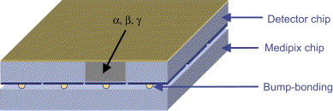
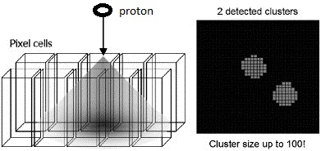
GaAs on the proton beam 1-3 MeV
The idea is using a proton beam as a tool to measure the charge collection efficiency of various sensor areas.
Changing proton energy gives the signal from different depth(Bragg's peak) combination with Medipix chip gives the space resolution ~55 um, that allows study detector surface homogeneity.
Medipix detector
Charge sharing effect

Slide 13
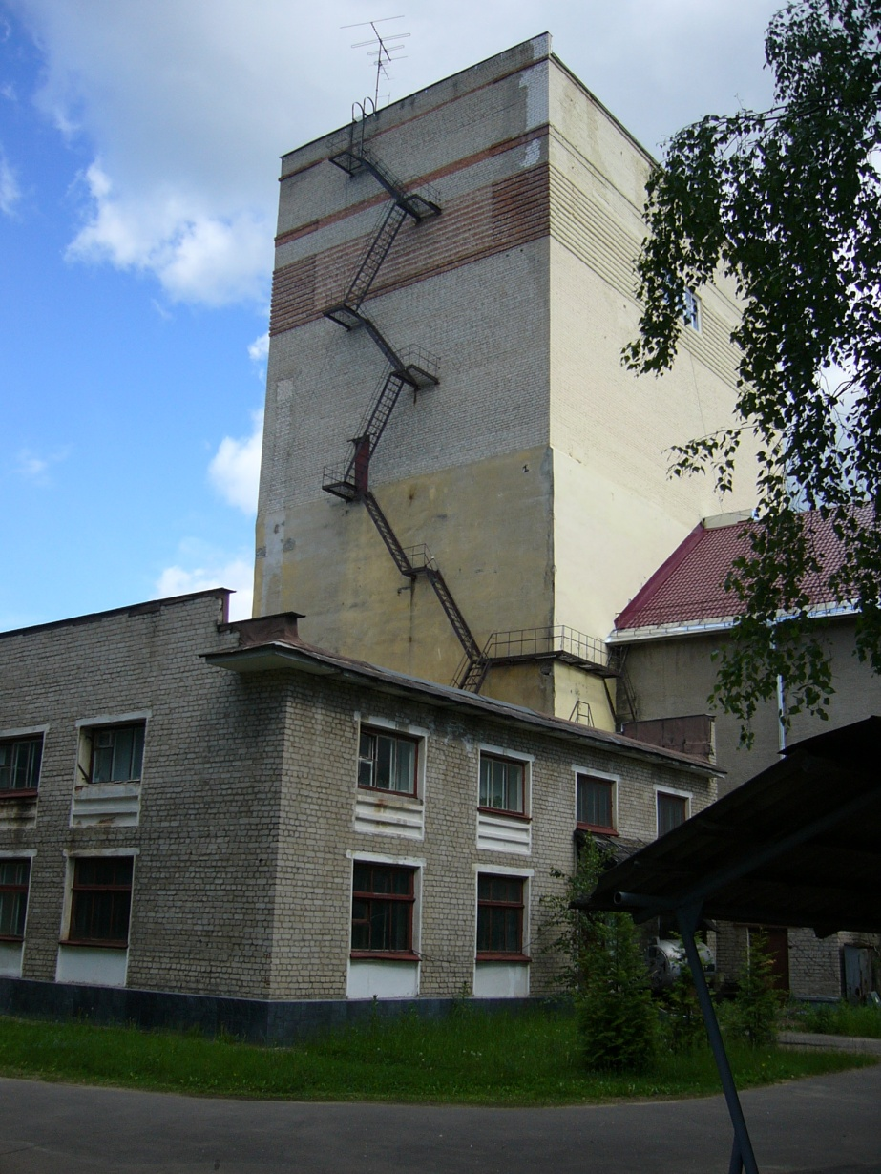
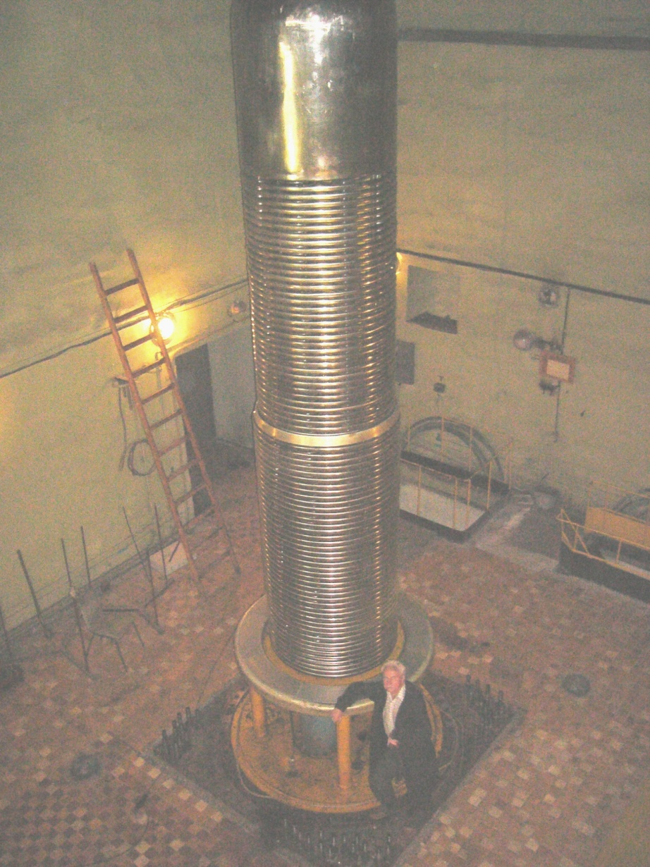
GaAs on the proton beam 1-3 MeV
Laboratory of the neutron physics JINR has the accelerator EG-5

Slide 14
GaAs on the proton beam 1-3 MeV
PRINCIPLE OF THE ACCELERATOR VAN-DE-GRAAF

Slide 15
GaAs on the proton beam 1-3 MeV
MAIN PARAMETERS OF THE ACCELERATOR EG-5
1. Particle energy 0,9 – 3,5 MeV;
2. Accelerated particles – singly charged ions of hydrogen and helium;
3. The intensity of the beam: protons – up to 30uA, helium ions – up to 10 uA;
4. Energy spread - less than 500 eV
5. Energy set accuracy - 2 keV;
6. Vertical accelerator with three magnets can provide beam on 6 horizontal channels.

Slide 16
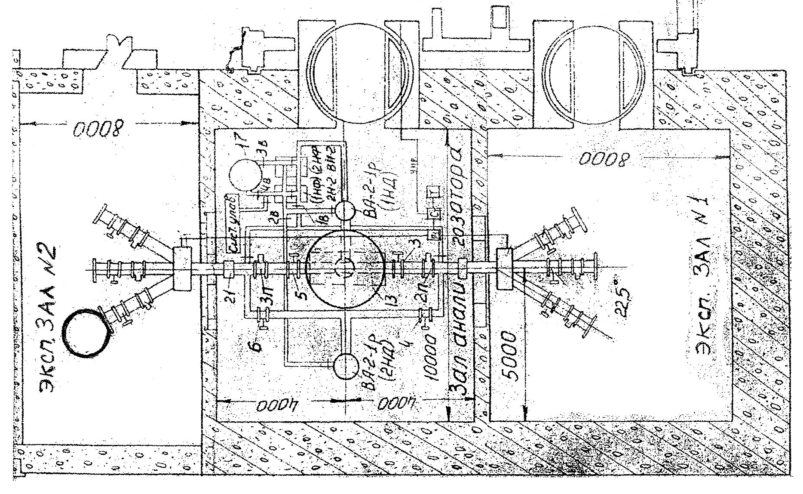
GaAs on the proton beam 1-3 MeV
Experimental setup
Channel №6
Vacuum chamber with detectors
Top view

Slide 17
GaAs on the proton beam 1-3 MeV
The problem is that beam intensity is too high in order to fix separate protons. Idea to put target foil and measure elastic scattered protons. That allows reduce the intensity by several orders.
First experiments with 50 um Cu target and Medipix Si and GaAs detectors + scintillator were done in July 2013.
Second step was done in october 2013 with Medipix & single pad GaAs detectors. 3 different target foils were used.

Slide 18
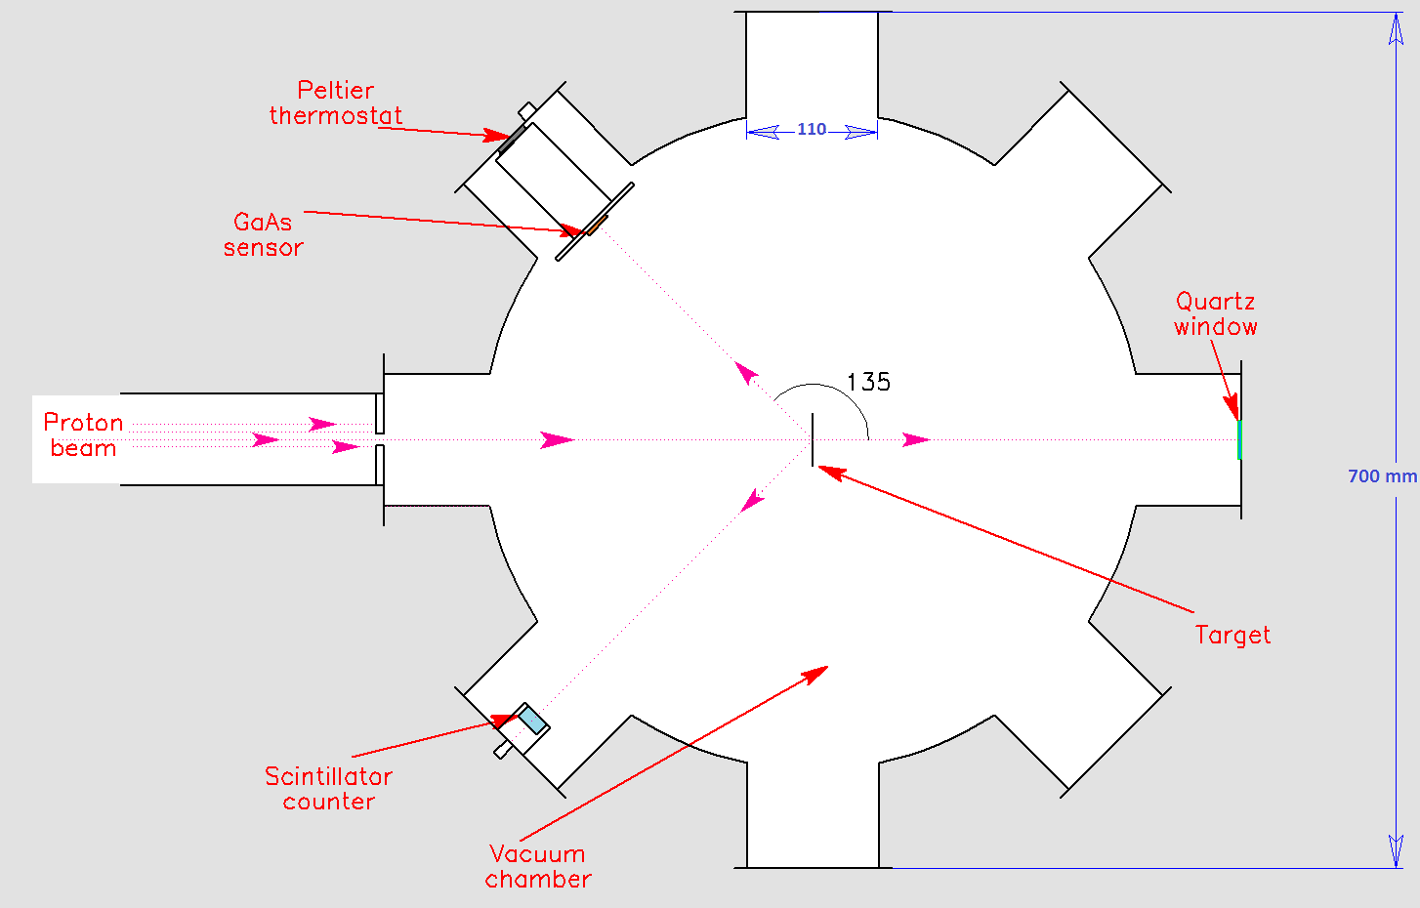
GaAs on the proton beam 1-3 MeV
Vacuum chamber with Mpix detector & scintillator.
50 um Cu

Slide 19
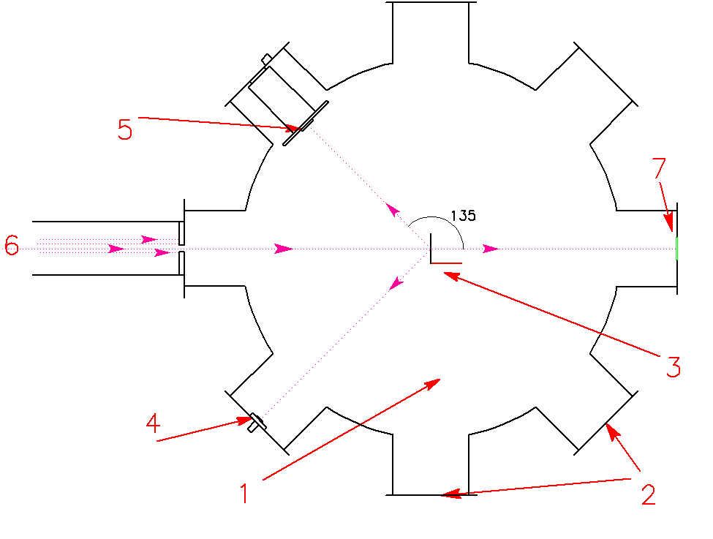
GaAs on the proton beam 1-3 MeV
Vacuum chamber with Mpix & pad detectors.
Vacuum chamber
Flanges
Target foils
Pad GaAs
Mpix
Beam
Quartz window
3 targets:
10 um Fe
15 um Al
10 um mylar

Slide 20
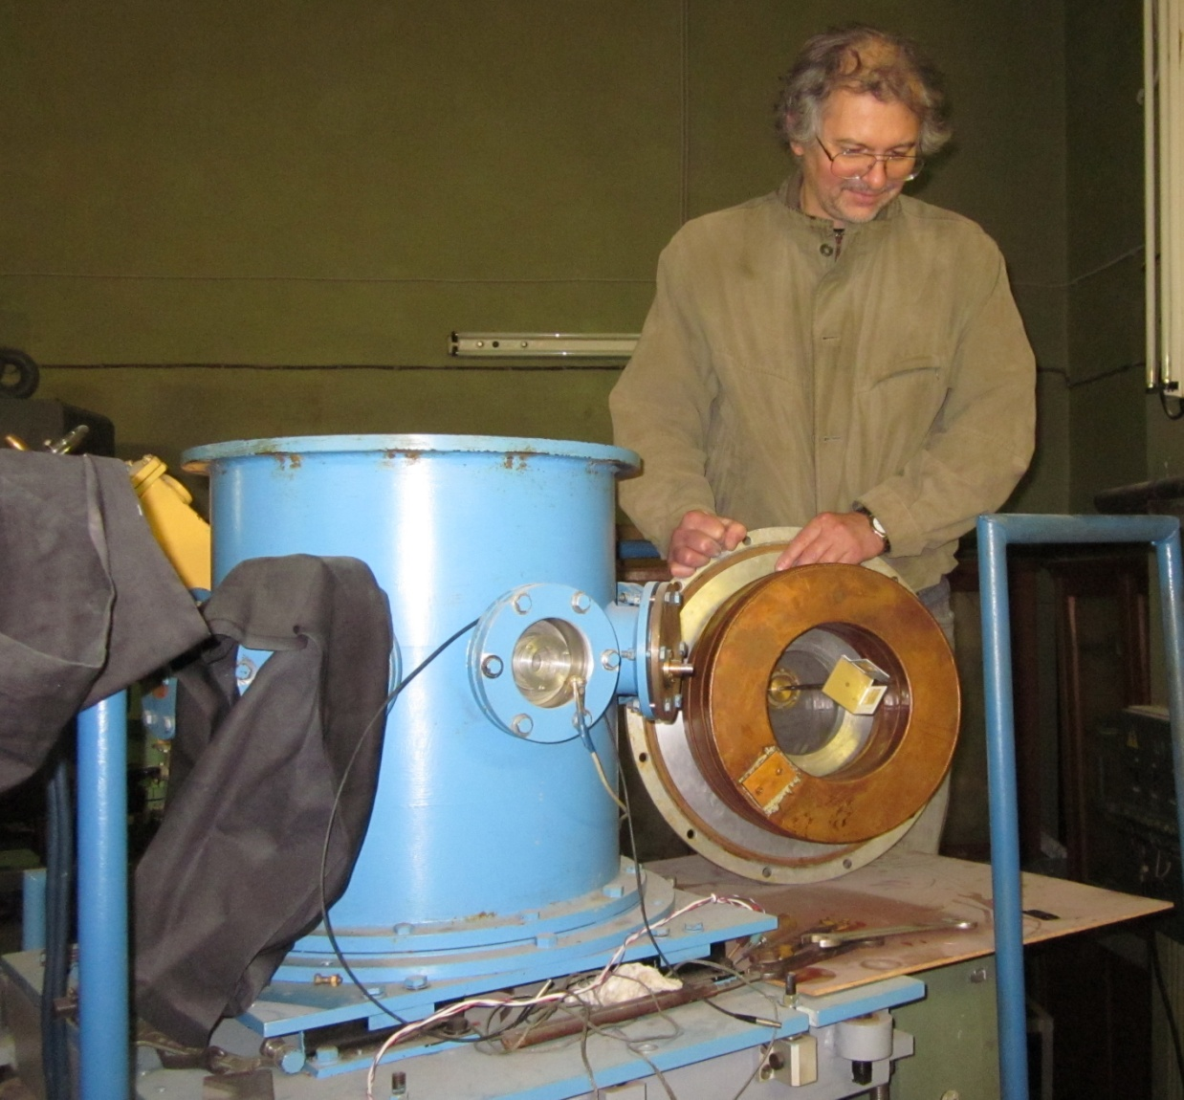
GaAs on the proton beam 1-3 MeV
Vacuum chamber with detectors
Vacuum chamber
Target foils
Quartz window for beam control

Slide 21
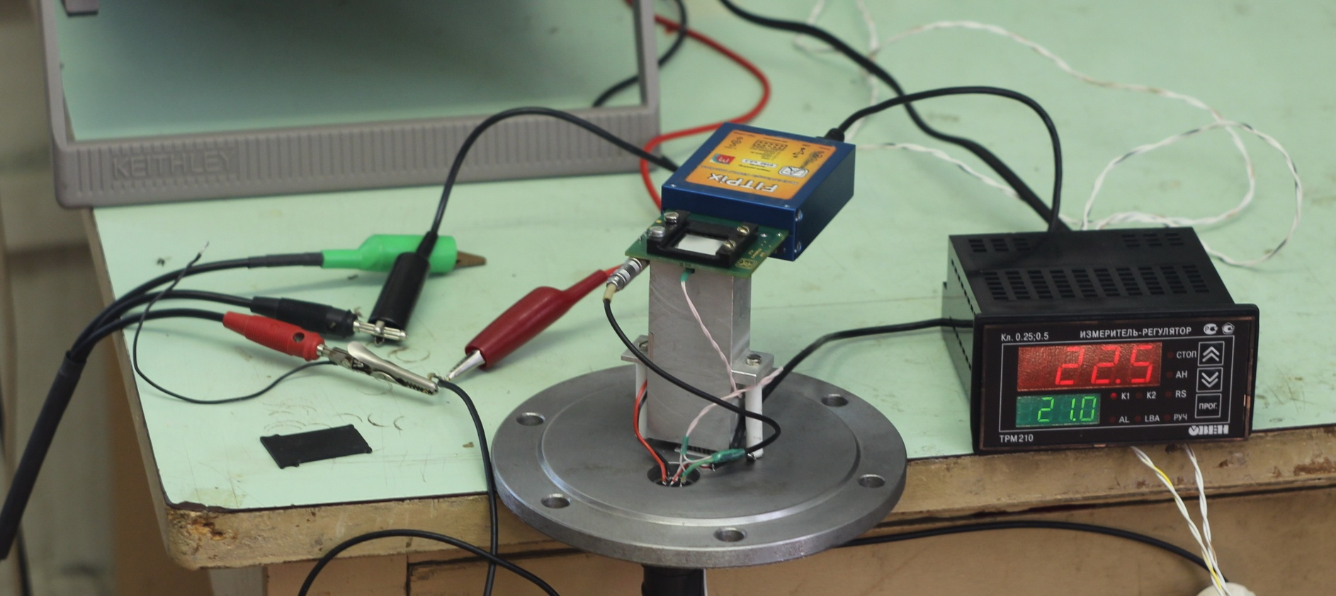
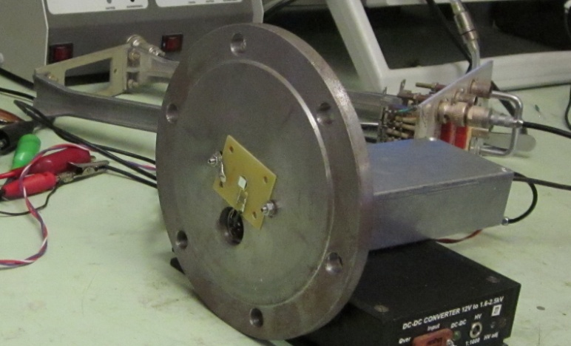
GaAs on the proton beam 1-3 MeV
Sensors
Two flange were prepared: with MediPix and with pad sensors.
MediPix has also the thermostabilisation system

Slide 22
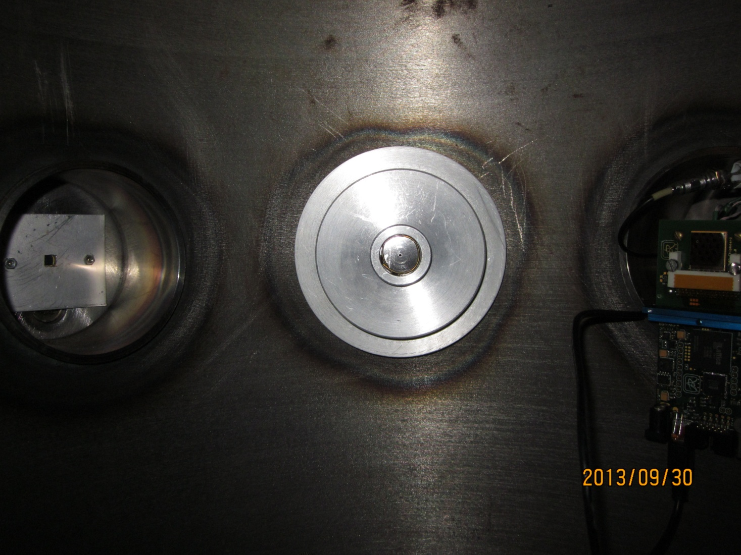
GaAs on the proton beam 1-3 MeV
Vacuum chamber with detectors.
Beam
Sensors

Slide 23
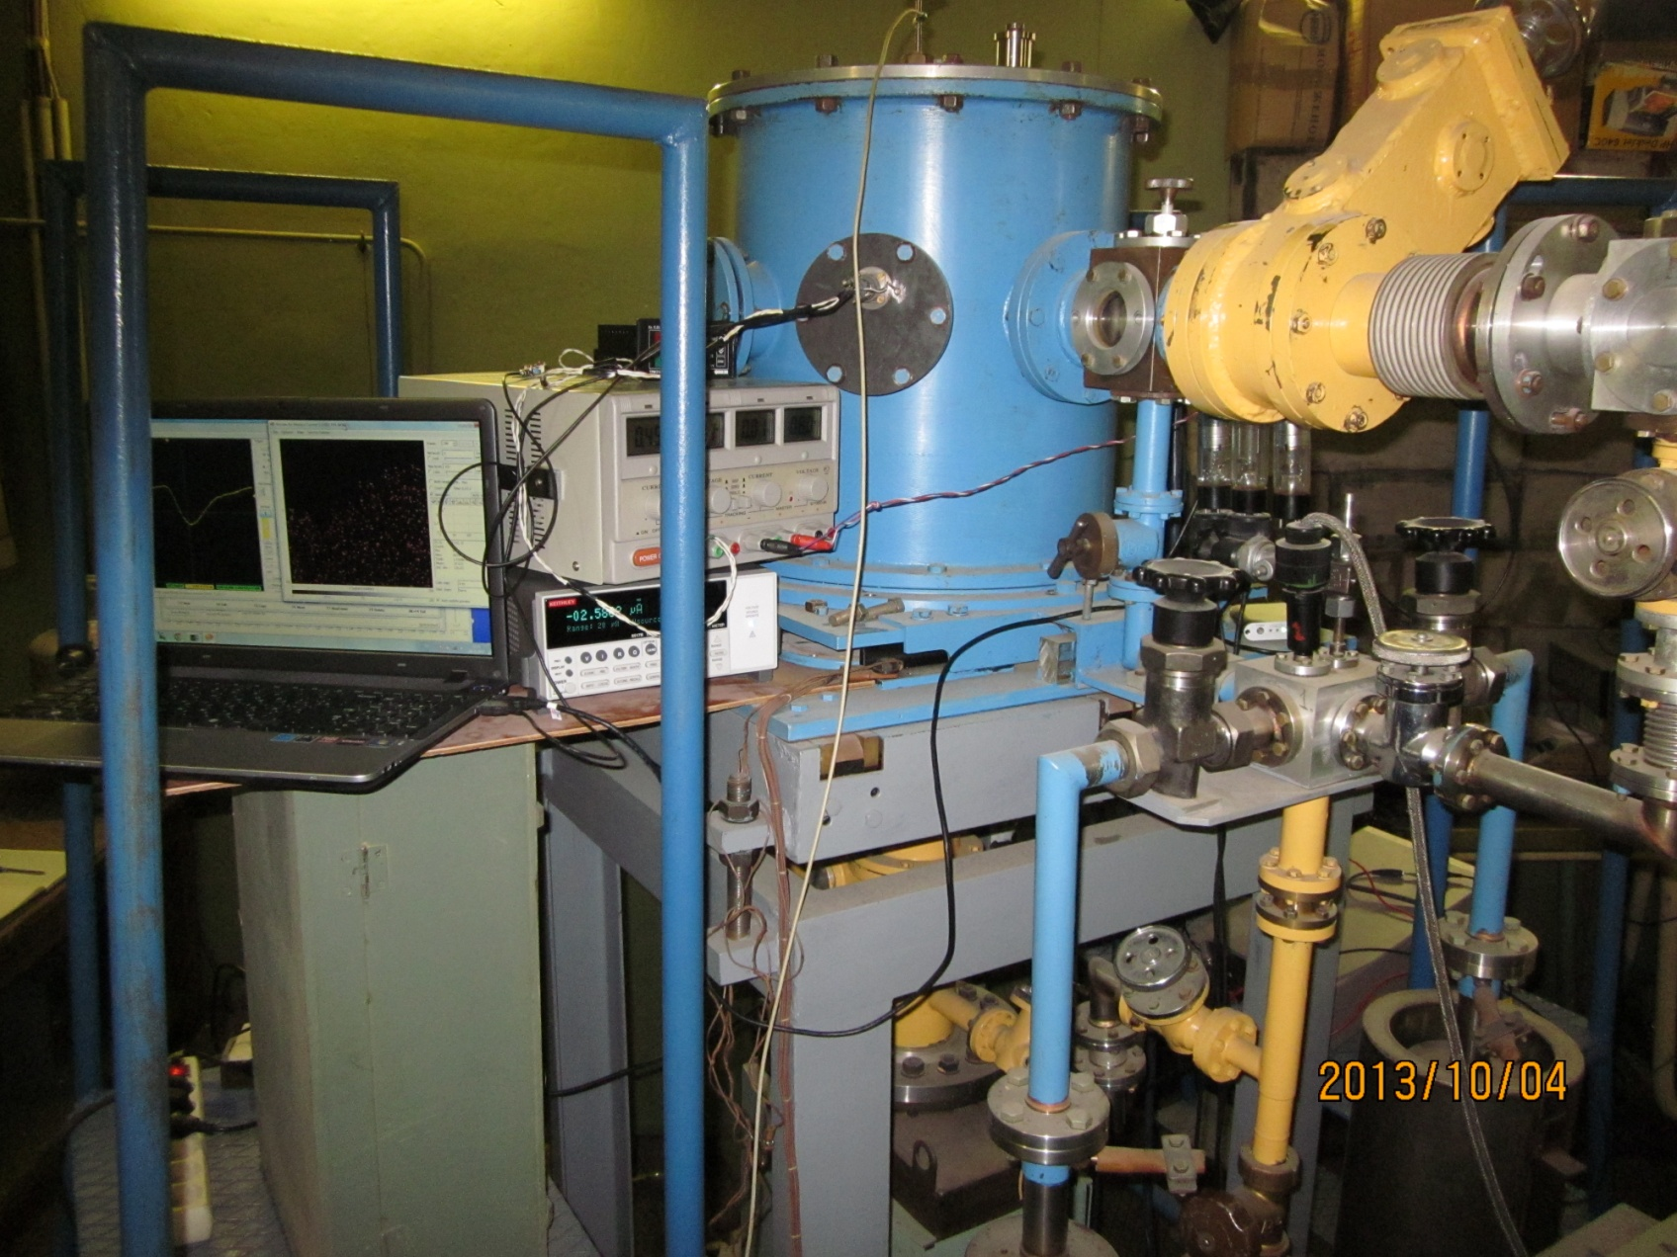
GaAs on the proton beam 1-3 MeV
Vacuum chamber on channel № 6
Beam channel №6
Pad & Mpix signals
Flange with detector

Slide 24
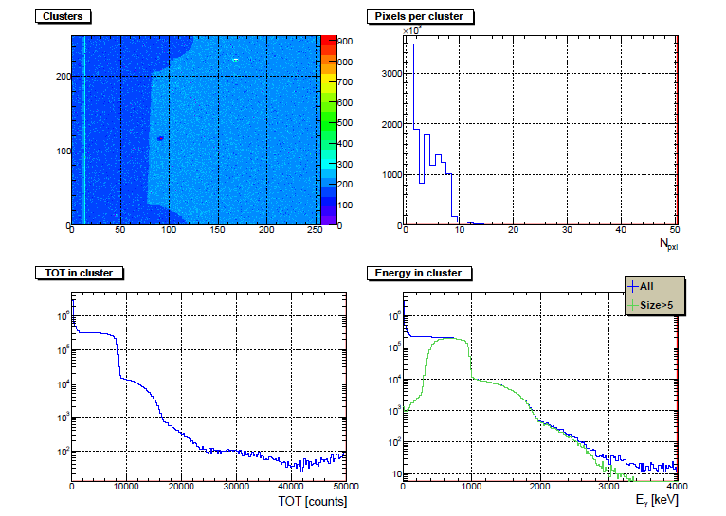
Sensor Si-D05 on the beam E = 1.1 MeV .

Slide 25
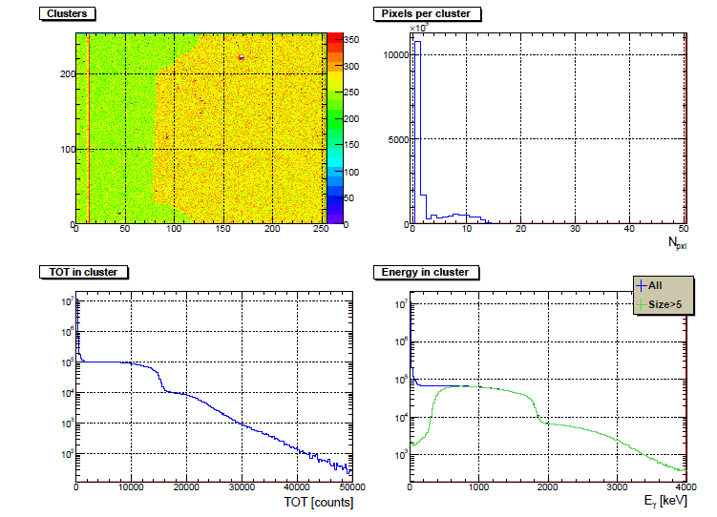
Sensor Si-D05 on the beam E = 2.0 MeV .

Slide 26
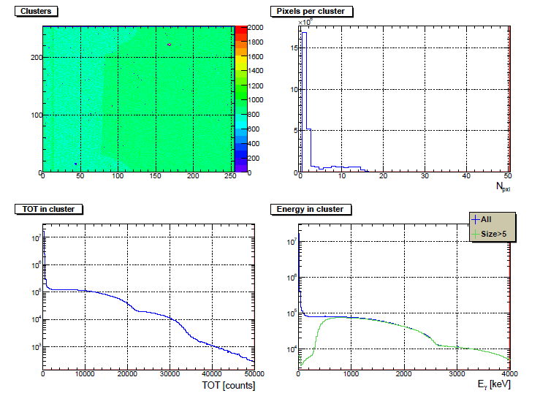
Sensor Si-D05 on the beam E = 2.8 MeV .

Slide 27
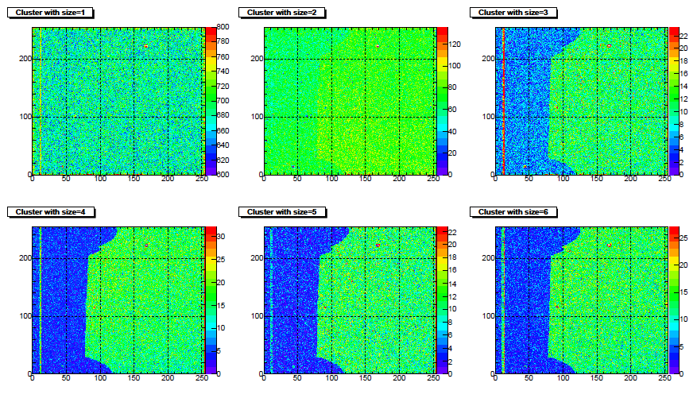
Sensor Si-D05 dependence on cluster size.

Slide 28
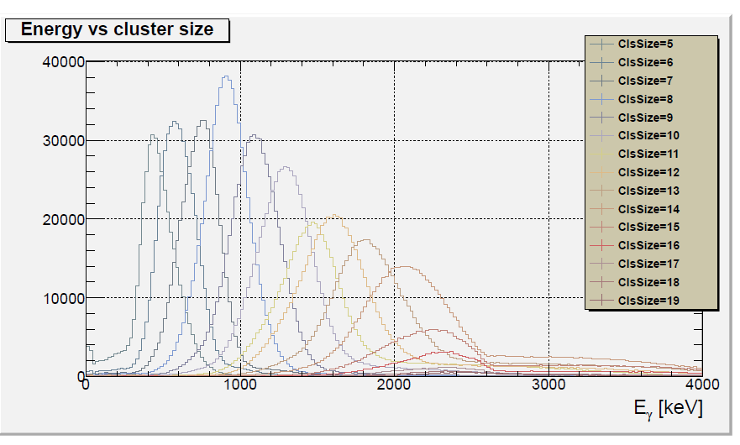
Dependence energy in cluster from the cluster size for Si-D05
E = 2.8 MeV.

Slide 29
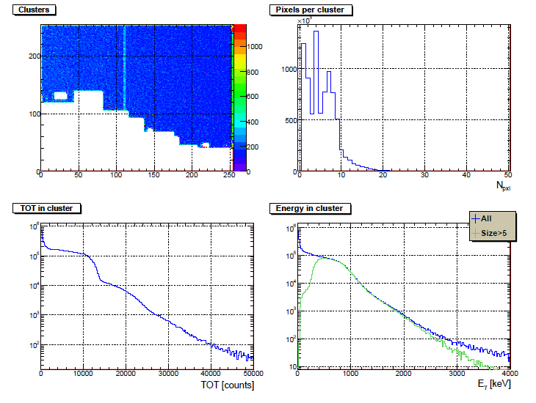
Sensor GaAs-S02 on the beam E = 1.1 MeV .

Slide 30
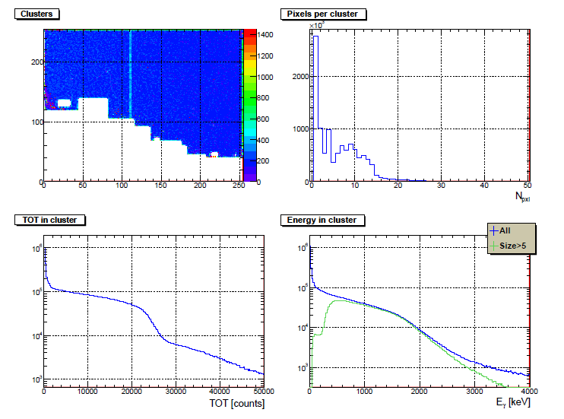
Sensor GaAs-S02 on the beam E = 2.0 MeV .

Slide 31
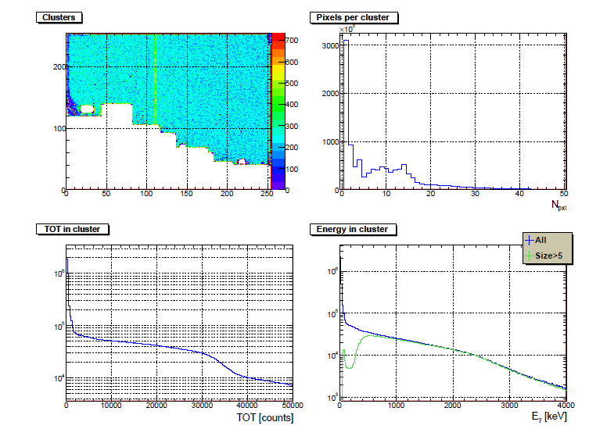
Sensor GaAs-S02 on the beam E = 2.8 MeV .

Slide 32
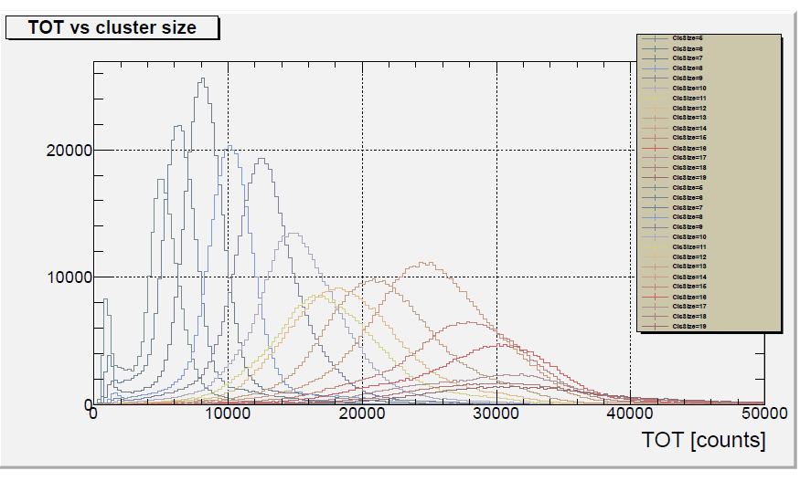
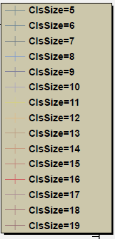
Dependence energy in cluster from the cluster size for GaAs-S02 E = 2.8 MeV.

Slide 33
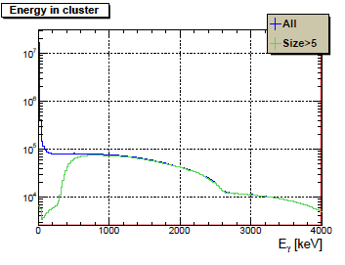
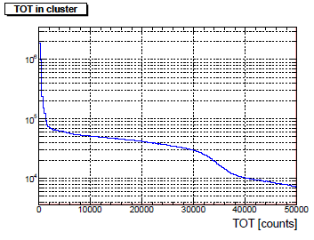
GaAs on the proton beam 1-3 MeV
Si
GaAs
It made clear that energy spectra are not sufficient. Cu foil completely stops the beam and we have continuum spectra from 0 to Ebeam
We need more thin foils in order to get pike on the maximum beam energy.
Second step was done in october 2013 with Medipix & single pad GaAs detectors. 3 different target foils were used.

Slide 34
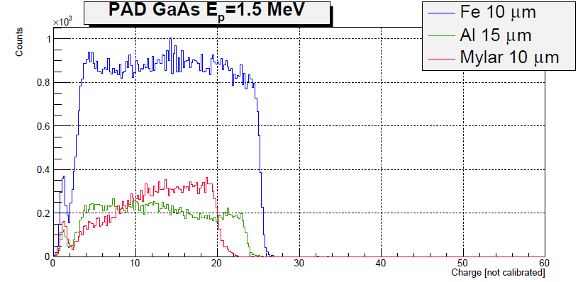

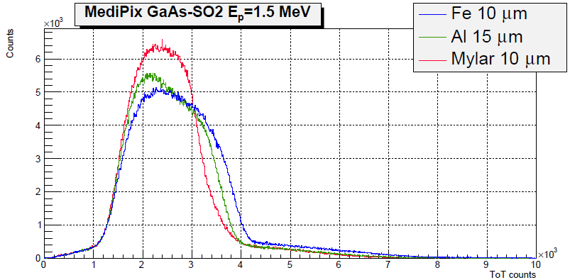
GaAs pad & Mpix S02 on the beam E = 1.5 MeV .
EFe = 0,92 E0
EAl = 0,84 E0
EC = 0,75 E0
After elastic scattering from
C, Al and Fe
protons have different energies.

Slide 35
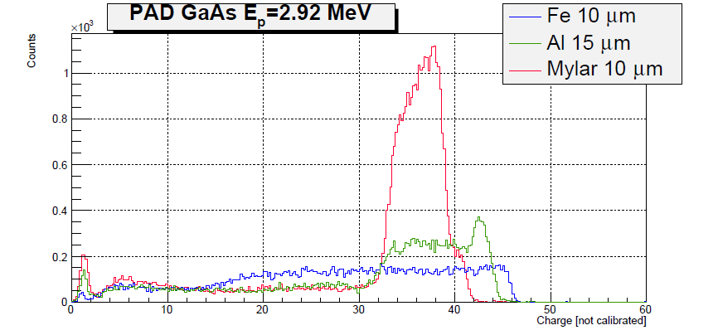
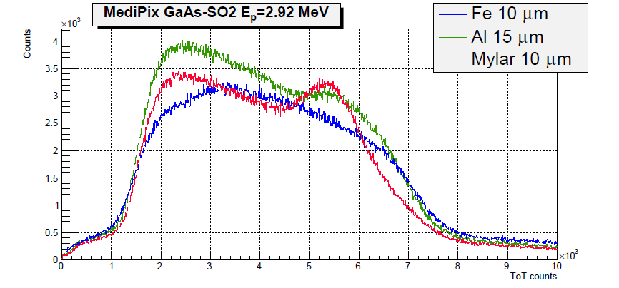
GaAs pad & Mpix S02 on the beam E = 2.92 MeV .

Slide 36
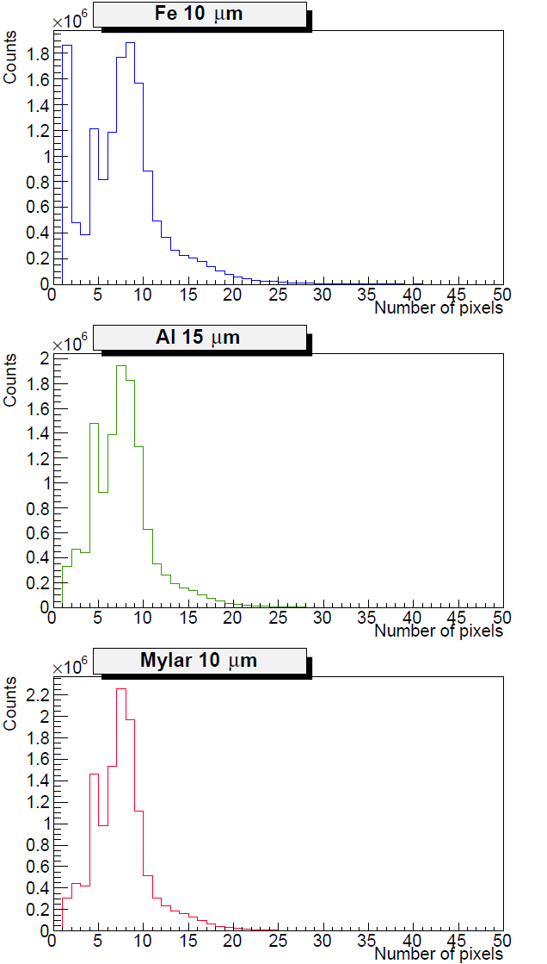
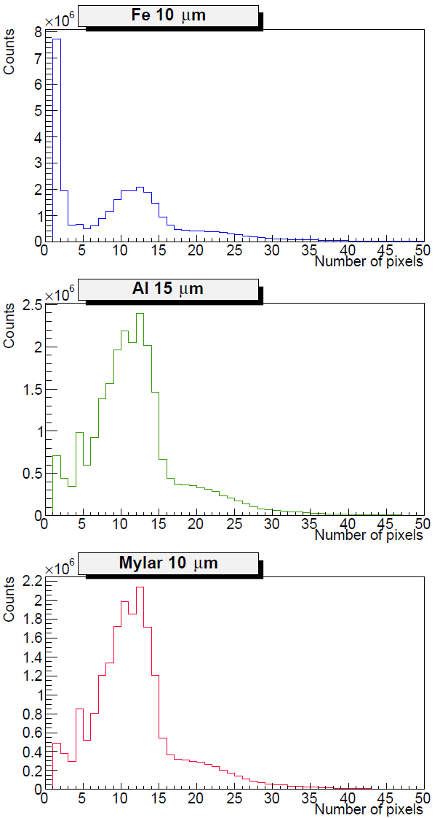
Dependence pixels in cluster from the target and energy for GaAs-S02 E = 1.5MeV E = 2.92MeV.

Slide 37
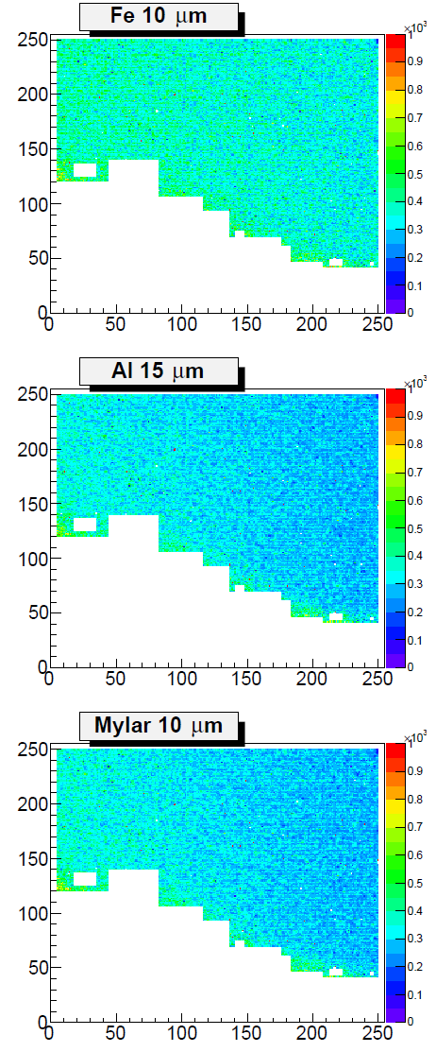
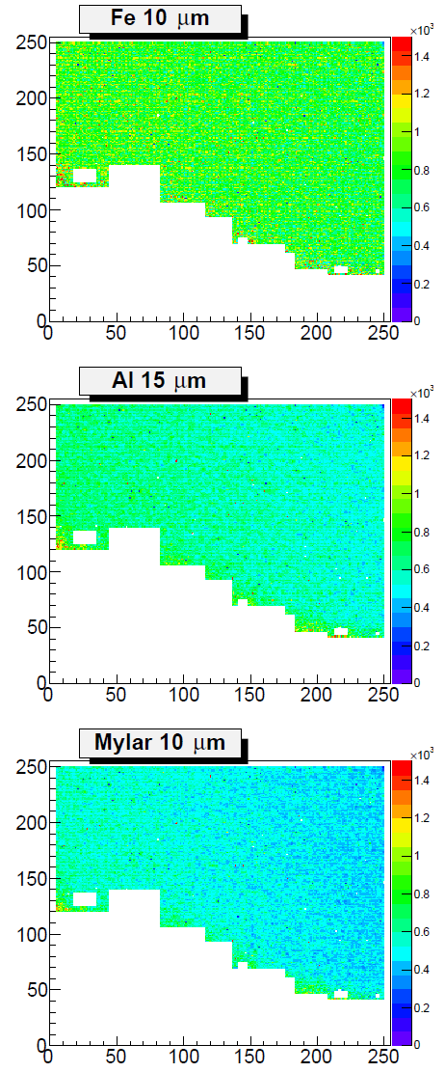
Dependence pixels in cluster from the target and energy for GaAs-S02 E = 1.5MeV E = 2.92MeV.

Slide 38
Conclusions
Experimental setup for test semiconductor sensors by proton beam
1-3 MeV was created in Dubna.
Si and GaAs Mpix and GaAs pad sensors were tested with different proton energies using different target foils.
Obtained results have shown efficiency of this method. For Si sensor two distinguish areas were found.
Next measurements with thin gold leaf can give monochromatic scattered protons.
It is possible to make test with 64-pad plane GaAs sensor.

Slide 39
Backup slides

Slide 40
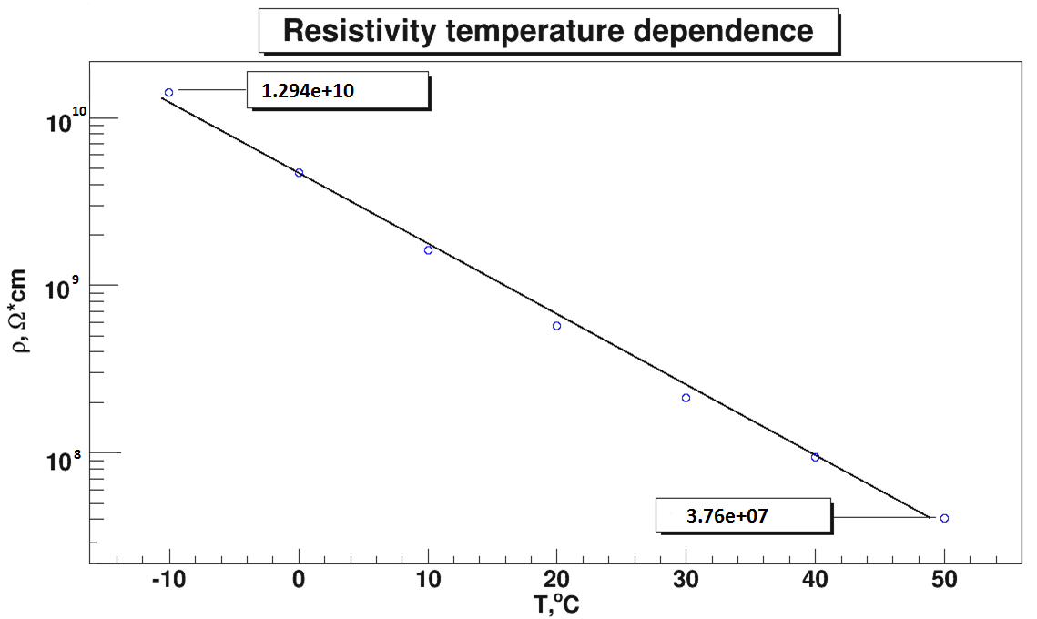

Temperature dependence of the resistivity
AG221N25

Slide 41
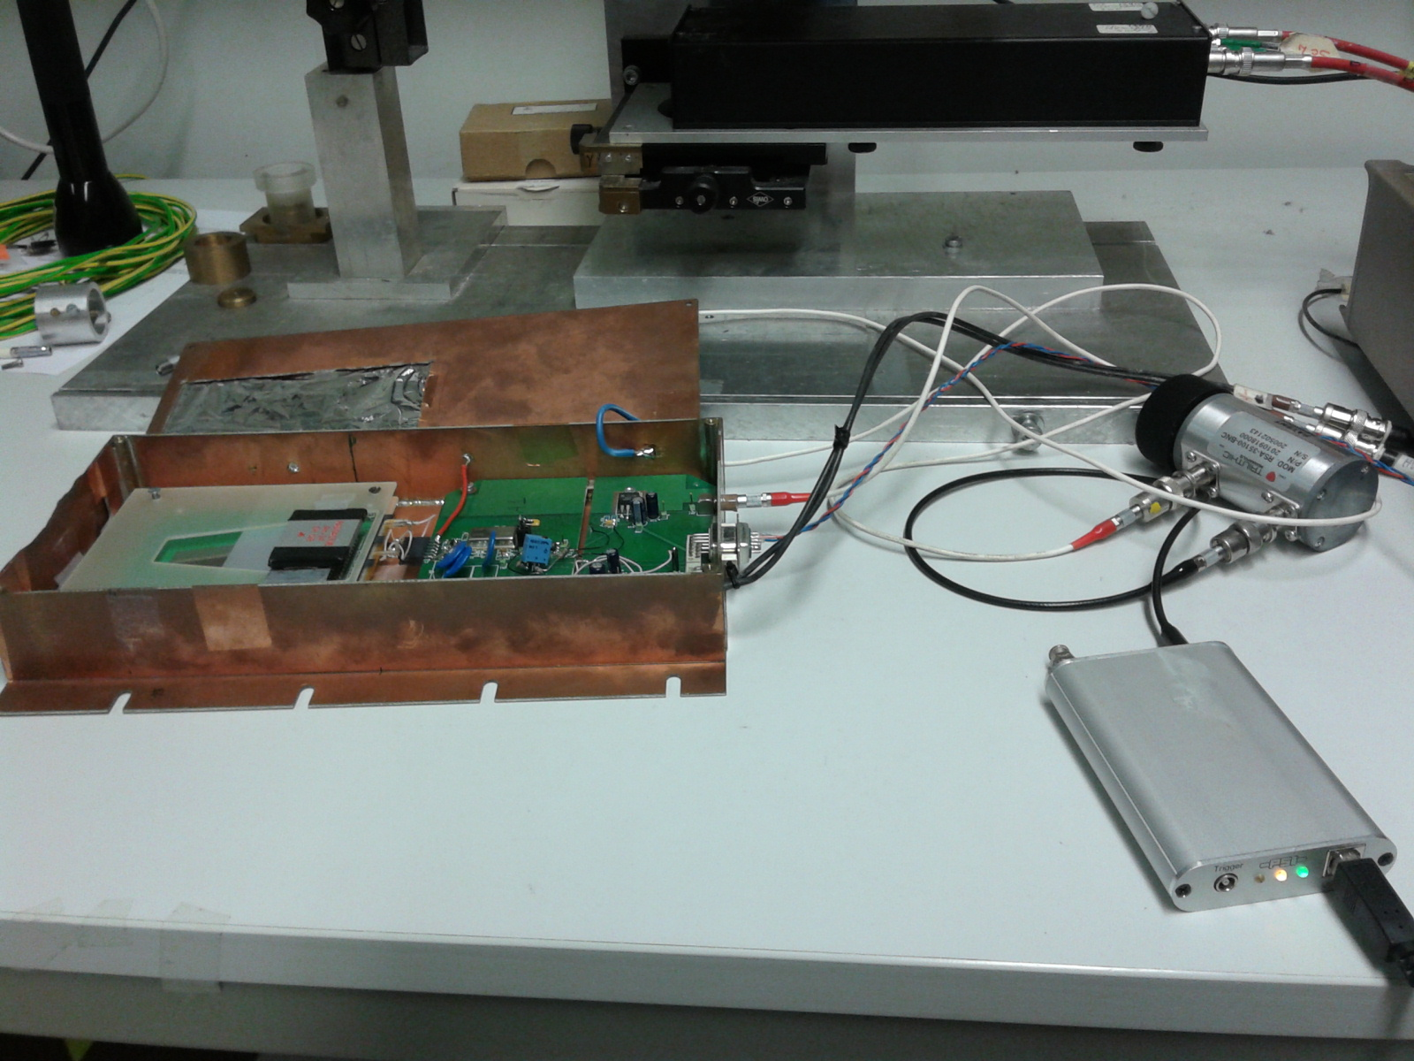
α-spectra of ²⁴¹Am experimental setup.

Slide 42
Forward region of the ILC
Beam calorimeter (BeamCal) - monitor the beam parameters at the interaction point; adjacent to the beampipe.
Luminosity detector (LumiCal) – covers larger polar angles; luminometer of the detector.
The gamma detector (GamCal) – together with BeamCal, measures beamstrahlung photons, which are very collinear to the beam.

Slide 43
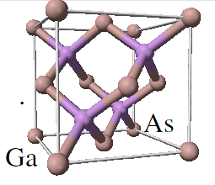
Gallium arsenide (GaAs)
Compound semiconductor, direct bandgap
Two sublattices of face centered cubic lattice
(zinc-blende type)
GaAs grown by Liquid Encapsulated
Czochralski (LEC).
doped by Te or Sn (shallow donor)
to fill EL2+ trapping centers.
Compensated by Cr (deep acceptor) to
high-ohmic intrinsic material.
Compensation is temperature controlled
Semi-insulating - no p-n junction
Signal charge transport mainly by electrons
Structure provided by metallisation (similar to diamond)
Density 5.32 g/cm3
Pair creation E 4.3 eV/pair
Band gap 1.42 eV
Electron mobility 8500 cm2/Vs
Hole mobility 400 cm2/Vs
Dielectric const. 12.85
Radiation length 2.3 cm
Ave. Edep/100 μm 69.7 keV
(by 10 MeV e-)
Ave. pairs/100 μm 13000
Structure p-n or insul

