Slide 1
Optimisation Studies
for the BeamCal Design
Lucia Bortko, DESY – Zeuthen
FCAL Meeting | DESY - Zeuthen | 7-8 Oct 2013

Slide 2
The Aim and Content
The Aim: • compare 2 types of segmentation of calorimeter
• investigate the characteristics
Content: • Introduction
• Simulation studies
- SNR
- efficiency of reconstruction of showers
- range of charge deposited into the pads
- dependence $E_{dep}$ vs $E_{e}$
- energy resolution
- spatial resolution
• Conclusion
Notes:
Since one of the tasks of BeamCal is to measure single high-energetic electrons (sHEe), the goal of finding better segmentation of calorimeter for this purpose was made.
Finding an optimum segmentation for better reconstruction of single high-energetic electrons (sHEe).

Slide 3
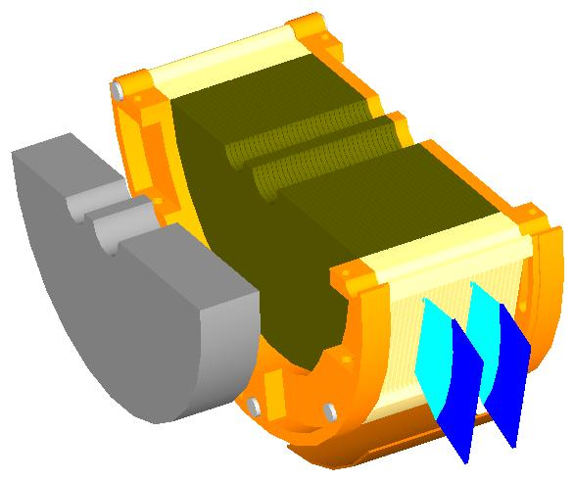
Beam Calorimeter for ILC
BeamCal aimed:
Detect sHEe
- Determine Beam Parameters
Masking backscattered low energetic particles
Graphite absorber
FE
Beam parameters from the ILC Technical Design Report (November 2012)
- Nominal parameter set
- Center-of-mass energy 1 TeV
Tungsten absorber
Diamond sensor
Readout plane/air gap
30 layers
1 $X_{0}$

Slide 4
BeamCal Segmentation
Y, cm
Uniform
Segmentation (US)
pads size are the same
Proportional
Segmentation (PS)
pads size are proportional to the radius
Similar number of channels
Notes:
Skazat chto vsebylo poschitano dlya Diamond??
Find number of channels for each segmentation(~ 70000 in total? And in 1 layer)

Slide 5
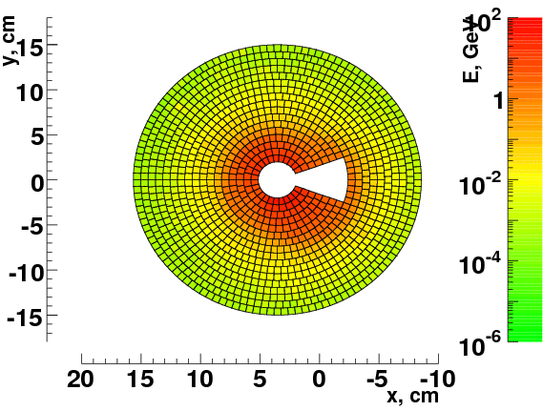
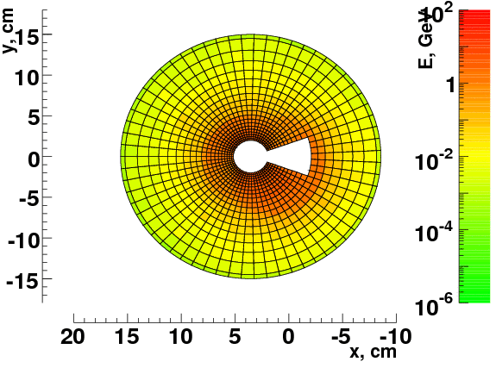
Energy Deposition due to Beamstrahlung
Average
10 BX
Beamstrahlung (BS) pairs generated with Guinea Pig
Energy deposition in sensors from BS simulated with BeCaS (Geant4)
→ considered as
Background (BG)
RMS of the averaged BG
→ considered as
noise (for SNR)
$E_{dep}$ is the same, but
$E_{dep}$/pad is different!
RMS
US
Average
10 BX
PS
Figures show sum of all layers
Notes:
Skazat pro to chto tak kak yadro livnya okolo 2?mm to umenshaya razmer yacheek na malyh radiusah my umenshaem shum ot bg, signal net, sledovatelno ozhidaem luchizhiy SNR
Put pictures for rms?? Or
- Put histo bg(radius) with rms as errors?? For all layers or for layer with maximum energy deposition?

Slide 6
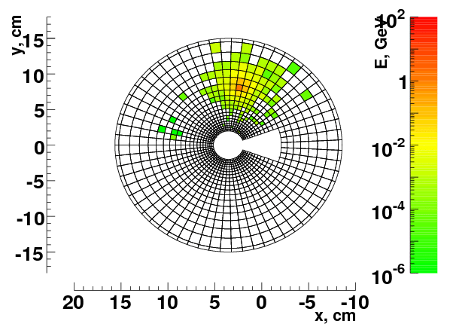
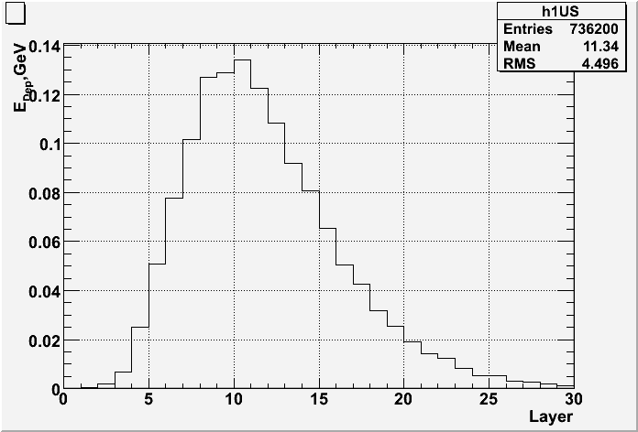
Shower from Single High Energy Electron
Showers are simulated with BeCaS (Geant4)
Investigated energies: 10, 20, 50, 100, 200, 500 GeV
Shower from 100- GeV electron
Longitudinal shower profile
$E_{e}$ = 100 GeV
Maximum in
10th layer
(average over 10 showers)

Slide 7
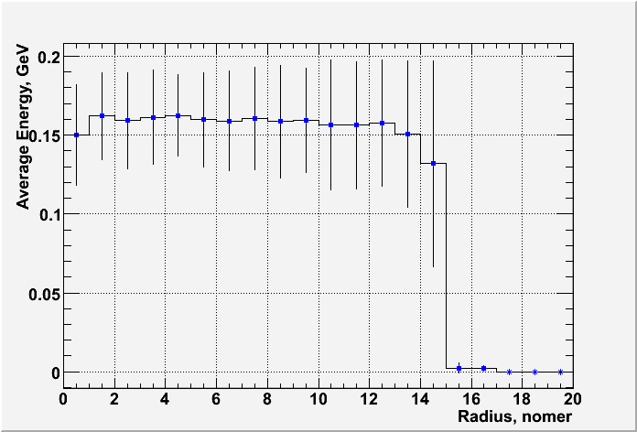
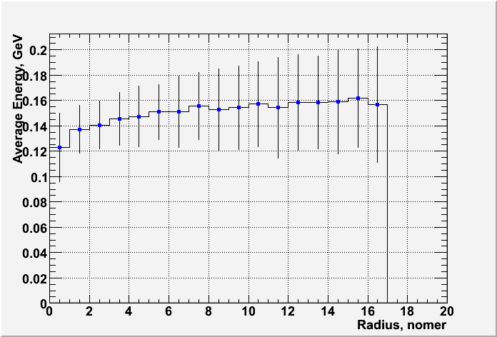
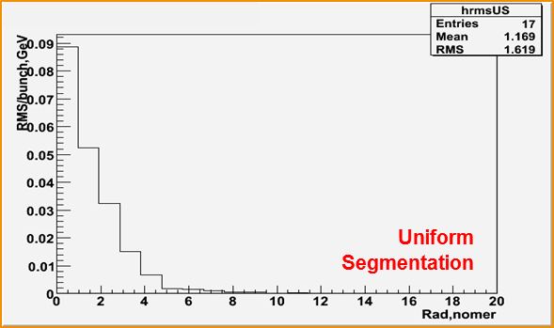
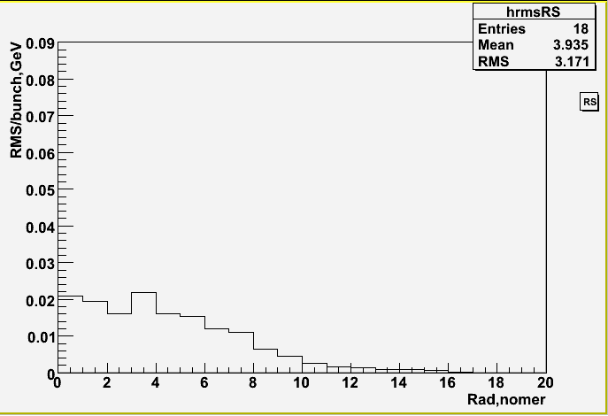
Signal and RMS for both Segmentations
The average energy in the pad of the core of shower
Signal nearly segmentation-independent!
Uniform
Segmentation
Proportional
Segmentation
RMS of the averaged Background
Proportional
Segmentation
Different distributions!
20 bunch crossings were given
Notes:
SIGNAL ALMOST INDEPENDET OF SEGMENTATION!!
Peredelat grafik dlya rms chtob y os’ u PS byla takaya zhe kak u US

Slide 8
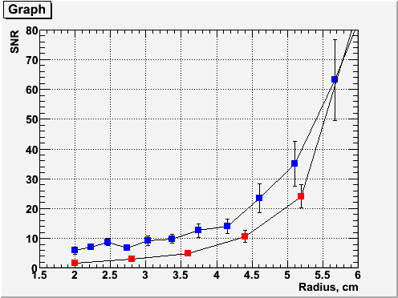
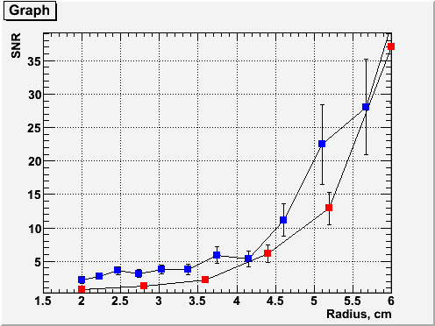
SNR in cell with maximum 𝐄_𝐝𝐞𝐩
PS
US
$E_{e}$ = 100 GeV
SNR = $\frac{\text{signal} \text{from} \text{HE} \text{electron}}{\text{RMS} \text{from} \text{background}}$
PS
US
$E_{e}$ = 50 GeV
Notes:
SDELAT’ v log – shkale!!!!!!

Slide 9
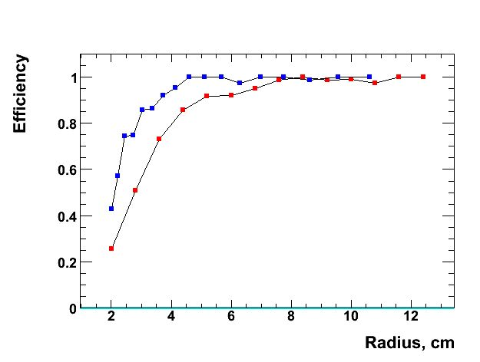
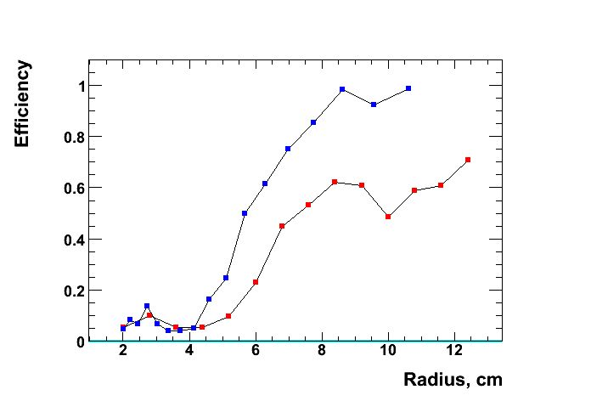
Efficiency of Showers Reconstruction
$E_{e}$ = 200 GeV
$E_{e}$ = 50 GeV
PS
US
PS
US
Radius, cm
Efficiency = $\frac{Reconstructed SH considering BG}{Reconstructed SH without considering BG}$
Notes:
SDELAT’ v log – shkale!!!!!!

Slide 10
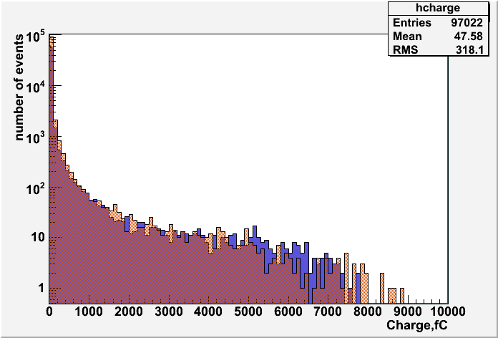
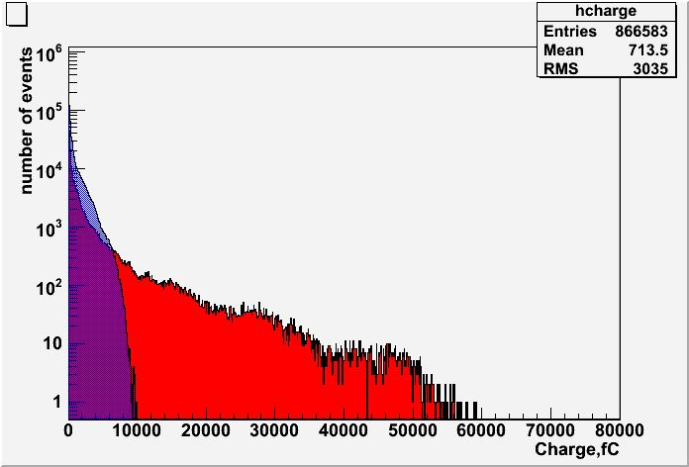
Charge Range Estimate
Distribution of the collected charge per pad from 500Gev electron for Diamond
Distribution of the collected charge per pad from Background for Diamond
Showers
Background
PS
Diamond
US
US
PS
 | Diamond | GaAs
Charge collected from MIP | 2.44 fC | 4.29 fC
Maximum collected charge from 500GeV electron | 12 214 fC | 21 497 fC
 | Correspond to about 5 000 MIPs
For sensor pad thickness 300 µm:
Notes:
Ukazat kak rasschety provedeny? T.k energovydeleniye na yacheyku rastet (grubo) lineyno. I my znaem enorgovydeleniye dlya 100GeV – nogo electrona
Sdelat bolshe statistiki -> dodelat kod s ringo chtoby mozhno bylo mnogo input failov podavat’ v programmu bgaver_for_thisto_charge_collection…bla-bla-bla….

Slide 11
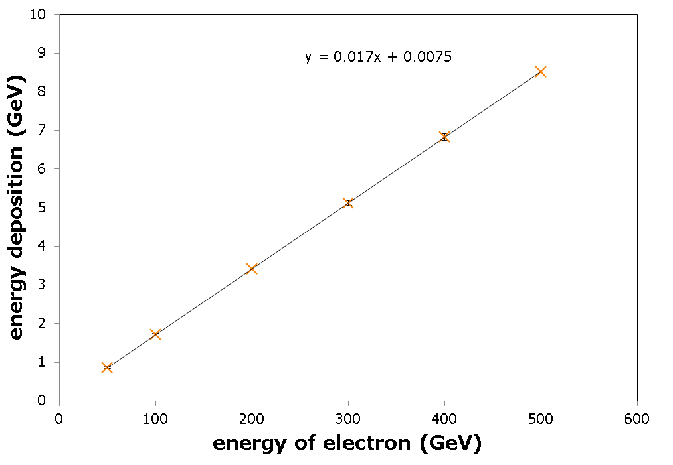
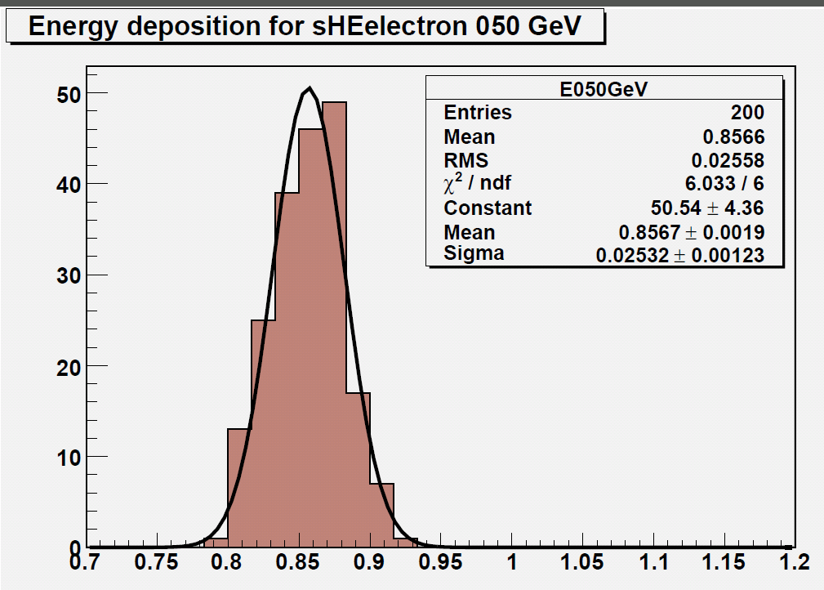
Deposited Energy vs Energy of Electron
y = 0,017x + 0,0051
Number of events
$$E_{e}=A∗E_{dep}−B$$
$$A=58.66±0.03974; B=−0.2972±0.1183$$
Energy deposition (GeV)
Notes:
SDELAT’ v log – shkale!!!!!!

Slide 12
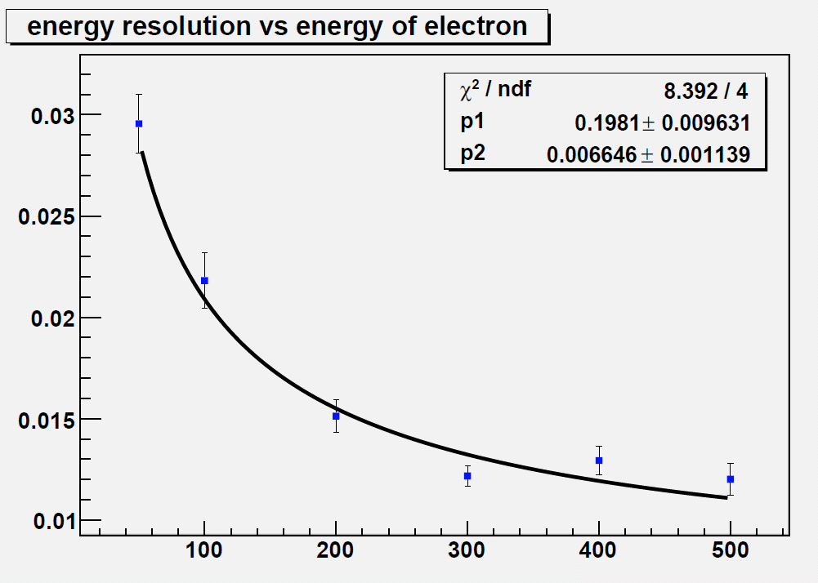
Energy Resolution vs Energy of Electron
Energy Resolution
$$\frac{σE}{E}= \sqrt{\frac{{p_{1}}^{2}}{E}+ {p_{2}}^{2}}$$
$$\frac{σE}{E}= \sqrt{\frac{{0.1981}^{2}}{E}+ {0.006646}^{2}}$$
Energy of Electron (GeV)
Notes:
SDELAT’ v log – shkale!!!!!!

Slide 13
Spatial Resolution ( In Progress)
US
PS
$σd_{R}= \frac{∆d_{R}}{\sqrt{12}}$ = 2.21 mm
$σR_{in}$ = 0.609 mm
$\frac{σR}{R}= \frac{∆R}{R\sqrt{12}}$ = 2.9%
Estimation
$σR_{out}$ = 3.97 mm
$σd_{C}= \frac{∆d_{C }}{\sqrt{12}}$ = 2.16 mm
$σφ_{in}$ = 5.14 deg
$σ_{φ}= \frac{∆φ}{\sqrt{12}}$ = 1.65 deg
$σφ_{out}$ = 0.848 deg
y
1
2
$$R_{3}$$
$$E_{R3}$$
6
0
$$R_{2}$$
$$E_{φ1}$$
$$E_{2}$$
$$E_{φ3}$$
COG
3
5
$$R_{1}$$
$$E_{R1}$$
4
x
$$φ_{1}$$
$$φ_{2}$$
$$φ_{3}$$
$$X_{COG}=\frac{\sum_{i=0}^{6}{X_{i}E_{i}}}{\sum_{i=0}^{6}{E_{i}}}$$
$$R_{COG}=\frac{R_{1}E_{R1}+R_{2}E_{2}+R_{3}E_{R3}}{E_{R1}+E_{2}+E_{R3}}$$

Slide 14
Spatial Resolution ( In Process)
$$σ_{R}$$
$$R_{COG}$$
$$R_{true}$$
Gaussian fit
$σ_{R}= \frac{A}{\sqrt{E}}$
$$σ_{R}$$
0
$R_{COG}$ - $R_{true}$
Energy of Electron
$$R_{true}$$
∆R
Corrected COG
Parameters
∆R
$$R_{COG}$$

Slide 15
Conclusion
Performance of BeamCal for two different sensor segmentations is compared
Number of readout channels is kept similar
Signal from sHEe nearly independent of the segmentation
Energy deposition per pad from Beamstrahlung differs significantly
Proportional segmentation improves the signal-to-noise ratio
Proportional segmentation gives better reconstruction efficiency
The charge range has been estimated
Collected charge per pad from sHEe nearly independent of the segmentation
Collected charge per pad from BS for US in 6 times bigger than for PS
Energy deposition was investigated
Dependence between energy of electron and deposited in calorimeter energy is linear.
Deposited in sensors energy is 1,7% from the original energy of electron.
Dependence energy resolution vs energy of electron is calculated and parameterized.
Calorimeter gives good energy resolution: $\frac{σE}{E} ≈ \frac{0.2}{\sqrt{E_{e}}}$ 2% for 100GeV electron.

Slide 16
Thank you for your attention!

Slide 17
Backup slides

Slide 18
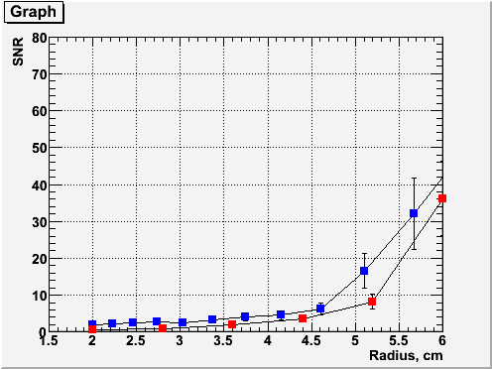
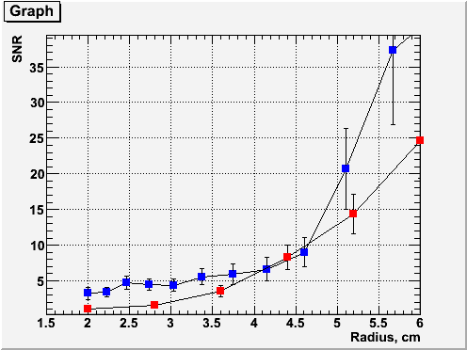
SNR for 50 GeV Electron
SNR in cell with maximum $E_{dep}$
Shower maximum – Layer 9
PS
US
Layer 7
Layer 11
PS
US
PS
US

Slide 19
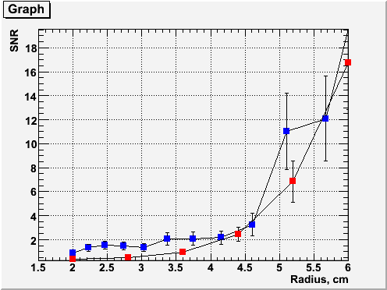
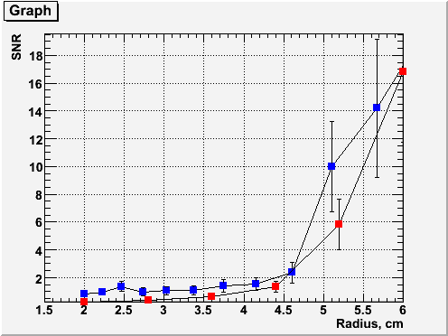
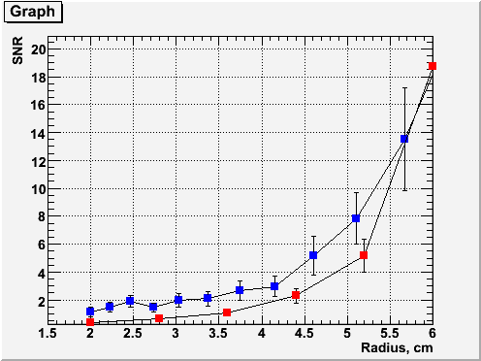
SNR for 20 GeV Electron
Shower maximum – Layer 8
PS
US
Layer 6
Layer 10
PS
US
PS
US

Slide 20
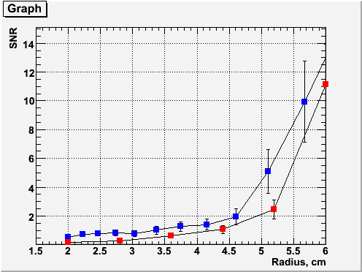
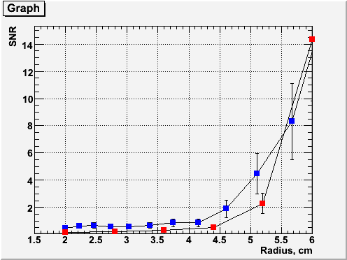
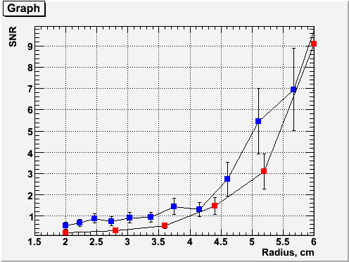
SNR for 10 GeV Electron
Shower maximum – Layer 7
PS
US
Layer 5
Layer 9
PS
US
PS
US
Notes:
+2 -2 layers – it is kind of testing of stability of our result
Dlya nizkih energiy mozhet byt chto snr v 9 sloe luchshe chem v 7 t.k. v 7om sloye bg vnosit bolshiy vklad.
Переделать все графики снр если останется время.

Slide 21
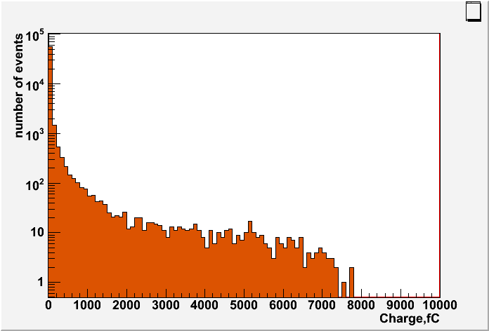
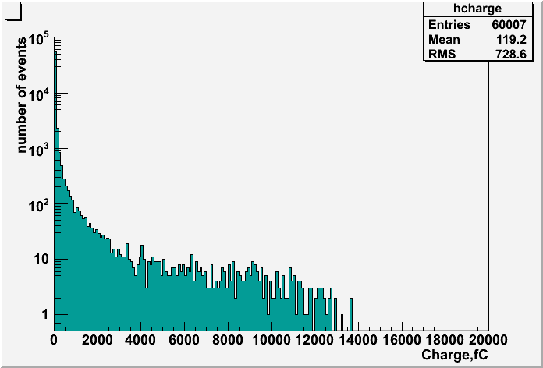
Charge range estimate
Distribution of the collected charge per pad for 500Gev electron showers
Diamond
GaAs
For Diamond sensor pad thickness 300 µm:
- Charge collected from MIP: 2.44 fC
- Maximum charge collected – for shower from 500 GeV electron: 12214 fC
(correspond to about 5000 MIPs)
Notes:
Ukazat kak rasschety provedeny? T.k energovydeleniye na yacheyku rastet (grubo) lineyno. I my znaem enorgovydeleniye dlya 100GeV – nogo electrona
Sdelat bolshe statistiki -> dodelat kod s ringo chtoby mozhno bylo mnogo input failov podavat’ v programmu bgaver_for_thisto_charge_collection…bla-bla-bla….

Slide 22
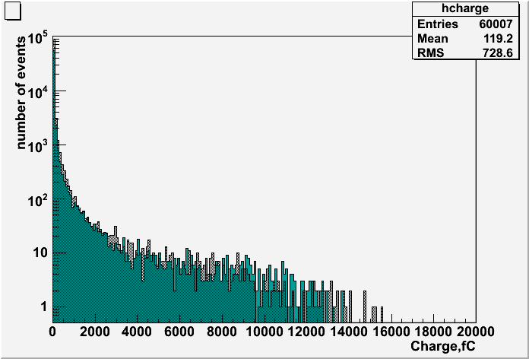
Diamond
Blue – Uniform Segmentation
Orange - Proportional
Distribution of the collected charge per pad for 500Gev electron showers
GaAs
Green – Uniform Segmentation
Blue - Proportional

Slide 23
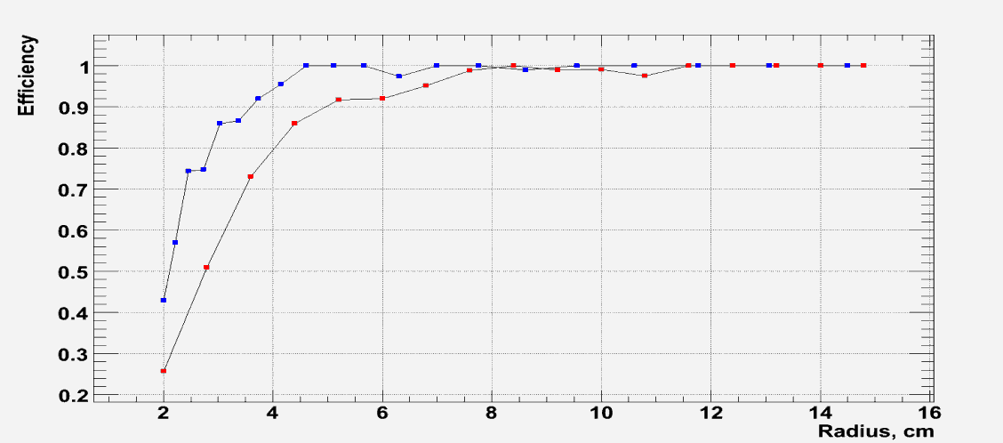
Efficiency of Showers Reconstruction
PS
US
$E_{e}$ = 200 GeV
Efficiency for 50 GeV
Efficiency = $\frac{Reconstructed SH considering BG}{Reconstructed SH without considering BG}$
Notes:
SDELAT’ v log – shkale!!!!!!

Slide 24
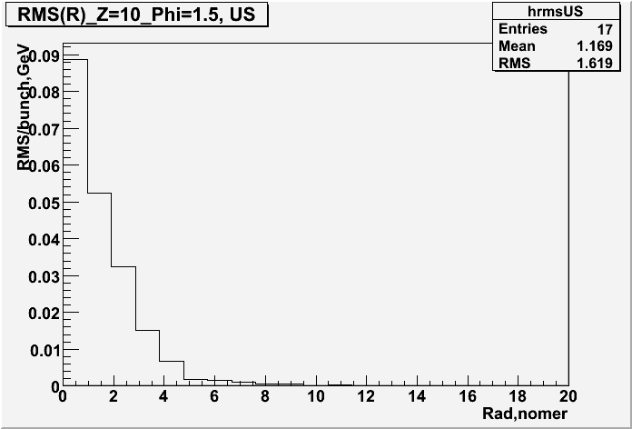
Signal and RMS for both Segmentations
The average energy in the pad of the core of shower
Signal nearly segmentation-independent!
Uniform
Segmentation
Proportional
Segmentation
RMS of the averaged Background
Proportional
Segmentation
Different distributions!
Uniform
Segmentation
20 bunch crossings were given
Notes:
SIGNAL ALMOST INDEPENDET OF SEGMENTATION!!
Peredelat grafik dlya rms chtob y os’ u PS byla takaya zhe kak u US

