Slide 1
Infrastructure for very forward calorimeters TEST BEAM PREPARATION DESY Hamburg 01/2013
7/10/2013
In collaboration with:
François-Xavier Nuiry Szymon Kulis
Andrea Catinaccio Jakub Moron
Konrad Elsener

Slide 2
Overview
Tungsten plates status
Integration tests summary (services, cooling)
Possible configurations
Transport
Summary
Summary (2) Future electronics
Appendix
-Requirements
-AIDA very forward calorimeter design – reminder –
-Tungsten assemblies in permaglass frames
-Metrology with tungsten plates – Design validation –

Slide 3
Tungsten plates status
PLANSEE | PLATES | TOLERANCE ASKED | PLANSEE PLATE 1 | PLANSEE PLATE 2 | PLANSEE PLATE 3 | PLANSEE PLATE 4 | PLANSEE PLATE 5
 | Flatness plan A | 10µm | 90 | 10 | 9 | 3 | 7
 | Position opposite plan | 40µm | 40 | 68 | 48 | 56 | 24
MG SANDERS | PLATES | TOLERANCE ASKED | MG SANDERS PLATE 1 | MG SANDERS PLATE 2 | MG SANDERS PLATE 3 | MG SANDERS PLATE 4 | MG SANDERS PLATE 5 | MG SANDERS PLATE 6
 | Flatness plan A | 10µm | 36 | 70 | 108 | 138 | 137 | 37
 | Position opposite plan | 40µm | 214 | 90 | 132 | 288 | 294 | 88
STEEL PLATES | PLATES | TOLERANCE ASKED | Steel plate 1* | Steel plate 2*
 | Flatness plan A | 10µm | 13 | 14
 | Position opposite plan | 40µm | 48 | 46
*Steel plates machined in Belgium in the Britte Mustad company

Slide 4
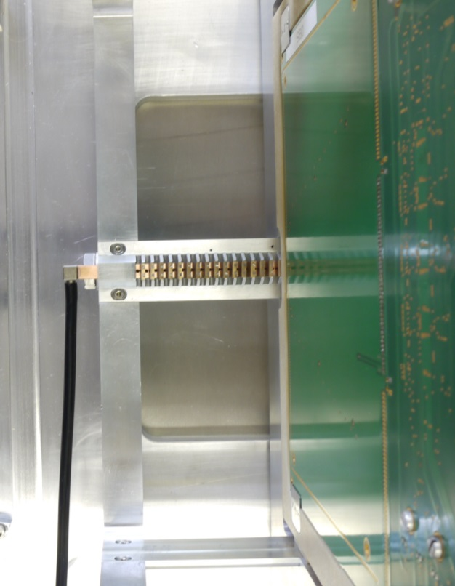
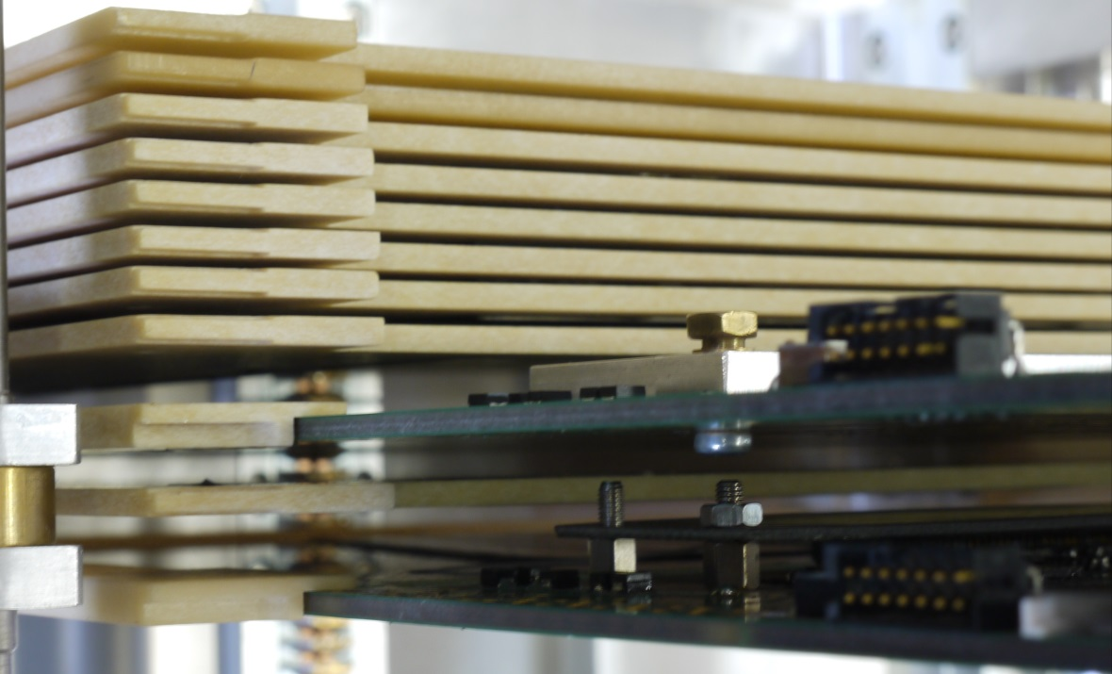
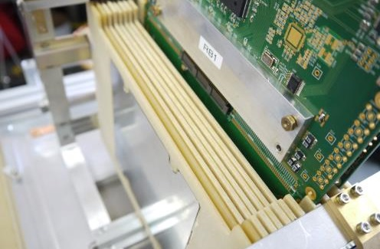
Integration tests
2/10/2013
Implementation of a cooling system Checking of the tungsten sandwich
MG Sanders plates

Slide 5
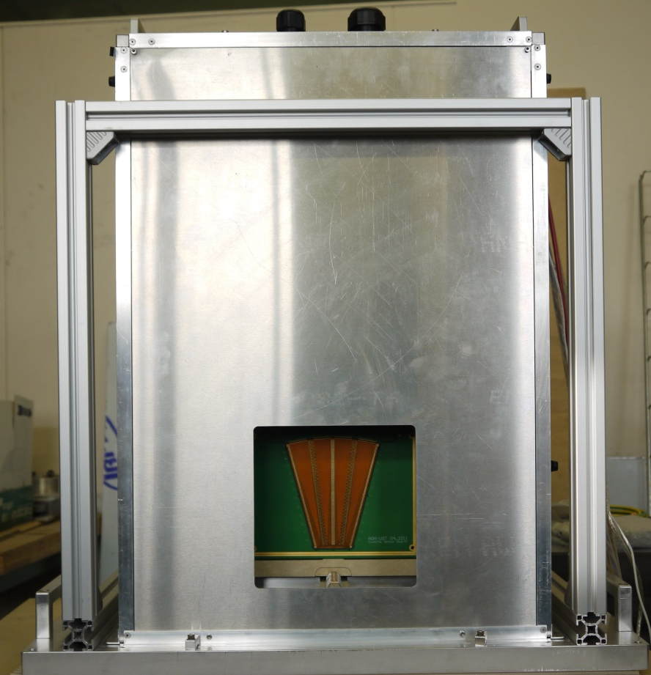
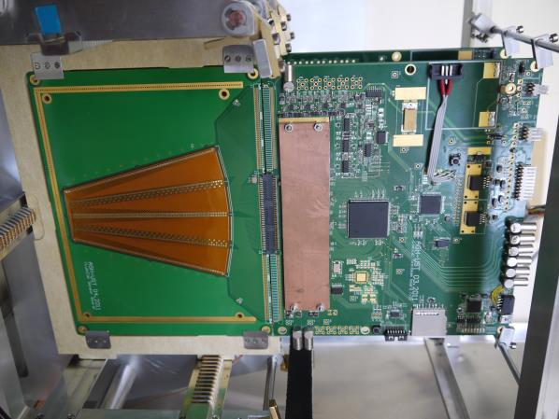
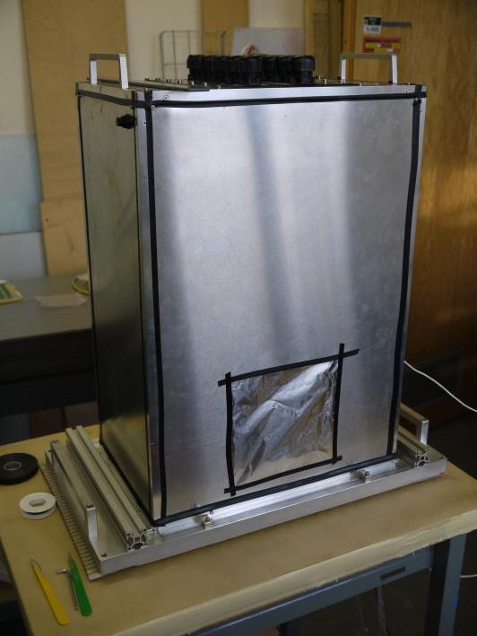
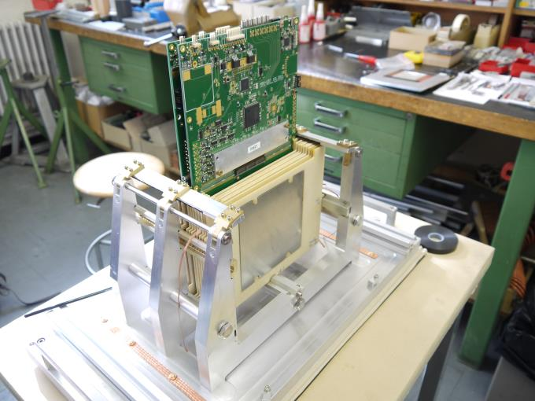
Integration tests
2/10/2013
Mounting of 2 sensors + their electronic cards Light shielding

Slide 6
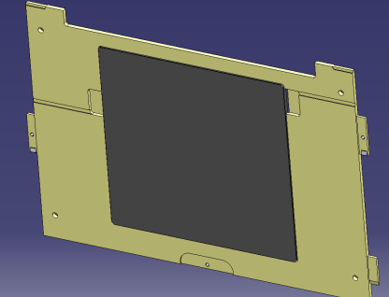
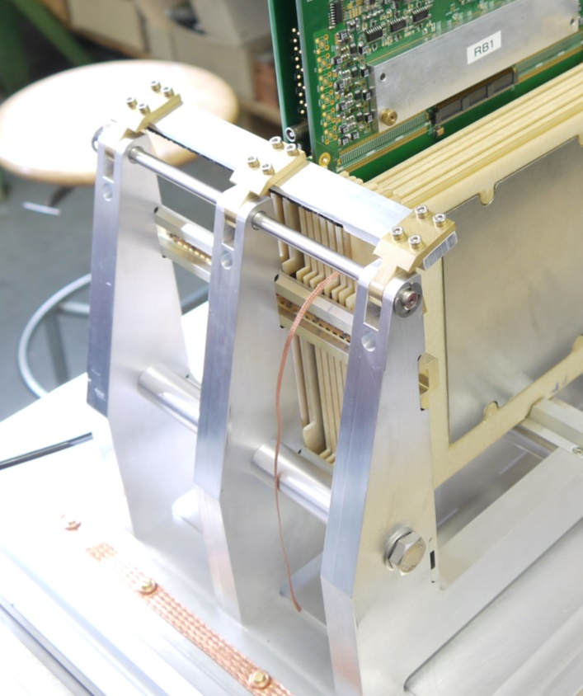
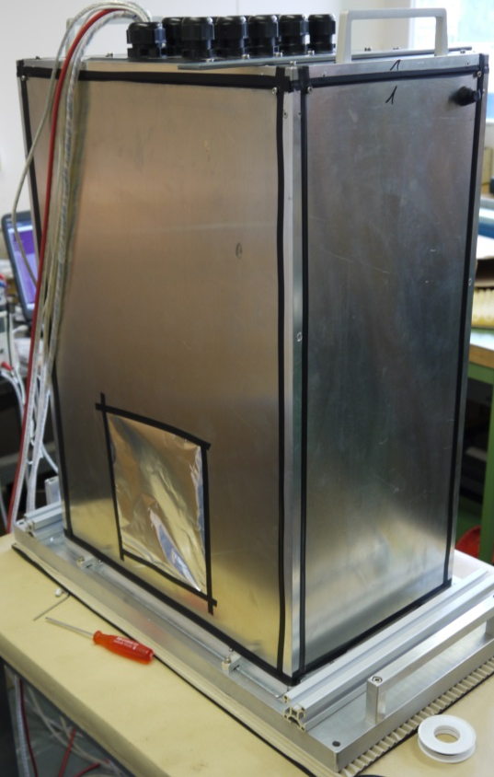
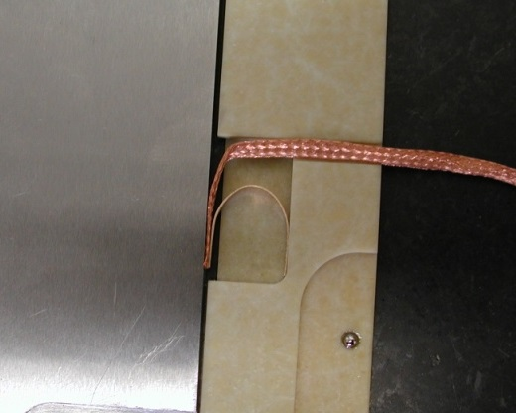
Integration tests
Grounding connections
Cupper cable connected here

Slide 7
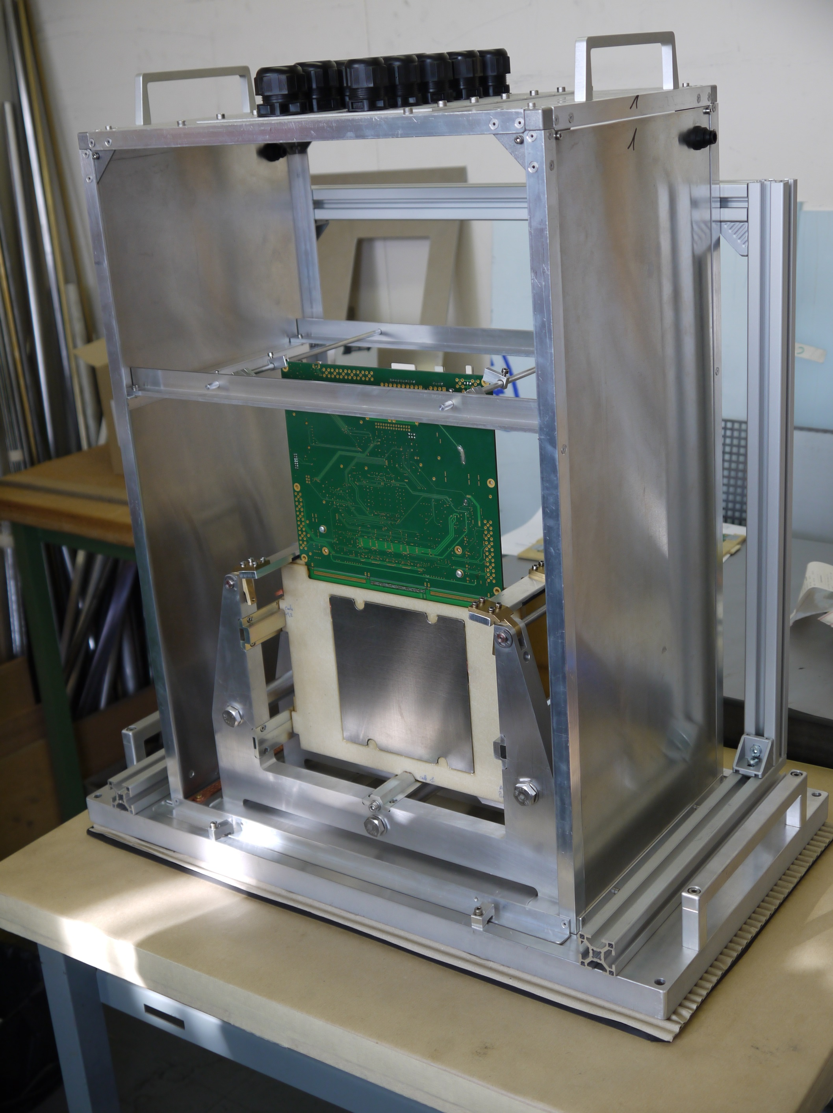
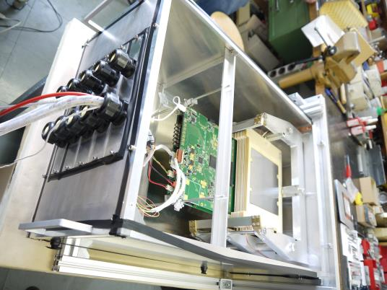
Integration tests
Both orientations tested
-Tungsten plate well supported
-Electronic card well fixed

Slide 8
Integration tests
Small issue with the sensor support: Very small clash with tungsten supports in certain configurations
Electronic board
Electronic board
Electronic board
~10.5
~10.5
~10.5
A=3.5
~2.5
~2.5
~2.5
BEAM
Sensor
Sensor
Sensor
C=1
Gap=4.5
Gap=4.5
Gap=4.5
Gap=4.5
Gap=4.5
Gap=4.5
Gap=4.5
Gap=4.5
Gap=4.5
Clash here
Clash here
Clash here
7/10/2013
AIDA Presentation François-Xavier Nuiry
8

Slide 9
Integration tests
Preliminary solution
Electronic board
Electronic board
Electronic board
~10.5
~10.5
~10.5
A=3.5
~2.5
~2.5
~2.5
BEAM
Sensor
Sensor
Sensor
C=1
Gap=4.5
Gap=4.5
Gap=4.5
Gap=4.5
Gap=4.5
Gap=4.5
Gap=4.5
Gap=4.5
Gap=4.5
Clash here
Clash here
Clash here
7/10/2013
7/10/2013
AIDA Presentation François-Xavier Nuiry
AIDA Presentation François-Xavier Nuiry
9
9

Slide 10
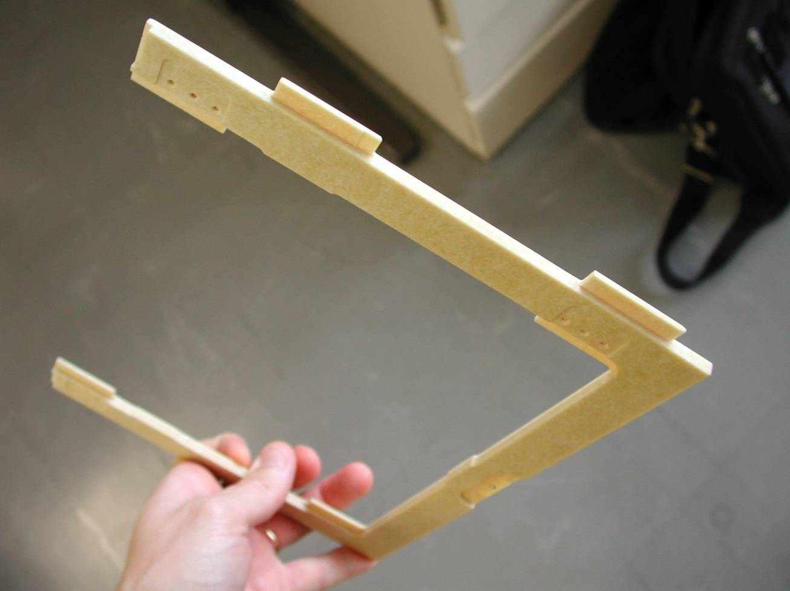
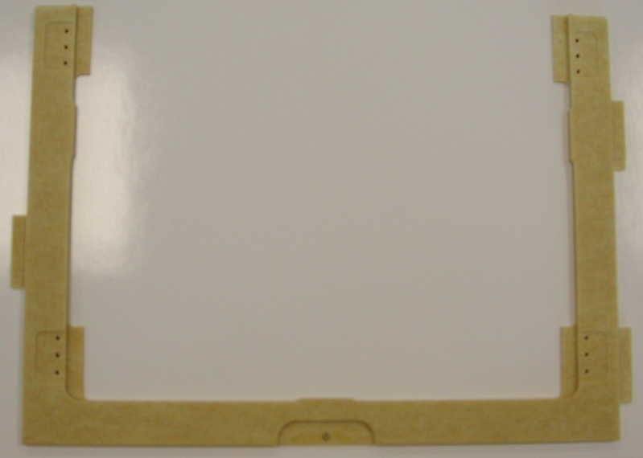
Integration tests
Second solution
→Re-machine sensor permaglass supports
Is it really necessary for the next test beam?
Too thick by ~ 1mm
7/10/2013
7/10/2013
AIDA Presentation François-Xavier Nuiry
AIDA Presentation François-Xavier Nuiry
10
10

Slide 11
Configurations
C=2mm
→ We work with an offset of 5.5mm
C=1mm
→ We work with an offset of 4.5mm
A=3.5
A=3.5
Distance before next
tungsten
Distance before next
tungsten
BEAM
C=2
Tungsten plate 140*140
C=1
Tungsten plate 140*140
Gap=5.5
Gap=4.5

Slide 12
2mm between each tungsten
→ We work with an offset of 5.5mm
Electronic board
Electronic board
Electronic board
~10.5
~10.5
~10.5
A=3.5
~2.5
~2.5
~2.5
BEAM
Sensor
Sensor
Sensor
C=2
C=2
C=2
C=2
Gap=5.5
Gap=5.5
Gap=5.5
Gap=5.5
Gap=5.5
Gap=5.5
Gap=5.5
Gap=5.5
Gap=5.5

Slide 13
2mm between each tungsten
Electronic board
Electronic board
Electronic board
Electronic board
~10.5
~10.5
~10.5
A=3.5
~2.5
~2.5
~2.5
BEAM
Sensor
Sensor
Sensor
Tungsten plate 140*140
C=2
Gap=5.5
Gap=5.5
Gap=5.5
Gap=5.5
Gap=5.5
Gap=5.5
Gap=5.5
Gap=5.5
No sensor In this gap
No sensor In this gap
No sensor In this gap
No sensor In this gap

Slide 14
1mm between each tungsten
→ We work with an offset of 4.5mm
Electronic board
Electronic board
Electronic board
New set of combs!
~10.5
~10.5
~10.5
A=3.5
A=3.5
~2.5
~2.5
~2.5
BEAM
Sensor
Sensor
Sensor
C=1
C=1
C=1
Gap=4.5
Gap=4.5
Gap=4.5
Gap=4.5
Gap=4.5
Gap=4.5
Gap=4.5
Gap=4.5
Gap=4.5
No tungsten
No tungsten
No tungsten

Slide 15
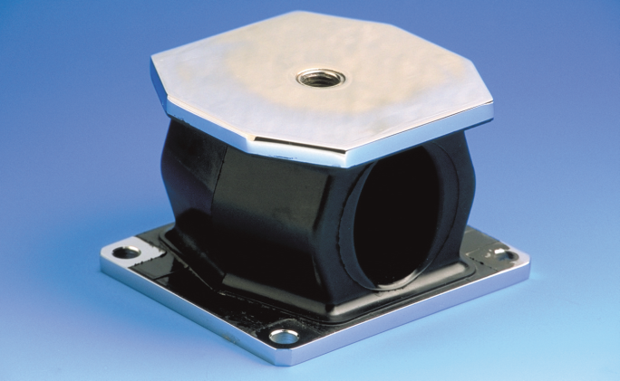
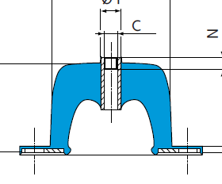
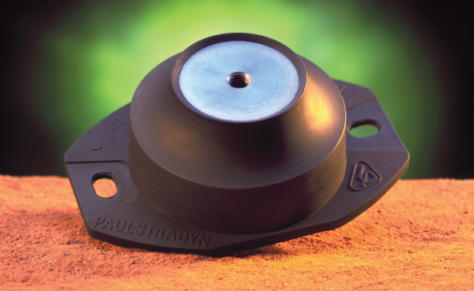
Transport CERN – DESY Packaging
First quote got from ORDEM SA
Rigid wood painted box 85 *70 *40 cm
Rigid wood box for tungsten 30 *20 *25 cm
Soft material supplied
Total: 1160 CHF
We are going to ask for a new quote as we want to add dampers / choc absorbers
Vibrations induced by a truck < 30 Hz

Slide 16
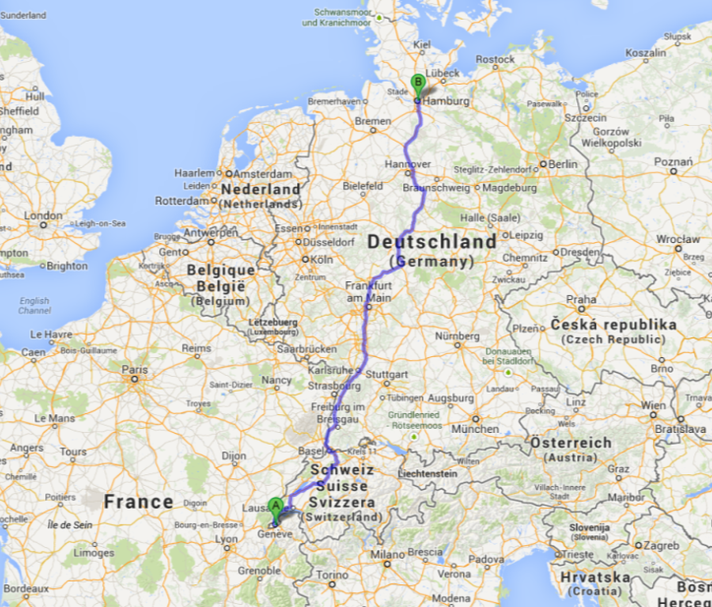
Transport CERN - DESY
Several Possibilities
Standard shipment by truck (Several truck changes)
~ 200 euros Outward + Return
Special shipment by truck (only 1 truck change)
~400 euros Outward + Return
Dedicated transport (fully direct transport)
Outward 580 euros
Return 680 euros
Ourselves (we rent a car)
Expansive
Long travel (1063 km, 10 h)

Slide 17
Summary
11 tungsten plates ready:
→4 with a very good shape
→1 correct
→6 acceptable for a 1 mm gap configuration, with no guarantee concerning the +/-50µm precision
Several integration tests performed with tungsten and electronics
→Mechanical integrity validated in both horizontal and vertical positions
→Services supported by the structure
→Light shielding (excepted the light coming from the electronic card)
→A grounding connection for both tungsten and electronic cards is provided
→A cooling system is implemented
→A small clash between permaglass frames is detected in 1 configuration.
Could be eventually solved, if necessary?
Which configurations would you like to test during the test beam?
→1mm
→2mm
→both of them
Different tungsten / sensor places…?
What about the Z position of the sensor in between each tungsten?
NEXT STEP
Thin electronic to be installed with the current frame

Slide 18
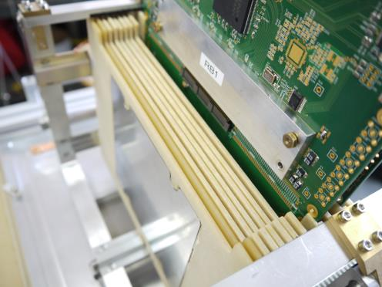
Summary (2)
Next electronic generation
Insert a thinner electronic to be able to have a sensor in a 1mm slit (between 2 tungsten plates).
Y
X
Z
→The mechanical infrastructure could be re-used
→Modification of the permaglas frame should be done
Any other specific requirements?
Concerning the position of the sensor (X, Y)?
Etc…

Slide 19
APPENDIX

Slide 20
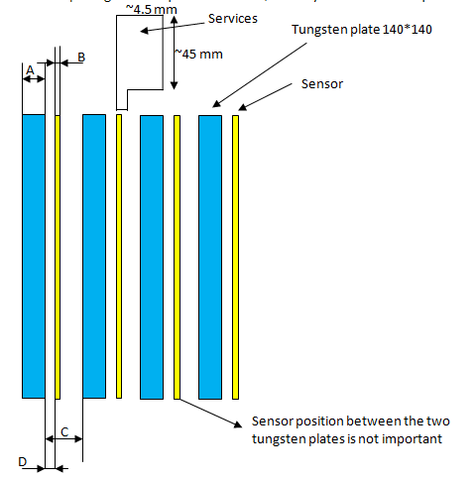
Requirements
Design and manufacturing of a mechanical structure for tungsten plates and silicon sensors.
A=3.5±0.5mm B=0.32±0.015mm C=2, 1, or 0.5 ±0.05mm D=not really important
Other requirements:
-Necessity to remove sensors and tungsten in a safe and easy way.
-Services have to be held.
-W plates are linked to the ground.
-An electromagnetic + light shielding has to be provided.
-horizontal + vertical position for cosmic muons.

Slide 21
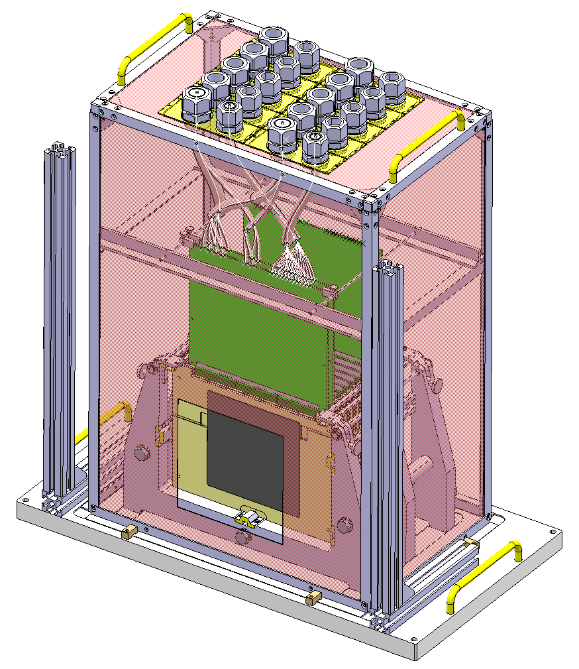
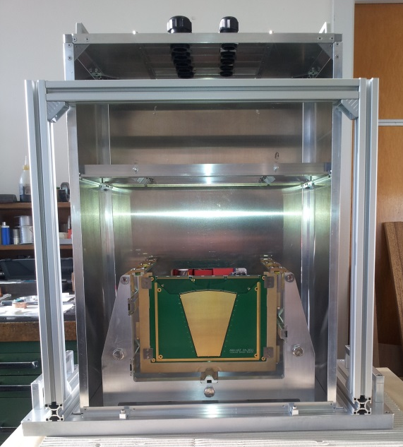
Global design – reminder –
Cradle, combs, permaglass frames + W plates, hood, services supports
Able to work with 2mm and 1mm gap between tungsten plates

Slide 22
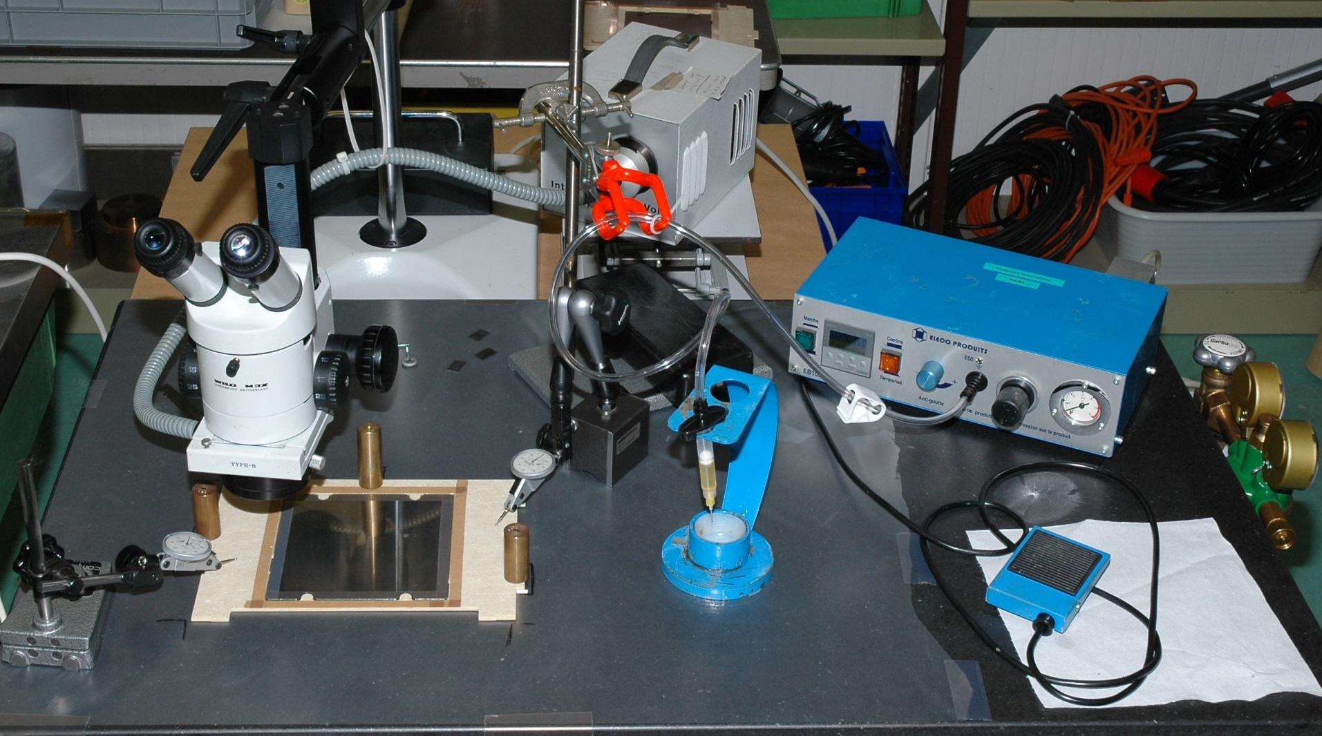
Tungsten assemblies in permaglass frames
Microscope
Pneumatic dispenser
Syringe
Marble

Slide 23
Tungsten assemblies in permaglass frames
On the marble
W
W
J=C+D-(A+B)
A=3.5 +/-25μm
B=2 +/-2μm
C=5.5 +/-20μm
D=2 +/-2μm
Jmax = 5.520+2.002-3.475-1.998=2.049mm
1. W plate put on the marble
2. Three red spacer are installed on top of bearings
3. Perm. frame installed around the W plate, supported only on 3 red spacers
4. Glue (Araldite 2011) between W and Permaglass
J
A
3.5
B
D
C
J=B-A
A min=3.475mm
A max=3.525mm
B min=5.480mm
B max= 5.520mm
J max= 5.520-3.470= 2.05mm
J min= 5.480-3.530= 1.95mm
In the calorimeter
W
W
1. W + Permaglass insertion in combs
2. Accuracy given only by the W machining and the comb machining.
J
A
3.5
B

Slide 24
Metrology with tungsten plates Design validation
9 points are probed on each plate, with the MMT machine.
The distance point-point is measured by the machine.
Only the 1mm gap configuration (1mm gap combs) has been measured.
9 configurations have been tested with 2 plates (each time with 3 different positions)
4 configurations have been tested with 5 plates (each time with 2*2 different positions)
Both orientations were tested (horizontal and vertical beam)
More than 50 measures where done which corresponds to a bit more than 900 probes!
All results are available in the following EDMS document: 1276587

Slide 25
Metrology with tungsten plates
First example: Measure of the distance between PLANSEE plates 3 and 4
1mm
3
4
64mm
4
4
127mm
Position
Slot 1
Slot 2
Slot 16
Slot 30
Slot | Plate number | Plate average thickness | Theoretical distance – Distance measured
1 | 3 | 3.520
 |  |  | 1.000 – 0.988
2 | 4 | 3.475 | 1.000 – 0.994
 |  |  | 64.000 – 63.981
16 |  |  | 64.000 – 63.993
 |  |  | 127.000 – 126.973
30 |  |  | 127.000 – 126.983

Slide 26
Metrology with tungsten plates
Second example: Measure of the distance between 5 PLANSEE plates
5
4
3
2
1
23.5mm
50.5mm
77.5mm
109mm
Position
Slot 3
Slot 9
Slot 15
Slot 21
Slot 28
Slot | Plate number | Plate average thickness | Theoretical distance – Distance measured | Distance N / N+1
3 | 5 | 3.490
 |  |  |  | 23.526
9 | 4 | 3.475 | 23.500 - 23.526 | 23.508
 |  |  | 23.500 - 23.508 | 23.523
15 | 3 | 3.520 | 50.500 - 50.519 | 23.53
 |  |  | 50.500 - 50.508 | 23.494
21 | 2 | 3.470 | 77.500 - 77.533 | 23.477
 |  |  | 77.500 - 77.505 | 28.049
28 | 1 | 3.505 | 109.000 - 109.052 | 28.023
 |  |  | 109.000 - 108.999

Slide 27
Metrology with tungsten plates
Third example: Vertical measure of the distance between 5 PLANSEE plates
Slot | Plate number | Plate average thickness | Theoretical distance – Distance measured | Distance N / N+1
3 | 5 | 3.490
 |  |  |  | 23.522
9 | 4 | 3.475 | 23.500 – 23.522 | 23.514
 |  |  | 23.500 – 23.514 | 23.507
15 | 3 | 3.520 | 50.500 – 50.507 | 23.499
 |  |  | 50.500 – 50.499 | 23.515
21 | 2 | 3.470 | 77.500 – 77.515 | 23.495
 |  |  | 77.500 – 77.495 | 28.043
28 | 1 | 3.505 | 109.000 – 109.043 | 27.991
 |  |  | 109.000 – 108.991

Slide 28
Metrology with tungsten plates Conclusions
In most of the configurations the +/-50 microns precision has been respected.
The global shape of each plate is cross check with this 3D measurement
→A thin plate will give distances higher than a large plate.
→the flatness default can be cross-checked.
Selecting Plansee plates 5, 4, 3, 2, (and 1), in this order, should always give good precision.
An short training of the way to use the calorimeter is necessary.
No measurements were done with MG sanders plates but we should be in nearly all cases out of the +/-50microns asked.

Slide 29
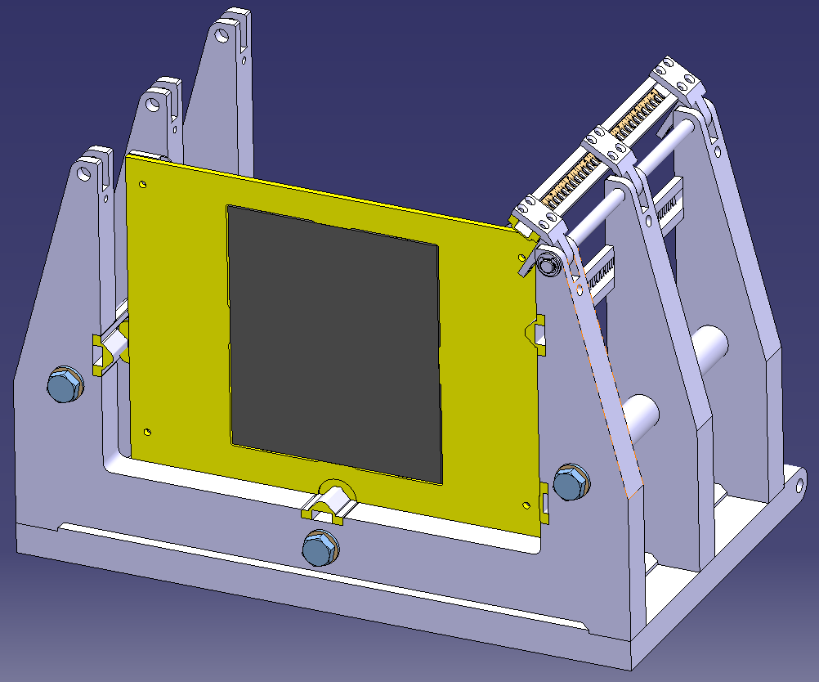
AIDA very forward calorimeter design Tungsten support
3 bearings
Front view
Back view
Spring
Ground
Material: Epoxy + glass fibres = PERMAGLAS
Tungsten plate is glued inside this frame

Slide 30
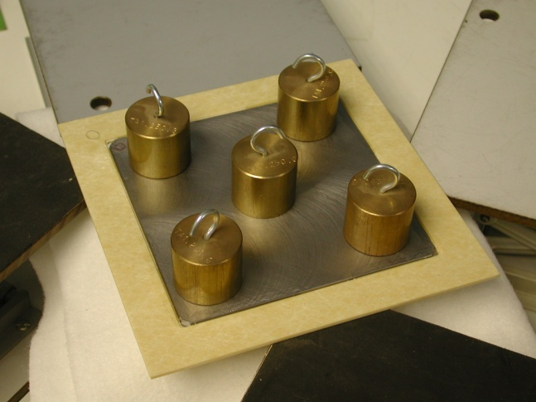
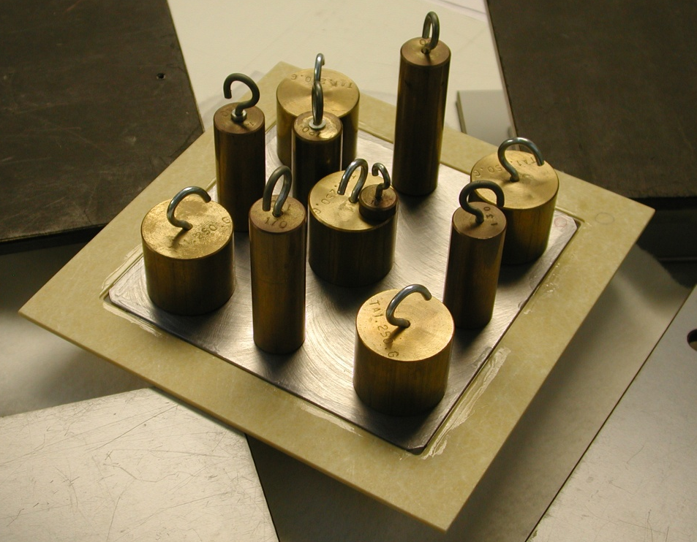
Calorimeter design validation Tests on glued joints
Glued joint
1Kg
W plate + Permaglas assembly held on 3 points
2Kg
During 24 hours
The tungsten plate can be easely removed from the frame while putting it in a methyl chloride bath (the test has been done).

Slide 31
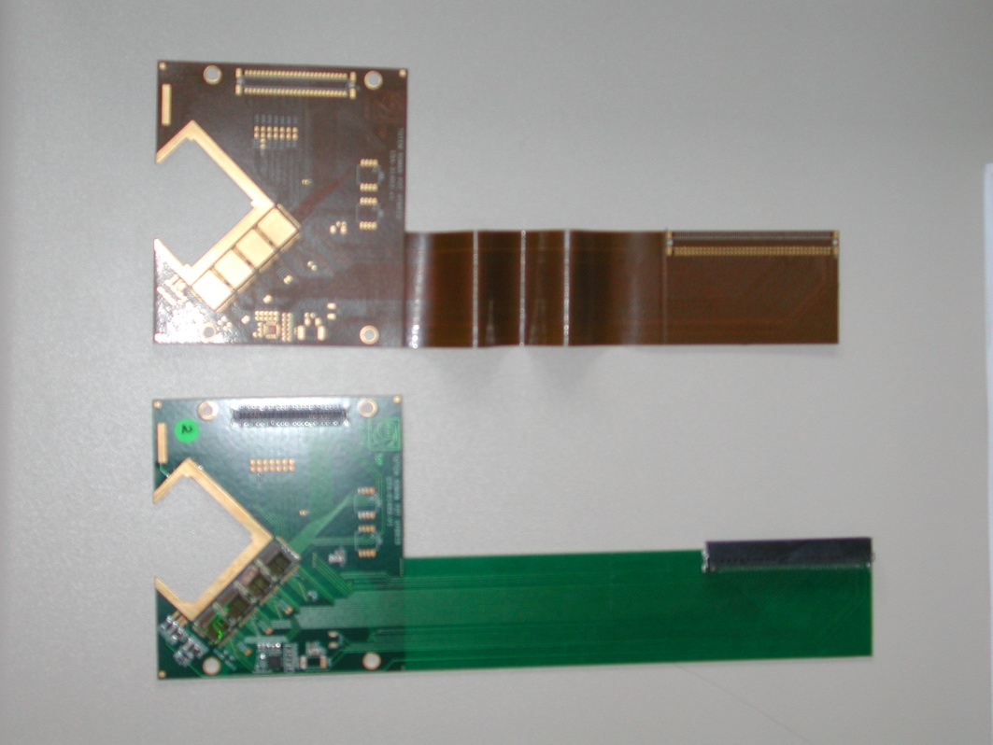
Next Step...C=0.5 mm
The most important for us:
Realising a flexible link between the sensor and the read out.
Something similar to this example:
Silicon sensor
Connector for the read out
Flexible part
Rigid part (PCB)

