Slide 1
New Observable for the TTbar Asymmetry Measurement in ATLAS
General Overview
Asymmetry at Tevatron
Asymmetry at LHC
New Observable FBrap
Asymmetry for MC truth
Asymmetry for MC reconstructed
Summary and Outlook
Natascha Rupp
5. September 2013

Slide 2
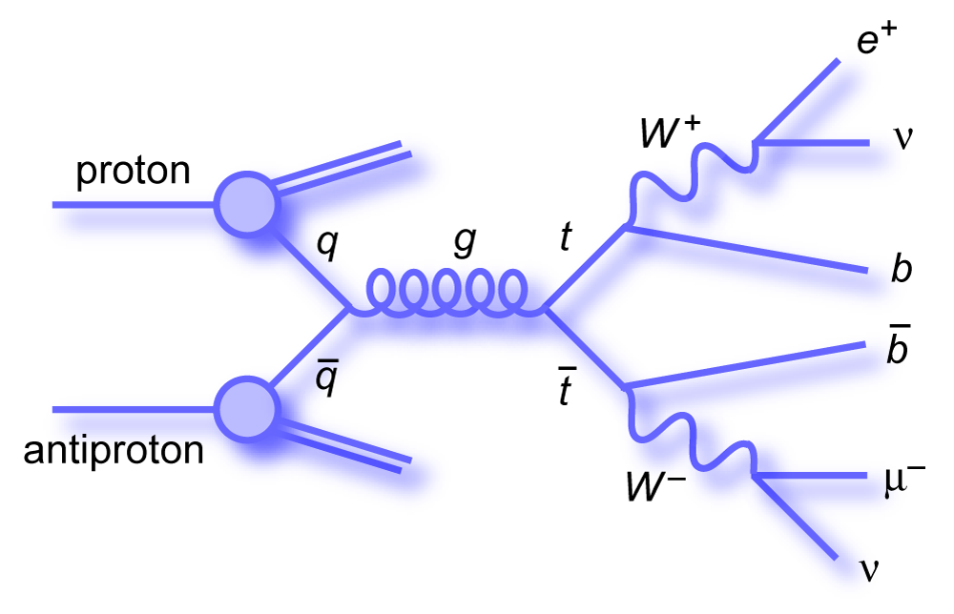
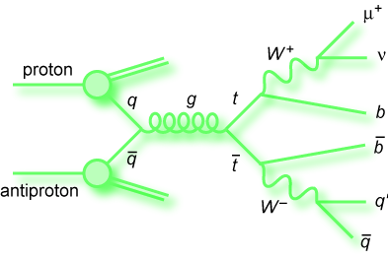
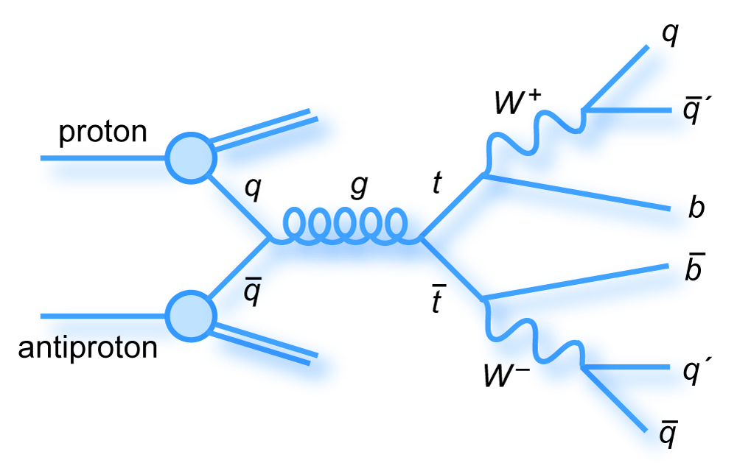
General Overview
top is heaviest elementary particle: m = 172.9 ±0.6(stat)±0.9(sys) GeV
extremely short lifetime: t = 5 x 10 s
only “bare” observed quark
-25
dilepton
lepton + jet
hadronic
top and antitop events reconstructed from decay products of dileptonical decay in this analysis
Requirement: two jets, two charged leptons and a high missing transverse energy of the non detected neutrinos

Slide 3

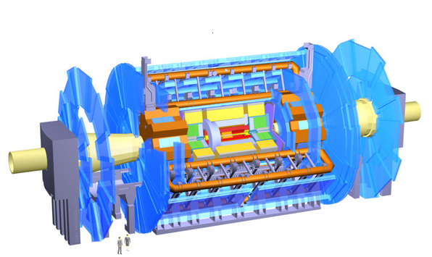
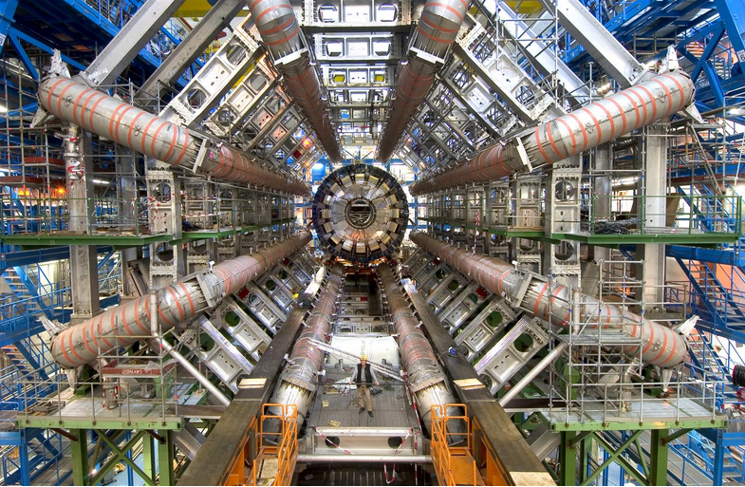
General Overview of Analysis Method
theory make predictions value we want to measure and the properties of the measured events
also about event characteristics that cannot be measured later on
MC truth
unfolded data
unfolding
MC reconstructed
measured data
simulation of events after measuring process
takes detector influences (e.g. limited resolution or undetected neutrinos) into account

Slide 4
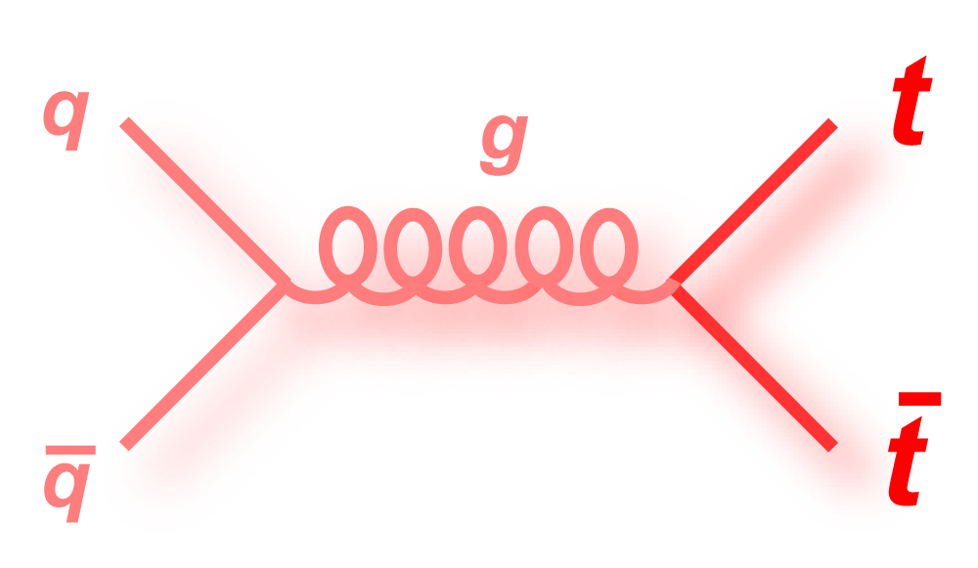
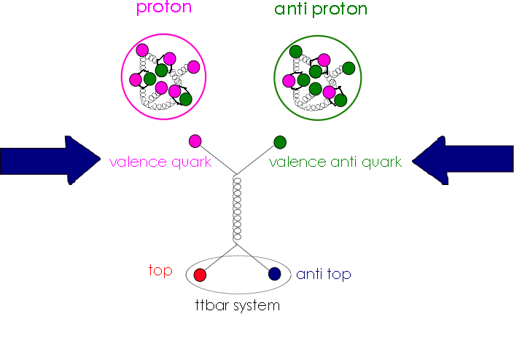
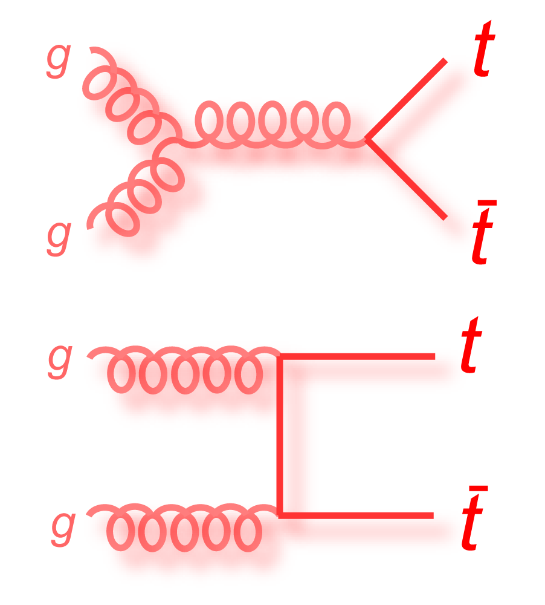
Asymmetry at the Tevatron
collision of proton and antiproton @ √s = 1.96 TeV
gluon-gluon fusion doesn't contribute to Asymmetry (AS)
higher probability for valence quarks to create ttbar system
ttbar system = t and tbar at very initial state
both valence quarks are carrying (almost) same momentum fraction
85%
15%
Notes:
Gg doesn't contribute to AS. Amount of ttbat systems from qqbar annihilation is very big in comarison witch is very good and practiaval for the analysis
The p and the pbar collide, to form a t and a tbar one needs a quark and an anti quark of the tw protons. In the proton are the three valence quarks and sea quarks. In the pbar are the corresponding anti valence quarks. The valencequarks carry a much higher fraction if the momentum of the proton and antiproton and their probability to annihilate and thus forming a t and tbar is greater than the annihilation of tow sea quarks or an valence and sea quarks. Becauese the valence quark and the valence anti quark have almost the same momentum, ttbat system is basicaly at rest witch is a nice feature for the analysis of the asymmetry.

Slide 5
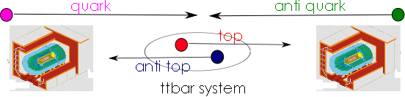

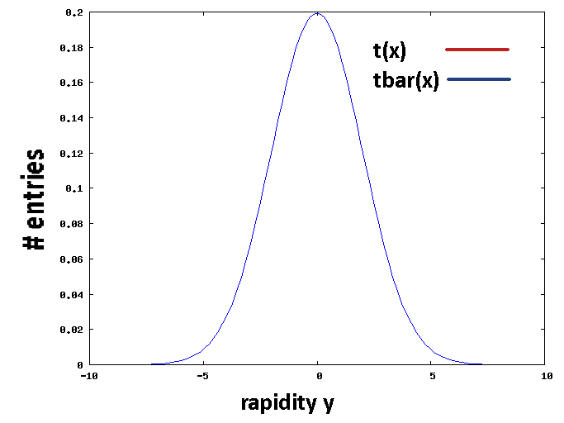
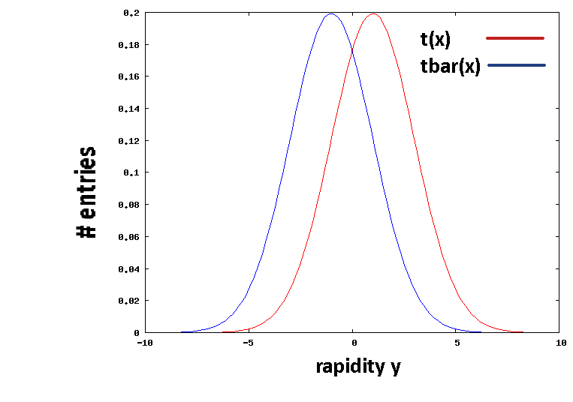
Asymmetry at the Tevatron
no preferred direction of ttbar system
Asymmetry: top more likely emitted into direction of incoming quark
measurement of spatial distribution of t and tbar → FB-Asymmetry
NLO effect
SM prediction: (8.8 ± 0.6)%
measurement Tevatron: CDF:16.4±3.9(stat)±2.6(sys)% (9,4 1/fb)
rapidity:
[W. Bernreuther, Universität Aachen]
[R. Demina, University of Rochester]
Without AS
With AS

Slide 6
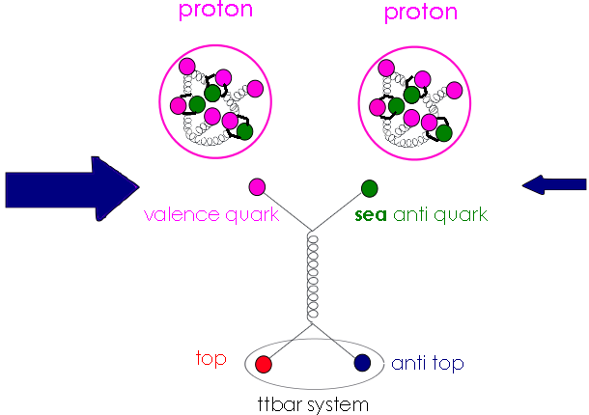
Asymmetry at the LHC
symmetric initial state: collision of p and p
much smaller contribution of quark-antiquark annihilation
cross section 20 times bigger than at Tevatron
valence quark is carrying higher momentum fraction than sea quark
15%
85%

Slide 7
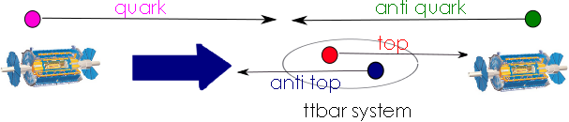
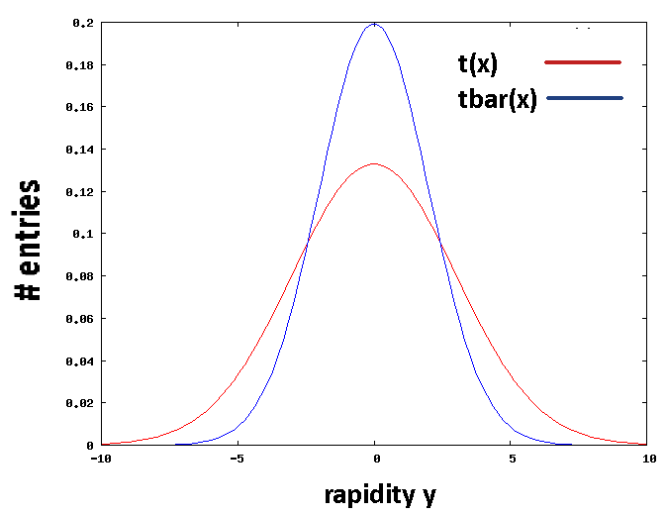
Asymmetry at the LHC
ttbar system boosted into direction of incoming quark
boosted to higher rapidities y
Asymmetry measurement has to be done differently at LHC
Without AS
With AS

Slide 8
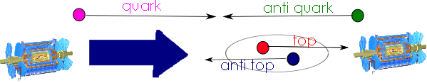
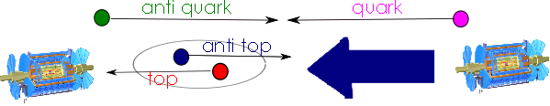

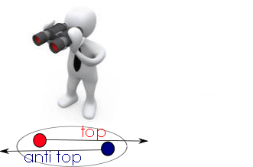

Introduction of new variable FBrap
+1
-1
need to have access to initial quark direction to measure FB Asymmetry
problem: in measured data we don't know the direction of incoming quark
only have access to direction of ttbar system
assume that ttbar system has same direction as incoming quark
rapidity:
TTbar Rest Frame
Value of y

Slide 9
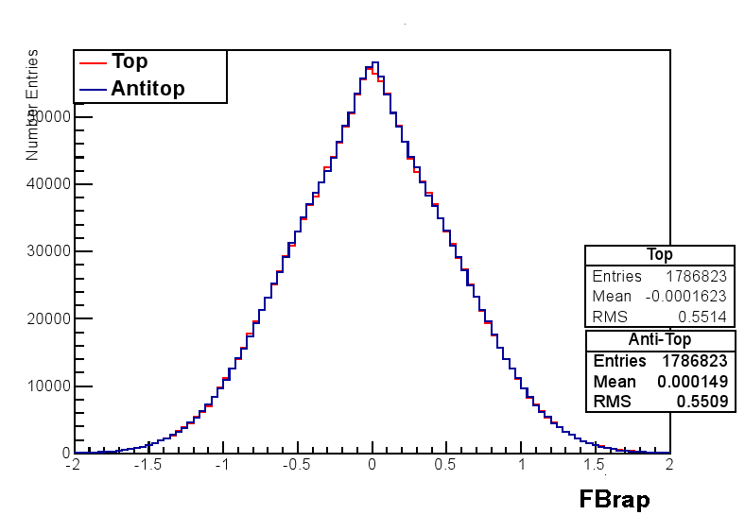

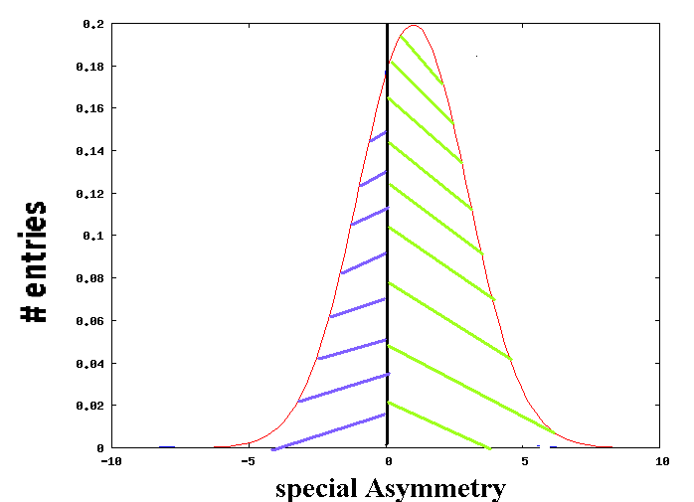
Special Forward-Backward Asymmetry (MC truth)
MC generator: MC@NLO
four event categories:
all events
events from gluon-gluon fusion (gg)
events from qqbar annihilation (qqbar)
ttbar system and initial quark have same direction (correct sign)
All events
Atlas work in process
Correct sign
Atlas work in process

Slide 10
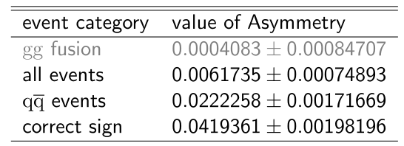
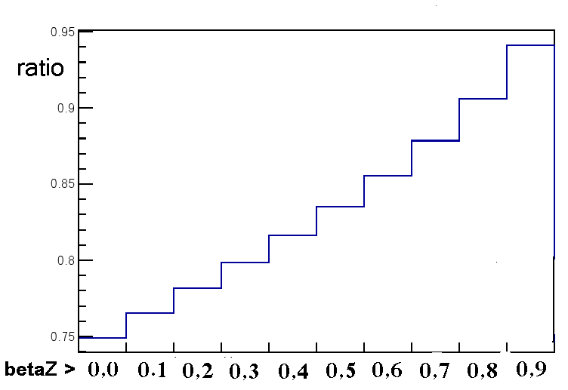

Special Forward-Backward Asymmetry (MC truth)
MC truth in good agreement with expectation
can we make the assumption that the ttbar system has the same direction as the initial quark?
Ratio for different boost levels
Special Asymmetry for different boost levels
Atlas work in process
Atlas work in process
Beta z of ttbar systems greater than

Slide 11
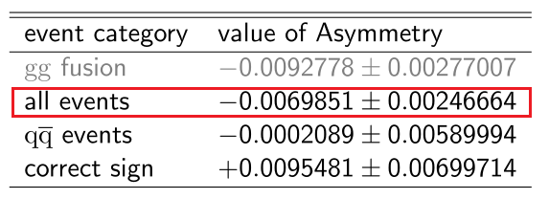
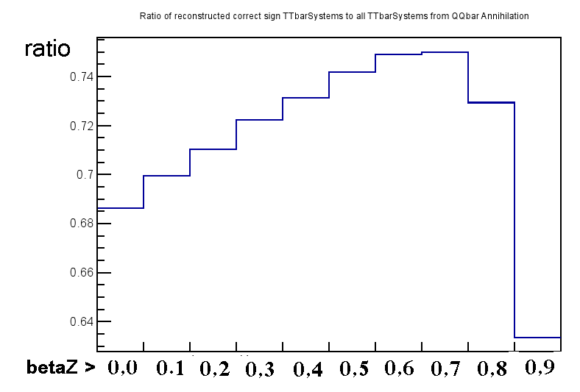
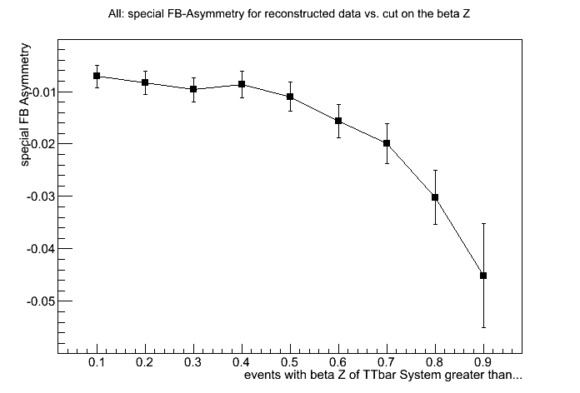
Special Forward-Backward Asymmetry (MC reconstructed)
still using information from MC truth to have access to all categories
Asymmetry is negative!!!
relative fraction of correct sign events is smaller for higher boost
Asymmetry decreasing with higher boost values (for all categories)
Ratio for different boost levels
Special Asymmetry for different boost levels
Atlas work in process
Atlas work in process
Beta z of ttbar systems greater than

Slide 12
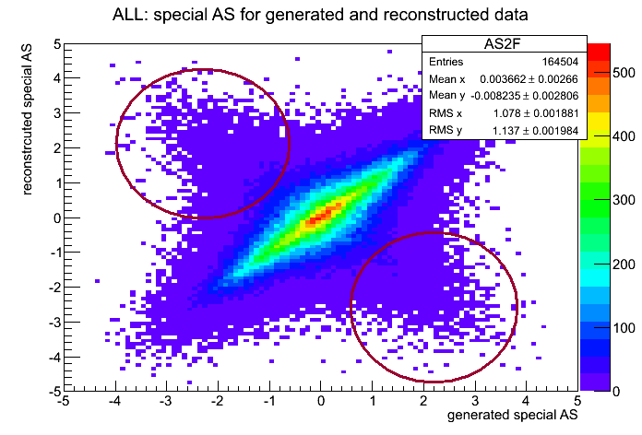
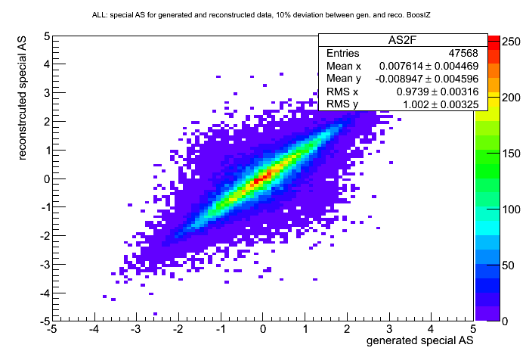
Special Forward-Backward Asymmetry (MC reconstructed)
comparison of reconstructed and truth Asymmetry
many events with opposite sign
Cut on Boost: allow only 10% deviation between reconstructed and truth boost of ttbar system
wrong sign events reduced
Asymmetry still negative
Atlas work in process
Atlas work in process

Slide 13
Summary and Outlook
introduction of new variable FBrap
MC truth agrees well with expectation
negative Asymmetry for MC reconstructed
Further Analysis:
check on reconstruction of t and tbar
cut on two jets
Special Asymmetry for different boost levels
Atlas work in process
Beta z of ttbar systems greater than

Slide 14
Back Up

Slide 15
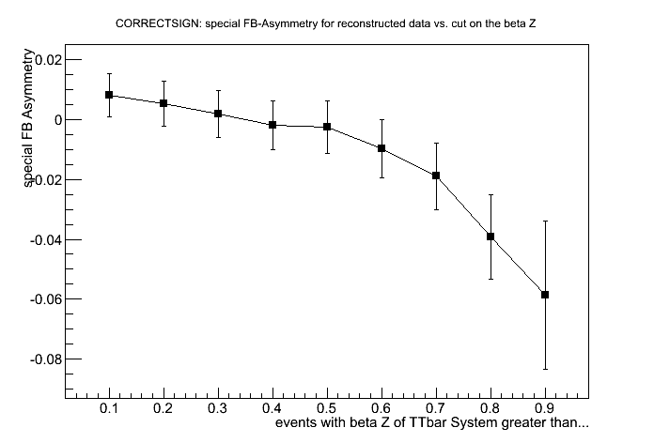
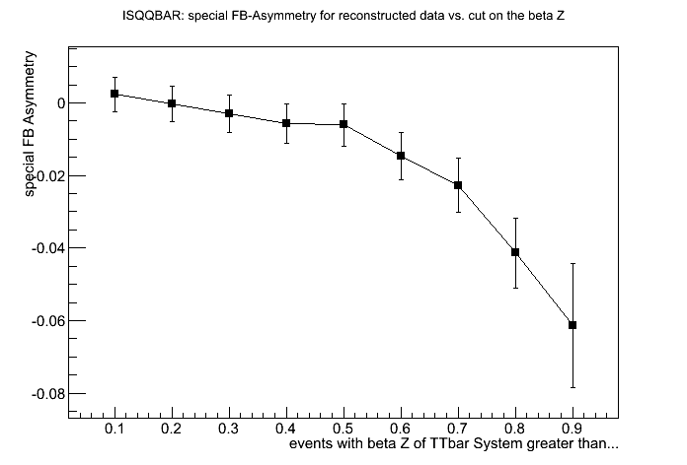
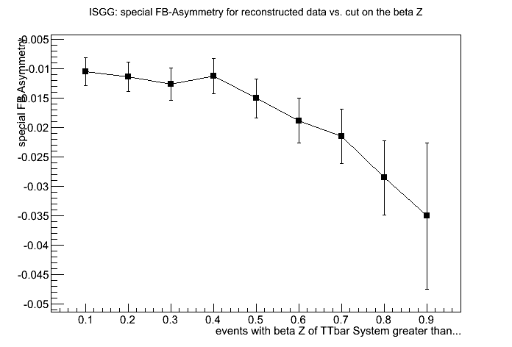
Special Forward-Backward Asymmetry (MC reconstructed)
Special Asymmetry values with cut on the Z Component of the ttbar system boost: correct sign events
Tried to find out which production mechanism is responsible for negative Asymmetry
In all of them the Asymmetry is decreasing with higher boost of ttbar system
Atlas work in process
Special Asymmetry values with cut on the Z Component of the ttbar system boost: events from qqbar
Special Asymmetry values with cut on the Z Component of the ttbar system boost: events from gg
Atlas work in process
Atlas work in process

Slide 16
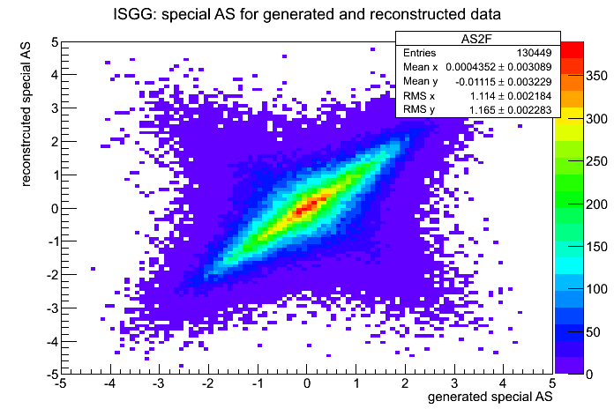
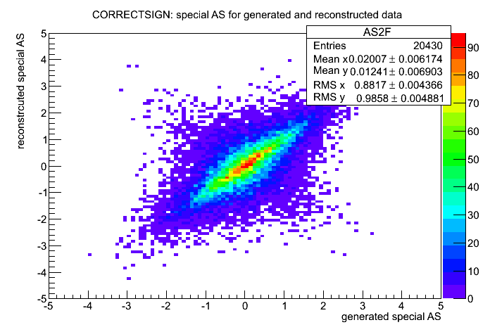
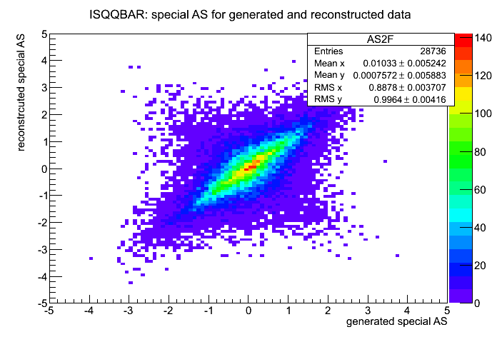
Comparison of special AS between MC truth and MC reco
Atlas work in process
Atlas work in process
Atlas work in process

