Slide 1
Simulations for the
recalibration of the sFLASH FEL energy monitor
Summer Student: Elizabeth Mondragón
elizabeth.mondragon@desy.de
Supervisor: Jörn Bödewadt joern.boedewadt@desy.de
Summer 2013

Slide 2
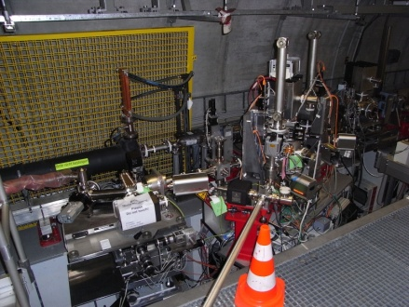
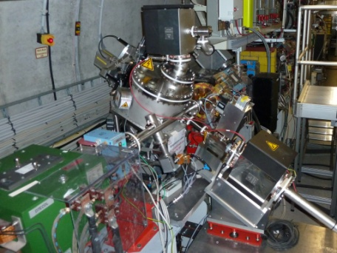
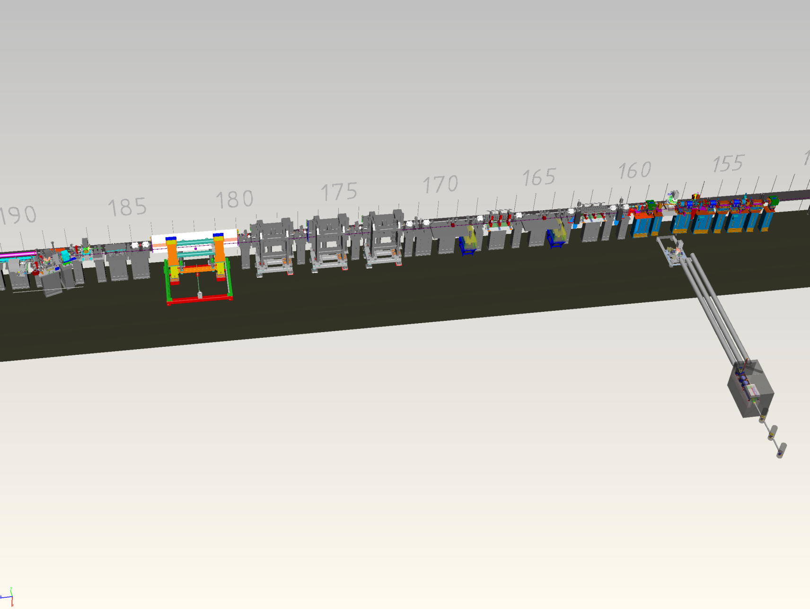
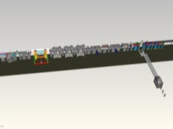
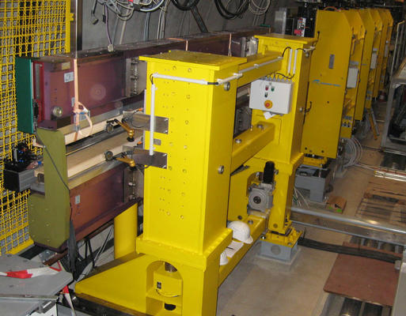
sFLASH experiment
ORS* section
FEL extraction
Undulator section
Seed injection
hutch for first experiments with sFLASH pulses
Ti:sapphire laser system and HHG source
HHG source
* Optical Replica Synthesizer
Elizabeth Mondragón
Summer 2013

Slide 3
Motivation
Predicta-bility
Why Undulator Radiation?
Elizabeth Mondragón
Summer 2013

Slide 4
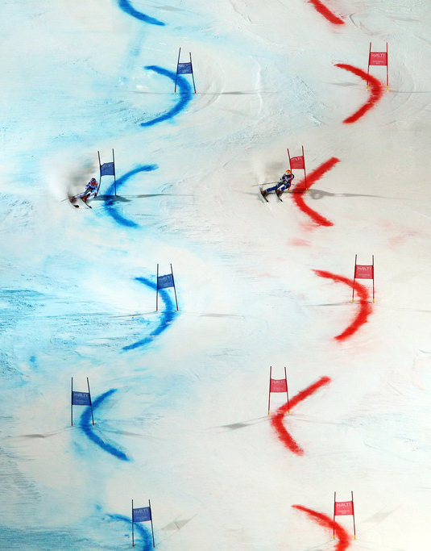
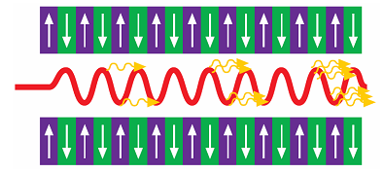
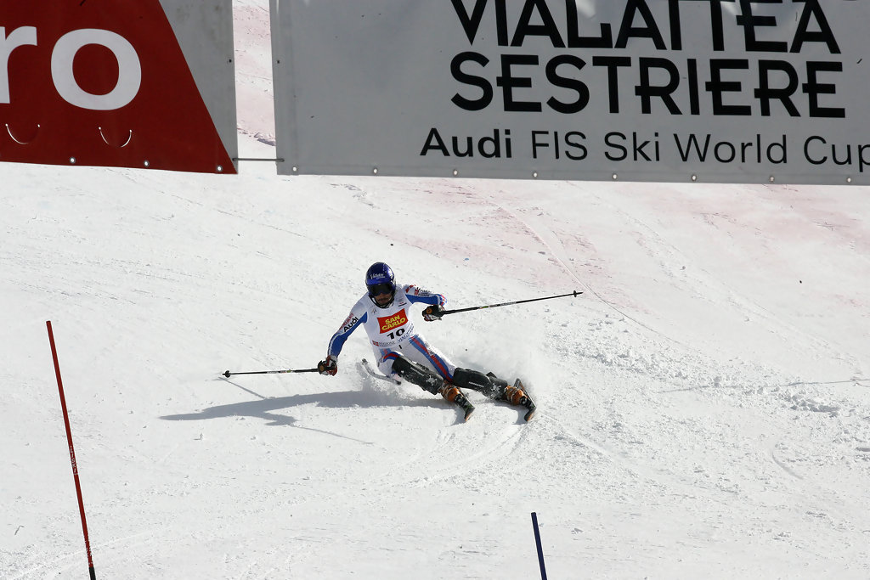
Motivation
Elizabeth Mondragón
Summer 2013

Slide 5
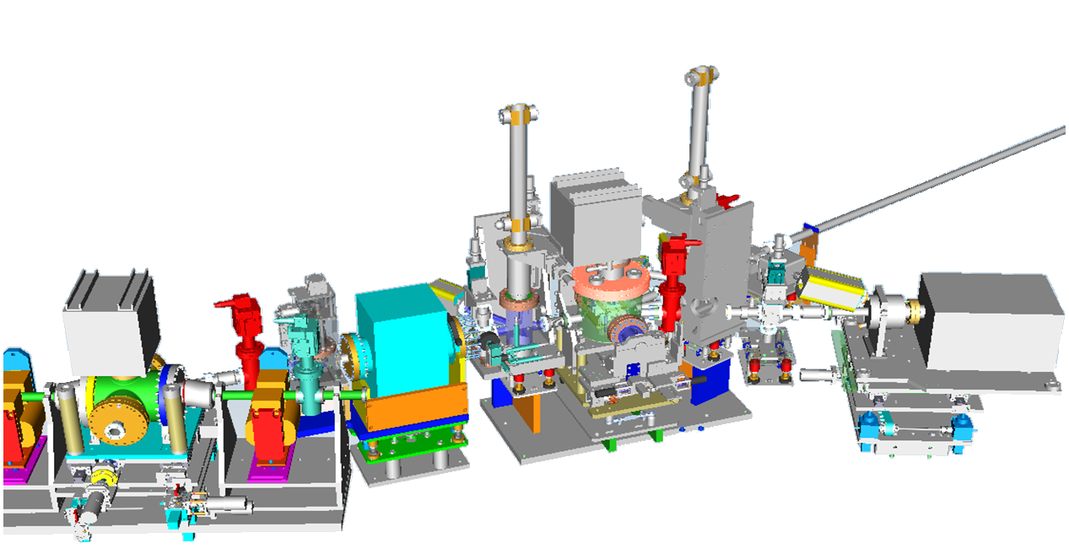
Setting up…
Energy monitor
Second mirror chamber
Pinholes
First mirror chamber
Elizabeth Mondragón
Summer 2013

Slide 6
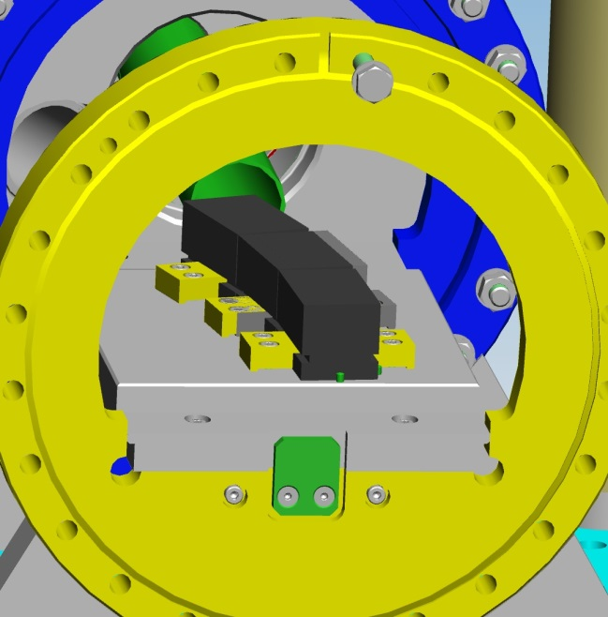
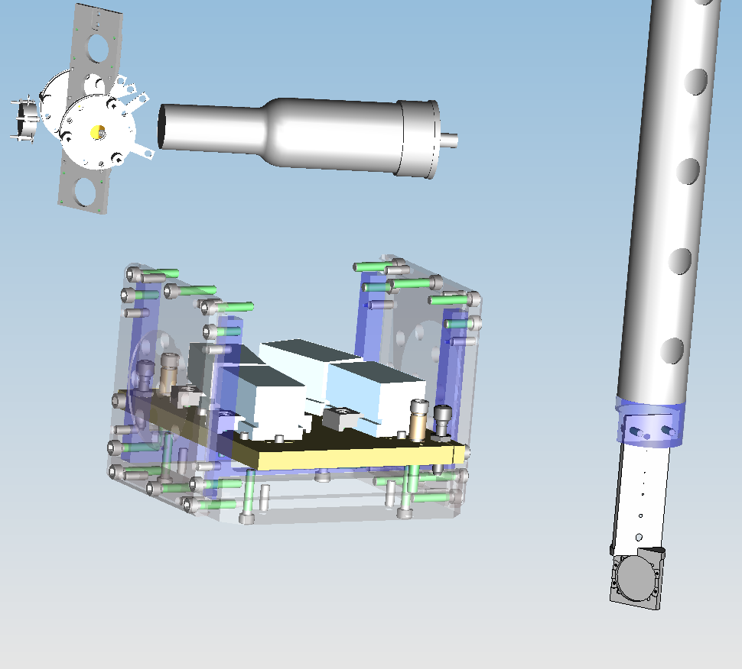
Setting up…
Energy monitor
First mirror chamber
Second mirror chamber
Pinholes
Elizabeth Mondragón
Summer 2013

Slide 7
Setting up…
SPECTRA
Elizabeth Mondragón
Summer 2013

Slide 8
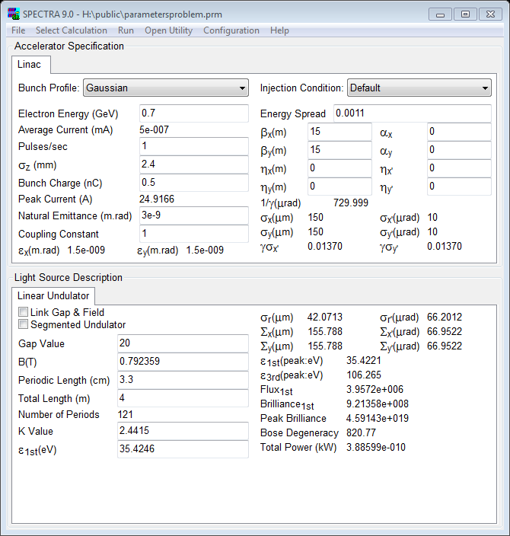
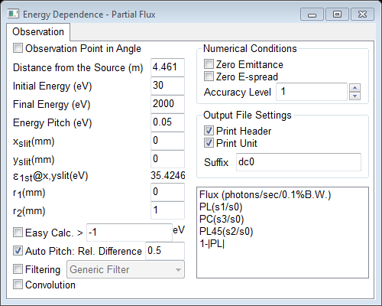
Setting up…
Elizabeth Mondragón
Summer 2013

Slide 9
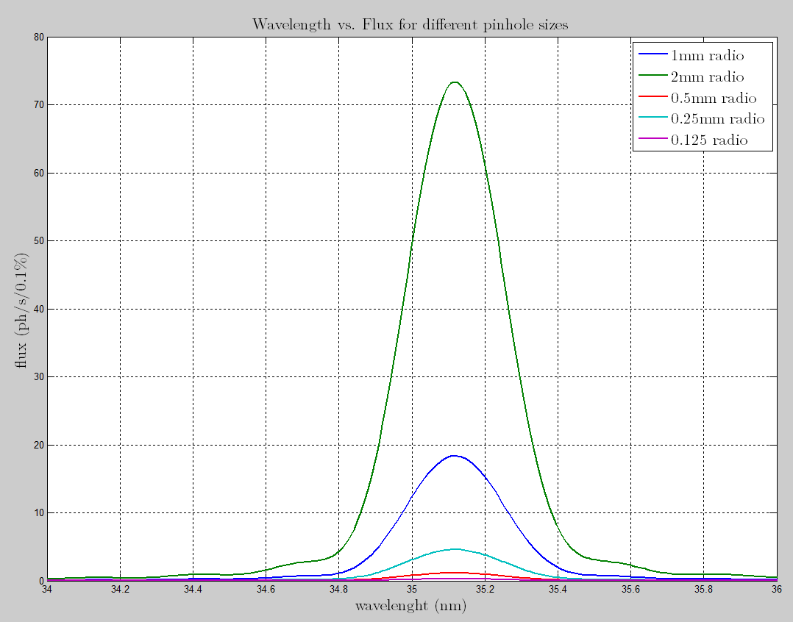
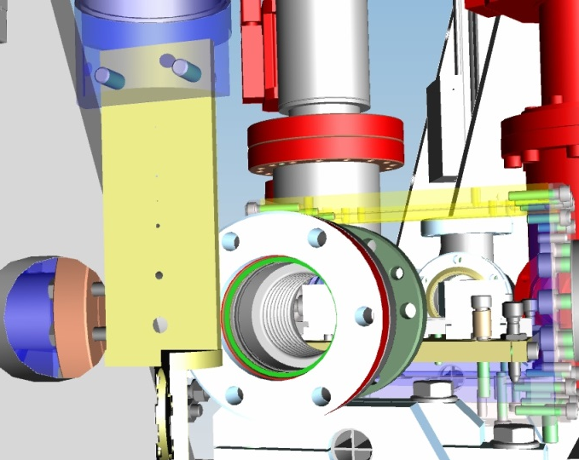
Results & Plots
Elizabeth Mondragón
Summer 2013

Slide 10
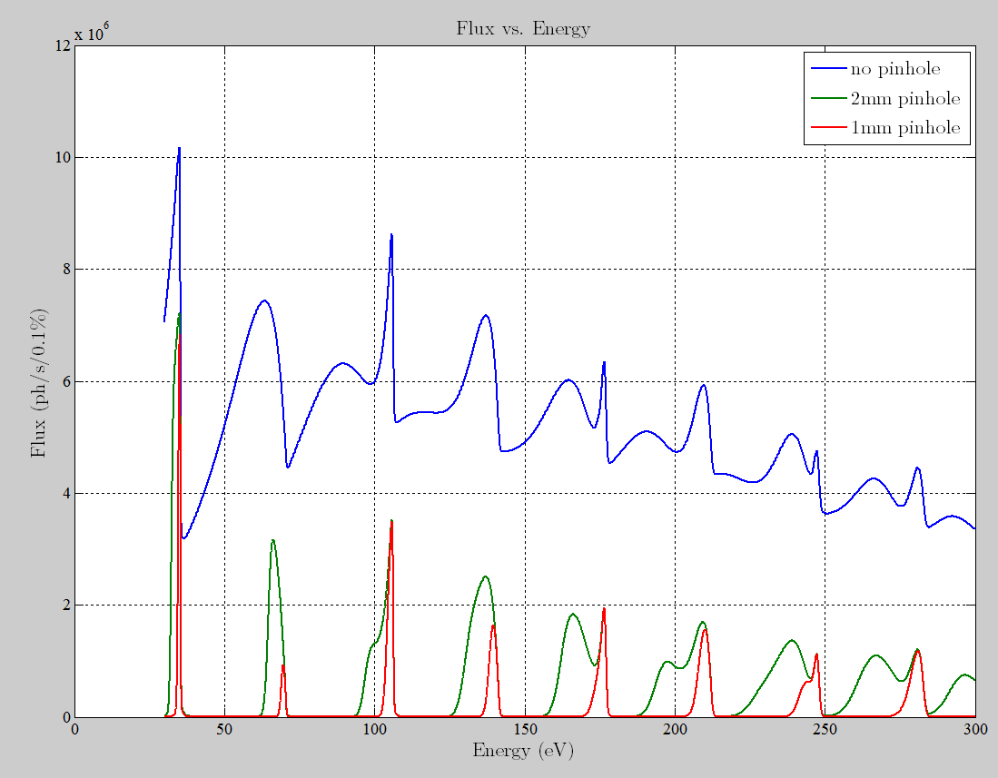
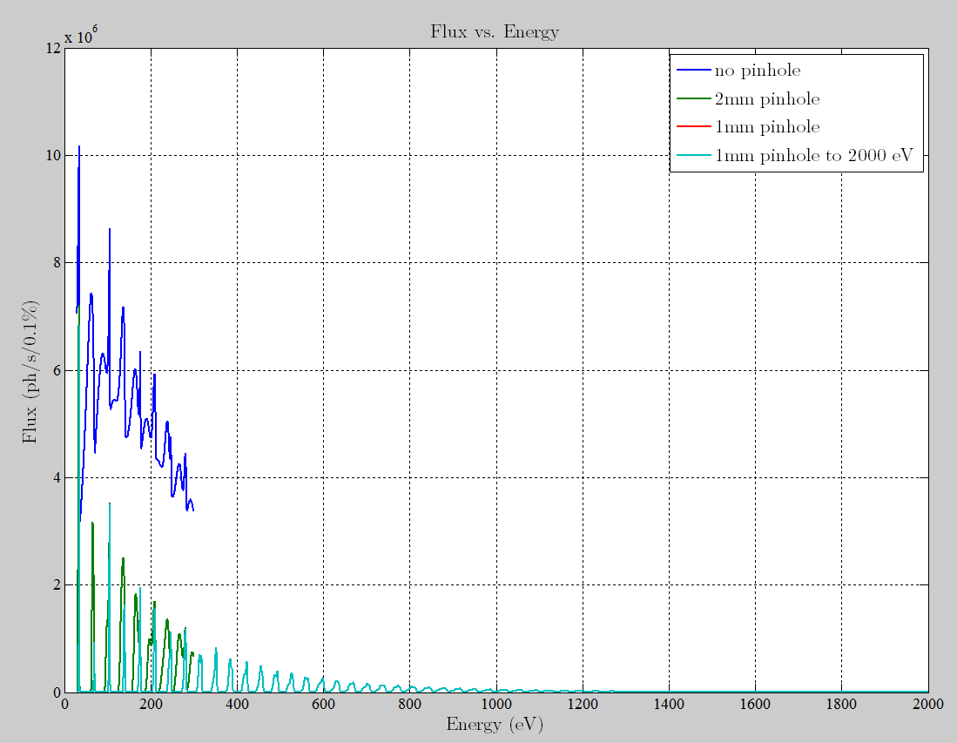
Results & Plots
Flux and Energy
Power
Mirrors
Elizabeth Mondragón
Summer 2013

Slide 11
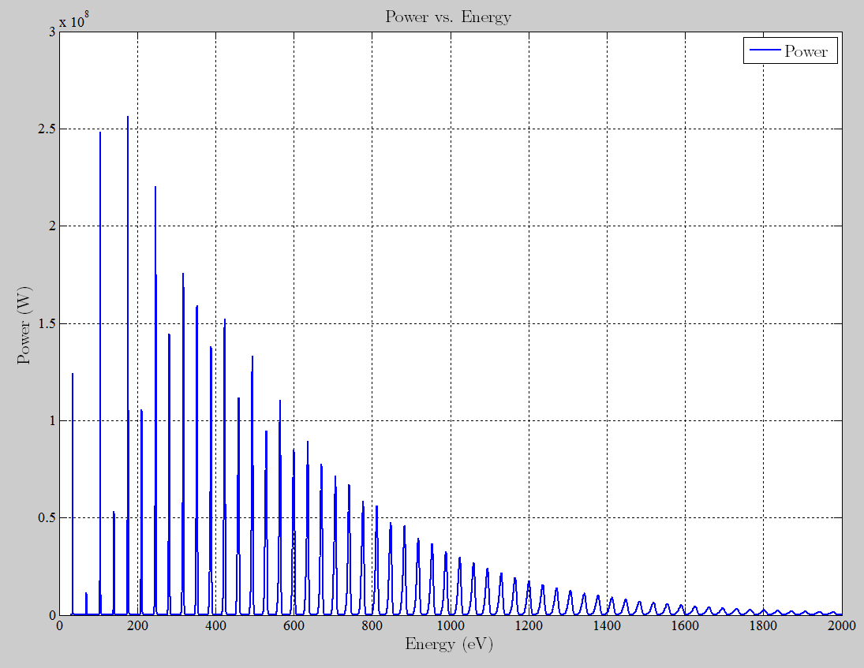
Results & Plots
Flux vs. Energy
Power
Mirrors
Elizabeth Mondragón
Summer 2013

Slide 12
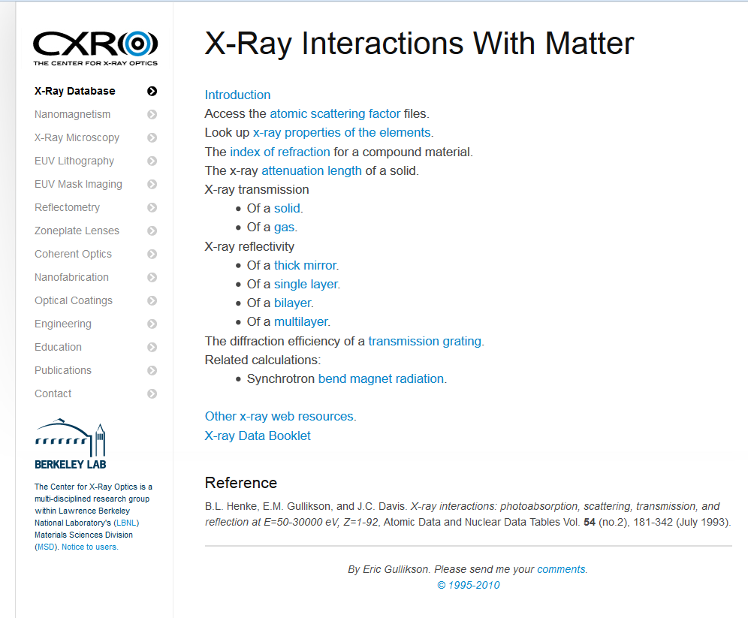
Results & Plots
http://henke.lbl.gov/optical_constants/
Elizabeth Mondragón
Summer 2013

Slide 13
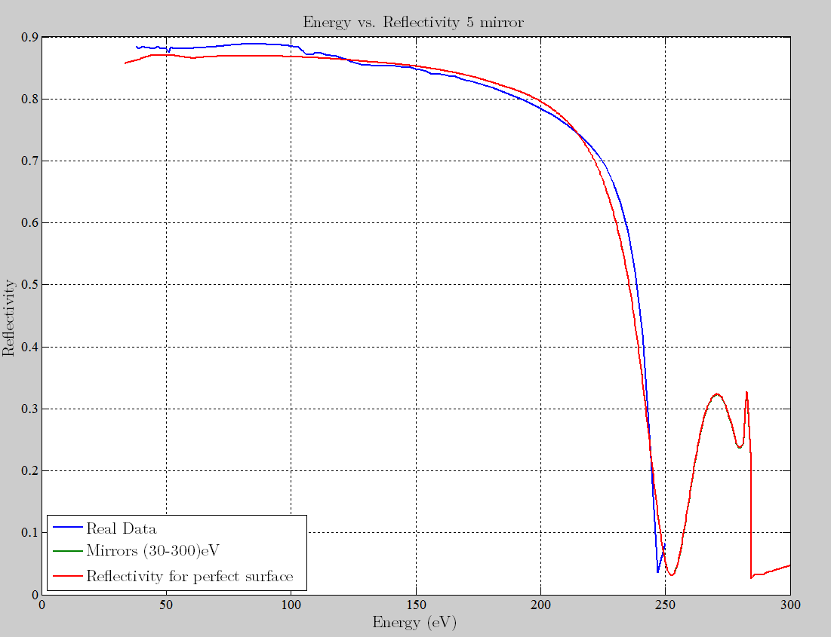
Results & Plots
Elizabeth Mondragón
Summer 2013

Slide 14
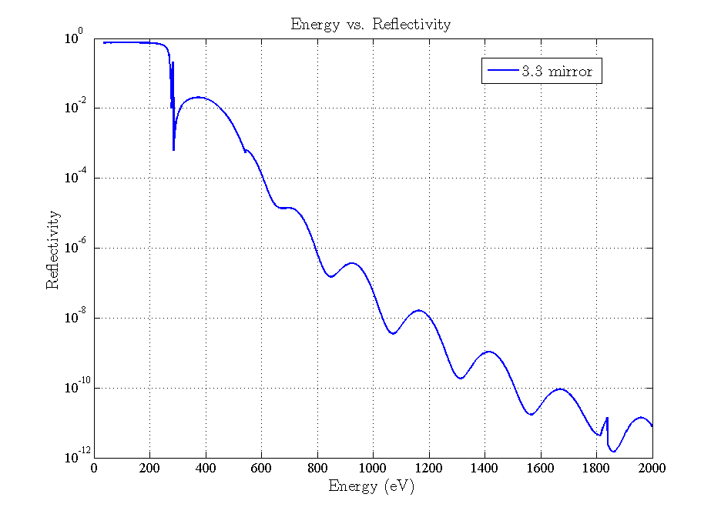
Results & Plots
Flux and Energy
Power
Mirrors
Elizabeth Mondragón
Summer 2013

Slide 15
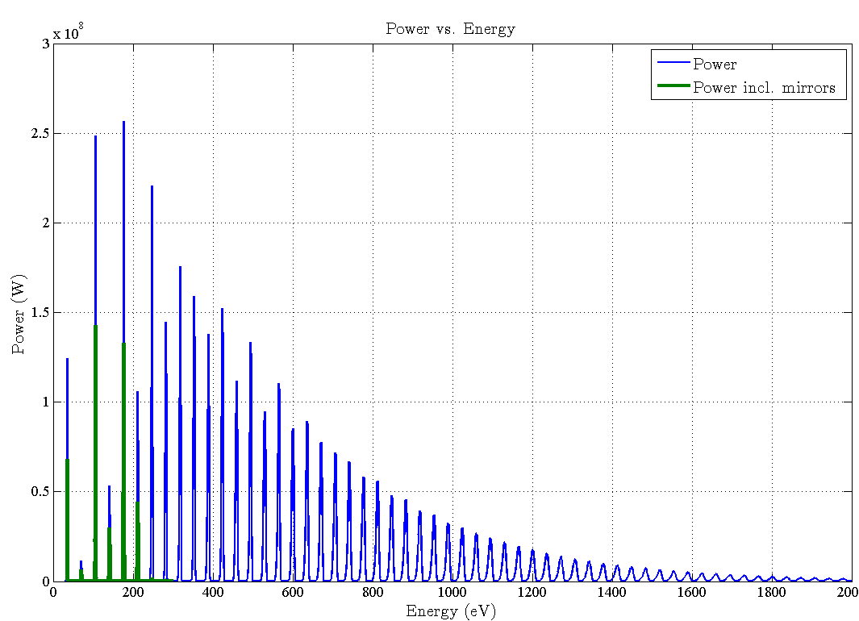
Results & Plots
Elizabeth Mondragón
Summer 2013

Slide 16
Thanks for your attention!
Elizabeth Mondragón
Summer 2013

Slide 17
Elizabeth Mondragón
elizabeth.mondragon@desy.de
Supervisor: Jörn Bödewadt joern.boedewadt@desy.de
Summer 2013

Slide 18
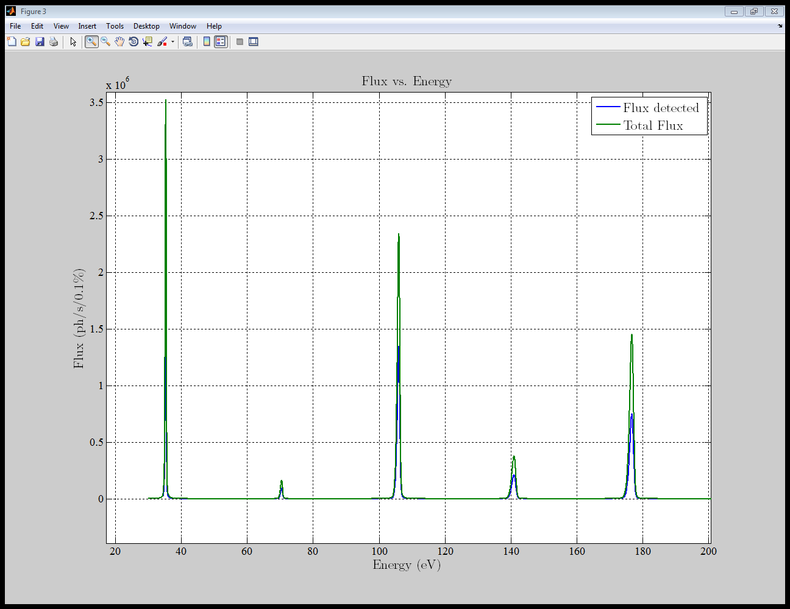
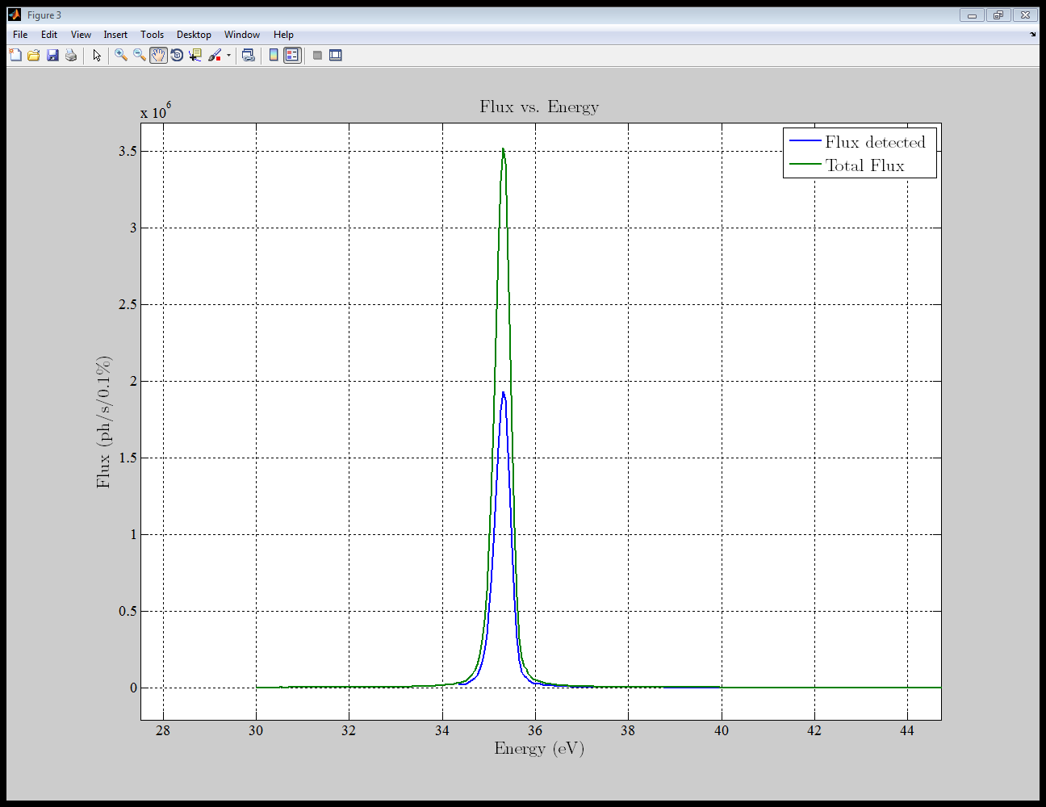
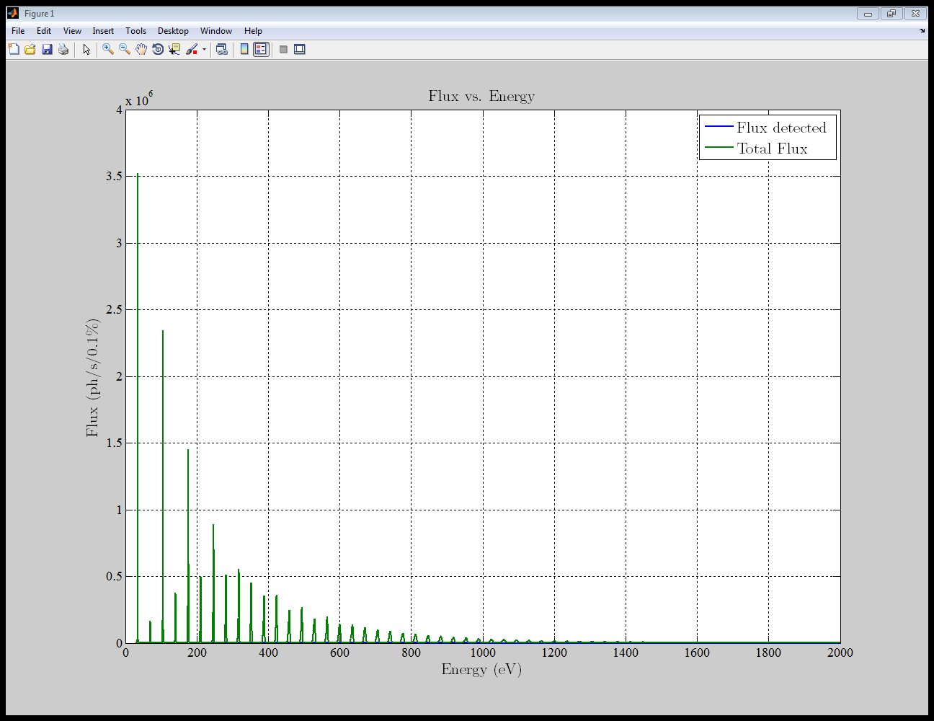
Results & Plots
Elizabeth Mondragón
Summer 2013

