Slide 1
2nd Sound as tool for quench detection in superconducting cavities
Superconducting cavities
Detection of 2nd Sound
Setup of measurement
Evaluation program
Summary

Slide 2
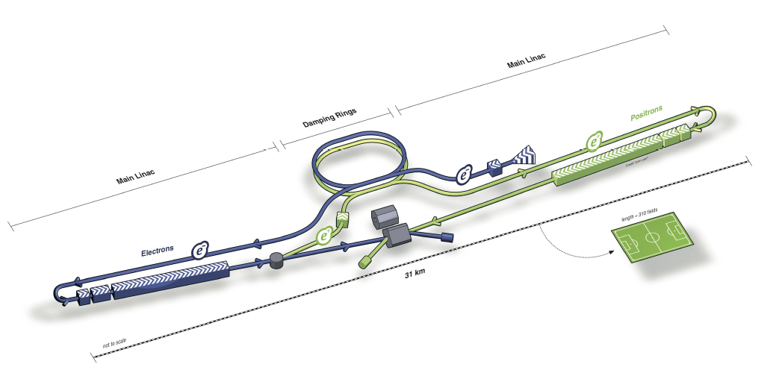
Superconducting cavities
Accelerate electrons, used at FLASH (European XFEL, ILC)
Made out of Niobium, operate at 2 K
Length of ~1.3 meters
Radio frequency (1.3 GHz)

Slide 3
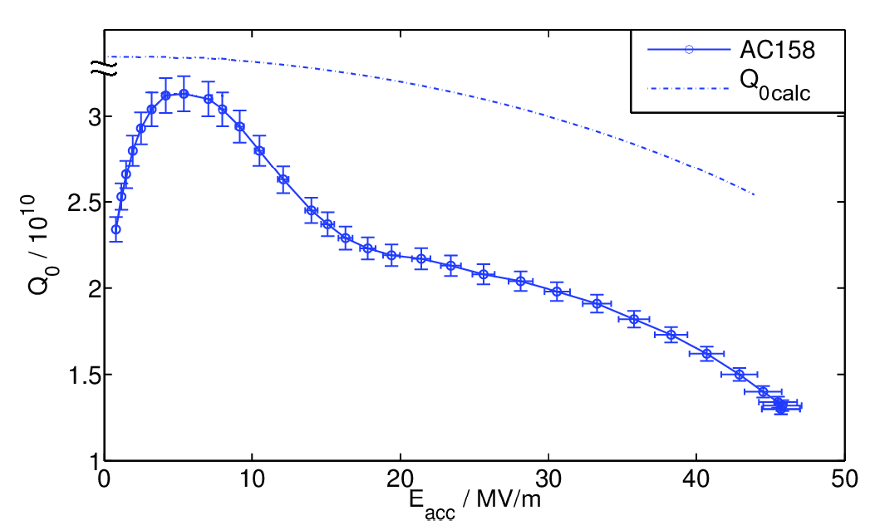
Standing wave (through power coupler)
Quality Factor:
Quench: Cavity becomes normal conducting at one spot (due to critical field) →generates heat pulse
Happens at defect (detection could improve cavity)
$$Q_{0}= \frac{ωU}{P_{diss}}= \frac{ω}{∆ω}≈{10}^{10}$$

Slide 4
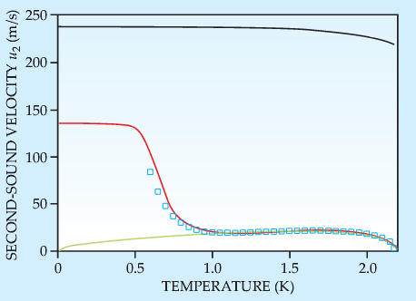
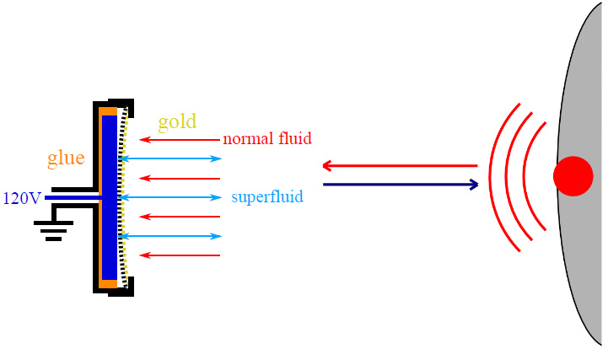
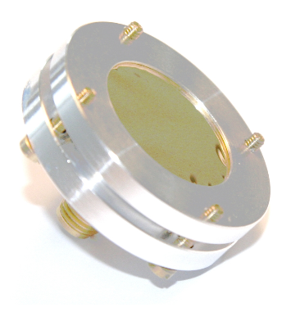
Detection of 2nd Sound
Helium below ~2 K can be described as mixture of normal (Helium I) and superfluid (Helium II, no viscosity!) liquid
Heat transfer by wave like motion beginning at quench (velocity ~ 19.9 m/s)
detectors: consists of plate and gold coated membrane (Helium 2 inside)
When wave arrives: oscillation due to density difference

Slide 5
Setup of measurement
Reflected wave from power coupler provides quench time
Detectors give arrival time of wave
They need direct line of sight to quench
Before: 8 detectors, now: 16

Slide 6
Old Evaluation program

Slide 7
New evaluation Program

Slide 8
Quench spot calculation

Slide 9
Output file
Name of file and cavity
Quench times
Quench position
Used Detectors + positions, Running time, Intensity

Slide 10
Summary
Summary
Calculate quench spot with program
Recorded by up to 16 detectors
Heat wave (2nd sound) is radiated
These defects cause quenches (become normal conductive)
Improving superconducting cavities by location of defects on surface

