Slide 1
A Real-time Histogramming Unit for Luminosity Measurement of each Bunch Crossing at CMS
Anne Dabrowski², Hans Henschel¹, Holger Leich¹,
Jessica Lynn Leonard ¹, Wolfgang Lohmann¹, Marek Penno¹,
David Stickland³
TWEPP 2013 in Perugia
¹ - Deutsches Elektronen-Synchrotron, DESY
² - European Organization for Nuclear Research, CERN
³ - Princeton University

Slide 2
Overview
BCM1F detector and setup
Hardware rev.1
Hardware rev.2
DAQ software
Outlook

Slide 3
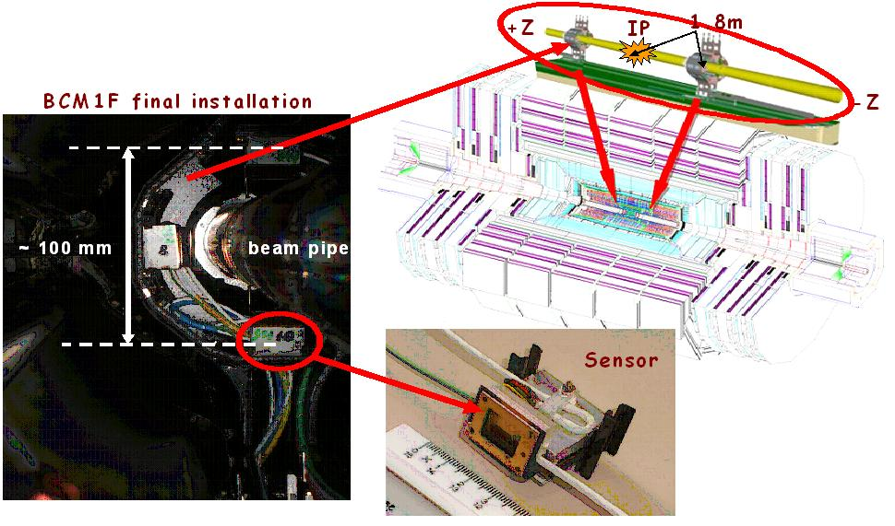
BCM1F Detector
BCM1F, a subsystem of the CMS Beam Condition Monitor System
  designed for fast flux monitoring measuring bunch-by-bunch both beam halo and collision products
  located inside the CMS pixel detector close to the beam-pipe
Source: https://znwiki3.ifh.de/CMS/Bcm1F

Slide 4
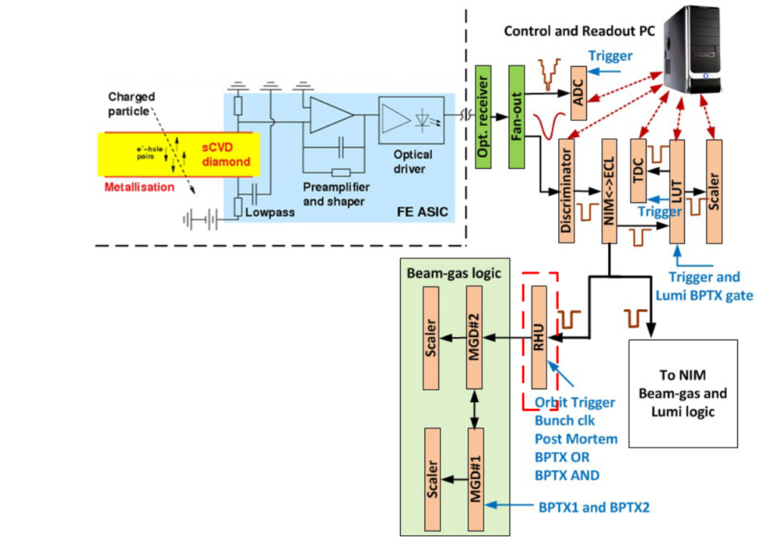
Setup at BCM1F
Source: Leonard-ADAMAS-18Dec12.odp

Slide 5
RHU Hardware Revision 1
(finished development 2012)

Slide 6
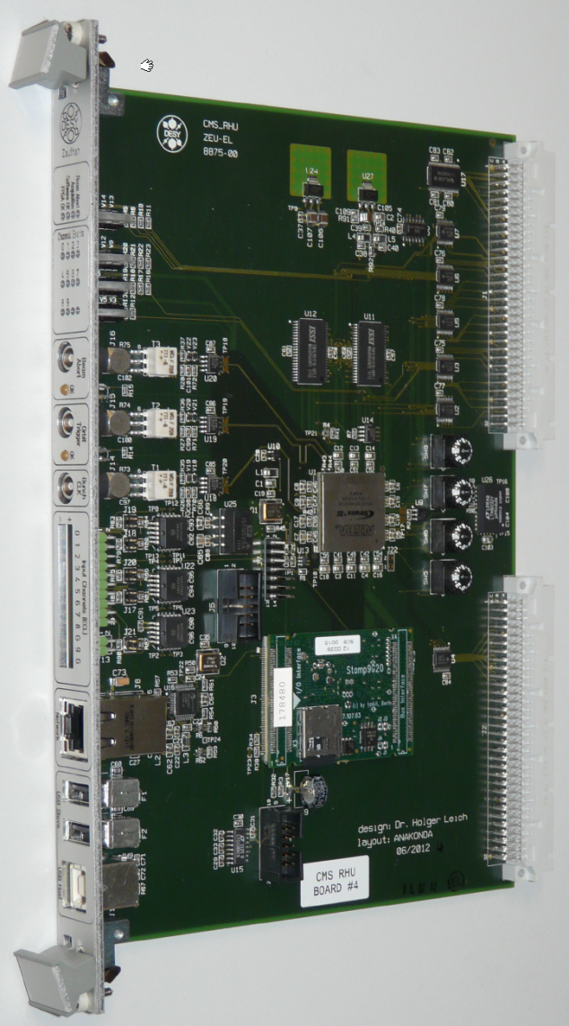
RHU Hardware Rev.1
RHU → Real Time Histogramming Unit
FPGA based digital recorder
3x NIM inputs for clock/control
12x ECL inputs for input data
VME interface (not used)
Embedded Linux System
Readout via ethernet
5MBit RAM in FPGA
16MBit external RAM (3.2GBit/s)

Slide 7
RHU Schematic Rev.1

Slide 8
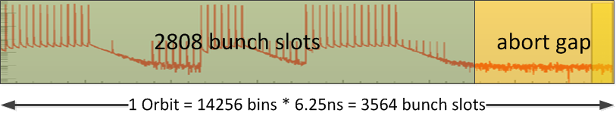
RHU Features
8 input channels with orbit histograms
  Internal 320MHz sampling rate: two samples get „OR-ed“ and stored into one bin
  → result is 160MHz sampling rate
Histograms:
  6.25ns per bin, 14256 bins/orbit
No deadtime (via double buffering)
Continuous postmortem ring buffer
Configurable # of orbits for histogramming

Slide 9
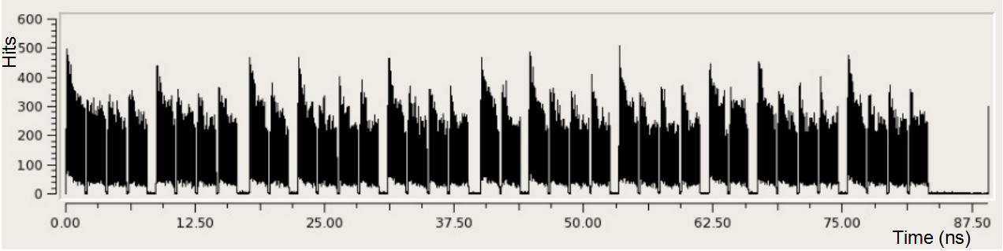
RHU Features
Configurable delay for orbit trigger
Readout and control via network
Postmortem buffer for > 50 Orbits
Realtime Histogram Data of one channel over several orbits
Time µs
Source: Leonard-ADAMAS-18Dec12.odp
Notes:
the discriminator is more efficient in the first bunches after a gap
the frontend has a peaking time around 30ns
and a total pulse width of 70 ns
so there is a small probability that you miss and don't count the second one
if the second pulse is 50 ns away and the threshold is low

Slide 10
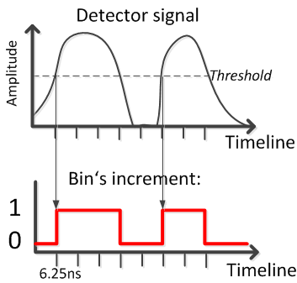
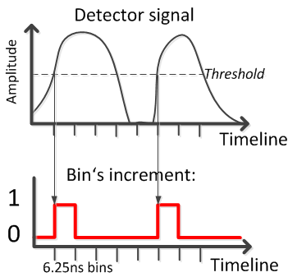
RHU Operation Modes
When the detector signal is above the threshold, the discriminator creates a logical ‚1‘ at the RHU input channel. Two modes of sampling exist:
Level-Triggered Mode
Consecutive bin‘s are incremented by 1 for each orbit
Edge-Triggered Mode
Only one bin is incremented by 1, when the detector signal is above the threshold

Slide 11
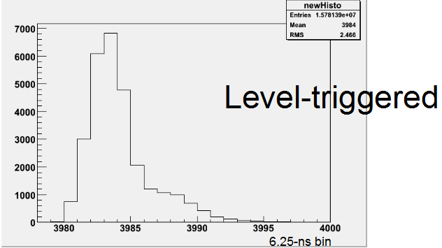
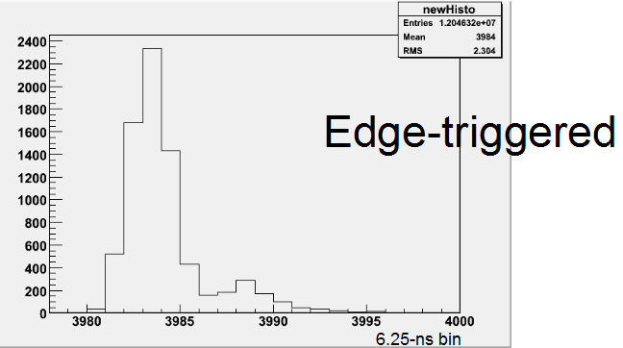
RHU Operation Modes
Level-Triggered Mode
Used when interessted in Time over Threshold
Increases event-count per bin
Number of real events is hidden
Time distribution is blured
Edge-Triggered Mode
Used when interessed in the exact number of events
gives clean statistical time distribution of events
Reduces event-count per bins
Source: Leonard-BRM-RHUplans-12Feb13.odp

Slide 12
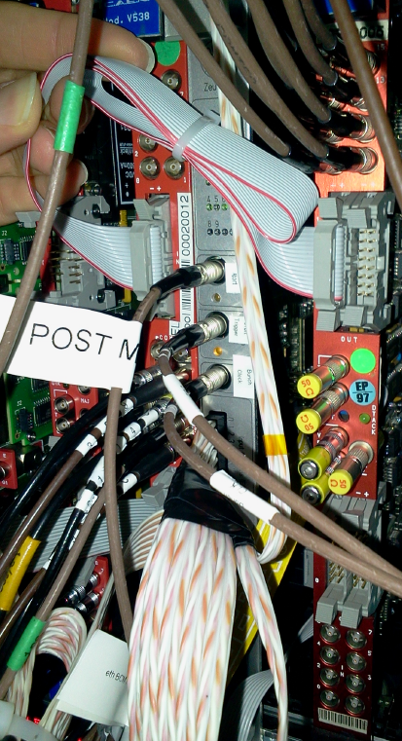
RHU Commissioning 2012
1 Device installed for CMS experiment and validated
1 Device installed for LHC Beam Background measurements, in Prevessin

Slide 13
RHU Hardware Revision 2
(ongoing development 2013/2014)

Slide 14
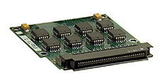

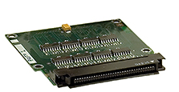
Hardware Rev.2 (2013)
Use mezzanine card for signal inputs
  use CAEN V1495 mezzanine cards
  extensible with customized cards
Add interface for the TTC timing system
  decoding events in FPGA
  support for synchronized luminosity DAQ
Removed USB host and one USB slave connector
Removed FPGA flash memory → Boot FPGA via microcontroller
Add reset switch for SBC
Improve software and firmware stability
32x LVDS/ECL input channels
8 NIM/TTL in/out channels
32 LVDS input channels
Source: CAEN

Slide 15
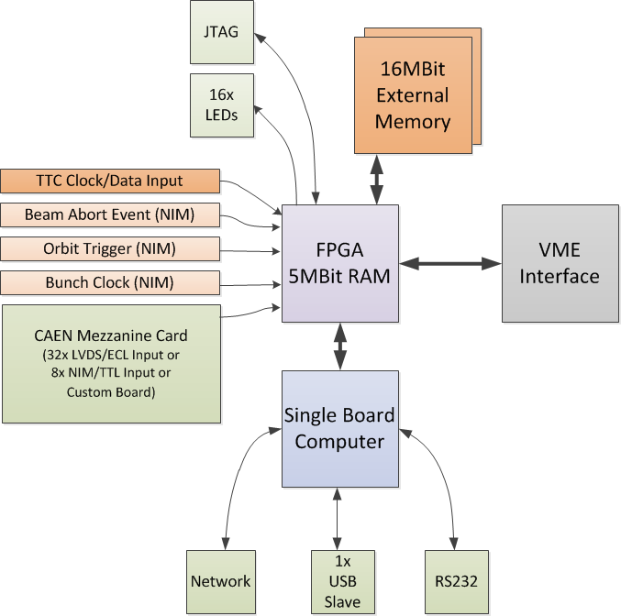
Hardware Rev.2 (2013)
32x LVDS/ECL input channels
8 NIM/TTL in/out channels
Source: CAEN
32 LVDS input channels

Slide 16
Luminosity DAQ

Slide 17
Luminosity DAQ
DAQ dataflow for luminosity and beam background measurements is synchronized at CMS via TTC „short (broadcast) commands“
Data of 4096 Orbits ≡ 1 Lumi Nibble
Lumi Nibbles are identified with ID‘s
→ Readout of RHU devices is synchronized
→ Data can be combined and correlated with other systems

Slide 18
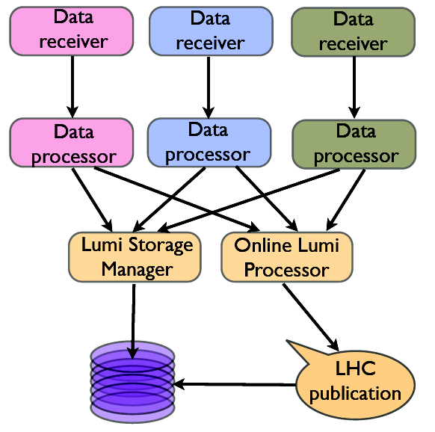
Luminosity DAQ Architecture

Slide 19
RHU DAQ Software

Slide 20
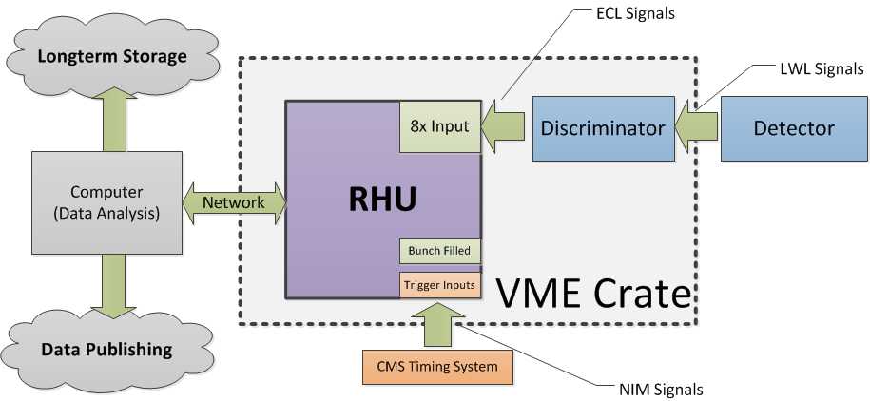
RHU Setup

Slide 21
RHU Software Architecture

Slide 22
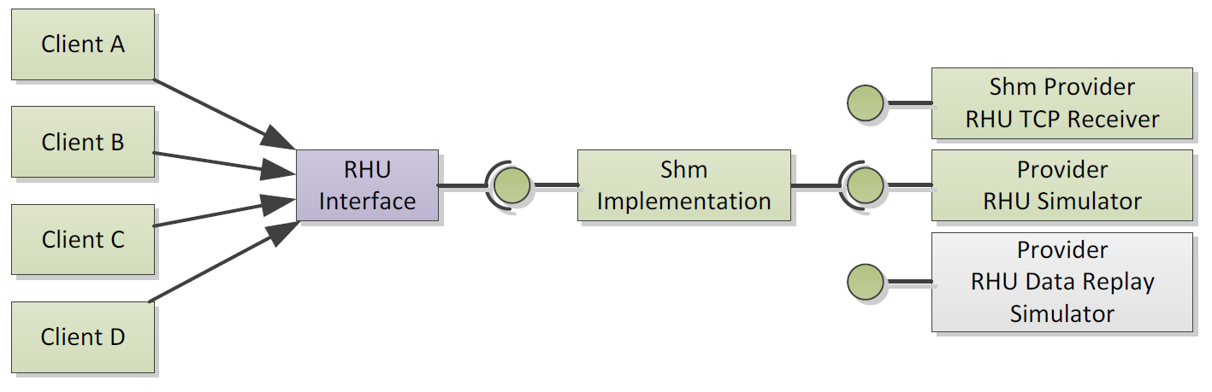
RHU Software
Shared Memory Concept works
  Client Software/Library is kept simple
  Implementation Details hidden from Clients
  RHU Data Connection can be reused without performance drop
  RHU Data Provider can be changed between Simulator and Real-time-Receiver
Current Software Dependencies:
  ROOT Framework 5.x
  Boost C++ Library >= 1.43 (needed in general)
  QT4 & QWT (For GUI only)
  DIP Library (for DIP Server only)

Slide 23
Outlook 2013/2014
Production and test of 12 RHU devices rev.2
RHU firmware extended for TTC and Luminosity DAQ synchronisation
Test TTC interface and luminosity DAQ
Adapt software to hardware changes
Software documentation
Install hardware and DAQ software at CMS

Slide 24
Thank you!

Slide 25
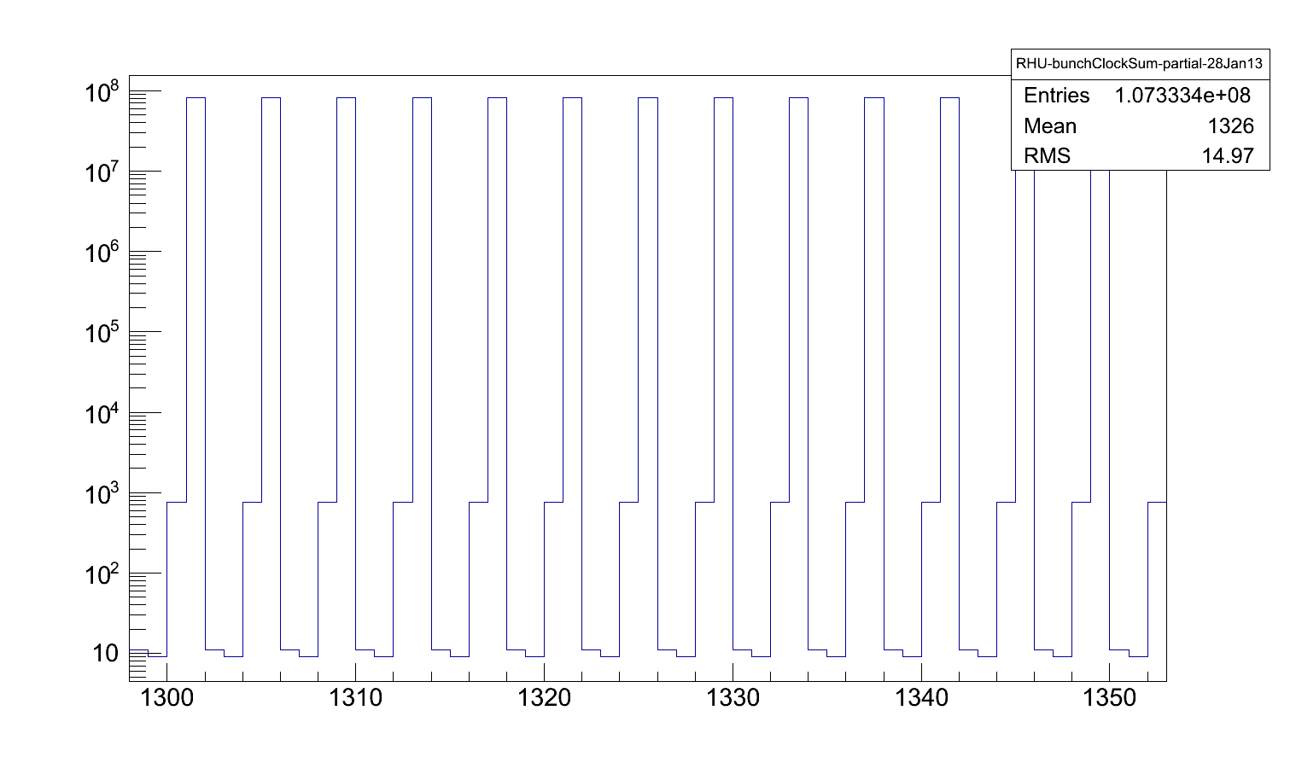
RHU with test input signal
Using bunch clock as input signal
Source: Leonard-BRM-RHUplans-12Feb13.odp

