Slide 1
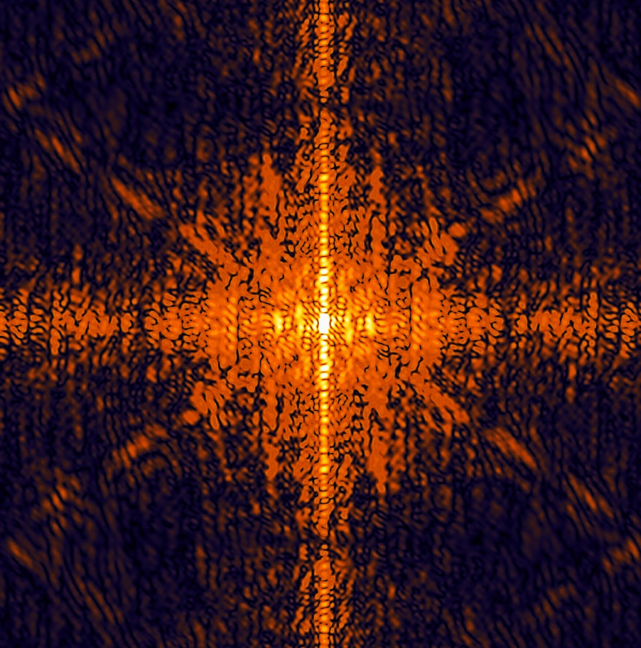
Calibration Working Group and
Calibration Infrastructure
Jola Sztuk-Dambietz (XFEL)
on behalf of
the Calibration Group
December, 2nd 2013
15th Meeting of the XFEL Detector Advisory Committee
European XFEL GmbH, Hamburg
Notes:
How to edit the title slide
Upper area: Title of your talk, max. 2 rows of the defined size (55 pt)
Lower area (subtitle): Conference/meeting/workshop, location, date,
your name and affiliation,
max. 4 rows of the defined size (32 pt)
Change the partner logos or add others in the last row.

Slide 2
Outline
Introduction
Highlights from the last Calibration Meeting
Infrastructure for detector calibration and tests at the XFEL – status and plans
Summary

Slide 3
Calibration Group
Calibration Working Group meeting – November 2013
Goal: Exchange information, discuss progress, next steps and open issues related to calibration
Participants: Consortia, XFEL WP-75 representatives
Status of calibration activities in the consortia and XFEL:
Status of the calibration activity ((non-)linear gain conversion, etc..) from the detector consortia
Calibration pipeline – status
Status of detector calibration infrastructure at the XFEL
Next meeting April/May 2014

Slide 4

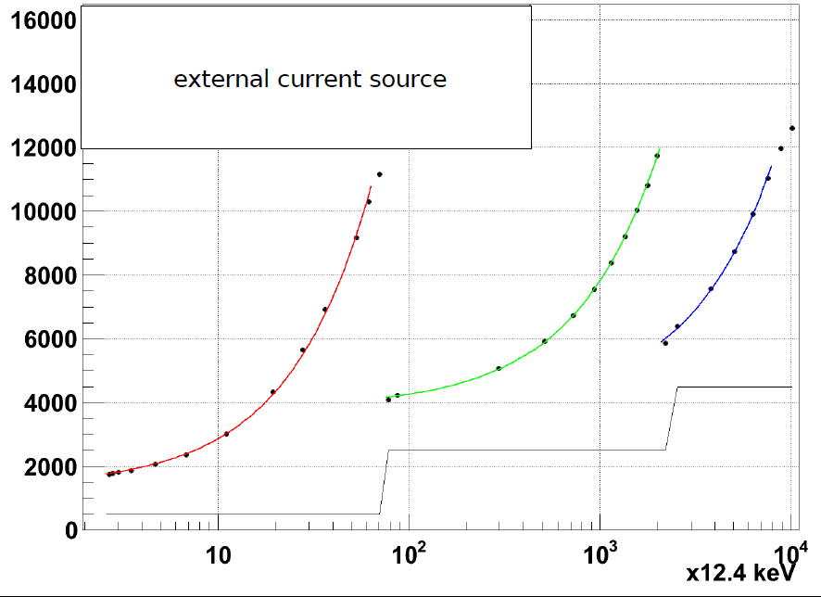
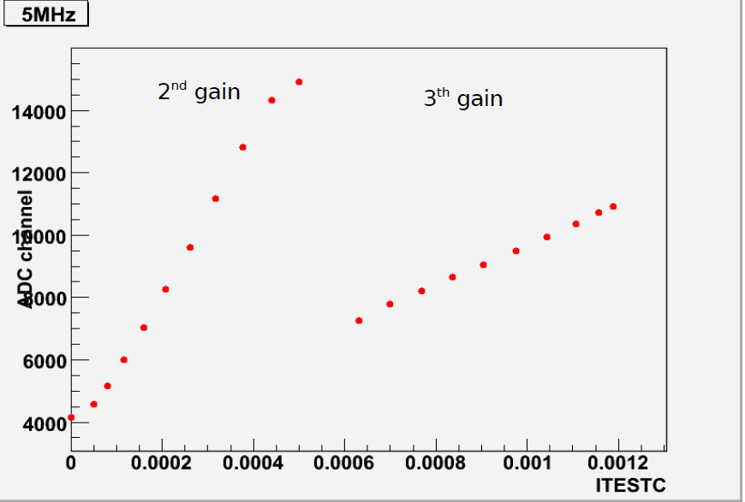
Highlights From the Last Calibration Meeting (I)
AGIPD (L. Bianco):
Characterization of AGIPD1.0 using chiptest box is ongoing → focus on the calibration circuit test
Development of calibration routines to be run on FPGA
Internal Current Source Scan –
2nd and 3rd gain
AGIPD1.0 – 3 gain intervals
Correspondence to effective charge needs to be verified and calibrated

Slide 5

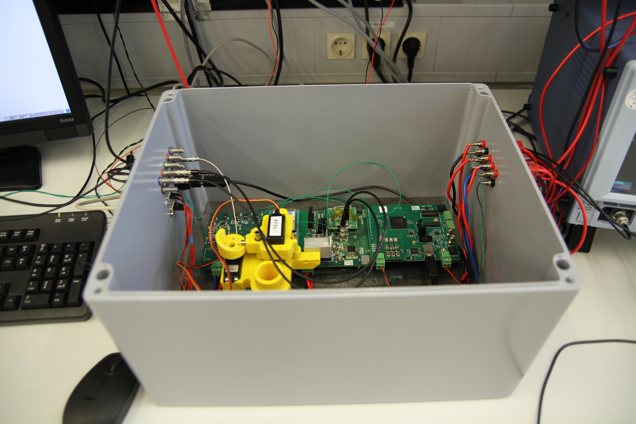
Highlights From the Last Calibration Meeting (II)
DSSC (G. Weidenspointner):
Sensor test bench for pxd7/8 characterization
Check of NLSR Calibration for high signal using charge pulses
→ 1MeV protons at LABEC
Study the use of a selection of fluorescence lines to improve NLSR calibration
Study of Collected-charge Distribution Function and Charge Sharing in preparation
Work on system simulation is ongoing
Determination of ADC Bin Boundaries
Charge sharing

Slide 6
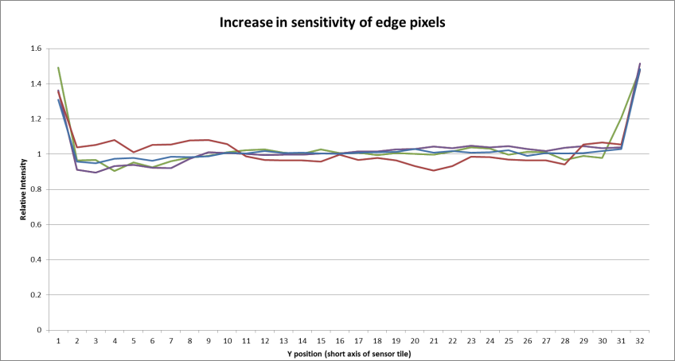
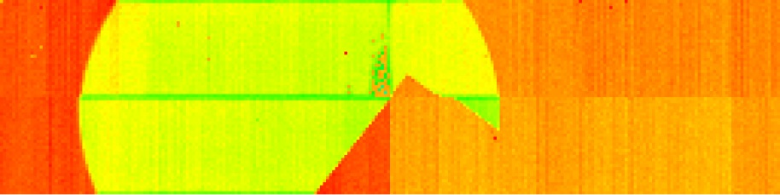
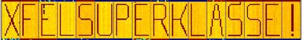
Highlights From the Last Calibration Meeting (III)
LPD (M. Hart):
LPD
Beam test (LCLS and PETRAIII) in May 2013 → results of the analysis available
LCLS – Edge and Corner Response
LCLS – Copper Florescence
Internal injection circuit - new firmware and software
The system API has been updated to enable independent programming of any pixel in the system.
ROI gain settings
On-chip injection of signals in to pixels
More details in the consortia talks at the general and closed sessions

Slide 7
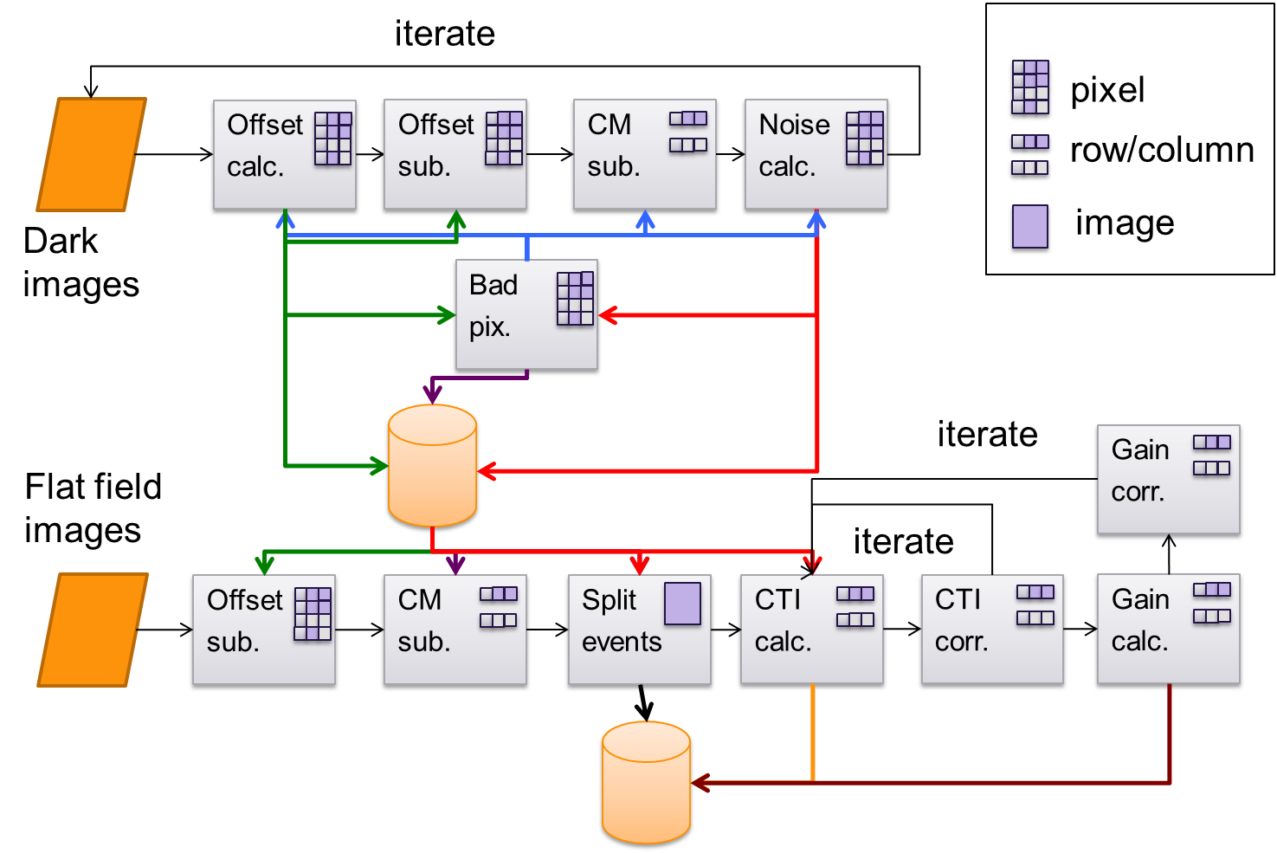
Calibration Pipeline (S. Hauf)
iterate
granularity
Modular calibration pipeline (stand-alone and in Karabo-framework) exists
  Monitoring & near online calibration for rapid feedback
  Processing for archive after experiment
row/column
Dark
images
Pipeline development approach
Step1 : Stand-alone pipeline:
pnCCD pipeline as a reference implementation
tested and validated against existing CCD CAST calibration analysis
Performance tests
Step2: Karabo framework pipeline
Flat field
images
More details in WP75 closed sessions

Slide 8
From Concepts to “Software in Action” (S. Hauf)
Calibration results for CCD CAST
Results obtained using CAST calib. software and XFEL pipeline are in agreement
Gain calibration after full event reconstruction
Split event spectrum
More details in WP75 closed sessions

Slide 9
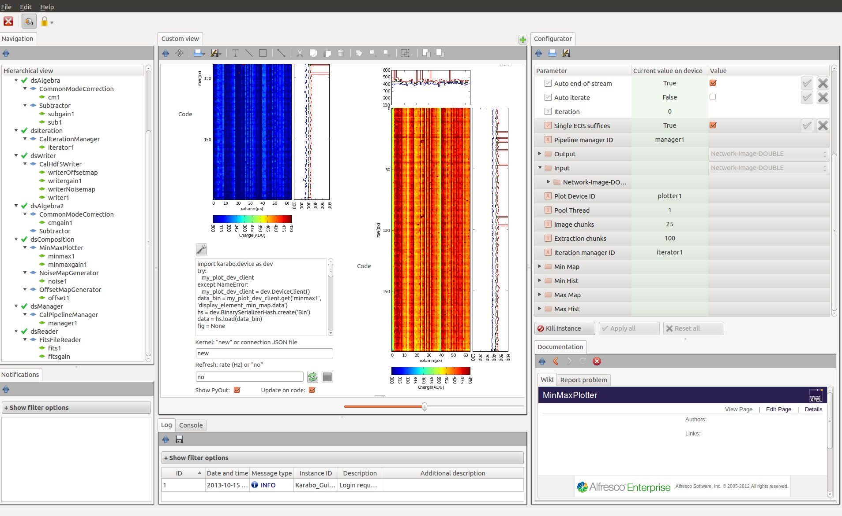
From Concepts to “Software in Action”
– Karabo Pipeline (S. Hauf)
Plot display and interactive editing of python code is also possible from within Karabo GUI
Registered devices
Powerpoint-like composition canvas
Device parameters
Plotting code
Device Wiki
Logger with filtering

Slide 10
Lab X-ray Sources vs. Requirements
Requirements | Radioactivie isotopes | X-ray source in DC mode | Pulsed multi-target X-ray source
Energy range 0.26 – 25 keV | Different isotopes/filters | Exchangeable X-ray tubes/filters | Anode with different target materials
Pulsed X-rays Pulse length < 50 ns Δt = 220 ns or (4.5 MHz rep rate) |  |  | Pulsed electron source
Intensity Adjustable 1- 10³⁻⁴ photons/ pixel Instability < 1 % |  | High-power micro-focusing X-ray tube
Illumination point-like d<= 20-50μm Line-like Flat –field (homogeinity > 10%) | Optics, pinholes, collimators | Optics, pinholes, collimators | Optics, pinholes, collimators

Slide 11
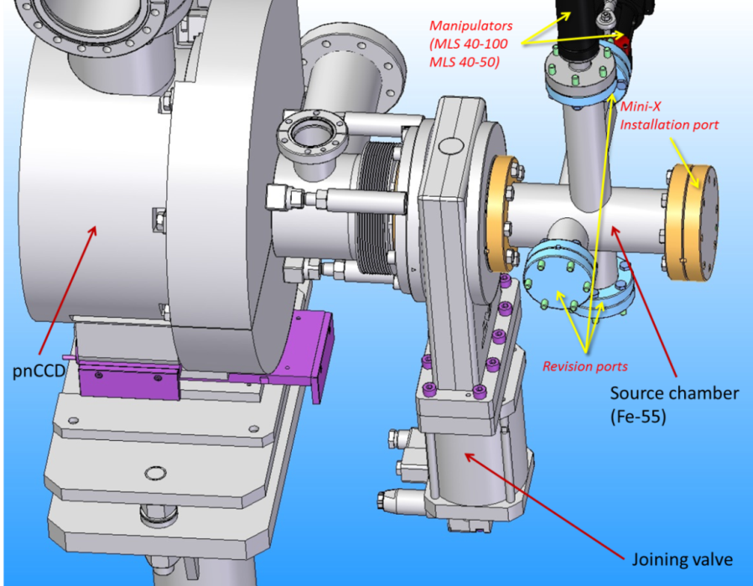
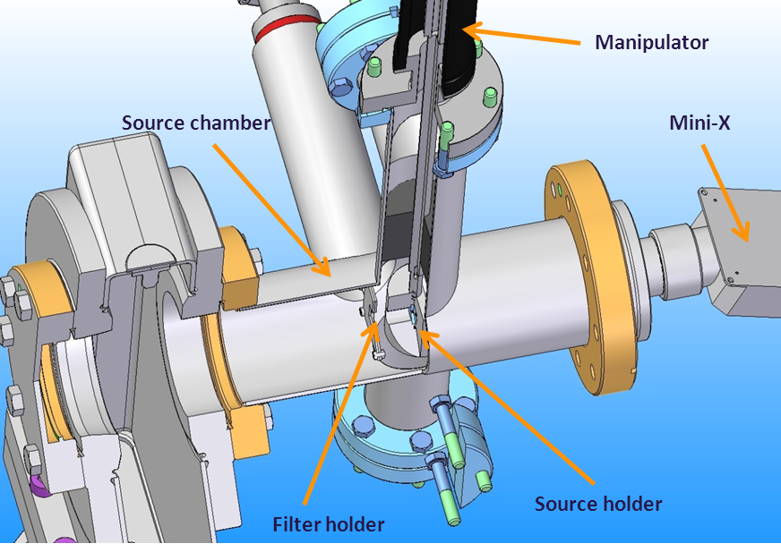
Vacuum compatible X-ray setup
Modular flexible device for multipurpose usage (filters, pin-holes, collimator, etc..)
Interlock and PLC system
Status:
Most of the components in house (sources, vacuum vessel, manipulators, holders, Beckhoff PLC components)
Functional tests of the setup ongoing
Pumping system designed and ordered → delivery December 2013
Operational December 2013

Slide 12
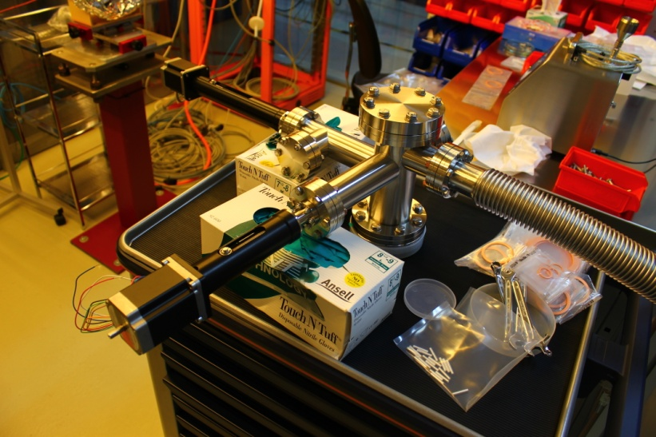
Vacuum compatible X-ray setup
Modular flexible device for multipurpose usage (filters, pin-holes, collimator, etc..)
Interlock and PLC system
Status:
Most of the components in house (sources, vacuum vessel, manipulators, holders, Beckhoff PLC components)
Functional tests of the setup ongoing
Pumping system designed and ordered → delivery December 2013
Operational December 2013

Slide 13
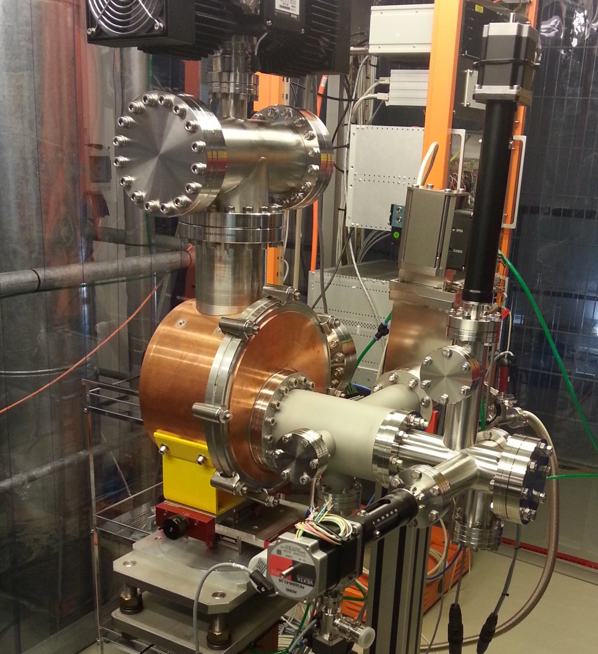
Vacuum compatible X-ray setup
Modular flexible device for multipurpose usage (filters, pin-holes, collimator, etc..)
Interlock and PLC system
Status:
Most of the components in house (sources, vacuum vessel, manipulators, holders, Beckhoff PLC components)
Functional tests of the setup ongoing
Pumping system designed and ordered → delivery December 2013
Operational December 2013

Slide 14
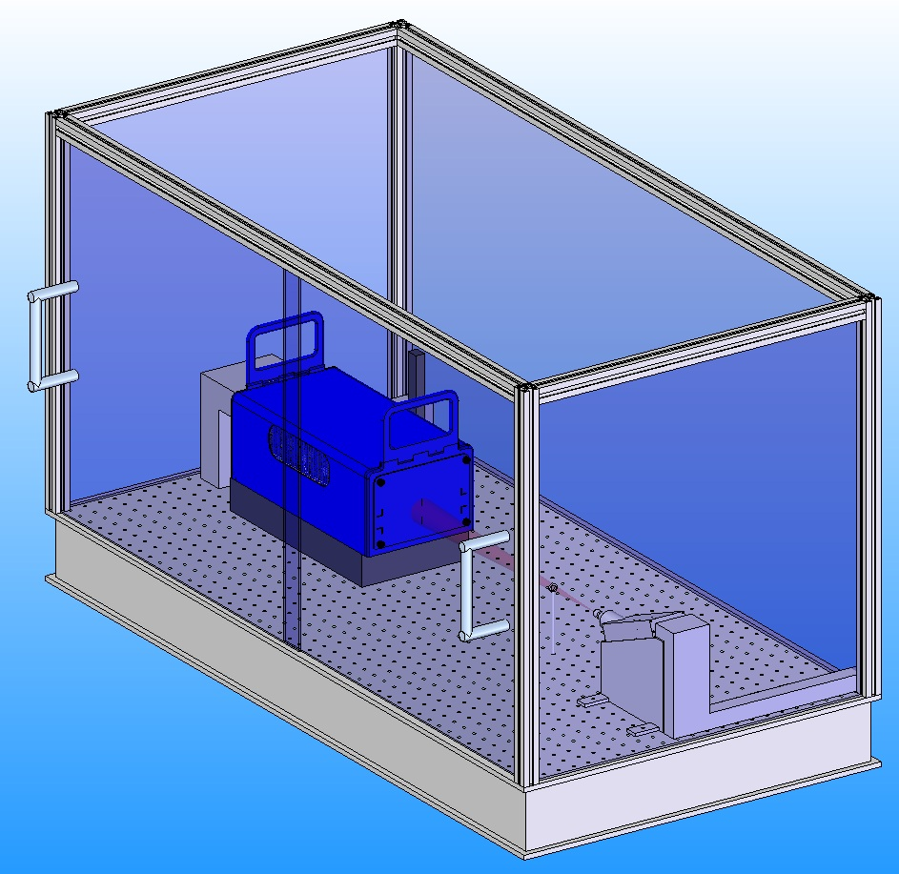
Portable X-ray Test Stand
Back side with thin
steel foil (1mm)
Black hardboard sides
Ambient X-ray setup for test and calibration of detector prototypes
Sliding door
LPD detector
Precision XY stages
Status:
All the components in house (sources, stages, holders, PLC Beckhoff components)
Installation started
Breadboard
X-ray source holder
→ Operational December 2013

Slide 15
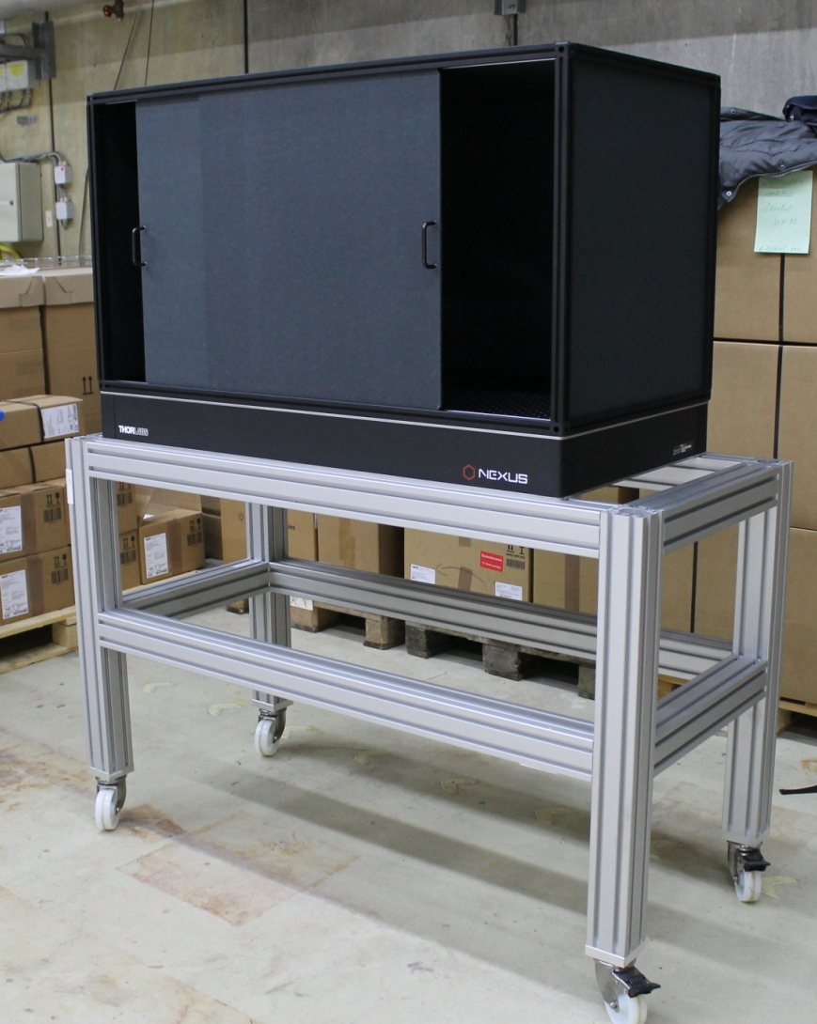
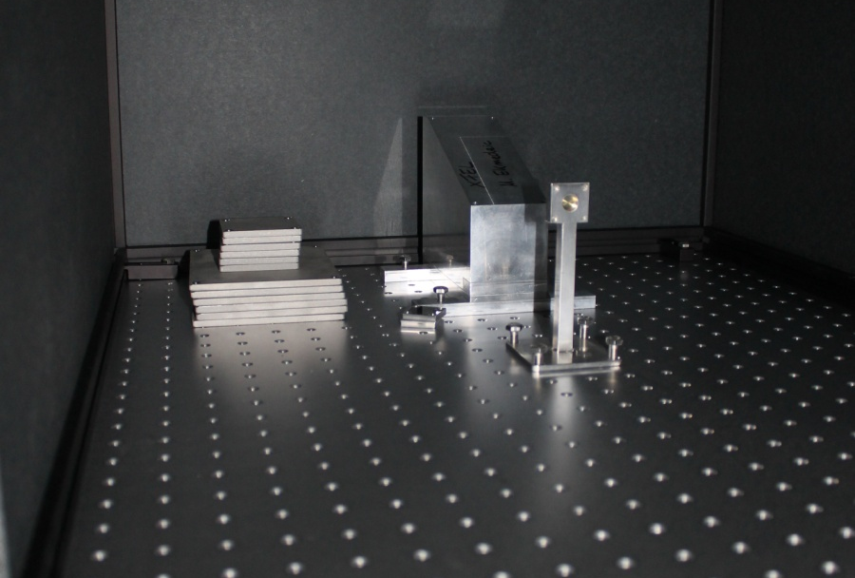
Portable X-ray Test Stand
Back side with thin
steel foil (1mm)
Black hardboard sides
Ambient X-ray setup for test and calibration of detector prototypes
Sliding door
LPD detector
Precision XY stages
Status:
All the components in house (sources, stages, holders, PLC Beckhoff components)
Installation started
Breadboard
X-ray source holder
→ Operational December 2013

Slide 16
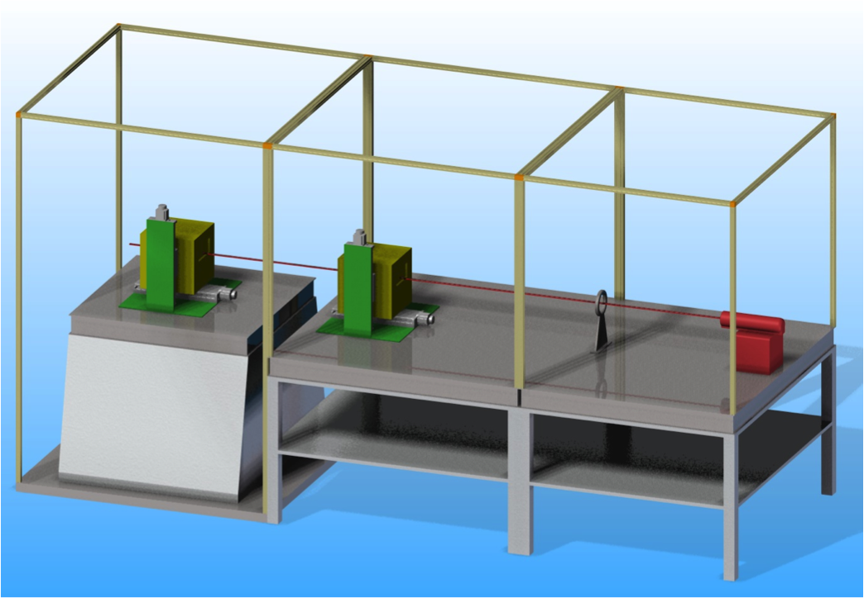
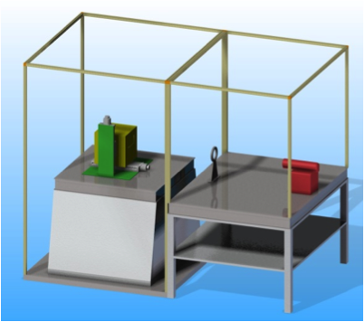
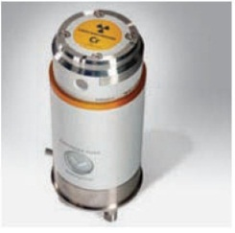
Permanent Ambient X-ray Test Setup
Shielding and Enclosure
Detector System
Pin Holes, Masks etc.
X-ray Tube
Bread Board
Modular setup for large area and small area detectors
Cooling for ¼ Mpx modules
Dry air or N₂ atmosphere
DAQ and control system
High power X-ray tube (2-4kW), different energies → potential suppliers identified
x-y-z Translation Stage
and Support
→ Operational Q2 2014 for small detector systems up to ¼ Mpx
Notes:
The concept is to built up infrastructure for XFEL in several steps.
Problem is …
→ go through right part of the slide
What are the specifications, requirements → next slide

Slide 17
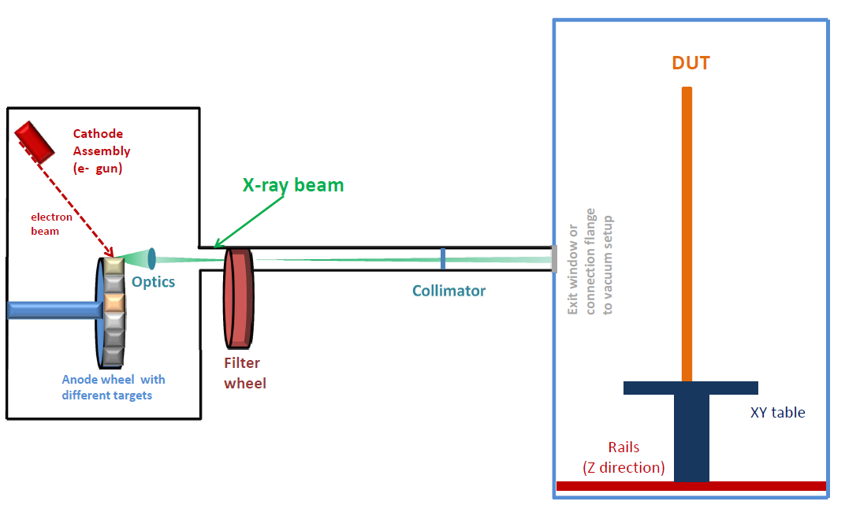
Multi-target Pulsed X-ray/Electron Setup
Laboratory multi-purpose X-ray setup for detector characterization and calibration
  on daily use
  use as electron source for direct electron illumination
Modular
Main components:
Calibration source (electron or X-ray):
X-ray optics (filters, focusing & collimating optics)
  beam spot down to 20-30μm
  collimated beam with size range from a few mm to a few cm
Detector test chamber (vacuum and ambient)
Reference detector → pin diodes, SDD
Exchangeable
Pulsed X-ray/electron source
DC X-ray/electron source
Radioactive isotopes

Slide 18
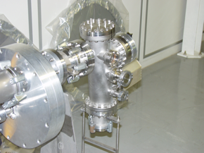
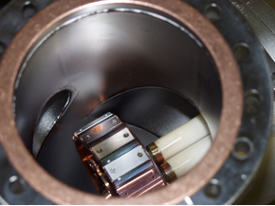
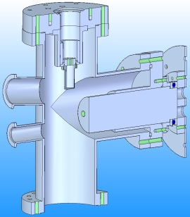
Multi-target Pulsed X-ray source approach
First step: Copy of PANTER X-ray source assembled & operated at the XFEL
Collaboration with PANTER X-ray test facility of the Max-Planck Inst. for extraterrestrial Physics
PANTER X-ray source
- similar concept (different electron source)
- TÜV approved at PANTER
- In successful operation for > 10 years
- Group member has been strongly
involved in commissioning and
operation of the source
Electron source
Target wheel
Status:
Technical drawing of the PANTER multi-target X-ray tube sent to XFEL → work on optimization of the design is ongoing
Filter wheel
Copy of the PANTER X-ray source will be delivered to the XFEL for assembly and commissioning at HERA South → excellent testbed for our project and TÜV approval
Next step: Replace the existing electron source with the pulsed electron source

Slide 19
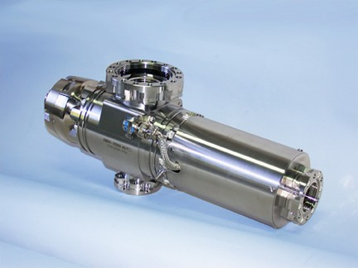
Multi-target Pulsed X-ray source approach
Electron Gun for pulsed multi-target X-ray source
Proposal for custom customized EGH 6210/ EGPS-6210 (Kimball Physics) electron source accepted by XFEL MB
→ expected delivery of the source –May 2014
Parameter | Pulsed mode | DC mode
Electron energy Ee | 1 - 50 keV (adjustable) | 1- 60 keV (adjustable)
Electron beam current Ie | 10μA - 20 mA (adjustable), Stability better than 0.1 %/h | 10μA – 2(6)mA (adjustable), Stability better than 0.1 %/h
Beam diameter d_{beam} | 0.15 – 10 mm (adjustable) | 0.1-10 mm (adjustable)
Pulsed beam parameters | Length: τ = 50(20)-150 ns (adjustable) rise: 2 ns / fall: 3-4 ns Burst mode: rep. rate 4-5 MHz (600μs ON with high frequency bursts, followed by 99.4ms OFF gap ) | n.a.

Slide 20
Multi-target Pulsed X-ray source approach
Electron Gun for pulsed multi-target X-ray source
Proposal for custom customized EGH 6210/ EGPS-6210 (Kimball Physics) electron source accepted by XFEL MB
→ expected delivery of the source –May 2014
Parameter | Pulsed mode | DC mode
Electron energy Ee | 1 - 50 keV (adjustable) | 1- 60 keV (adjustable)
Electron beam current Ie | 10μA - 20 mA (adjustable), Stability better than 0.1 %/h | 10μA – 2(6)mA (adjustable), Stability better than 0.1 %/h
Beam diameter d_{beam} | 0.15 – 10 mm (adjustable) | 0.1-10 mm (adjustable)
Pulsed beam parameters | Length: τ = 50(20)-150 ns (adjustable) rise: 2 ns / fall: 3-4 ns Burst mode: rep. rate 4-5 MHz (600μs ON with high frequency bursts, followed by 99.4ms OFF gap ) | n.a.

Slide 21
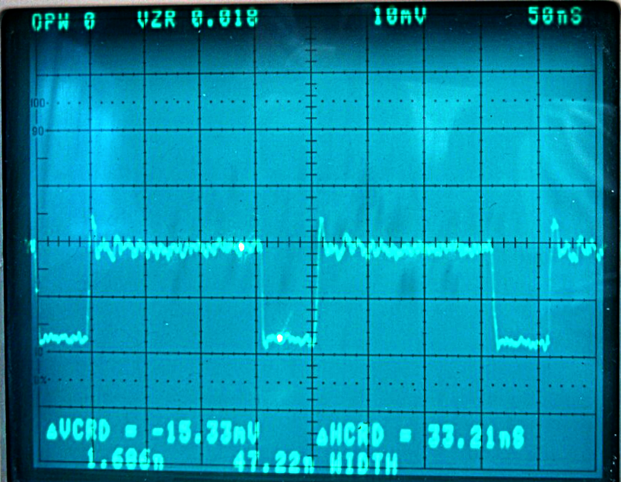
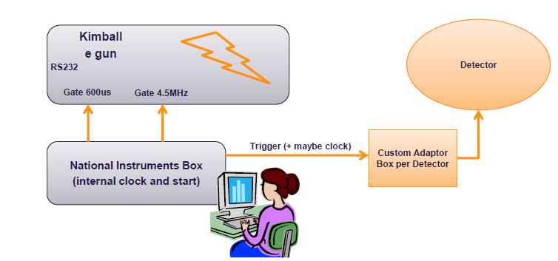
Electron gun for pulsed multi-target X-ray source
Multi-target Pulsed X-ray source approach
Electron beam - fast pulsing – proof of concept :
Oscilloscope measuring the electron beam into the lab Faraday cup
Pulse length 50 ns, fall/rise time ~2 ns
Clock and Control system (P. Gessler)
Day one solution – detector “triggered” by the source

Slide 22
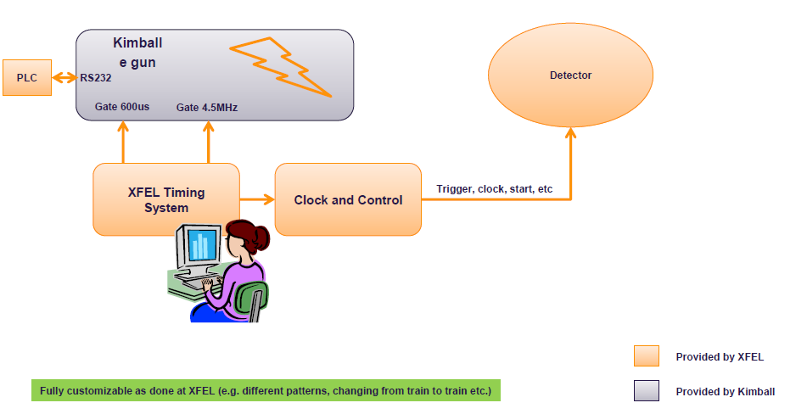
Electron gun for pulsed multi-target X-ray source
Multi-target Pulsed X-ray source approach
Electron beam - fast pulsing :
Oscilloscope measuring an electron beam into the lab Faraday cup
Pulse length 50 ns, fall/rise time ~2 ns
Clock and Control system (P. Gessler)
Final solution – XFEL Timing system

Slide 23
Summary
Work on calibration is ongoing in the Consortia and XFEL → discussed during regular meetings
Setup of the calibration infrastructure is ongoing
Baseline for laboratory X-ray/electron sources defined
→ Fe-55 source and a portable X-ray tube setups operational soon
→ Work in progress for setup with high-power X-ray tube
→ Work on design of the pulsed multi-target X-ray setup progressing well
→ PLC Beckhoff control system requirements defined
→ Implementation ongoing
Calibration pipeline implemented in Karabo

Slide 24

Outlook
Proposal for parameters to be calibrated or characterized exists
Responsibilities were defined
Open questions to be addressed by the Consortia and XFEL
how precise the calibration needs to be done (input from instruments necessary) ←→ definition of methodology/tools ←→ how precise the calibration can be done for each of the parameters
definition of priorities
Example:
1 - gain conversion, noise,
bad pixels, droop
2- quantum efficiency
3 – split events?

Slide 25
Answers to the Questions
of the XDAC
Committee

Slide 26
Comments from the last XDAC report
“…It should be clarified if the consortia are expected to supply a detector performance data sheet.”
The Consortia already provided the expected performance data sheet. The specs sheets are and will be updated accordingly to the best current knowledge.
“We recommend purchase of a single shot-pules high-intensity x-ray source; high repetition need not be top priority’’
The company which can provide such kind of device was contacted (L3). The usage of their source “Pulserad Flash X-ray System 150kV” was evaluated. Finally we decided do not go for this solution.
1. The main technical reasons for that are:
Nominal energy 150kV and electron current 2kA will cause a significant safety problems as controlled areas are not foreseen in the XFEL labs and even if we decide to use the device at lower energies and current, a TÜV approval will be required for the worst case scenario.
Life time of the X-ray tubes, 250 pulses, makes the usage of this device very expensive.
2. For tests of detector parameters, which require high intensity and short pulses we are planning to use a beam from synchrotrons and/or FELs, where we can also test the time response of our detectors at the same time. In our opinion the pulsed multi-target X-ray source with the time structure of the XFEL and a power peak of 1kW and commercially-available X-ray tubes (P> 2kW) should allow us to characterize most of the detector parameters in our lab.
3. LPD performance test at PETRA and LCLS demonstrated importance of high rep. rate sources even in the laboratory

Slide 27
Backup slides

Slide 28
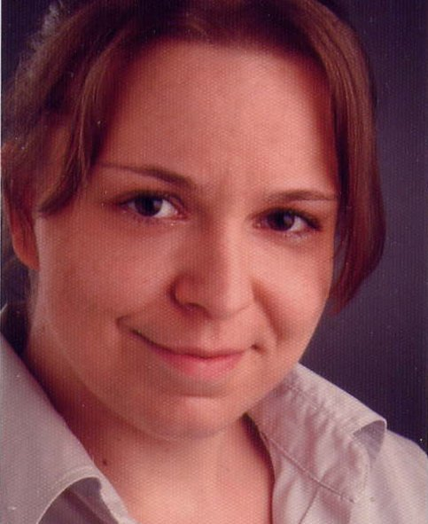
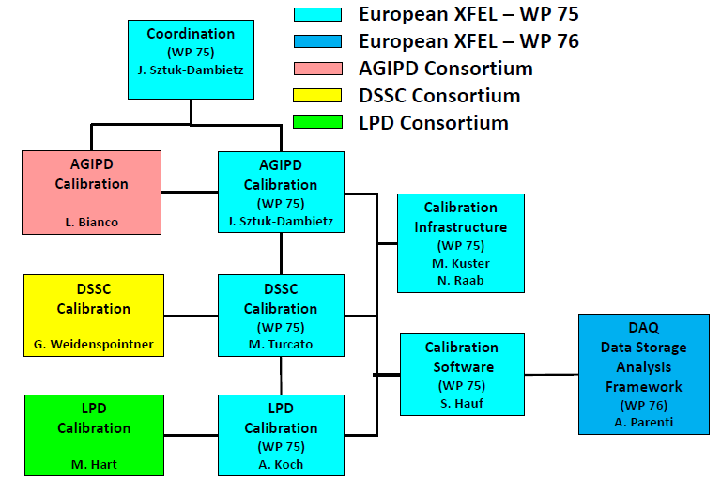
Calibration Working Group - Update
Calibration Scientist – Natascha Raab
  Started November 2013
  Work on construction, installation and commissioning of X-ray test setups and calibration infrastructure
  Prototype detector characterization and calibration tests

Slide 29
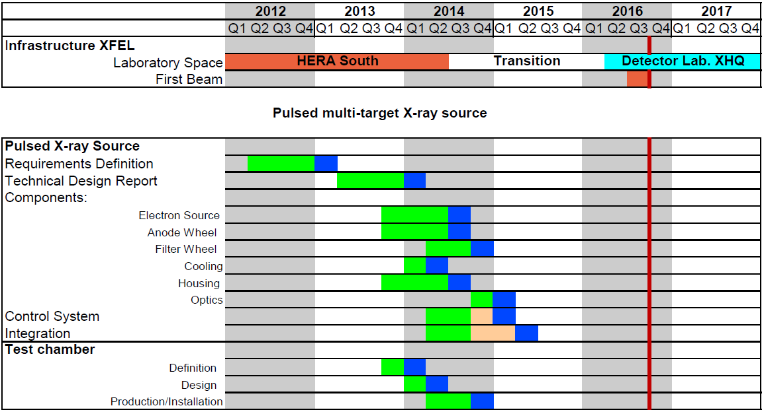
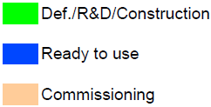
Pulsed multi-target X-ray generator - schedule

Slide 30
Pulsed multi-target X-ray generator - schedule
TDR for pulsed X-ray source ready
Pulsed X-ray source
ready for operation
Detector test chamber ready to use

Slide 31
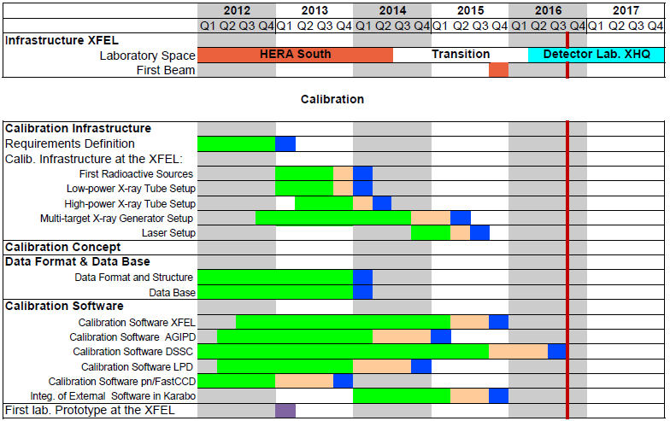
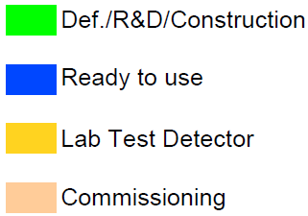
Schedule
First X-ray sources at XFEL
Data Base & Data format ready for use
Integration of external sw in Karabo started
First lab. prototypes at the XFEL

Slide 32
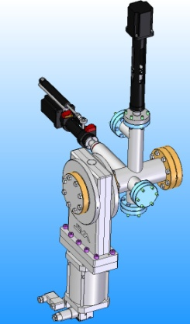

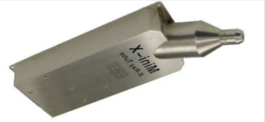
Lab X-ray Sources for Detector Calibration
Laboratory X-ray
sources at the XFEL
Radioactive isotopes
Pulsed multi-target X-ray generator
- Electron source from Kimball
- Multi target anode
- Optics (e.g. polycapillary)
Low power
P < 10W
High power
P > 2kW
micro-focusing
Conventional “DC” X-ray tubes

Slide 33
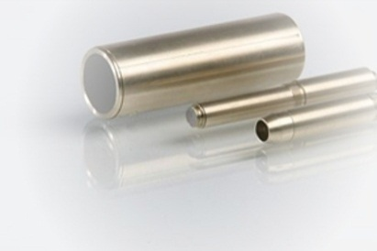
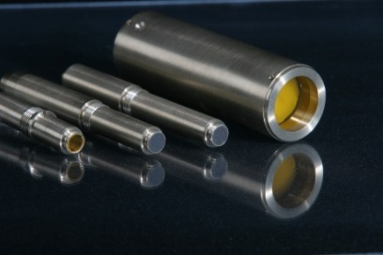
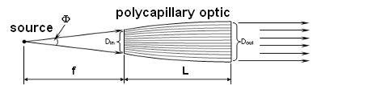

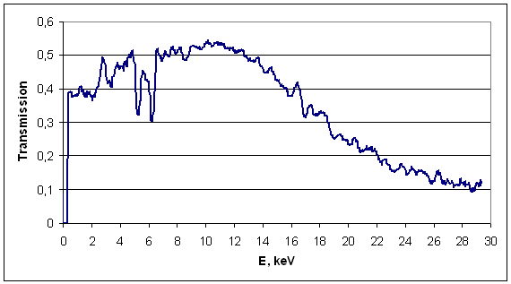
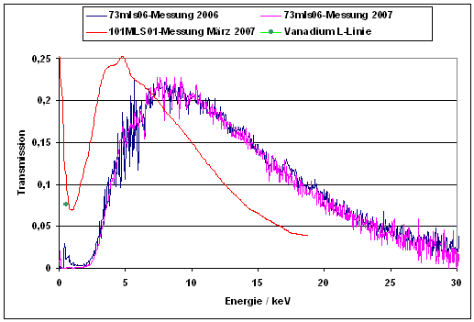
Multi-target Pulsed X-ray source approach
Polycapillary optics for wide energy range
Potential suppliers were identified
Could be a full system with support
Energy range 1(3)- 30 keV and capture angle up to 0.2 rad
  IFG Institute for Scientific Instruments

Slide 34
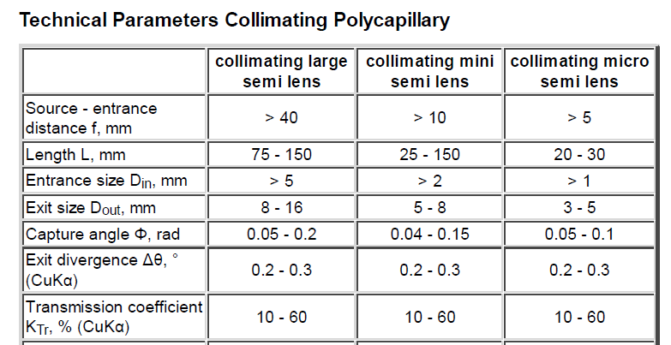
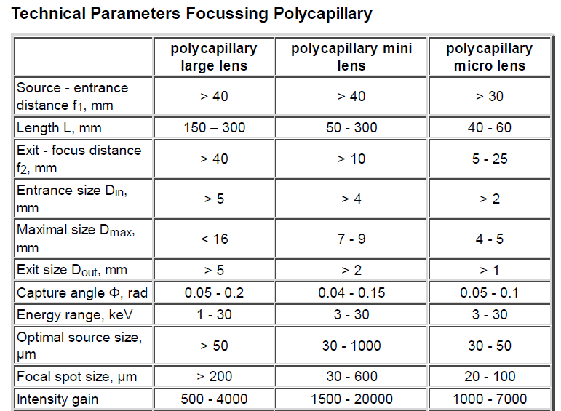
Pulsed multi-target X-ray generator – Optics
Polycapillary optics for wide energy range
Potential suppliers were identified
Delivery time 4-6 weeks
Could be a full system with support
Energy range 1(3)- 30 keV and capture angle up to 0.2 rad
  IFG Institute for Scientific Instruments

Slide 35
X-ray yield estimation for detector plane
Intensity estimation based on simulation:
Simulation parameters
Ee= 50 keV
Target: Cu 5mmx100mm
Target angle: α = 18°
Plane virtual detector
20 cm x 20 cm x 0.5 cm
IP - detector - 20 cm
Expected number of X-rays @
Ee=50keV, I_{e} = 20 mA & t_{pulse} = 50 ns
2 x 10⁶ → 2 hits per pulse/pixel (200 μm x 200 μm)
+ Optics
Cluster illumination (~a few mm²)
Collimating optics (gain factor > 10 ) →
> 20 hits per pulse/pixel (200 μm x 200 μm)
Point-like illumination
Focusing optics (gain factor = 500 – 20000) → > 1000 hits per pulse/pixel (200 μm x 200 μm)

Slide 36
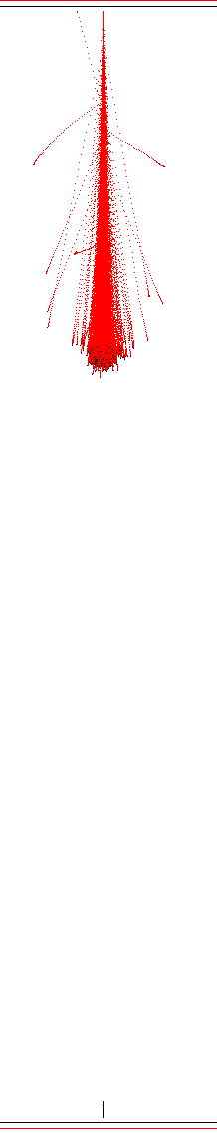
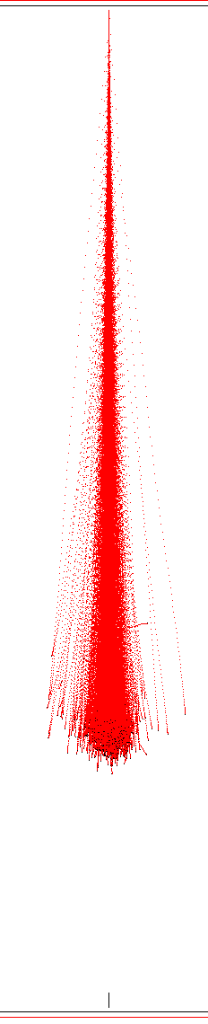
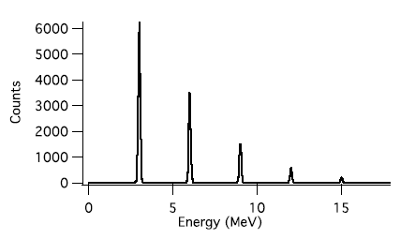
Highlights From the Last Calibration Meeting (V)
DEFEL (LABeC) proton beam line for silicon detector characterization (A.Castoldi)
Motivation: calibration for high intensity regime (low gain)
Solution: mono-energetic MeV protons → Absolute energy calibration !
Main parameters of the facility
  Energy 1-6 MeV
  Position resolution of 10-100µm
  Time resolution <1ns
  Ionization profile: from shallow (1 MeV p) deep (6 MeVp)
  Single shot up to 10 kHz rep rate
Lateral range of protons in Si
1 MeV
3 MeV
1 µm
5 MeV
4.5 µm
N=1
Energy spectrum
(3 MeV proton beam)
Proton range vs Si thickness
N=2
9.5 µm
N=3
N=4
N=5

Slide 37
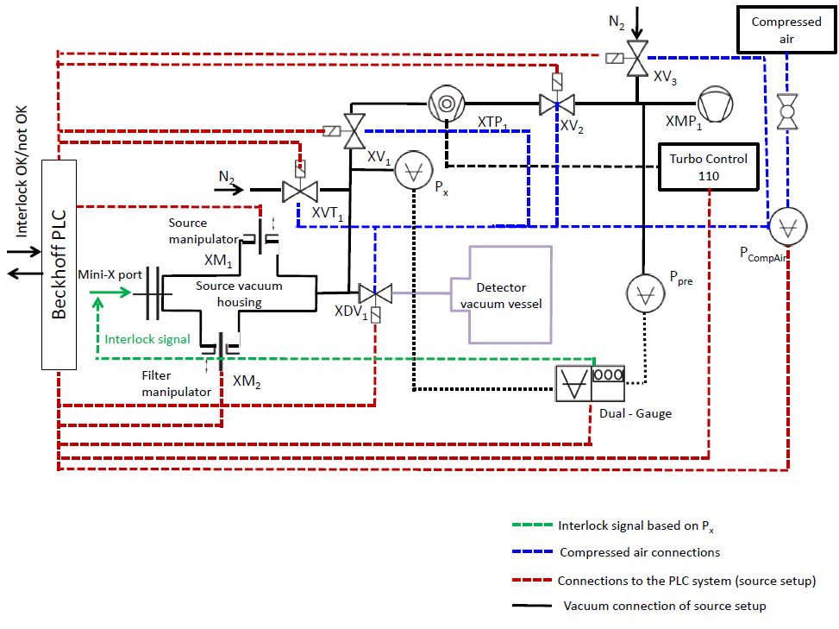
Vacuum compatible X-ray setup
Vacuum system – fully controllable by Beckhoff PLC
Functional tests of the setup are ongoing

Slide 38
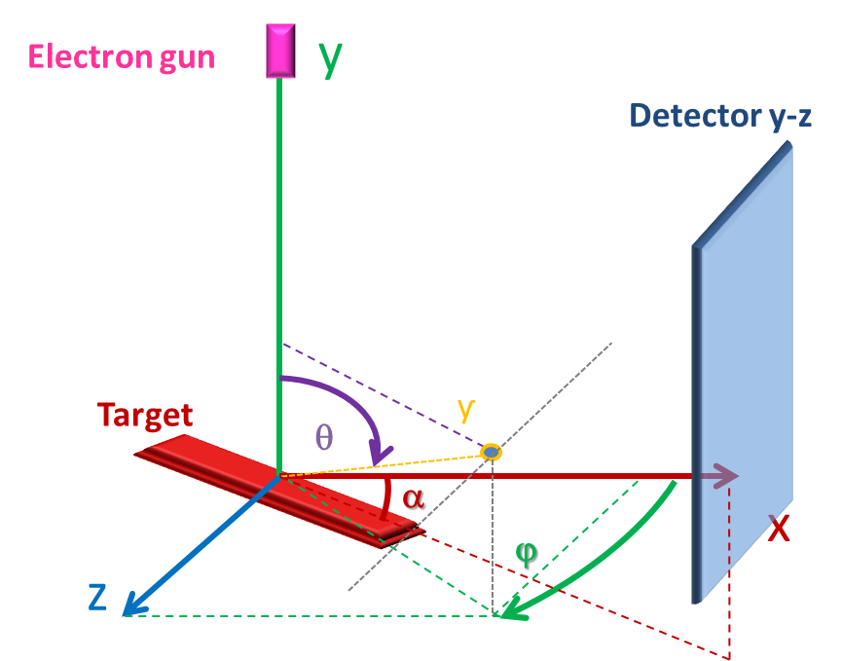
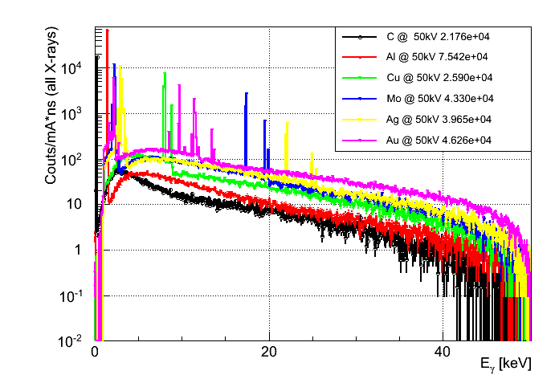
X-ray Generator - GEANT4 Simulation
Intensity estimation using GEANT4 simulation toolkit
Model for low energy – EM-physics: Penelope
(based on validation in an independent paper)
Simulation was done for:
different target materials,
different electron energies,
different electron beam size,
different target angles
tanθ = y/x
tanϕ = z/x
Ee= 50 keV
α = 18º

Slide 39
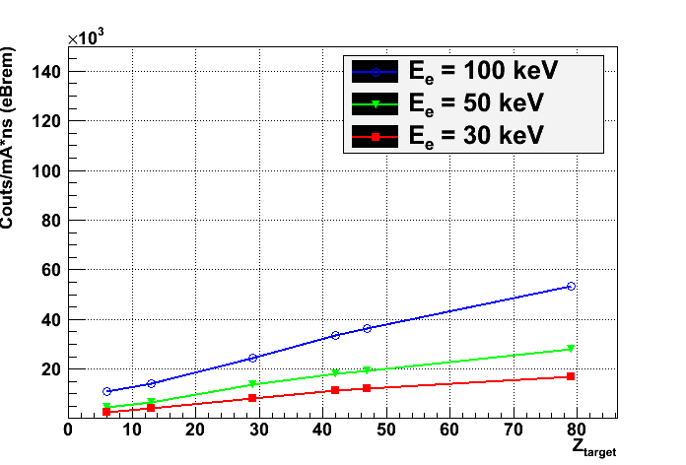
39
Target material & e- energy dependences –
X-ray Intensity – Bremsstrahlung
Simulation parameters:
40 M primary e-
Ee = 30,50,100 keV
Target size: 5mmx100mm
Target materials: C, Al, Cu, Mo, Ag, Au
Target angle: α =18°
Spherical virtual detector → full angular range
Simulated number of Bremsstrahlung @ I_{e} = 20 mA & t_{pulse} = 50 ns
Target | C Z=6 | Al Z=13 | Cu Z= 29 | Mo Z=42 | Ag Z=47 | Au Z=79
e- energy
30 keV | 2.6 x 10⁶ | 4.2 x 10⁶ | 8.3 x 10⁶ | 1.1 x 10⁷ | 1.2 x 10⁷ | 1.7 x 10⁷
50 keV | 4.7 x 10⁶ | 6.7 x 10⁶ | 1.4 x 10⁷ | 1.8 x 10⁷ | 1.9 x 10⁷ | 2.8 x 10⁷
100 keV | 1.1 x 10⁷ | 1.4 x 10⁷ | 2.4 x 10⁷ | 3.3 x 10⁷ | 3.6 x 10⁷ | 5.4 x 10⁷

Slide 40
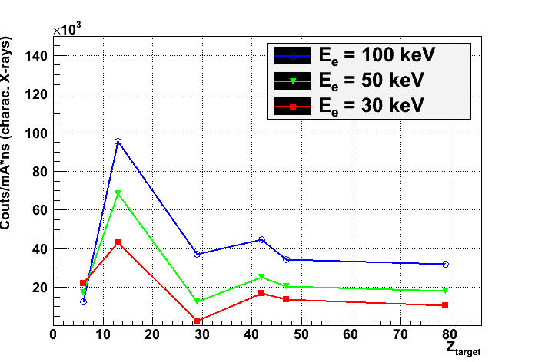
40
Target material & e- energy dependences –
X-ray Intensity – Fluorescence
Simulation parameters:
40 M primary e-
Ee = 30,50,100 keV
Target size: 5mmx100mm
Target materials: C, Al, Cu, Mo, Ag, Au
Target angle: α =18°
Spherical virtual detector → full angular range
Simulated number of fluorescence @ I_{e} = 20 mA & t_{pulse} = 50 ns
Target | C Z=6 | Al Z=13 | Cu Z= 29 | Mo Z=42 | Ag Z=47 | Au Z=79
e- energy
30 keV | 2.2 x 10⁷ | 4.3 x 10⁷ | 2.8 x 10⁶ | 1.7 x 10⁷ | 1.4 x 10⁷ | 1.0 x 10⁷
50 keV | 1.7 x 10⁷ | 6.9 x 10⁷ | 1.2 x 10⁷ | 2.5 x 10⁷ | 2.0 x 10⁷ | 1.8 x 10⁷
100 keV | 1.3 x 10⁷ | 9.5 x 10⁷ | 3.7 x 10⁷ | 4.5 x 10⁷ | 3.5 x 10⁷ | 3.2 x 10⁷

Slide 41




41
Target material & e- energy dependences –
X-ray production efficiency
Eff $= \frac{Nγ}{N prim. electrons}$
All X-rays
Bremsstrahlung
Fluorescence
Efficiency of X-ray production
~ 0.2- 1.8 %

Slide 42



42
Target material & e- energy dependences –
X-ray angles - θ
Simulation parameters
40 M primary e-
Ee = 30,50,100 keV
Target size: 5mmx100mm
Target materials: C, Al, Cu, Mo, Ag, Au
Target angle: α =18°
Spherical virtual detector → full angular range
Ee=100 keV
Ee=30 keV
Ee=50 keV

Slide 43



43
Target material & e- energy dependences –
X-ray angles - ϕ
Simulation parameters
40 M primary e-
Ee = 30,50,100 keV
Target size: 5mmx100mm
Target materials: C, Al, Cu, Mo, Ag, Au
Target angle: α =18°
Spherical virtual detector → full angular range
Ee=100 keV
Ee=50 keV
Ee=30 keV

Slide 44
X-ray Generator Setup
X-ray generator setup with different targets and filters for detector characterization
Targets
Target material |  | Emission Line Energy [keV]
Z | Symbol | K_{a1} | K_{a2} | K_{b1} | L_{a1} | L_{a2} | L_{b1}
6 | C | 0.277
12 | Mg | 1.25 | 1.25 | 1.30
13 | Al | 1.49 | 1.49 | 1.56
8 14 | O Si | 0.525 1.74 | 1.74 | 1.84
22 | Ti | 4.51 | 4.50 | 4.93 | 0.452 | 0.452 | 0.458
24 | Cr | 5.41 | 5.41 | 5.95 | 0.573 | 0.573 | 0.583
26 | Fe | 6.40 | 6.39 | 7.06 | 0.705 | 0.705 | 0.719
27 | Co | 6.93 | 6.92 | 7.65 | 0.776 | 0.776 | 0.791
28 | Ni | 7.48 | 7.46 | 8.26 | 0.852 | 0.852 | 0.868
29 | Cu | 8.045 | 8.027 | 8.905 | 0.929 | 0.929 | 0.950
42 | Mo | 17.48 | 17.38 | 19.61 | 2.29 | 2.29 | 2.39
47 | Ag | 22.16 | 21.99 | 24.94 | 2.98 | 2.98 | 3.15
74 | W | 59.32 | 57.98 | 67.24 | 8.40 | 8.36 | 9.67
79 | Au | 68.80 | 66.99 | 77.98 | 9.71 | 9.63 | 11.44
 | Makrolon (ceramics) | 0.52 | 0.68 | 0.93 | 1.25 | 1.49 | 1.74
 |  | 2.62 | 3.31 | 3.59 | 6.40 | 7.06 | 8.04
Filters
Description | Material | Thickness
Multilayer Thin | Al Polyimide | 40 nm 160nm
Multilayer Medium | Al Polyimide | 80 nm 160 nm
Multilayer Thick | Sn Al Polypropylen Al | 45 nm 55 nm 330 nm 55 nm
Al Thin | Al | XX nm
Al Think | Al | XX nm
Cu Thin | Cu | XX nm
Cu Thick | Cu | XX nm
Ni Thin | Ni | XX nm
Ni Thick | Ni | XX nm

Slide 45
Kimball Electron guns – Pulsing
Dual grid pulsing option, there are two grid power supplies built into the main power supply. A pulsing TTL (transistor-transistor-logic) signal switches rapidly between the two supplies, pulsing the beam on and off.
Beam blanking is a different type of pulsing that does not rely on grid cut-off and is used in some high current guns. Blanking deflects the electron beam to one side of the gun tube to interrupt the flow of electrons to the target without actually turning off the beam.

