Slide 1
Future Collider Projects at CERN
Daniel Schulte
Jahresversammlung der deutschen Teilchenphysik
Bad Honnef - 23rd November 2013

Slide 2
The European Strategy for Particle Physics
Update 2013
c) Europe’s top priority should be the exploitation of the full potential of the LHC, including the high-luminosity upgrade of the machine and detectors with a view to collecting ten times more data than in the initial design, by around 2030. This upgrade programme will also provide further exciting opportunities for the study of flavour physics and the quark-gluon plasma.
HL-LHC from a study to a PROJECT
300 fb⁻¹ → 3000 fb⁻¹
including LHC injectors upgrade LIU (Linac 4, Booster 2GeV, PS and SPS upgrade)

Slide 3
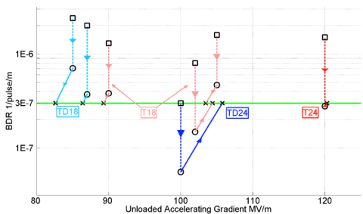
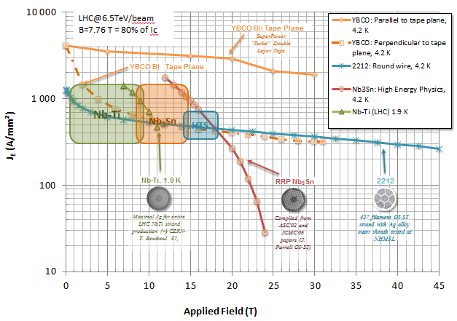
Ambitious Post-LHC Accelerator Project at CERN
d) CERN should undertake design studies for accelerator projects in a global with emphasis on proton-proton and electron-positron high-energy frontier machines. These design studies should be coupled to a vigorous accelerator R&D programme, including high-field magnets and high-gradient accelerating structures, in collaboration with national institutes, laboratories and universities worldwide.
HGA
HFM
F. Bordry

Slide 4
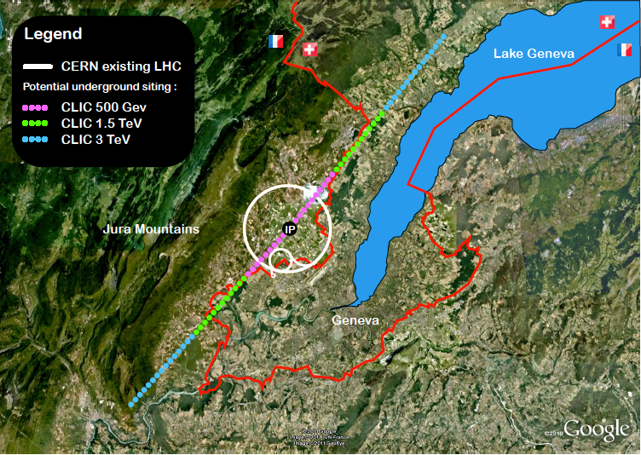
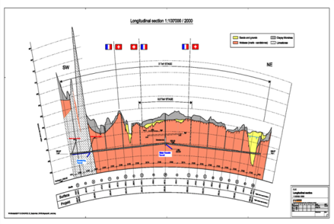
CLIC Site
Tunnel implementations (laser straight)
Central MDI & Interaction Region
Notes:
Main points:
After the work done for the CDR there are several key points that need to be addressed or improved in the coming years (mention the five points on the fly in)
Several of them, for example costing-power-physics-some technical developments, can and will be done in collaboration with similar work for the large ring

Slide 5
CLIC Developments Towards 2018
Notes:
Main points:
After the work done for the CDR there are several key points that need to be addressed or improved in the coming years (mention the five points on the fly in)
Several of them, for example costing-power-physics-some technical developments, can and will be done in collaboration with similar work for the large ring

Slide 6
CLIC Collaboration
29 Countries – over 70 Institutes
Accelerator collaboration
Detector collaboration
Accelerator + Detector collaboration
Next CLIC workshop 3-7 February 2014 at CERN
http://indico.cern.ch/conferenceDisplay.py?confId=275412
Notes:
The CLIC accelerator and detector&physics studies are already set up at international collaboraitons with wide participation from member and non-member states

Slide 7
FCC Study Scope and Structure
Future Circular Colliders - Conceptual Design Study
for next European Strategy Update (2018)
Infrastructure
tunnels, surface buildings, transport (access roads), civil engineering, cooling ventilation, electricity, cryogenics, communication & IT, fabrication and installation processes, maintenance, environmental impact and monitoring, safety
Hadron injectors
Beam optics and dynamics
Functional specs
Performance specs
Critical technical systems
Operation concept
Hadron collider
Optics and beam dynamics
Functional specifications
Performance specs
Critical technical systems
Related R+D programs
HE-LHC comparison
Operation concept
Detector concept
Physics requirements
e+ e- collider
Optics and beam dynamics Functional specifications
Performance specs
Critical technical systems
Related R+D programs
Injector (Booster)
Operation concept
Detector concept
Physics requirements
e- p option: Physics, Integration, additional requirements

Slide 8
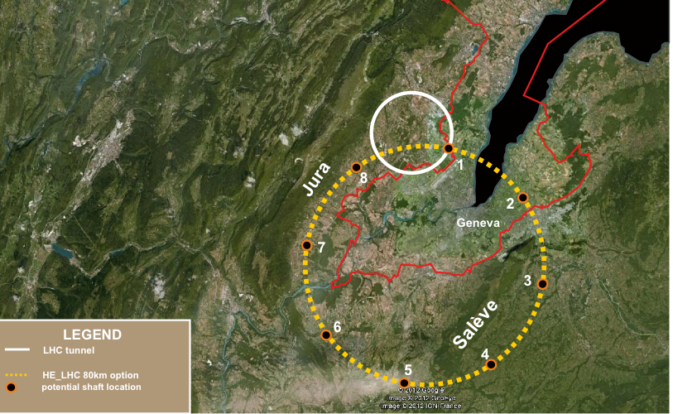
Tentative Site Layout
80-100 km tunnel infrastructure in Geneva area
design driven by pp-collider requirements
with possibility of e+-e- (TLEP) and p-e (VLHeC)
15 T ⇒ 100 TeV in ~100 km
20 T ⇒ 100 TeV in ~80 km

Slide 9
Prel. Parameters for FHC (VHE-LHC)
CMS energy = 100 TeV
Peak luminosity = 1-5x10³⁴ cm⁻²s⁻¹ per main IP
# main IPs = 2
Bunch spacing = 25ns
Range 5-50 ns being explored
Pile-up of 34, 170, 340 for 5, 25, 50ns and 5x10³⁴cm⁻²s⁻¹
Dipole field = 15 T (baseline)
20 T option, using high temperature superconductor
Circumference ~100 km
Total beam-beam tune shift = 0.01 (conservative)
β* = 1.1 m [2 m conservative option] linked to total beam current (~0.5-1 A)
From M. Benedikt, D. S. and F. Zimmermann

Slide 10
FHC Challenges
Dipole and other magnets
Heat load at beam screen, cryogenics, beam pipe design
Machine protection, failures, radiation, collimation
Electron cloud
Machine detector interface
Operation with significant damping
…
Cost
To reduce cost will have to push parameters
Need to find an optimised design

Slide 11
Prel. Parameters for FEC (TLEP)
Energy = 91, 160, 240, 350 GeV c.m.
(energy upgrade 500 for ZHH/ttH)
Peak luminosity / IP
5x10³⁴ cm⁻²s⁻¹ at Higgs
~1x10³⁴ cm⁻²s⁻¹ at top
~50x10³⁴ cm⁻²s⁻¹ Z
#IPs = 2 or 4
Circumference ~100 km (from FHC)
Total SR power ≤ 100 MW (design limit)
Beam-beam tune shift / IP scaled from LEP
Top-up injection required
β_{y}* = 1 mm ~ σ_{z}
From M. Benedikt and F. Zimmermann

Slide 12
Prel. Parameters FHEC (VHELHC-TLEP)
Lepton energy = 60, 120, 250 GeV
p energy = 50 TeV
#IPs = 1 or 2
Spot size determined by protons
Lepton current from FEC (SR power ≤ 50 MW)
From M. Benedikt and F. Zimmermann

Slide 13
Main areas for design study
Preparatory group
for a kick-off meeting
=> Steering committee
Machines and infrastructure conceptual designs
Technologies
R&D activities
Planning
Physics experiments detectors
Infrastructure
High-field magnets
Hadron physics experiments
interface, integration
Hadron collider conceptual design
Superconducting RF systems
e⁺ e⁻ coll. physics experiments interface, integration
Hadron injectors
Cryogenics
Lepton collider conceptual design
Specific technologies
e⁻ - p physics, experiments,
integration aspects
Safety, operation, energy management environmental aspects
Planning

Slide 14
Timeline
CDR and Cost Review 2018
today
Project
FCC Study : p-p towards 100 TeV
Kick-off meeting: 12th-14th Feb. 2014
FCC: Future Circular Colliders

Slide 15
Summary
The CLIC study is continued to be ready for decision in 2018
Also contributions to ILC
CLIC meeting 3.-7. February at CERN
CERN is starting a new international study of future circular colliders (FCC): CDR and cost review for the next ESU (target 2018)
The study is driven by the hadron collider at the energy frontier, determining also the infrastructure.
The study will also contain an e⁺e⁻ collider, as potential intermediate step, and look at an e-p option.
FCC kick-off meeting: 12-14. February 2014 in Geneva area
- Establishing international collaborations
Set-up study groups and study committees
International Advisory Committee (IAC)
Thanks to Michael Benedikt and Steinar Stapnes for some slides

