Slide 1
News from DESY.
Joachim Mnich
KET Jahresversammlung
Bad Honnef
November 23, 2013

Slide 2
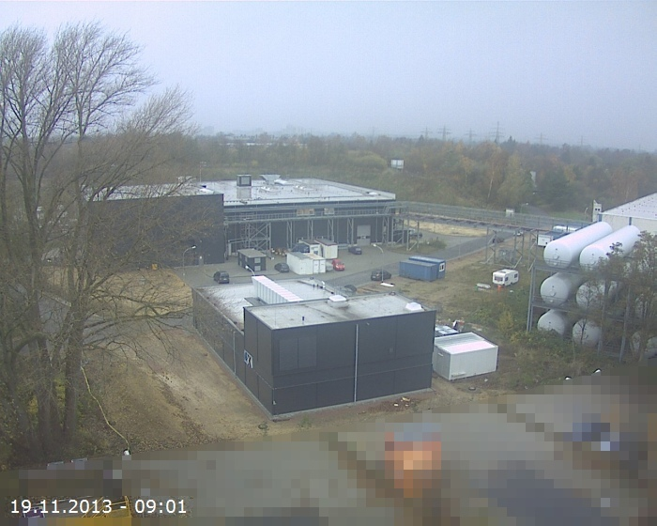
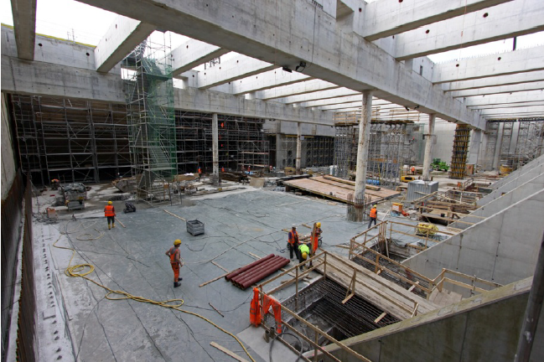
Status European XFEL
Experimental Hall
Injector complex on DESY site

Slide 3
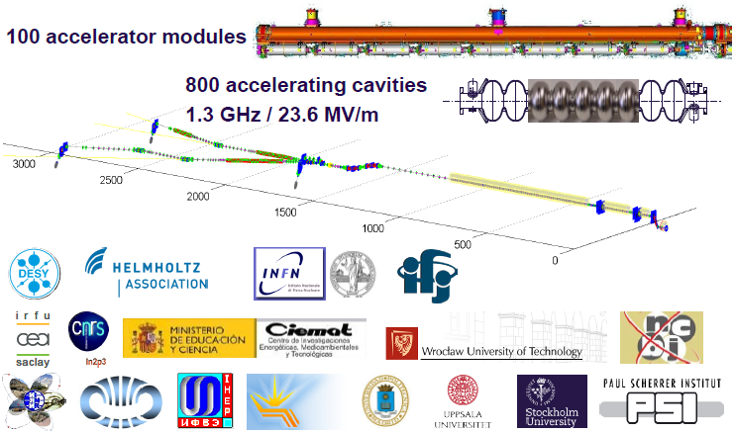
Accelerator

Slide 4
Industrial Cavity Production
As of 11.09.2013
Num. of cavities:
vendor 1 23
vendor 2 56
Close to ILC specs
2nd pass: additional high-pressure rinse
Maximum gradient
usable gradient: X-ray limited (dark current)

Slide 5
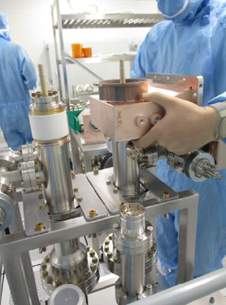
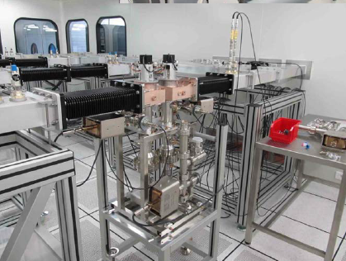
RF Coupler
Main problem
RF couplers
  Delivery rate of 8 per week not yet reached
  Still problems with copper plating quality
Critical issue for schedule

Slide 6
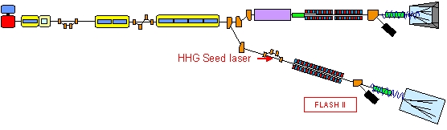
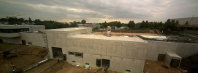
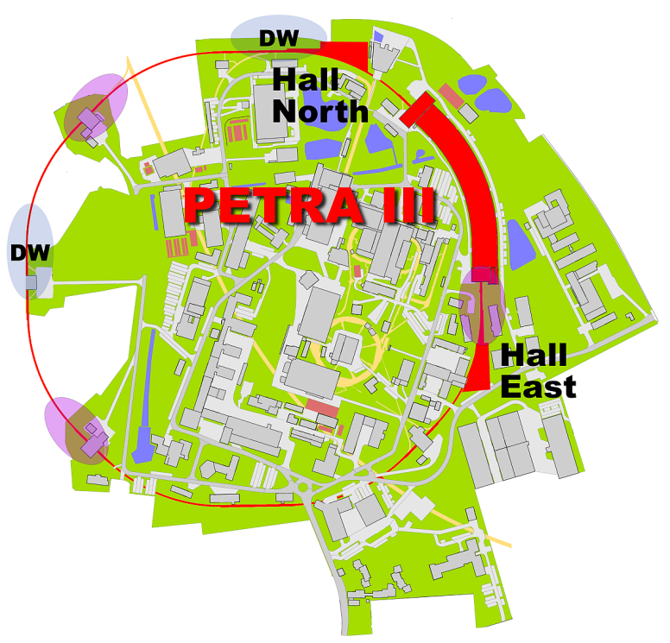
FLASH II and PETRA III
FLASH II:
  Civil engineering finished
  User operation in 2015
PETRA III extension:
Civil engineering in 2014
No PETRA III operation in 2014
Impact on DESY Testbeam
(see below)

Slide 7

DESY Particle Physics
New funding proposal 2015-19 to Helmholtz (DESY+KIT)
  submitted November 1st
  evaluation February 2014
Common proposal with astro-particle and hadron & nuclei
  with other Helmholtz centres
Application for base budget
Investment proposals:
  LHC upgrades and German Tier-1/2 computing in preparation

Slide 8
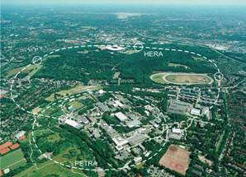
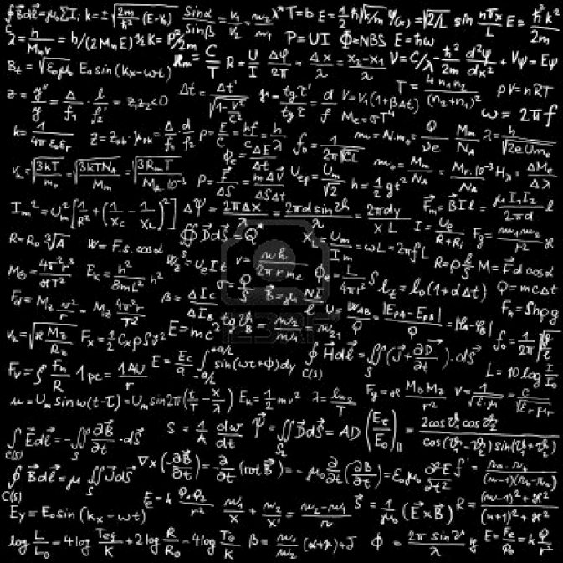
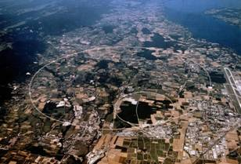
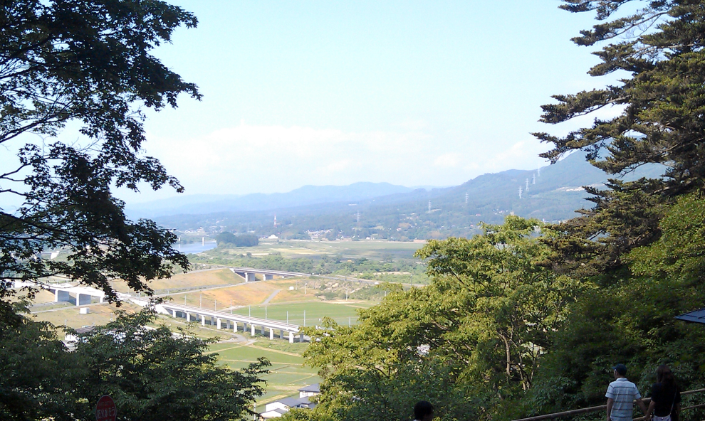
DESY Particle Physics 2015-19
HERA
Theory
LHC
LHC (ATLAS & CMS)
e⁺e‒ physics: (Belle & ILC)
Theory
ILC

Slide 9
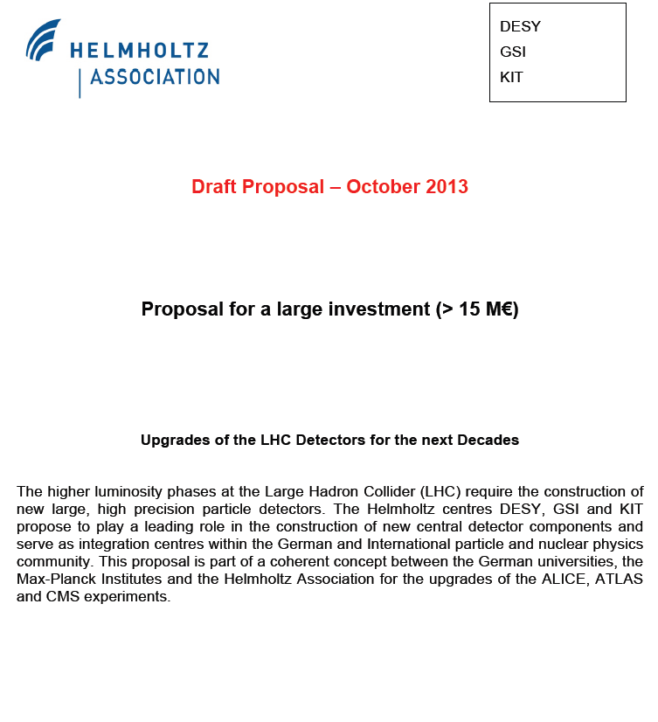
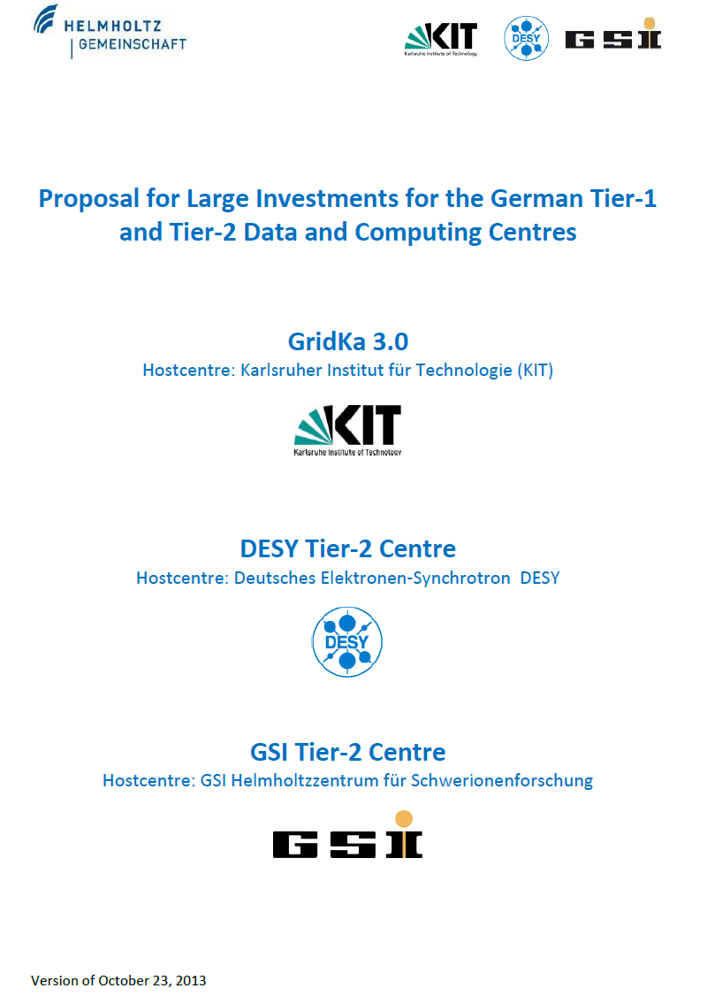
Helmholtz Large Investment Proposals
DESY: 20 M€ ATLAS + CMS
GSI: 4.2 M€ ALICE
KIT: 3.8 M€ CMS
KIT: 16.4 M€ Tier-1
DESY: 13.2 M€ Tier-2
GSI: 3.5 M€ Tier-2 (ALICE)
(invest for 5 years)

Slide 10
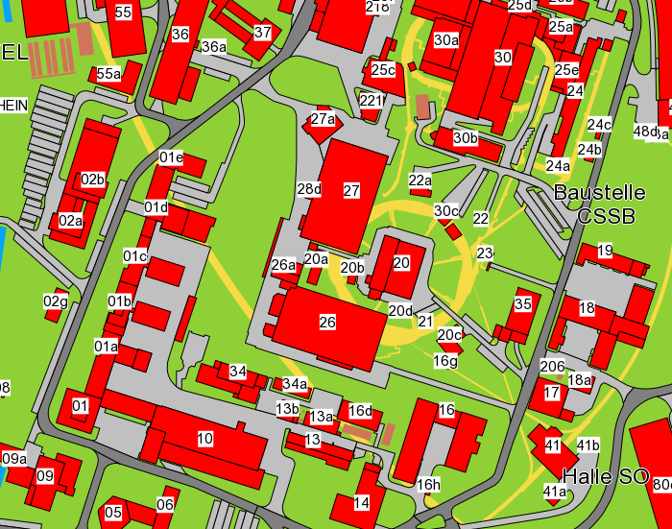
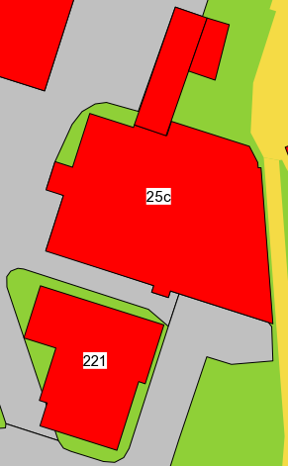
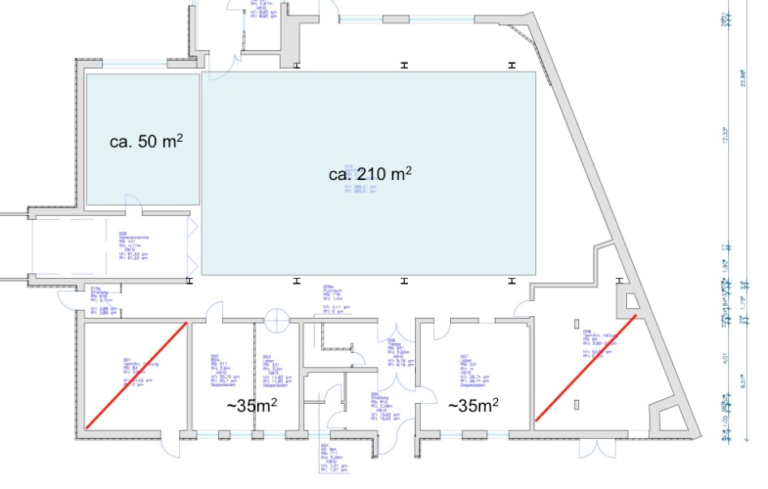
Laboratory for Large Detectors
Geb. 25c + extention1
DESY will provide the infrastructure for the detector construction & commissioning:
  reuse Geb. 25c (annex to DORIS hall)
  plus extension

Slide 11
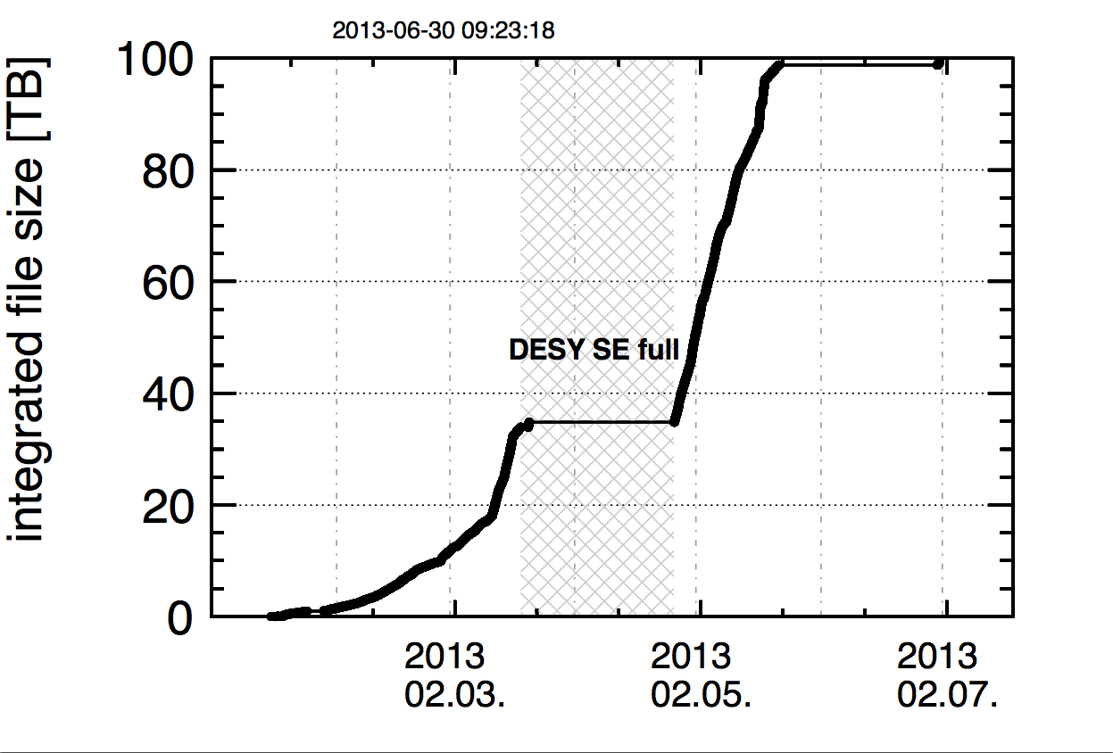
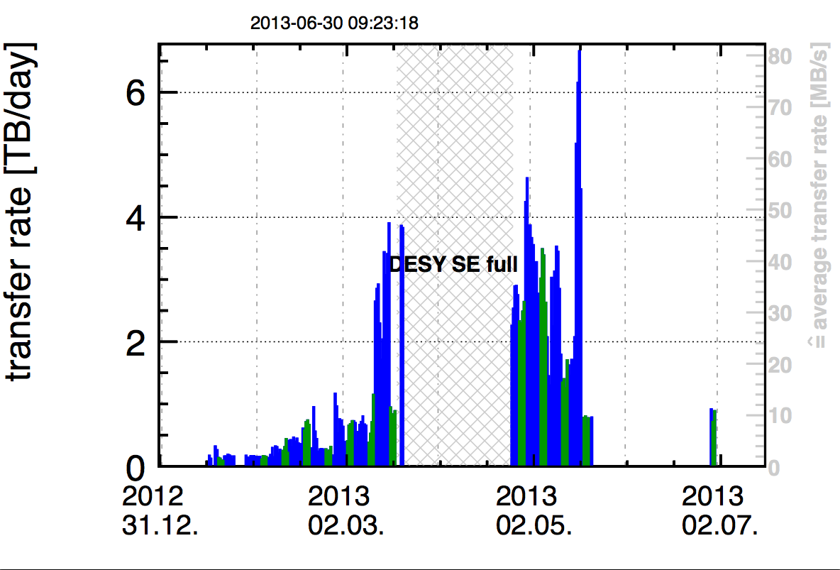
Belle
Backup copy of full Belle data set at DESY
  about 1000 fb⁻¹ collected between
  1999 and 2010

Slide 12
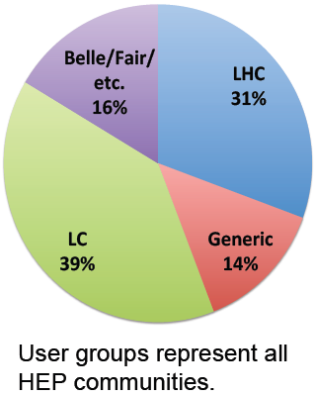
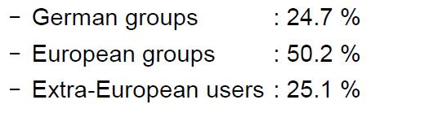
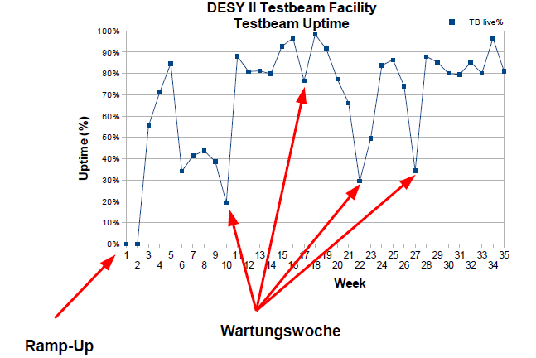
DESY Testbeam
High demand in 2013 for detector R&D
  SPS shutdown at CERN 2013/14
Used by many projects
  >300 users in 2013
2014: due to PETRA shutdown
dedicated resources required
  to operate DESY III and pre-accelerators
Only 2 months scheduled (Jan/Feb 2014)
  booked out already
Service weeks

Slide 13
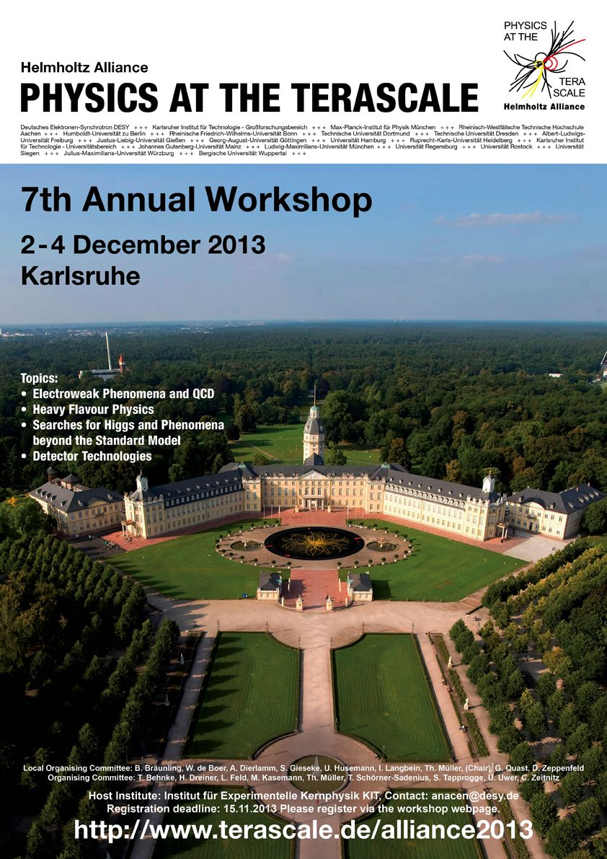
Alliance: Schools & Workshops (since 08/2012)
“Prejudice meets reality” – 08/12 (Bonn)
“Advanced programming concepts” – 10/12
Proton structure in the LHC era – 10/12
Introduction to the Terascale – 02/13
Fast detector simulation in HEP – 03/13
Introductory statistics school – 03/13
MCNet+Alliance MC School – 08/13
LC Physics School – 10/12
C++ - 11/13
MC methods in statistics /
data analysis – 11/13 (MPI)
Fast MC in HEP – 01/14
MC School - 03/14
Introduction to the Terascale – 03/14
Statistics, PDFs – probably 04/14
Annual meeting – 12/12
MC methods in natural sciences, engineering, finance… - 02/13
Detector Workshop – 02/13
GPU workshop – 04/13
SUSY workshop – 05/13
Event generators and resummation
(Durham, series initiated by Z. Nagy) – 07/13
Anomalous Quartic Gauge couplings – 09/13 (Dresden)
LC Forum – 10/13
GPU workshop in Italy – series based on our first event – 04/14
PDF Benchmarking WS – 04/13 (?)
Event generators and resumation – 06/13 (Münster)
….
Plus:
Sponsorship of conferences (Top2013, QCD@LHC2013, QCD Tools WS at FNAL, …)
10 Theorists of the Month in 2013
(Maltoni, Porod, Hautmann, Nason, Frixione, Papucci, Cacciari, Stewart,
Krämer, Glover)
Analysis Centre seminars
….

Slide 14
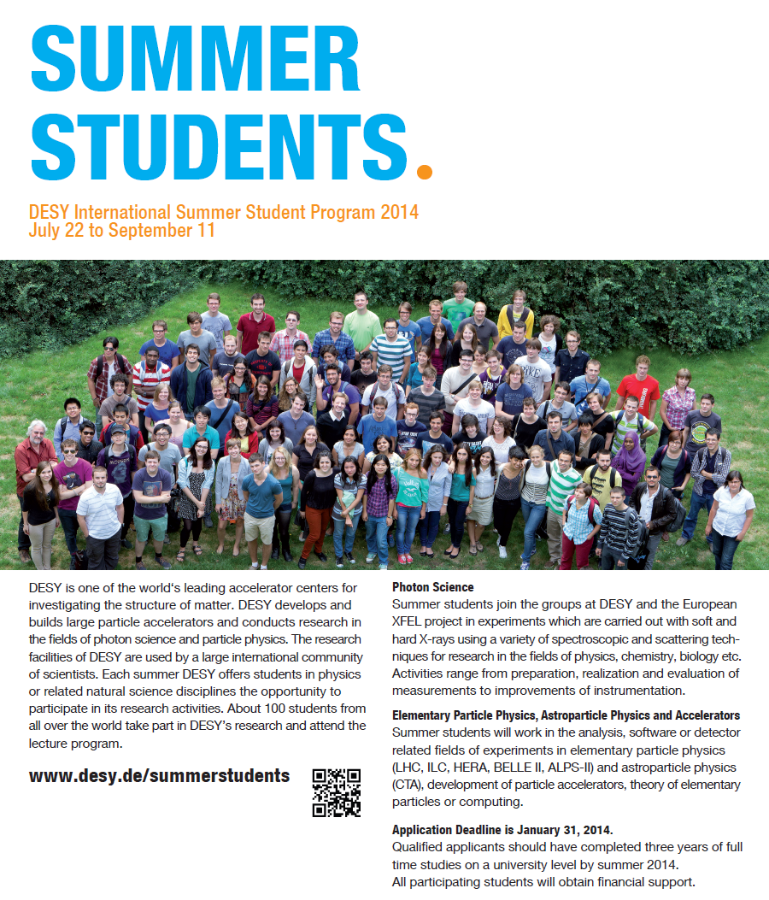
Application deadline for 2014:
January 31, 2014

