Slide 1
Summary RF locking of EO Laser in 28 f

Slide 2
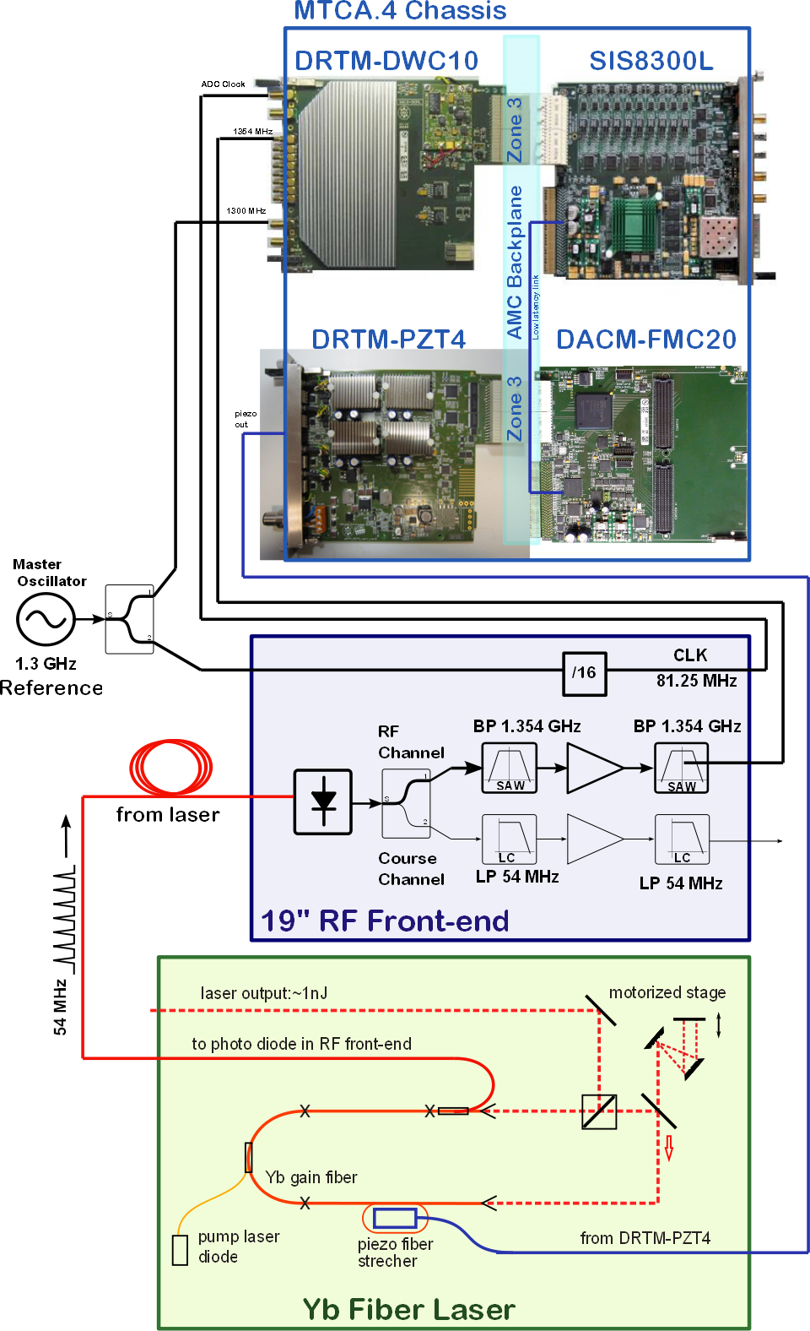
System Block Diagram
DWC8300
SIS8300-L
FMC20
PZT4
New
Piezo driver in MTCA.4
Locking through LLL
Locking BW (spec. 100 kHz) -> latency?
What is the limiting element?

Slide 3
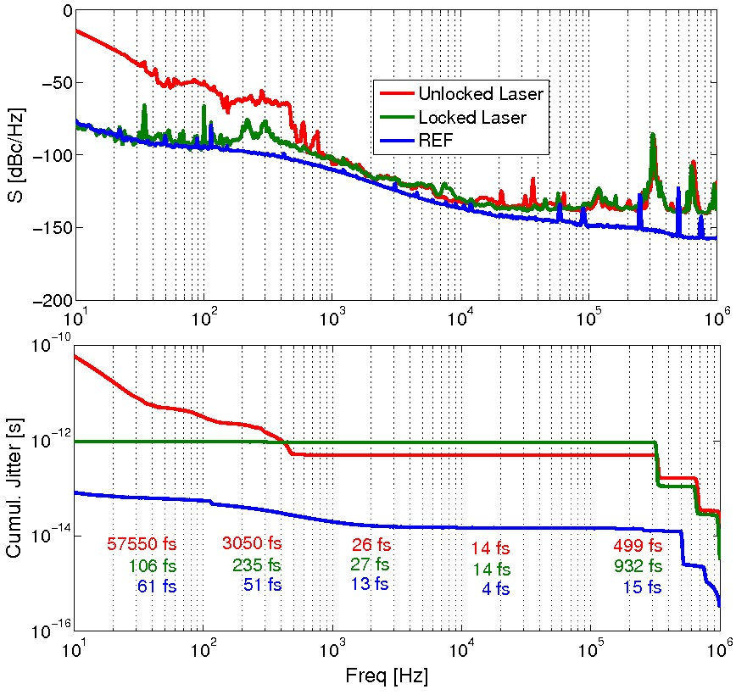
Measurement Results
Quick measurements for conference.
Open questions:
Phase noise (Recent results show better performance)
Vibration tests
EMI disturbances
Board overheating

