Slide 1
MTCA for optical Links & Laser-Synchronization
for the Laser Based Synchronization System at XFEL
Matthias Felber
2nd Follow-up meeting of Swierk MSK Collaboration Workshop
DESY, 15th October, 2013

Slide 2
Optical Links at the European XFEL
RF Master Oscillator
Some open points remain:
7 BAMs planned (could be 10)
2nd Injector comes much later, when?
2 additional Links from Synch Hutch to Und. BAMs and PPL in case Sub-Synch Hutch has problems
Seed laser ?
How many PPL links required / feasible ?
Master Laser Oscillator
Synch Hutch
10-12 Links
12 RF Links
Sub-Synch Hutch
? Links
? RF Links
RF
Links
Links
2x
Master Laser Oscillator
Links
2x
1-6x
2x
2x
2x
3x
INJL
REFM
REFM
BAM
REFM
2x
BAM
3x
REFM
2x
BAM
REFM
REFM
REFM
REFM
SEED
2x
BAM
SEED
BAM
PPL
INJL
REFM
REFM
BAM

Slide 3
Link Setup – MTCA Signals
One Channel requires ¼ of a set of 2 boards / 2 slots
4 Link stabilzations with 2 slots
(option: 8 Links on one ADC/Controller, but 2 Actuator cards)

Slide 4
Crate Configuration max. 32 Links
Data Flow:
Analog Analog
ADC ADC
Zone3/SPI?
Controller
LLL/SRIO
Hub (SFP Fiber)
LLL/SRIO
Hub (SFP Fiber)
LLL/SRIO
FMC20
FMC/SPI Zone3/SPI?
MD22 PZT4
ADCs
FMC/SPI
Controllers
Motor
Actuators
Piezo
Actuators

Slide 5
Lasers

Slide 6
New RTM for Laser Synch. (to be designed)
Phase detection with drift free detector or DWC, maybe hybrid locking using both?
Drift-free detector is OXC or L2RF (Read-out of analog electronics or direct sampling)
Frequencies:
Rep. Rate | LO | RF | IF | Clk | IF/Clk Ratio
54 MHz | 1300 MHz | 1354 MHz | 54 MHz | 81 MHz | 2/3
108 MHz | 1300 MHz | 1408 MHz | 108 MHz | 81 MHz | 4/3
216 MHz | 1354 MHz | 1300 MHz | 54 MHz | 81 MHz | 2/3
216 MHz alt. | 1300 MHz | 1516 MHz | 216 MHz | 81 MHz | 8/3
83 MHz | 3025 MHz | 3000 MHz | 25 MHz | 125 MHz | 1/5
83 MHz | 3000 MHz | 3083 MHz | 83 MHz | 125 MHz | 2/3

Slide 7
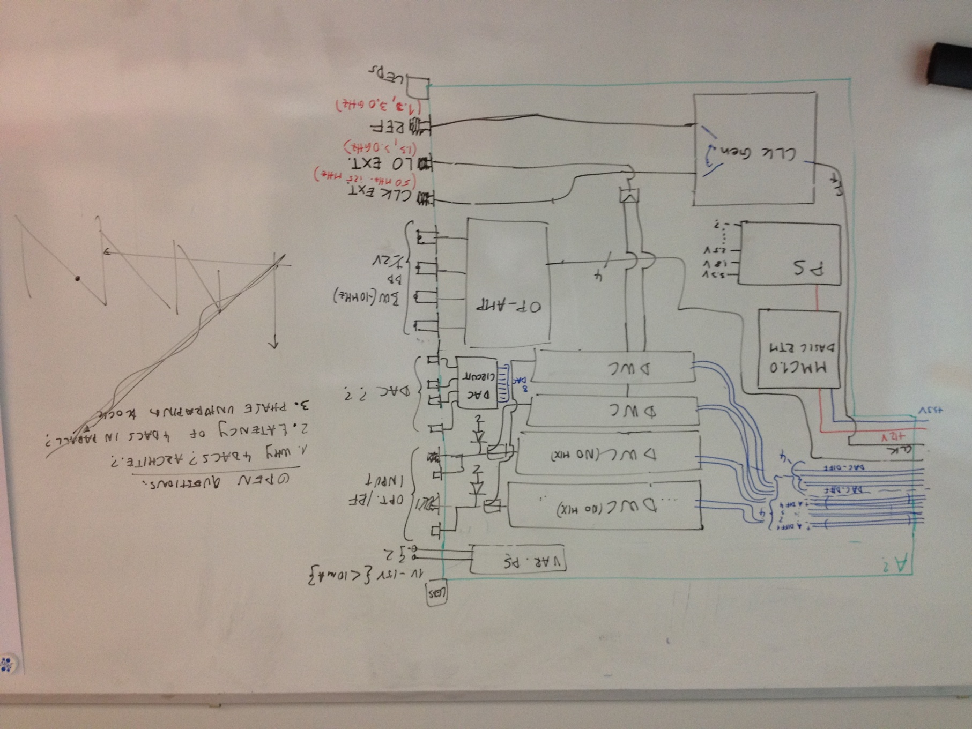
New RTM for Laser Synch. (to be designed)
2 Channel (2 lasers/4 piezos):
RTM for SIS8300L
4 DWC cells - only two with mixer, others for bucket detection (direct sampling)
External LO/Clk input or internal generation from Ref.
Baseband Inputs for balanced detector
DAC for external feed of PZT4 or other analog driver
Laser signal:
RF input (ext. diode)
Opt. input (int. diode)
PS for ext. Diode
Notes:
Before you start editing the slides of your talk change to the Master Slide view: Menu button “View”, Master, Slide Master:
Edit the following 2 items in the 1st slide: 1) 1st row in the violet header: Delete the existent text and write the title of your talk into this text field 2) The 2 rows in the footer area: Delete the text and write the information regarding your talk (same as on the Title Slide) into this text field.
If you want to use more partner logos position them left beside the DESY logo in the footer area Close Master View

