Slide 1
DAMC-FMC20 Status and general FW/HW remarks
Michael Fenner
2nd Follow-up Meeting on MTCA.4 Board Development
DESY, 15th October, 2013

Slide 2
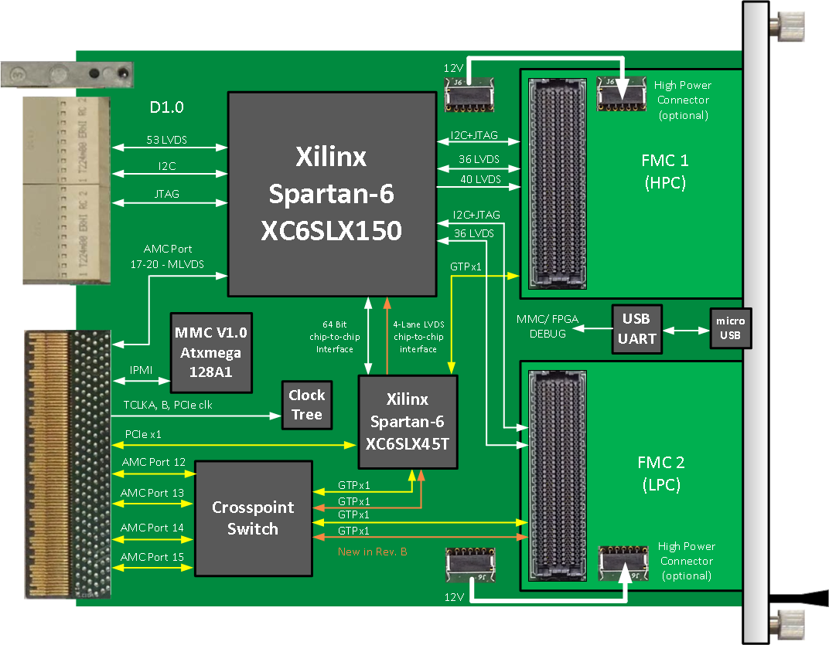
FMC20 - Overview

Slide 3
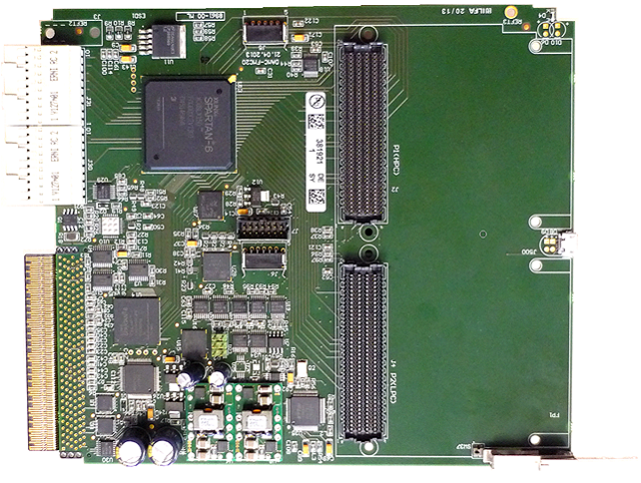
FMC20 - Status
General:
Rev. A produced
In operation together with PZT4
„Licensed“ to EicSys
Flyer/ Manual/ Package created
Deep analysis/ check
Rev. B under development
Practical point of view:
Engineer has done a good job
Board works 100% in our scenario
Total success
Product-View:
not MTCA compliant
not FMC compliant
Rev. A bug list is 2 pages long
Question: “Lab Quality” or “Industrial Quality”?
No systematic checks → many Rev. A issues would not have been detected
Problem when selling to 3rd parties
→ We need design process improvement

Slide 4
Schematic Checks for Licensing
Avoidable Bugs
Little mistakes in FMC connections → possible problems with 3rd party cards
Little mistakes in AMC connector pin-out → unterminated clocks (not used)
PCB footprint issues → some chips will be tested first in licensed Rev. B
Data sheet recommendation sometimes not followed → thermal problems ?
“NoERC-markers” not used → no open-pin checking → missing connections
MMC V1.0 and interlock standard not followed (not available at design time)
Can be avoided by 2-day check by second person
→ Omitting checks does not save time!

Slide 5
Conclusion
We can be happy with the results of FMC20 test
We can not be happy with the design process of our boards
Proposed changes in future
Written-down standards (MMC and Interlock)
Single source for symbols and footprints (Robert Wedel)
Identification of unchecked components
Design checklist for checks during development
Production approval checklist
Will be reviewed together before production
Design review by 2nd person: 2 days, Pareto principle (80% check in 20% time)
Interoperability review
Mechanics review
Error log and feature request list
All digital interfaces over my desk (FMC20, FMC25, MD22, PZT4, …)

Slide 6
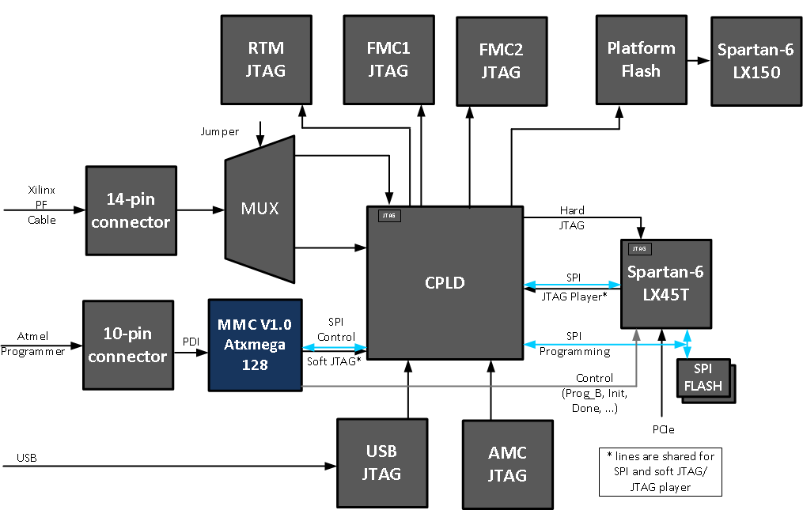
Spare Slide 1: MMC V1.0 Architecture
DESY offers MMC V1.0 Starter Kit → WE should stick to this
Benefits
Common architecture
Common MCU software
Common FW update software
Common JTAG distribution
Common RTM / FMC firmware update

Slide 7
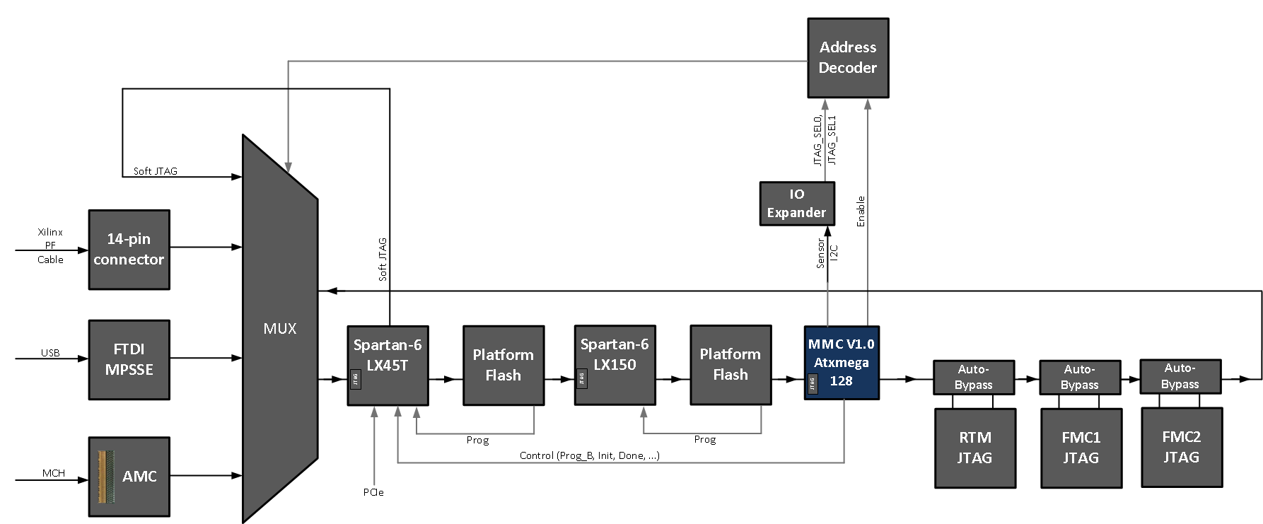
Spare Slide 2: FMC20 Rev. A JTAG Chain

