Slide 1
Paul Scherrer Institut
Rasmus Ischebeck, Pavle Juranić, Christoph Hauri, etc
Status of the THz Streak Camera Development for SwissFEL at PSI
PSI,
11. November 2013

Slide 2
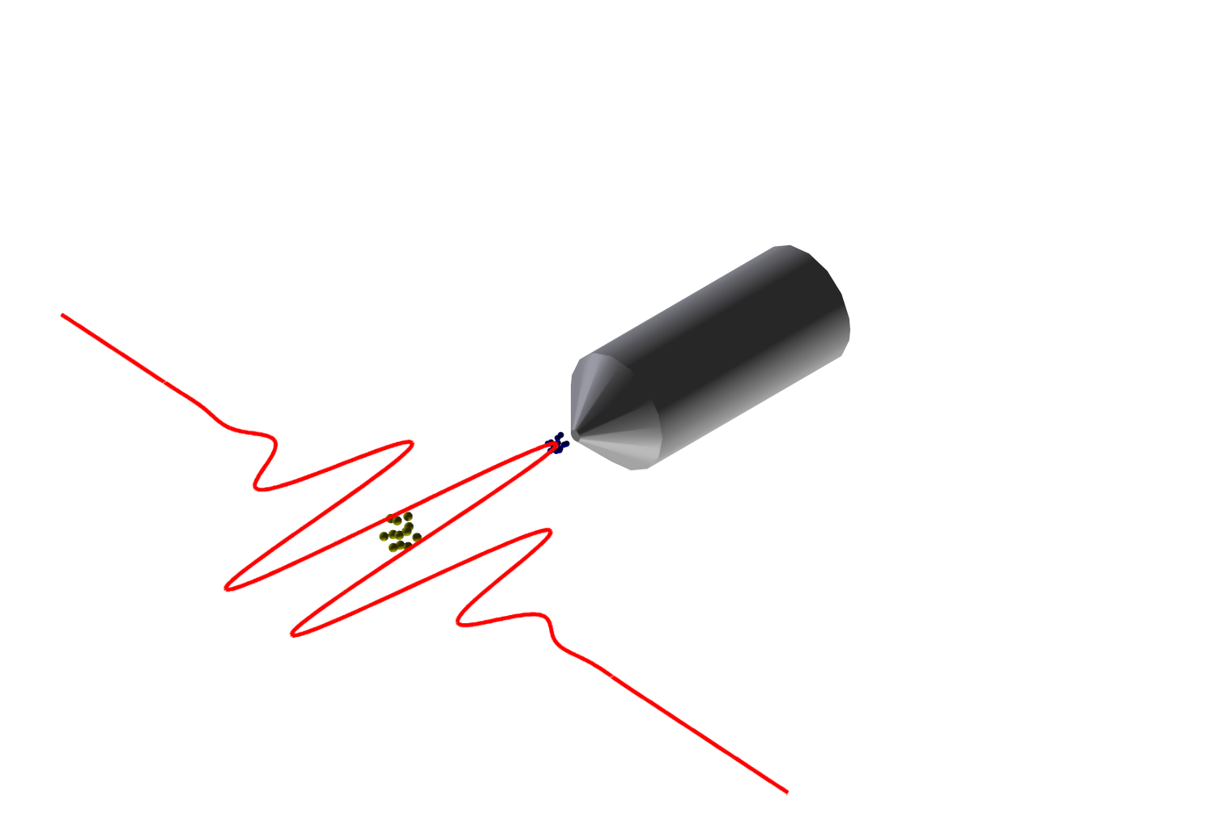

THz Streaking Reminder
Electrons
X-ray Beam
Electron
electron TOF
Atom
IR Beam/THz Field
KE_{electron} = E_{photon} – Binding Energy
±W
  Use a THz streak camera concept to measure the arrival time and length of the photon pulse.

Slide 3
THz Streaking Reminder
XUV Pulse 1:
XUV Pulse 2:
Vector Potential
Vector Potential
W₁
W₂
W
W
XUV Pulse @ T₁
XUV Pulse @ T2
time
time
W₂-W₁
T₂-T₁
Concept only works along a linear slope

Slide 4
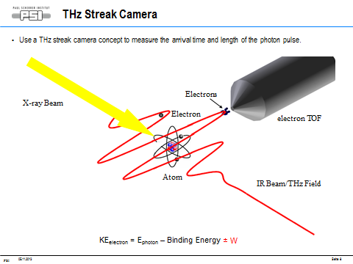
PALM and PSEM
Purpose: Non-destructive measurement of photon beam pulse arrival relative to the experimental laser and photon beam pulse length.
Usage: 2000 eV – 14500 eV, SASE mode.
Accuracy: 0.5-5 fs rms, depending on the wavelength and FEL/Laser jitter.
Theory: A double-set of THz/IR streak cameras (PALM) will be used in conjunction with a spectral encoding setup (PSEM) to measure the arrival time and pulse length of the FEL beam relative to the experimental laser pulse.

Slide 5
Photon Arrival and Length Monitor (PALM) Goals
Arrival time (relative to laser) accuracy of 1 fs RMS or better.
Pulse length measurement accuracy of 1 fs RMS or better.
Ability to handle jitter in the synchronization between the experimental (pump) laser and the machine.
Data synchronization for every shot.
Reliability

Slide 6
Approach to Realizing PALM Goals
Build prototype THz streak camera for tests and experience.
Use the in-house High-Harmonic Generation (HHG) laser source for ionization of .
Use the same HHG laser for THz generation, creating a perfectly synchronized source for both X-ray and THz radiation.
Experiment with the setup to calibrate, gain experience, and optimize the THz streak camera setup.
Perform experiments at x-ray FEL facilities (SACLA, FLASH, etc).
Use the experience from these experiments to design a final version of the device.
Integrate the analysis tools developed during these experiments into a well-programmed system for on-line monitoring.
Design and build final version of device.
Install in SwissFEL, have it run.

Slide 7
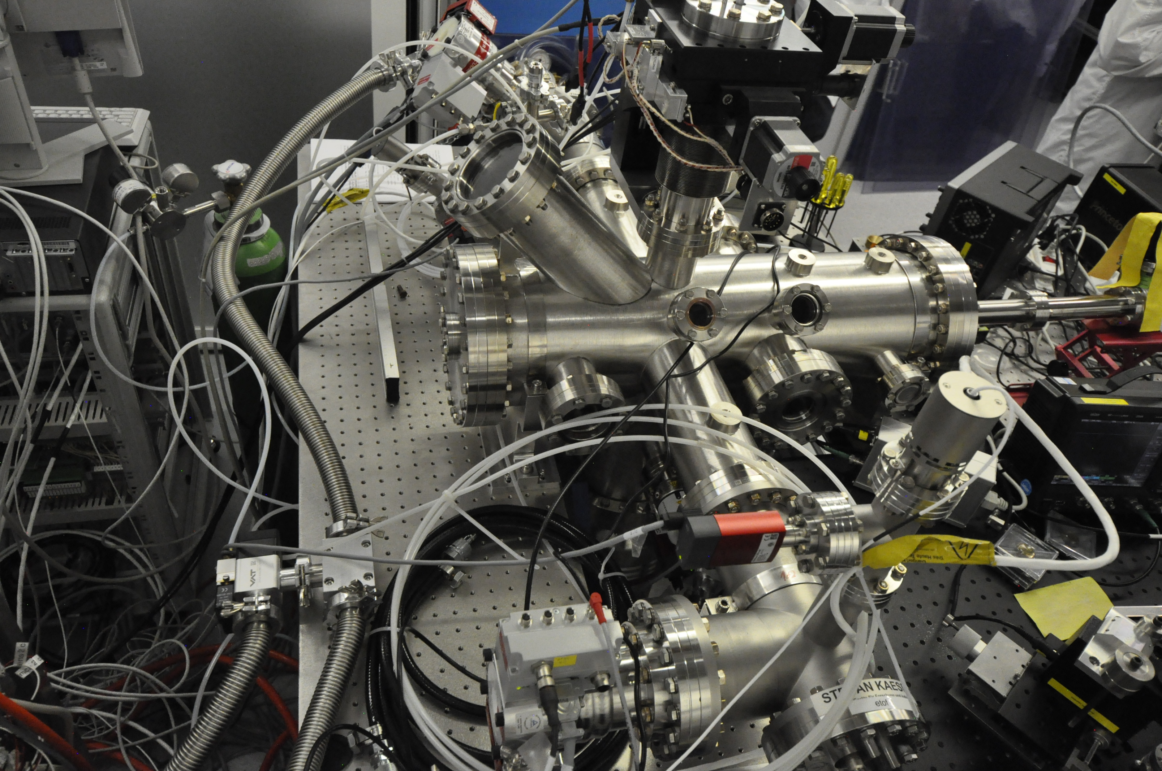
Prelimenary Results from HHG Source: Setup
eTOF 2
Gas Jet
HHG
eTOF 1
THz
The HHG Pulse ionizes the gas, creating electrons with kinetic energy E₀. The THz pulse oscillates, adding some energy W(t) that depends on when the electron was created during the THz pulse: E(t)=E₀+W(t). This lets us measure the arrival time of the HHG (X-ray) pulse relative to the THz pulse, and its width.
PSI,
11. November 2013

Slide 8
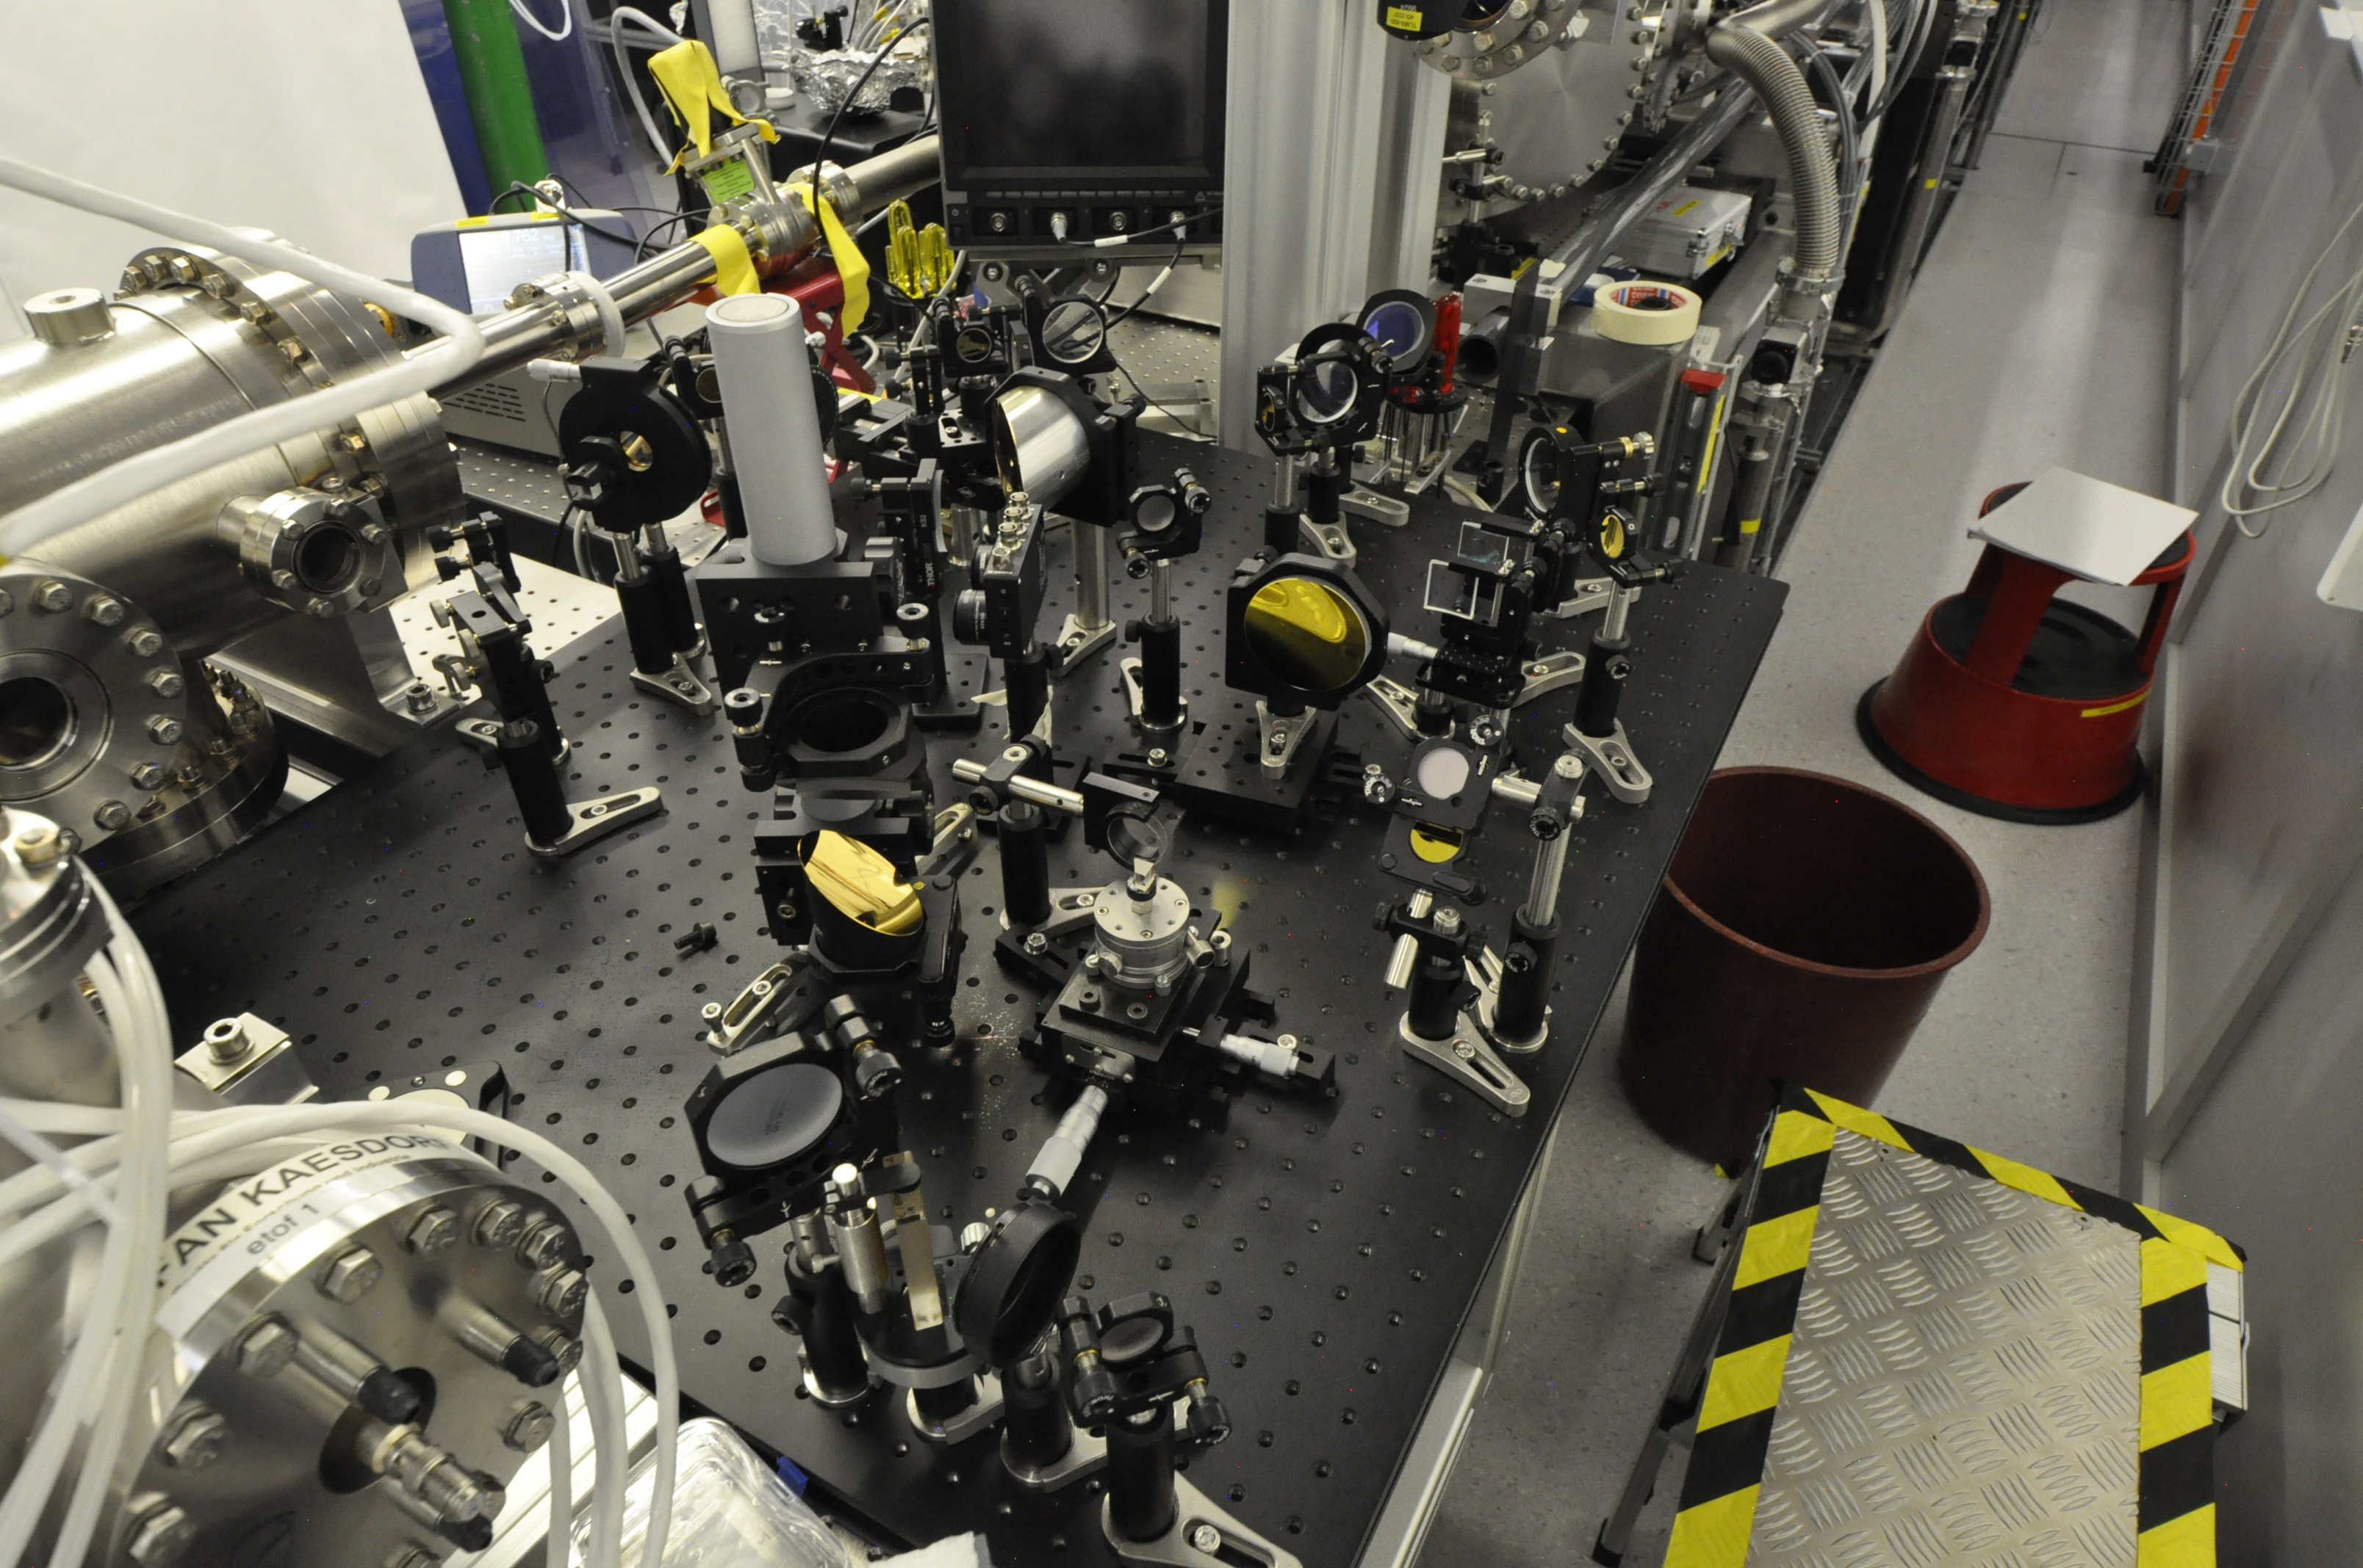
Prelimenary Results from HHG Source: Setup
Z-cut Quartz Window
Motorized Delay Stage
LiNb Crystal
We are currently using a LiNb crystal for THz generation, to prepare for the SACLA run. We will eventually try other methods (like DAST) for THz generation and other HHG sources.

Slide 9
THz: LiNb generation
THz field measured with EO in a virtual focus outside the chamber with identical mirror as in the chamber:
Pulse energy: 5.8 microJ
Pulse duration (FWHM): 1.5 ps
Beam diameter (FWHM): 2.8 mm
E = sqrt(2W/c*e0) = 2e7 V/m = 200kV/cm
The field strength is pretty good for our purposes, though it can go higher.

Slide 10
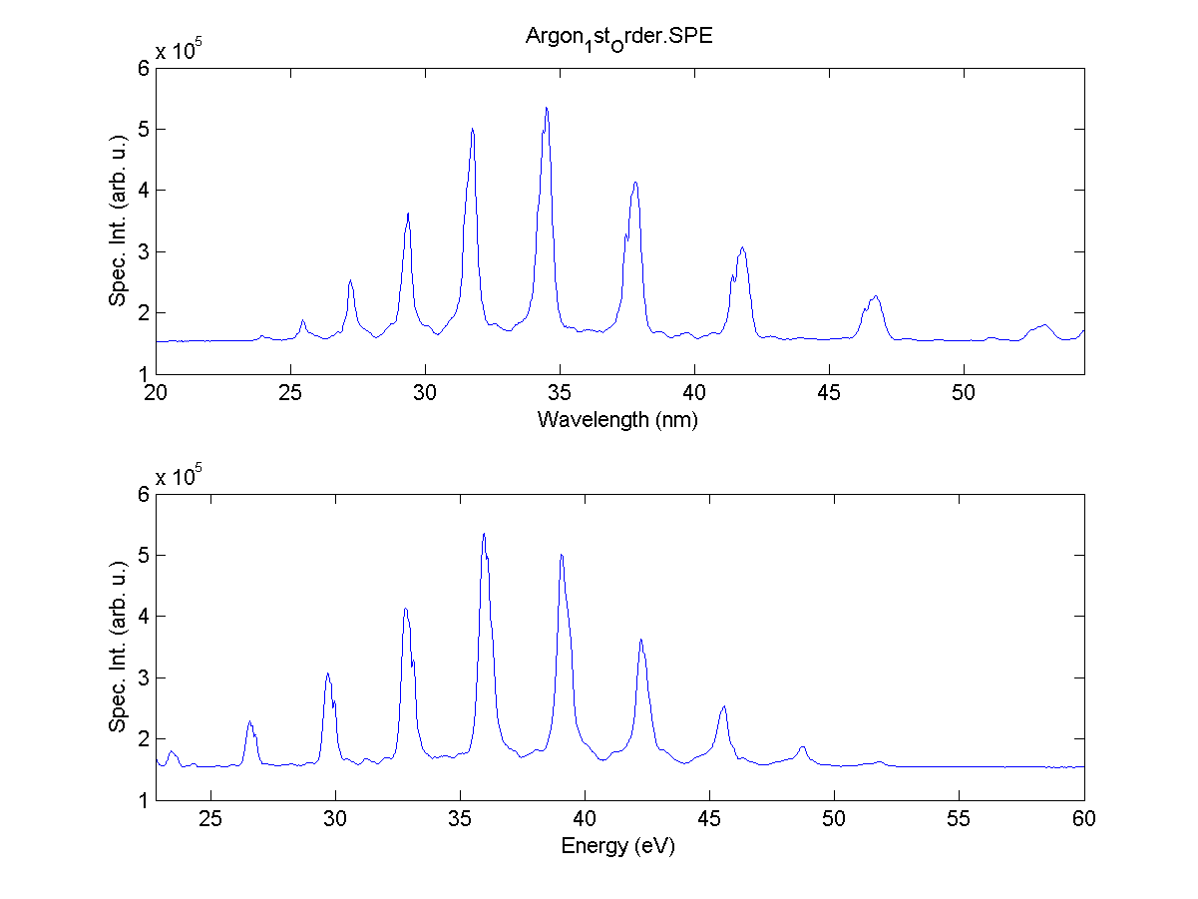
HHG: Spectrum from Grating Spectrometer
Strange spectral features
Pretty nice, but it’ll get better.

Slide 11
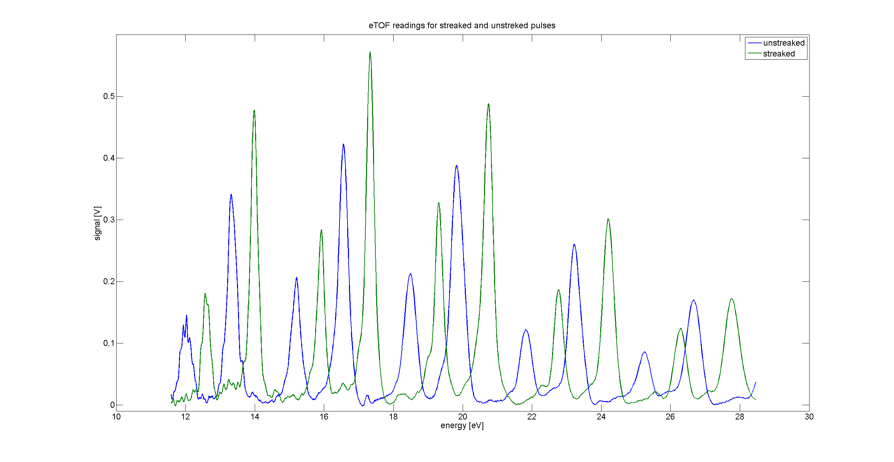
PALM: First (Prelimenary) Results
Xe 5p_{1/2}
Xe 5p_{3/2}
Xe 5s ?
HHG spectrum clearly visible
Peak shift indicates arrival time

Slide 12
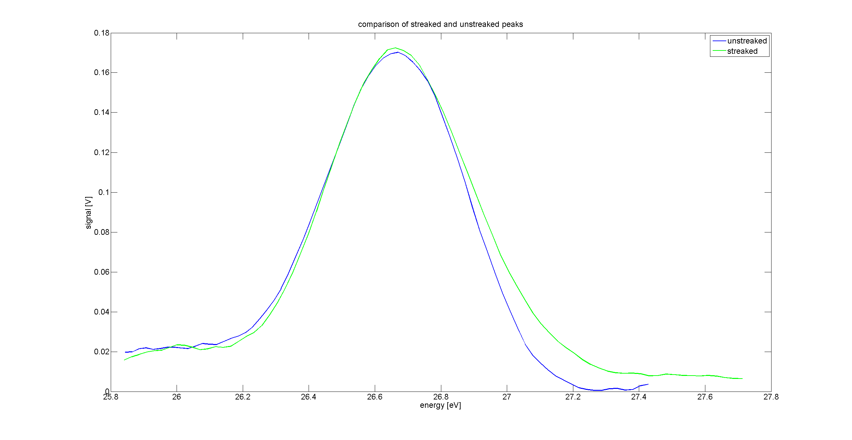
PALM: First (Prelimenary) Results
Peak width changes indicate pulse length: more observable with larger streaks

Slide 13
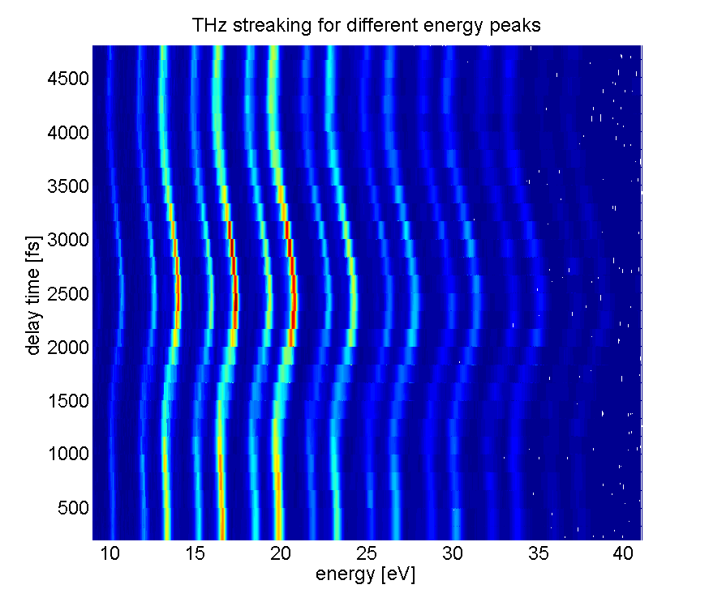
PALM: First (Prelimenary) Results
Seeing streak max of about 2 eV
PSI,
11. November 2013

Slide 14
PALM: First (Prelimenary) Results
Errors and accuracy measurement based on statistical analysis of hundreds of spectra. We set the delay between the THz and HHG, and then take data to find the statistical variations in peak positions and widths.
Observed arrival time measurement accuracy with the current setup: about 20 – 60 fs FWHM, depending on which harmonic peak we choose.
Large electron KE and stronger peaks give better time resolution. Best are the middle ones (18-22 eV).
Pulse length measurement and their error bars vary with peak strength (low signal peaks give less accuracy).
Oddities in the HHG generated spectrum yield pulse length measurements of between 50 and 100 fs FWHM, with error bars of up to 50 fs FWHM.

Slide 15
PALM: Current Issues
Using Ar-based HHG generation for now. May switch to He in the future for higher energies.
The HHG spectrum has some strange features that make analysis hard.
Estimated number of photons per harmonic: about 10⁸. Four order of magnitude lower than an FEL.
The HHG beam was unfocused and very, very large (estimate up to 7 mm in diameter.)
THz field strength was measured at 70 kV/cm with a virtual focus, improved, and then measured at 200 kV/cm with EO sampling. We should be able to do better with DAST.
The field strength calculated from the streaking signals was meaured at 4-7 kV/cm at the gas/HHG/THz interaction region.
Most likely culprit for the field strength discrepancy: bad alignment due to the large unfocused HHG beam size and lack of time to improve alignment.
Lots of room for improvement, which makes us optimistic to achieve even better accuracy.
PSI,
11. November 2013

Slide 16
PALM: Next Steps
Currently preparing for beamtime at SACLA in February 2014.
After the beamtime at SACLA, we will go back to HHG for more optimization and tests through 2014.
Develop spectral encoding (PSEM) at PSI in 2014-2015.
Want to have final version of PALM concept ready by end of 2014.
Building of final version of PALM/PSEM in 2015.
More tests and optimization for data taking and evaluation in 2015-2016.
Installation and commissioning PALM and PSEM in mid 2017 at SwissFEL.

Slide 17
Many Thanks to:
Ishkhan Gorgisyan, Beat Rippstein, Christian Erny, Fernando Ardana Lamas, Andrey Stepanov, Balazs Monoszlai, Peter Wiegand, Franziska Frei, Peter Peier, Rosen Ivanov, Jia Liu, Adrian Cavallieri, the PSI vacuum group, the PSI controls group, PSI technicians, and PSI and DESY in general.
PSI,
11. November 2013

