Slide 1
Beam Parameters for European XFEL
Presented by: Christopher Gerth
2nd Mini-Workshop on Longitudinal Diagnostics for FELs
DESY Hamburg
11-12 November 2013
Notes:
How to edit the title slide
Fill in the text written in brown

Slide 2
1. Introduction: Scope of WP-18 Devices
Distribution of fs-stable optical synchronization signals over entire facility (~ 3.5 km)
Monitoring of long. properties: beam energy, bunch profile/length and bunch arrival time.
Igor Zagorodnov, 2011
Energy | 130MeV | 600MeV | 2.5GeV | 17.5GeV
20pC | 4.53ps | 1.46ps | 185fs | 5.23fs
100pC | 4.80ps | 1.55ps | 197fs | 11.6fs
250pC | 5.27ps | 1.70ps | 223fs | 25.4fs
500pC | 6.00ps | 1.96ps | 259fs | 43.0fs
1000pC | 6.77ps | 2.23ps | 303fs | 84.0fs
Energy change (x 100) after accelerating sections: I0, L1, L2, L3
Bunch length change (x 1000) after bunch compressors: BC0, BC1, BC2
Bunch arrival time may change after dispersive sections: BC0, BC1, BC2
=> Long. Diagnostics after Accelerating and Dispersive Sections - only few but complex systems

Slide 3
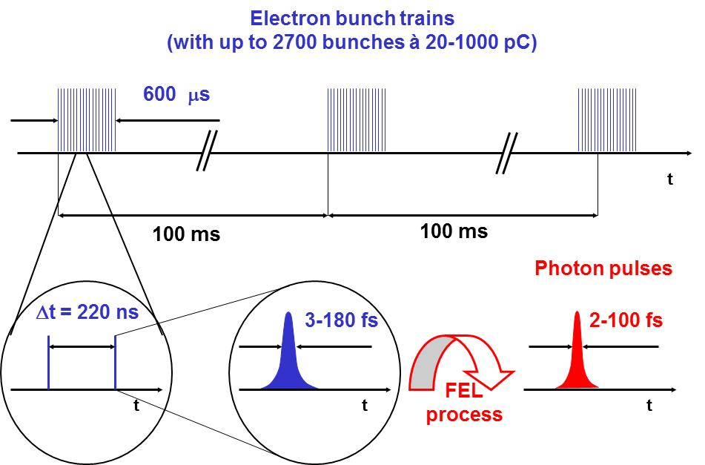
Super-Conducting LINAC – Time Structure
Pulse repetition rate: 10 Hz (up to 25 Hz or cw)
RF flat top length: < 600 μs
Bunch frequency: n*111 ns with n ≥ 2

Slide 4
2.8 Diagnostics Upgrades: Reserved Space in BC2
Beam direction
~ 5 m
BC2: about 5 m space reserved for future diagnostics upgrade (originally ORS )
Space could also be used for beam manipulation with lasers

Slide 5
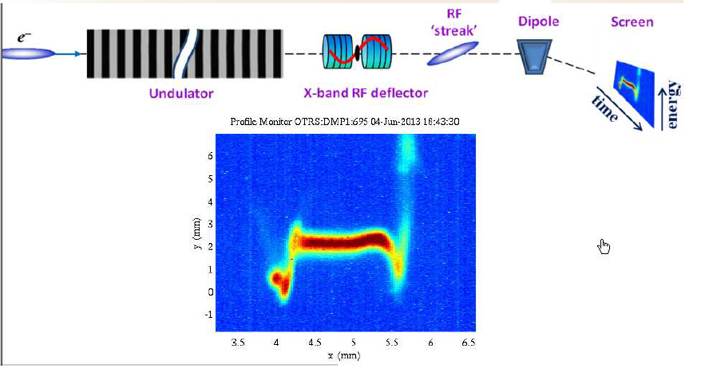
XTCAV
Where to measure: Before or after FEL undulators?

Slide 6
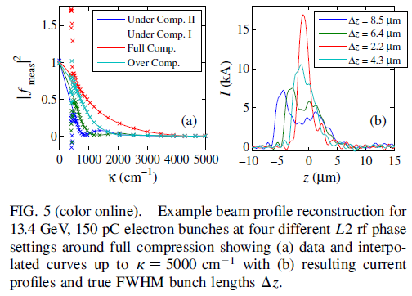
Frequency Domain

