Slide 1
2nd Mini-Workshop on
Longitudinal Diagnostics for FELs
DESY Hamburg, 11-12 November 2013
Notes:
How to edit the title slide
Fill in the text written in brown

Slide 2
Welcome
Original Idea of this workshop:
European XFEL and SwissFEL have similar timelines
Longitudinal Diagnostics comes in small numbers
=> Exchange of knowledge, collaboration on development of diagnostic
=> PSI / DESY Mini-Workshop on Longitudinal Diagnostics for FELs
KIT implemented same EO diagnostics at ANKA => PSI / DESY / KIT Mini-Workshop on Longitudinal Diagnostics for FELs
11/12 March 2013 at PSI: http://indico.psi.ch/conferenceDisplay.py?confId=2352
IBIC’13: STFC/ Dundee University and MAX IV showed interest in this workshop => 2nd (PSI/DESY/KIT/STFC/Dundee/ MAXIV) Mini-Workshop on Longitudinal Diagnostics for FELs
Not only FELs: ANKA storage ring and plasma acceleration => 2nd Mini-Workshop on Longitudinal Diagnostics for FELs
Workshop style: A lot of time for discussion
Questions during the presentations: Yes, please!

Slide 3
Workshop Fee / Agenda
40 Euro Workshop Fee:
For those who chose the option ‘CASH’:
=> Please pay tomorrow during the first coffee break
https://indico.desy.de/conferenceTimeTable.py?confId=9079#all.detailed

Slide 4
Hotel Mercure
Those of you who stay at the Mercure Hotel:
1) Let Mercure Hotel know that you are DESY guest in order to get the DESY special rate. => I hope you did that ☺
2) Please collect your confirmation that your stay is business related. You will need to present that when you are paying your bill at the hotel. Otherwise you have to pay a ‘tourist tax’.

Slide 5
Tour XFEL Tunnel
XFEL Tour: Who would be interested?
You will need to wear helmets and wellies

Slide 6
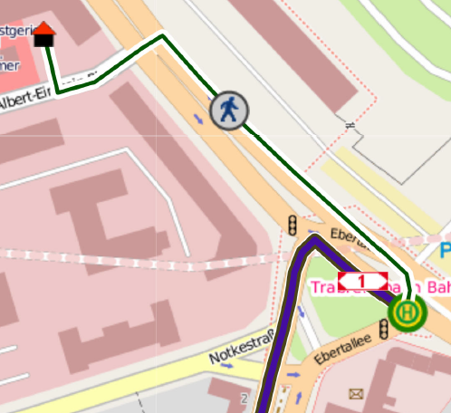
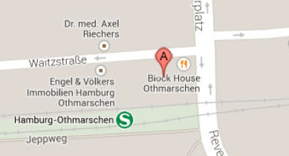
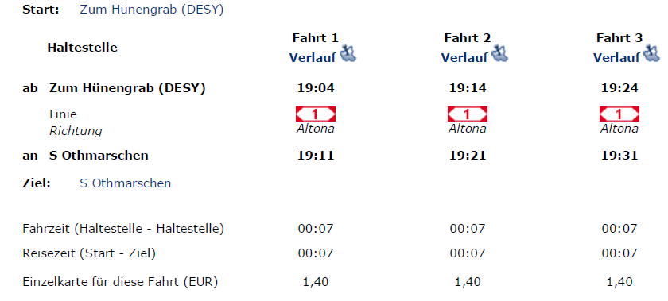
Workshop Dinner
Block House
S-Othmarschen
Waitzstraße 1
22607 Hamburg
From Mercure Hotel 3 minutes later!

