Slide 1
Status European XFEL and
Overview on Longitudinal Diagnostics
Presented by: Christopher Gerth
2nd Mini-Workshop on Longitudinal Diagnostics for FELs
DESY Hamburg
11-12 November 2013
Notes:
How to edit the title slide
Fill in the text written in brown

Slide 2
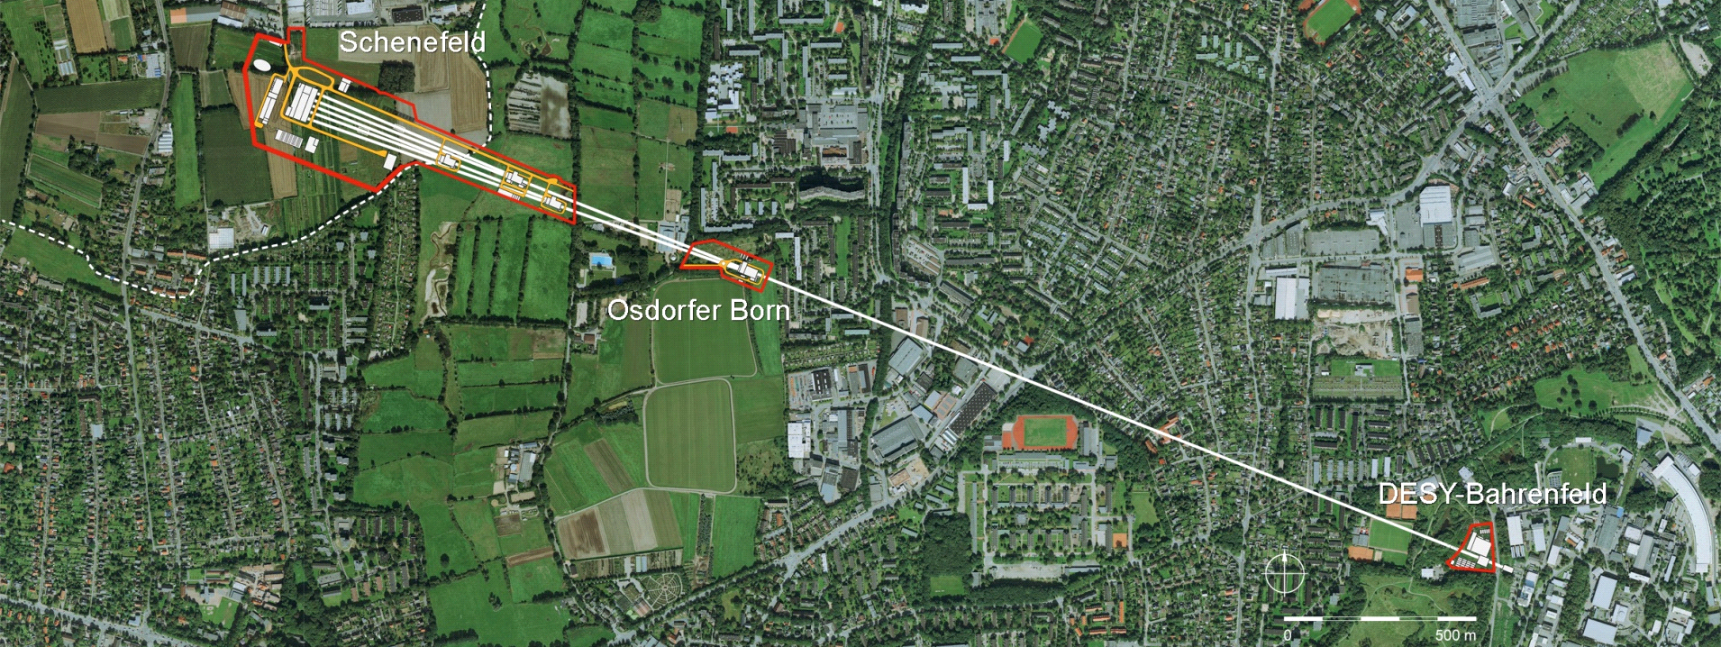
Civil Construction European XFEL
3.3 km
Three construction sites
5.8 km total length of tunnels
12000 m^{2 of} surface buildings
150000 m³ of underground building volume
We are here
Notes:
Before you start editing the slides of your talk change to the Master Slide view:
Menu button “View”, Master, Slide Master:
Edit the following 2 items in the 1st slide:
1) 1st row in the violet header:
Delete the existent text and write the title of your talk into this text field
2) The 2 rows in the footer area: Delete the text and write the information
regarding your talk (same as on the Title Slide) into this text field.
If you want to use more partner logos position them left
beside the DESY logo in the footer area
Close Master View

Slide 3
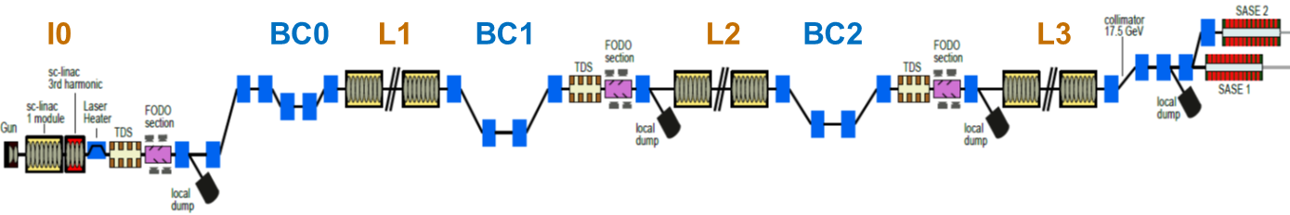
Layout of European XFEL
  4 accelerating sections
  3 bunch compressor chicanes
Injector
building
tunnel
Igor Zagorodnov, 2011
Energy | 130MeV | 600MeV | 2.5GeV | 17.5GeV
20pC | 4.53ps | 1.46ps | 185fs | 5.23fs
100pC | 4.80ps | 1.55ps | 197fs | 11.6fs
250pC | 5.27ps | 1.70ps | 223fs | 25.4fs
500pC | 6.00ps | 1.96ps | 259fs | 43.0fs
1000pC | 6.77ps | 2.23ps | 303fs | 84.0fs

Slide 4
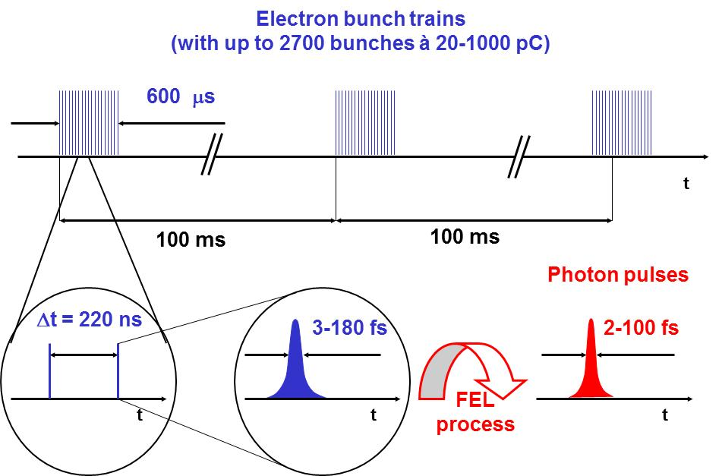
Super-Conducting LINAC – Time Structure
RF pulse repetition rate: 10 Hz (up to 25 Hz or cw)
Max. RF flat top length: < 600 μs
Bunch frequency: n*111 ns with n ≥ 2 (1 MHz or 4.5 MHz)
=> bunch trains with up to 2700 bunches

Slide 5
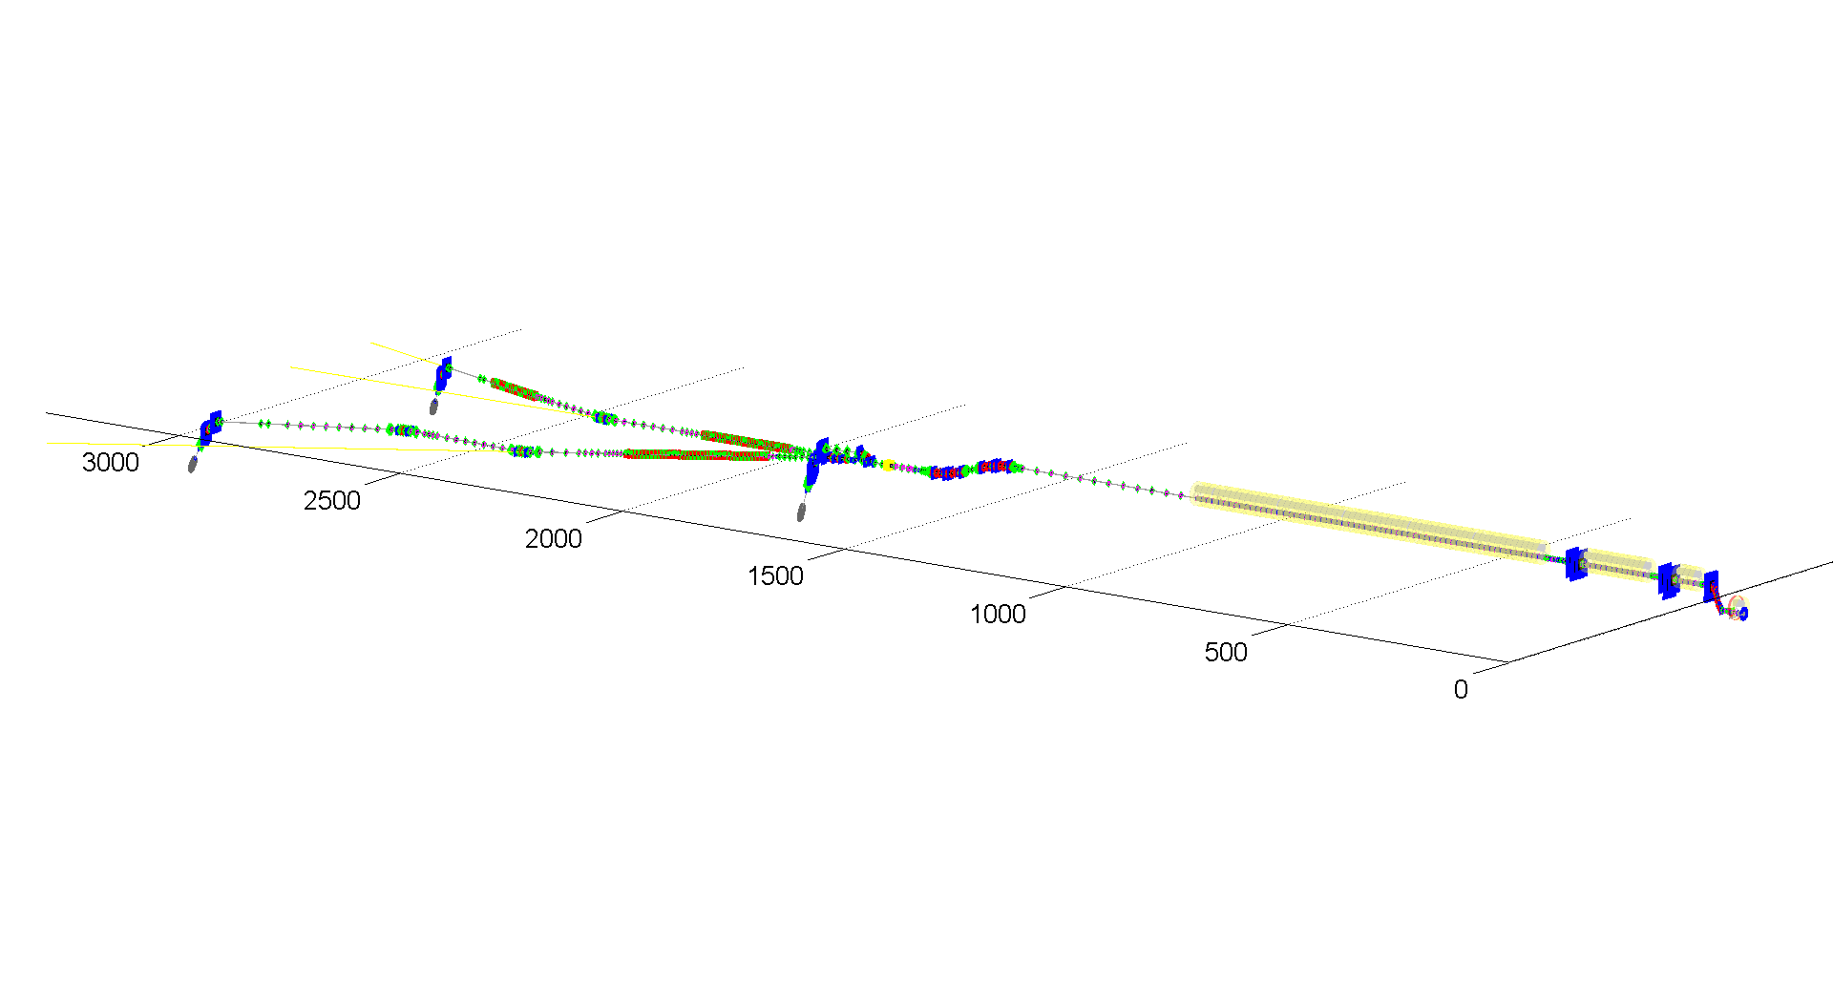
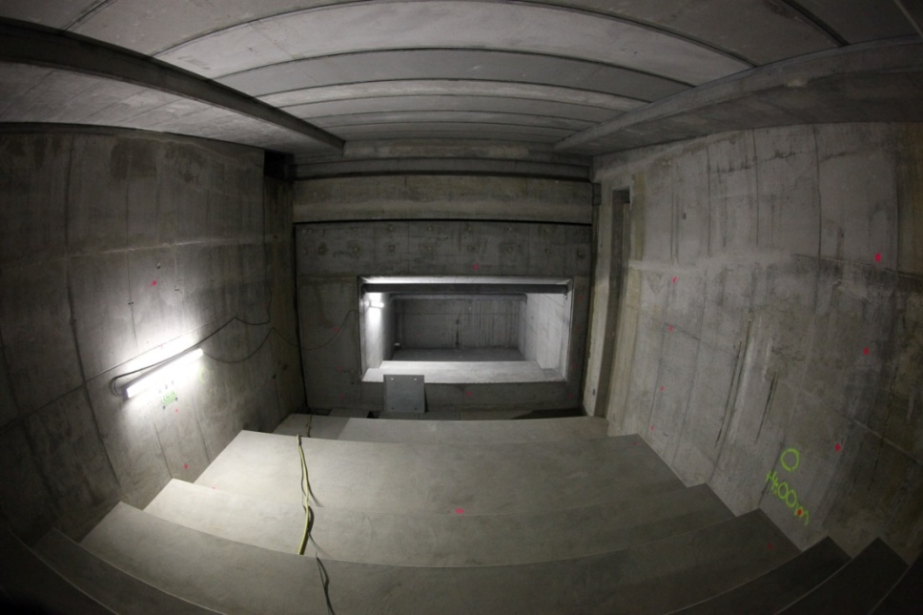
Beam Lines and Beam Dumps
Commissioning beam dumps:
To be used as energy spectrometers
Longitudinal Phase Space Measurements with TDS
3 main beam dumps:
P_{ave}= 300 kW
=> 1/2 max beam power (1 nC)
beam magnified
slow sweep to distribute heat

Slide 6
Pulse Pattern: Beam Distribution
2 e- beam lines (black), 3 (5) undulator lines (red), 6 (15) instruments
Pulse switching is done with fast kickers: One split per pulse
Both beam lines have same bunch properties
  Arbitrary patterns in each beam line by stopping bunches in pulse picker dump (= commissioning dump)
MID
HED
SPB
FXE
SQS
SCS
e⁻

Slide 7
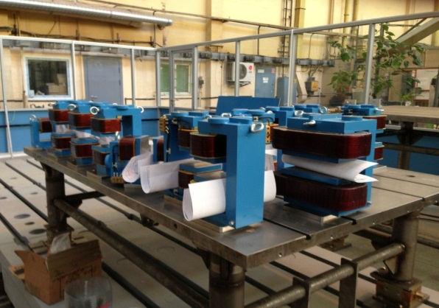
Beam Distribution
MID
HED
SPB
FXE
SQS
SCS

Slide 8
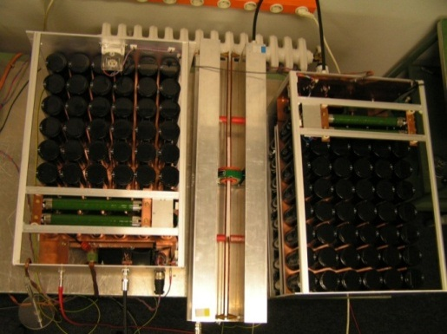
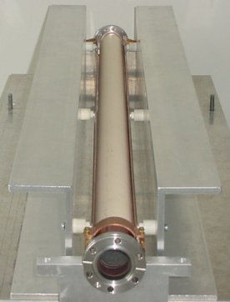
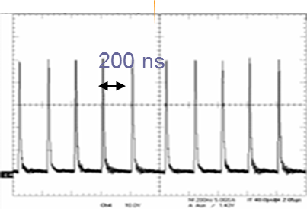
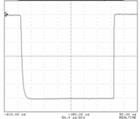
Beam Distribution
MID
HED
SPB
FXE
SQS
SCS
300 μs

Slide 9
Beam Distribution
MID
HED
SPB
FXE
SQS
SCS
300 μs

Slide 10
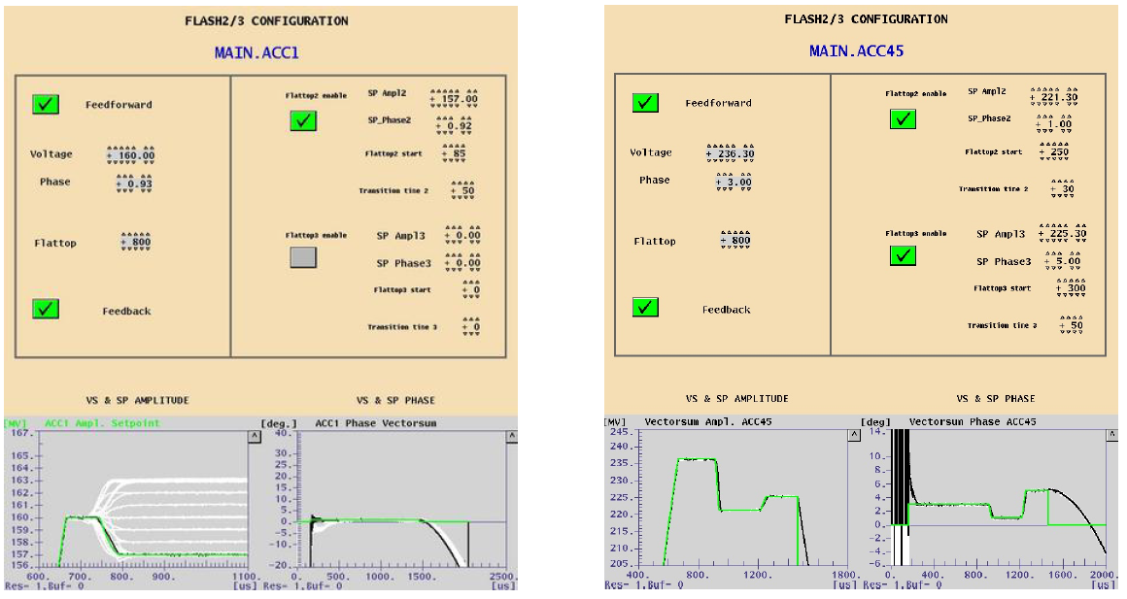
LLRF – RF pulse for multi modes
RF pulse can be adjusted for 2 (or more) operation modes for different charges. ‘Worst case’ 1nC and 20 pC mode!
Tests at FLASH:

Slide 11
Overall Time Schedule
Gun
Conditioning without beam: December 2013
Injector
  Start Installation diagnostics: mid 2014 (after cryo bypass)
  3.9 GHz module on critical path: installation Feb 2015
  Start injector commissioning: March 2015
Main Linac
  Start installation BC sections: Aug. 2014 (after cryo bypass)
  Start Linac commissioning Jan 2016
  First beam: March 2016
  First SASE: mid 2016

Slide 12
Longitudinal Diagnostics at the European XFEL
EOD
TDS
EOD
BCM
EOD
BCM
TDS
BCM
BCM
TDS
CRISP4
Igor Zagorodnov, 2011
Energy | 130MeV | 600MeV | 2.5GeV | 17.5GeV
20pC | 4.53ps | 1.46ps | 185fs | 5.23fs
100pC | 4.80ps | 1.55ps | 197fs | 11.6fs
250pC | 5.27ps | 1.70ps | 223fs | 25.4fs
500pC | 6.00ps | 1.96ps | 259fs | 43.0fs
1000pC | 6.77ps | 2.23ps | 303fs | 84.0fs

Slide 13
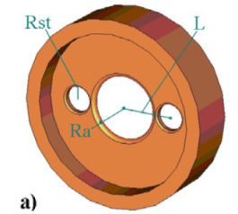
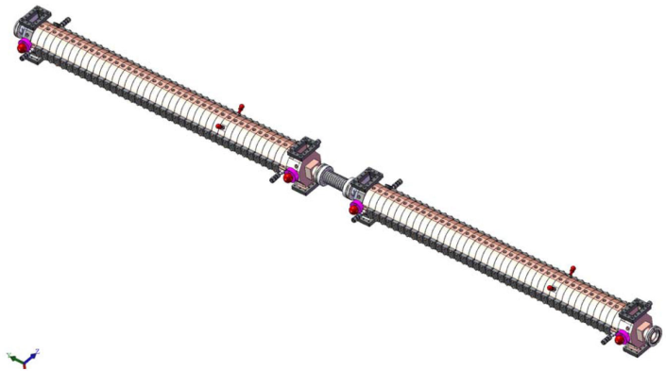
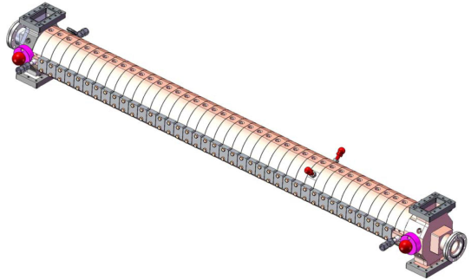
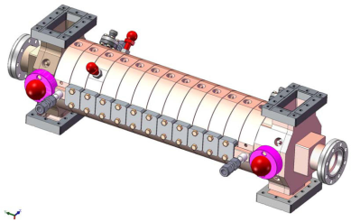
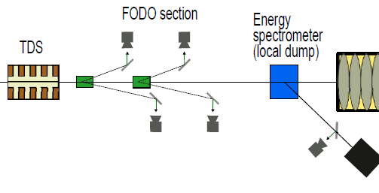
TDS: Locations at E-XFEL
Disk-Loaded
Travelling Wave
S-Band 2.997 GHz
BC0
BC1
BC2
Bunch profile & slice emittance monitor:
‘Steal’ 4 bunches with a fast kicker out of bunch train and deflect them onto view screens
E-spectrometer for Longitudinal Phase Space measurements after FODO section
Notes:
Before you start editing the slides of your talk change to the Master Slide view:
Menu button “View”, Master, Slide Master:
Edit the following 2 items in the 1st slide:
1) 1st row in the violet header:
Delete the existent text and write the title of the EoI for WPnumber
2) The row in the footer area: write the institute name
Close Master View

Slide 14
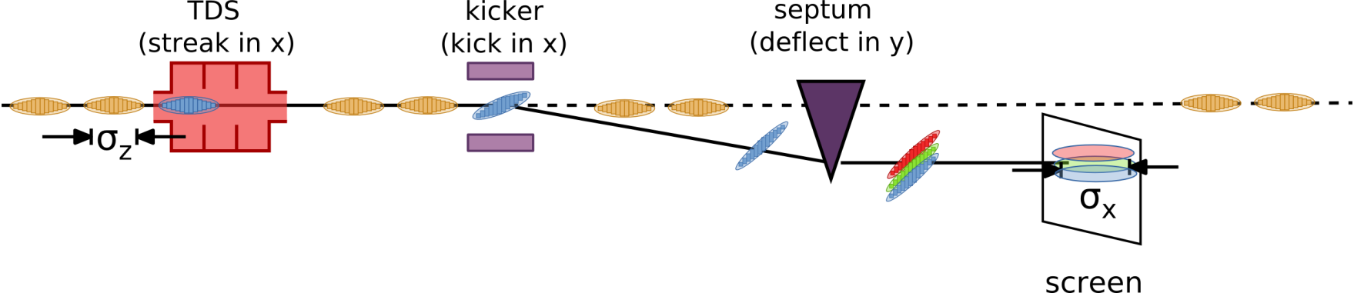
TDS: Longitudinal Phase Space Monitor
Longitudinal Phase Space measurements routinely done at FLASH. However:
Beam operation to be stopped and dipole magnet of E-spectrometer to be switched on/off (and cycled)
To be operated in single-bunch mode (different settings in single- and multi-bunch mode)
No information on actual SASE level during longitudinal phase space measurements
Proposal for E-XFEL: Longitudinal phase space monitor
TDS + kicker + septum in BC1: All hardware is developed
M. Yan et al, IPAC’13, MOPME012
BC1
BC2
Longitudinal Phase Space Monitor for XFEL
Minjie Yan
Session 4: TDS and Other
Particle
Tracking
Simulation of
measurement

Slide 15
EOD: Locations at E-XFEL
TDS
TDS
TDS
EOD
EOD
EOD
BC0
BC1
BC2
Only bunch profile monitor after BC0
No EO Diagnostics after BC2 due to limited time resolution (< 150 fs)
=> Vacuum chamber will be installed for future upgrade option with higher time resolution
=> Session 5: Sub-10fs Diagnostics for fully Compressed Bunches
Notes:
Before you start editing the slides of your talk change to the Master Slide view:
Menu button “View”, Master, Slide Master:
Edit the following 2 items in the 1st slide:
1) 1st row in the violet header:
Delete the existent text and write the title of the EoI for WPnumber
2) The row in the footer area: write the institute name
Close Master View

Slide 16
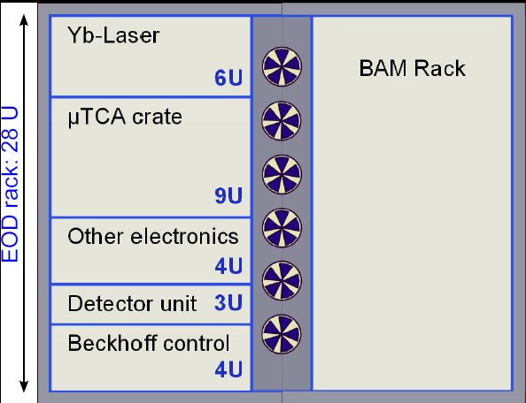
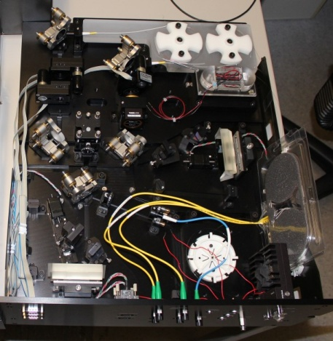
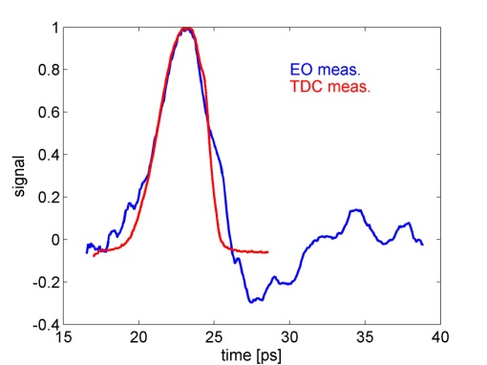


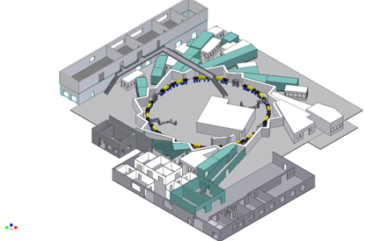

Electro-Optical Diagnostics: Collaborations
16
Beamline Unit
e⁻
SwissFEL
Test Injector
Collaboration between DESY, PSI, KIT for development of EO Diagnostics
Same EO Diagnostics installed at FLASH, SwissFEL Injector and ANKA
=> Session 2: Electro-Optical Diagnostics
Notes:
16
Before you start editing the slides of your talk change to the Master Slide view:
Menu button “View”, Master, Slide Master:
Edit the following 2 items in the 1st slide:
1) 1st row in the violet header:
Delete the existent text and write the title of your talk into this text field
2) The 2 rows in the footer area: Delete the text and write the information
regarding your talk (same as on the Title Slide) into this text field.
If you want to use more partner logos position them left
beside the DESY logo in the footer area
Close Master View

Slide 17
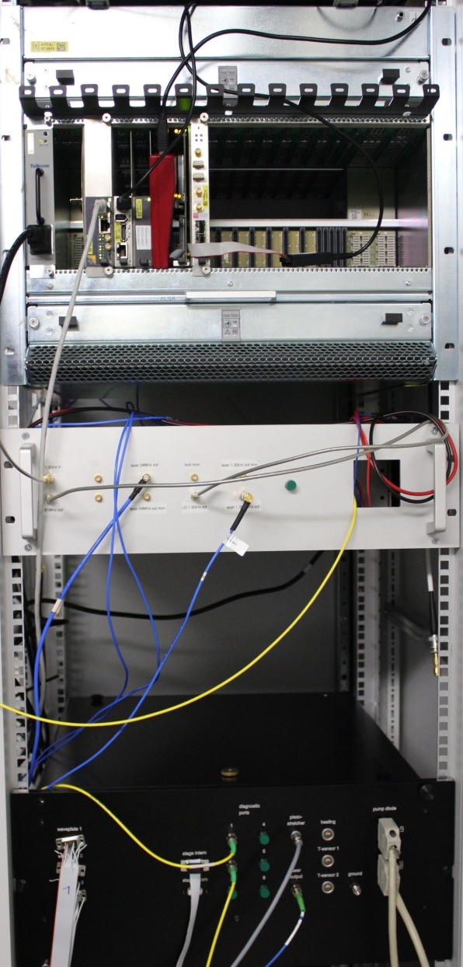
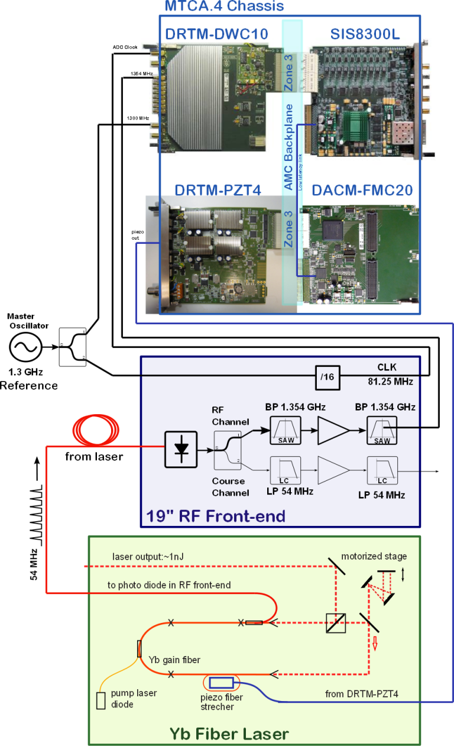
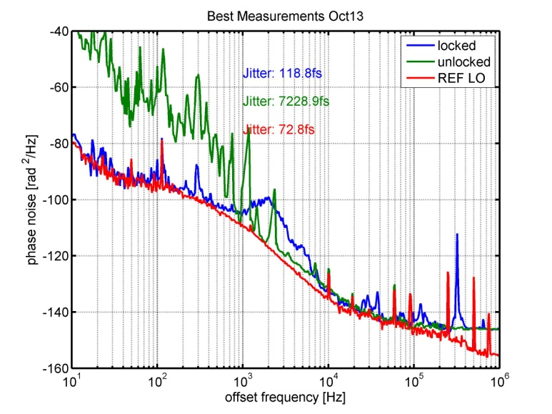
EOD: Laser to RF Synchronization based on LLRF
New:
Laser synchronization scheme based on LLRF down-conversion scheme in MTCA.4 standard
MTCA
Experience with RF locking of EO laser based on MTCA.4
Bernd Steffen
Session 2: Electro-Optical Diagnostics
EO Laser

Slide 18
BCM / THz Spectrometer : Locations at E-XFEL
TDS
TDS
TDS
EOD
EOD
EOD
BC0
BC1
BC2
CRISP4
BCM
BCM
BCM
BCM
Notes:
Before you start editing the slides of your talk change to the Master Slide view:
Menu button “View”, Master, Slide Master:
Edit the following 2 items in the 1st slide:
1) 1st row in the violet header:
Delete the existent text and write the title of the EoI for WPnumber
2) The row in the footer area: write the institute name
Close Master View

Slide 19
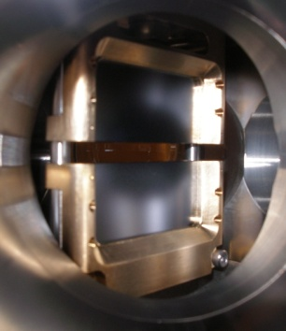
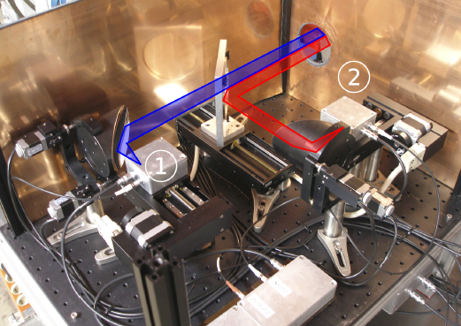
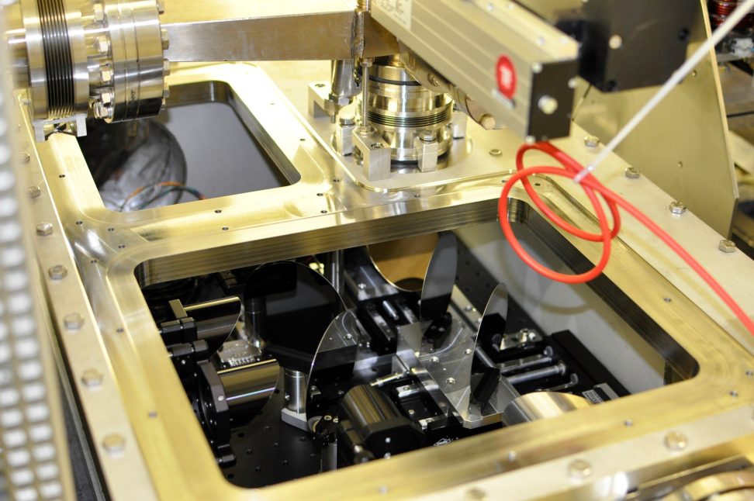
BCM: Bunch Compression Monitor
Layout under development for XFEL
Coherent Radiation Diagnostics for European XFEL
Peter Peier
Session 3: Coherent Radiation Diagnostics
e⁻
Fast detectors required
(XFEL: 220 ns, SwissFEL: 36 ns)
=> Session 3: Coherent Radiation Diagnostics
FLASH
SwissFEL Test Injector

Slide 20
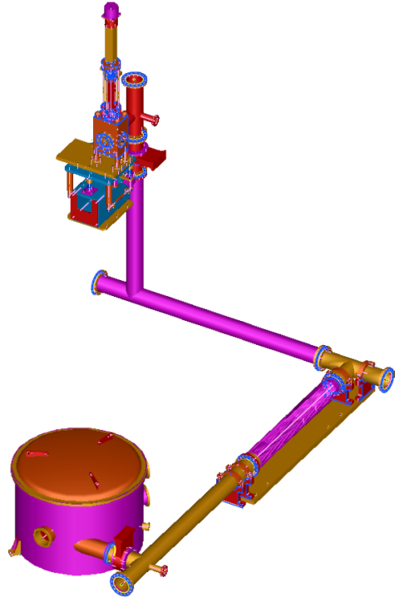
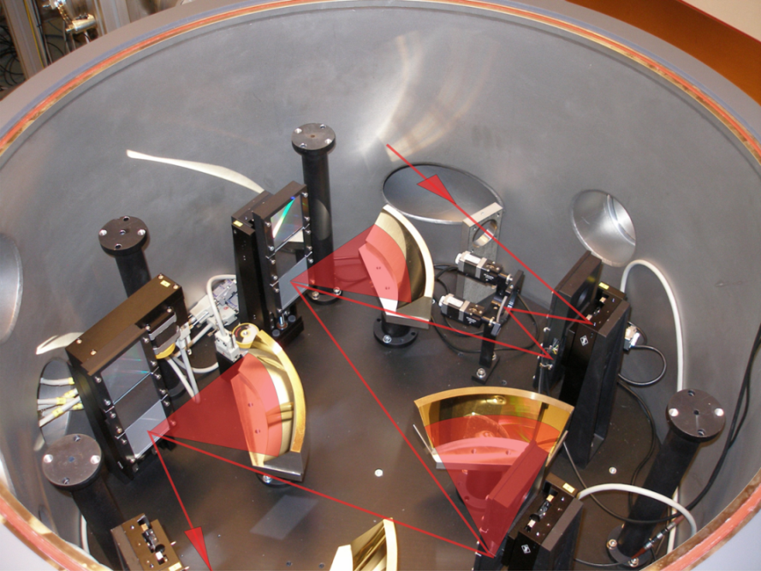
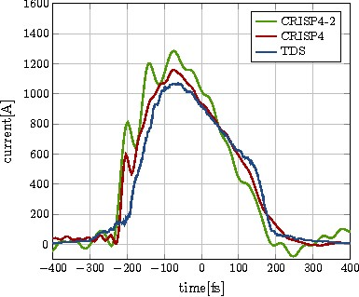
20
THz Spectrometer (CRISP4)
E. Hass et al, IBIC’13, MOPC37
e⁻
THz spectrometer (CRISP4) developed by B. Schmidt (FLA):
2 x FLASH, 1 x FLASH2, 1 x E-XFEL
Reconstruction of bunch profile possible with Kramers-Kronig Relation
Works best with compressed bunches and at high beam energies:
=> installation behind collimator section with diffraction screen
Notes:
20
Before you start editing the slides of your talk change to the Master Slide view:
Menu button “View”, Master, Slide Master:
Edit the following 2 items in the 1st slide:
1) 1st row in the violet header:
Delete the existent text and write the title of your talk into this text field
2) The 2 rows in the footer area: Delete the text and write the information
regarding your talk (same as on the Title Slide) into this text field.
If you want to use more partner logos position them left
beside the DESY logo in the footer area
Close Master View

Slide 21
Longitudinal Diagnostics – What is not covered!
21
energy
Longitudinal Phase Space
TDS + E-Spectrometer
Bunch Profile / Length
TDS
EOD
BCM
THz Spectrometer
Incoherent radiation
THz Streaking
ΔE
E₀
Arrival Time
BAM
Beam Energy
BPMs in BC (EBPM)
2 BAMs
E-Spectrometer
Energy Spread
VIS SR Monitor (SRM)
E-Spectrometer
t₀
time
Δt
Notes:
Electron bunches and x-ray pulses can be represented in longitudinal phase space diagram shown here7
The distribution looks different for different positions in the FEL
The bunches or pulses are located in time t0 and energy E0
They have a temporal width Dt and an energy distribution DE
The longitudinal diagnostic components have to provide full information about longitudinal phase space.

Slide 22
Thank you for your attention

Slide 23
2.7 Summary Longitudinal Diagnostics: Properties
All devices to be designed as monitors with single bunch resolution
Most diagnostics is to be installed in XTL and not accessible during operation
Suite of diagnostics to cover all requirements
 | Measurement | Pros | Cons
TDS | Longitudinal beam profile Longitudinal phase space slice emittance | Direct method | Single bunch resolution Destructive to measured bunch
EOD | Longitudinal beam profile | Multi bunch resolution | Limited resolution (> 150 fs)
THz Spectr. | Spectral dist. of THz radiation (Longitudinal beam profile) | Multi bunch resolution High resolution | Reconstruction depends on profile Only compressed bunches (< 1ps) Works best at high beam energies
BCM | Integrated THz radiation Compression | Multi bunch resolution Simple RF phase monitor | Only compressed bunches (< 1ps) No reconstruction of profile possible
BAM | Arrival time Beam energy | Multi bunch resolution High resolution | Requires laser-based synchronization Small dynamic range
EBPM | Beam energy | Multi bunch resolution Large dynamic range | Large dynamic range Requires absolute energy calibration
SRM | Beam energy profile | Energy profile | Limited resolution Requires absolute energy calibration
View Screen (WP17) | Beam energy profile | Absolute reference | Destructive Method Single Bunch Operation
Notes:
Before you start editing the slides of your talk change to the Master Slide view:
Menu button “View”, Master, Slide Master:
Edit the following 2 items in the 1st slide:
1) 1st row in the violet header:
Delete the existent text and write the title of the EoI for WPnumber
2) The row in the footer area: write the institute name
Close Master View

Slide 24
1. Introduction: Overview on WP-18 Devices
Beam energy
Bunch arrival
femtosecond optical
timing distribution
Bunch length/profile
2.1 TDS⁽¹⁾
Transverse
Deflecting
Structure
2.2 EOD
EO
Diagnostics
2.3 BCM
Bunch
Compression
Monitor
2.5 EBPM
Energy BPM
SRM
Synchrotron
Radiation
Monitors
3.1 LbSync
Laser-based Synchronization
Bunch profile
Slice emittance
Phase space
Bunch profile
Compression
Beam energy
(Bunch arrival)
Beam Energy
Energy profile
2.4 CRD
THz
Spectrometer
2.6 BAM
Bunch Arrival
Monitor
3.2 REFM
RF
Synchronization
L2L
Laser
Synchronization
Bunch profile
Bunch arrival
Beam energy
1)
High-Power RF system and TDS are part of contract between European XFEL GmbH and Inst. for Nuclear Research (INR).
Most diagnostics is to be installed in accelerator tunnel XTL and not accessible during beam operation (reliability, remote diagnosis, maintainability, …)
To reduce R&D costs, ease maintenance and number of spare parts
=> re-use hardware where possible
BAM, BCM and EBPM to be used for fast intra bunch-train Beam-Based Feedback (BBFB)
Notes:
Before you start editing the slides of your talk change to the Master Slide view:
Menu button “View”, Master, Slide Master:
Edit the following 2 items in the 1st slide:
1) 1st row in the violet header:
Delete the existent text and write the title of the EoI for WPnumber
2) The row in the footer area: write the institute name
Close Master View

Slide 25
2.7 Summary Longitudinal Diagnostics: Locations
TDS
TDS
TDS
EOD
EOD
EOD
BAM
BAM
BAM
BAM
EBPM
EBPM
EBPM
THz
SRM
SRM
BCM
BCM
BCM
BCM
Notes:
Before you start editing the slides of your talk change to the Master Slide view:
Menu button “View”, Master, Slide Master:
Edit the following 2 items in the 1st slide:
1) 1st row in the violet header:
Delete the existent text and write the title of the EoI for WPnumber
2) The row in the footer area: write the institute name
Close Master View

Slide 26
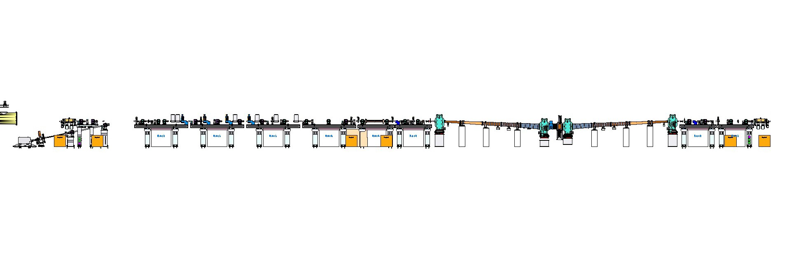
2.9 General Layout of Diagnostics Section
Diagnostic Sections:
Bunch Compression (BCM)
Bunch-Arrival Time (BAM)
Long. Bunch Profile (EOD)
BC1
Matching Section:
FODO Lattice
Slice Emittance (TDS)
Long. Bunch Profile (TDS)
e-spectrometer:
Energy
Long. PS
BC chicane:
Energy (EBPM)
Energy spread (SRM)
BC0
Matching into chicane
Beam direction
L2
L1
BCM
EBPM
BCM
BAM
BAM
Controller
Beam Based FB
REFM
Experimental Hall:
SLO
~ 3.5km
Pump-Probe Laser 1
Links
x 24
MLO
MO
Pump-Probe Laser n
* MLO/SLO: master/slave laser oscillator
WP-02 LLRF

Slide 27
Beam Distribution
MID
HED
SPB
FXE
SQS
SCS

Slide 28
Beam Distribution
MID
HED
SPB
FXE
SQS
SCS

Slide 29
Beam Distribution
MID
HED
SPB
FXE
SQS
SCS

Slide 30
Beam Distribution
MID
HED
SPB
FXE
SQS
SCS
Dedicated kicker not baseline
Might use beam distribution system

Slide 31

TDS: Longitudinal bunch profile / slice emittance
Long bunch trains can be exploited for on-line bunch profile & slice emittance measurements:
‘Steal’ 1- 4 bunches with a fast kicker out of the bunch train and deflect them onto view screens
Challenge: Small beam sizes in FODO section => screen resolution of 10 μm sufficient
Screen 2
Screen 4
Exit BC
Kicker
Kicker
TDS
Kicker
Kicker
Screen 1
Screen 3
TDS Voltage => Powerful commercial klystron
TDS Frequency => As high as possible
Wakefields => Iris > 40 mm => TDS Frequency < 4GHz
Streak 1 - 4 bunches within bunch train => short filling time
=> S-Band at 2.997 GHz
(fTDS = 332 * fMO)
=> Travelling-wave structure
Location | Length | Resolution | Fill Time | No. of cells | Klystron
Injector | < 0.7 m | < 200 fs | 140 ns | 16 | 3 MW
BC1 | < 1.7 m | < 20 fs | 360 ns | 46 | 24 MW
BC2 | < 3.6 m | < 14 fs | 720 ns | 2 x 46 | 24 MW

